Slide 1
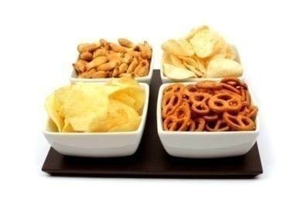
School Nutrition and Meal Cost Study (SNMCS)
Training
If you have any questions, call (877) xxx-xxxx

Slide 2
Your Role
Complete two forms for your school about:
    Vending machines
    Other sources of foods and beverages
Please complete both forms within one week of receiving your email
Fax completed forms back to Mathematica

Slide 3
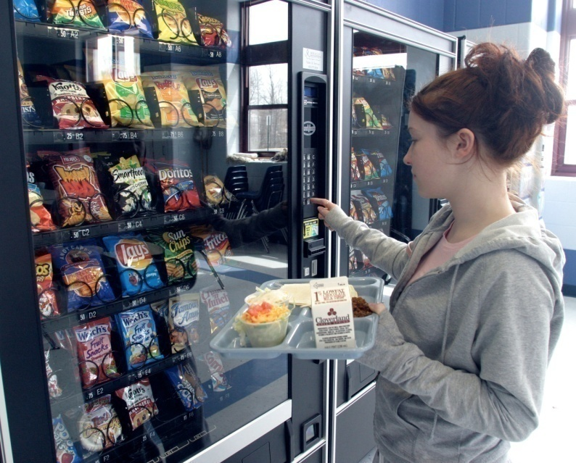
Goals Of This Training
Introduce the two data collection forms
Clarify the types of information to be collected
Provide guidance about how to complete the forms
Please have the forms in front of you as you go through the rest of this document!
Notes:
3

Slide 4
Vending Machine Form

Slide 5
Vending Machine Form
Collects information about every machine available to students during the school day (including before or after school), including:
    Location
    Type of machine
    Capacity/size of machine
    Contents (types of items available)
Separate sections for:
    Beverage machines
    Snack machines

Slide 6
Filling in the Form
Each column should contain information for only one vending machine

Slide 7
Vending Machine Locations
In Cafeteria
Includes the entire cafeteria area, including the serving lines and the seating/eating area
Outside but Near (within 20 feet) Cafeteria or Seating/Eating Area
Adjacent to the cafeteria area (within 20 feet) but outside of the cafeteria walls
Elsewhere in School Building
Any other location that is accessible to students and inside the walls of the school building(s)
Outside School Building(s) but on School Grounds
Areas on school grounds, but outside of the walls of the building(s)
For each machine, choose only ONE location:

Slide 8
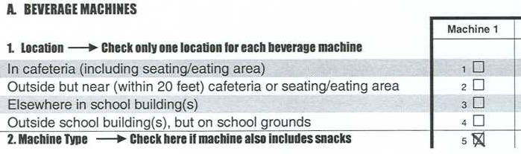
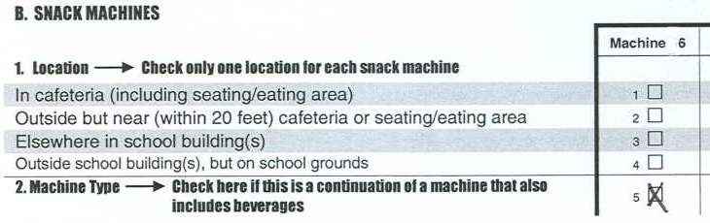
Vending Machine Type
(Use only for combination beverage and snack machines)
Step 1:
In Section A (Beverage Machines), check the box for “Machine Type” to indicate that the machine includes both beverages and snacks. Then record information about the beverages in the machine.
Step 2:
In Section B (Snack Machines), check the box for “Machine Type” to indicate that the machine includes both beverages and snacks. Then record information about the snacks in the machine.

Slide 9
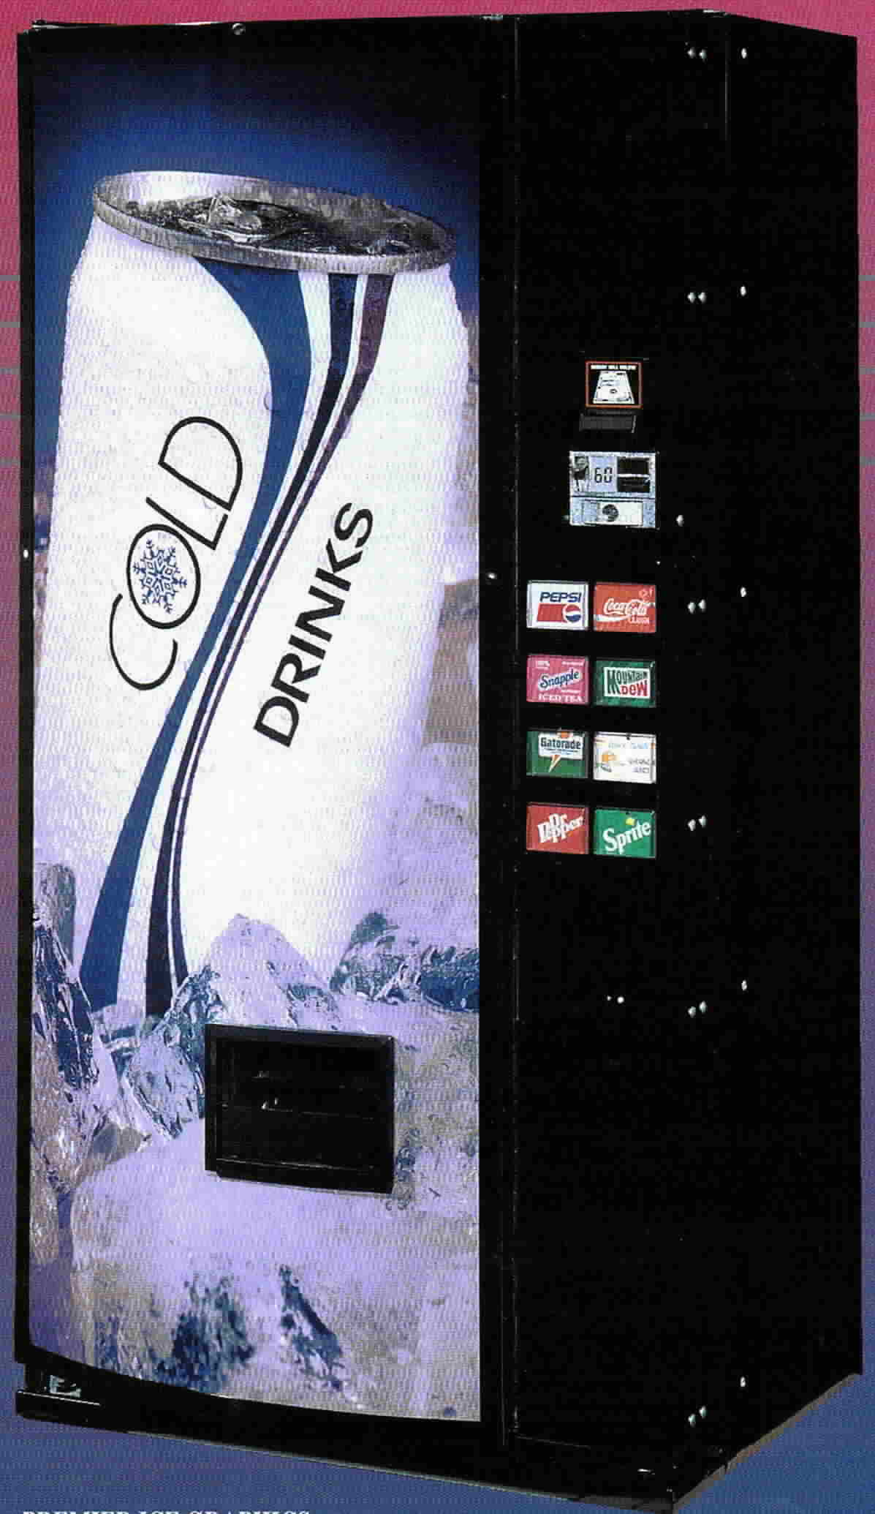
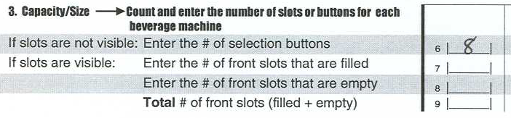
Vending Machine Capacity/Size:
If Slots Are Not Visible
If slots are not visible, enter the number of buttons THAT ARE NOT SOLD OUT
This machine has eight buttons. None are sold out.

Slide 10
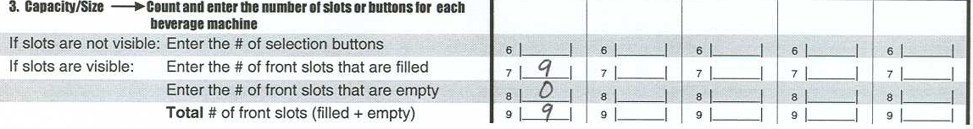
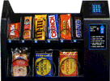
Vending Machine Capacity/Size:
If Slots Are Visible
Count the number of front slots that are filled
Count the number of front slots that are empty
Total the number of filled and empty slots
This machine has nine front slots. None of the front slots are empty.

Slide 11
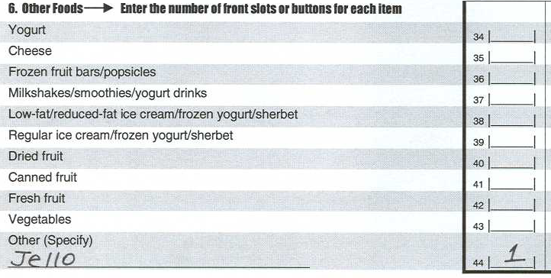
Vending Machine Contents
Record the number of slots (or buttons) dedicated to each type of food or beverage
For machines with visible slots, base your counts on the item in the front slot
If you observe any items that are not on the list, record them on the lines marked “Other (Specify)”

Slide 12
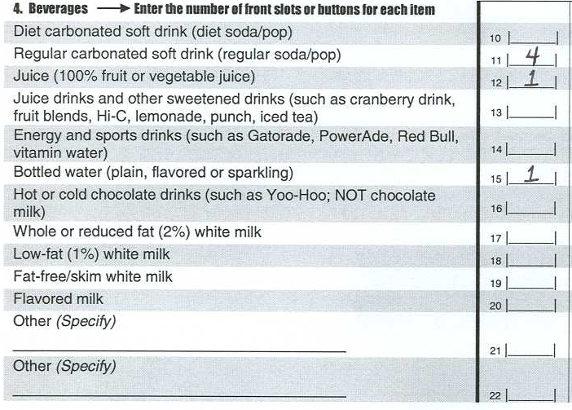
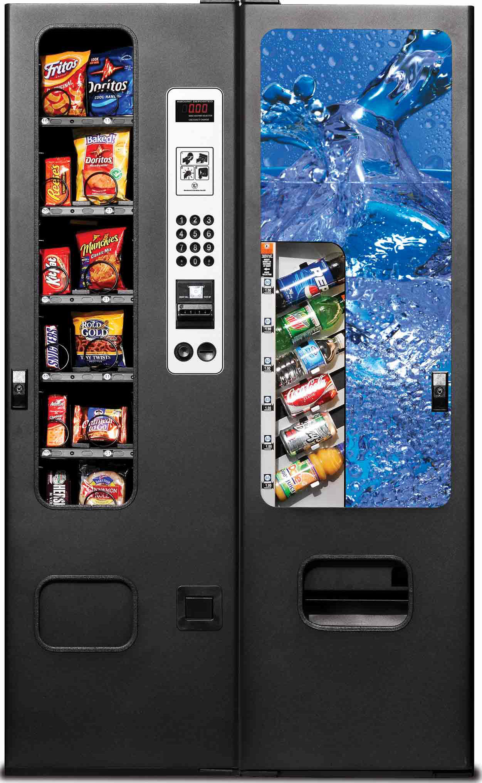
Example #1 - Beverages

Slide 13
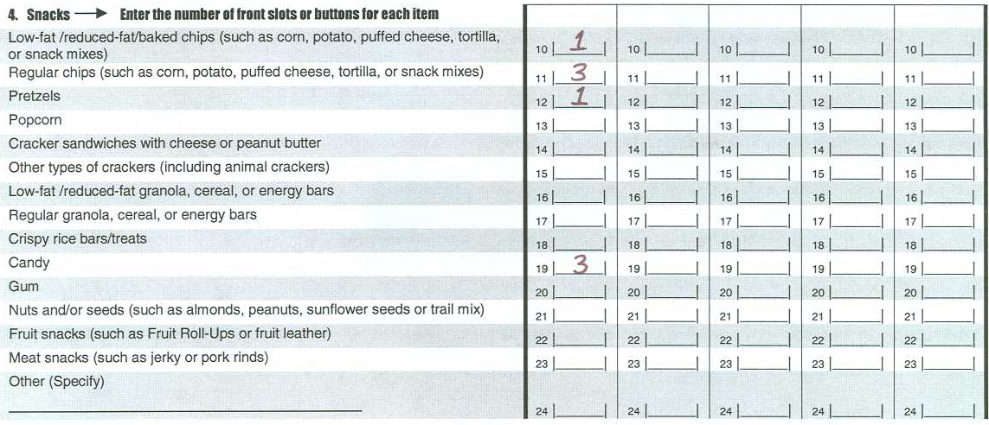
Example #2 - Snacks

Slide 14
Other Sources of Foods/Beverages Form

Slide 15
Other Sources of
Foods/Beverages Form
Documents the availability of:
    School stores
    Snack bars and food carts/kiosks outside the cafeteria
    Fundraisers
    Other sources
For each available source, documents:
    Location
    Types of items available
Vending machines and food served in the cafeteria should NOT be included in this form

Slide 16
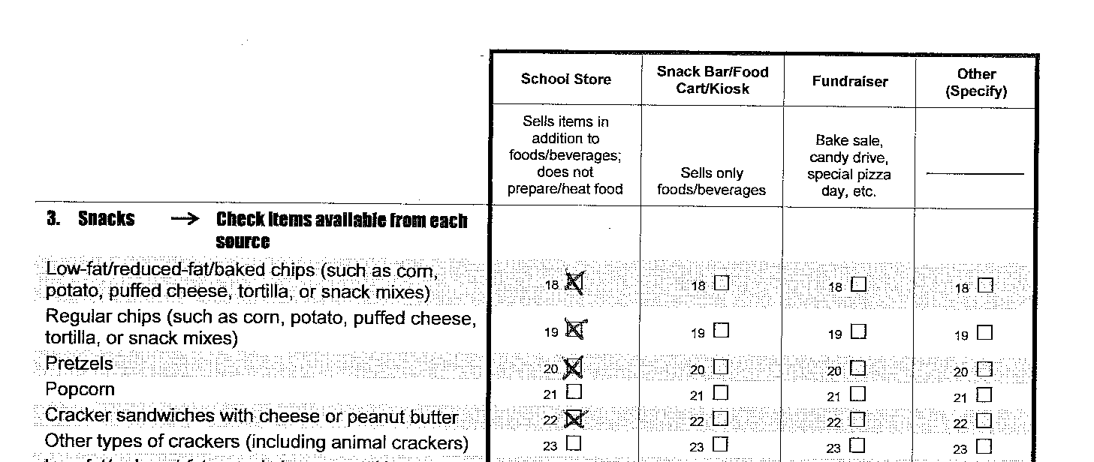
Filling in the Form
Note that the column headings on this form refer to specific types of food sources, not individual vending machines
Also note that you do not need to enter counts, simply check the box if the item is available

Slide 17
Other Food Source Locations
School Store
-Sells other items in addition to food and beverages
-Does not prepare or heat food
-May be located in the cafeteria
Snack Bar/Food Cart/Kiosk
-Sells only food and beverages
-Includes canteens and cafes
-Located outside of the cafeteria
Fundraisers
-Includes bake sales, candy drives, or other sales that raise money for special school needs or charity
-May be sold inside of the cafeteria

Slide 18
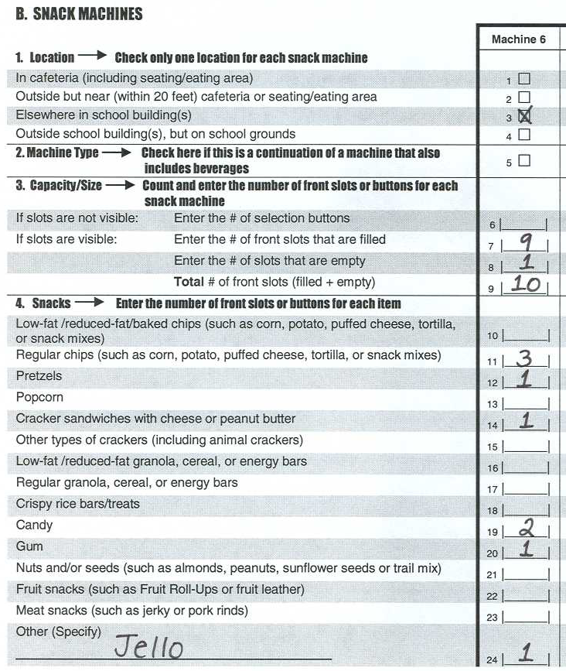
Before You Return Your Forms
Carefully review all of your entries on both forms to be sure they are complete and accurate
Check that the sum of items in each vending machine matches your entry for “the # of front slots that are filled”
Be sure you have filled in your name and other important contact information
3+1+1+2+1+1=9

Slide 19
Returning Your Completed Forms
*Please complete your forms within one week of receiving your email
*Remember to return both forms even if there are no vending machines or other food sources in your school
Please return your forms by fax to:
(877) xxx-xxxx
Attention: SNMCS
If you do not have access to a fax machine, please mail your forms to:
School Nutrition and Meal Cost Study (40208)
Mathematica Policy Research
P.O. Box 2393
Princeton, NJ 08540-2393

Slide 20
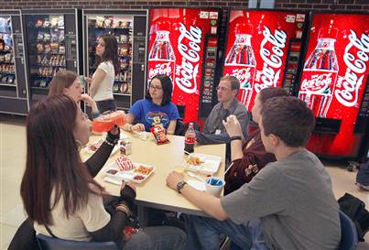
Thank you very much!

