Slide 1
Appendix E6 State Webinar Summer Meals Participant Characteristics Study State Webcast <date>
OMB Control No.:0584-NEW
Expiration Date: xx/xx/xxxx
Public reporting burden for this collection of information is estimated to average 30 minutes per response, including the time for reviewing instructions, searching existing data sources, gathering and maintaining the data needed, and completing and reviewing the collection of information. An agency may not conduct or sponsor, and a person is not required to respond to, a collection of information unless it displays a currently valid OMB control number. Send comments regarding this burden estimate or any other aspect of this collection of information, including suggestions for reducing this burden, to: U.S. Department of Agriculture, Food and Nutrition Services, Office of Policy Support, 3101 Park Center Drive, Room 1014, Alexandria, VA 22302 ATTN: PRA (0584-xxxx*). Do not return the completed form to this address.
1

Slide 2
Study Overview—Optimal Solutions Group
Optimal Solutions Group (Optimal)
Policy research firm located in College Park, MD
Specialize in policy research focused on health, education, workforce development, social policy, and housing and economic development
Contracted by USDA/FNS to conduct evaluation of the Summer Meals Programs’ participant characteristics
2

Slide 3
Study Overview—Research Goals
Research Goals
Ascertain how the summer meals programs operate at the state, sponsor, and site levels.
Describe participant characteristics and examine the differences and factors that affect participation by sponsors and children across states.
State Survey
Understand the challenges to finding sponsors, administering training, facilitating outreach efforts, etc.
Census of ALL states.
Information will help FNS better serve state agencies in administering summer meals programs.
3

Slide 4
Study Overview—Methodology
Surveys
State-level
Sponsor-level
Site -level
Interviews
Parents/caregivers of summer meals participants
Parents/caregivers of summer meals-eligible non-participants
4

Slide 5
State Participation—Sponsor List & Administrative Data
2015 Sponsor List
Formal request via email
Items needed include:
Sponsor Name | Number of Sites Operated
Sponsor Address | Sponsor Type (school, gov’t, non-profit, NYSP, camp)
Sponsor Phone Number | Meals served (breakfast, lunch, snacks)
Dates of Operation | Meal counts by sponsor
Identify new or returning sponsor
Time sensitive <date needed by>
Memorandum of Understanding (MOU)
Site list request from sponsors
5

Slide 6
State Participation—Web Survey
Web Survey
Email invitation with link to survey
User-friendly interface
Responses will—
be kept confidential
be combined with other states
not be reported individually
Can save progress and complete later
Telephone follow-ups
6

Slide 7
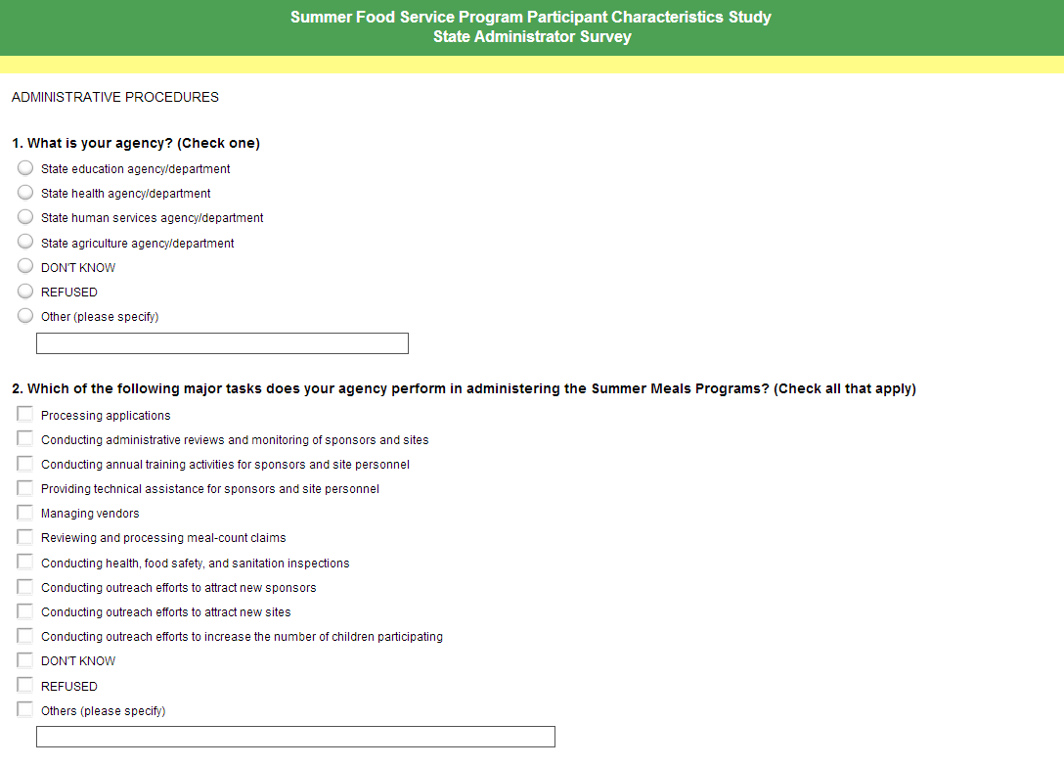
State Participation—Web Survey
7

Slide 8
QUESTIONS
?
8

