Slide 1
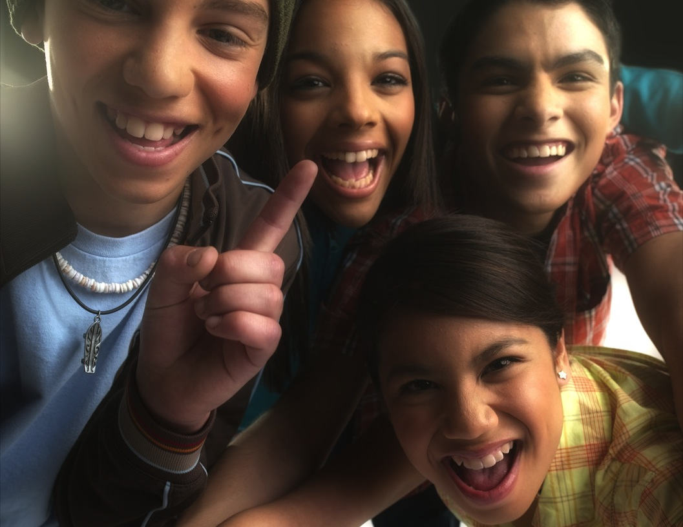
Refined Brand & Non-Trier Campaign Strategic Concepts
RESEARCH STIMULI

Slide 2
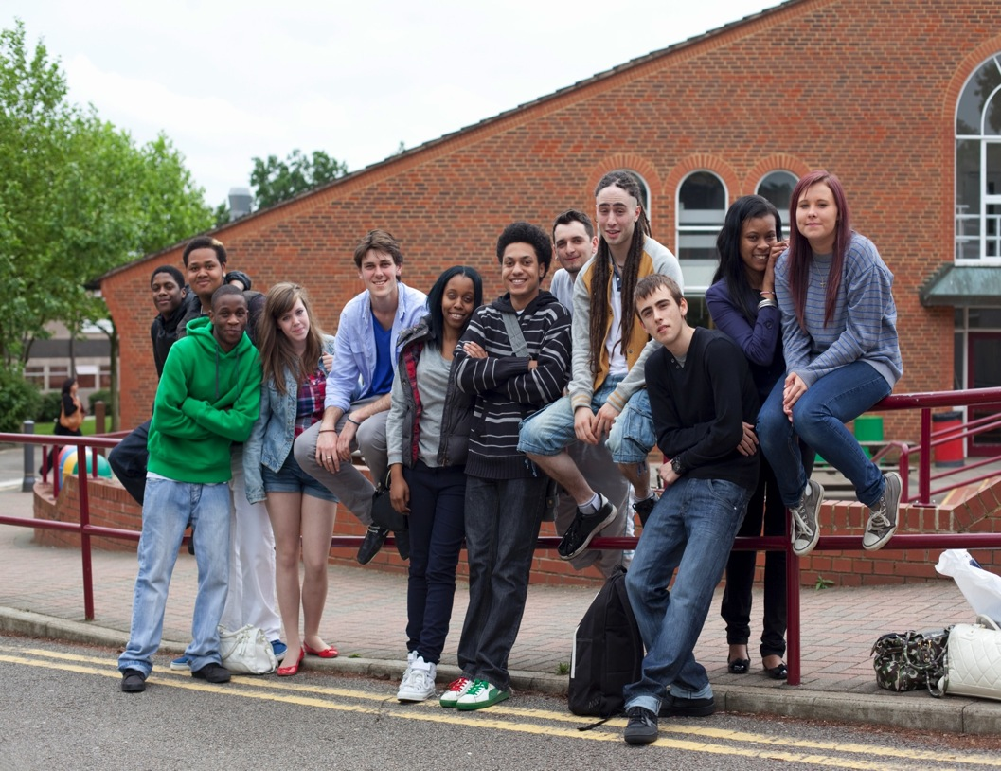
STRATEGIC CONCEPTS Day 2- NON-TRIER

Slide 3
We’ve Moved On From Cigarettes
Concept A:
More than 80% of teens have said no to cigarette smoking – it’s at its lowest point in generations.
You are smarter than previous generations and see cigarettes for what they are— a deadly holdover from the past. You know smoking means you’re controlled by tobacco and puts your future at risk. So maybe it used to be cool to smoke, but it definitely isn’t now.
Research Note: Probe on right terminology to express something being not cool anymore (e.g. so over, lame, etc). How would teens express.

Slide 4
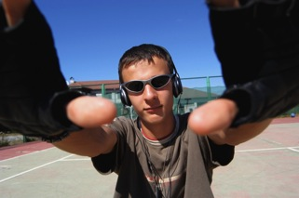
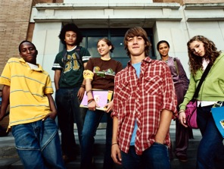

Slide 5
Friendship Is About More Than Cigarettes
Concept B:
Some of your friends smoke, worried that you’ll lose them if you don’t too?
Friendships are based on more than just smoking together. Cigarettes can permanently change your life by causing you to lose your taste buds, stunting your growth, creating fertility issues, and making you vulnerable to cancer later in life. Your friends will be cool if you don’t want to smoke - and they’ll still be your friends.

Slide 6
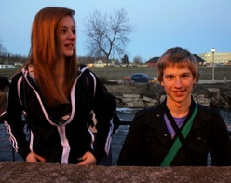
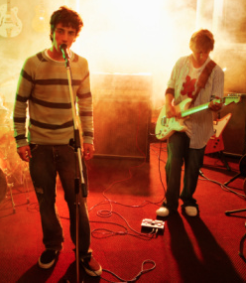
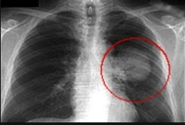
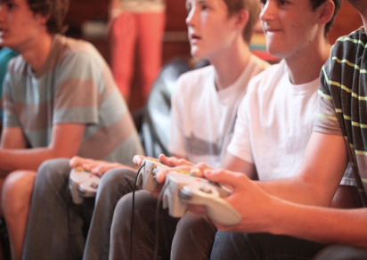
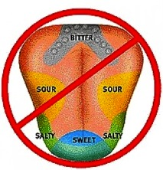
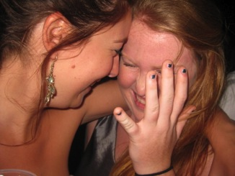
tastebuds

Slide 7
Smoking Is A Fake Solution To Fitting In
Concept C:
School can be tough, but finding a group of friends makes it easier to get through.
Think cigarettes will help you make friends? Cigarettes will give you cancer.
Think cigarettes will make you look more grown up? They actually stunt your growth.
Think they will help you look cool? How about those yellow teeth and fingers?
So what are you really getting from cigarettes?

Slide 8
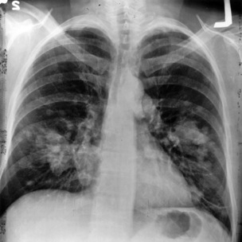
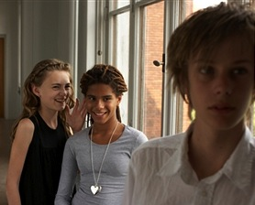
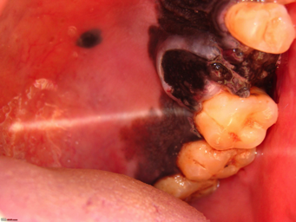
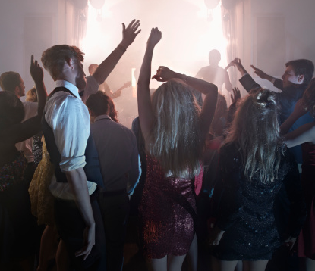
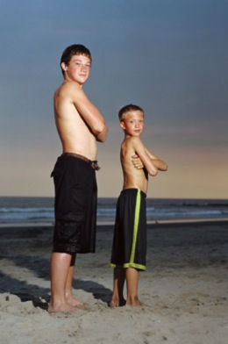

Slide 9
Tobacco Makes You Gross
Concept D:
Do you think what you wear and how you look is important?
How would you like to be that kid, the one who has yellow-stained fingers, patchy skin, bad teeth, and coughs all the time? Or the one who has bad breath and, you know, stinks? Tobacco does all that. Isn’t people thinking you are gross the last thing you want?
Research Note: Probe on right terminology to express “gross”. Consider probing on “wrinkles”.

Slide 10
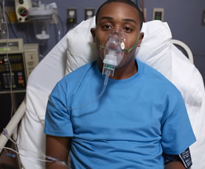
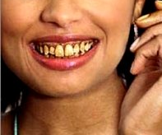
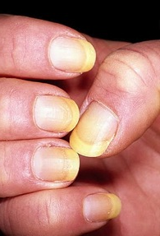

Slide 11
Consequences of Tobacco Use
ADDITIONAL MOODBOARD PROBING ON HEALTH CONSEQUENCES

Slide 13
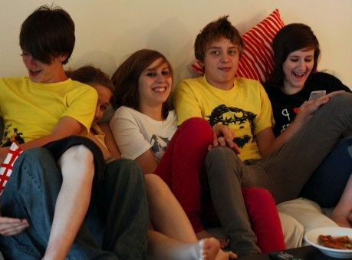
STRATEGIC CONCEPTS Day 3- BRAND
DraftFCB - Content Intended for Recipient Only

Slide 14
Be Bigger Than a Cigarette
Concept A:
Four inches. Not really that big, right? But every year cigarettes cause people to pay the ultimate price because they could never overcome their need for that small thing between their fingers. Don't let that tiny thing take anything from you. You’re bigger than that.

Slide 15
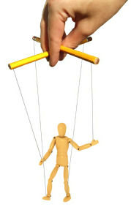
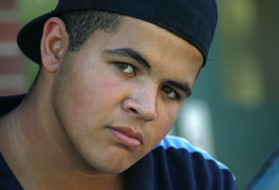
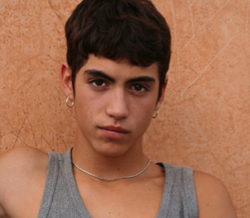
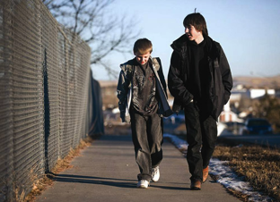

Slide 16
Smoking Sucks, You Don’t Have To
Concept B:
Think your life is tough? Smoking isn’t going to make it better. Every day teens who thought “it’s just one cigarette, once in a while” become regular smokers, losing control to smoking and signing themselves up for major health issues. Don’t let smoking make your life get worse.

Slide 17
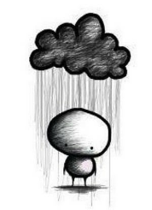
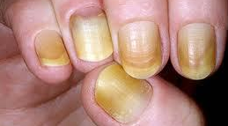

Slide 18
Don’t Let Cigarettes Tell You What To Do
Concept C:
Between school, friends and family, your problems are very real. But cigarettes are not the answer. Cigarettes not only take your health, they take control away from you. You think things are tough now, just wait until cigarettes start telling you what to do.

Slide 19
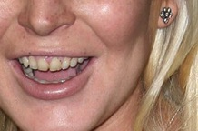
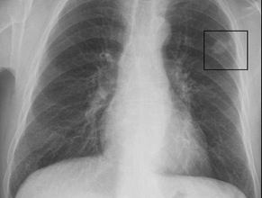
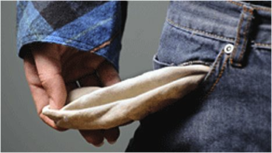

Slide 20
Don’t Let Tobacco Label You
Concept D:
You are your own person. But tobacco takes that away from you. You can start to lose control to tobacco after just a small amount of use. Become who you want to become, don’t lose yourself to tobacco.

Slide 21
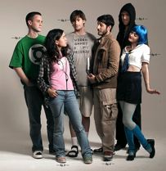
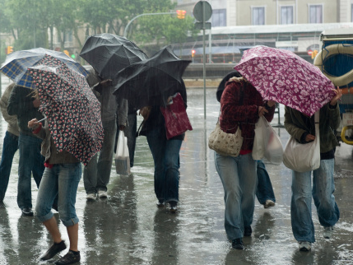
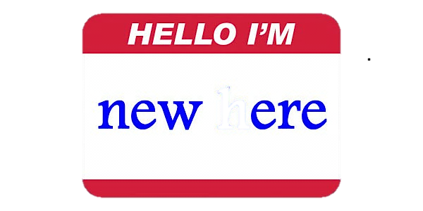
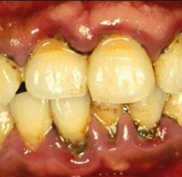
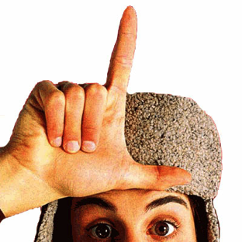
What I decide

