Slide 1
Online Quantitative Study of Youth Reactions to Rough-Cut Advertising Designed to Prevent Youth Tobacco Use; OMB Control Number 0910-0674. STIMULI
Copy testing will use rough cut videos. The following concepts/scripts are placeholders.

Slide 2
Table of Contents
Tiny Bully – “If You Knew Me” 3-7
Tiny Bully – “Beast Released” 8-12
What’s it Cost? – Skin 13-16
What’s it Cost? – Tooth 17-19
Menthol – Skin 20
Menthol – Tooth 21

Slide 3
TINY BULLY
“IF YOU KNEW ME”
This commercial begins with a tough-looking bully getting up in someone’s face at school. Except the weird thing is, this bully is only a few inches tall. He says:
BULLY: If you knew me, you’d know that when I say go outside, we go outside.
We see this Tiny Bully shove the kid down, viciously bounce him off of lockers, and drag him towards the doors that lead outside the school.
Then we see the Tiny Bully collecting money from a girl, and he says:
BULLY: If you knew me, you’d know when I say fork it over, you fork it over.
Then we see a bunch of friends playing a video game in one of their houses, and the Tiny Bully is dragging one kid away by his ear. He says:
BULLY: And if you knew me, you’d know that when I say pause the game, you pause the game. ‘Cause, like, whatever the score is, ask me if I care.
The kid’s friends are like, “come on, again? We’re in the middle of a game here!”
Then a weird thing happens. The Tiny Bully hops into the shirt pocket of the boy as he heads outside.
And when the boy goes outside, he reaches towards that pocket, pulls something out, and we see smoke rising above his head.
We hear the Tiny Bully say:
BULLY: And if you knew me, you’d know you don’t really wanna know me.
And words come on the screen that say:
CIGARETTES ARE TINY BULLIES.
BE BIGGER THAN TOBACCO.

Slide 4
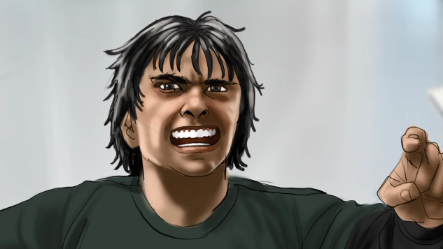
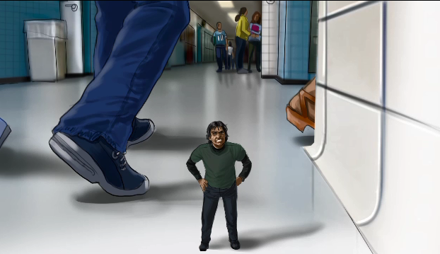
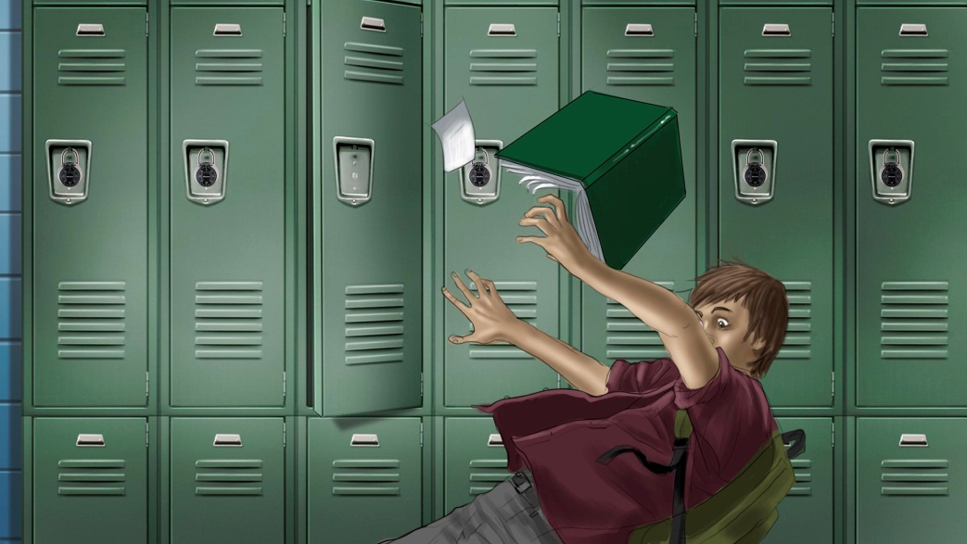
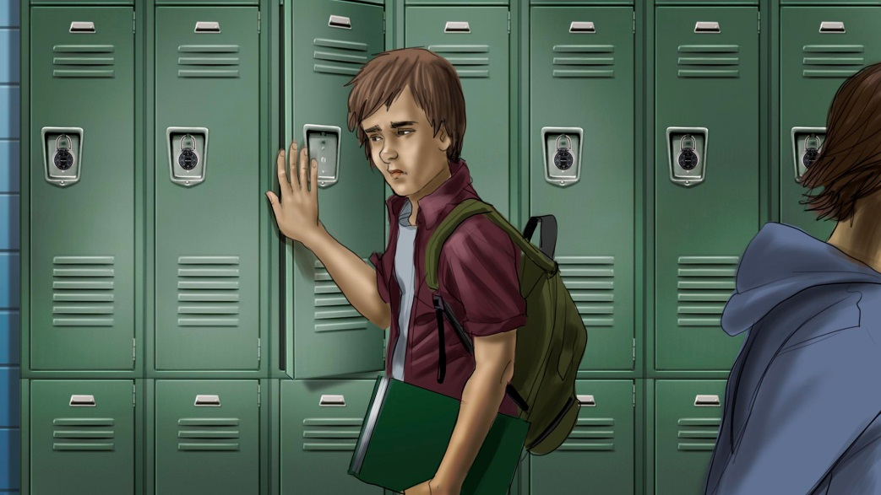
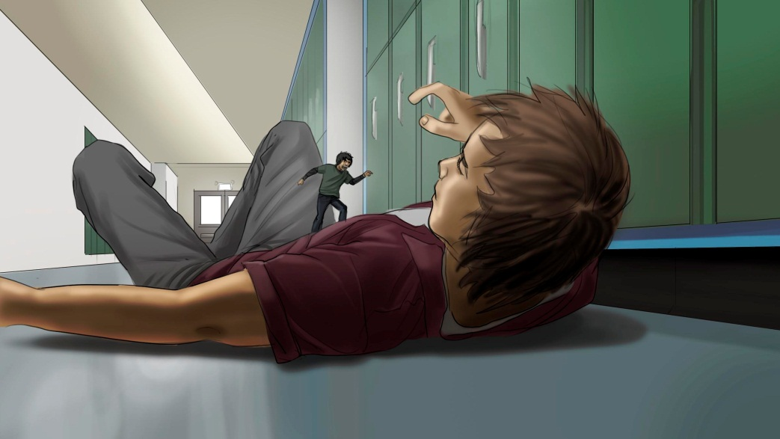

Slide 5
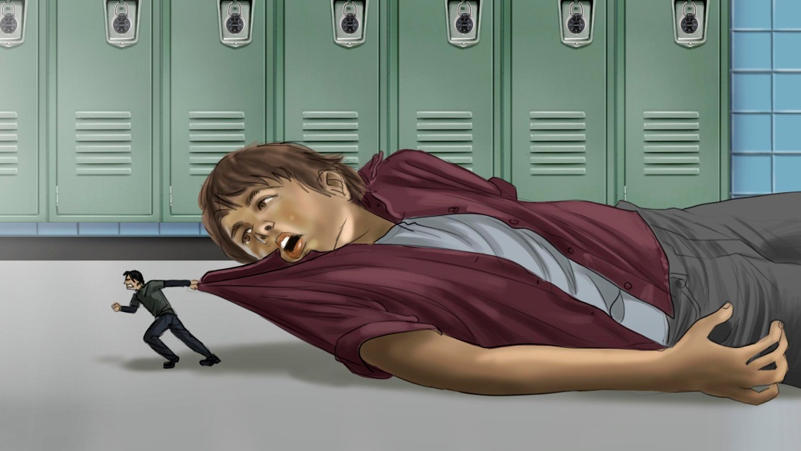
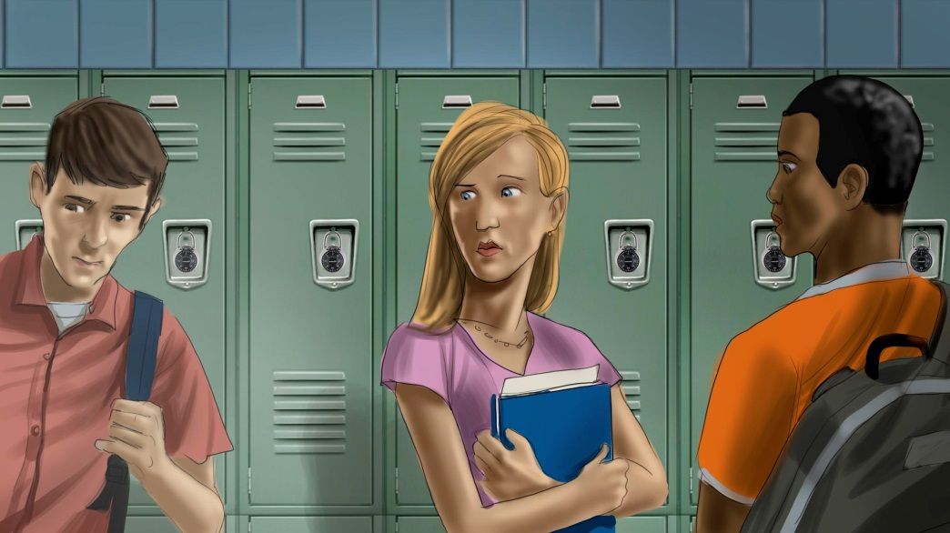
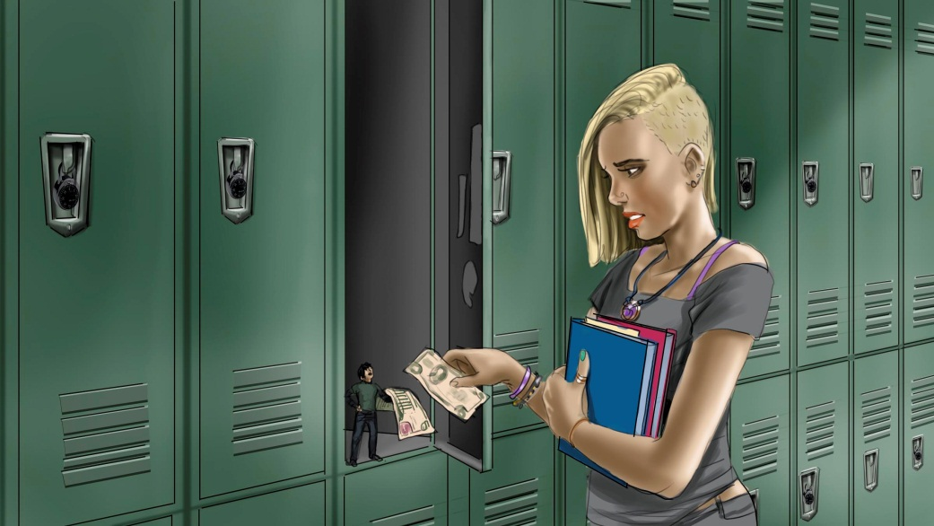
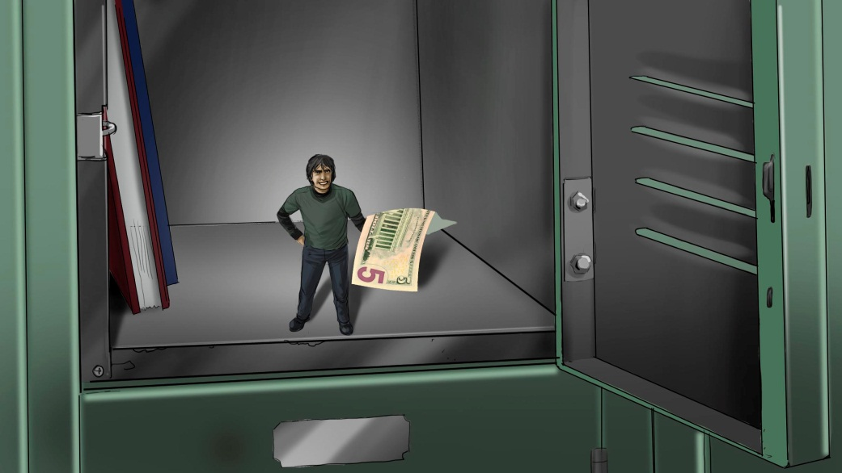

Slide 6
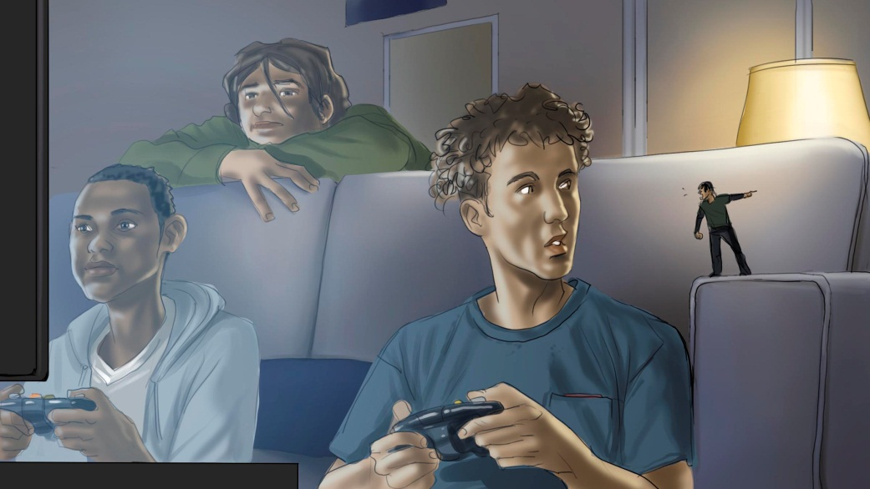
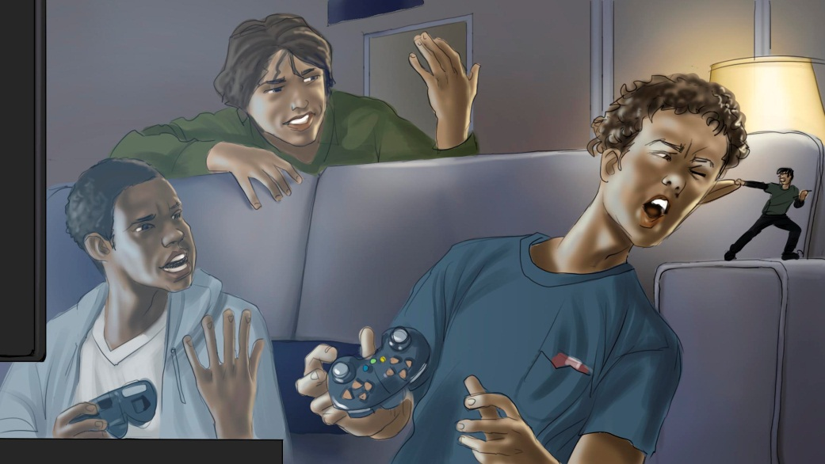
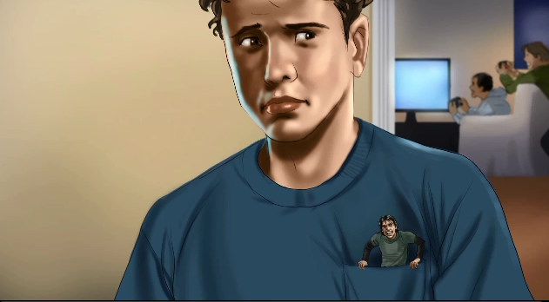
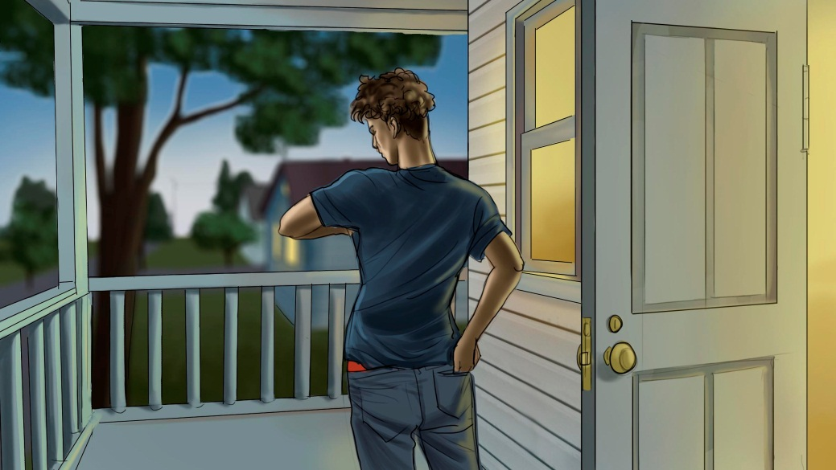

Slide 7
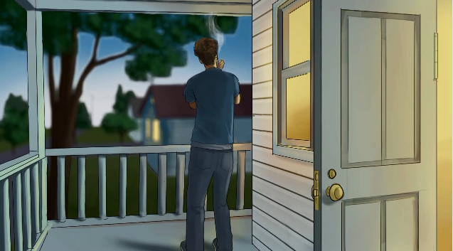
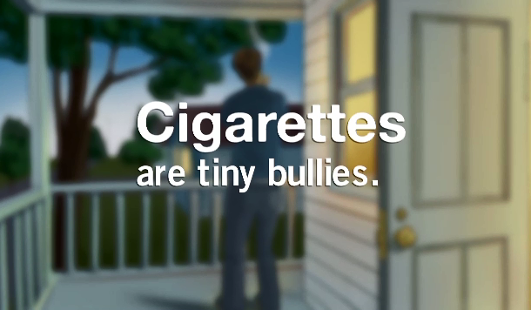
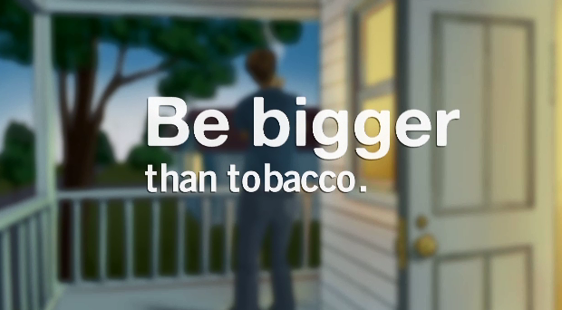

Slide 8
TINY BULLY
“BEAST RELEASED”
This commercial begins with a young girl at school telling us about her scary situation. She says to the camera.
ALISON: I didn’t meet him until maybe my third cigarette. My first two cigarettes were real rough. Head-spinning gonna puke rough. But by my third, I was starting to get the hang of it. And that’s when he showed up. It’s a day I’ll never forget.
ALISON: At first, I didn’t take him seriously. I heard the stories, but thought they were overblown. But over time, he became, like, really annoying. Possessive even. Everywhere I went, he had to follow.
ALISON: And bossy, just so bossy. “Let’s go outside now!” No, I’m talking to Jack. “Outside now!” It’s pouring. “OUTSIDE NOW!” Well fine!
ALISON: He was so needy. “I haven’t seen you in over an hour.” Uh, yea you did, like twenty minutes ago. “But I miss you sooo much.”
ALISON: He started taking my money. Like I wanted to go to this movie with Lisa and Stephanie and he was all like, “Sorry, we need cash for you know what.”
ALISON: If I could go back to that third cigarette, yeah, I wouldn’t light it. I wish this guy would just go back to where he came.
And then we hear a voice from outside say “ALISOOOOON.”
The girl seems annoyed, yet powerless.
ALISON: Coming.
She leaves to go outside and we see her there, alone, smoking a cigarette.
And words come on the screen that say:
CIGARETTES ARE TINY BULLIES.
BE BIGGER THAN TOBACCO.

Slide 9
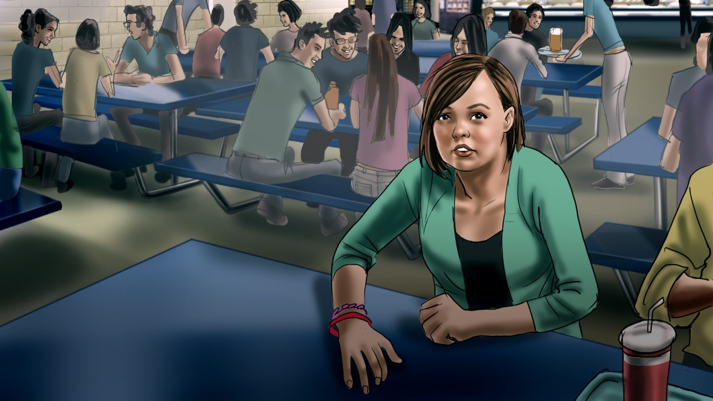
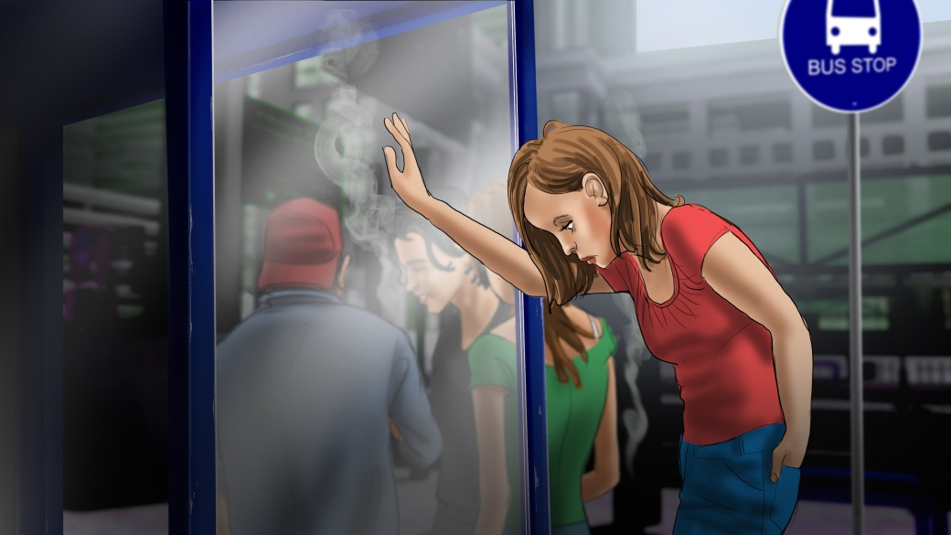
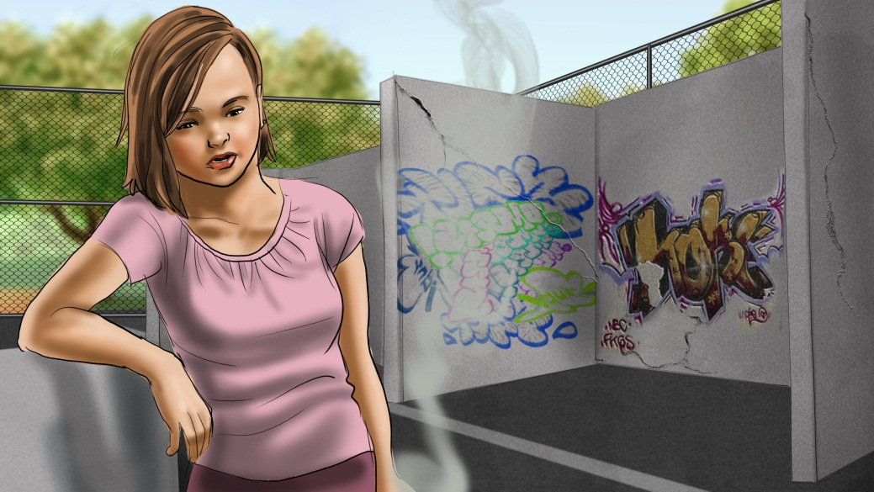
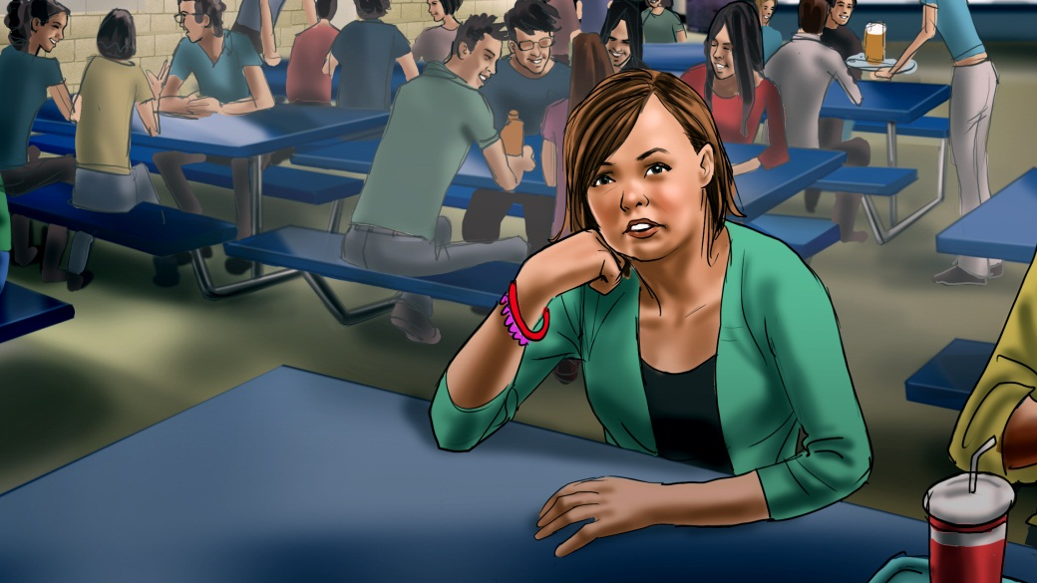

Slide 10
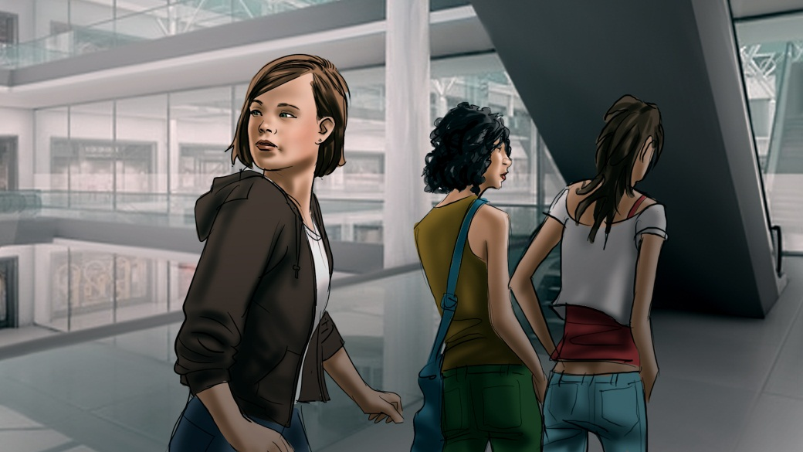
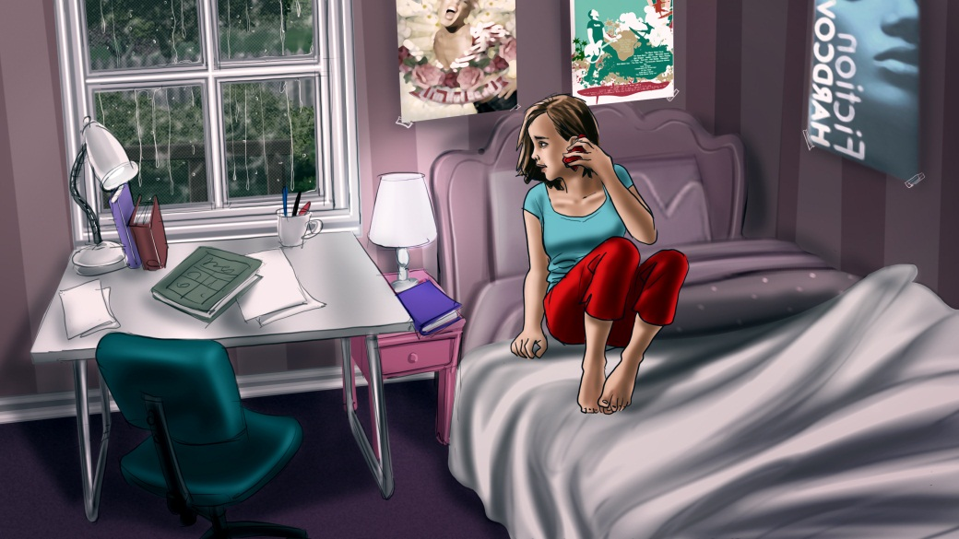
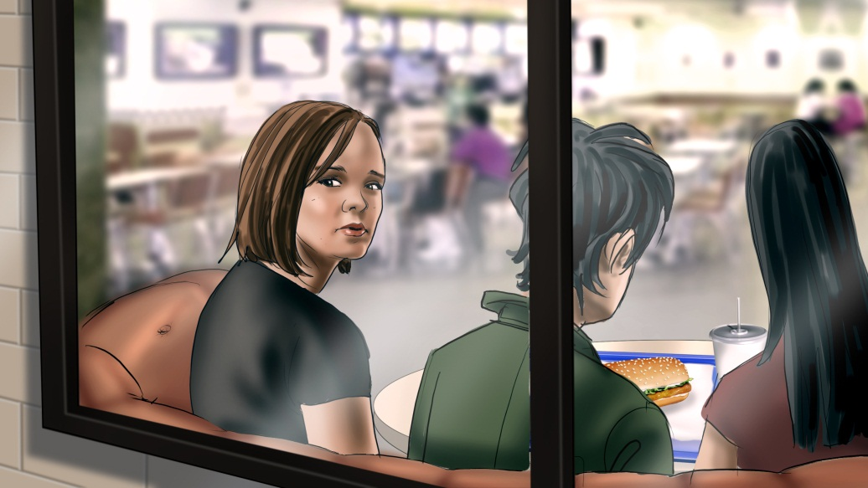
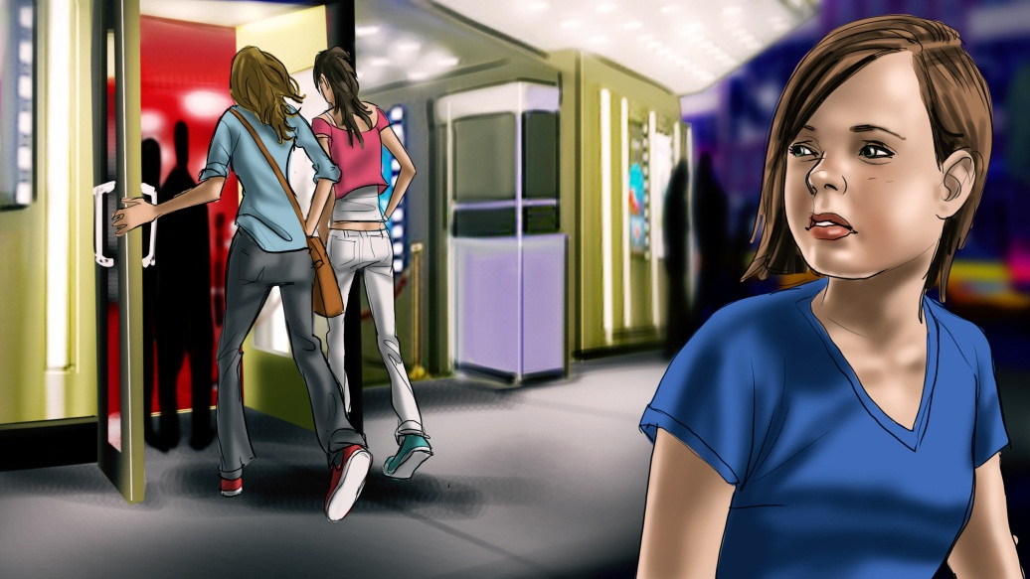

Slide 11
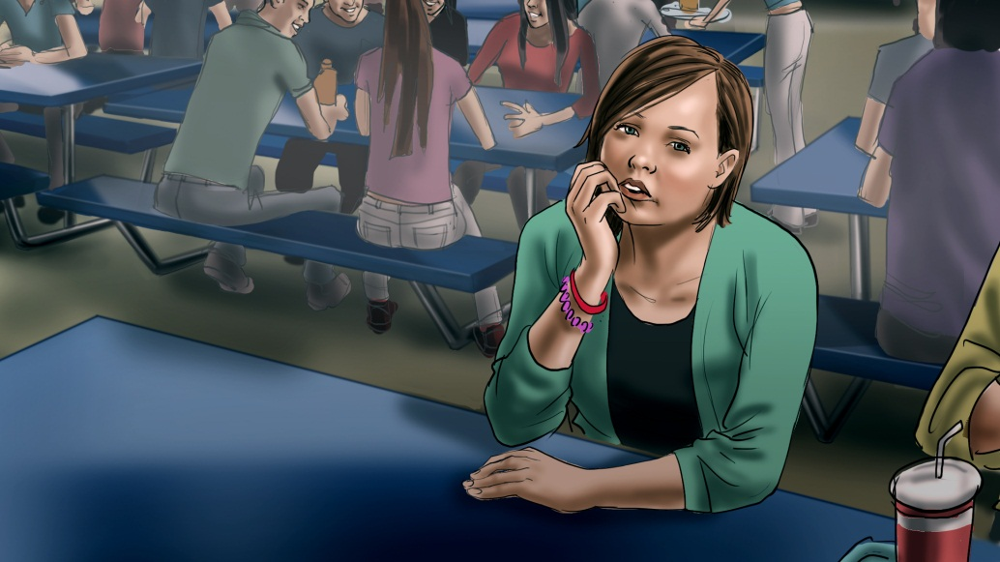
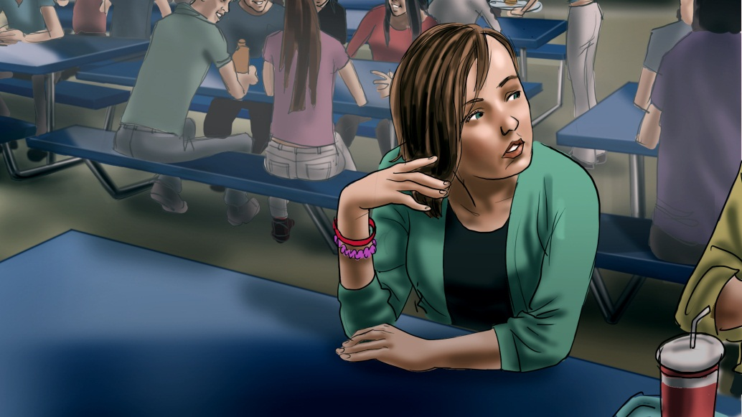
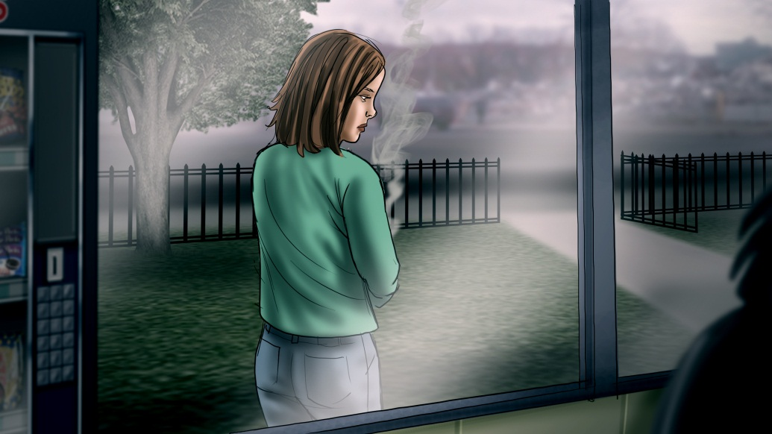
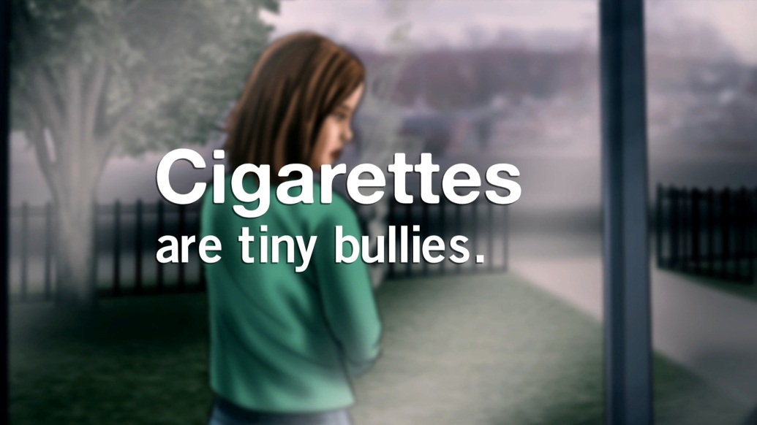

Slide 12
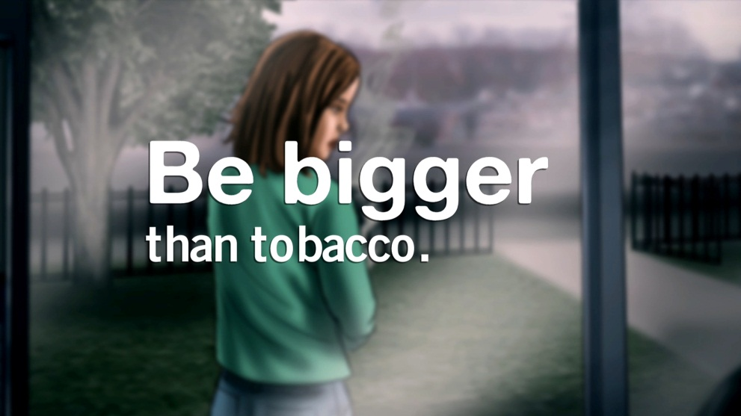

Slide 13
WHAT’S IT COST?
“POINT OF PURCHASE - SKIN”
This commercial begins as a young woman walks toward a convenience store. She enters and places some money on the counter. But the cashier just stares at the money. It’s apparently not enough.
The young woman sighs. She looks nervous. And then she begins to pick away pieces of her skin, scraping at it, peeling it off, revealing wrinkled, damaged skin underneath.
An announcer says:
ANNOUNCER: What’s a pack of smokes cost? Your smooth skin. Smoke in cigarettes impairs blood flow to your skin, stripping it of important nutrients and causing wrinkles that age you prematurely.
The girl places her young, good skin on the counter next to the money.
Now she’s paid enough and we hear her rung up.
SFX: Ching ching.
The announcer continues, saying:
ANNOUNCER: Cigarettes. What are they costing you?

Slide 14
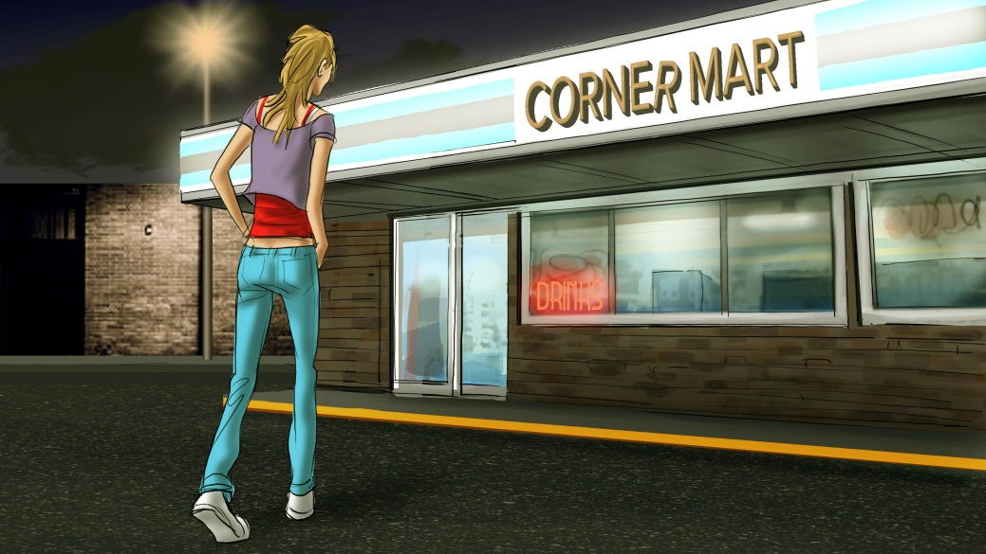
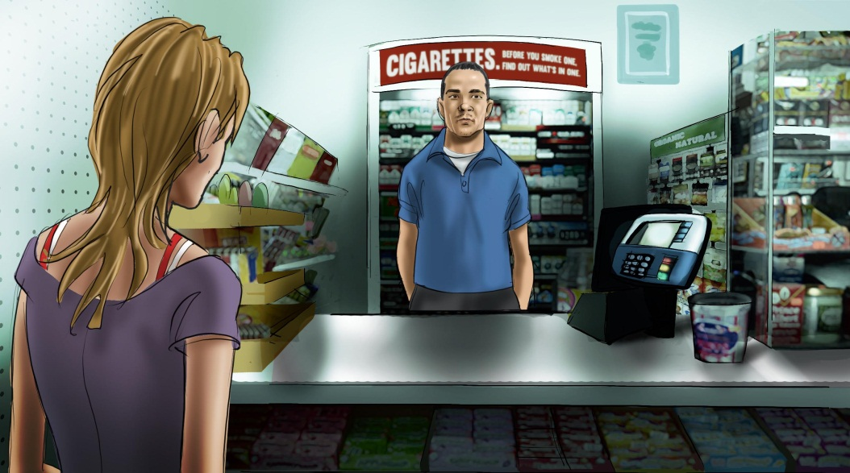
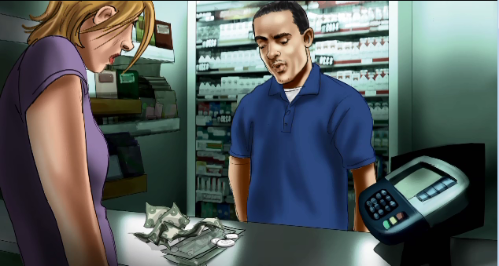
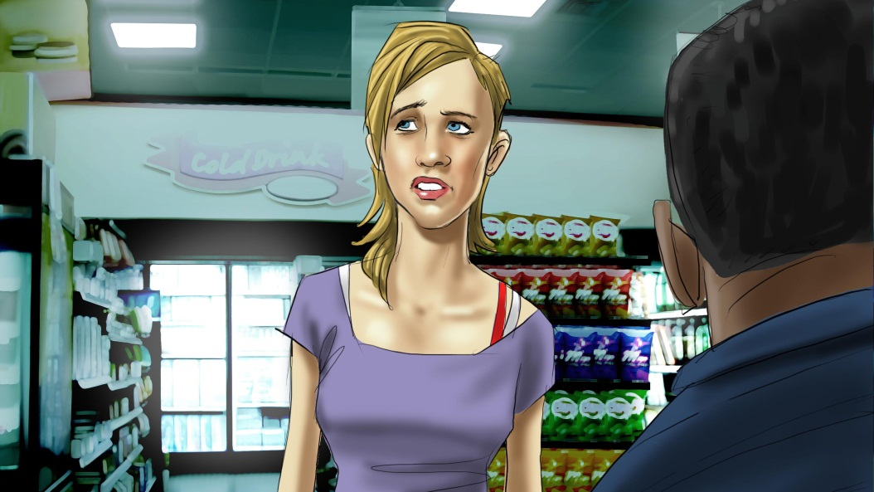

Slide 15
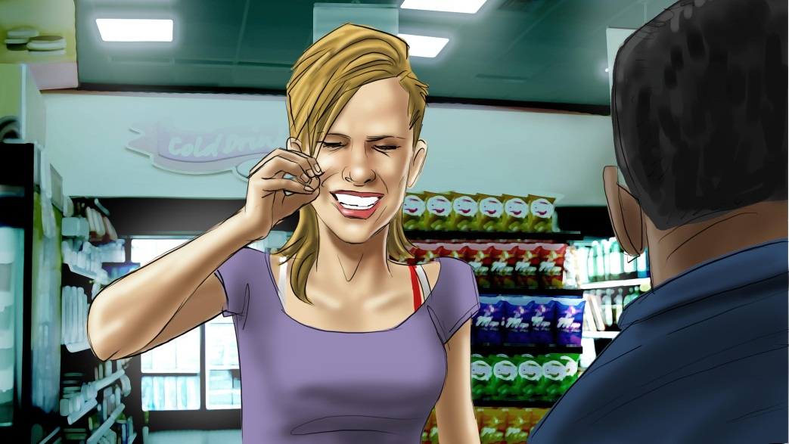
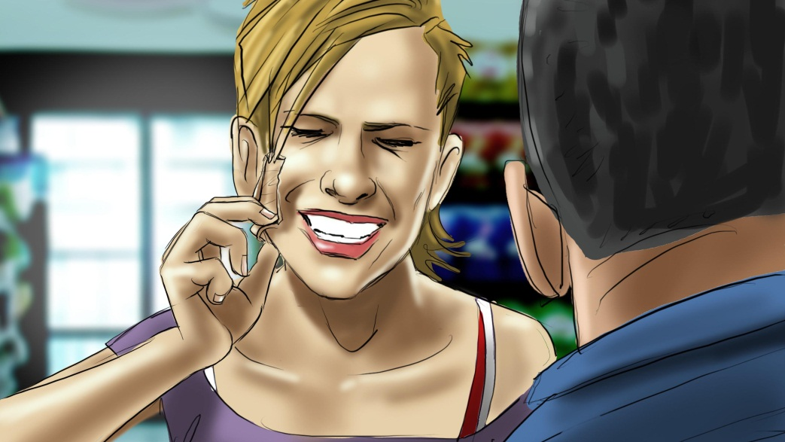
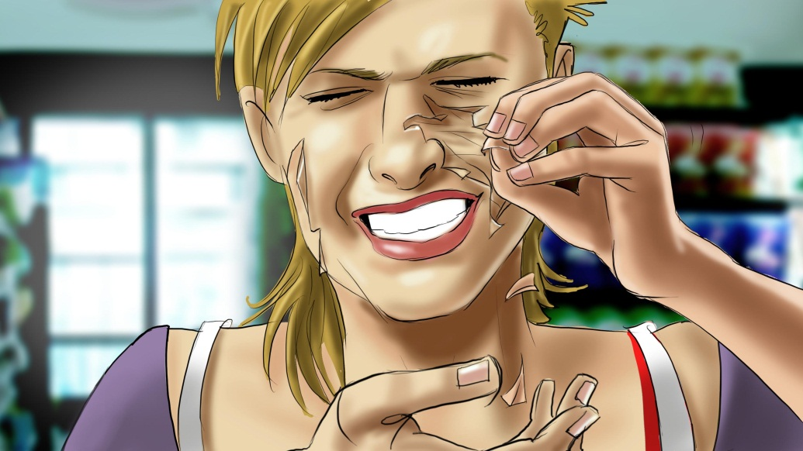
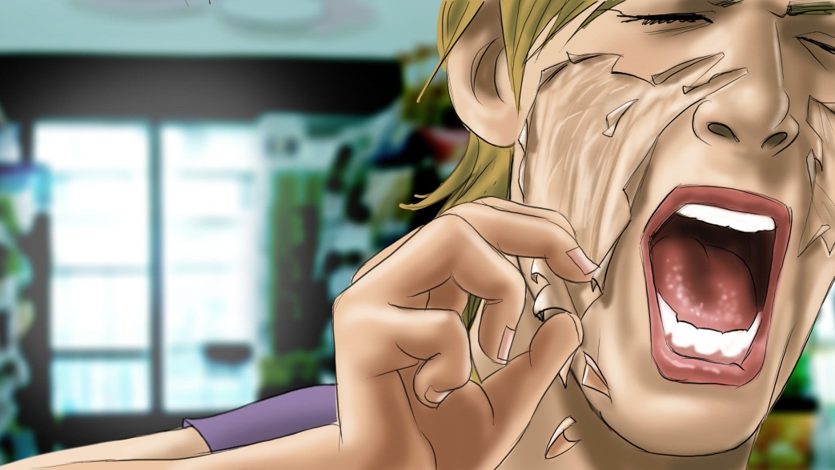

Slide 16
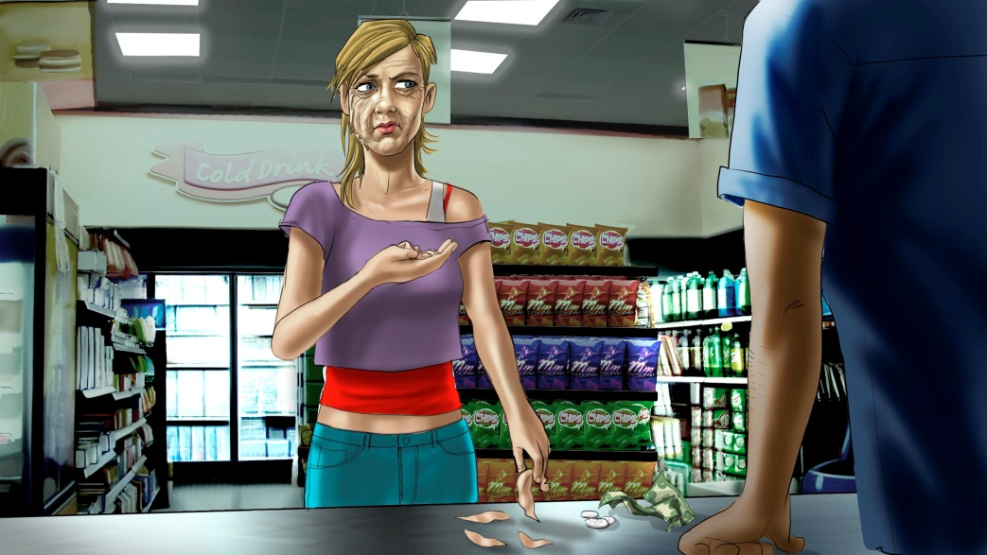
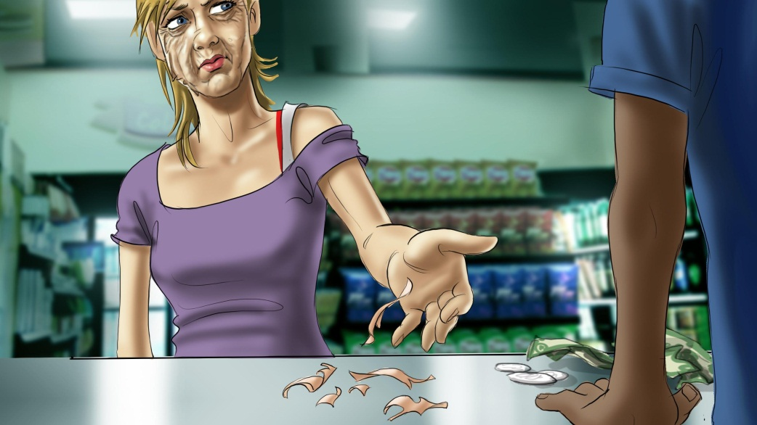
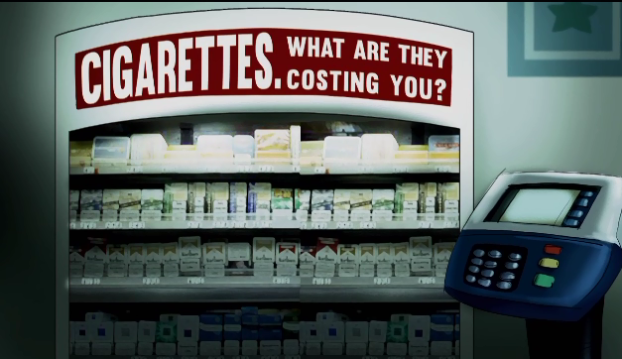

Slide 17
WHAT’S IT COST?
“POINT OF PURCHASE — TEETH”
This commercial begins as a young man walks towards a convenience store.
He enters and places some money on the counter. But the cashier just stares at the money. It’s apparently not enough.
The young man sighs. He looks nervous. He grips one of his teeth with pliers and struggles to yank it out.
An announcer says:
ANNOUNCER: What’s a pack of smokes cost? Your teeth. Smoking can cause serious gum disease that makes you more likely to lose your teeth than someone who doesn’t smoke.
The boy places the bloody tooth on the counter next to the money.
Now he’s paid enough, and we hear him rung up.
SFX: Ching ching.
The announcer continues, saying:
ANNOUNCER: Cigarettes. What are they costing you?

Slide 18
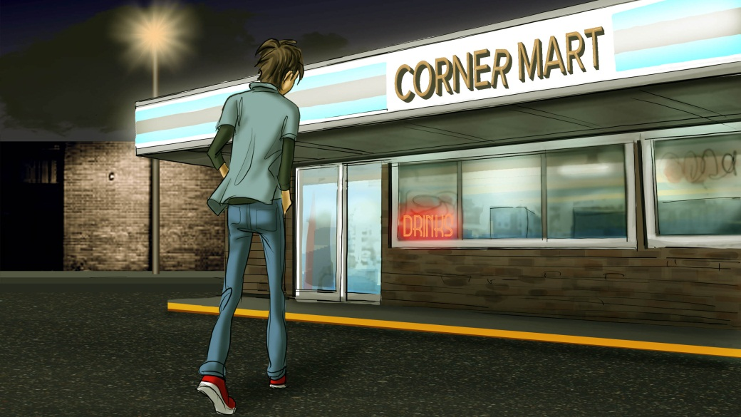
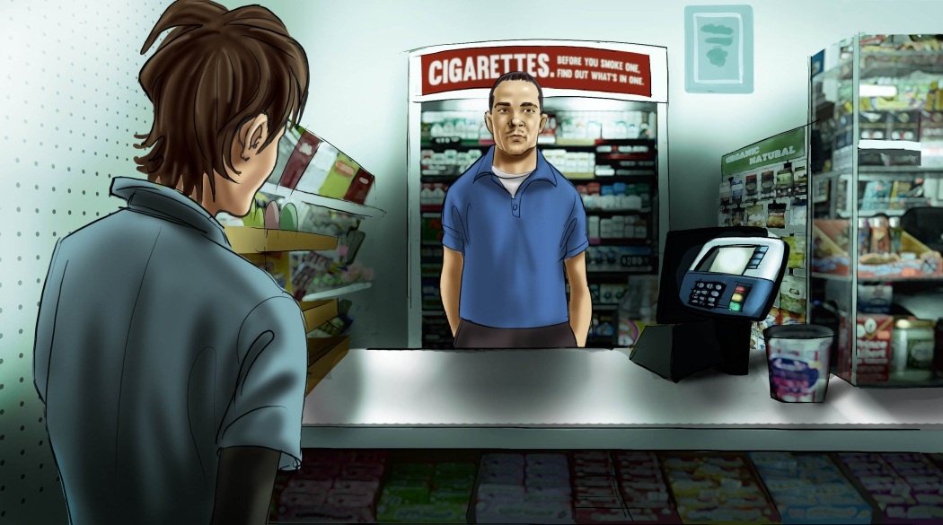
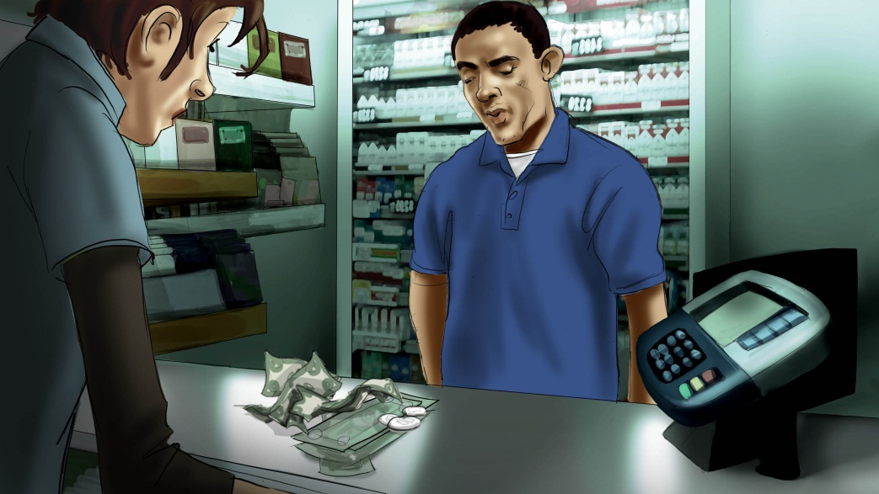
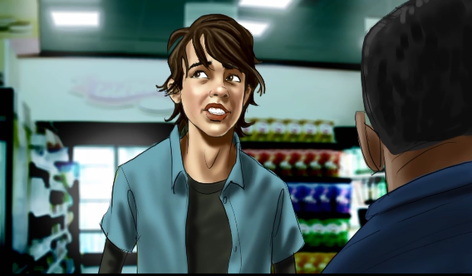

Slide 19
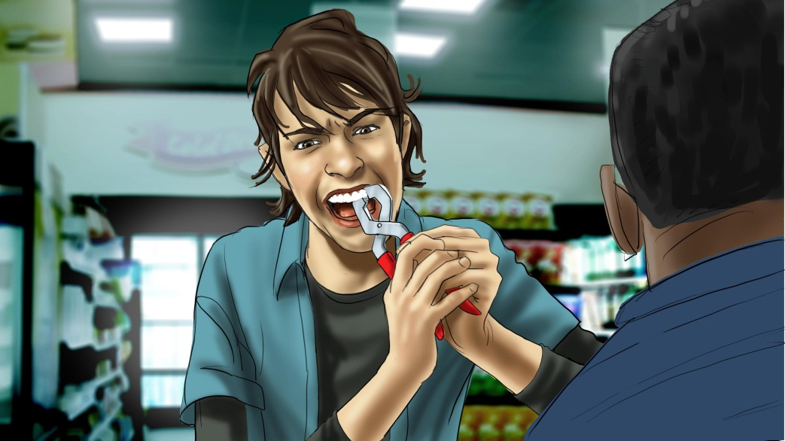
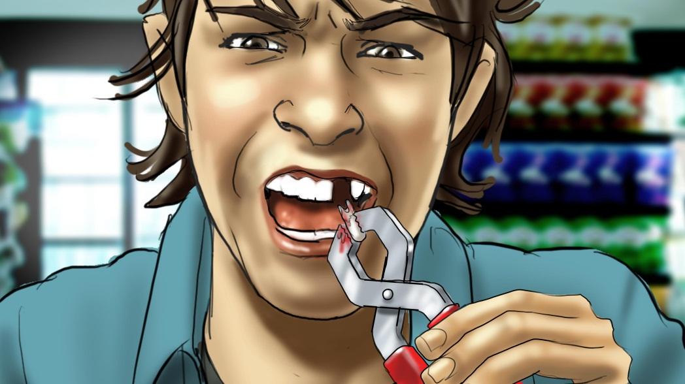
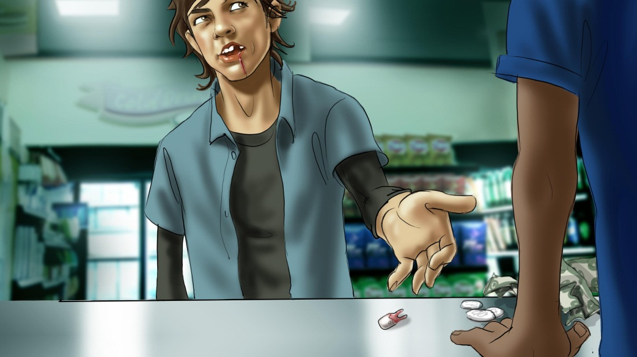

Slide 20
Skin - Menthol
“Skin – Menthol” :30 TV
We open on the exterior of a convenience store in the middle of nowhere. We hear the drone of a generator, the buzzing of the fluorescent sign above the store, the bugs in the woods.
A 19 year old girl approaches the store and enters.
She walks up to the counter, behind which we see the giant display of Menthol cigarettes . She puts some money on the counter along with her ID . The cashier simply looks at her. The money she’s paid is apparently not enough.
She pauses. Takes a deep breath.
She begins to pick away at the skin on her face. Grotesquely pulling it loose. Revealing damaged, blotchy, wrinkled skin underneath.
She throws the loose, healthy skin that she’s picked off on the counter.
She’s now paid enough. She’s rung up. A pack of Menthols is thrown on the counter next to her skin.
VO: What’s a pack of Menthols cost? Your smooth skin.
VO: Smoking menthols or regular cigarettes causes wrinkles that age you prematurely.
VO: Menthols. What are they costing you?
In some states the legal age is 19.
Any cigarette packaging imagery used should not include identifiable brands currently in the marketplace.
The ad must communicate that the girl is of legal age to purchase tobacco products.
This statement has been validated through FDA scientific review and cannot be altered without another review.

Slide 21
Tooth - Menthol
“Tooth - Menthol” :30 TV
We open on the exterior of a convenience store in the middle of nowhere. We hear the drone of a generator, the buzzing of the fluorescent sign above the store, the bugs in the woods.
A 19 year old boy approaches the store and enters.
He walks up to the counter, behind which we see the giant display of Menthol cigarettes . He puts some money on the counter along with his ID . The cashier simply looks at him. The money he’s paid is apparently not enough.
He pauses. Takes a deep breath. And takes a pair of pliers from his pocket.
He begins to tug at the tooth. Grimacing. Pulling. Moaning. And finally he yanks the tooth loose, the nerves still attached.
He places the bloody tooth on the counter next to the money.
Now he’s paid enough. He’s rung up. A pack of Menthols is tossed onto the counter next to his tooth.
VO: What’s a pack of Menthols cost? Your teeth.
VO: Smoking menthols or regular cigarettes can cause serious gum disease that makes you more likely to lose your teeth than someone who doesn’t smoke.
VO: Menthols. What are they costing you?
In some states the legal age is 19.
Any cigarette packaging imagery used should not include identifiable brands currently in the marketplace.
The ad must communicate that the guy is of legal age to purchase tobacco products.
This statement has been validated through FDA scientific review and cannot be altered without another review.

