Slide 1
J-1 Waiver Online (JWOL) 02.00.00
User Interface Design
as of February 14, 2014

Slide 2
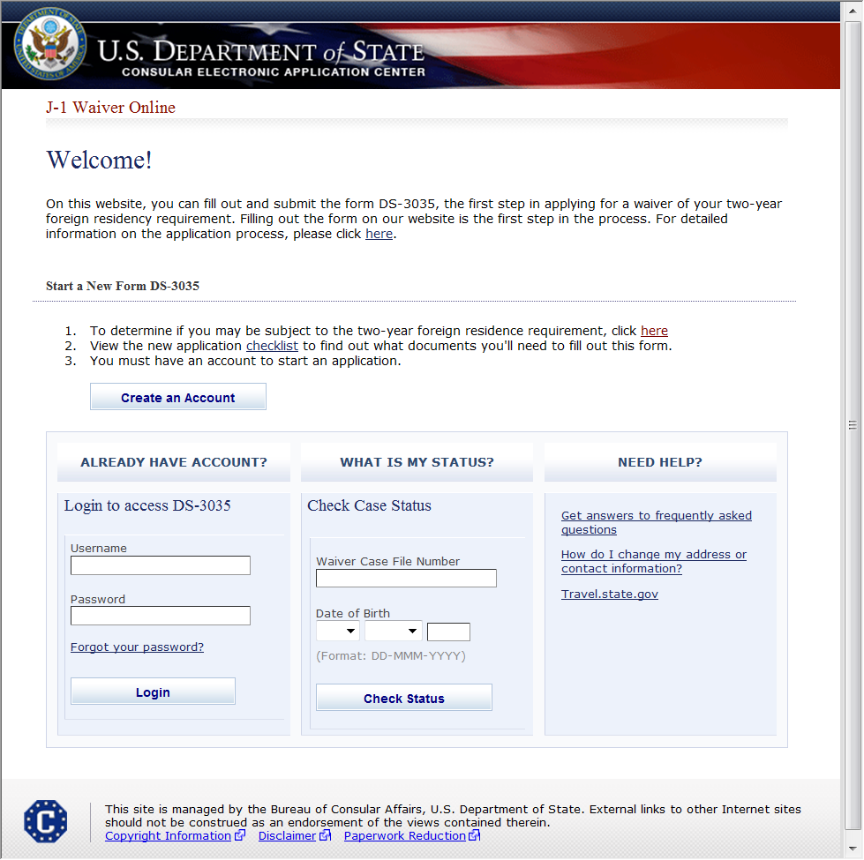
Login to Account
SAMPLE

Slide 3
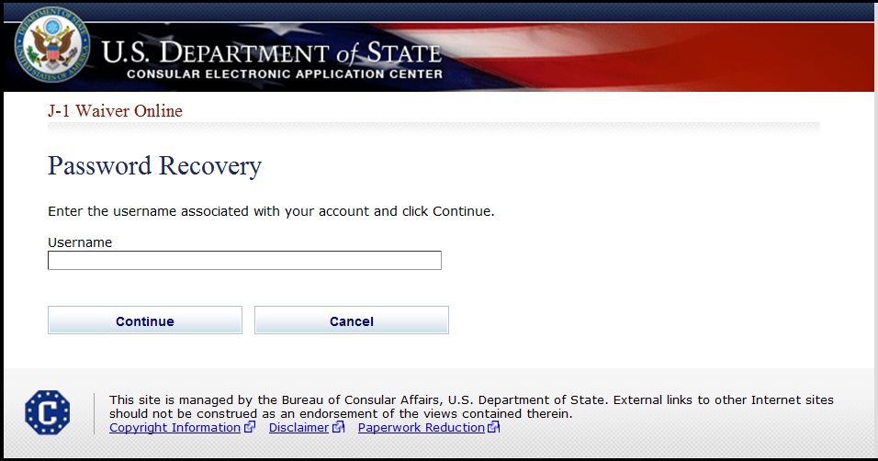
Forgot Password

Slide 4
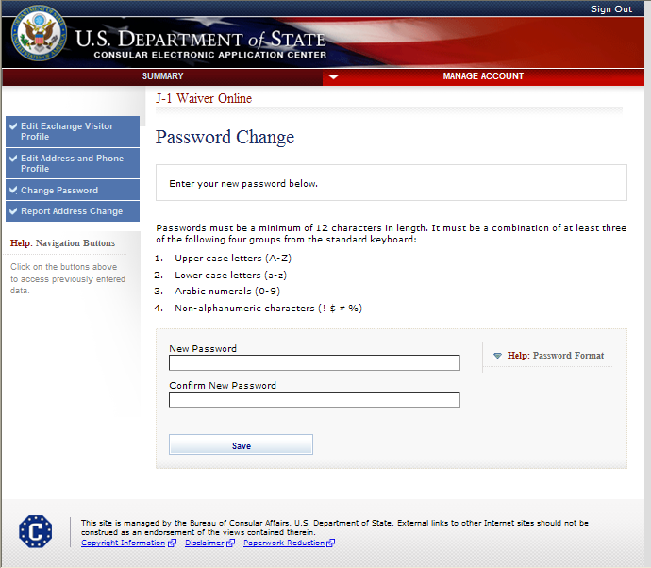
Change Password

Slide 5
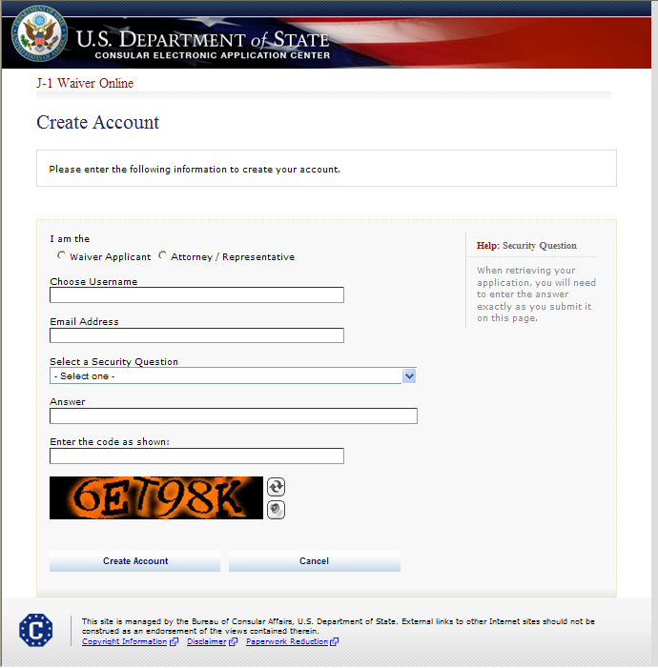
Create New Account

Slide 6
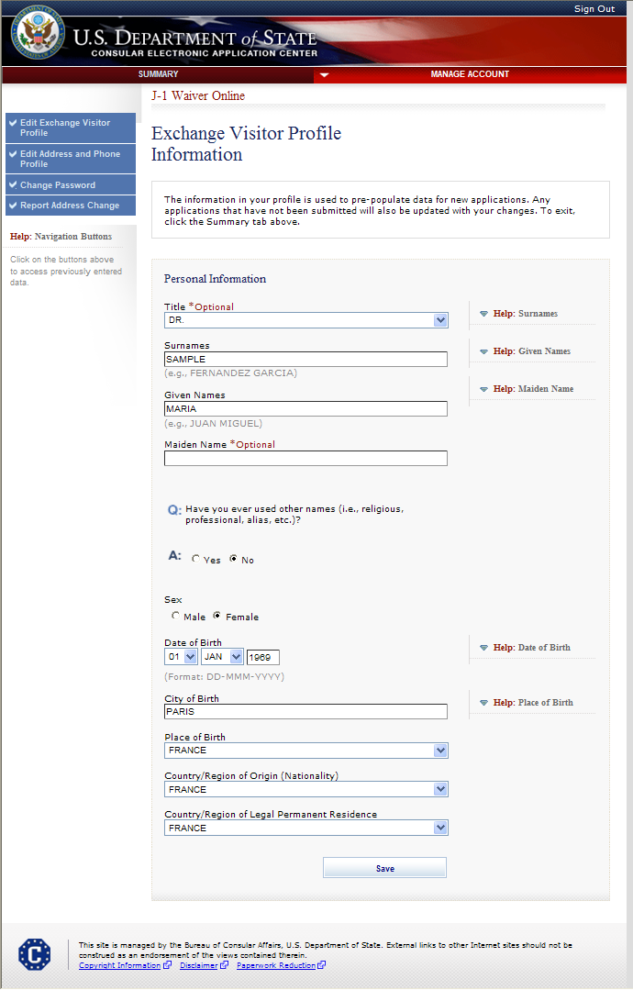
Create Applicant Profile If Account Type is Waiver Applicant

Slide 7
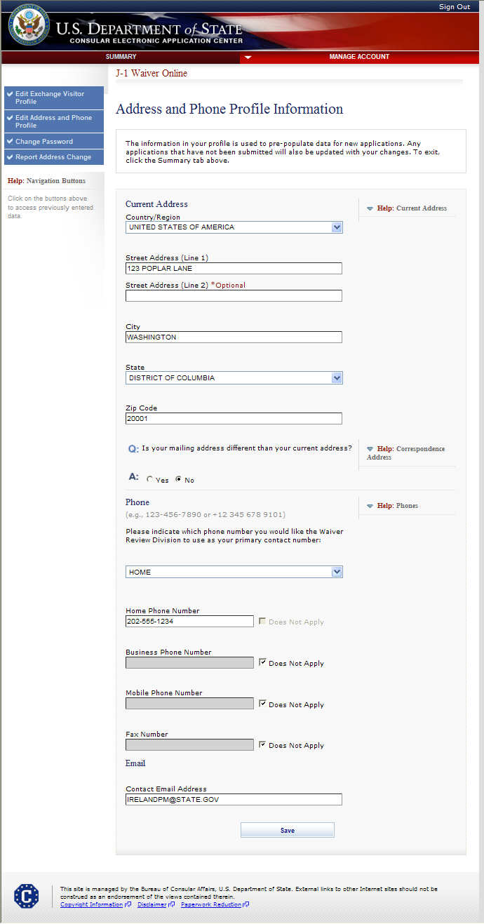
Create Applicant Profile (cont.) Address and Phone Profile Information

Slide 8
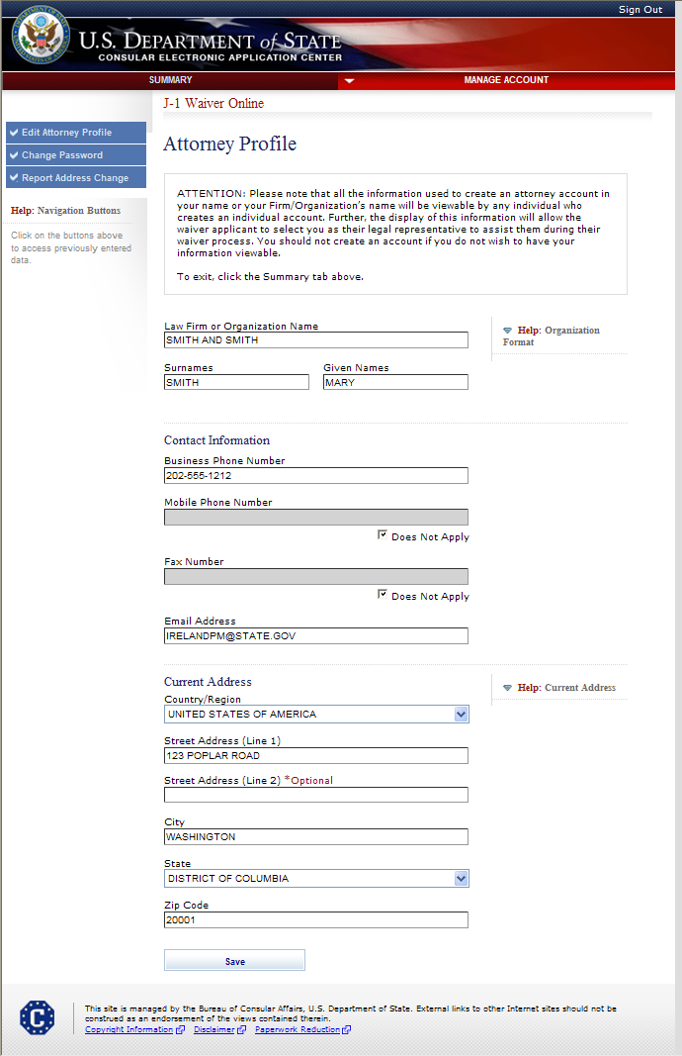
Create Attorney Profile If Account Type is Attorney/Representative

Slide 9
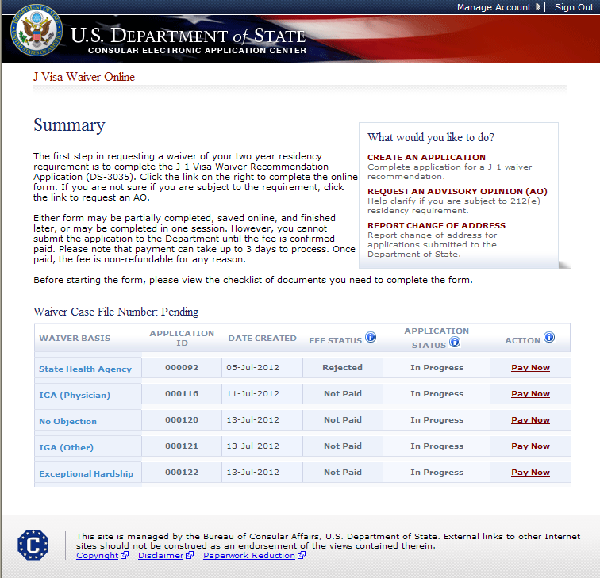
Summary Page For Waiver Applicants
SAMPLE

Slide 10
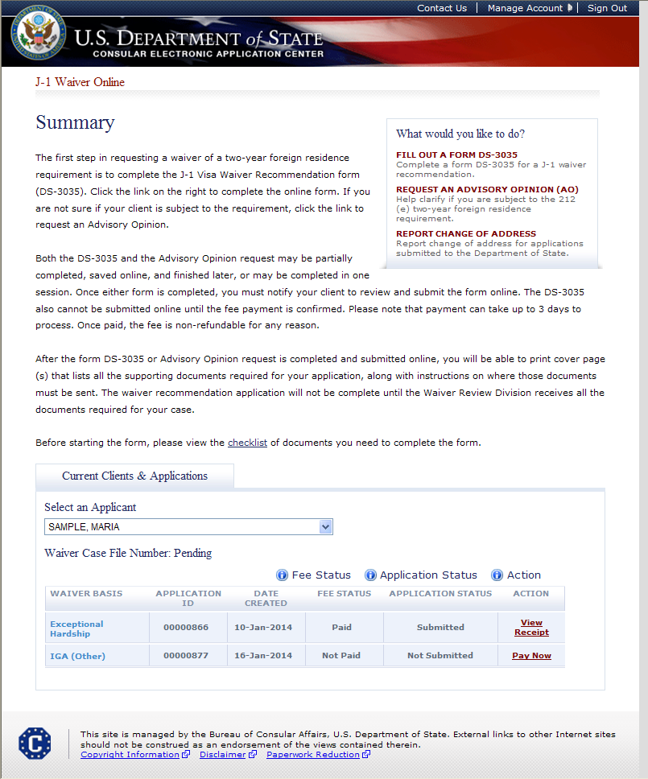
Summary Page For Attorneys
SAMPLE

Slide 11
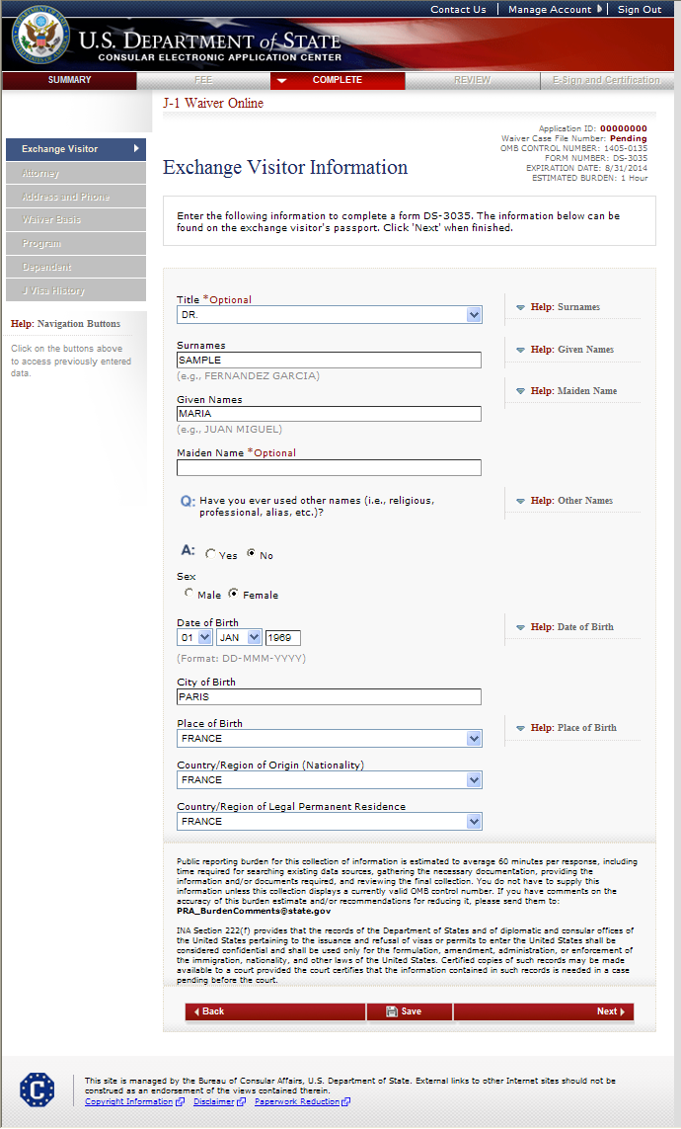
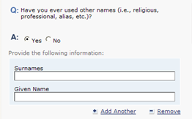
Exchange Visitor Information Page
Displays if user indicates other names were used

Slide 12
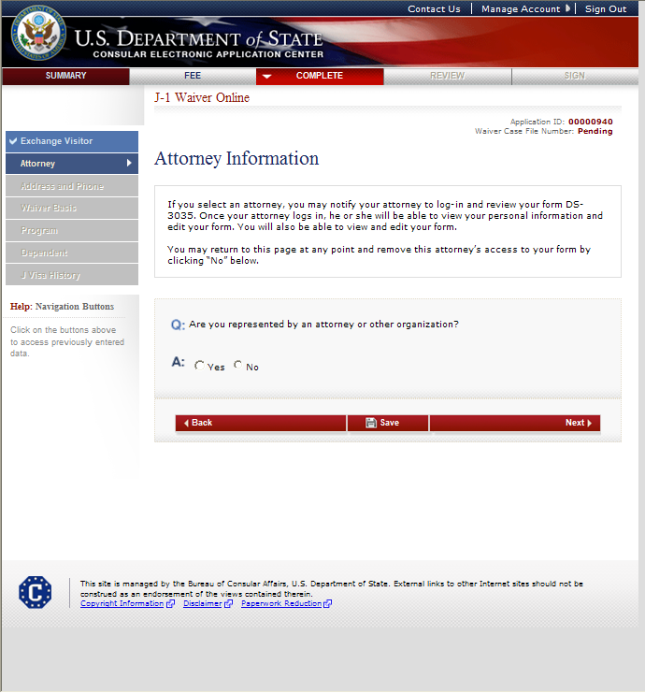
Attorney Information Page

Slide 13
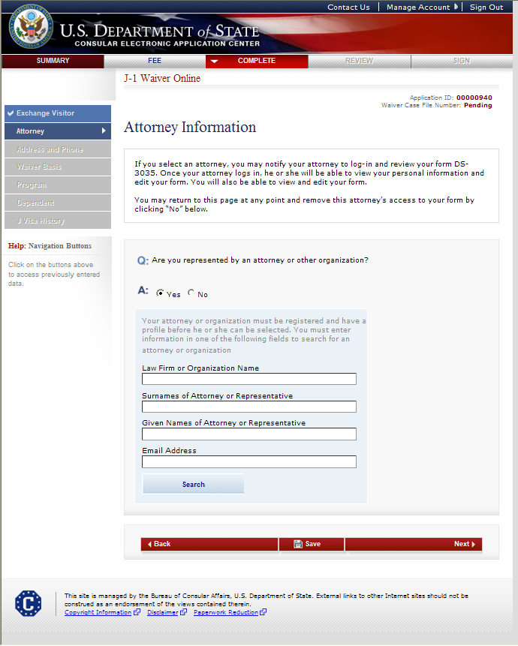
Attorney Information Page (cont.) Displayed if user indicates they are represented by an attorney or other organization

Slide 14
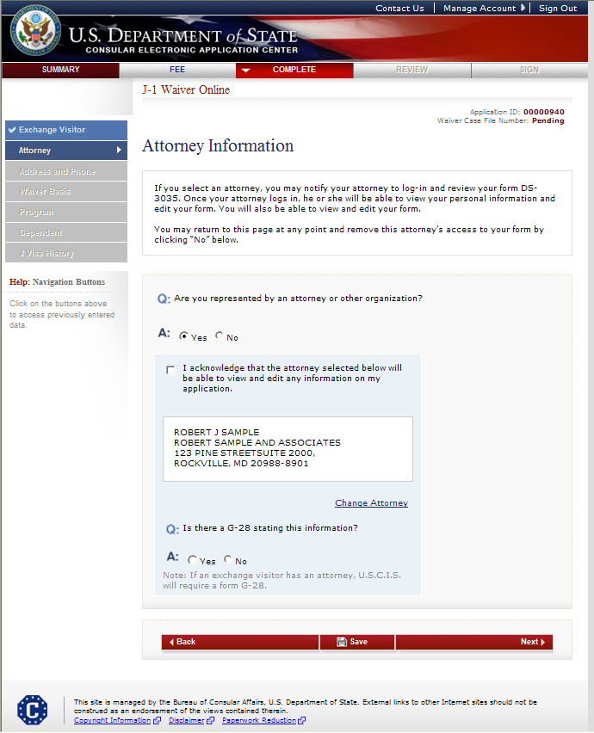
Attorney Information Page (cont.) G-28 question displayed after user selects an attorney/representative

Slide 15
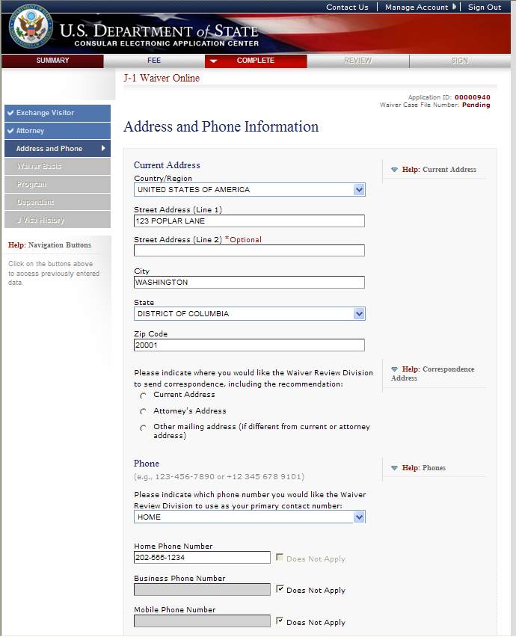
Address and Phone Page

Slide 16
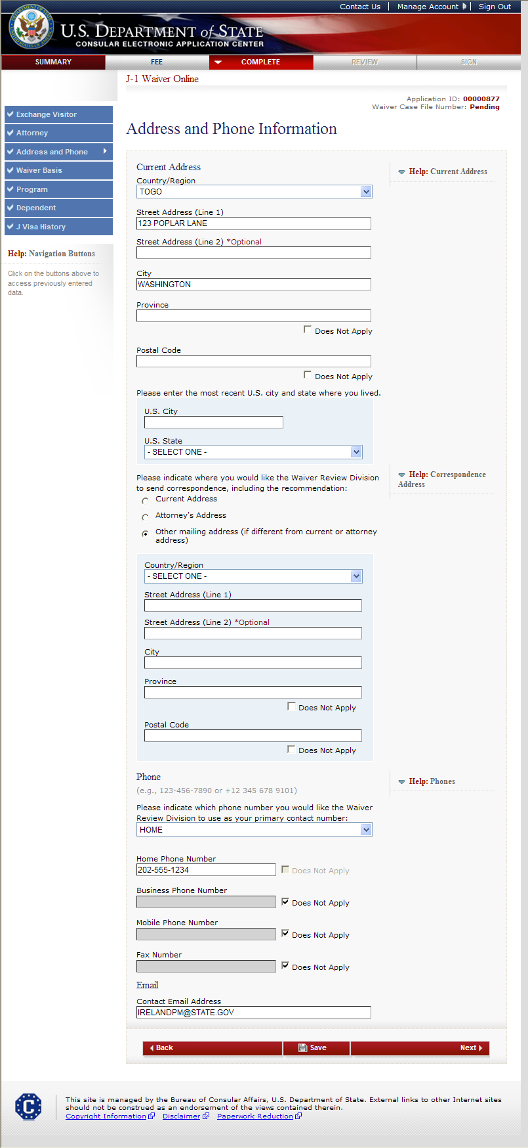
Address and Phone Page (cont.) Displays if current address is not in U.S. and if another mailing address for correspondence is selected

Slide 17
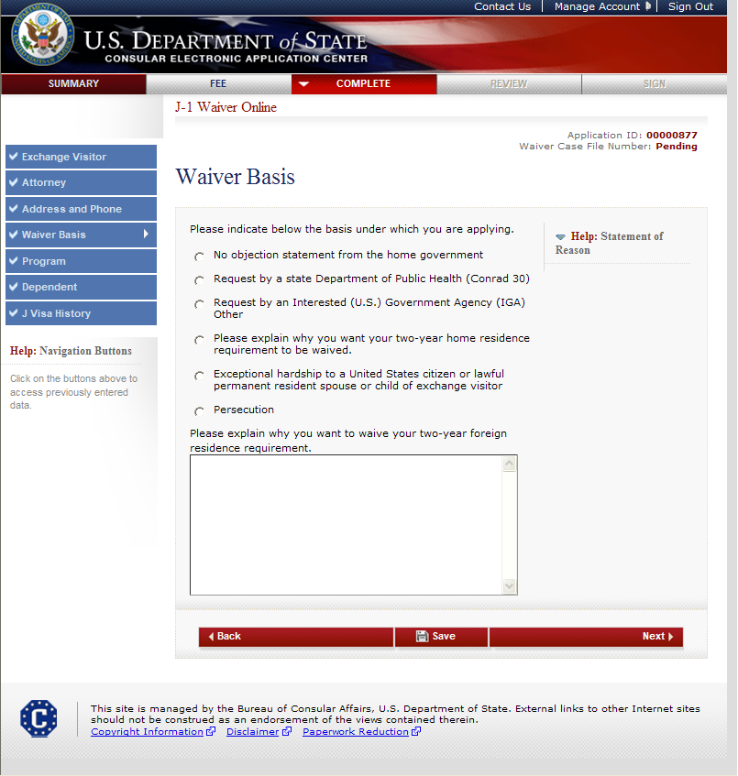
Waiver Basis Page Displayed for all users

Slide 18
Waiver Basis Page Displays if No objection from home government selected

Slide 19
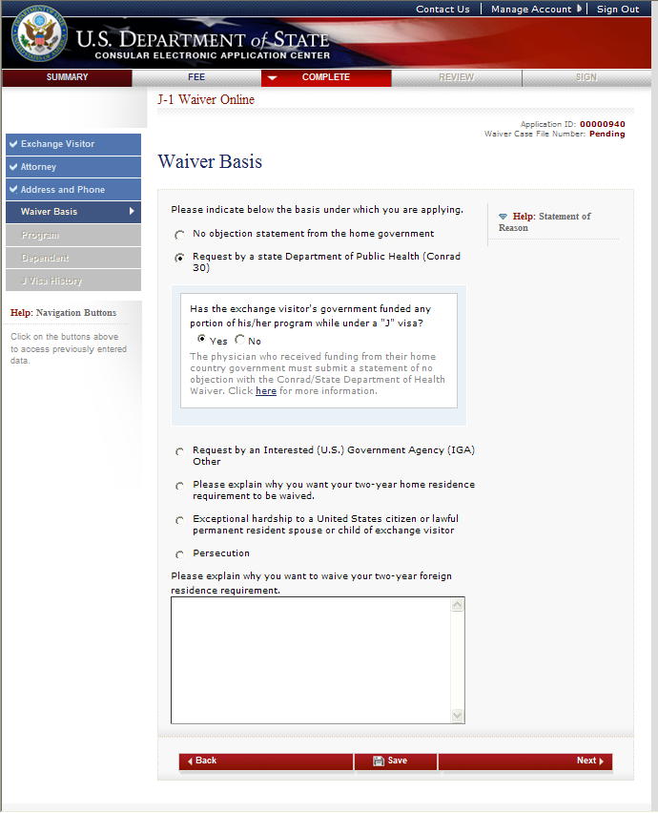
Waiver Basis Page Displays if Request by State Health Agency selected

Slide 20
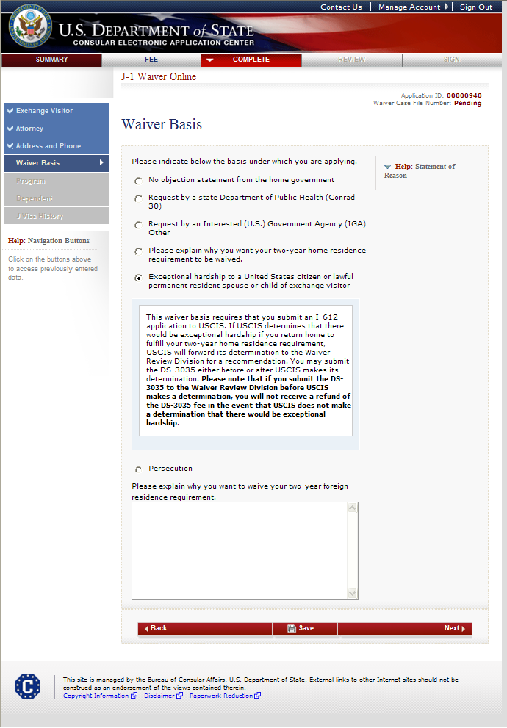
Waiver Basis Page Displays if Exceptional Hardship selected

Slide 21
Waiver Basis Page Displays if Persecution selected

Slide 22
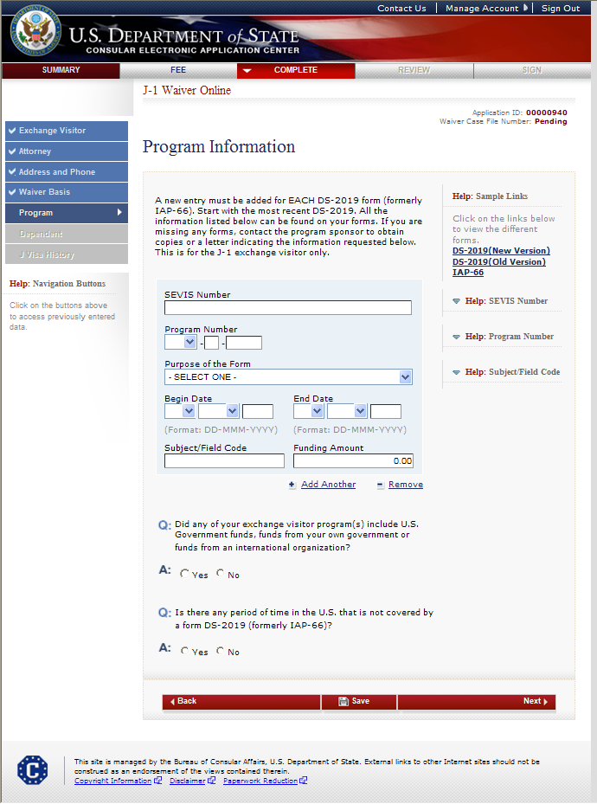
Program Information Page

Slide 23
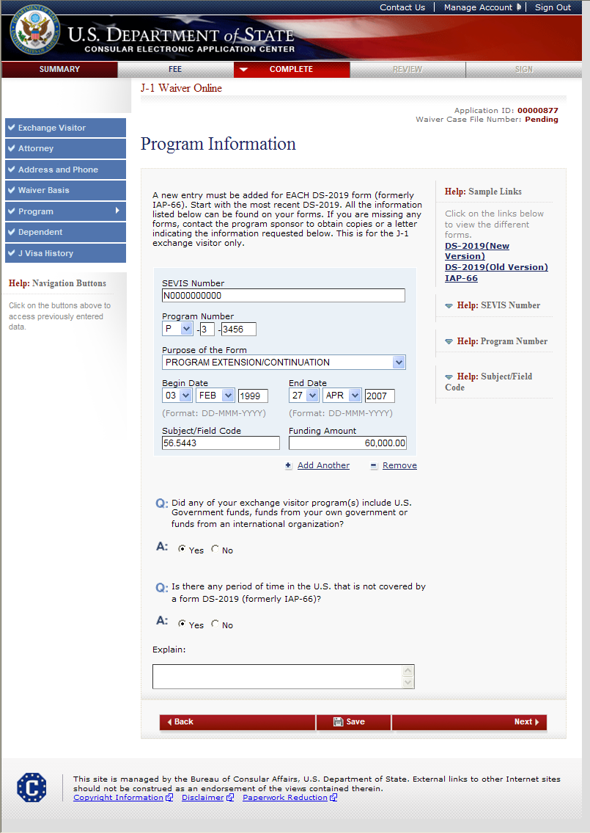
Program Information Page (cont.) Answers Yes to “Is there any period of time in the U.S. that is not covered by a DS-2019 or IAP-66 form?”

Slide 24
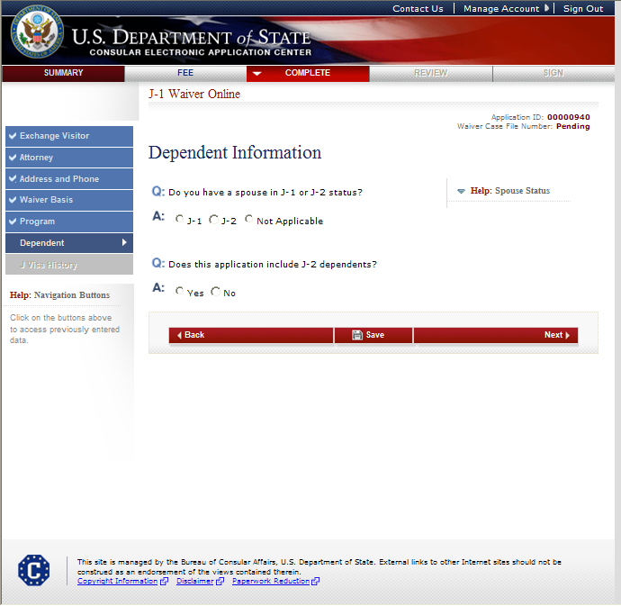
Dependent Information Page

Slide 25
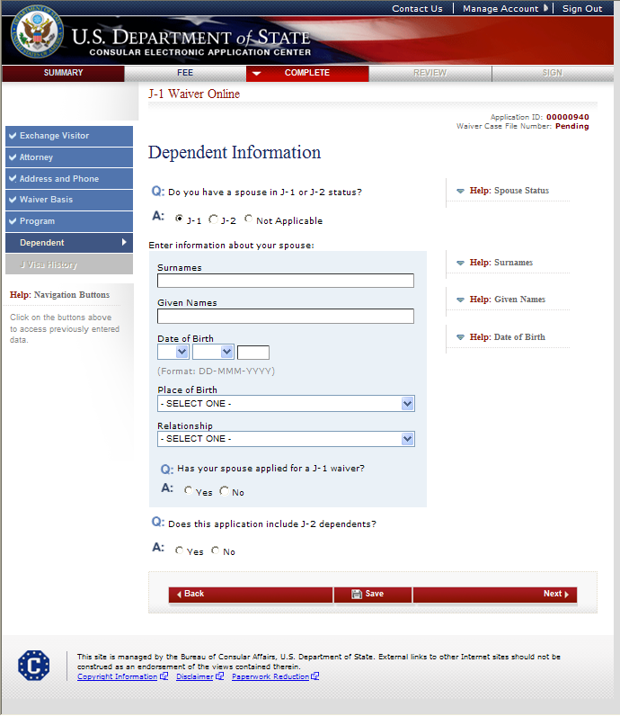
Dependent Information Page Spouse in J-1 Status

Slide 26
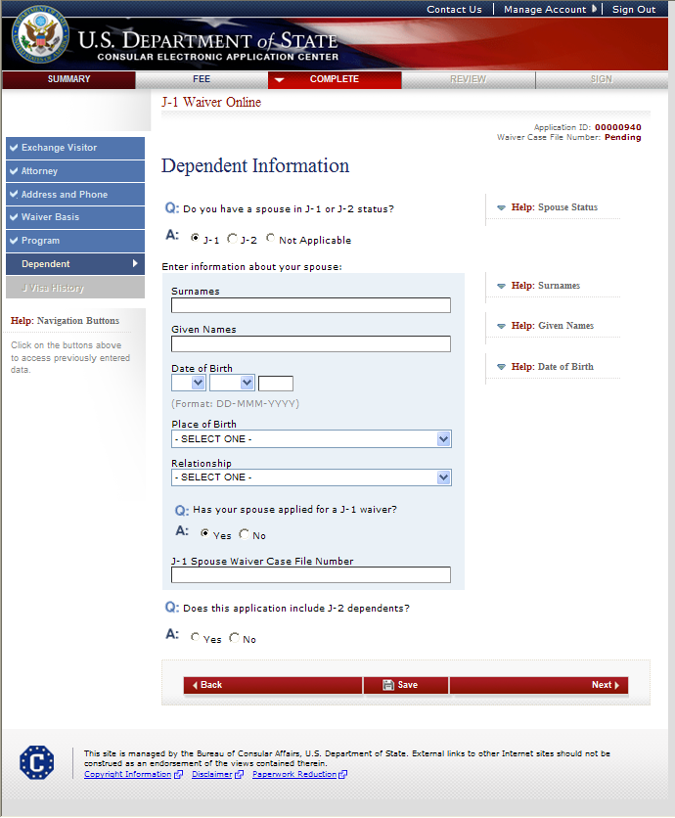
Dependent Information Page Spouse in J-1 status and applied for a waiver

Slide 27
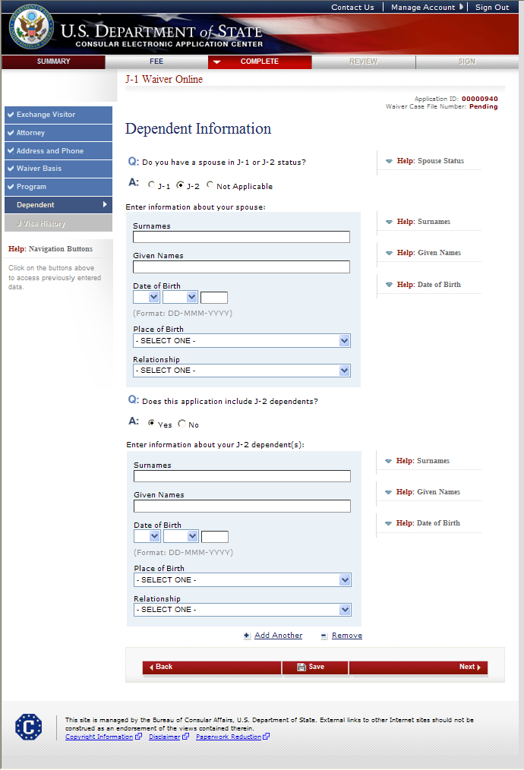
Dependent Information Page There are J-2 dependents

Slide 28
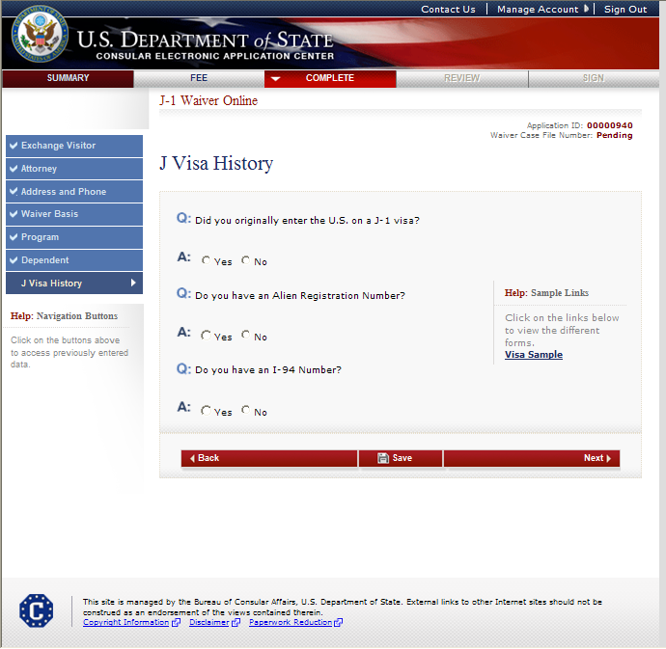
J Visa History Page

Slide 29
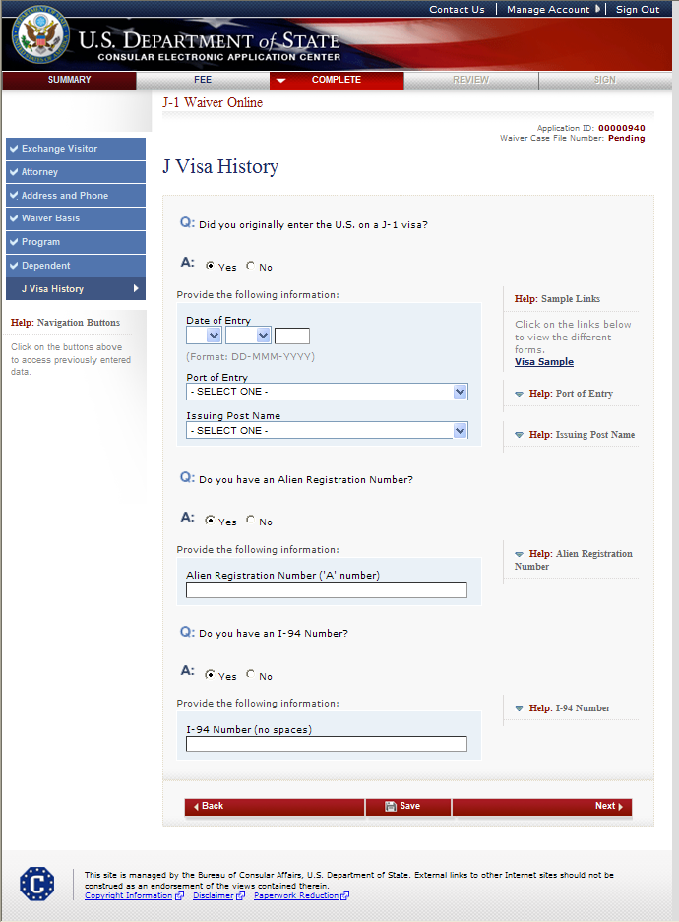
J Visa History Page (cont.) Answers Yes to all questions

Slide 30
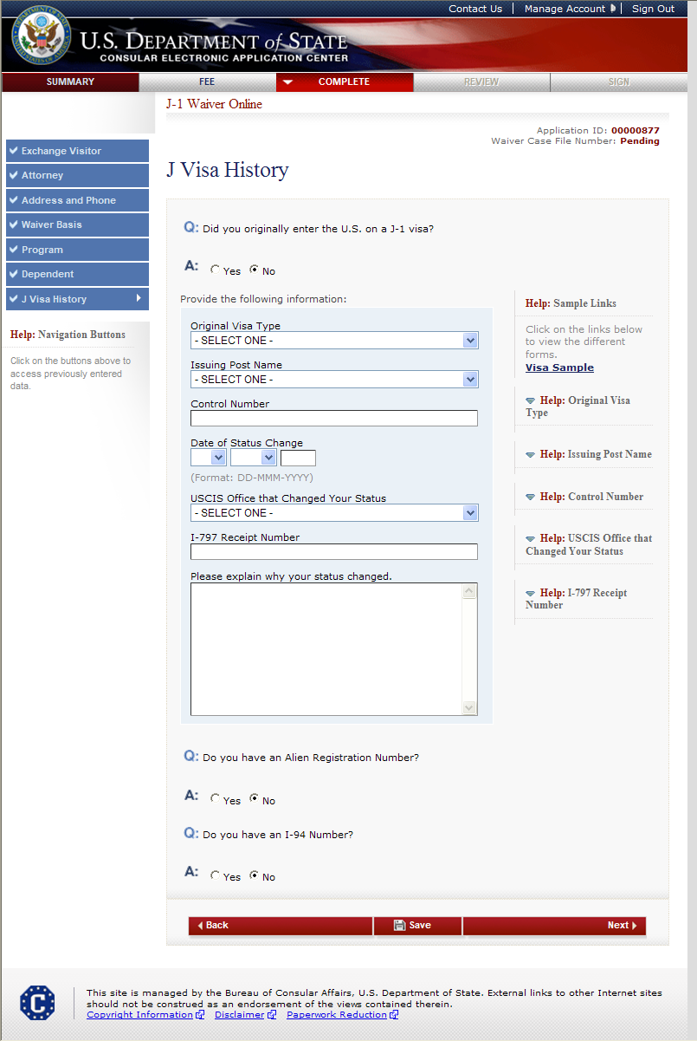
J Visa History (cont.) Answers No to all questions

Slide 31
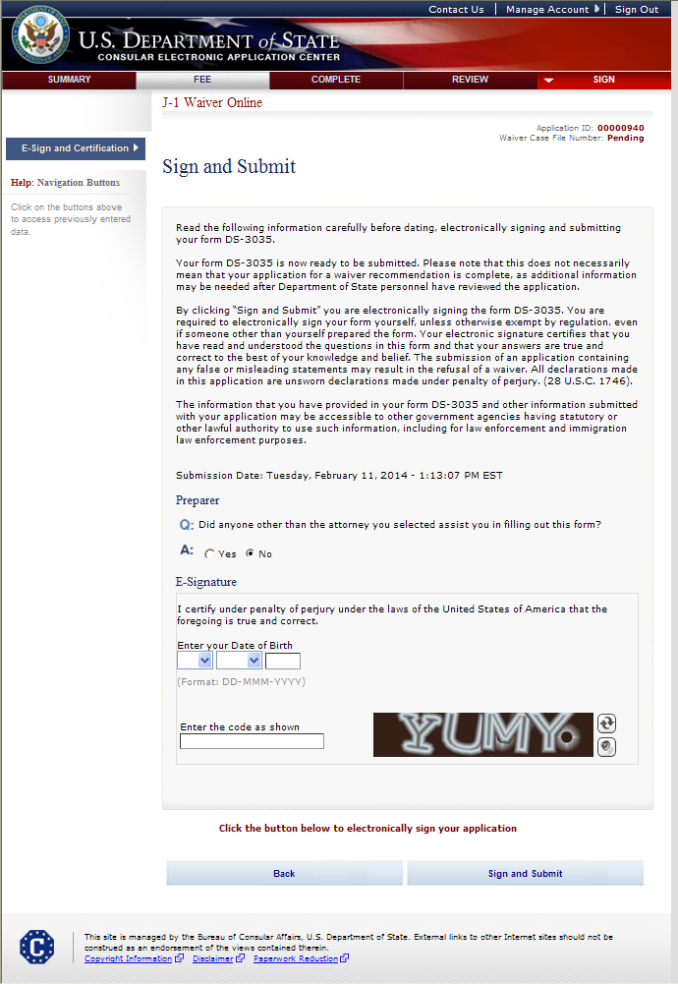
Sign and Submit Page
SAMPLE

Slide 32
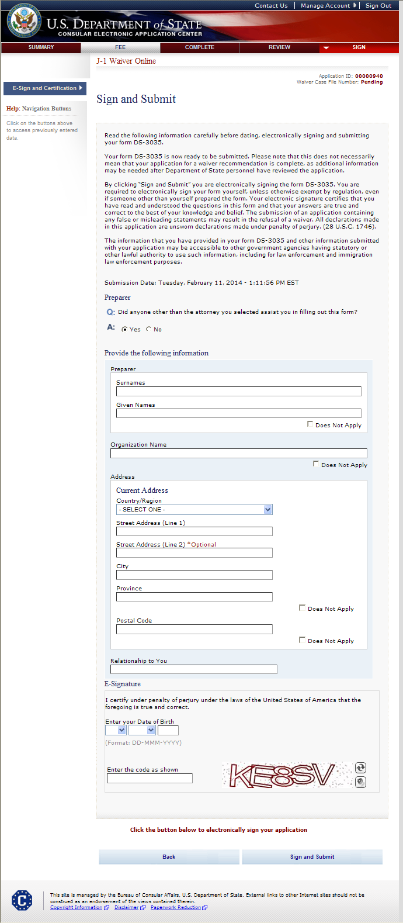
Sign and Submit Page (cont.) Answers Yes to “Did someone assist you in filling out this application?”
SAMPLE

Slide 33
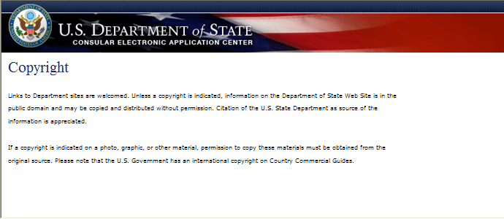
Copyright Page

Slide 34
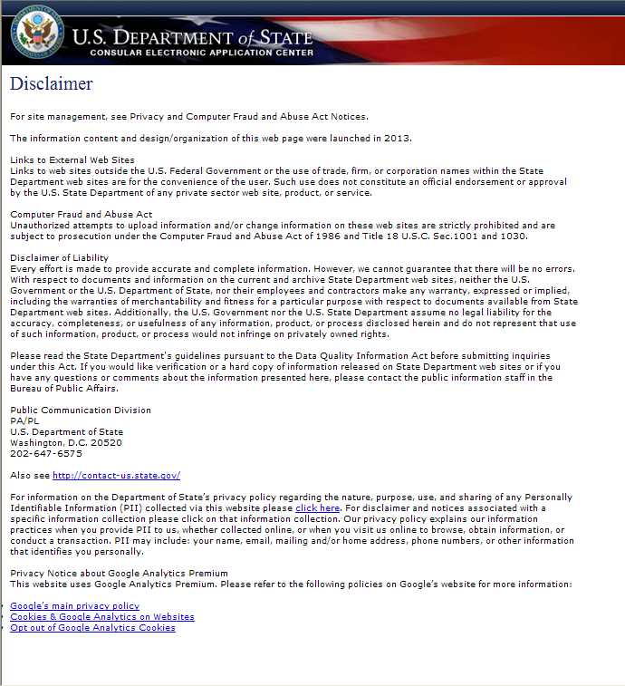
Disclaimer Page

Slide 35
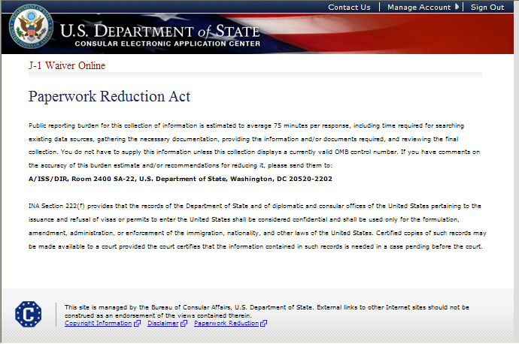
Paperwork Reduction Act Page

