Slide 1
2013-14 CRDC

Slide 2
2013-14 Lessons Learned
Key Lessons Learned | Changes to the CRDC System
CRDC data may be stored in separate systems, maintained by different offices within an LEA. Data elements gathered through decentralized systems represent a greater share of the reporting burden. | Better align the tool with the way LEAs collect, store, and report CRDC data. Make the CRDC submission system “modular” where groups of questions can be sent out for completion.
The flat file submission format particularly challenging due to concatenating every Part 1 or Part 2 variable. | Revise the flat file format to align with SIS system output. Allow files to contain as few or as many columns of data together in any order.
Some LEAs print out excel tables and hand-key information into the user interface. | Better support hand-keying data. Provide the ability to answer all questions for a school AND the ability to toggle between schools for a specific question.
Some CRDC definitions and instructions lack the clarity necessary for LEAs to accurately include or exclude students. Some LEAs are unaware of definitions, tip sheets, FAQs. | Embed relevant information for questions in the user interface, such as definitions and applicable FAQs on the data entry screen. Refine instructions and definitions to increase clarity.

Slide 3
2013-14 Lessons Learned
Key Lessons Learned | Changes to the CRDC System
Error reports were challenging to interpret and overwhelming to LEAs. One data element could trigger hundreds of errors. | Make the error reports actionable with clear resolution pathways. Create pre-set “reason codes” to explain plausible cases where an error or warning may be triggered.
SEAs often play an active role during the data collection, distributing information through established channels, offering TA, and a few even provide CRDC data already collected by the SEA. | Design the submission system to better support the work of SEAs in the CRDC process. Allow SEAs to pre-populate data through an online portal, give SEAs information about primary points of contact.
OCR communications about the CRDC sometimes don’t make it to the intended recipient. LEAs also have to craft their own communication tools to describe the purpose and importance of the CRDC to others in the agency. | Leverage existing communication channels where possible. Create a communications packet for LEAs to use to request data, explain the CRDC, and communicate the importance of the data collection.

Slide 4
Resources for School Districts
Technical Assistance Materials for School Districts
How to select a primary point of contact
How to prepare for the CRDC
Data quality tips
And more available at crdc.grads360.org

Slide 5
CRDC.GRADS360.ORG

Slide 6
Question: Would it also be helpful to also post SEA-developed materials?

Slide 8
Outreach Update: What We Are Hearing
A few districts are switching over from Web to flat-file for the first time. Mentioning that the flat-file specs are easier to review this time.
Districts appreciated seeing the new/optional items that will be collected for SY 13-14 and SY 15-16. Some of those items were not currently collected and they have started the process for collecting them for SY14-15.
Great idea reaching out prior to collection opening up but should gather feedback post collection to improve & implement suggestions for next collection.

Slide 9
Flat File Instructions
Flat File Submission #1: Your first flat file upload contained just grades (K-3) offered for 2 schools:
SCH_ID | SCH_GRADE_KG | SCH_GRADE_G01 | SCH_GRADE_G02 | SCH_GRADE_G03
150003000135 | Yes | Yes | Yes | Yes
150003000022 | Yes | Yes | Yes | Yes
Flat File Submission #2: You can over-ride a value by submitting a new file with new values. For example, if you wanted to change the kindergarten and Grade 1 answers for Barbers Point Elementary (150003000135), you could submit the following file:
SCH_ID | SCH_GRADE_KG | SCH_GRADE_G01
150003000135 | No | No
150003000022
CRDC Database Storage: The “No” for SCH_GRADE_KG and SCH_GRADE_G01 would override the previously submitted “Yes” for 150003000135. The null field for 150003000022 would make no changes to the previously submitted data. The CRDC database would store the following data
SCH_ID | SCH_GRADE_KG | SCH_GRADE_G01 | SCH_GRADE_G02 | SCH_GRADE_G03
150003000135 | No | No | Yes | Yes
150003000022 | Yes | Yes | Yes | Yes

Slide 10
Flat File Instructions: “NS” Code
Flat File Submission #3: However, let’s assume that you discover the kindergarten grades offered information is wrong for these schools. Maybe pre-kindergarten was pulled by mistake and you want to “clear out” the previously submitted data, basically returning the data to the original default of “not submitted”. By submitting a file with “NS”, you can clear out previously submitted data.
SCH_ID | SCH_GRADE_KG | SCH_GRADE_G01 | SCH_GRADE_G02 | SCH_GRADE_G03
150003000135 | NS
150003000022 | NS
CRDC Database Storage: The null fields would make no changes to previously submitted data. The NS code would clear out any previously submitted data and return the data element to a “not yet submitted” state.
SCH_ID | SCH_GRADE_KG | SCH_GRADE_G01 | SCH_GRADE_G02 | SCH_GRADE_G03
150003000135 |  | No | Yes | Yes
150003000022 |  | Yes | Yes | Yes

Slide 11
Pilot Overview
Open to 50 LEAs (and SEAs)
Goals:
Gather feedback on tool’s usability and functionality
Ensure skip patterns, validations, and all other key functionality of all modes of input – including flat file submissions- perform to the specifications.
Feedback will be prioritized and used to make decisions about needed changes for the immediate 2013-14 collection and for future collections
Testing both online data entry and flat file upload
Pilot data will not be saved for the official opening of the submission system.

Slide 12
Site Preview
Draft Screen Shots

Slide 13
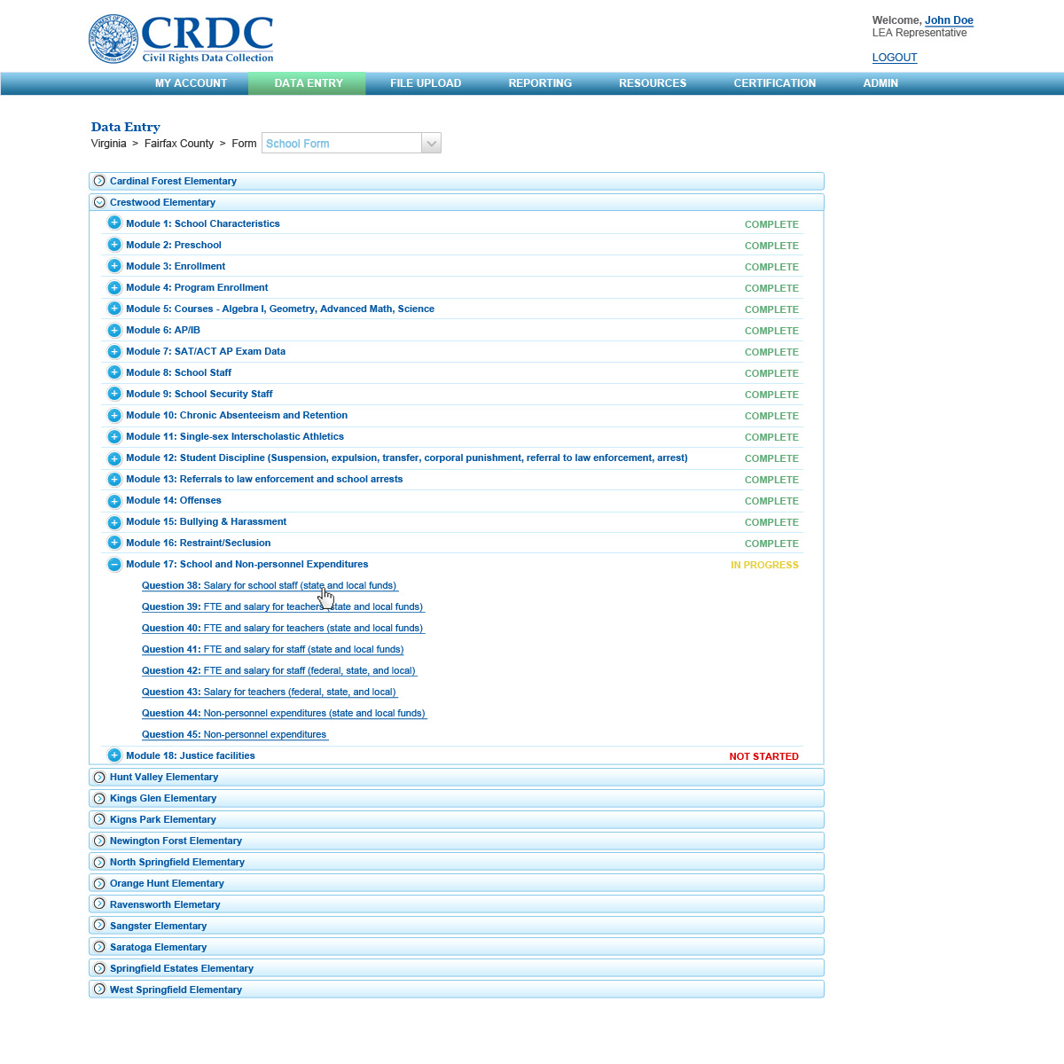
Data “Modules”
DRAFT Mock-Ups

Slide 14
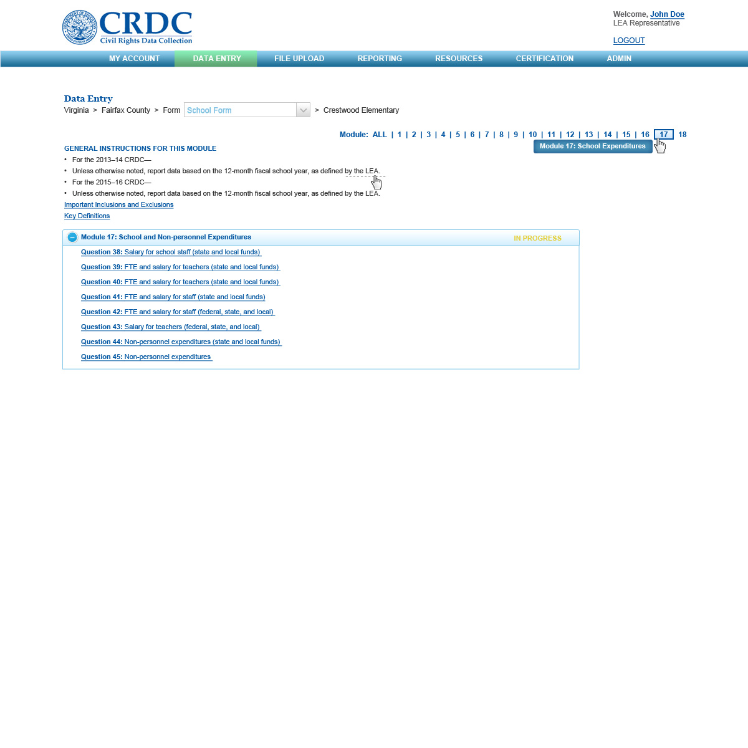
Module “Landing” Page
DRAFT Mock-Ups

Slide 15
Data Entry Screen
DRAFT Mock-Ups

Slide 16
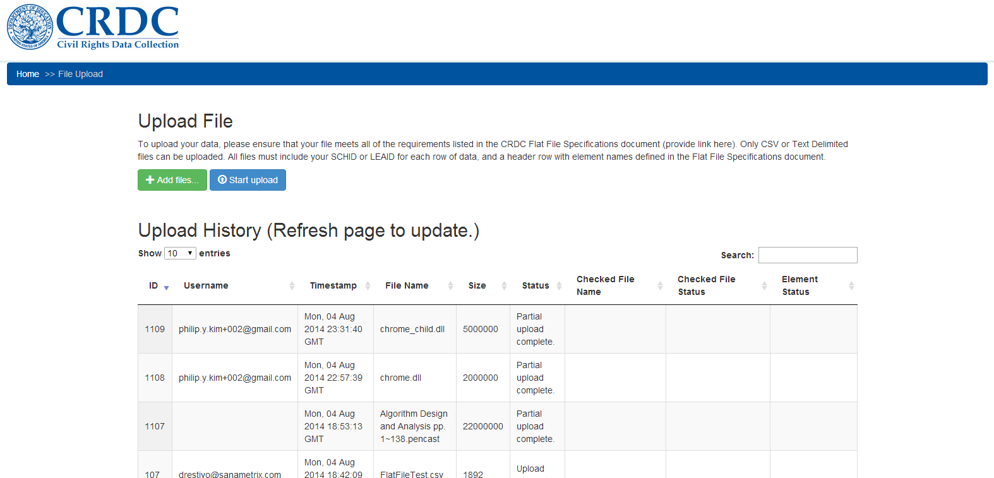
File Upload Status

Slide 17
Business Rules
Three Levels:
Warning (FYI): No action necessary to resolve warning
Example: Non-consecutive grades (e.g. Preschool is checked yes, Grade 1 is checked yes but Kindergarten is checked no)
Warning (Comment/Reason Code Required): Explanation required to certify
Example: Schools with over 100 students reporting more than 50% of all students [male/female] receiving an expulsion.
Error: Must be fixed prior to certification
Example: Alpha character in an integer field
Types
Completion: All required data elements are complete
Format – text, integer, decimal validation & length limit
Skip Condition – Consistency with skip logic rules
Reasonableness – Internal consistency checks
Validation against outside data - Checks against similar data sets (EDFacts membership, grades offered, etc.) – New for 2013-14

Slide 18
Business Rules
Data Element Rule: Gifted and talented enrollment (fall snapshot) for Female Hispanic students is greater than overall enrollment for Female Hispanic students (fall snapshot).
Resolution happens at individual data element level.
Table Rule: School characteristics question on whether the school primarily serves students with disabilities is checked yes, but IDEA and Section 504 enrollment in Overall Enrollment is zero.
Resolution happens at the table level, but we do not know which specific data element needs to be corrected (IDEA, 504, males or females), or if the school characteristics question needs to be corrected.
Submission Rule: Sum of school-level enrollment is greater than or equal to 50,000 students and zero allegations of bullying or harassment are reported.

