Slide 1
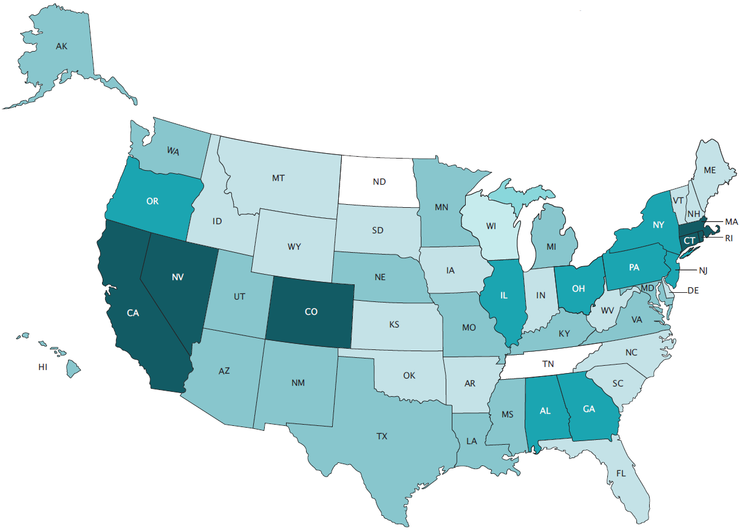
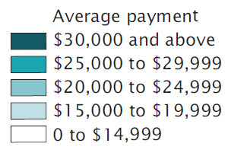
2014 Annual Survey of Public Pensions
The U.S. Census Bureau is responsible for producing data about the nation’s state and local governments including counties, municipalities, townships, special districts, and school districts. The Annual Survey of Public Pensions is one of the tools that is used to collect data on state and local government financial activity.
Why did I receive this survey?
Authorized by Title 13, U.S. Code, Section 182, the U.S. Census Bureau surveys state and local governments annually. The Census Bureau selects about 4,000 governments to participate in the annual survey.
Your response to this survey is important. These data will provide information about government financial activity and help public officials make informed decisions. This survey provides the only comprehensive source of data on local government finances including revenues, expenditures, financial assets, membership, and liabilities information for defined benefit public pension systems.
Government financial activity is used in the calculation of the Gross Domestic Product by the Bureau of Economic Analysis and the Flow of Funds by the Federal Reserve Board. This information is often utilized by a variety of governments, researchers, and media outlets to inform the public and disseminate data on state and local governments.
How can I respond to the survey or get help?
Respond online
Instructions including the User ID and Password are enclosed within this mailing. If you need assistance with the User ID or Password, please call us at 1-888-529-1963 and we can provide you that information.
Respond by mail
Simply return the completed questionnaire by mail in the prepaid envelope provided.
Have questions or need assistance?
Call us at 1-888-529-1963 weekdays,7 AM - 5 PM ET or email us at govs.pensions@census.gov
When is my response due?
Your response is due Month #, Year
State Average Annual Benefit Payments: 2012
Source: U.S. Census Bureau, 2012 Census of Governments: Finance—Survey of Public Pensions: State-Administered Defined Benefit Data.

