Slide 1
A1 Ways to Reduce Breast Cancer Infographic

Slide 2
B1 Learn Your Family History Infographic (General Public Version)

Slide 3
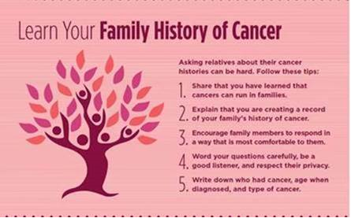
B2 Learn Your Family History Infographic (African American Version)

Slide 4
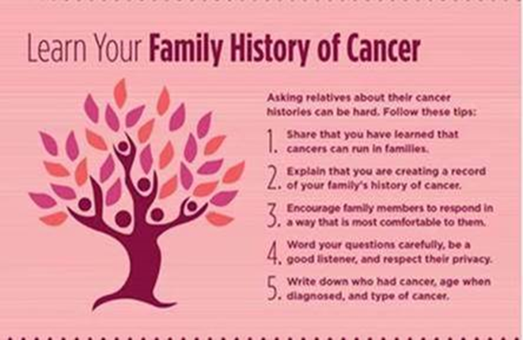
B3 Learn Your Family History Infographic (Ashkenazi Jewish Version)

Slide 5
C1 Lisa: Start the Conversation about Family History of Breast Cancer
https://www.youtube.com/watch?v=z4GezJiATLQ

Slide 6
C2 Jackie: Taking Action for My Daughter
https://www.youtube.com/watch?v=KNzRNWi4Qgc

Slide 7
C3 Cara: My Breast Cancer Journey
https://www.youtube.com/watch?v=TL1hZ9RB5E0

Slide 8
D1 Breast Cancer in Young Women Fact Sheet (General Public Version)

Slide 9
D2 Breast Cancer in Young Women Fact Sheet (African American Version)

Slide 10
D3 Breast Cancer in Young Women Fact Sheet (Ashkenazi Jewish Version)

Slide 11
E1 Payment for Genetic Services Factsheet

