Slide 1
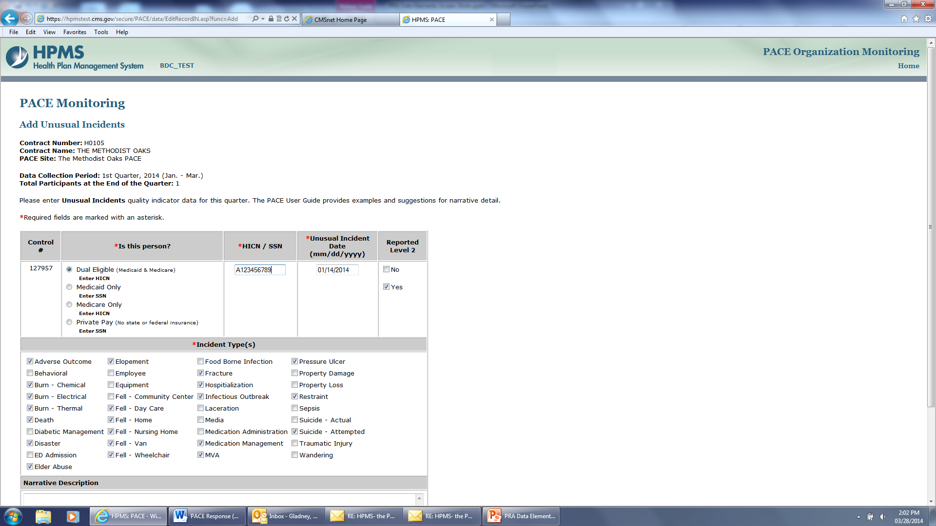
Example- Data Entry
Data will include age and gender, type of Incident, location contributing factors, health status, interventions initiated, outcome status

Slide 2
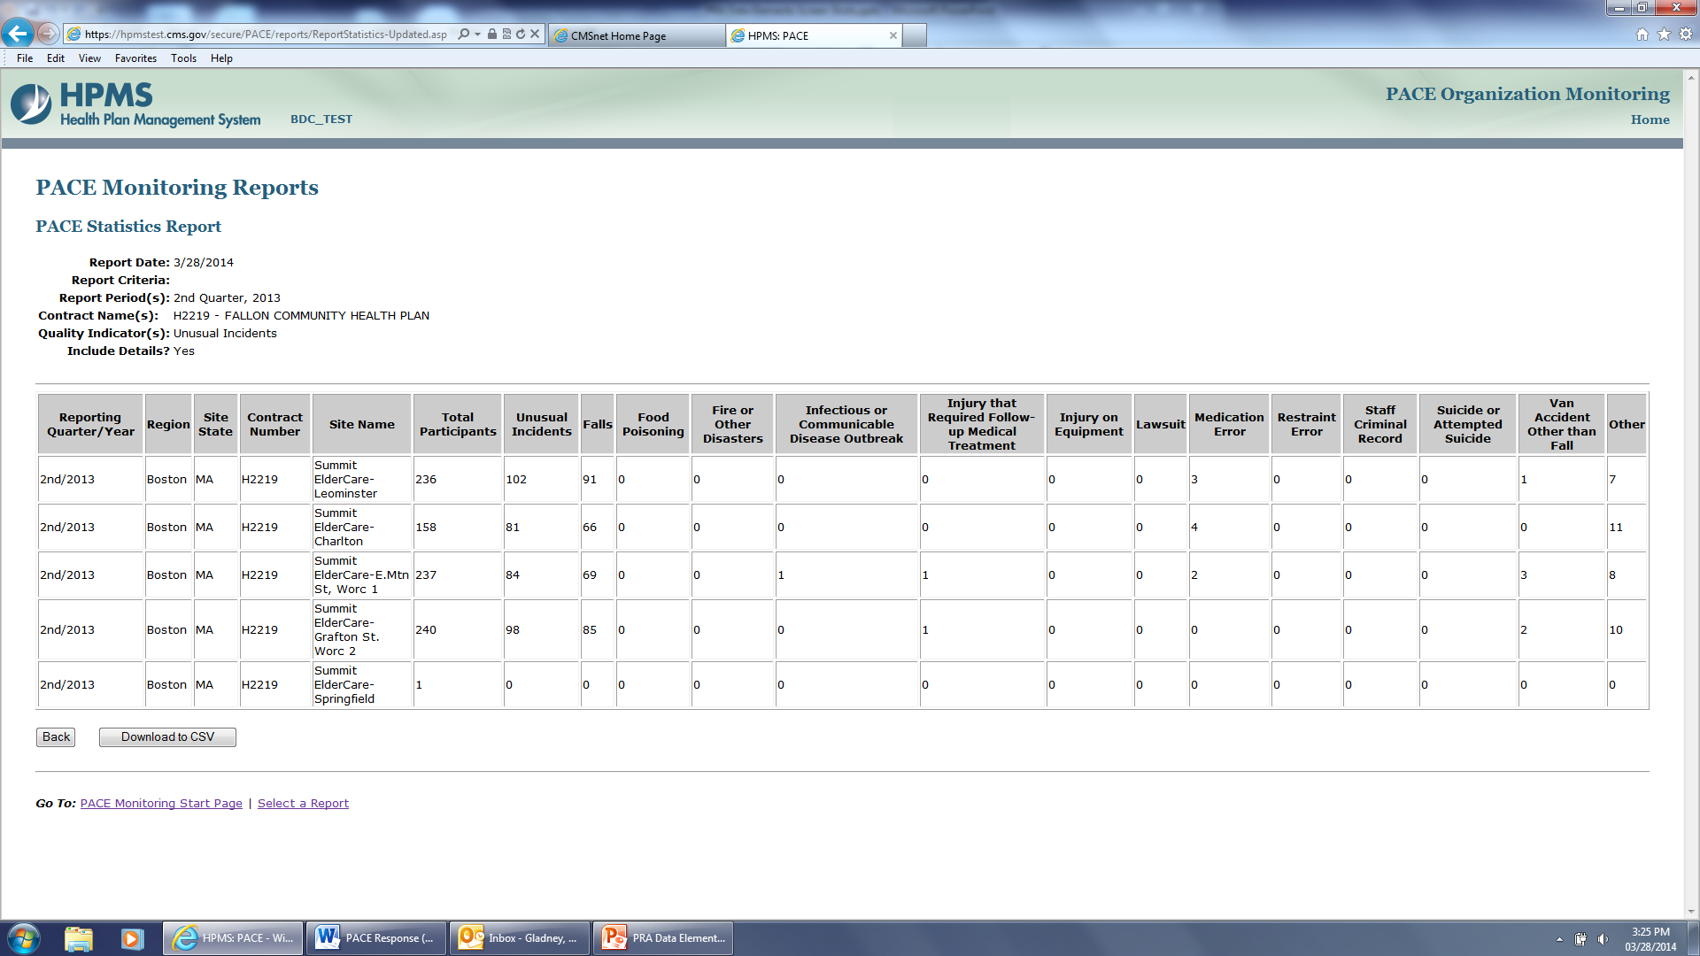
Example- Overall Statistical Reports
PACE Organizations have the ability in HPMS to assess their Element data statistically and make changes to their practices and processes according to their data findings.

