Slide 1
Electronic System for Travel Authorization (ESTA)
U.S. Customs and Border Protection
September 2014

Slide 2
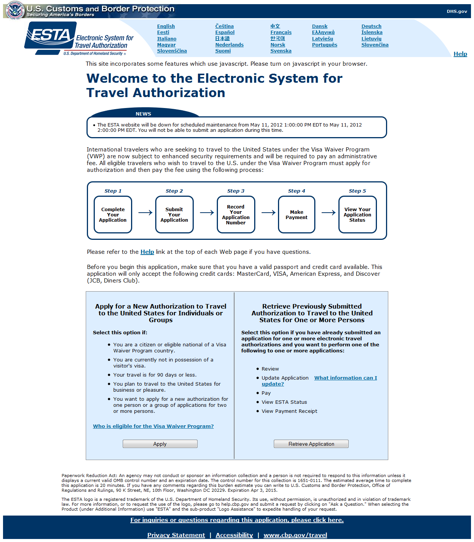
Main Page

Slide 3
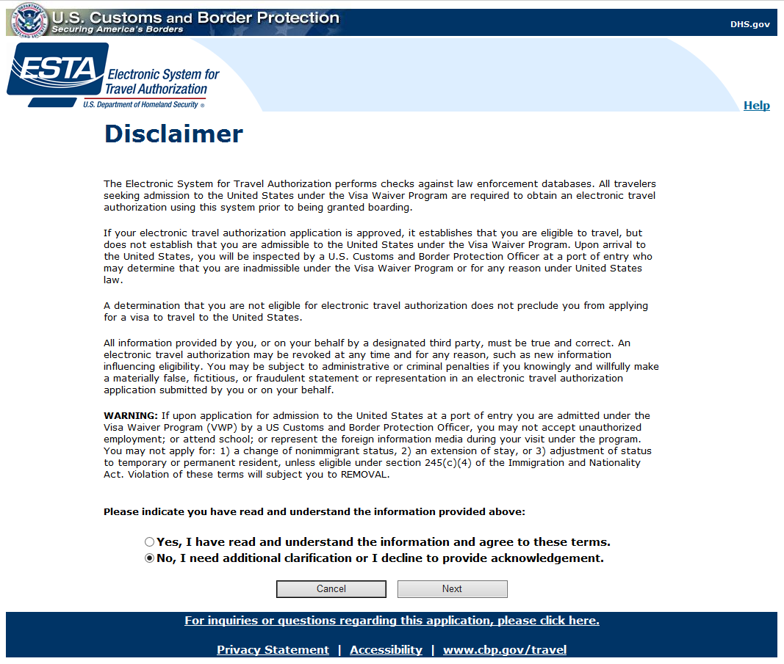
Disclaimer

Slide 4
Travel Promotion Act

Slide 5
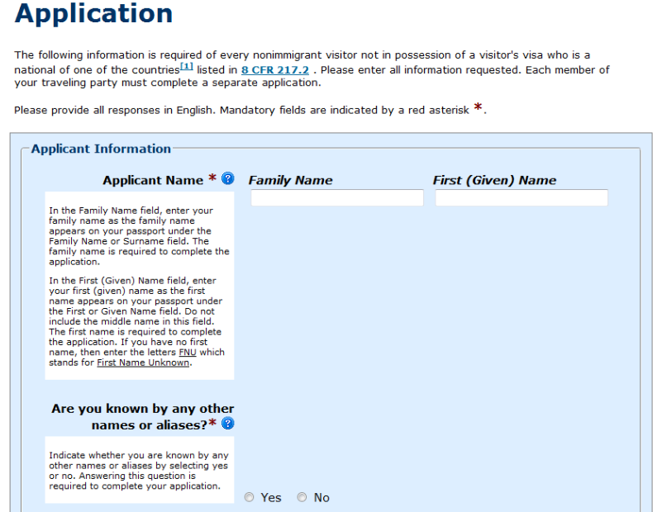
Applicant Information (1 of 3)

Slide 6
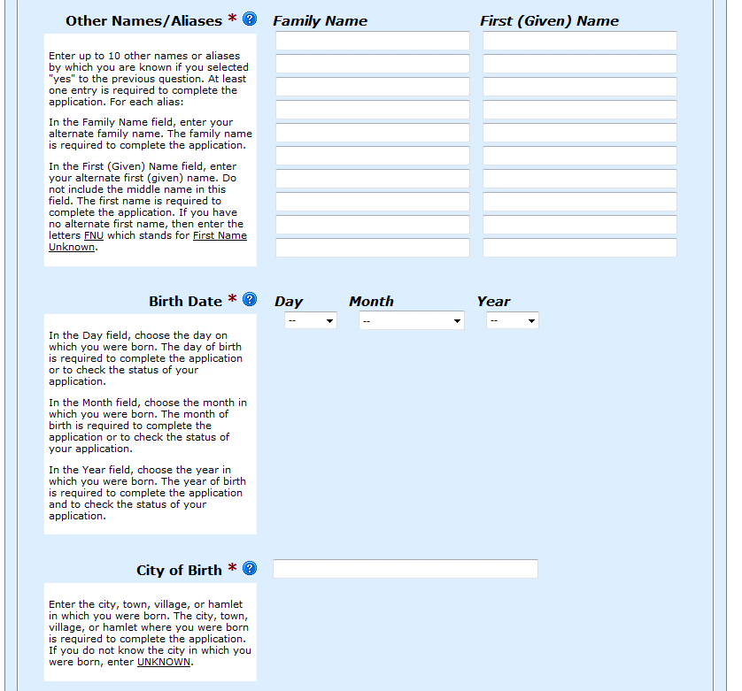
Applicant Information (2 of 3)

Slide 7
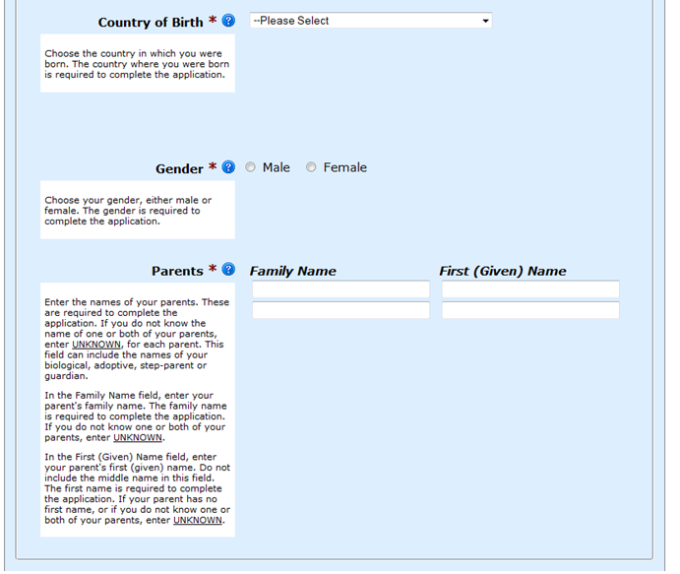
Applicant Information (3 of 3)

Slide 8
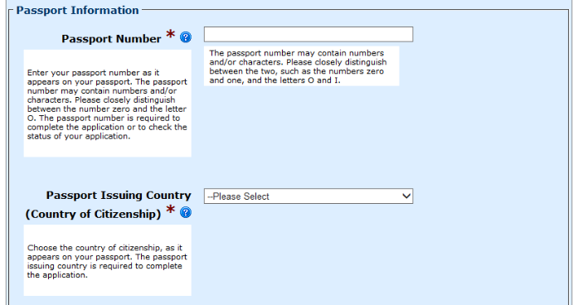
Passport Information (1 of 3)

Slide 9
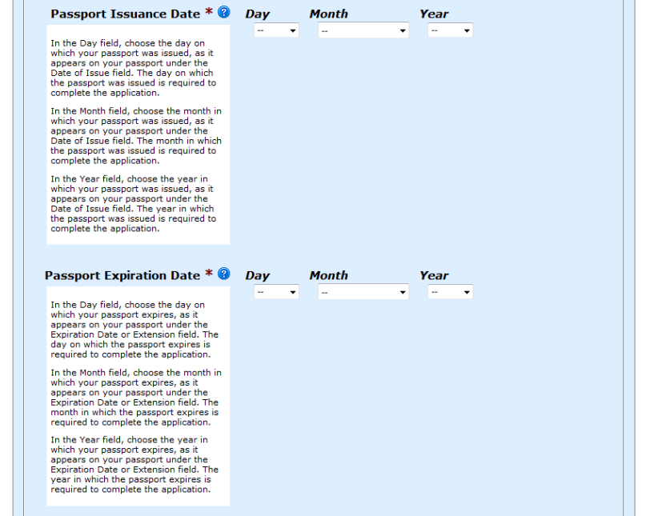
Passport Information (2 of 3)

Slide 10
Passport Information (3 of 3)

Slide 11
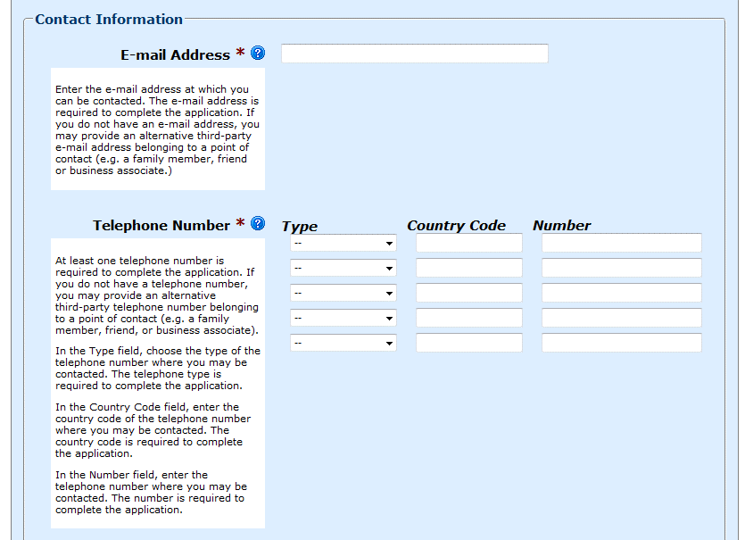
Contact Information (1 of 2)

Slide 12
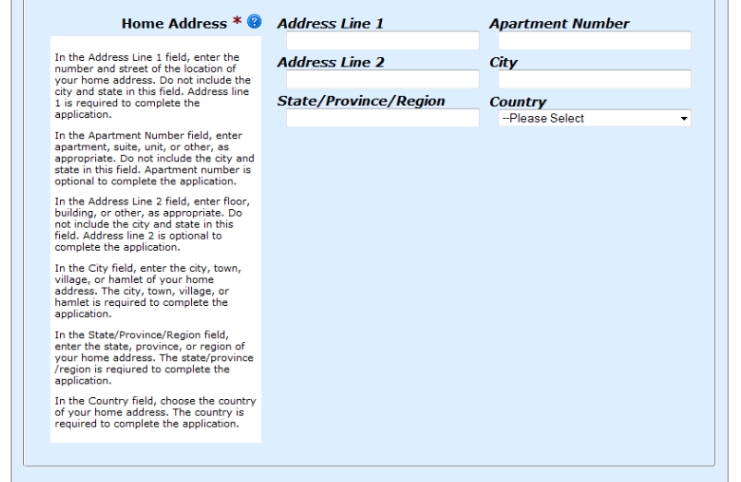
Contact Information (2 of 2)

Slide 13
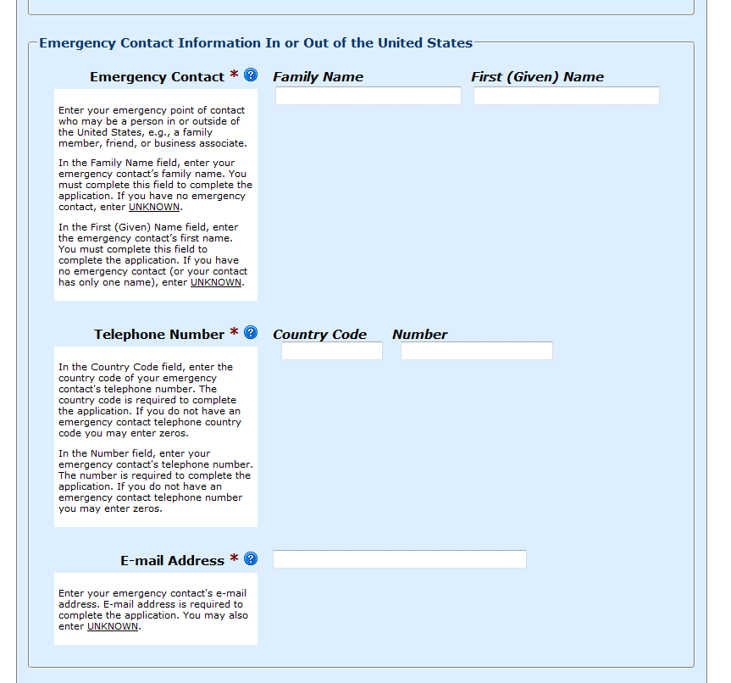
Emergency Contact Info

Slide 14
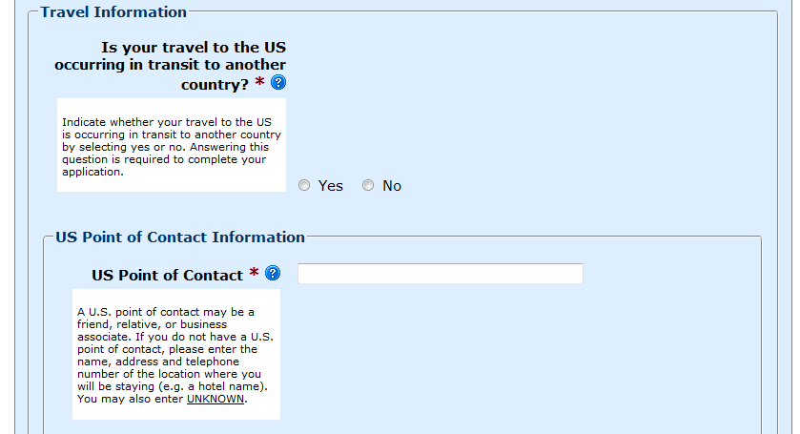
Travel Info / US POC (1 of 3)

Slide 15
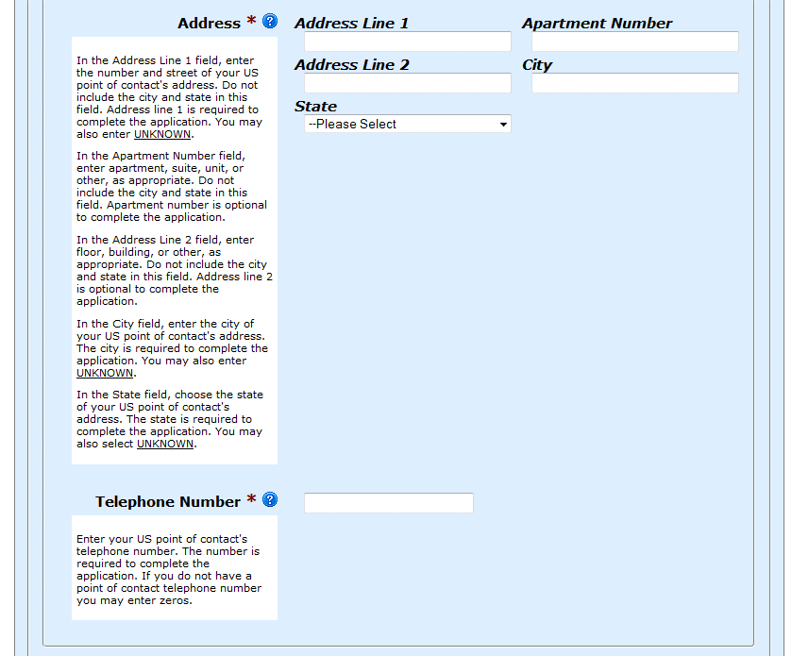
Travel Info / US POC (2 of 3)

Slide 16
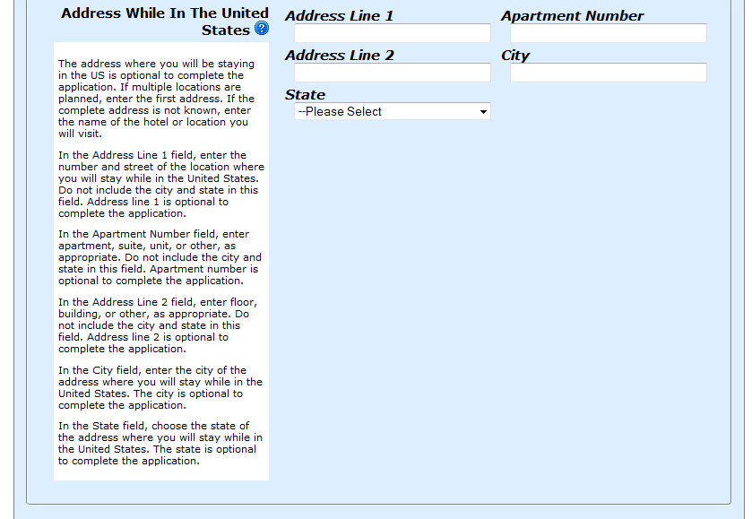
Travel Info / US POC (3 of 3)

Slide 17
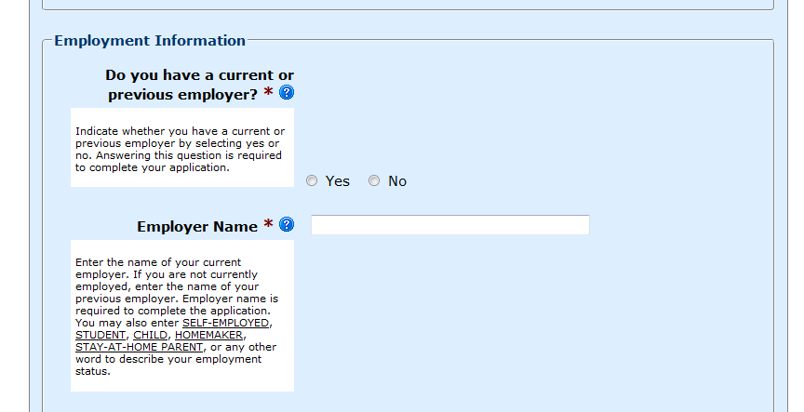
Employment Info (1 of 3)

Slide 18
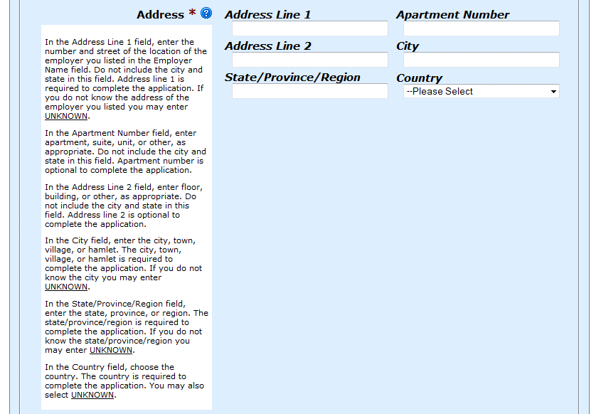
Employment Info (2 of 3)

Slide 19
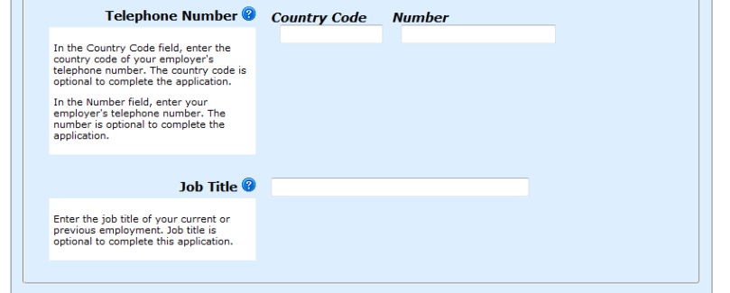
Employment Info (3 of 3)

Slide 20
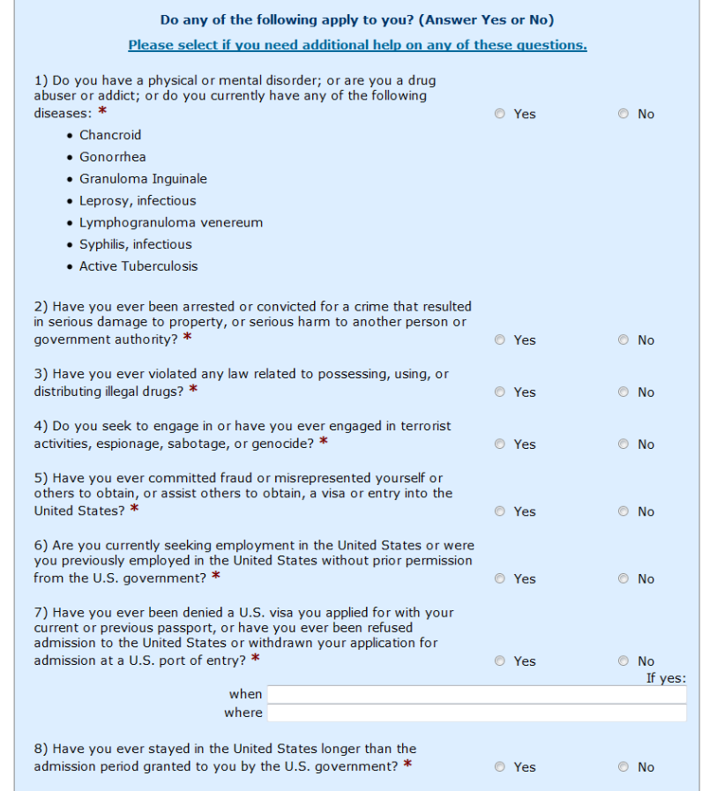
Eligibility Questions

Slide 21
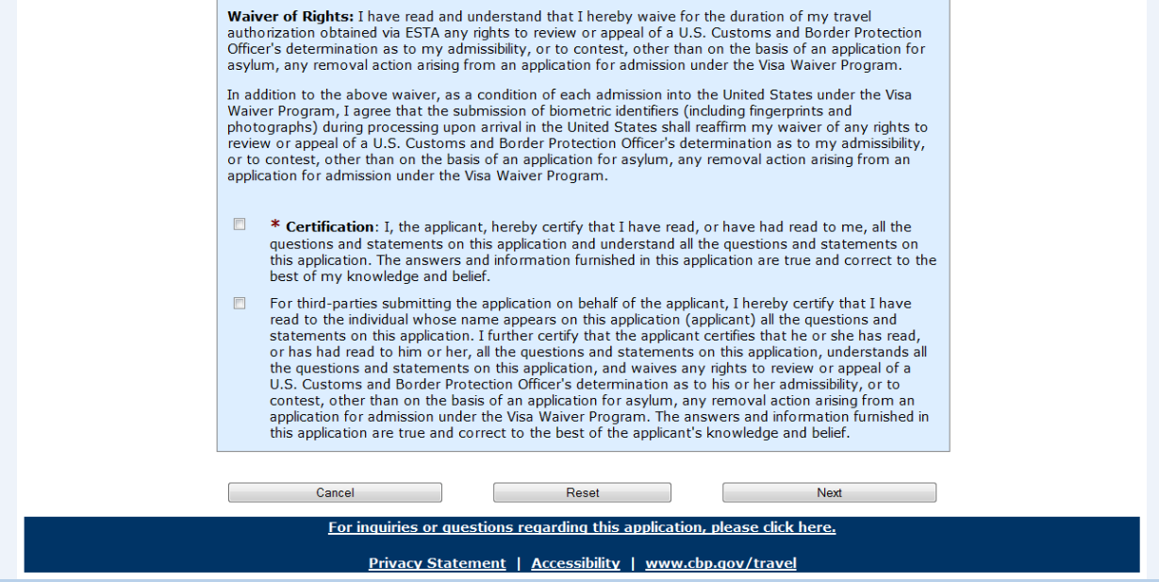
Waiver and Certification

Slide 22
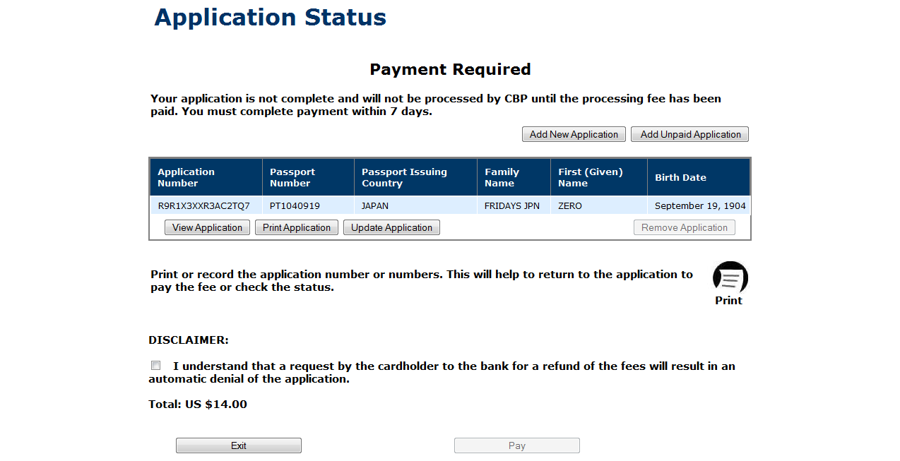
Payment Required Status

Slide 23
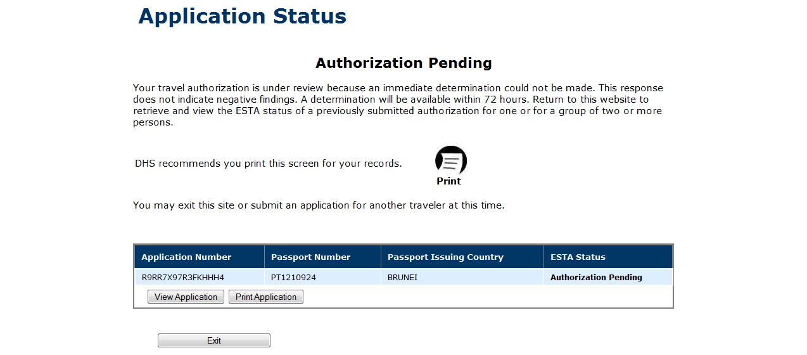
Pending Status

Slide 24
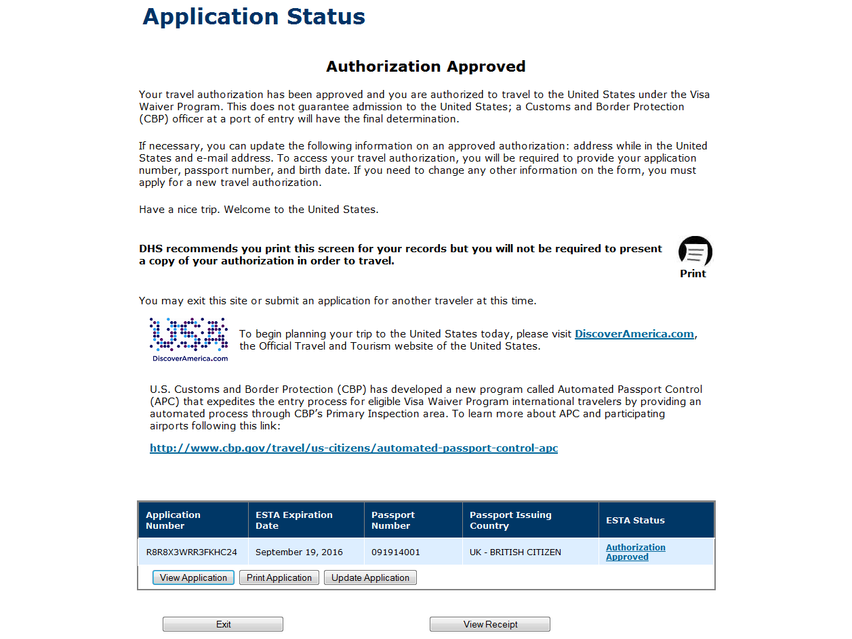
Approved Status

Slide 25
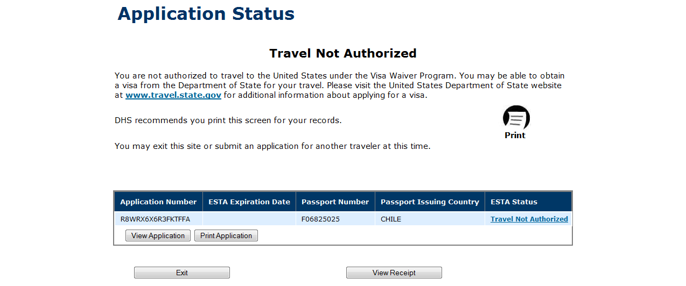
Denied Status

