Slide 1
Summer Meals Participant Characteristics Study Sponsor Webcast <date>
OMB Control No.:0584-NEW
Expiration Date: xx/xx/xxxx
Public reporting burden for this collection of information is estimated to average 30 minutes per response, including the time for reviewing instructions, searching existing data sources, gathering and maintaining the data needed, and completing and reviewing the collection of information. An agency may not conduct or sponsor, and a person is not required to respond to, a collection of information unless it displays a currently valid OMB control number. Send comments regarding this burden estimate or any other aspect of this collection of information, including suggestions for reducing this burden, to: U.S. Department of Agriculture, Food and Nutrition Services, Office of Policy Support, 3101 Park Center Drive, Room 1014, Alexandria, VA 22302 ATTN: PRA (0584-xxxx*). Do not return the completed form to this address.
Appendix F6 Sponsor Webinar
1

Slide 2
Study Overview—Optimal Solutions Group
Optimal Solutions Group (Optimal)
Policy research firm located in College Park, MD
Specialize in policy research focused on health, education, workforce development, social policy, and housing and economic development
Contracted by USDA/FNS to conduct evaluation of the Summer Meals Programs’ participant characteristics
2

Slide 3
Study Overview—Research Goals
Research Goals
Ascertain how the summer meals programs operate at the state, sponsor, and site levels.
Describe participant characteristics and examine the differences and factors that affect participation by sponsors and children across states.
Sponsor Survey
Understand the challenges of finding sites, monitoring sites, facilitating outreach efforts, and support from state agencies.
Information will help FNS better serve sponsors agencies in administering summer meals programs.
3

Slide 4
Study Overview—Methodology
Surveys
State-level
Sponsor-level
Site -level
Interviews
Parents/caregivers of summer meals participants
Parents/caregivers of summer meals-eligible non-participants
4

Slide 5
Sponsor Participation—Site List
2015 Site List
Formal request via email
Items needed include:
Site Name | Meals served by Site (breakfast, lunch, snacks)
Site Address (with ZIP) | Site Type (open, enrolled, closed)
Site Dates of Operation | Meal counts by Site
Site ADA | Identify new or returning site
Time sensitive <date needed by>
Memorandum of Understanding (MOU)
5

Slide 6
Sponsor Participation—Site Recruitment
Sponsor involvement in site recruitment is crucial
1. Site list email request from Optimal
2. Send site list to Optimal in format outlined in email request
3. Optimal selects sites for the study
4. Optimal sends list of selected sites and recruitment letters to sponsors
5. Sponsors distribute recruitment letter to selected sites
6. Optimal sends reminders to non-responsive sites
7. Optimal calls non-responsive sites to conduct survey via telephone
6

Slide 7
Sponsor Participation—Web Survey
Web Survey
Email invitation with link to survey
User-friendly interface
Responses will—
be kept confidential
be combined with other states
not be reported individually
Can save progress and complete later
Telephone follow-ups
7

Slide 8
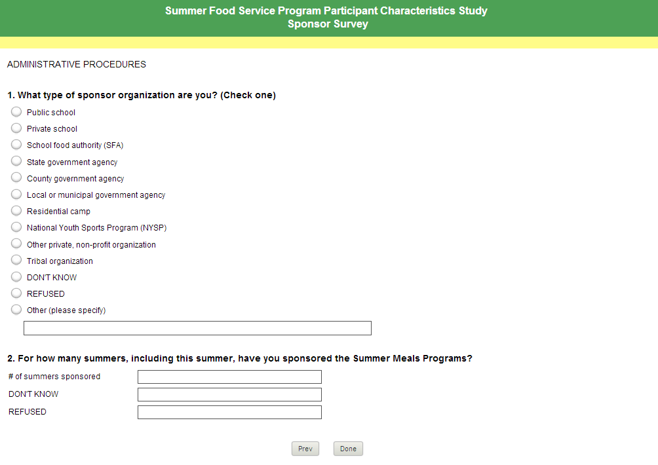
Sponsor Participation—Web Survey
8

Slide 9
QUESTIONS
?
9

