Slide 1
Focus Group Study of Youth Reactions to Creative Advertising Concepts Designed to Prevent Youth Tobacco Use among Multicultural Youth
OMB 0910-0796
Exp: 6/30/18
Addendum C - Tobacco Product Photographs

Slide 2
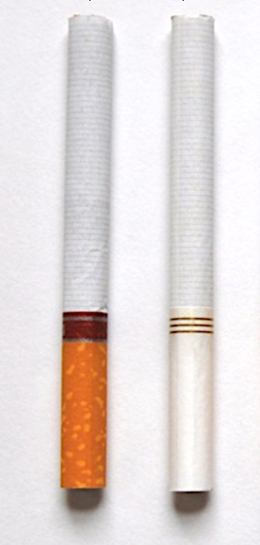
1
Notes:
Cigarettes, from CTP

Slide 3
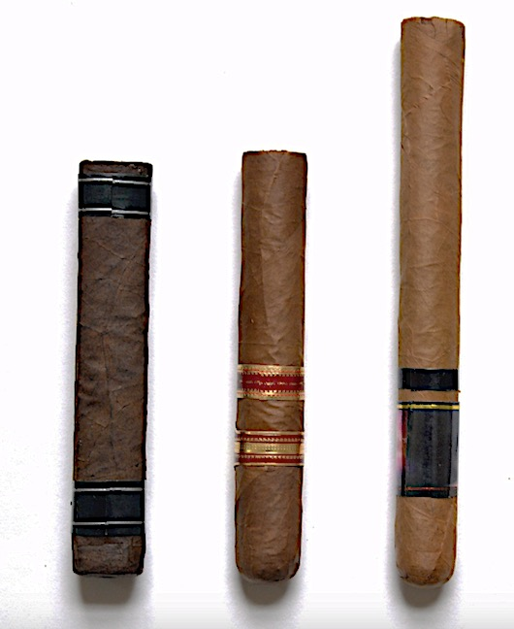
2
Notes:
Large Cigars, from CTP

Slide 4
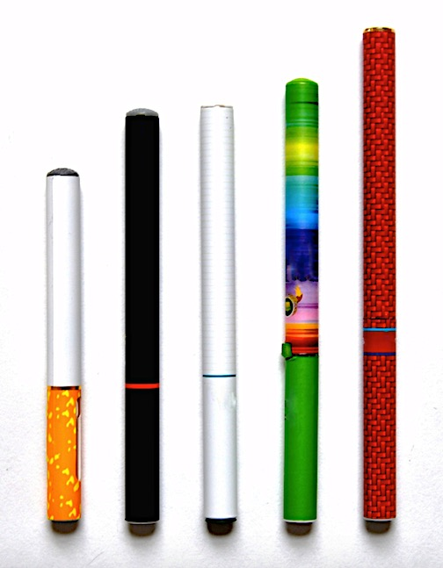
3
Notes:
E-cigarettes, from CTP

Slide 5
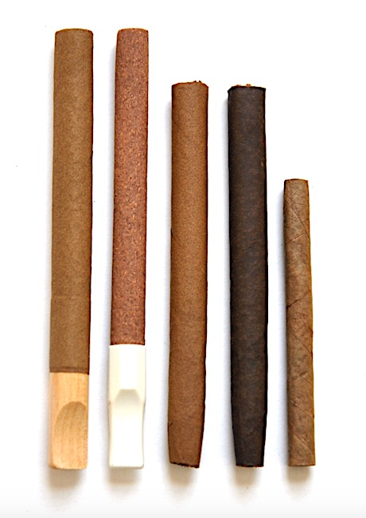
4
Notes:
Cigarillos, from CTP

Slide 6
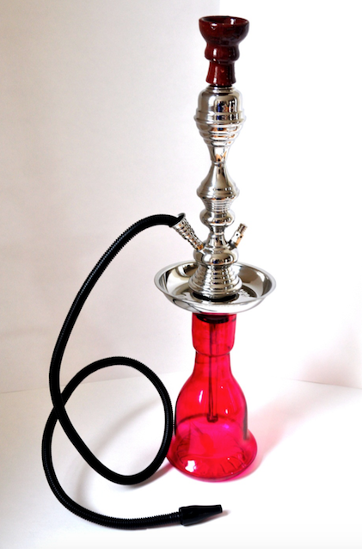
5
Notes:
Hookah, from CTP

Slide 7
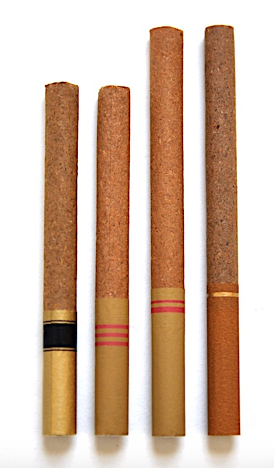
6
Notes:
Little Cigars from CTP

Slide 8
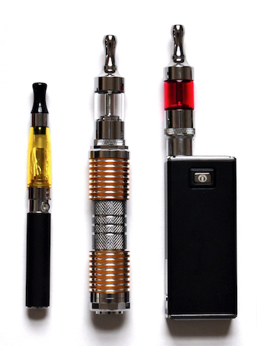
7
Notes:
E-cigarettes, from CTP

Slide 9
END

