Slide 1
StopAnthrax™ Pilot Test StopAnthraxTM: Anthrax MCMs Text Messaging Project
Dahna Batts, MD, FACEP
CAPT, US Public Health Service
Healthcare Preparedness Activity
Office of Public Health Preparedness and Response
June 2016
Office of Public Health Preparedness and Response
Division of State and Local Readiness

Slide 2
Overview
Healthcare Preparedness Activity (HPA) vision and mission
StopAnthraxTM
About the program
Jurisdictional Pilot Test Using Cipro Healthy Adult Protocol
Next steps
Notes:
I would delete second bullet.

Slide 3
Healthcare Preparedness Activity
Vision: healthcare systems effectively preparing for and responding to emergencies
Mission: to support public health, healthcare, and emergency management working together to safely deliver the right care at the right time and in the right place
Produce tools and guidance http://www.cdc.gov/phpr/healthcare
Coordinate and liaise with public and private partners
Conduct workshops, stakeholder meetings, and exercises

Slide 4
About the Program

Slide 5
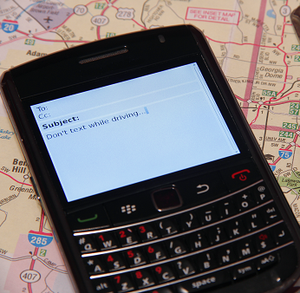
StopAnthraxTM Text Messaging Program
StopAnthrax™ is a set of text messaging protocols for Strategic National Stockpile (SNS) medical countermeasures (MCMs) that would be dispensed during an anthrax incident
Consists of text messages for adults, including pregnant women and parents for 4 anthrax MCMs
Amoxicillin (amox)
Ciprofloxacin (cipro)
Doxycycline (doxy)
Anthrax Vaccine Adsorbed (AVA)

Slide 6
StopAnthraxTM
CDC plans to activate StopAnthraxTM in a major anthrax incident
StopAnthraxTM is designed to:
Encourage MCM adherence
Encourage users to report adverse events to existing FDA Adverse Event Reporting System (FAERS)and Vaccine Adverse Event Reporting System (VAERS) systems
Direct users to seek medical attention for anthrax or MCM-related adverse event symptoms
Provide relevant (e.g., population specific) health education

Slide 7
StopAnthraxTM (continued)
Stand-alone, bidirectional program
Intended for adults who receive anthrax MCMs from points of dispensing (PODs)
Assumes they are not sharing their cell phone or medication
Provides text messages to users for up to 60 days

Slide 8
StopAnthraxTM Components
Four major types of text messages:
Education
Adverse event reporting
Adverse event feedback
Medication reminder

Slide 9
Jurisdictional Pilot Test using Cipro Healthy Adult Protocol

Slide 10
Purpose and Objectives
Purpose of the pilot test is to gather user feedback on the StopAnthrax™ program
Objectives
Identify potential issues or barriers to enrolling in StopAnthrax™ from a participant as well as local health department perspective
Identify potential issues or barriers to participating in StopAnthrax™ from a user's perspective
Collect opinions on StopAnthrax™ messaging

Slide 11
What to Expect
When you go through the POD, you will see posters and other materials encouraging you to enroll in StopAnthrax™
Enrollment in the pilot test is voluntary
Message and data rates may apply
If you enroll, you will receive text messages for up to 10 days
You may receive an average of 10 messages per day
You can opt-out at any time
At the end of the pilot test, you will have an opportunity to provide feedback about your experience
Feedback is optional and all responses will be anonymous

Slide 12
Security
All information collected for the purpose of this pilot test will not be shared
This includes your phone number
At the completion of the pilot test, we will delete all phone numbers from our records
If you provide feedback at the end of the test, your responses will not be tied to your phone number

Slide 13
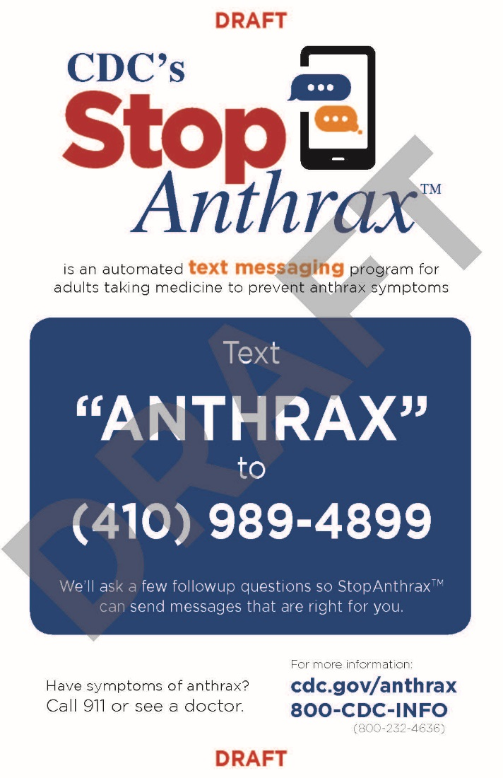
How to Enroll
Text "ANTHRAX" to the number designated on the posters and enrollment cards displayed at the POD
Answer 4 short enrollment questions
Once completed, you will be enrolled in the pilot test

Slide 14
How to Respond
Participate as if you were taking Cipro for anthrax
Some messages may ask if you are experiencing side effects from your medication or if you have changed antibiotics
Respond to these messages however you choose
Some messages may direct you to call phone numbers or visit websites
This is not part of the pilot test
Please ignore these directions and do not call these numbers or visit these websites

Slide 15
How to Provide Feedback
You will receive a message at the end of the pilot test with a link to an online survey consisting of 14 questions about your experience
The survey will be open to the first 660 respondents
All feedback will be anonymous

Slide 16
Questions?
Office of Public Health Preparedness and Response
Division of State and Local Readiness

