Slide 1
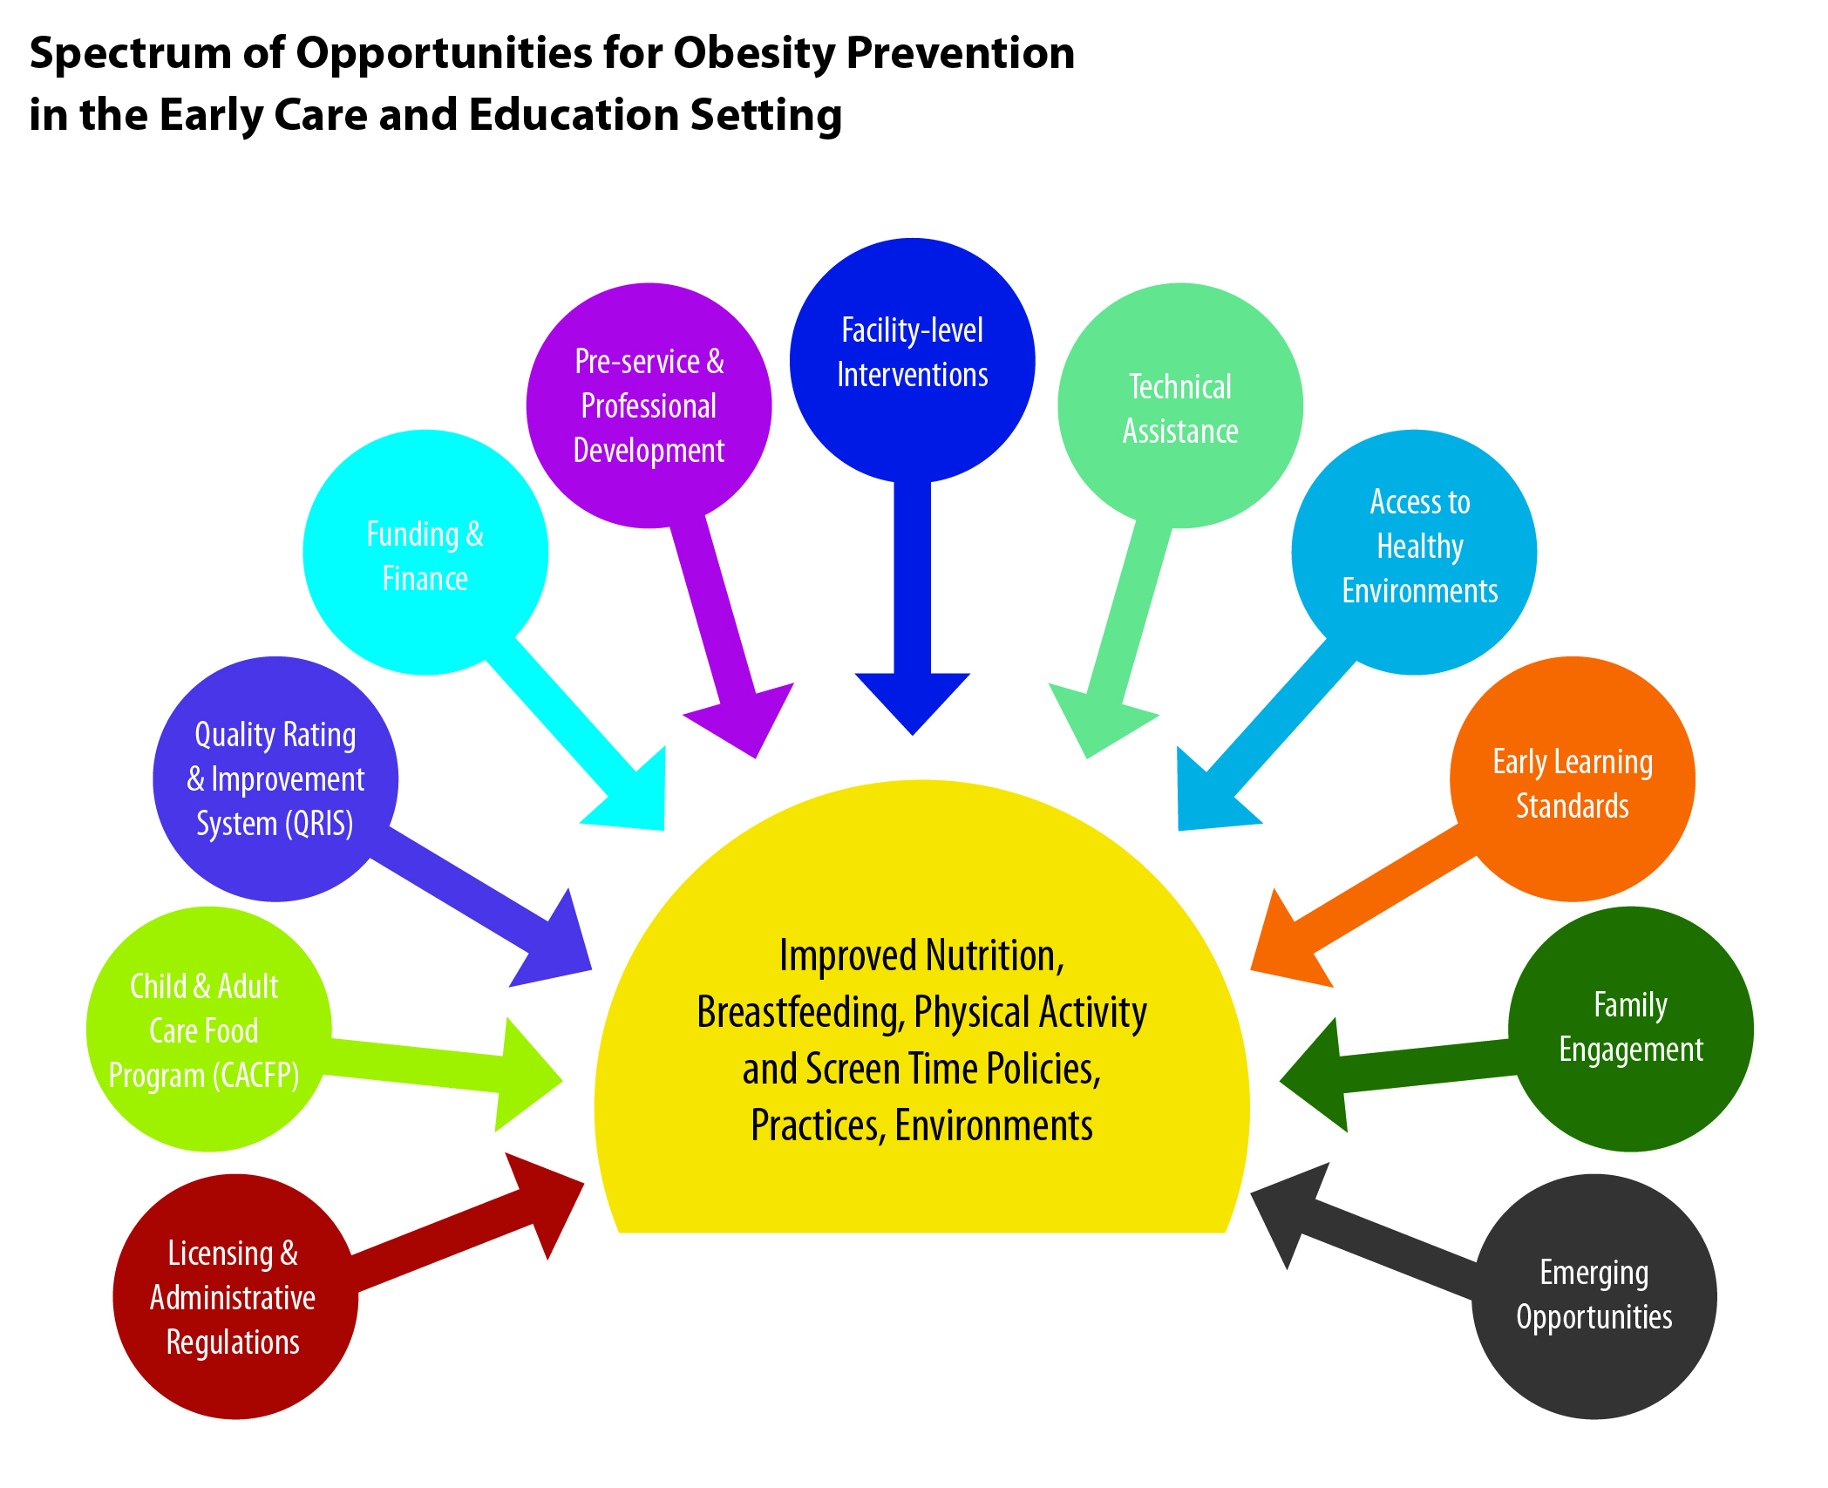
Attachment D
Source: http://www.cdc.gov/obesity/downloads/spectrum-of-opportunities-obesity-prevention.pdf

