Slide 1
Contents
US Concepts
English: Women
English: Men
Spanish: Women
Spanish: Men
Puerto Rico (PR) Concepts
Women
Men

Slide 2
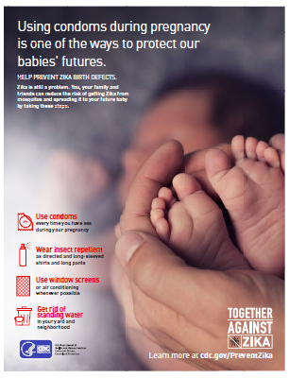
US Concepts – English: Women
Concept 1
Concept 2

Slide 3
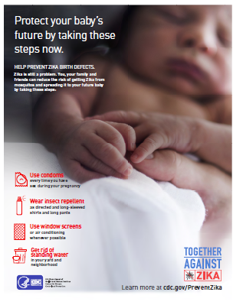
US Concepts – English: Men
Concept 1
Concept 2

Slide 4
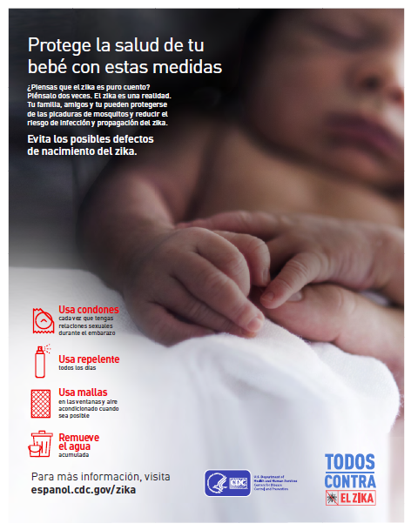
US Concepts – Spanish: Women
Concept 1
Concept 2

Slide 5
US Concepts – Spanish: Men
Concept 1
Concept 2

Slide 6
PR Concepts : Women
Concept 1
Concept 2

Slide 7
PR Concepts: Men
Concept 1
Concept 2

