Slide 1
Online Collaborator Solicitation - TRND
From Altum PCDEMO site, 10-9-2014

Slide 2
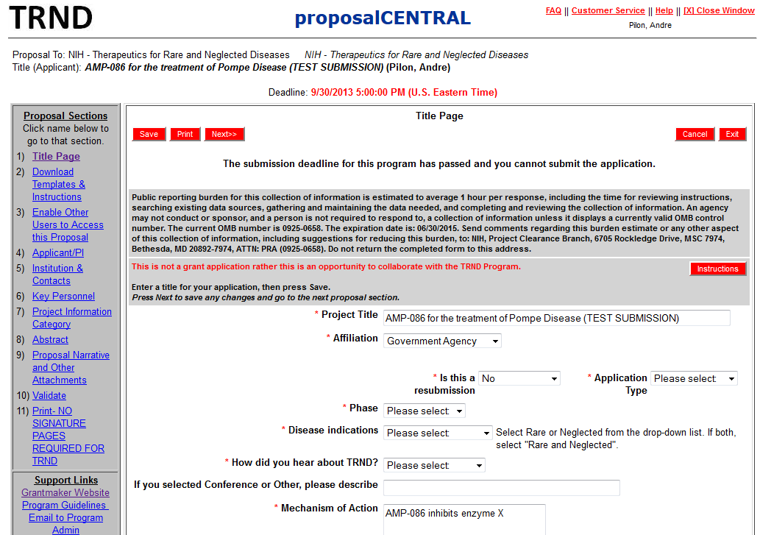
Title Page
Form Approved
OMB NO. 0925-0658
Exp. Date 06/30/2015

Slide 3
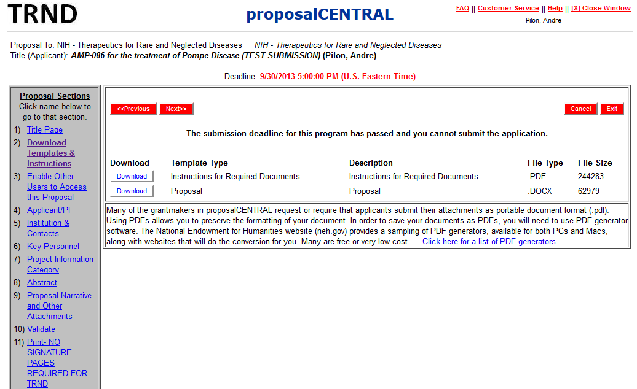
Download Templates and Instructions

Slide 4
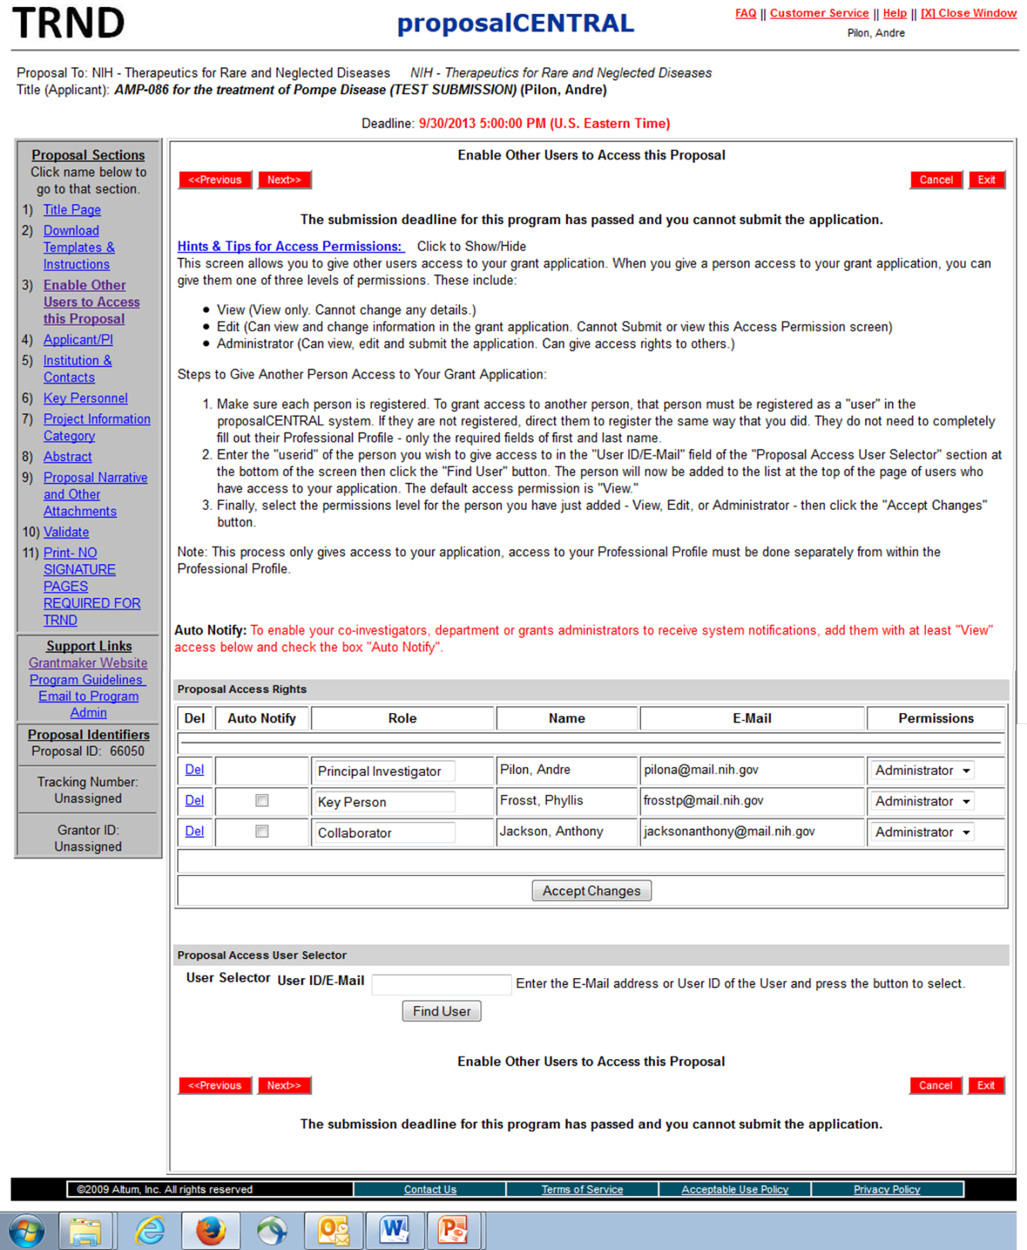
Enable other users to access this proposal

Slide 5
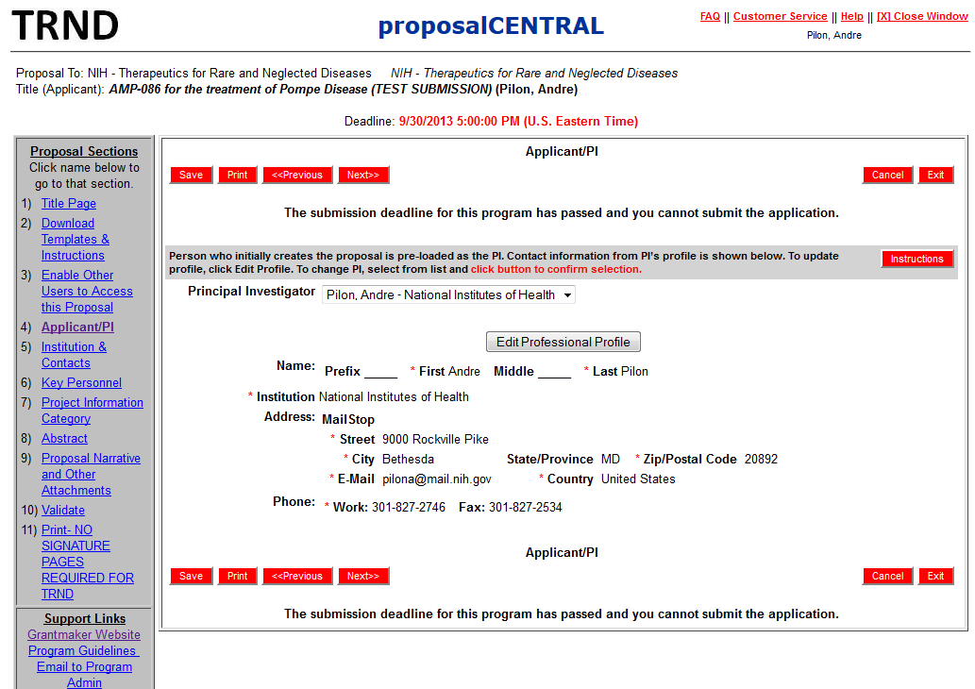
Applicant/PI

Slide 6
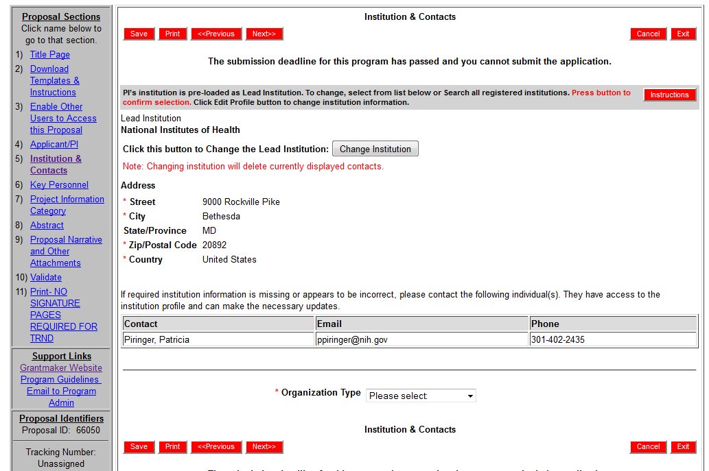
Institution and Contacts

Slide 7
Key Personnel

Slide 8
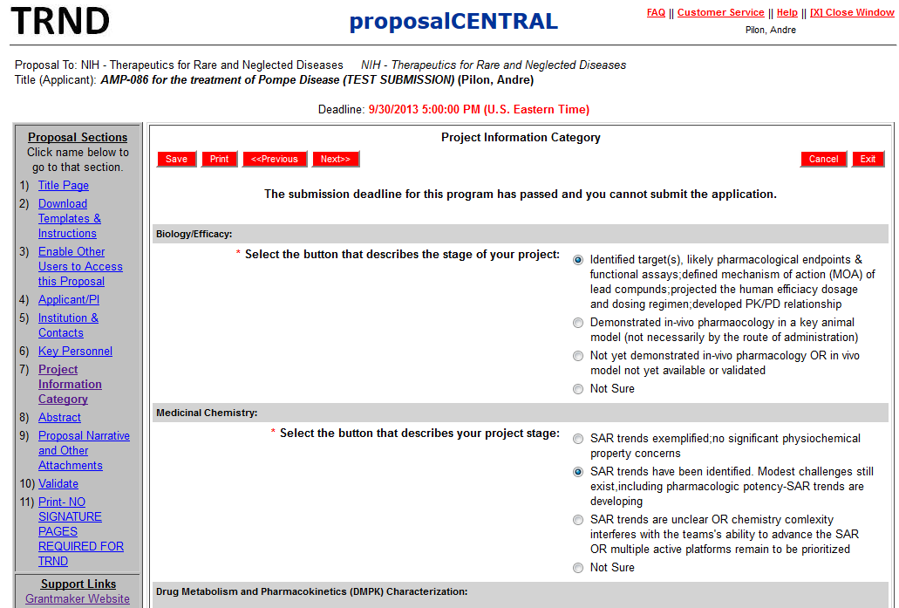
Project Information – 1

Slide 9
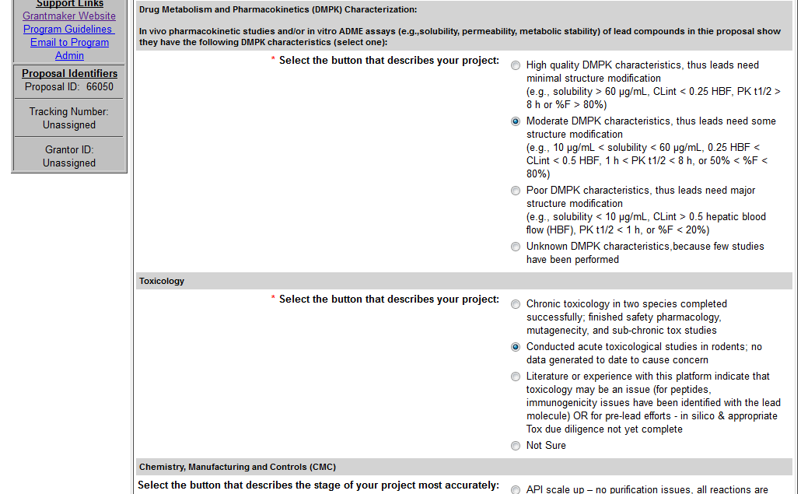
Project Information – 2(cont.)

Slide 10
Project Information – 3(cont.)

Slide 11
Abstract

Slide 12
Proposal Narrative and other Attachments

Slide 13
Validate

Slide 14
Print – (not required for TRND)

