Slide 1
Online Collaborator Solicitation - BrIDGs
From Altum PCDEMO site, 10-9-2014

Slide 2
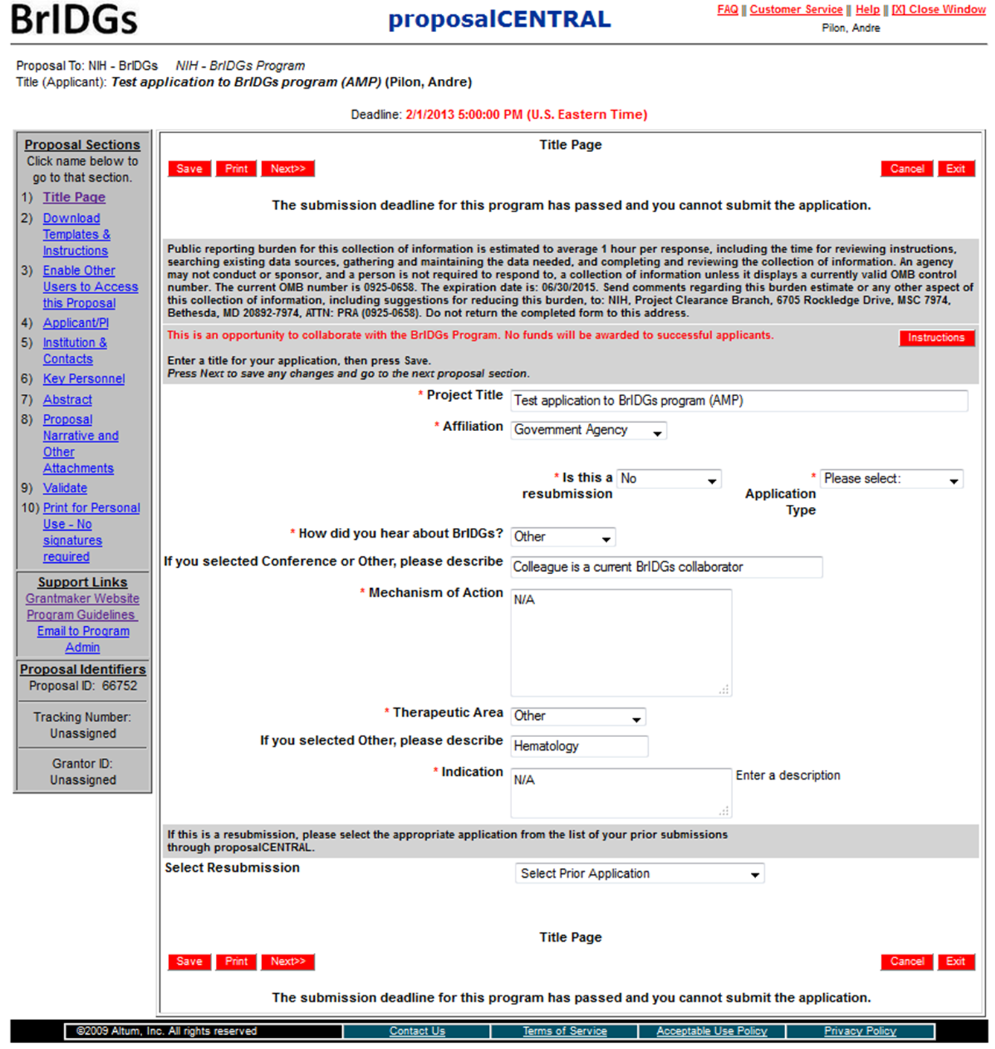
Title Page
Form Approved
OMB NO. 0925-0658
Exp. Date 06/30/2015

Slide 3
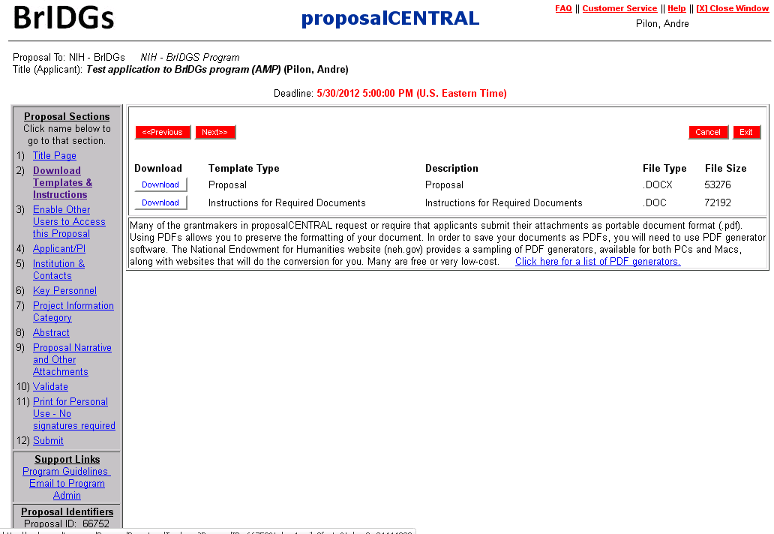
Download Templates and Instructions

Slide 4
Enable other users to access this proposal

Slide 5
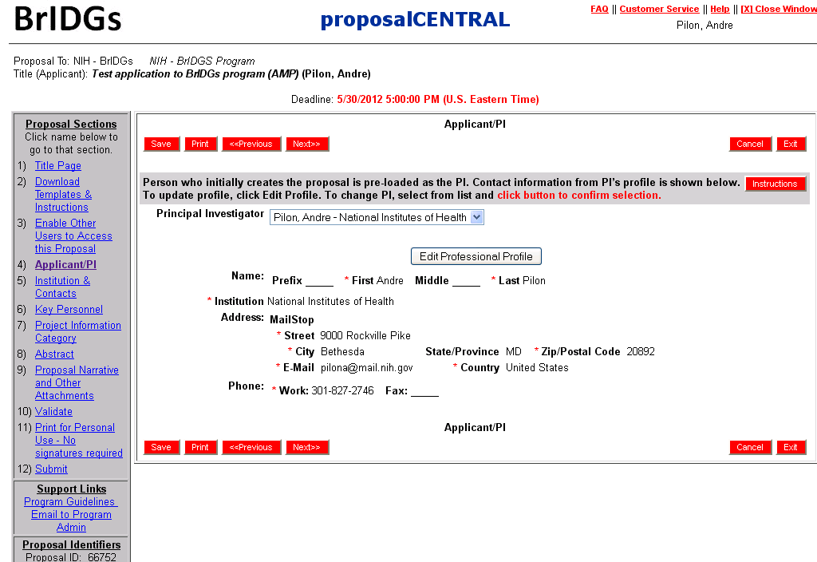
Applicant/PI

Slide 6
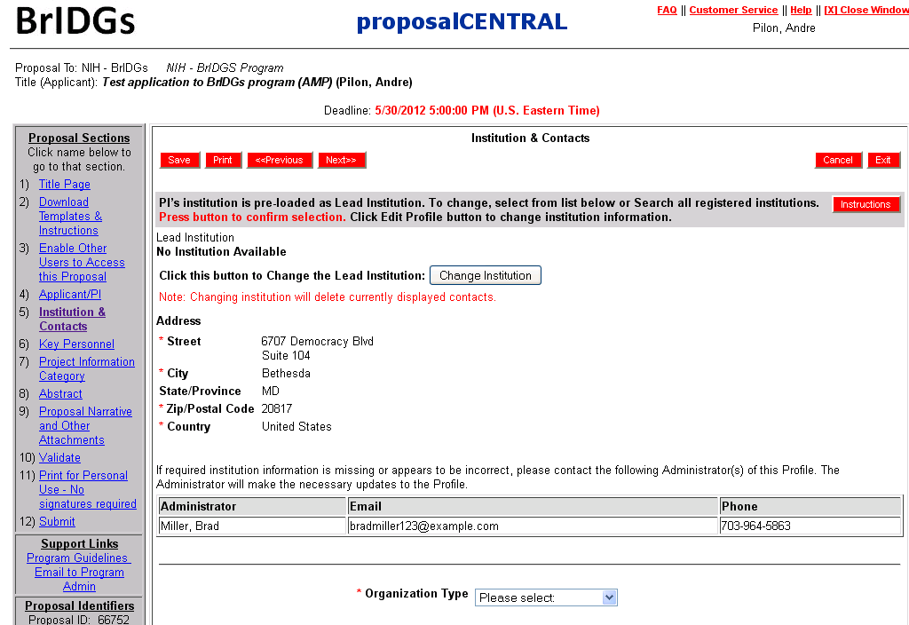
Institution and Contacts

Slide 7
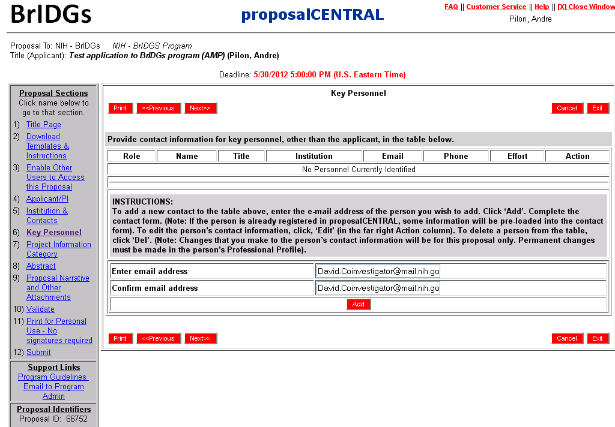
Key Personnel

Slide 8
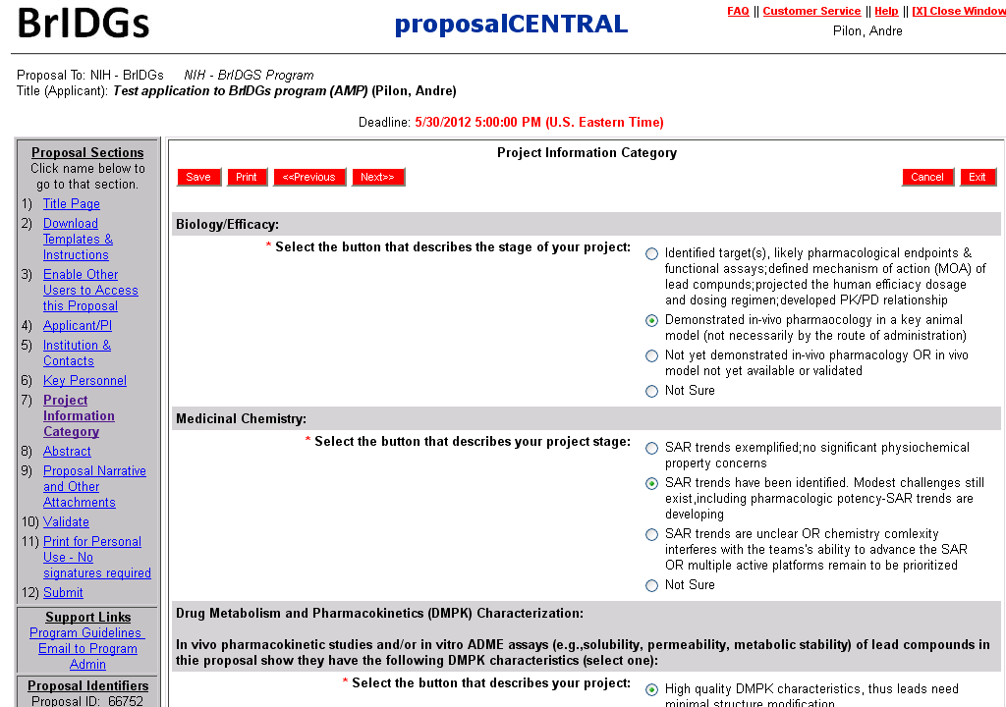
Project Information

Slide 9
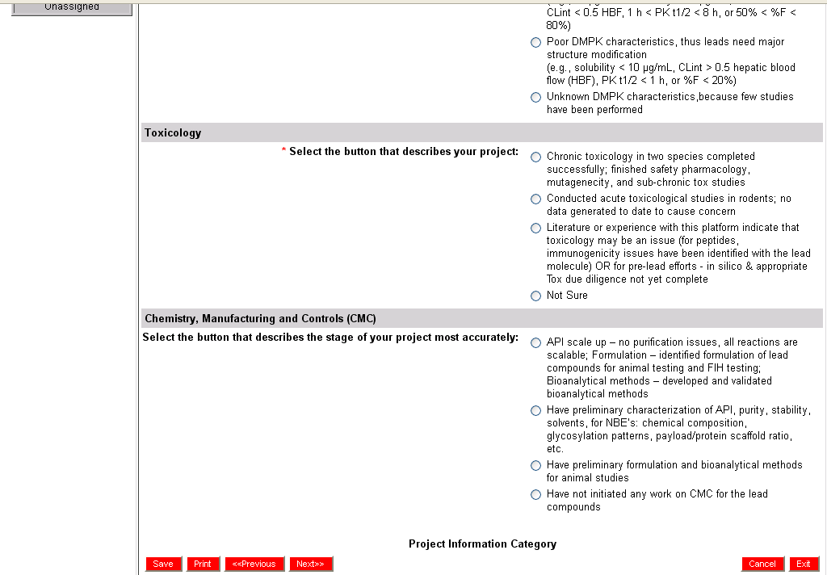
Project Information (cont’d)

Slide 10
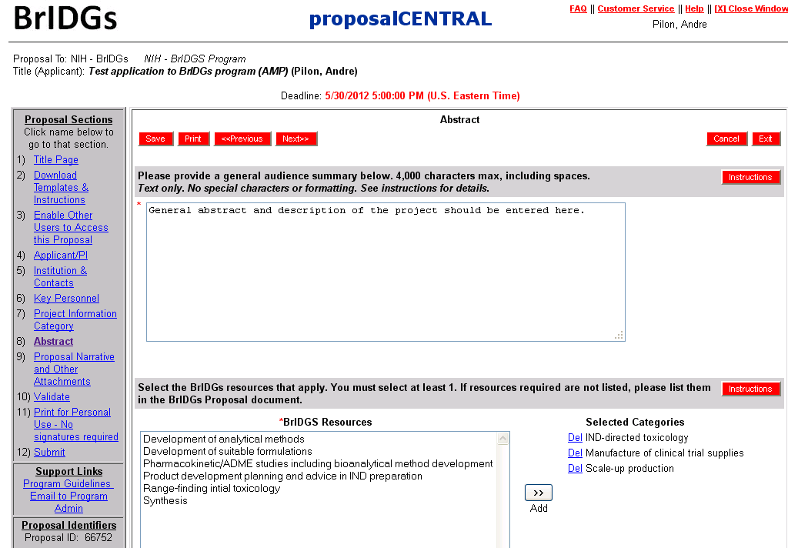
Abstract

Slide 11
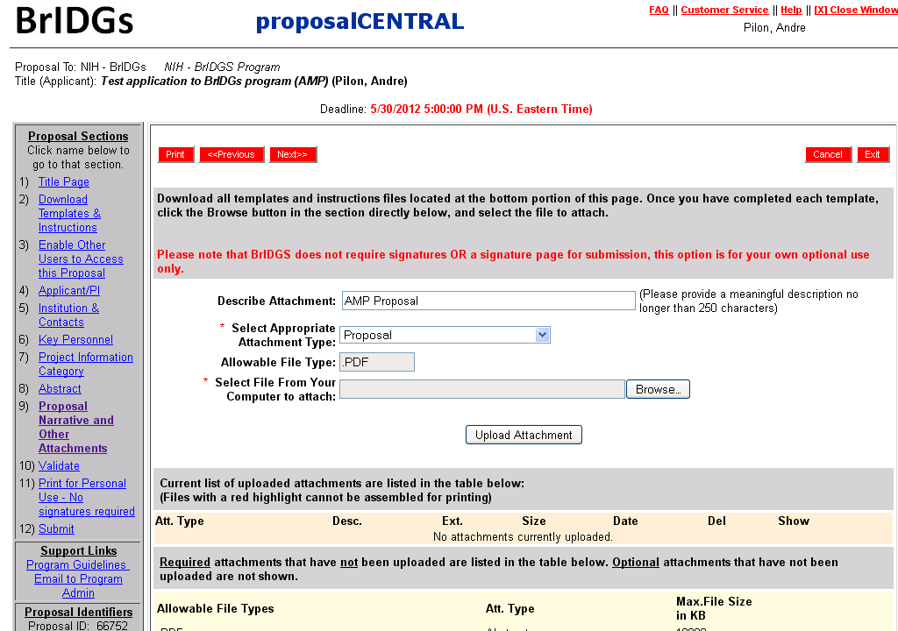
Proposal Narrative and other Attachments

Slide 12
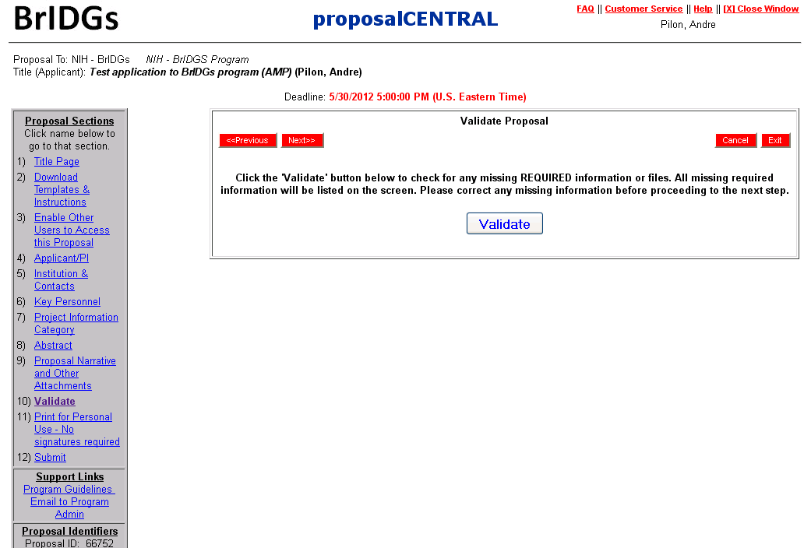
Validate

Slide 13
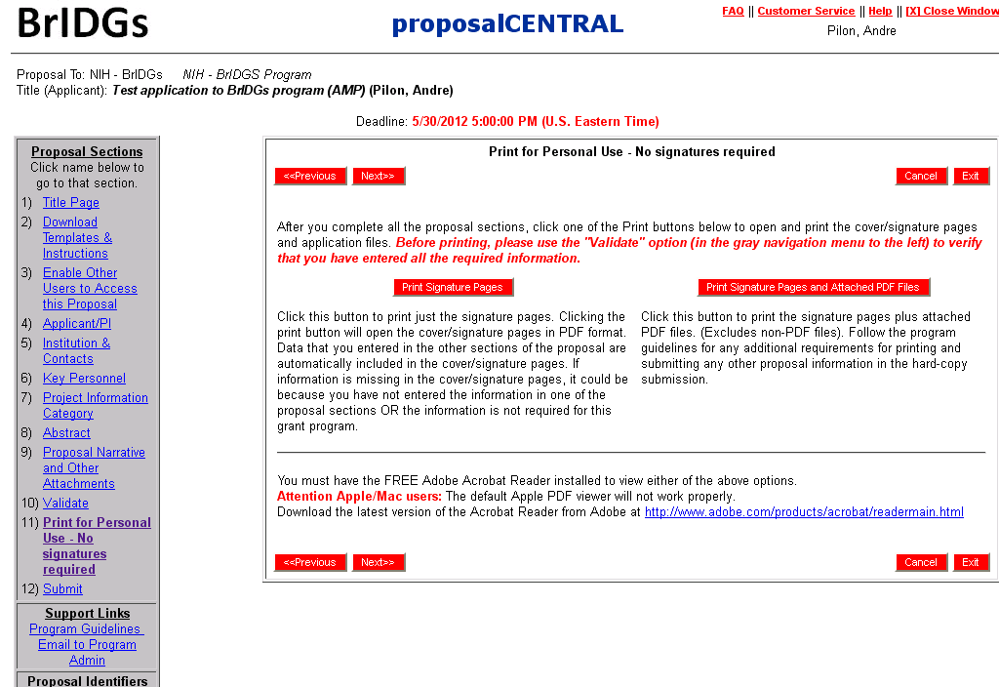
Print – (not required for BrIDGs)

Slide 14
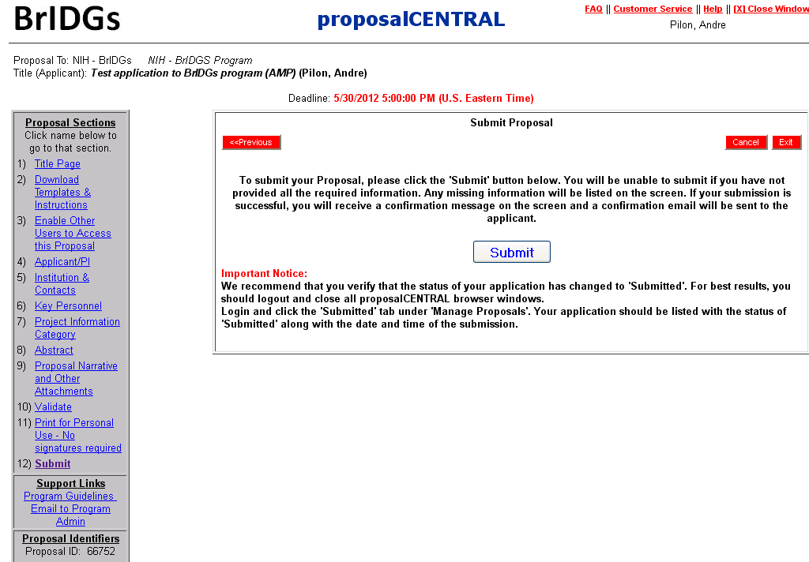
Submit

