Slide 1
Experimental Snow Forecast Products
Communicating probabilistic information using
Focus Group Study

Slide 2
General Decision Making and Information Needs
Part I.

Slide 3
Experimental Probabilistic Graphics
Part II.

Slide 4
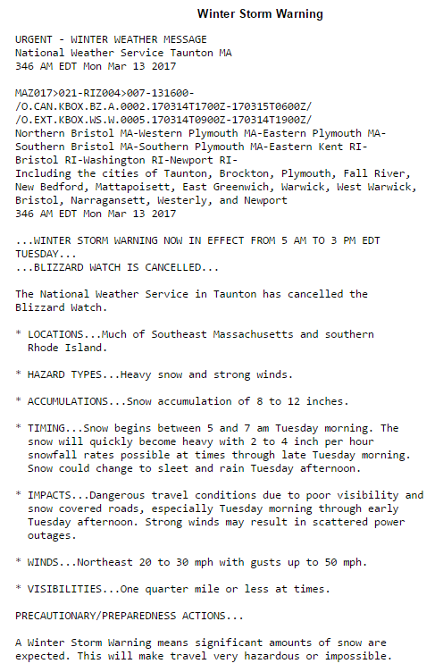
Winter Storm Warning Example

Slide 5
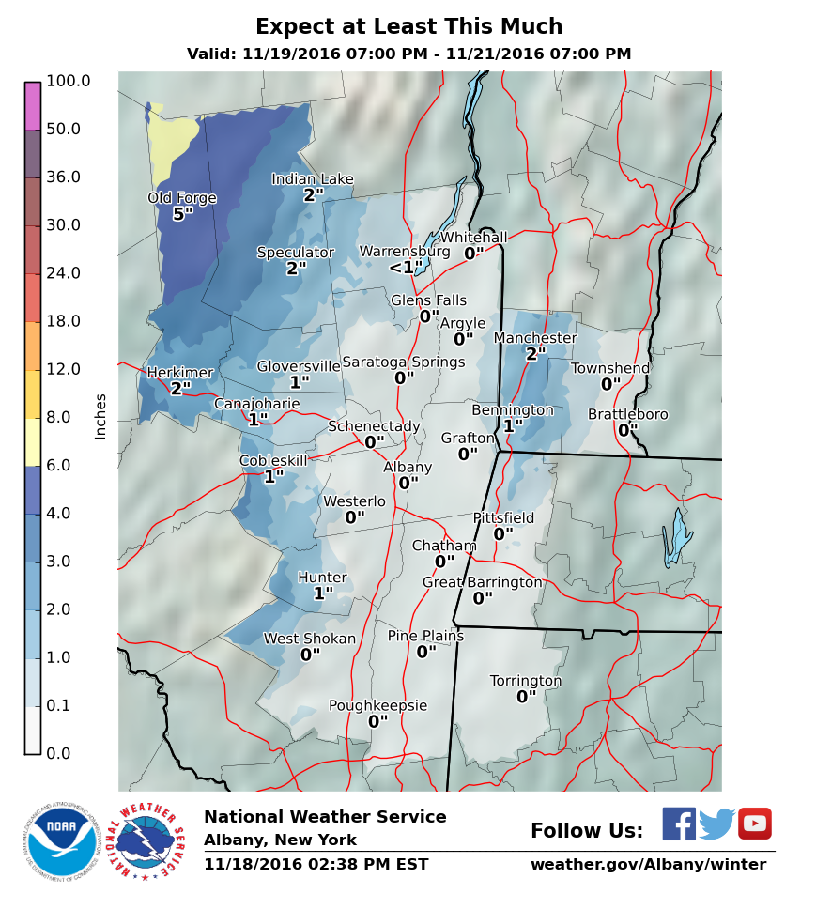
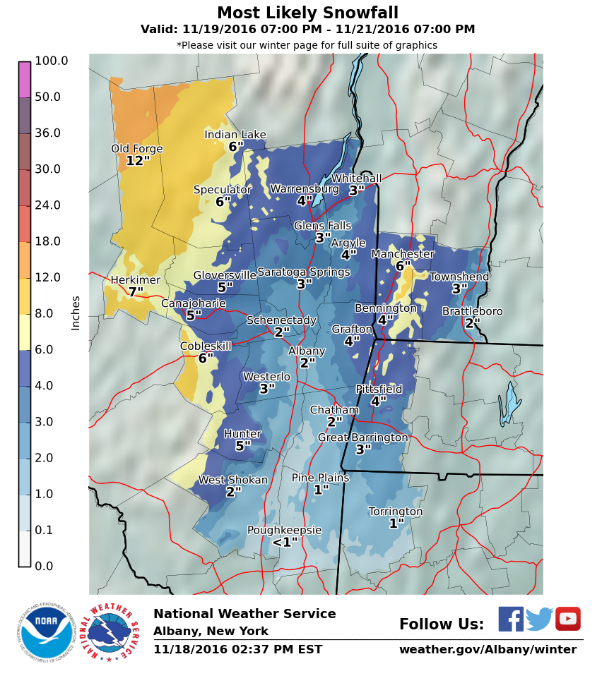
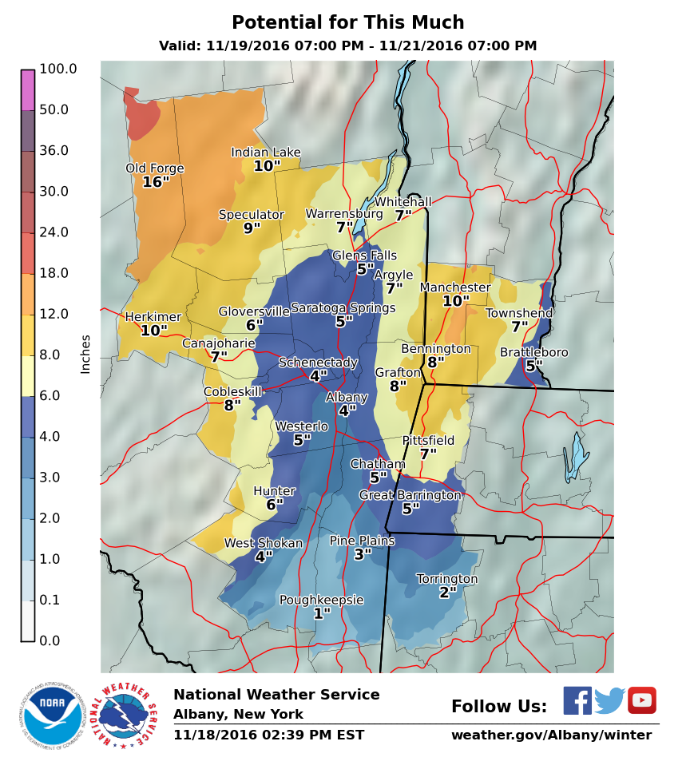
What do these graphics tell you?
Notes:
What does this set of graphics tell you? (Probe for the below questions if not mentioned already)
How do you feel about the title of the graphics?
Do you feel you have enough information to understand what the graphics are communicating?
(IF they don’t mention color) What do the colors represent in this picture?
How do you feel about the color representation?
Would you change it?
What do you see as the relationship among the 3 graphics?

Slide 6
Timing
Notes:
Timing
What does the graphic tell you about the timing of the snow?
What do you think is the relationship between the time on these graphics with the winter storm watch/warning/advisory products?
Then tell them how the graphic is supposed to work with the timing. Ask if that meets their needs.

Slide 7
Usefulness
Notes:
What do you see as the relationship among the 3 graphics?
How would you use these graphics to differentiate snow amounts by location?
How useful are these maps in guiding your decision-making process? Please explain.
(If useful) Are all three of the graphics equally useful?
Or, is one of the three more useful to you? Please explain.
Would you change anything to make it more useful to you?

Slide 8
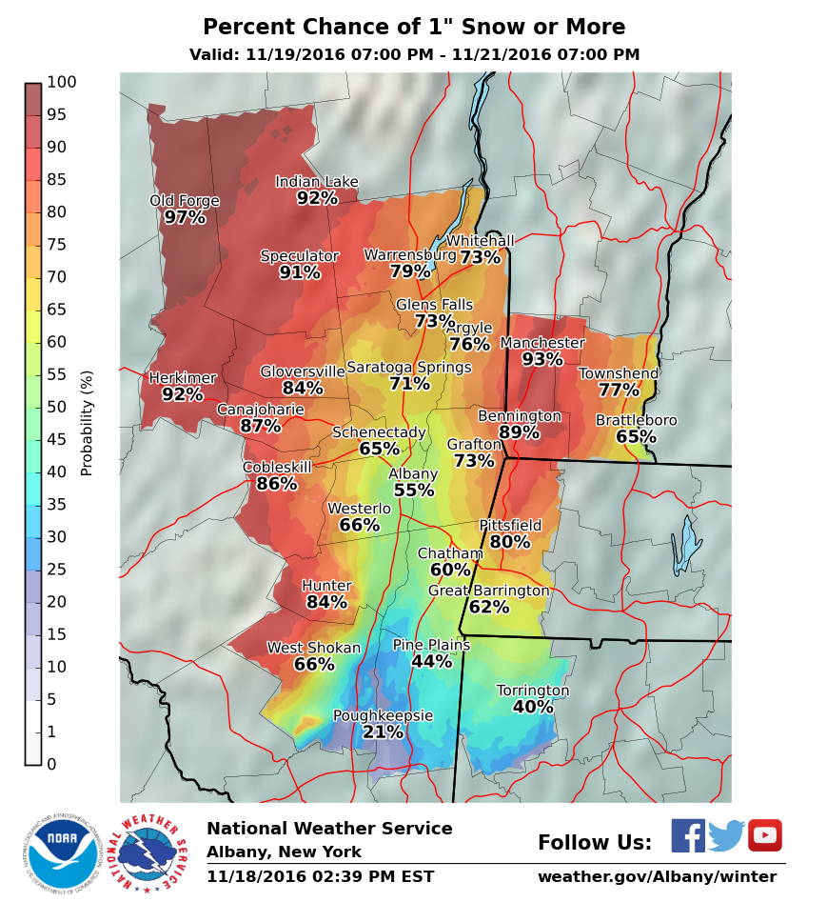
Percent chance >=1 inch snow

Slide 9
Percent chance >=4 inch snow

Slide 10
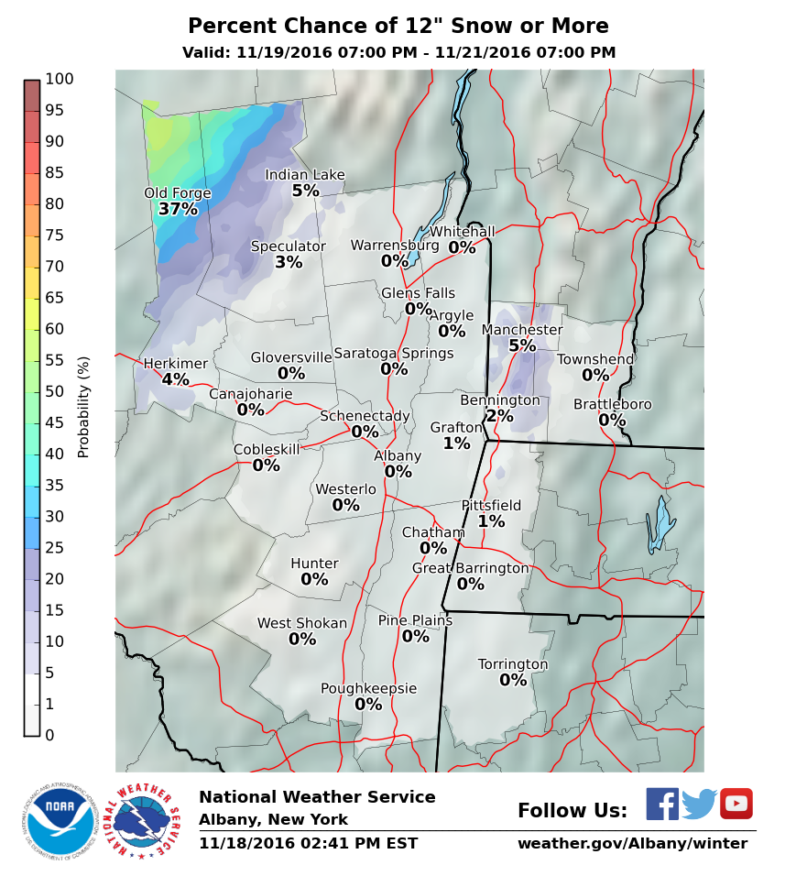
Percent chance >=12 inch snow

Slide 11
Percent Chance Greater Than

Slide 12
Set A “Expect/most/potential”
vs.
Set A Probability greater than
Notes:
Comparison of “expect/most/potential” to probability greater than
Please look at both graphics side by side.
What do the colors represent to you in each graphic?
Should the color scheme remain the same or different?
How do these graphics complement one another? In other words, please explain to us what you see as the relationship between the graphics.

Slide 13
What does this table communicate to you?

Slide 14
What does this table communicate to you?

Slide 15
Exceedance
vs.
Range
Preference?
Useful in decision making? How?
Any changes?

Slide 16
Set A. “Expect/most/potential”
Set B. Probability greater than
Set C. Chance of snow tables
Notes:
Comparison of “expect/most/potential” to probability greater than
Please look at both graphics side by side.
What do the colors represent to you in each graphic?
Should the color scheme remain the same or different?
How do these graphics complement one another? In other words, please explain to us what you see as the relationship between the graphics.

Slide 17
Final thoughts
Dissemination
file format, image resolution for TV or web text size/style?
Accessibility
Color blindness, low visibility, non-English speaking customers?
Improvements
Any other changes to improve the three products?

