Slide 1
NASA Enterprise Service Desk Customer Satisfaction Survey
Incident Management

Slide 2
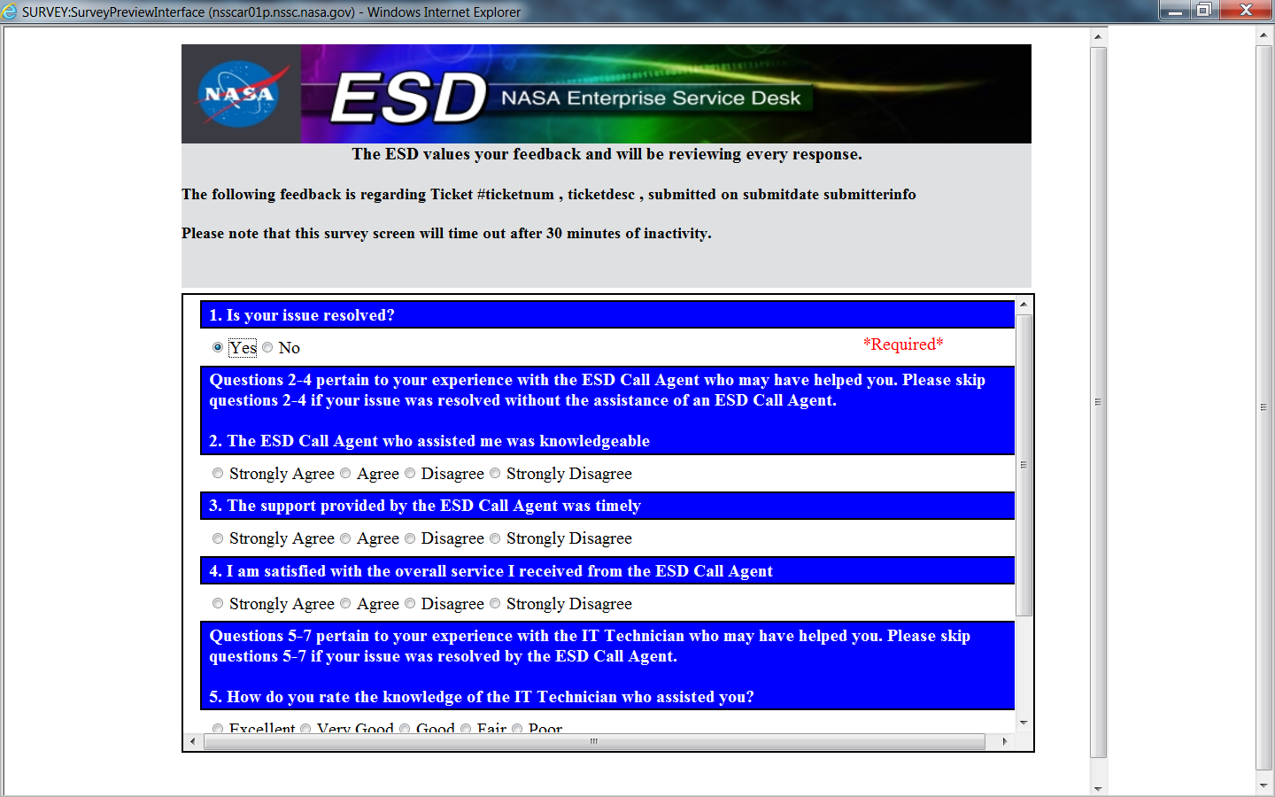

Slide 3
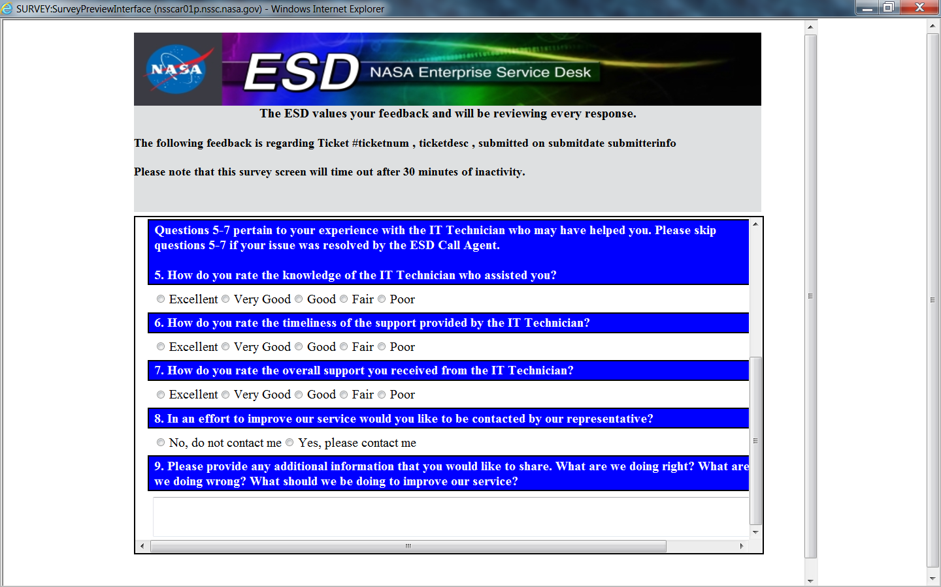

Slide 4
Paperwork Reduction Act Statement: This information collection meets the requirements of 44 U.S.C. § 3507, as amended by section 2 of the Paperwork Reduction Act of 1995. You do not need to answer these questions unless we display a valid Office of Management and Budget (OMB) control number. The OMB control number for this collection is 2700-0153 and expires on 07/31/2017. We estimate that it will take 4 minutes to read the instructions, gather the facts, and answer the questions. Send only comments relating to our time estimate to:nssc-esd-communications@mail.nasa.gov

