Slide 1
Investing in Manufacturing Communities Partnership (IMCP)
Agenda:
Opening Remarks by Ryan Hedgepeth, Senior Advisor, Economic Development Administration
IMCP Overview
IMCP Phases
Preferential Consideration: Inventory of Programs
IMCP Federal Register Notice
Proposal Narrative Requirements and Selection Criteria
OMB MAX Overview – Application Tool

Slide 2
IMCP Overview
The Investing in Manufacturing Communities Partnership (IMCP) will help accelerate the resurgence of manufacturing in regions across the country. The IMCP will reward communities that best highlight their strengths and demonstrate they can combine their efforts around workforce training, infrastructure and research centers to implement an economic development plan that will attract, retain and expand manufacturing investment.
By combining many of the elements companies seek when deciding where to locate their firms, this approach will help communities capitalize on the industrial growth taking place nationwide due to the United States’ competitive advantages in areas like energy, worker productivity, and intellectual property protection.
Through IMCP, thirteen agencies are working together to coordinate how the federal government supports manufacturing regions.

Slide 3
IMCP Phases
Phase 2
Phase 3
First 12 Manufacturing Communities
The following Communities were announced May 2014:
Southwest Alabama led by the University of South Alabama
Southern California led by the University of Southern California Center for Economic Development
Northwest Georgia led by the Northwest Georgia Regional Commission
The Chicago metro region led by the Cook County Bureau of Economic Development
South Kansas led by Wichita State University
Greater Portland region in Maine led by the Greater Portland Council of Governments
Southeastern Michigan led by the Wayne County Economic Development Growth Engine
The New York Finger Lakes region led by the City of Rochester
Southwestern Ohio Aerospace Region led by the City of Cincinnati
The Tennessee Valley led by the University of Tennessee
The Washington Puget Sound region led by the Puget Sound Regional Council
The Milwaukee 7 Region led by the Redevelopment Authority of the City of Milwaukee
2015 Manufacturing Communities’ Competition
Goals:
  Reward communities that demonstrate best practices in attracting and expanding manufacturing.
  Synchronize federal economic development dollars, maximizing taxpayer returns on investment.
  Build strong and durable industrial ecosystems, aligning industry needs for worker training, research, supply chains, capital access, infrastructure, and trade.
  Up to 12 Communities will be designated as Manufacturing Communities and receive:
    Preferential consideration for funding streams identified by the IMCP Participating Agencies.
    A federal point of contact to help access Federal economic development resources.
    Branding and promotion as a Manufacturing Community.
    Potential consideration for federal financial assistance through challenge grant awards, subject to the availability of funds.

Slide 4
Preferential Consideration: Inventory of Programs
Winning IMCP Communities will receive preferential consideration in federal competitions and assistance across 10 agencies to funds up to $1.3 billion
Preferential consideration (or supplemental awards for existing grantees) will be available for funding streams identified by the IMCP Participating Agencies as assisting Manufacturing Communities in bolstering their economic development plans. Manufacturing Communities will receive preference when applying for grants and projects consistent with the community’s economic development strategy.

Slide 5
Preferential Consideration: Inventory of Programs
Department Of Agriculture
  RBEG; REDLG; Intermediary Re-lending; Rural Development Loans; Business & Industry Loan Guarantees
Department Of Housing And Urban Development
  CDBG Section 108
Department Of Labor
  Grant and Funding Opportunities for Communities will be publicized to IMCP Designated Communities
Department Of Transportation
  Transportation Investment Generating Economic Recovery (TIGER)
Appalachian Regional Commission
  Local Access Road Program; Area Development Program
Delta Regional Authority
  States’ Economic Development Assistance (SEDAP)
Environmental Protection Agency
  Targeted Brownfield Assessments (TBA); Brownfield Site Assessment/cleanup/RLF (RLF)
National Science Foundation
  Advanced Technology Education (ATE); I/UCRC (supplemental awards)
Small Business Administration
  Accelerator Program; Regional Innovation Clusters Program
(Additional Technical Assistance (t.a.) available and programs that support IMCP objectives. )
Department Of Commerce
  Award Competitions for Hollings MEP Centers, NIST AMTech Consortia, MEP Network Special Competitions
Department Of Defense
  Community Economic Adjustment t.a.
Department Of Education
  Technical Education t.a.
Department Of Energy
  Clean Energy Company Incubation; CHP t.a.; Industrial Assessment Centers; National Lab Resources

Slide 6
IMCP Federal Register Notice: Key Points
IMCP designation competition announcement - TBD
Applications due March 2015
Applicants define their own regional boundaries, identify their own partners, for designation, which:
  Have a strong existing manufacturing base
  Is large enough to contain critical elements of key technologies or supply chains (KTS) prioritized by applicant – as evidenced by either jobs or firms
  Small enough to enable close collaboration by identified partners
Applicants must demonstrate that the IMCP designation will result in measurable improvement in key areas of their manufacturing ecosystem.

Slide 7
Proposal Narrative Requirements and Selection Criteria
Quality of implementation strategy
50 Points
Applicants should provide a detailed data-driven assessment of the local industrial ecosystem as it exists today, what is missing, and an evidence-based path to development that could make a region uniquely competitive.
The proposed development should involve strong coordination across all elements of the industrial ecosystem:
  Workforce and Training
  Supplier Network
  Research and Innovation
  Infrastructure and Site Development
  Trade and International Investment
  Operational Improvement and Capital Access
Methodology:
Current Capability?
Current Institutions for improving capability?
Gaps?
Plan?
Notes:
DONE

Slide 8
Proposal Narrative Requirements and Selection Criteria
Capacity
25 Points
  Proposal should demonstrate the Capacity To Carry Out the Implementation Strategy, including an evidence based assessment of:
    Overall leadership capacity
    Sound partnership structure
    Partner capacity to carry out planned investments and attract companies
    State of ecosystem's institutions
    Depth and breadth of communities’ development and employment goals
Notes:
DONE

Slide 9
Proposal Narrative Requirements and Selection Criteria
Commitment
25 Points
    Proposal should demonstrate a Verifiable Commitment From Existing and Prospective Stakeholders—Both Private and Public—To Executing a Plan and Investing in a Community, including an evidence based assessment of:
    Cohesion of partnership
    Strength and extent of partnership commitments (not contingent on federal funding)
    Breadth of commitment to plan from diverse institutions
    Investment commitments
Notes:
DONE

Slide 10
Determining Eligibility
Example of how to utilize FAQs on EDA website: http://www.eda.gov/challenges/imcp/
How can a community provide evidence that it ranks in the top third in the nation for their key manufacturing technology or supply chain (KTS)?
The purpose of a top-third ranking requirement for a community’s KTS is to ensure that regions are building on existing strengths (rather than starting from scratch). Thus, we encourage applicants to provide as much evidence as possible that points to the importance and growth of their KTS compared to other similar regions and the nation. This enables reviewers to better understand the strength and growth of your community’s KTS and assess whether it is a national leader. Communities may measure their top-third status either by using the absolute scale of activity (such as employment or sales) in their KTS, or by using location quotients (LQs).
The following sections offer guidance that may be of use to applicants. While communities may find this material helpful for demonstrating that the community ranks in the top-third nationally in their KTS, it is not required that applicants use the data we offer. However, applicants that choose not to use the guidance below should provide clear details on data and methods used to demonstrate that your community ranks in the top-third in your defined region and KTS.
Information and guidance on LQs and top-third rankings

Slide 11
Determining Eligibility
Location quotients (LQ) compare an area's business composition to that of a larger area (i.e., nation or a state). Economic development opportunities may exist for additional growth of the exporting or related industries because of the presence of an existing skilled labor pool or other resources such as suppliers, facilities or transportation hubs in the region.
The LQ is a measure of an industry's level of concentration within a location compared to a larger region, with an LQ greater than 1 (LQ>1) indicating a higher than average concentration in that location. An LQ greater than 1 indicates that an area has proportionately more workers or firms than the larger comparison area in a specific industry sector.
Calculating a LQ for employment is based on the following formula:
For LQs based on firms, use the number of establishments in that particular KTS rather than number of employees.
The following is an example of how applicants would calculate an LQ for a 4-county region that had employment in Pharmaceutical and Medicine Manufacturing (NAICS = 3254). Note that this same method can be applied to one or more counties. The example uses hypothetical data for the 4 county region and actual national data for Pharmaceutical and Medicine Manufacturing using the 2011 County Business Patterns data (http://www.census.gov/econ/cbp/):

Slide 12
Determining Eligibility
4 county Region’s Pharmaceutical and Medicine Manufacturing = 600 employees
4 county Region’s Total Employment = 250,000 employees
Nation’s Pharmaceutical and Medicine Manufacturing = 227,894 employees
Nation’s Total Employment = 113,425,965
Then, the LQ based on employment would be:
(600/250,000)/( 227,894/113,425,965) = 0.002400/.002009 = 1.19
From this example, the applicant’s LQ is 1.19.
To determine if their community is ranked in the top-third nationally, use the linked table that provides manufacturing employment and establishment LQ cutoff numbers for states. That is, the numbers in the table provide the LQ for each 4-digit NAICS manufacturing industry for the 17th-ranked state (including the District of Columbia) (Table: Top-Third Ranked Location Quotients for Establishments and Employment by 4-digit Manufacturing NAICS Codes (xls)).
Following the example given above and referring to the table, the LQ for the top third in employment in Pharmaceutical and Medicine Manufacturing is 1.05. Therefore, this region, with an LQ of 1.19, has demonstrated its eligibility to be considered for IMCP funding based on LQ. Also, for simplicity, even those communities whose regional boundaries do not conform to state borders can compare themselves to the state LQ rankings in the table provided.

Slide 13
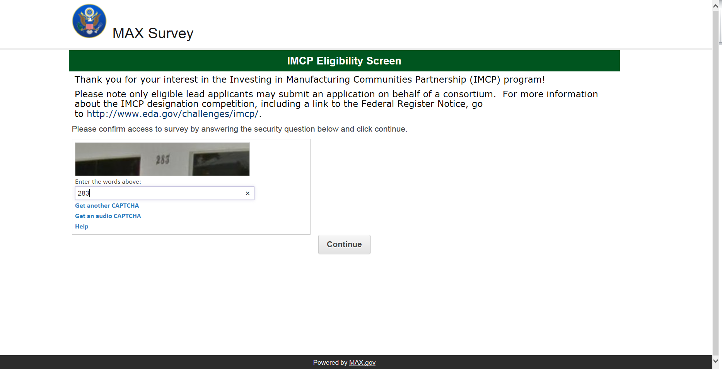
Preliminary Steps

Slide 14
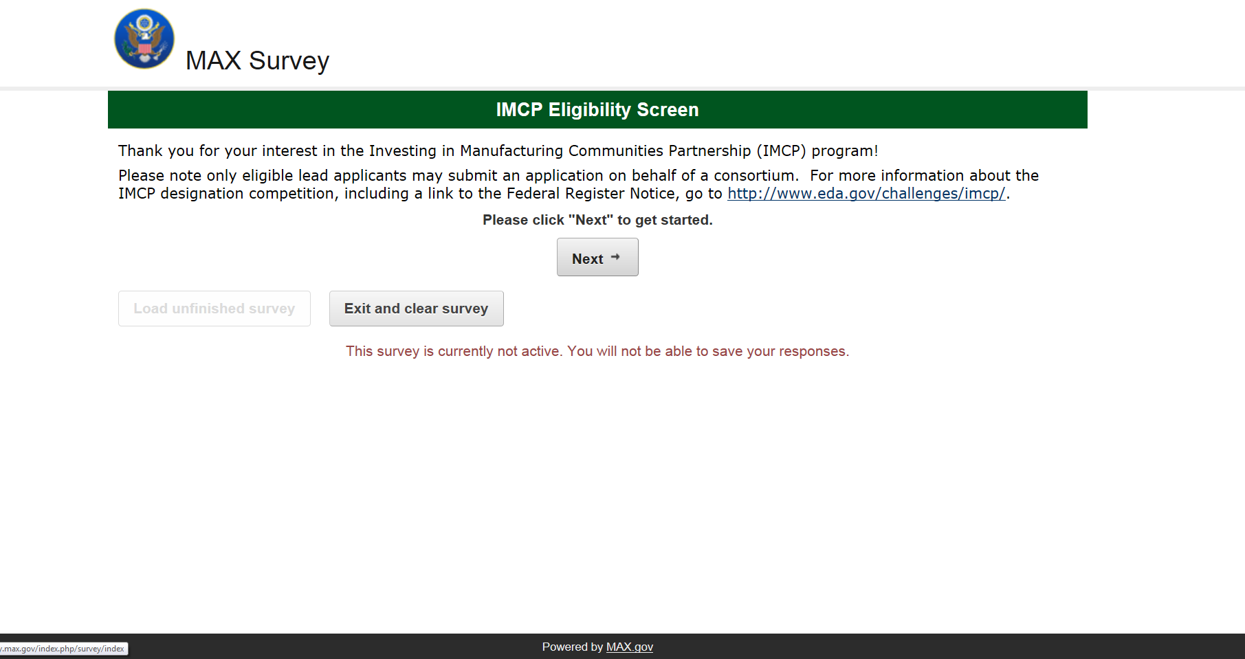
Preliminary Steps

Slide 15
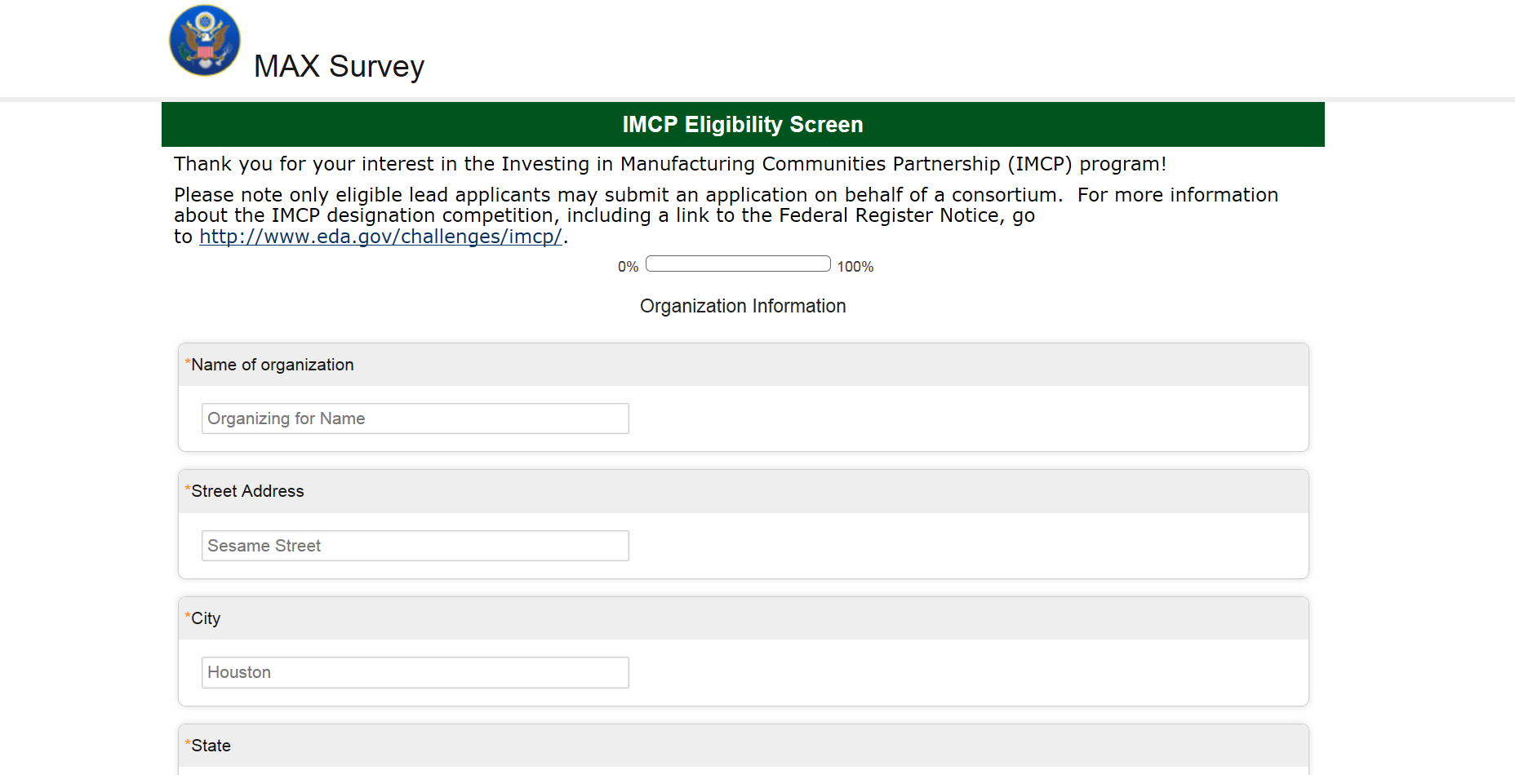
Preliminary Steps

Slide 16
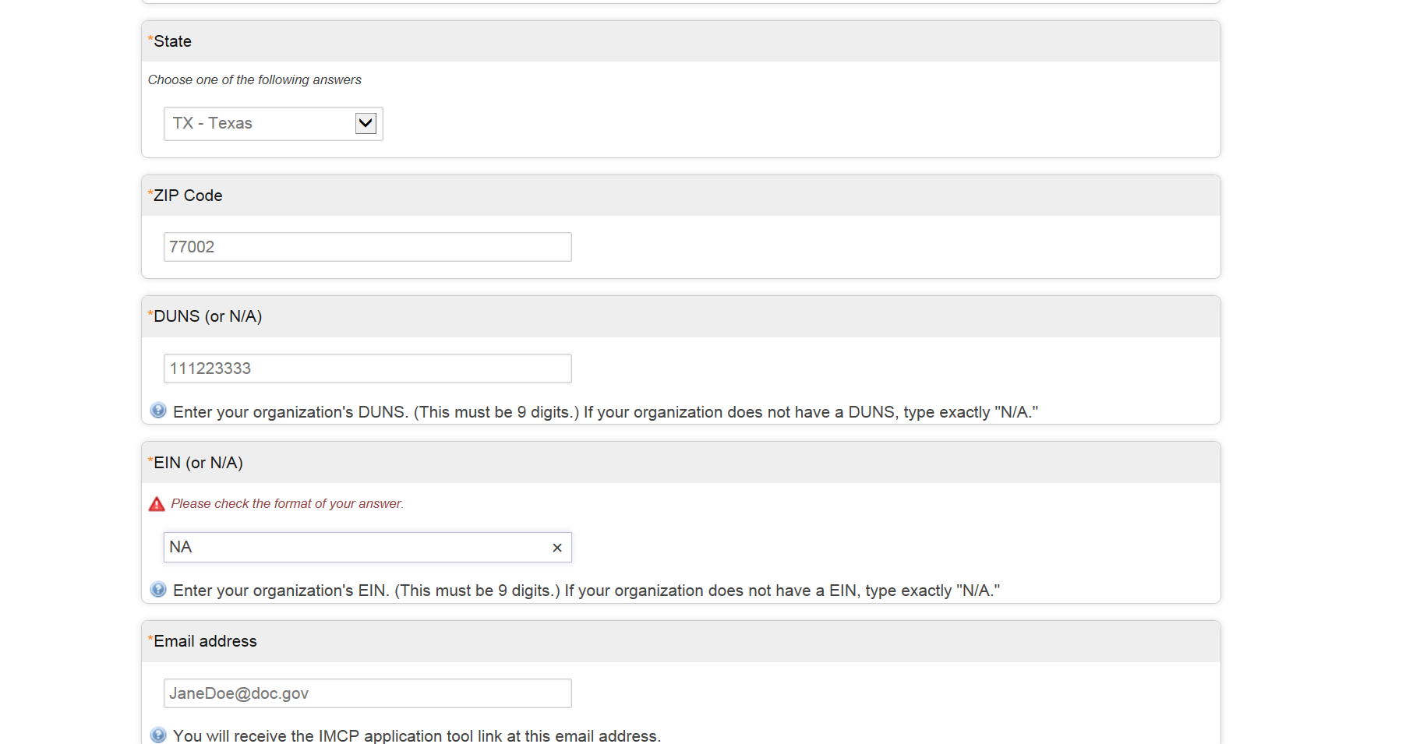
Preliminary Steps

Slide 17
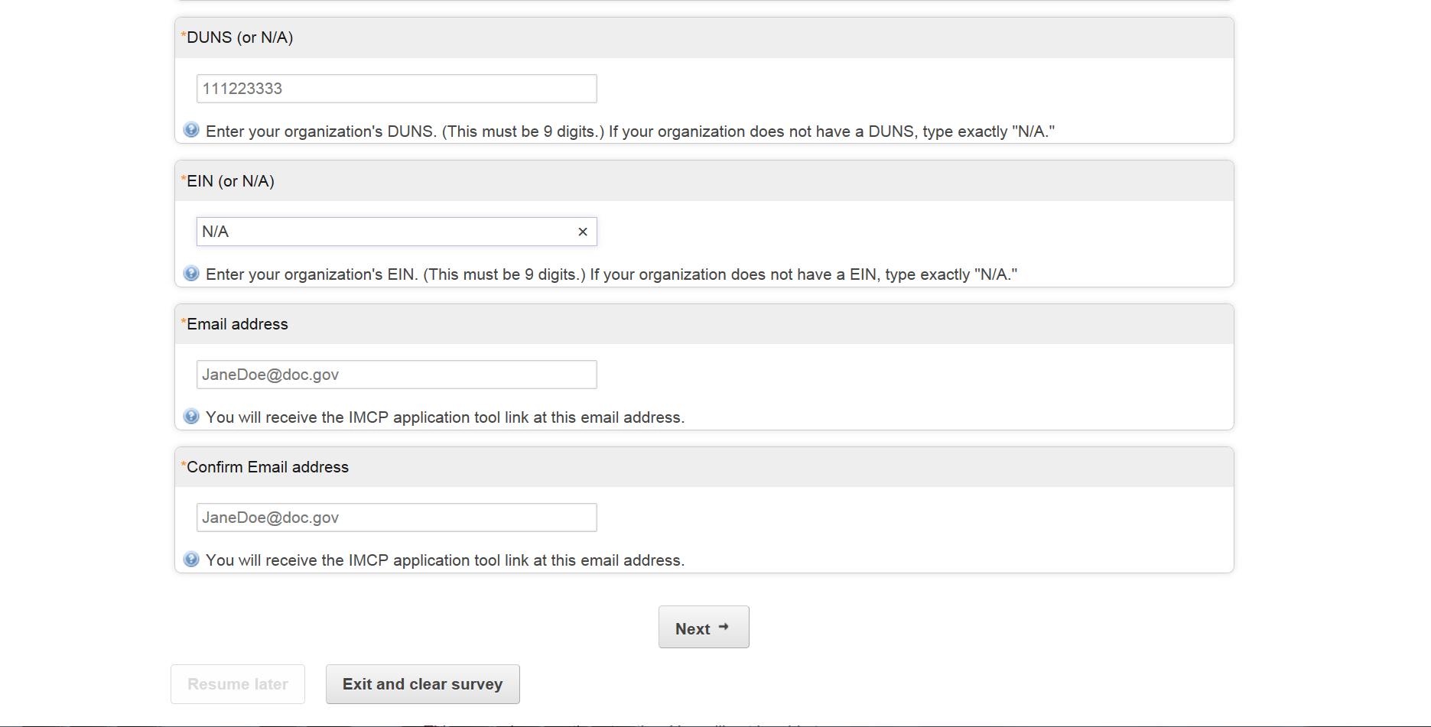
Preliminary Steps

Slide 18
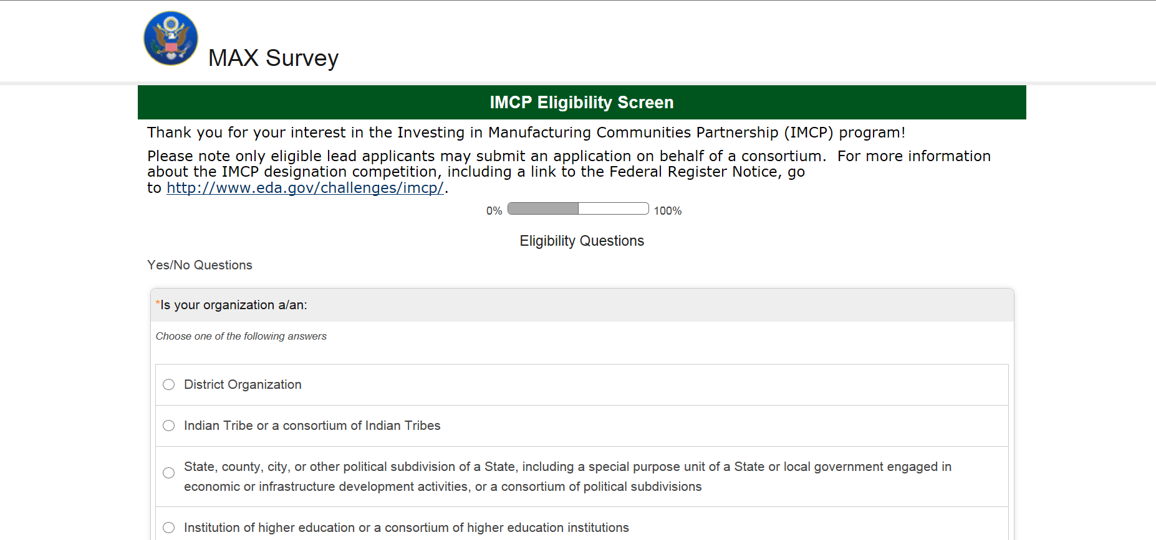
Preliminary Steps

Slide 19
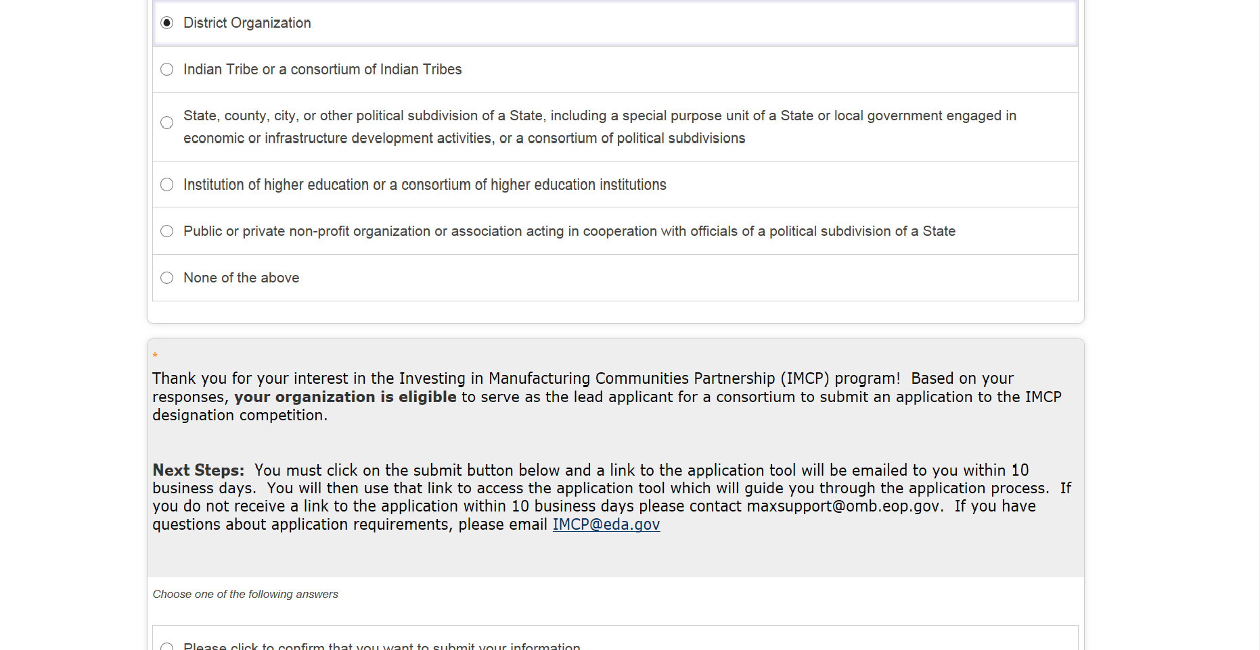
Preliminary Steps

Slide 20
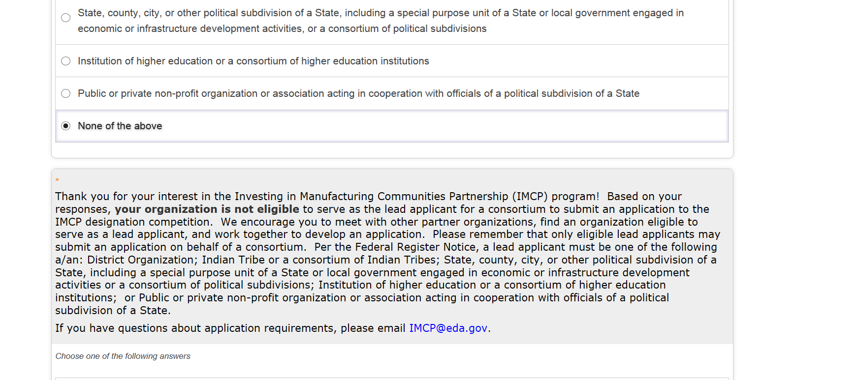
Preliminary Steps

Slide 21
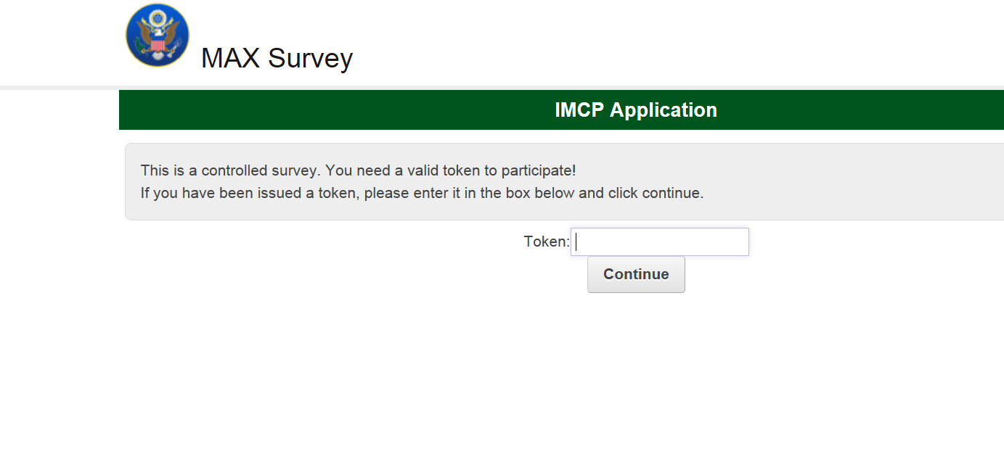
Validation via Token

Slide 22
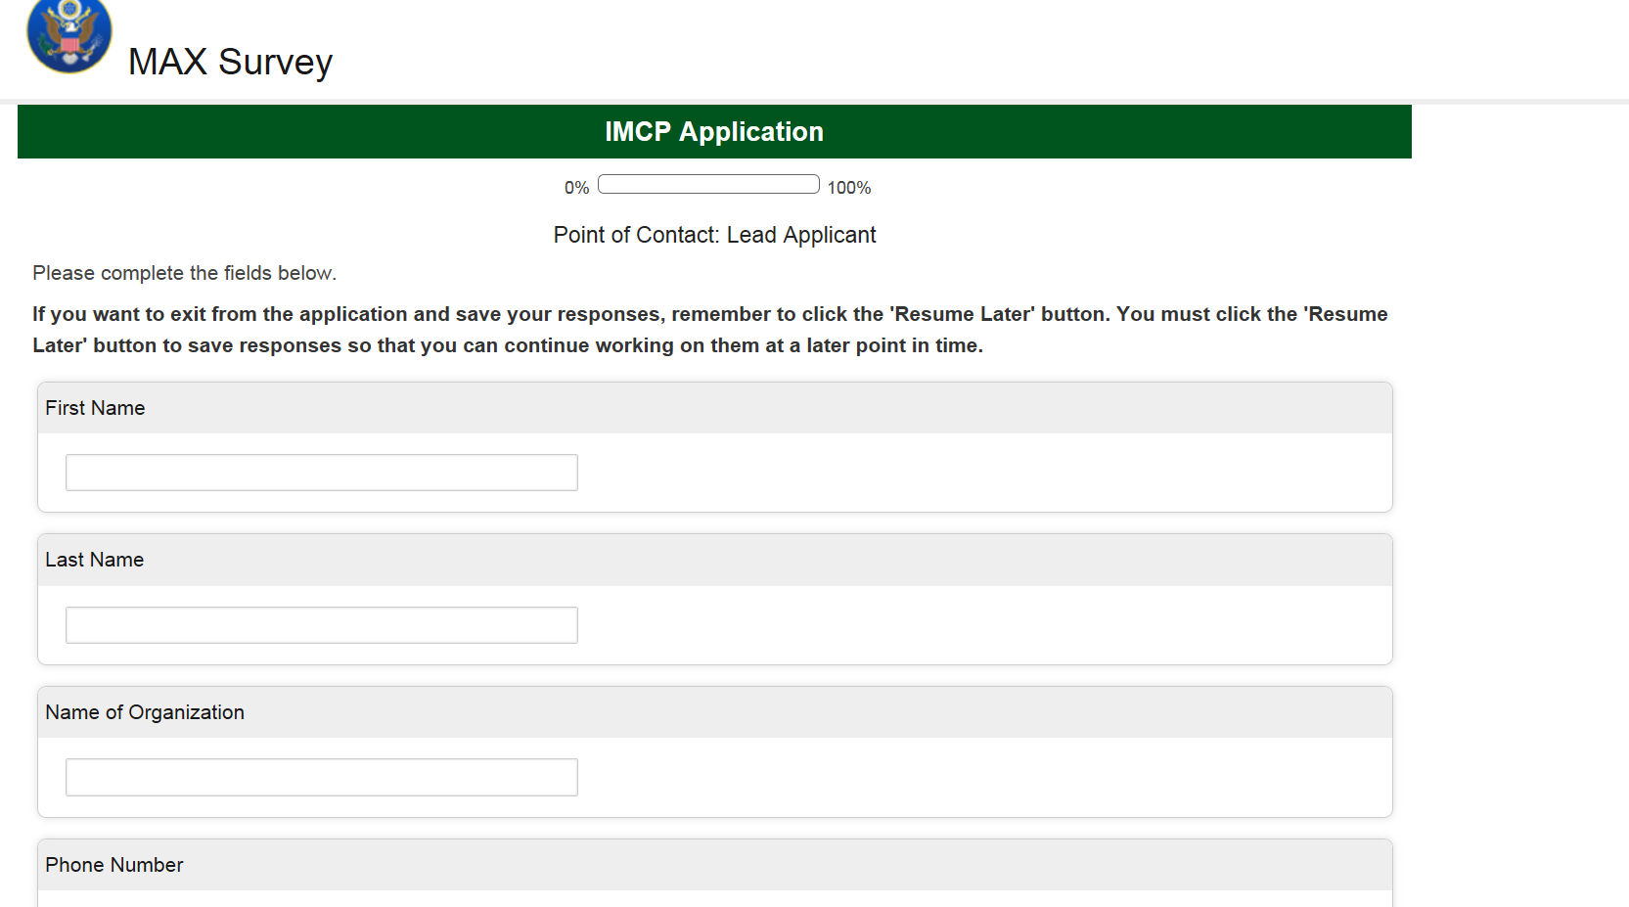
Section 1: Point of Contact/Lead Applicant (1 of 3)

Slide 23
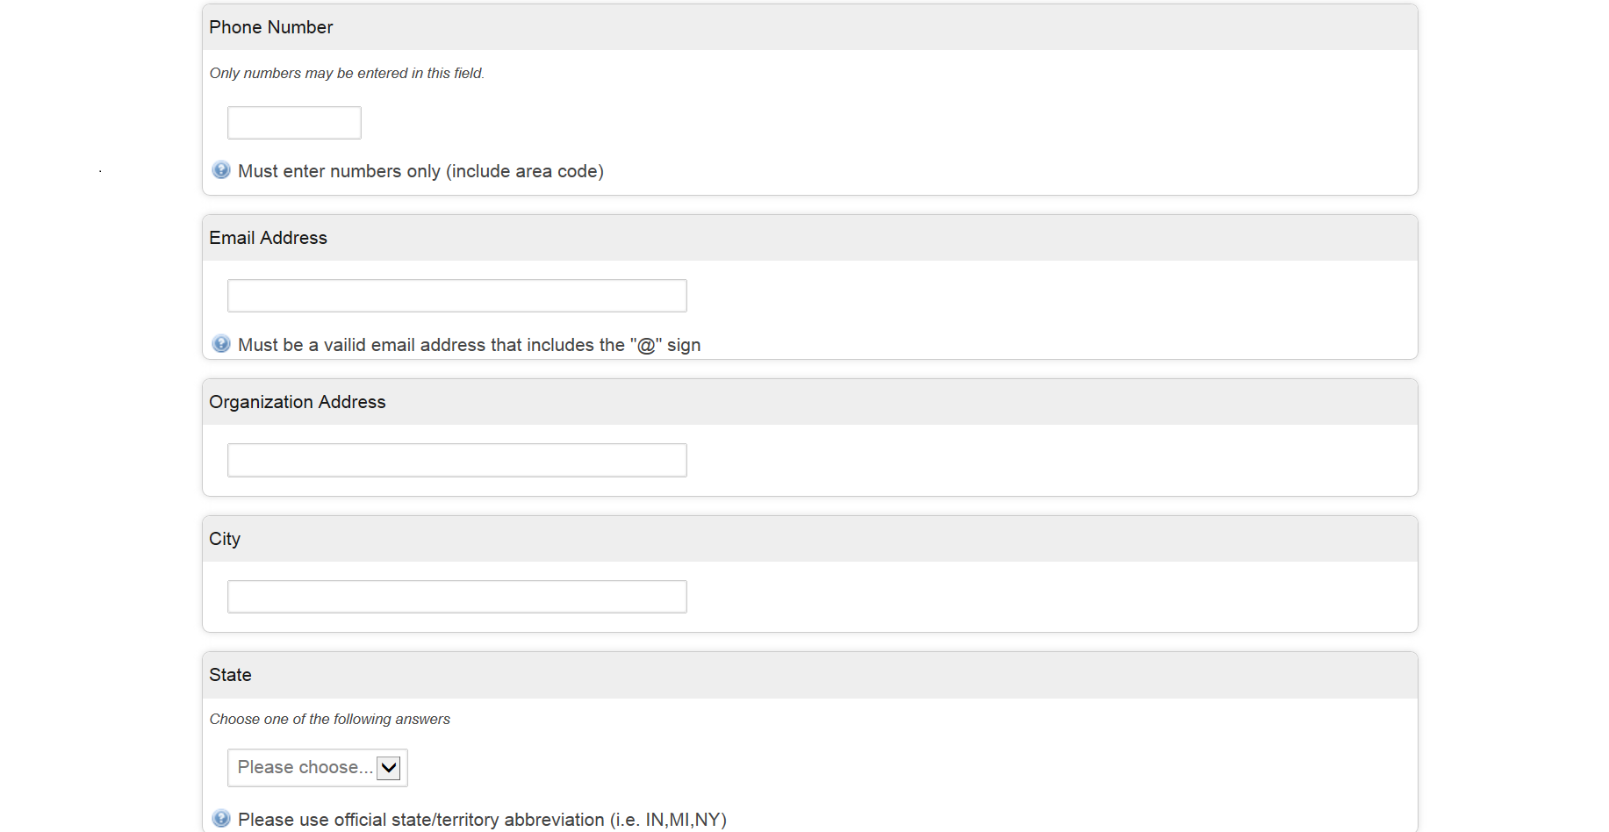
Section 1: Point of Contact/Lead Applicant (2 of 3)

Slide 24
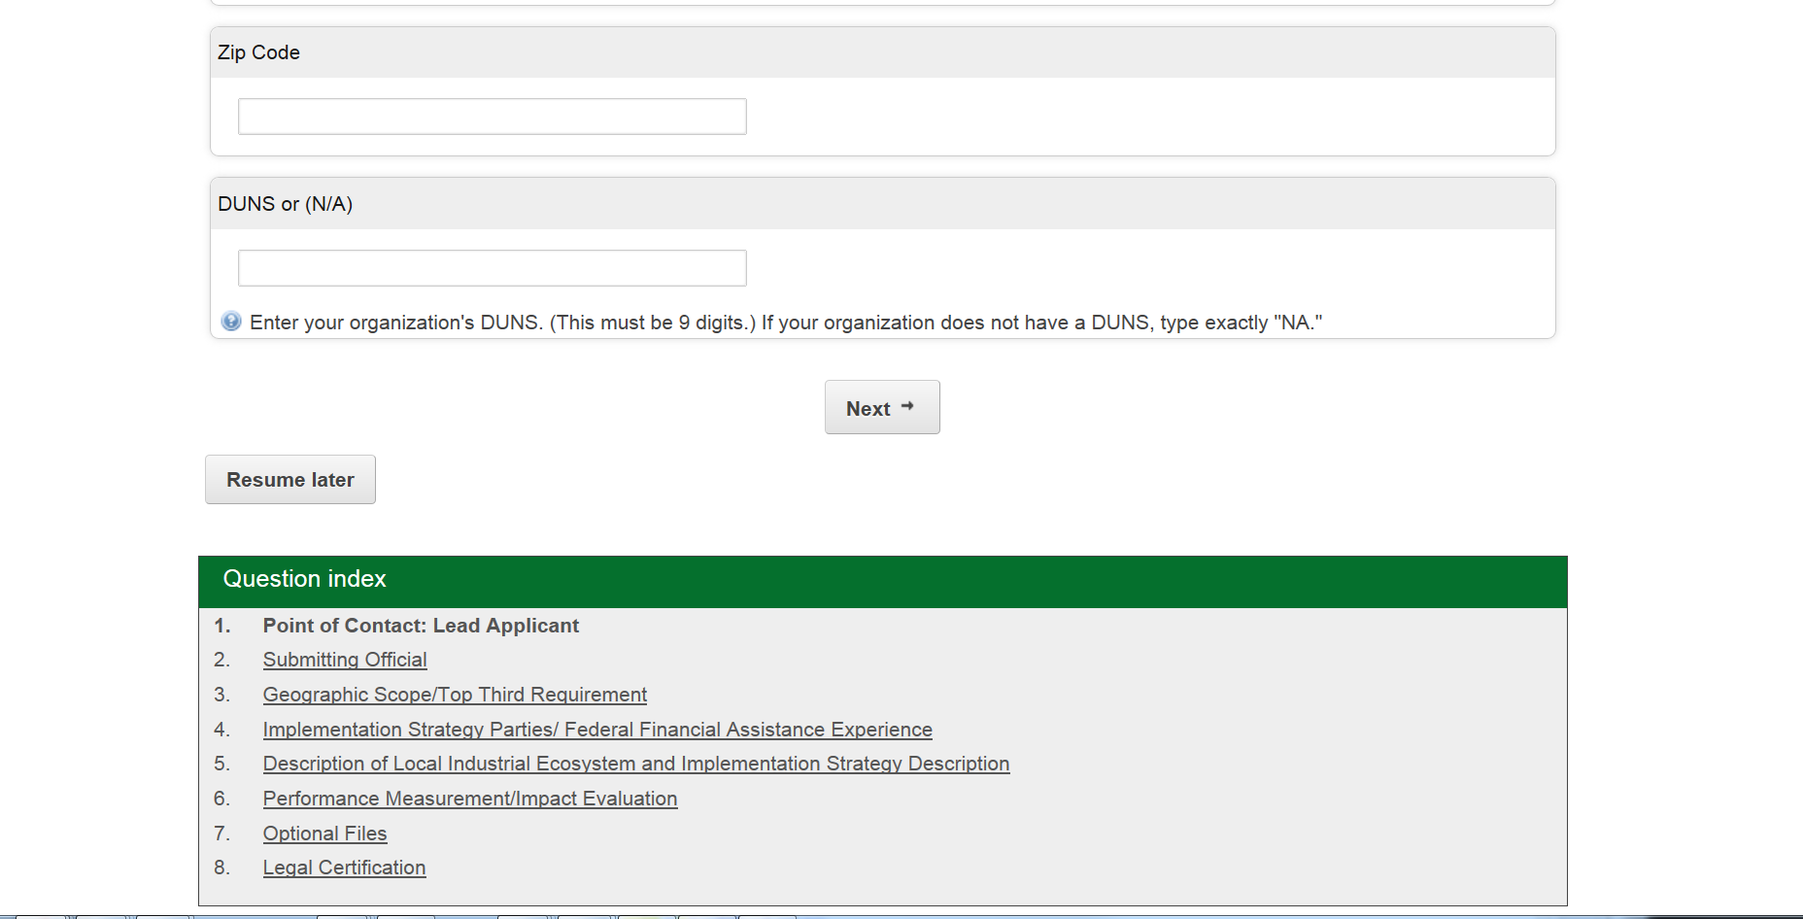
Section 1: Point of Contact/Lead Applicant (3 of 3)

Slide 25
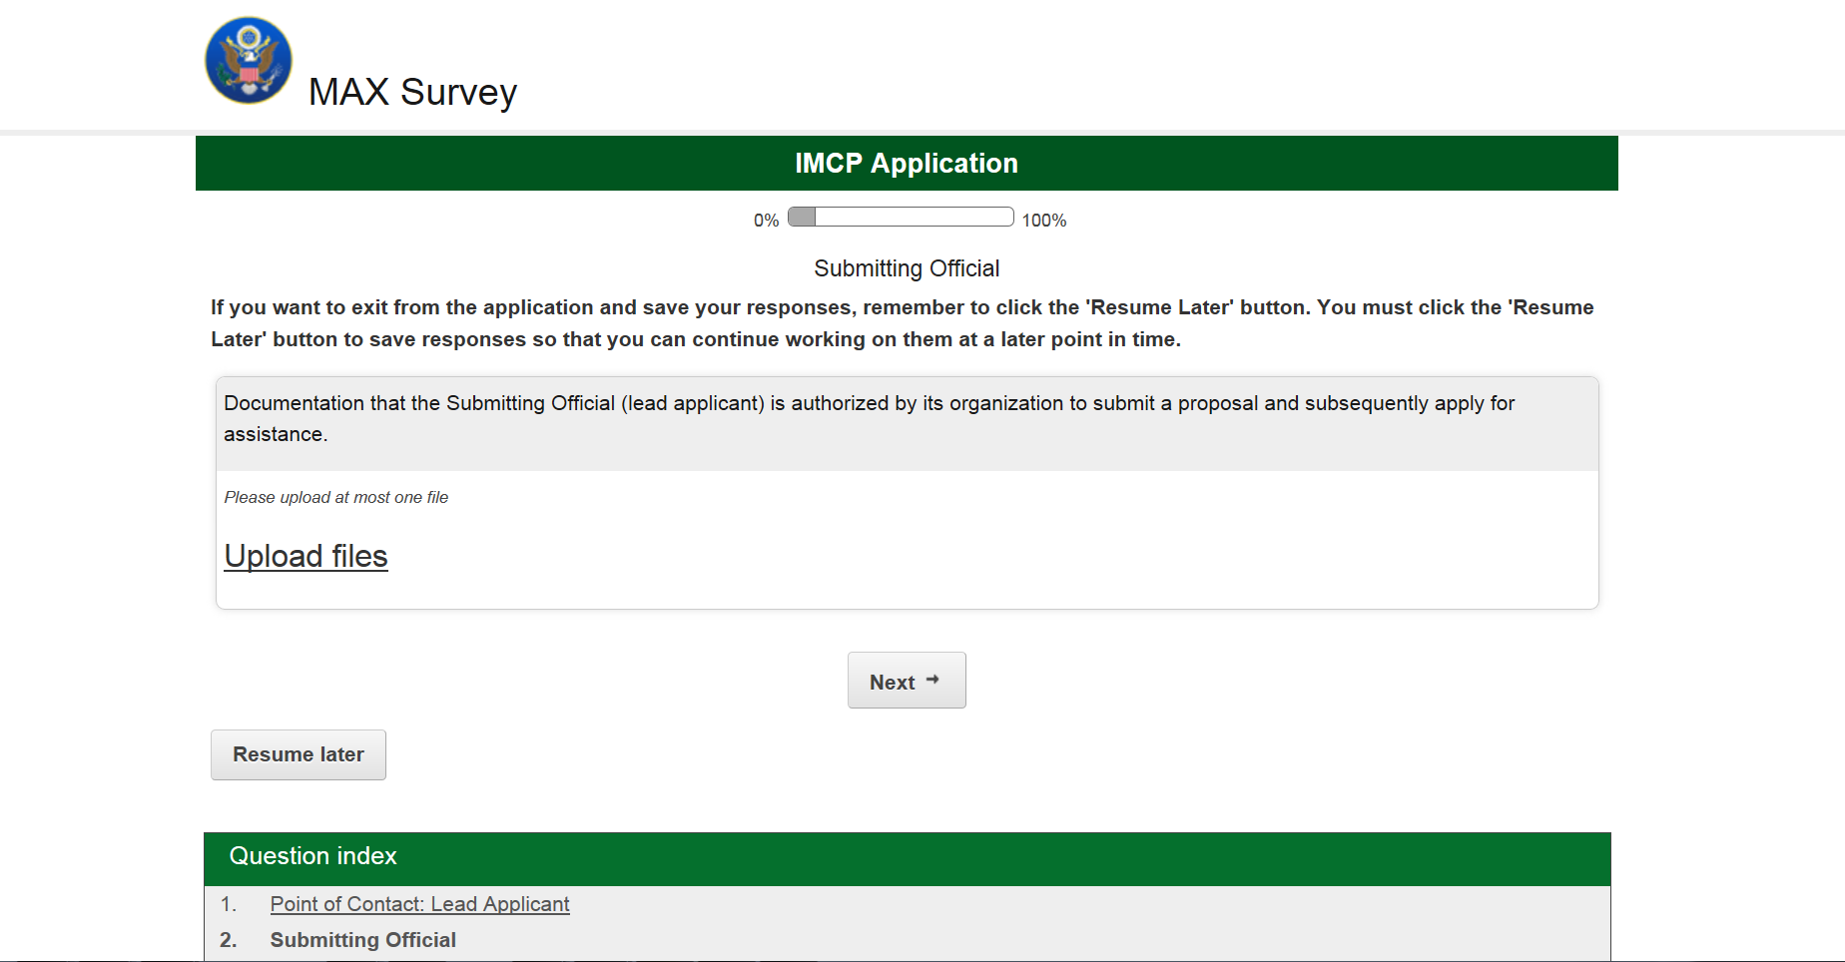
Section 2: Submitting Official (1 of 1)

Slide 26
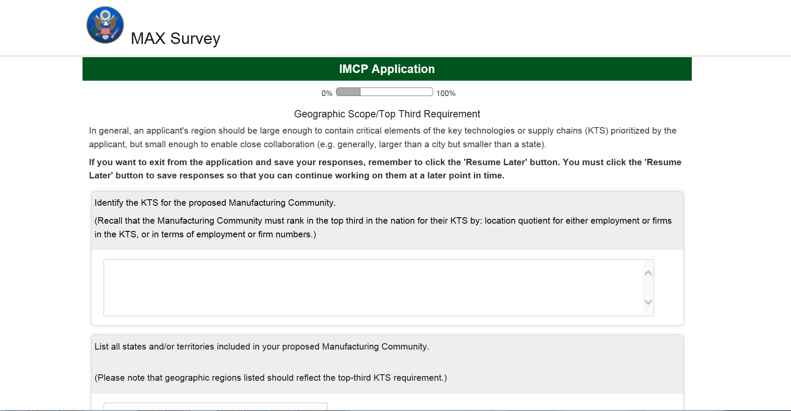
Section 3: Geographic Scope/ Top Third Requirement (1 of 3)

Slide 27
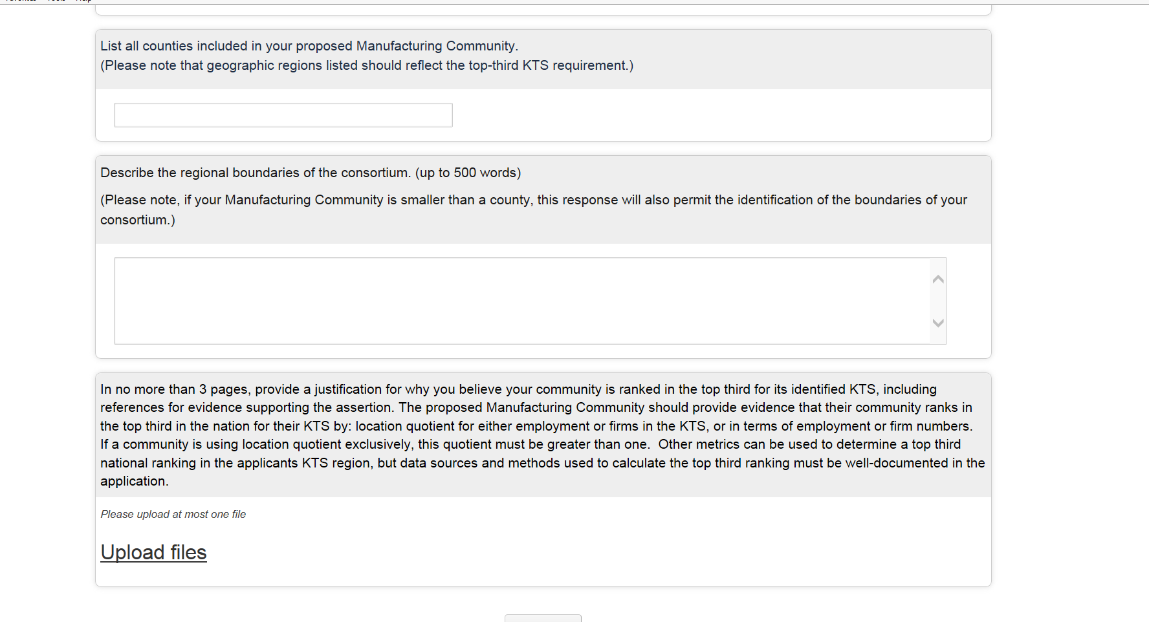
Section 3: Geographic Scope/ Top Third Requirement (2 of 3)

Slide 28
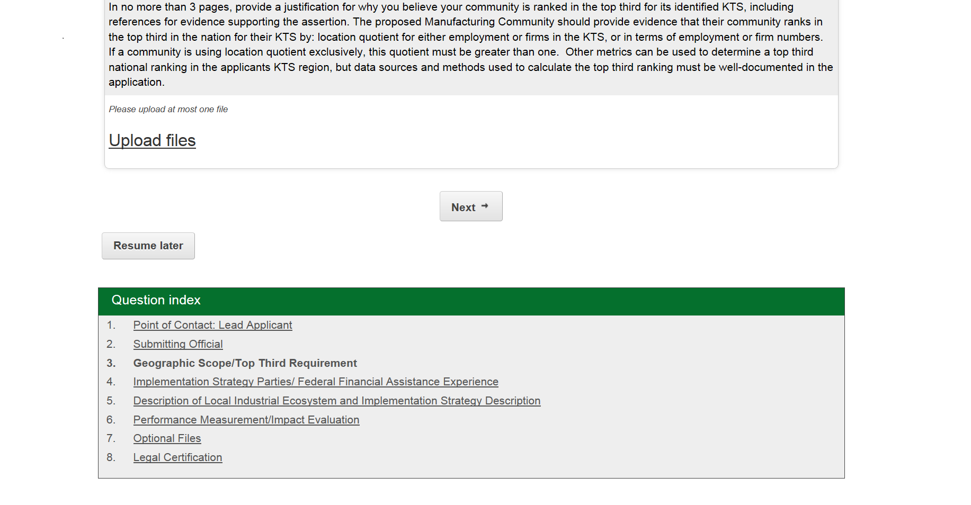
Section 3: Geographic Scope/ Top Third Requirement (3 of 3)

Slide 29
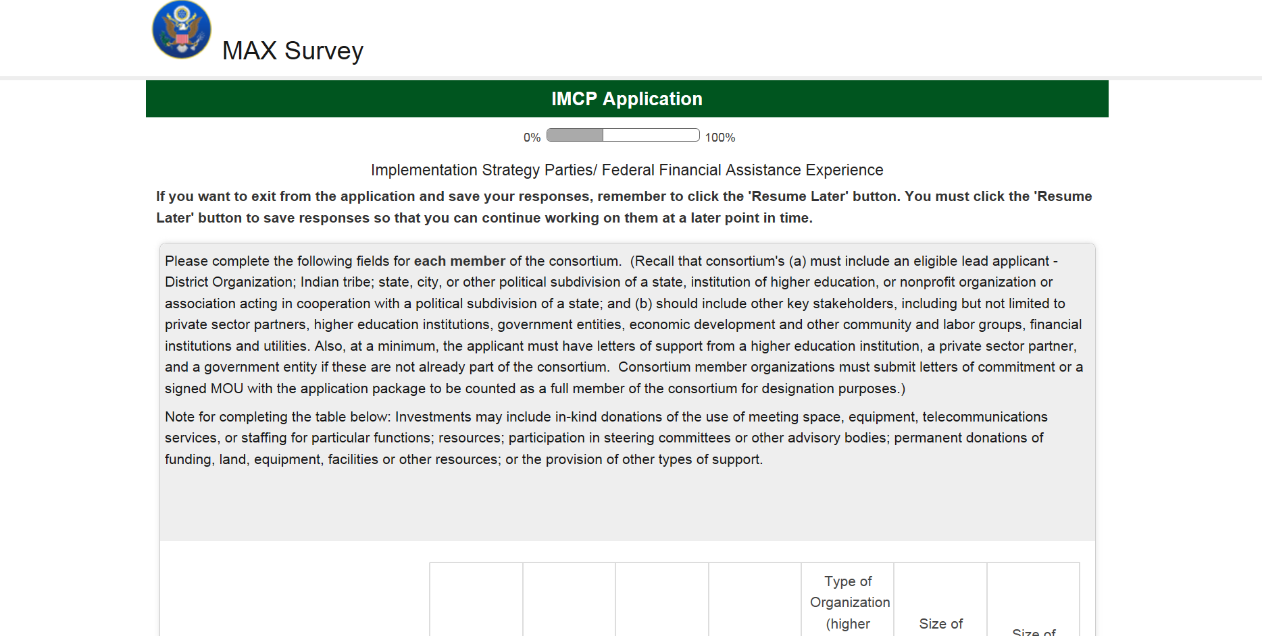
Section 4: Implementation Strategy Parties / Federal Financial Assistance Experience (1 of 3)

Slide 30
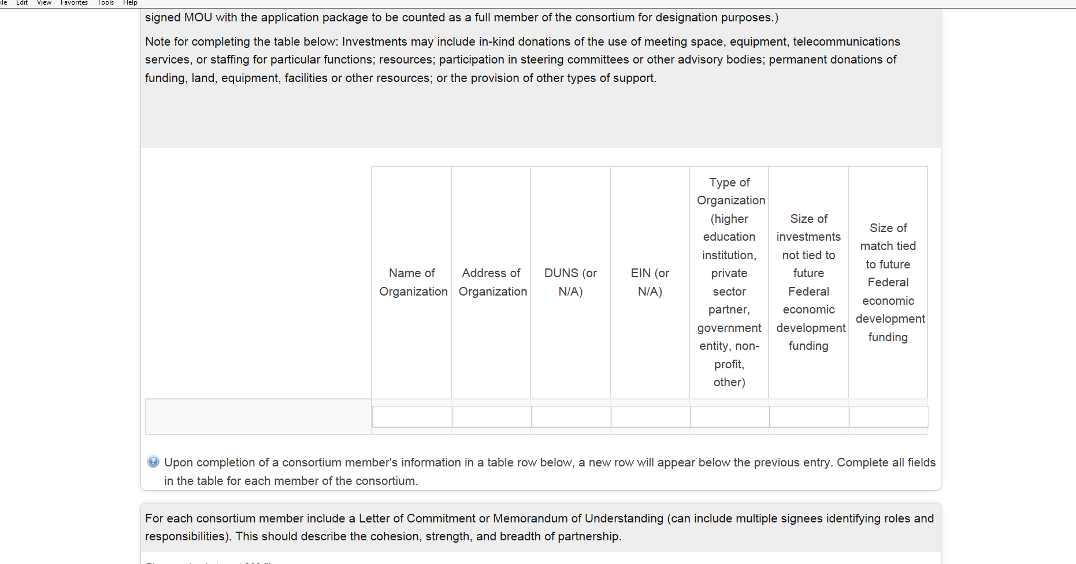
Section 4: Implementation Strategy Parties / Federal Financial Assistance Experience (2 of 3)

Slide 31
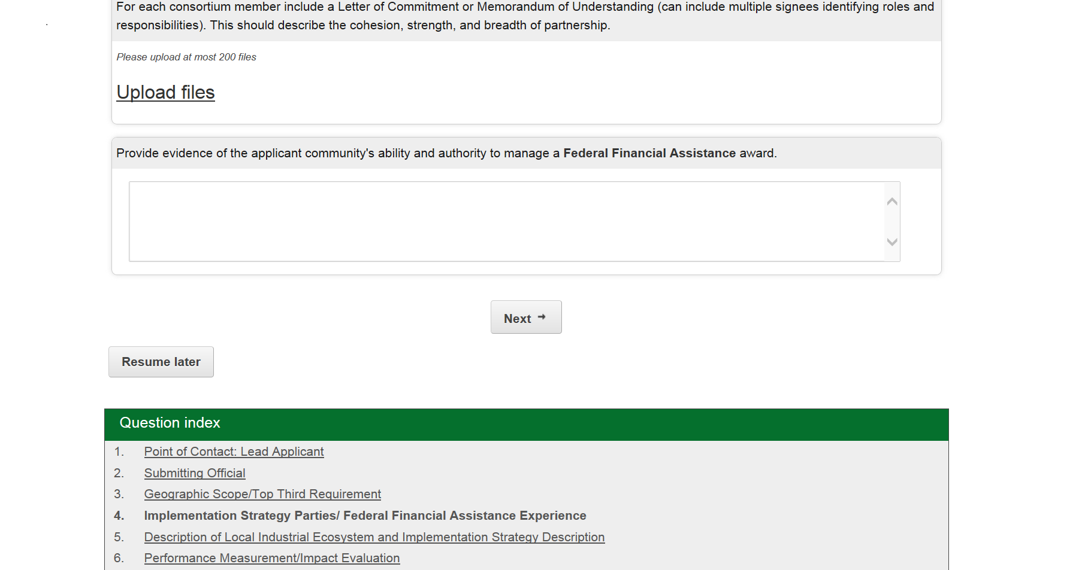
Section 4: Implementation Strategy Parties / Federal Financial Assistance Experience (3 of 3)

Slide 32
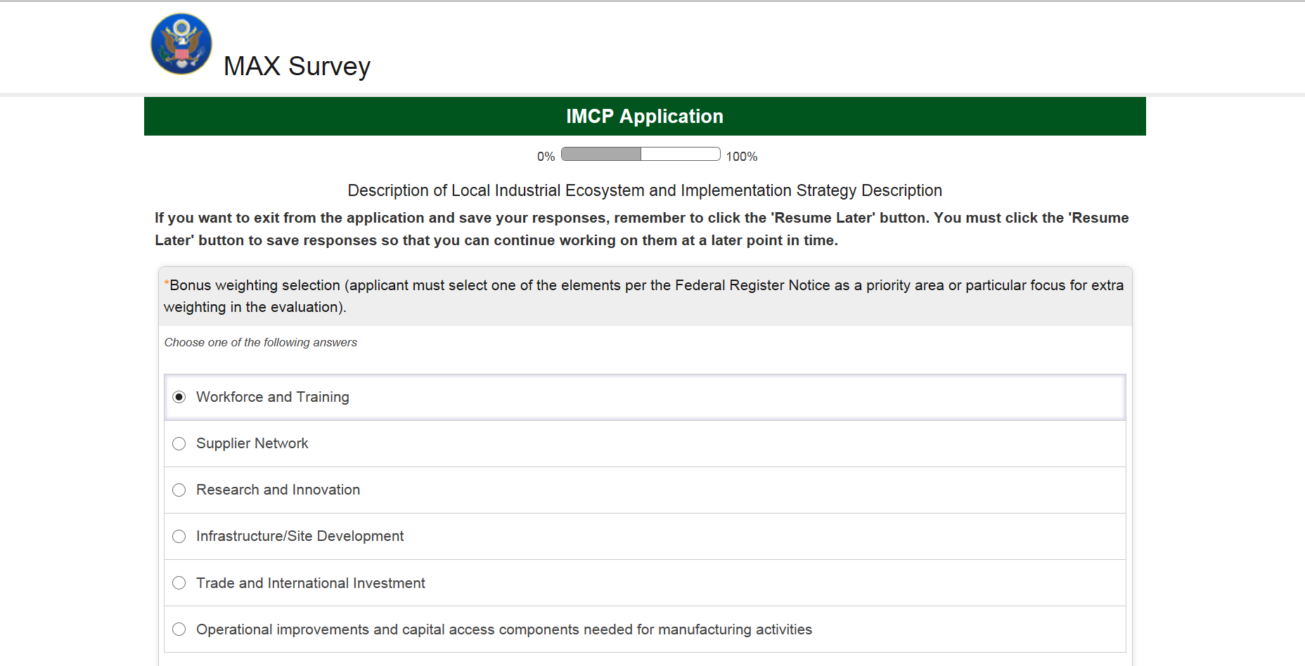
Section 5: Description of Local Industrial Ecosystem and Implementation Strategy Description (1 of 2)

Slide 33
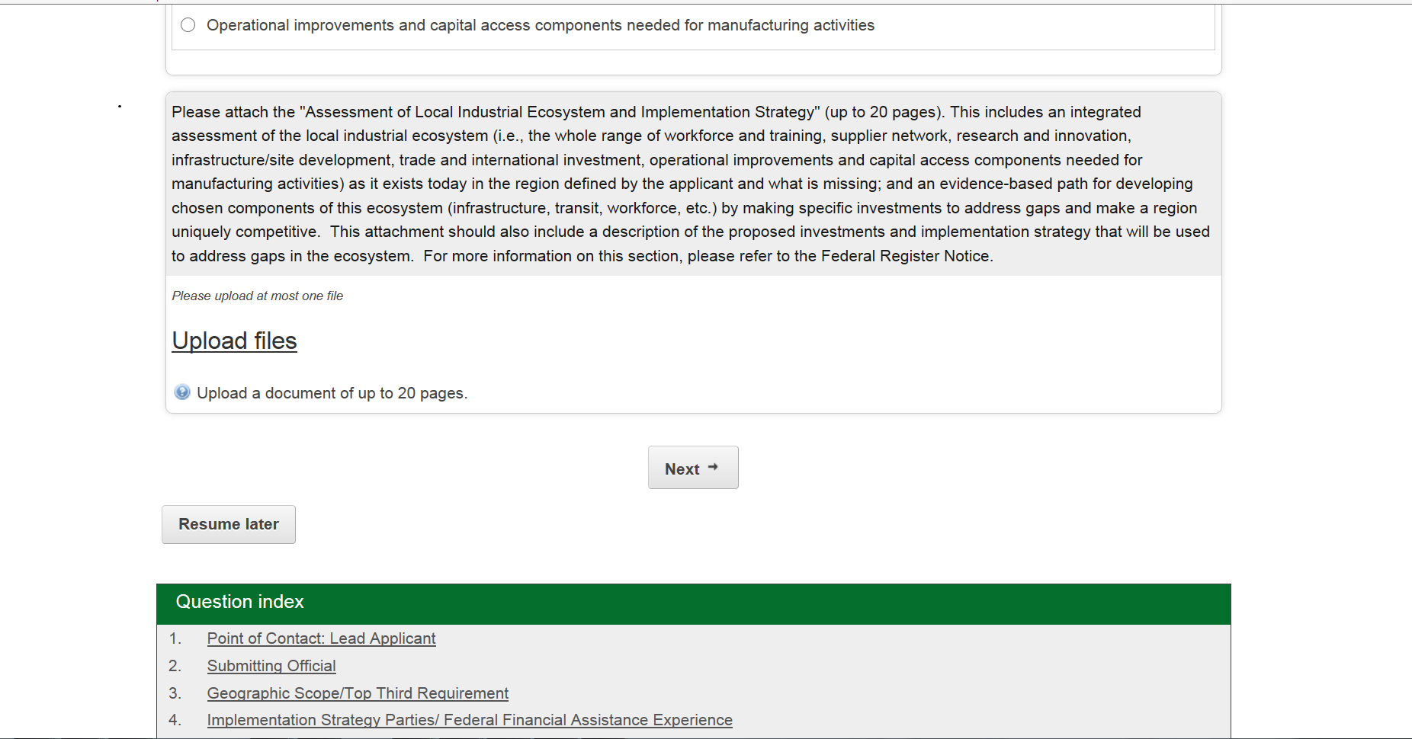
Section 5: Description of Local Industrial Ecosystem and Implementation Strategy Description (2 of 2)

Slide 34
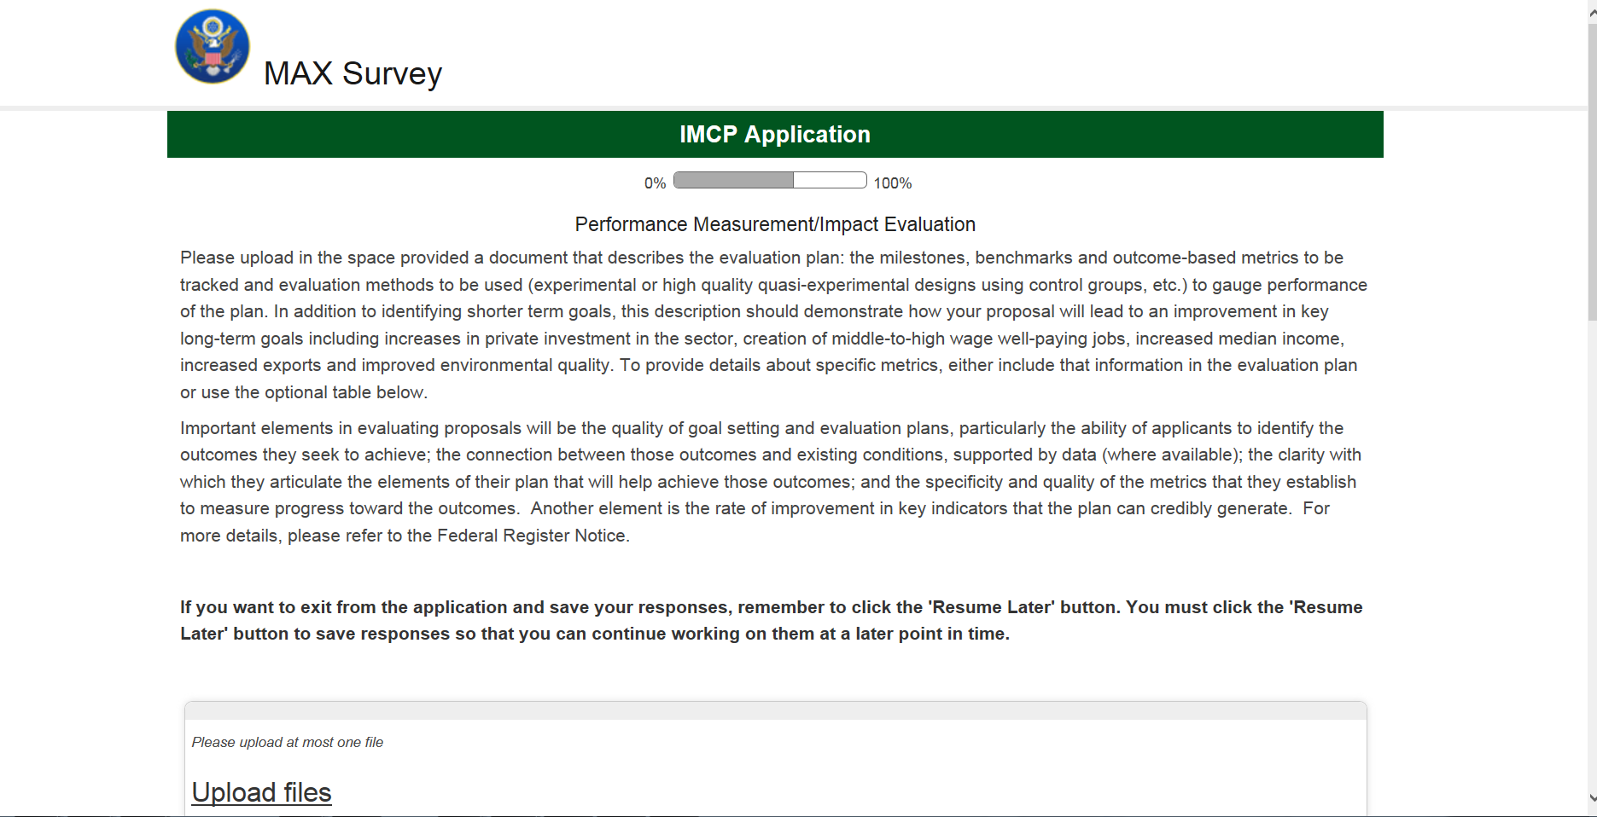
Section 6: Performance Measurement/ Impact Evaluation (1 of 2)

Slide 35
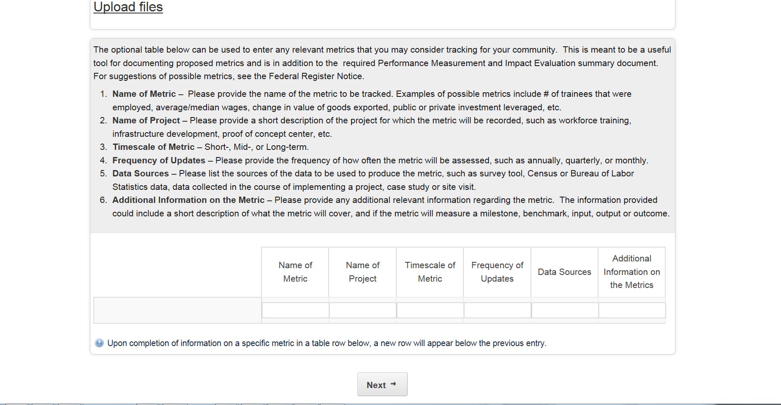
Section 6: Performance Measurement/ Impact Evaluation (2 of 2)

Slide 36
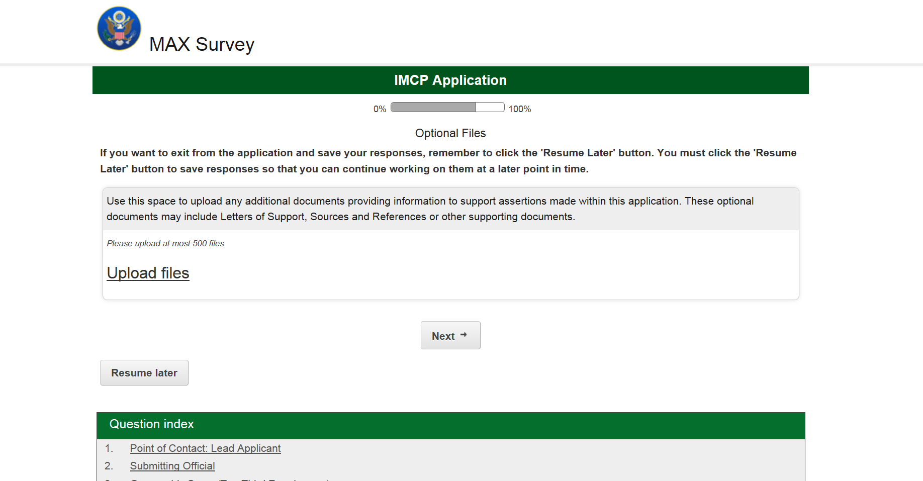
Section 7: Optional Files (1 of 1)

Slide 37
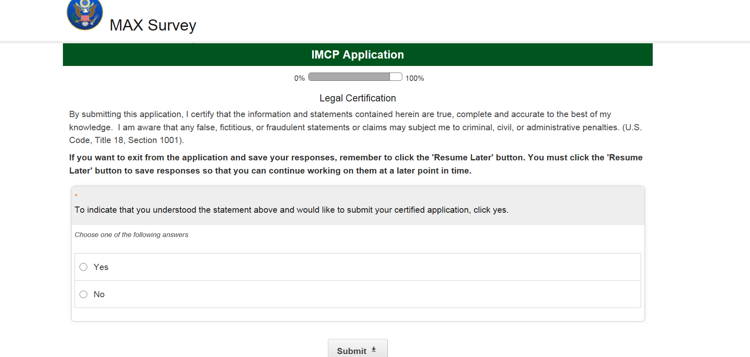
Section 8: Legal Certification (1 of 1)

