Slide 1
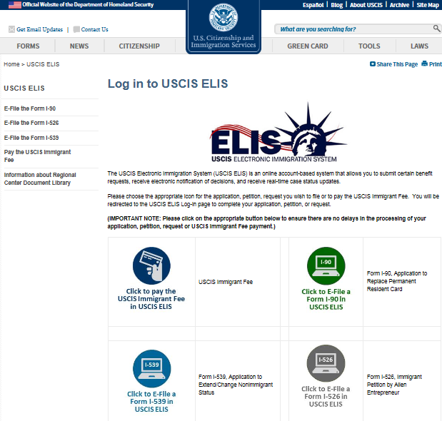

Slide 2
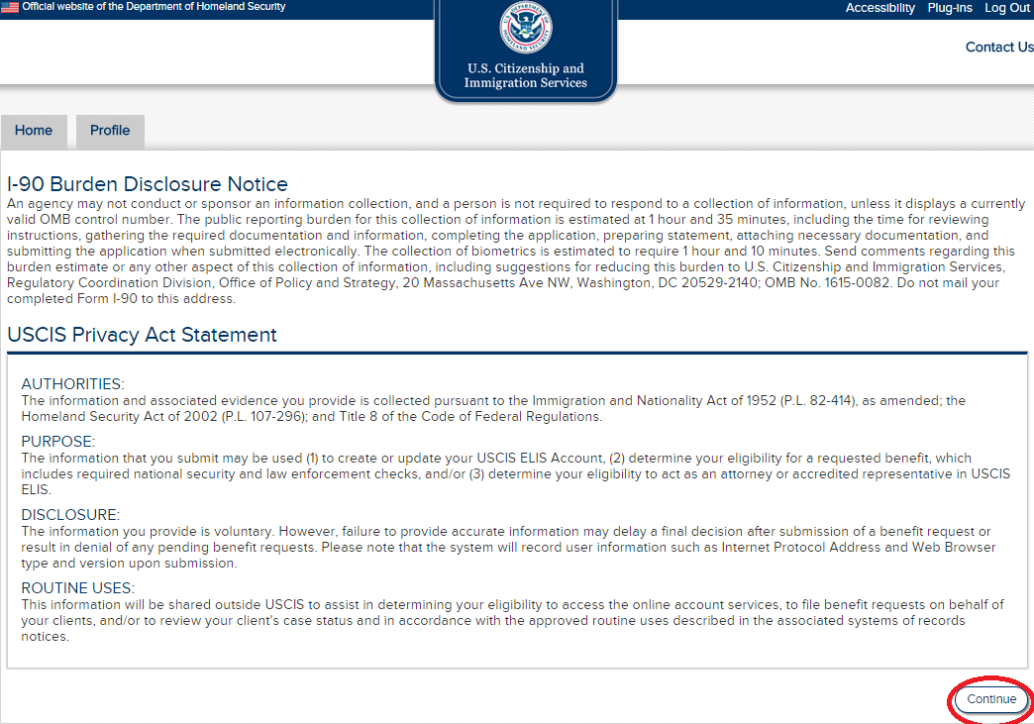
Burden Disclosure Notice
An agency may not conduct or sponsor an information collection, and a person is not required to respond to a collection of information, unless it displays a currently valid OMB control number. The public reporting burden for this collection of information is estimated at .167 hour or 5 minutes per response, including the time for reviewing instructions and completing and submitting the authorization. Send comments regarding this burden estimate or any other aspect of this collection of information, including suggestions for reducing this burden, to: U.S. Citizenship and Immigration Services, Regulatory Coordination Division, Office of Policy and Strategy, 20 Massachusetts Ave, NW, Washington, DC 20529-2140; OMB No. 1615-NEW. Do not mail your completed form to this address.
USCIS Immigrant Fee
AUTHORITIES: 8 CFR §103.7(b) 1(i) and (D) authorize the collection of this information.
PURPOSE: The primary purpose for providing the requested information is to authorize an electronic credit card or Automated Clearing House (ACH) payment in Pay.gov, which is owned and operated by the Department of Treasury, for the filing fees associated with a benefit request form.
DISCLOSURE: The information you provide is voluntary. However, failure to make a payment towards the associated benefit request fee may delay or prevent USCIS from accepting your benefit request form.
ROUTINE USES: This information may be used by and disclosed to USCIS personnel and contractors or other agents who need the information to assist in activities related to processing your filing fees. Additionally, USCIS may disclose the information to other federal, state, and local authorized organizations in accordance with approved routine uses, as described in the associated published system of records notice [TREASURY/FMS.017 – Collections Records – Treasury/Financial Management Service, which can be found at http://www.treasury.gov/privacy, and DHS-USCIS-007 – Benefits Information System, available at www.dhs.gov/privacy]. The information may also be made available as appropriate for law enforcement purposes or in the interest of national security.

Slide 3
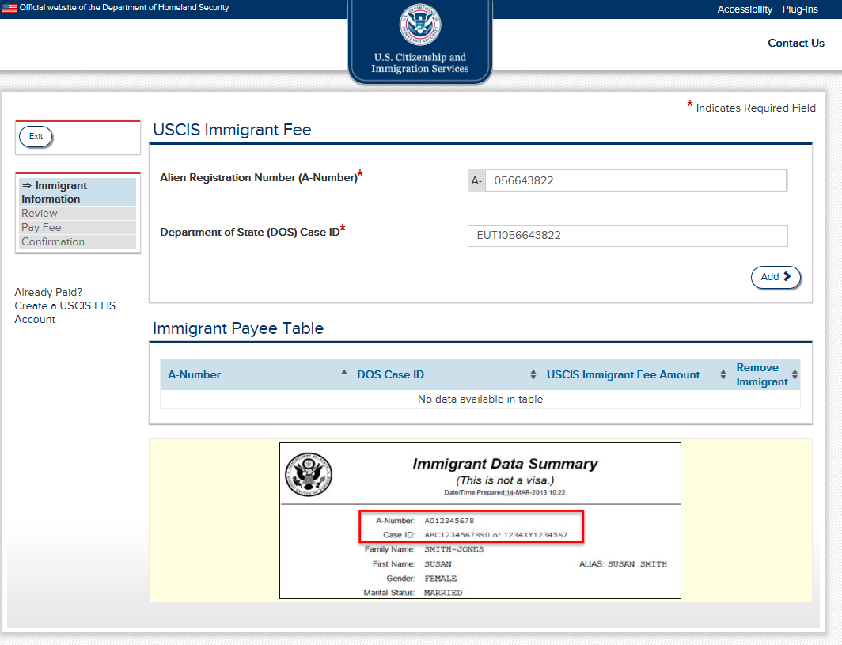
OMB No. 1615-NEW
Expires 07/31/2015
*Indicates Required Field
Notes:
3 A number and DOS Case ID

Slide 4
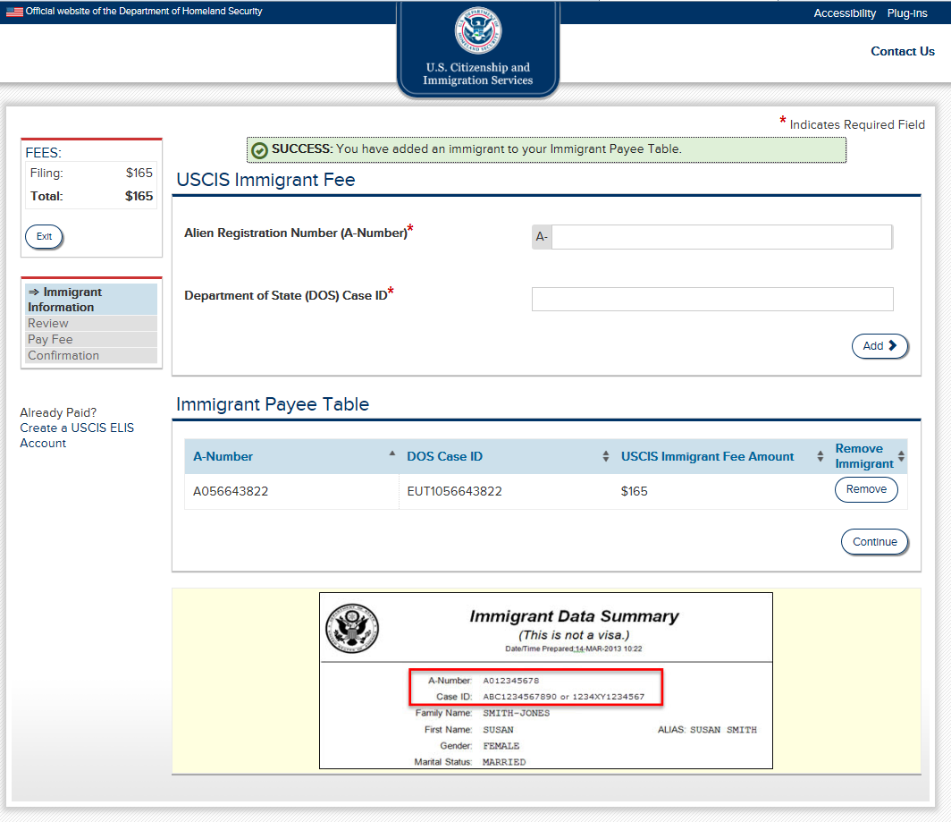

Slide 5
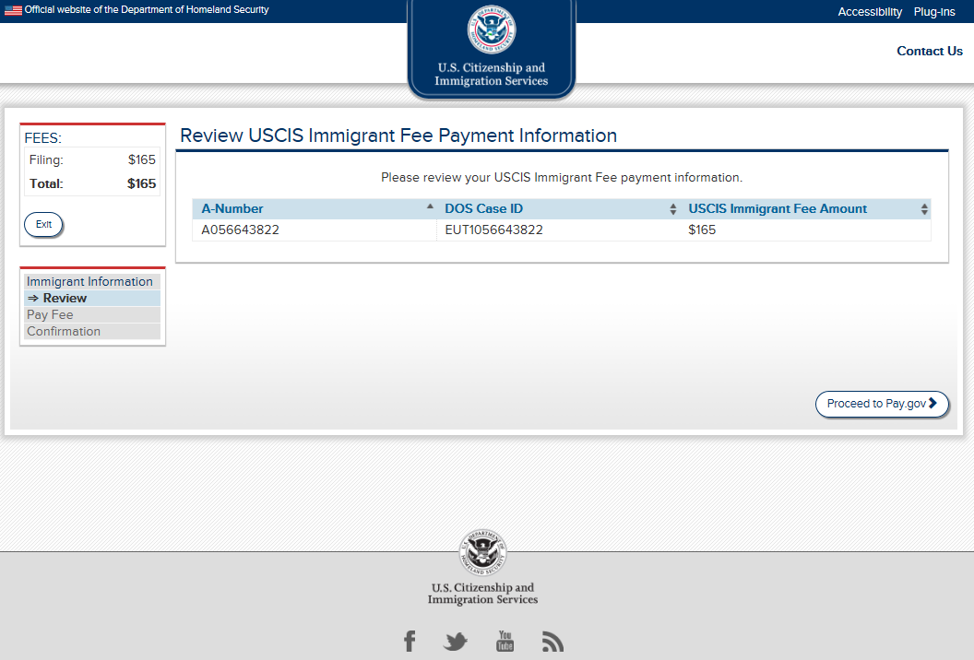
Notes:
4 Review Imm Fee Pmt Info

Slide 6
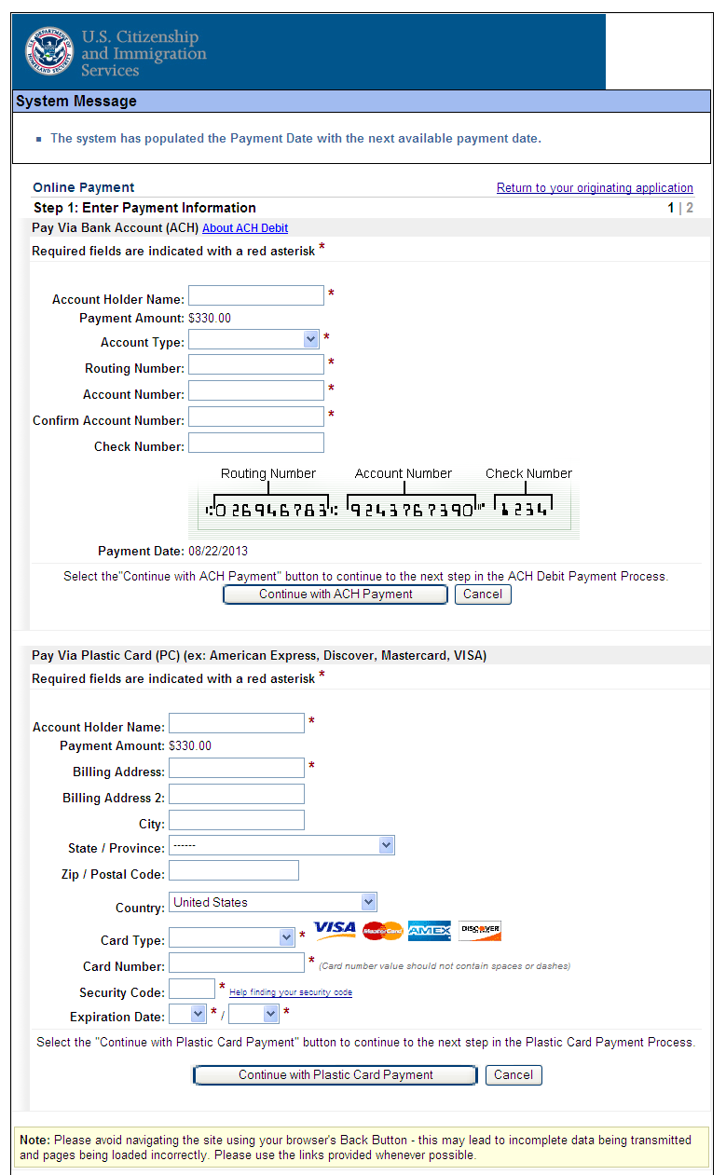

Slide 7
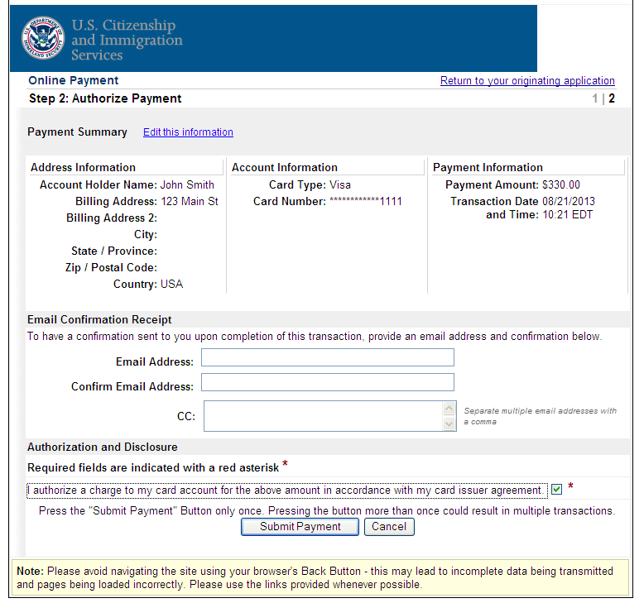

Slide 8
