Slide 1
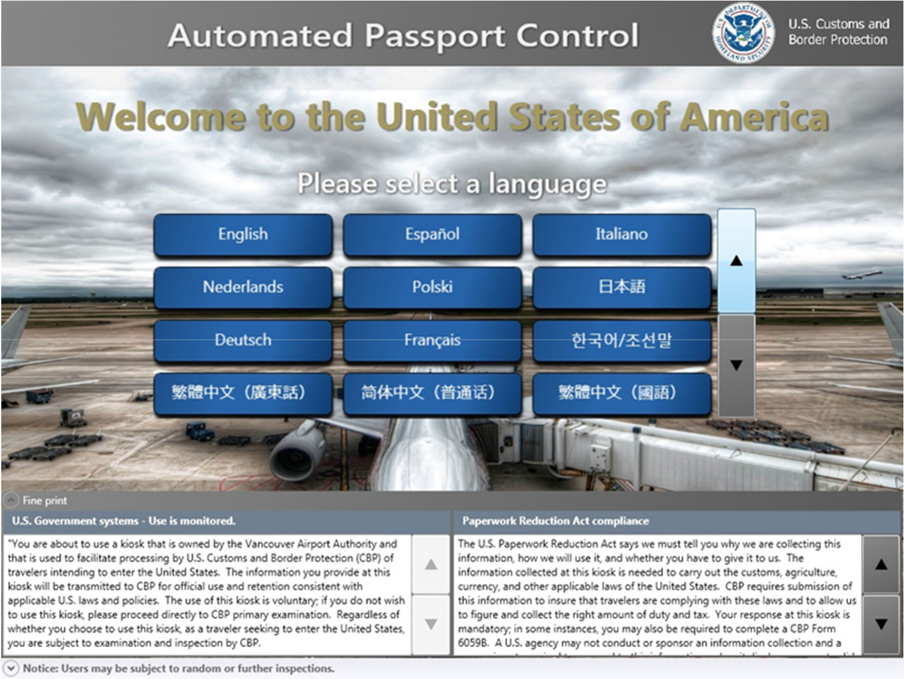
Kiosk Transaction
WELCOME
Traveler approaches an available kiosk
Traveler selects a language

Slide 2
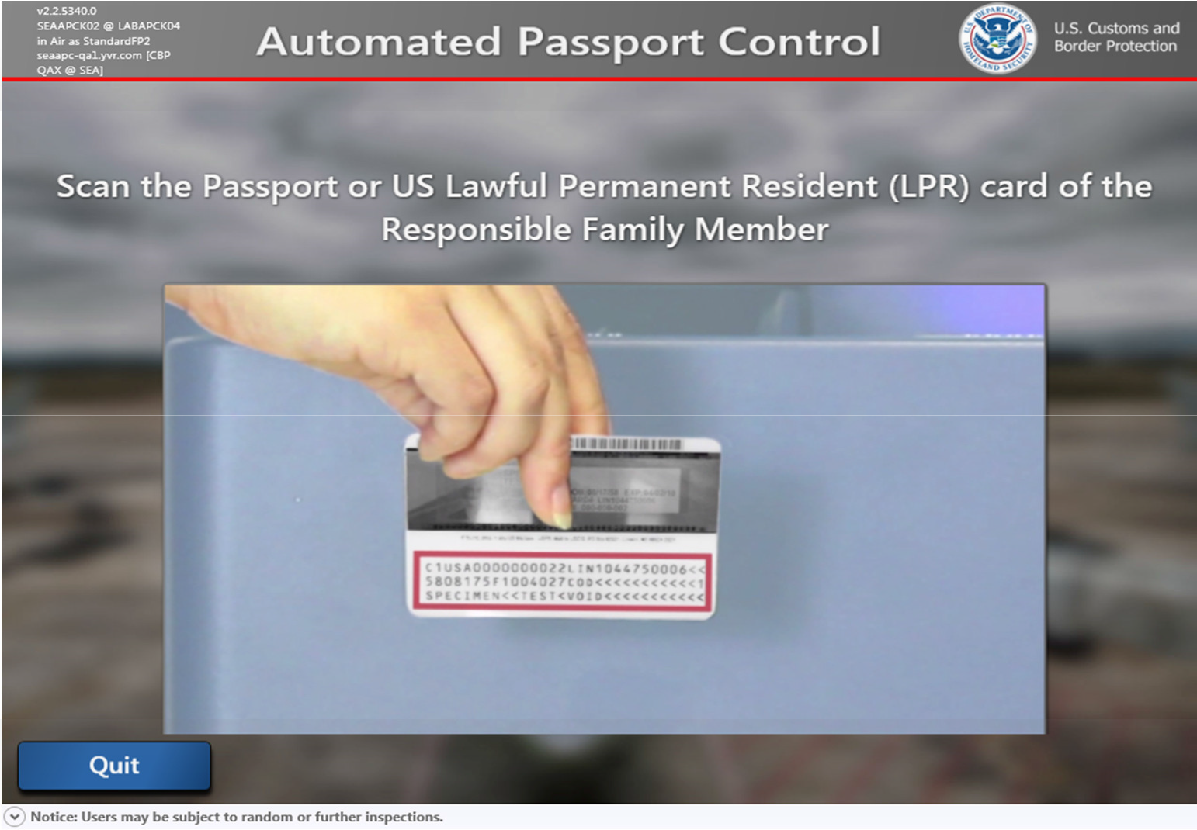
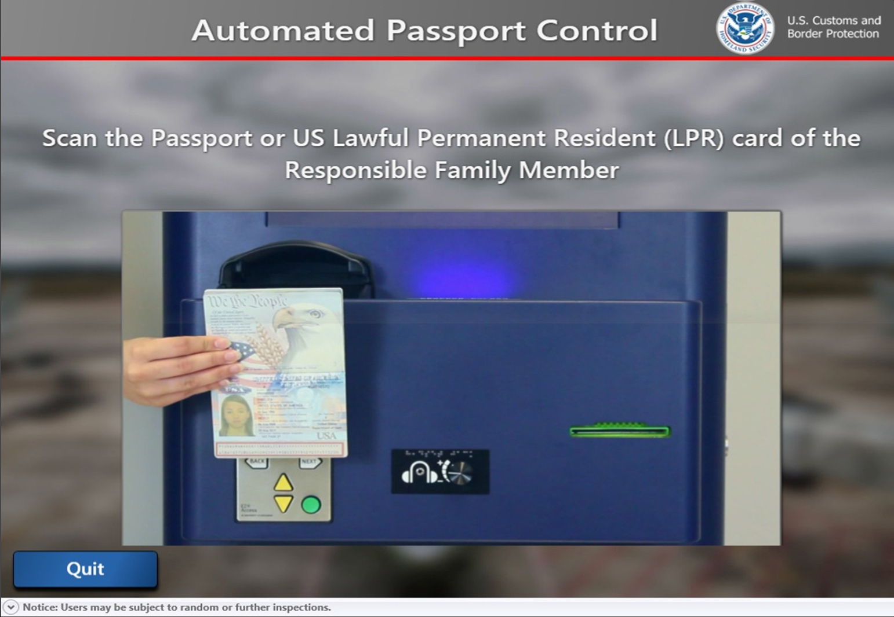
Kiosk Transaction:
Travel Documents
Primary traveler inserts their travel document (US, CDN or VWP Passport or US LPR) into the scanner

Slide 3
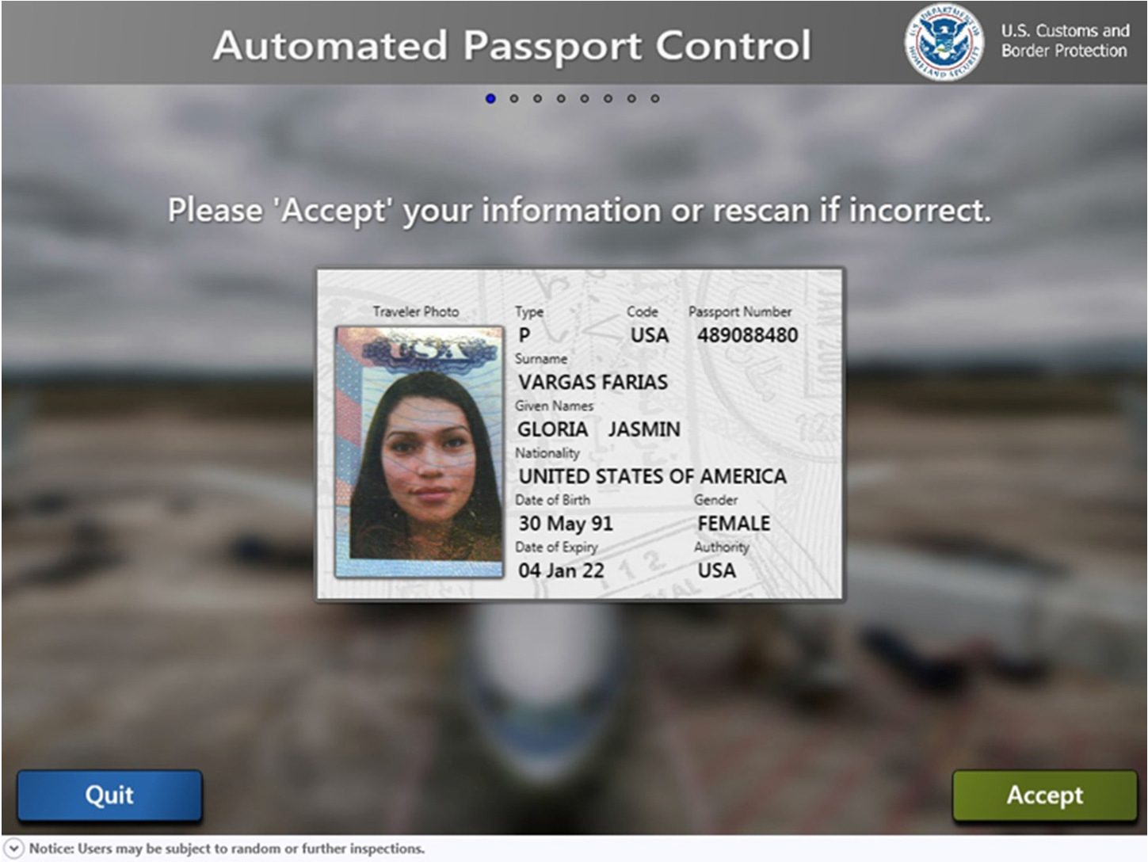
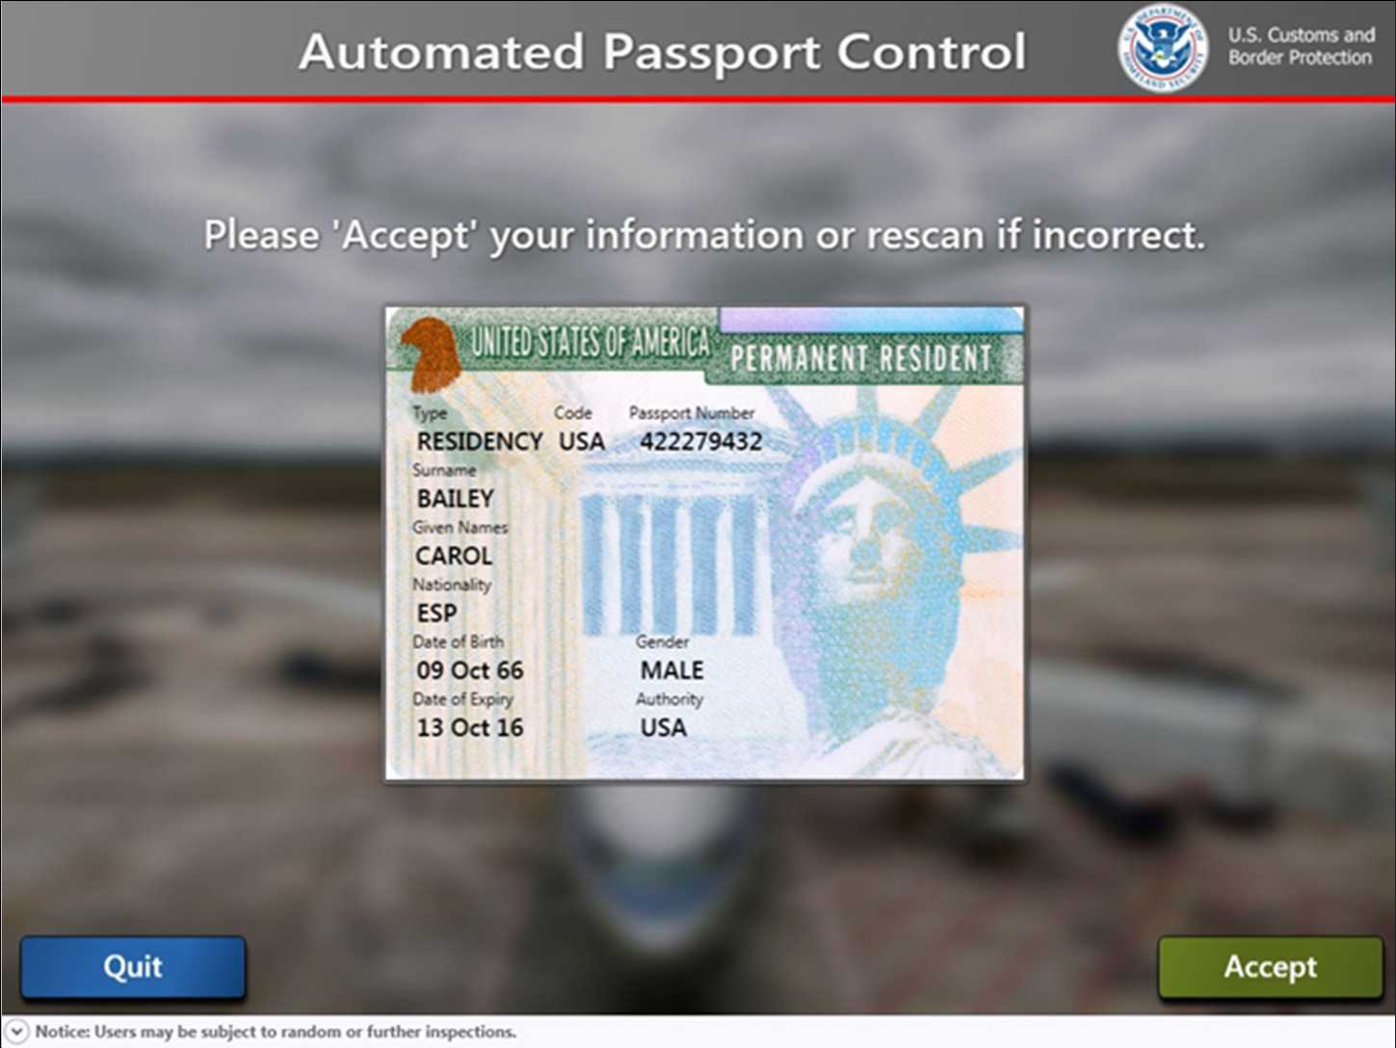
Kiosk Transaction:
Travel Documents
Primary traveler to confirm information.
If incorrect, passenger to rescan travel document.

Slide 4
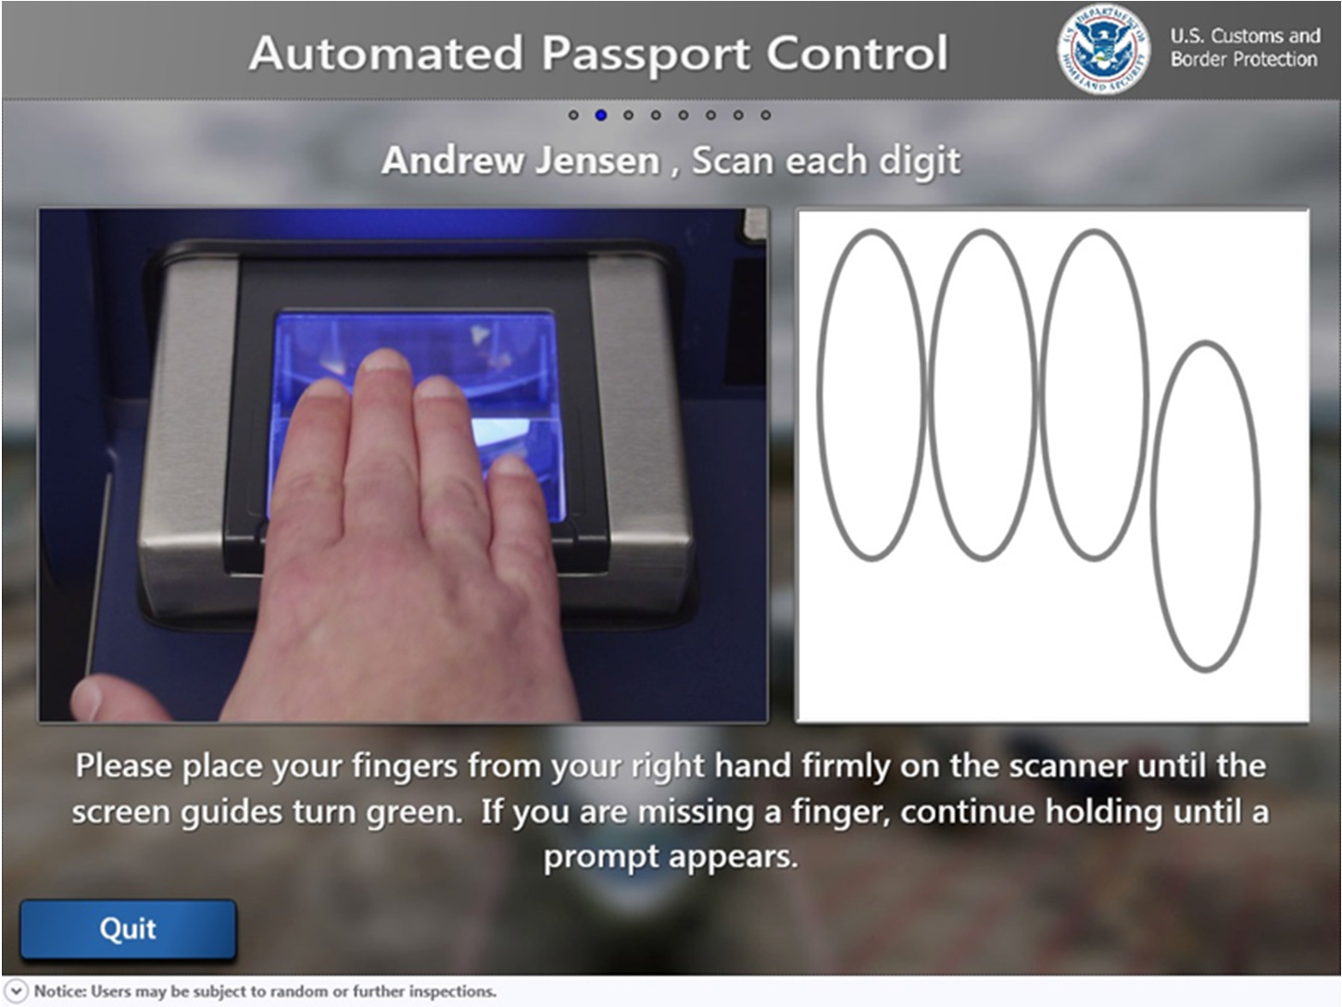
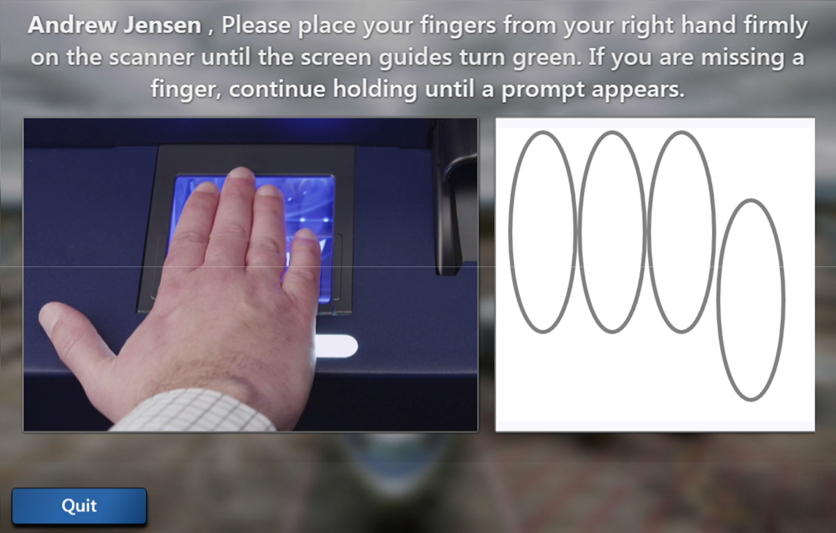
Kiosk Transaction:
Fingerprints if US LPR or VWP with ESTA between 14 – 79 years of age
Traveler to place right hand on scanner.
If unable to capture prints, screen will advise to try again or use left hand.

Slide 5
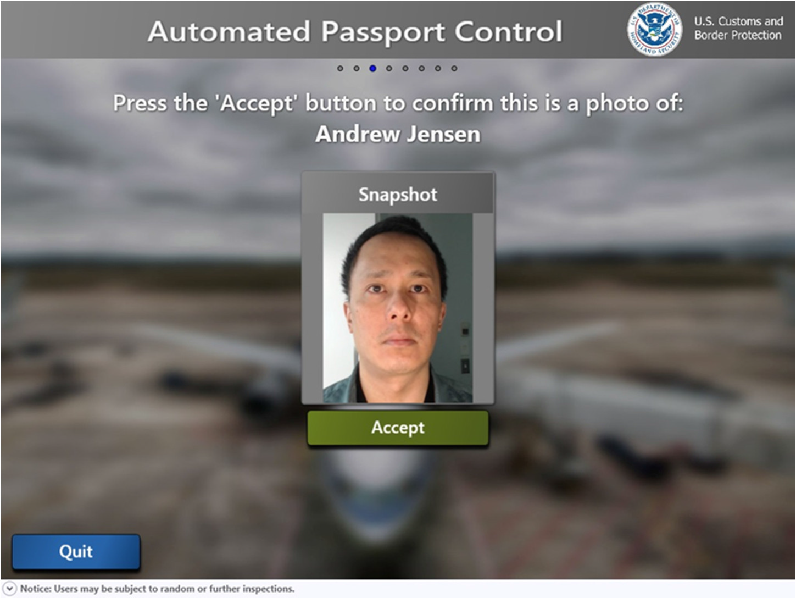
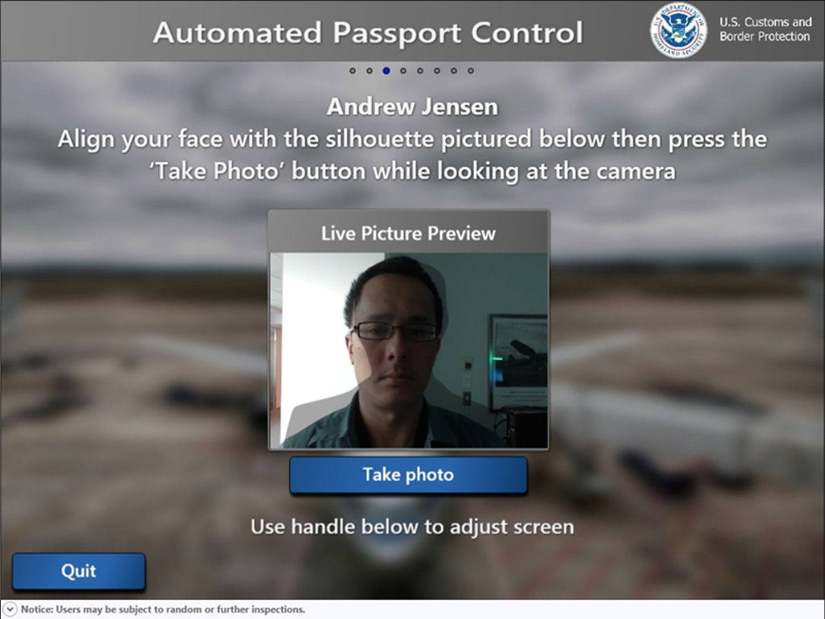

Kiosk Transaction:
Photo
Traveler to have photo taken.
Traveler accepts photo.

Slide 6
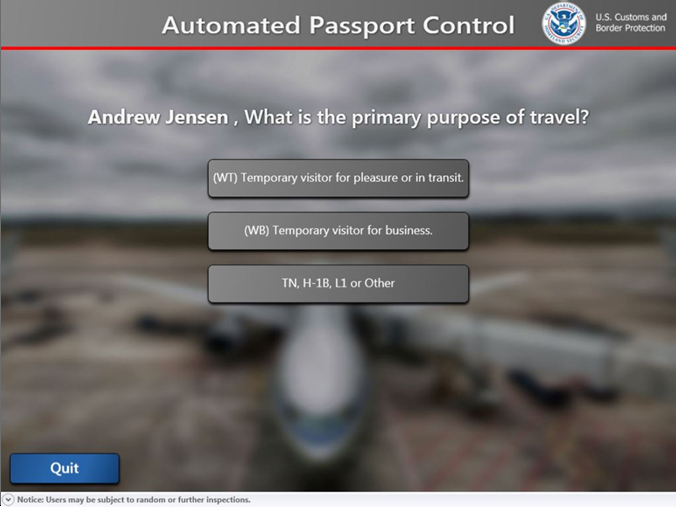
CDN and ESTA VWP Passport holders will be required to answer what their purpose of travel is.
Kiosk Transaction:
(Travel Purpose for CDN and VWP Passport Holders Only)

Slide 7
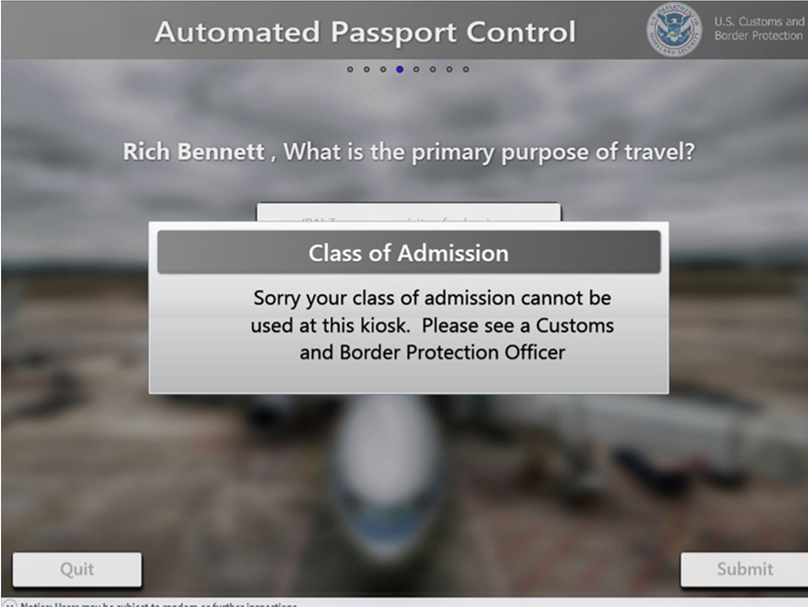
Kiosk Transaction:
(For Canadian and VWP Passport Holders Only)
If “Other” is selected, transaction ends.
User to report to CBP Triage Officer.

Slide 8
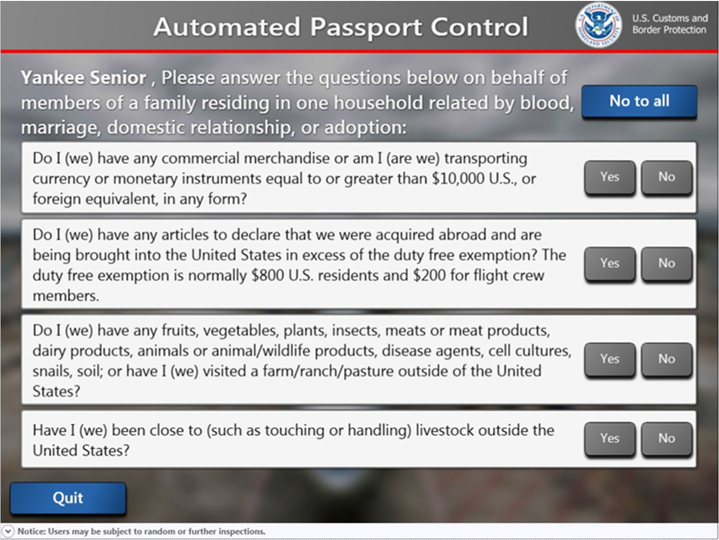
Kiosk Transaction:
Declaration
A written declaration card not required.
Primary traveler to answer questions followed by depressing “Submit”.

Slide 9
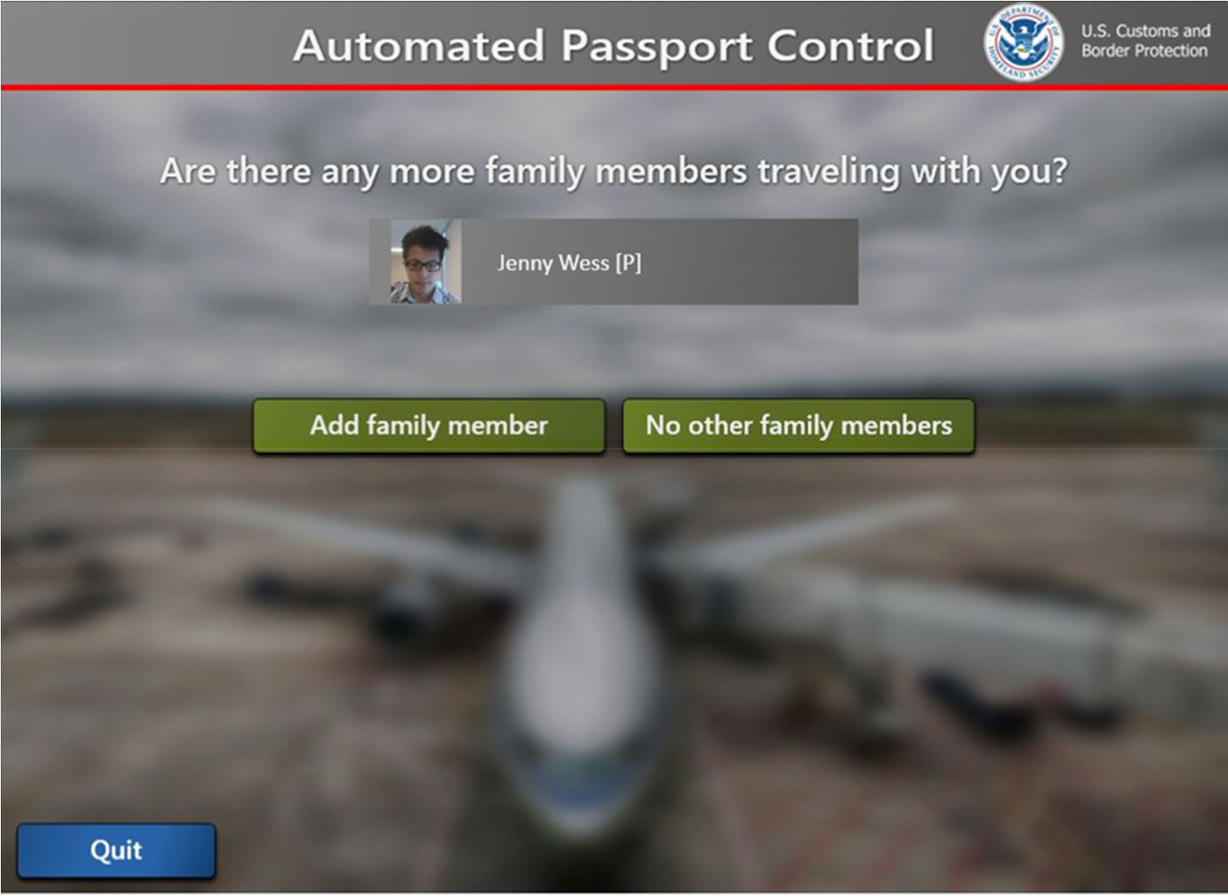
Kiosk Transaction:
Single or Multiple in Travel Party?
If single party, passengers depresses “No other family members”.
If multiple passengers, depress “Add family member” & repeat above steps.

Slide 10
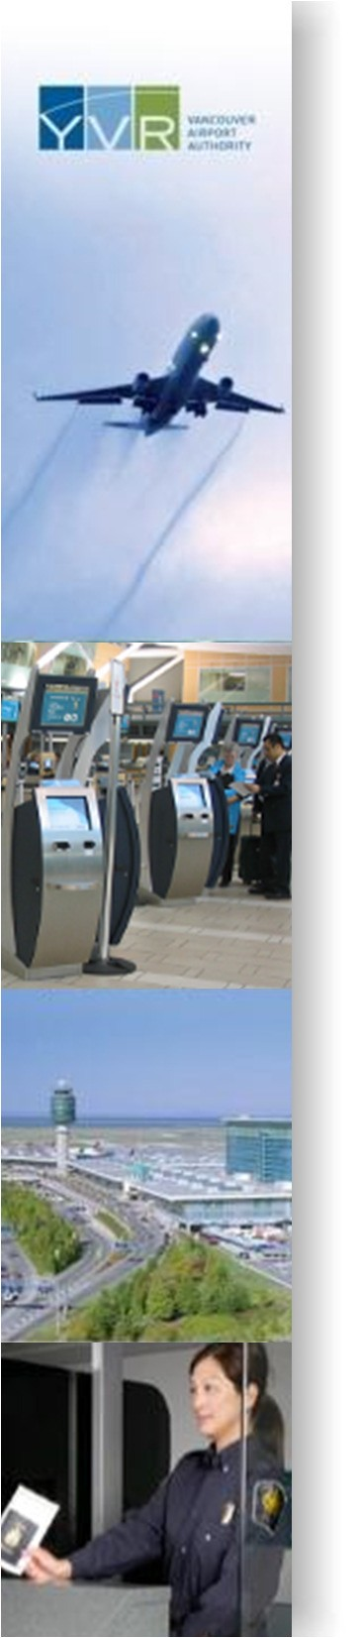
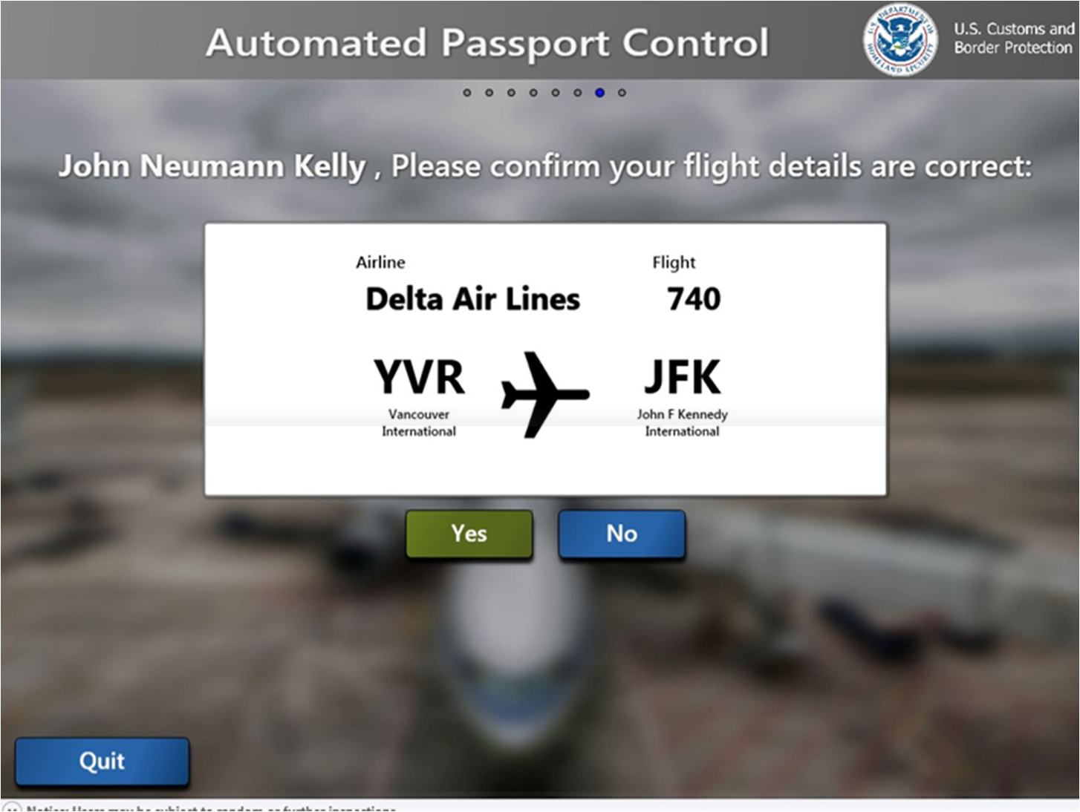
Kiosk Transaction:
Flight Confirmation
Primary traveler to confirm flight information.
If correct, depress “Yes”

Slide 11
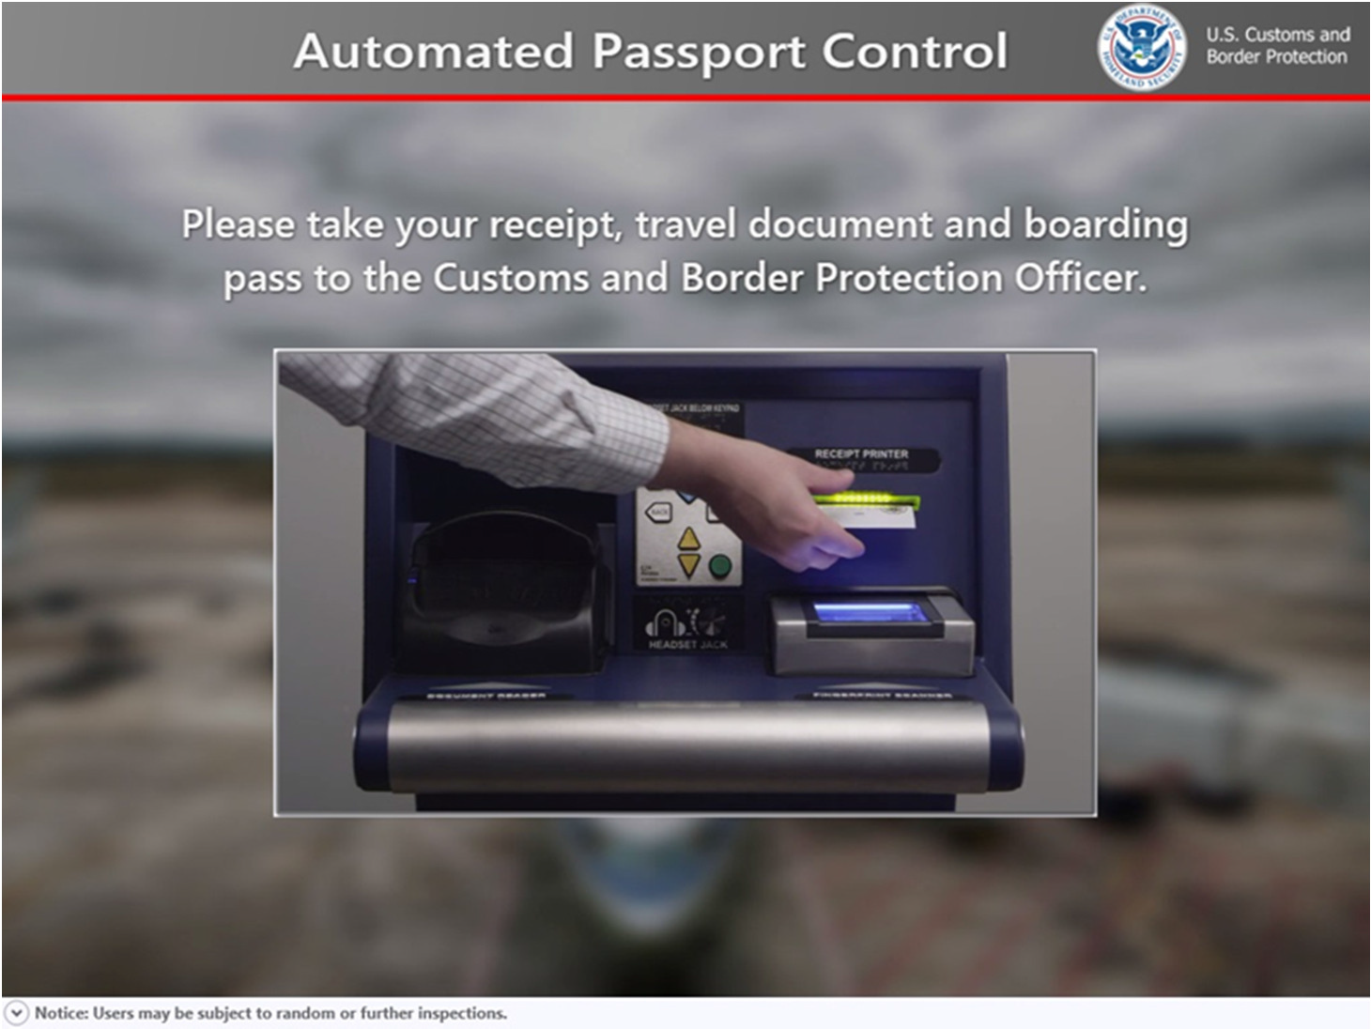
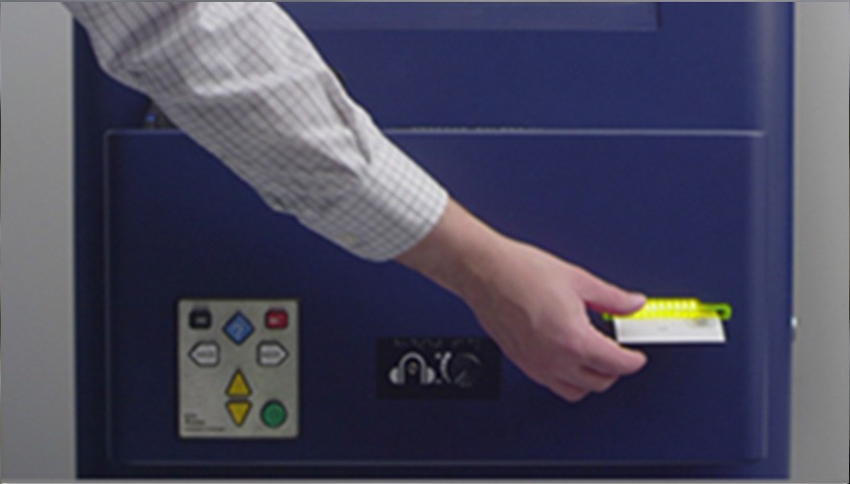
Kiosk Transaction:
Transaction Complete
Primary traveler to take receipt.
Passenger(s) proceed to CBP with passport and receipt.

