Slide 1
Customer Satisfaction Survey
NSSC Customer Contact Center (CCC)

Slide 2
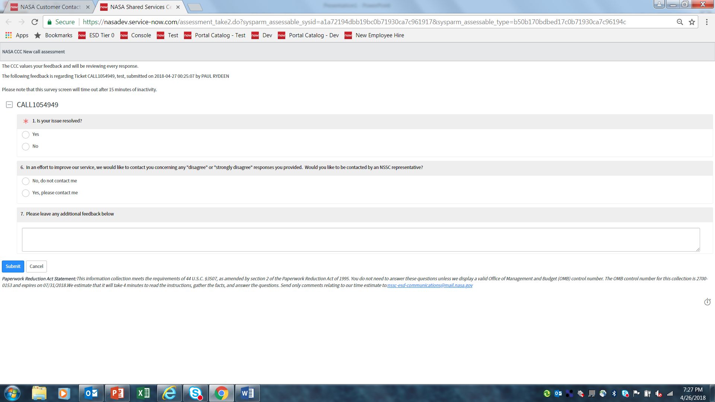

Slide 3
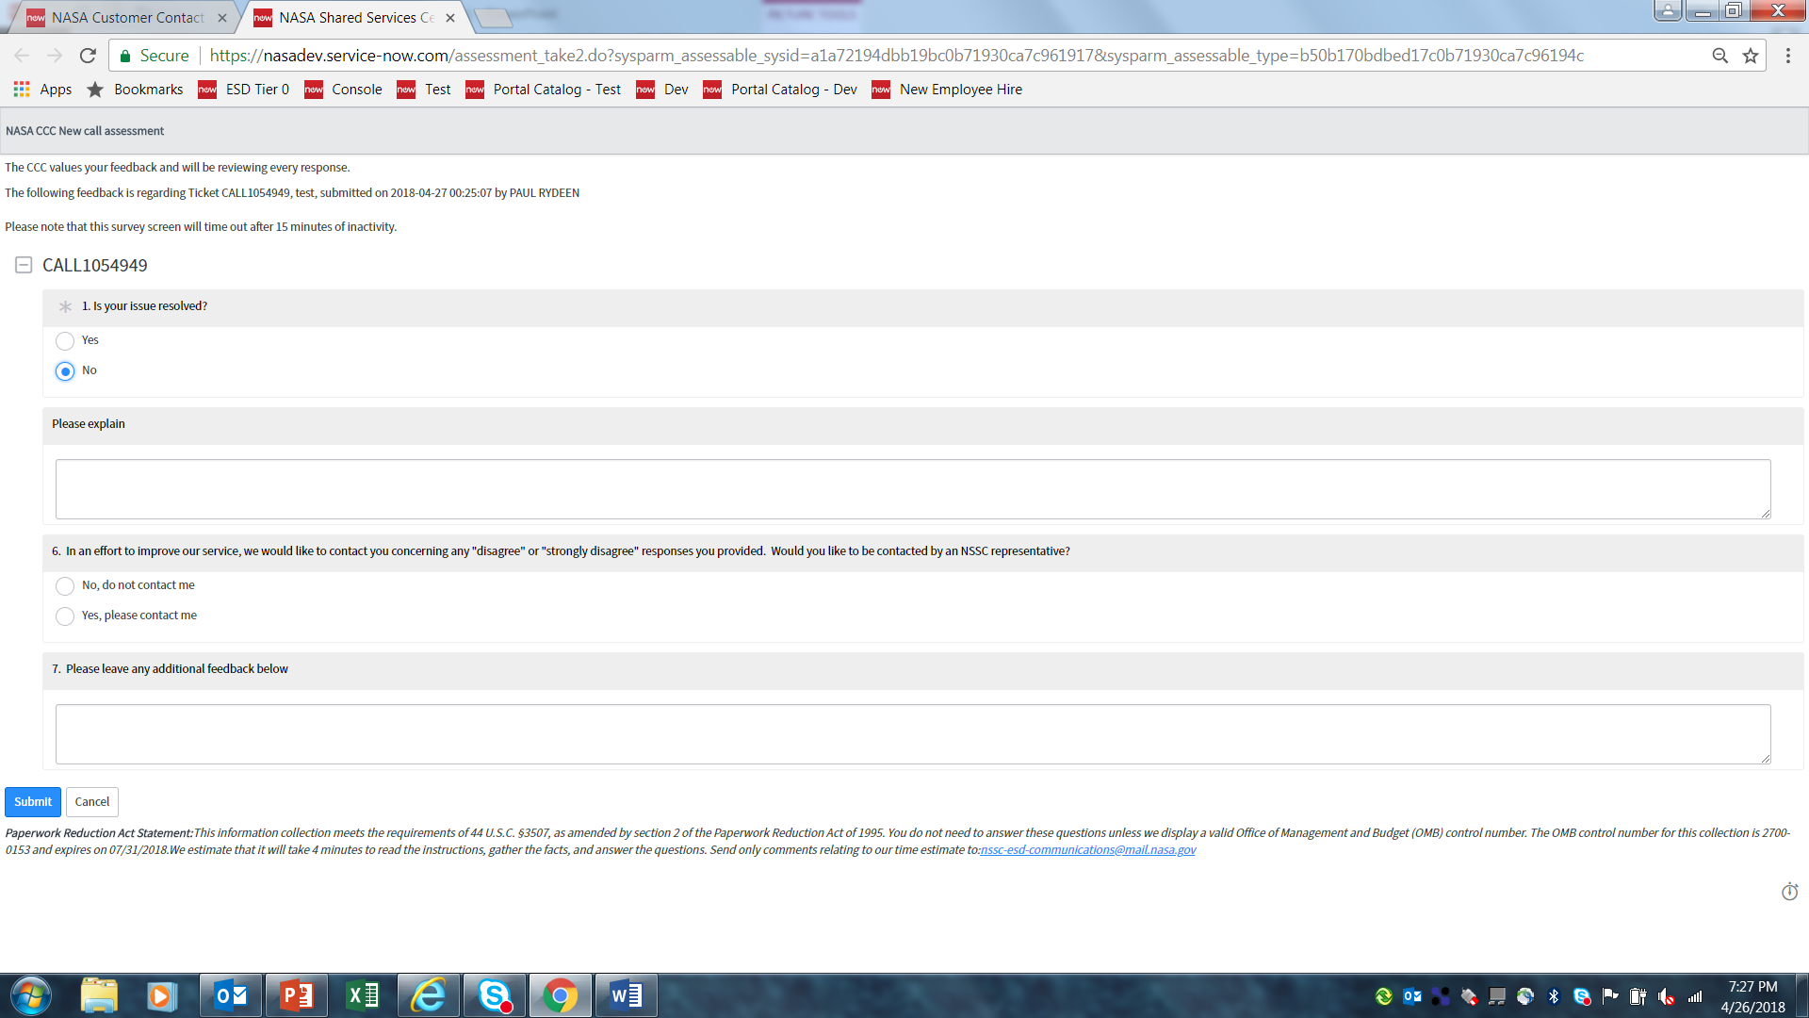

Slide 4
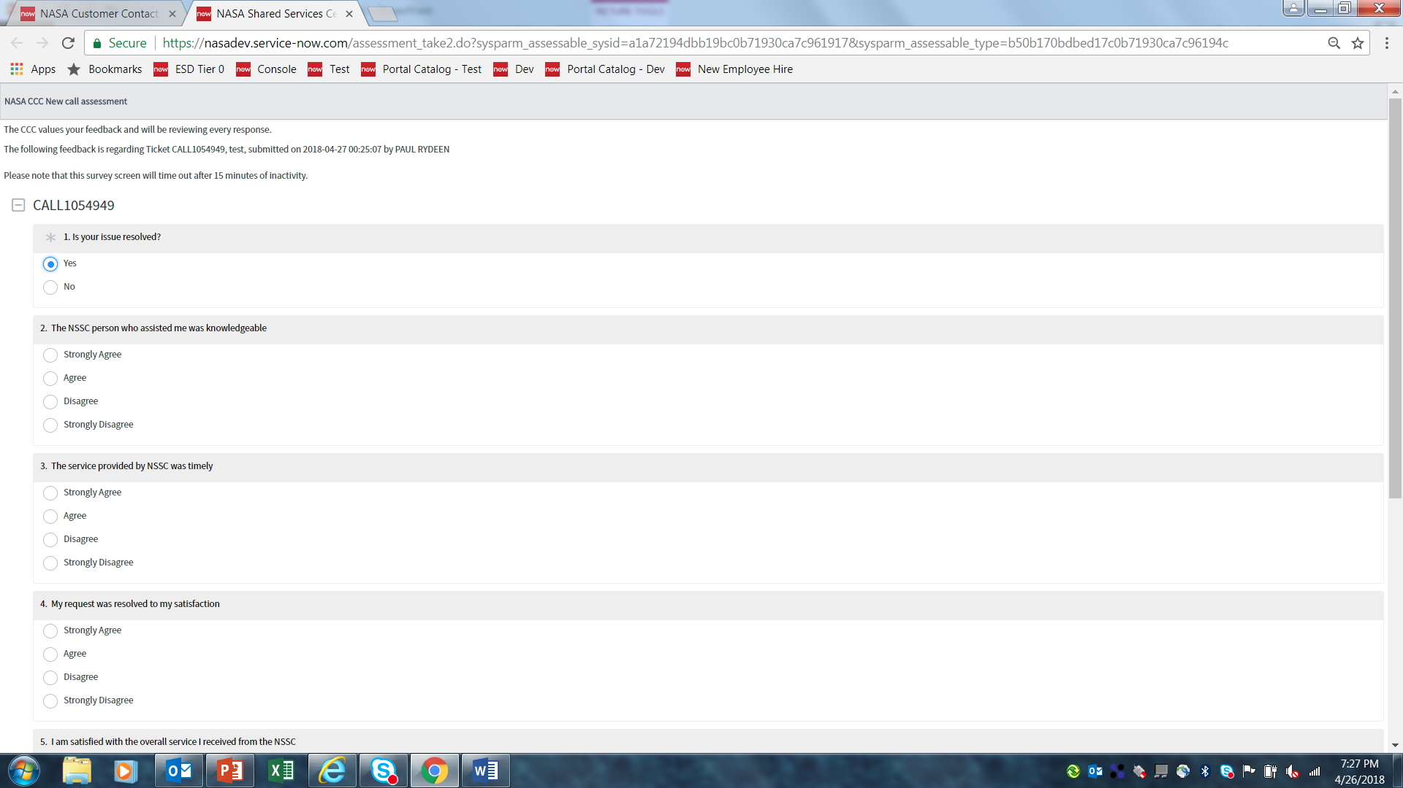

Slide 5
