Slide 1
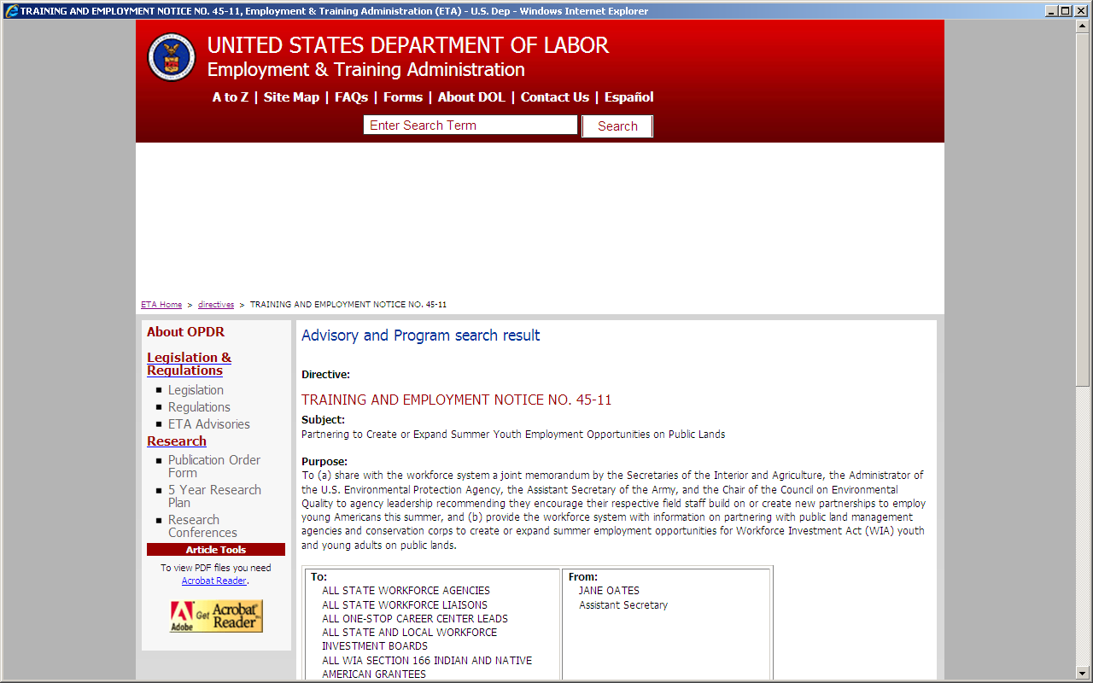
http://wdr.doleta.gov/directives/corr_doc.cfm?DOCN=8874
A Training and Employment Notice (TEN) will be published on the DOL ETA Web site and sent the workforce investment system nationwide via an e-mail notice to DOLETA listserv. The TEN will be similar to the notice above.
Subject: U.S. Construction Worker Employment Opportunities in Guam
Purpose: The National Defense Authorization Act of 2010 requires Federal construction contractors working on the Guam military base realignment and build-up to expand recruitment of U.S. construction workers for employment. This TEN will provide background information on Guam, the contractor recruitment standards, and other employment related information needed to encourage job candidates to consider referrals to Guam employment opportunities.

Slide 2
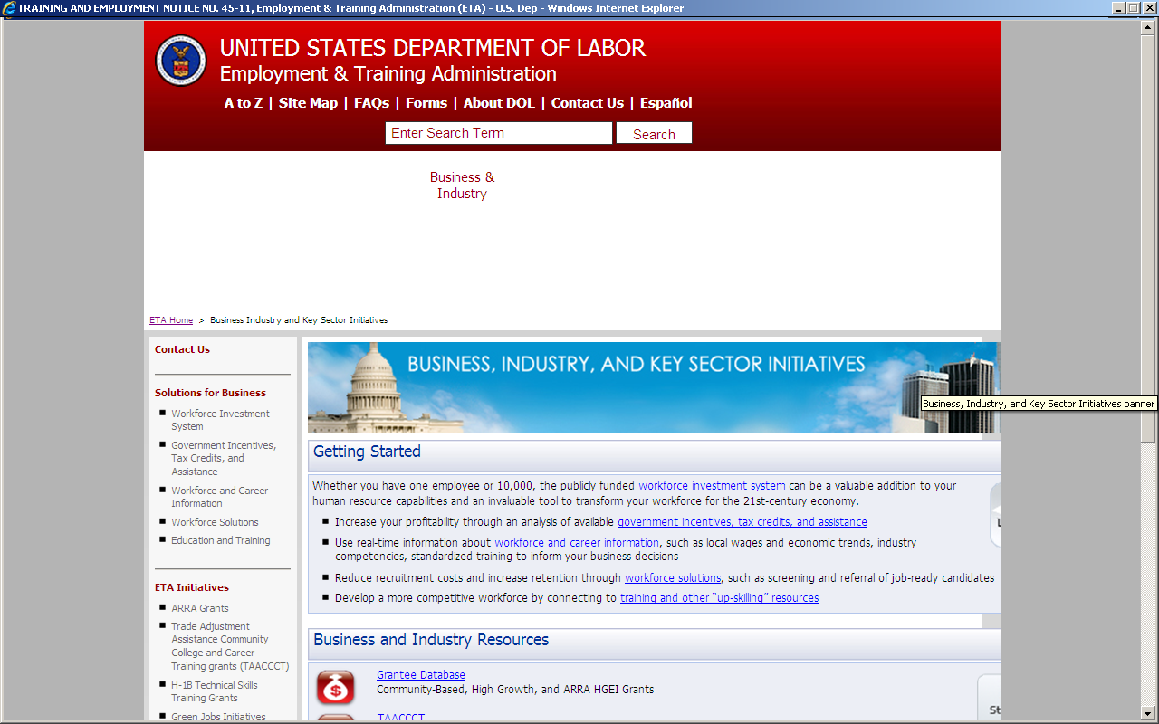
http://www.doleta.gov/business/
Under Business and Industry Resources an announcement will be posted
Guam Military Base Build-up Contractor Recruitment Standards Released:
  On October XX, 2012, DOL ETA published a Federal Register Notice Vol. XX, No. XXX page XXXX. This notice provides construction contractors and small businesses information on the recruitment standard to expand the recruitment of U.S. construction workers for employment opportunities on Guam as required by the National Defense Authorization Act of 2010.
  Click here to access the notice.

