Slide 1
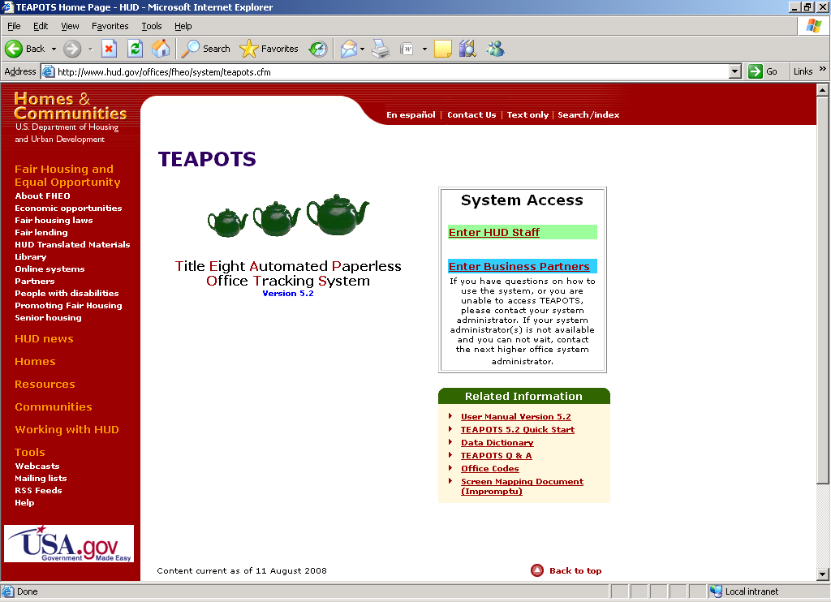
TEAPOTS URL: http://www.hud.gov/offices/fheo/system/teapots.cfm
FHAP Agency Login

Slide 2
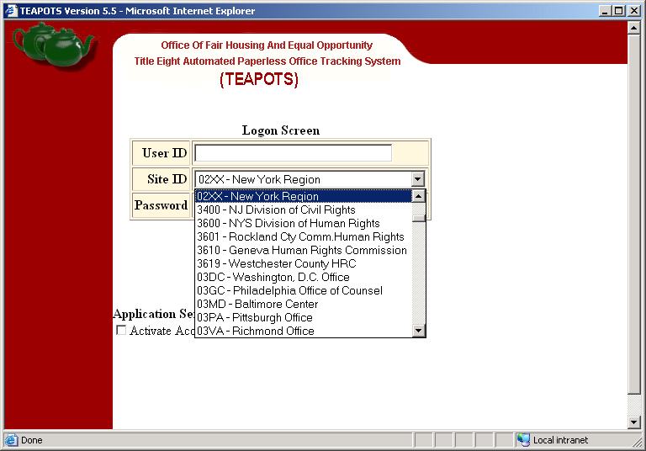
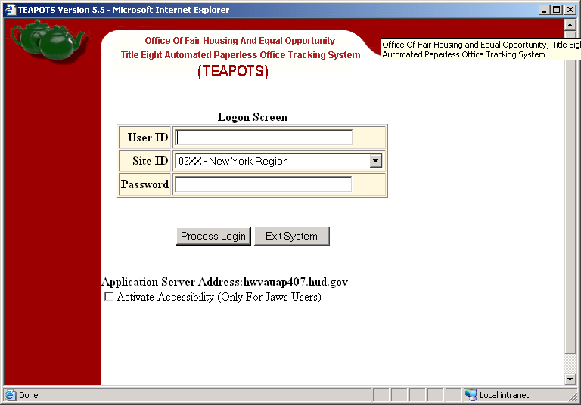
User’s Initials
Enter Password
(Passwords need to be updated every 90 days)
Select Appropriate Agency

Slide 3
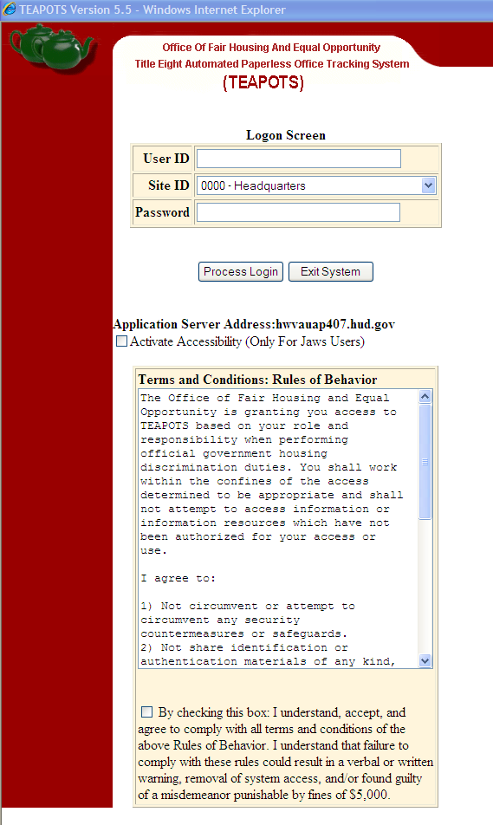
New “Rules of Behavior” required checkbox. Must check each time you login to TEAPOTS.

Slide 4
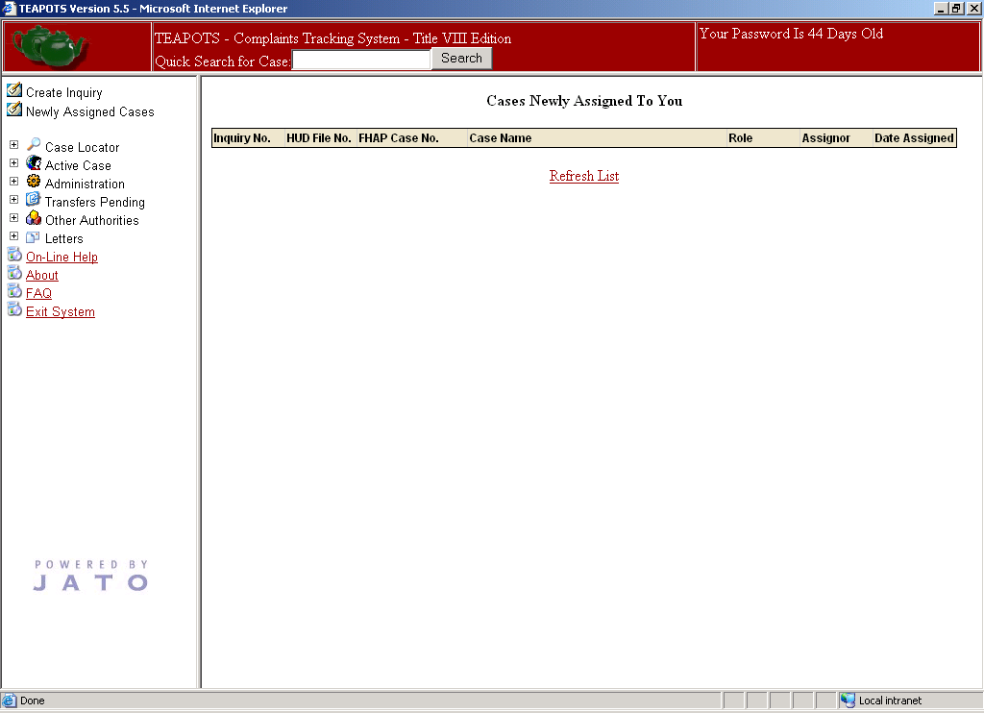
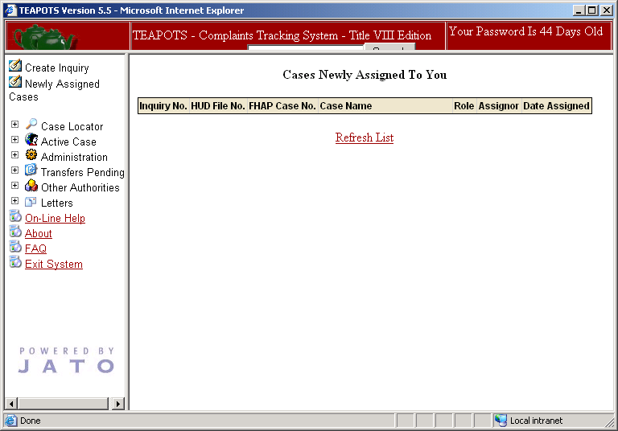
Remember to change your password every 90 days
Click here to maximize the screen. This will reveal the “Quick Search” function

Slide 5
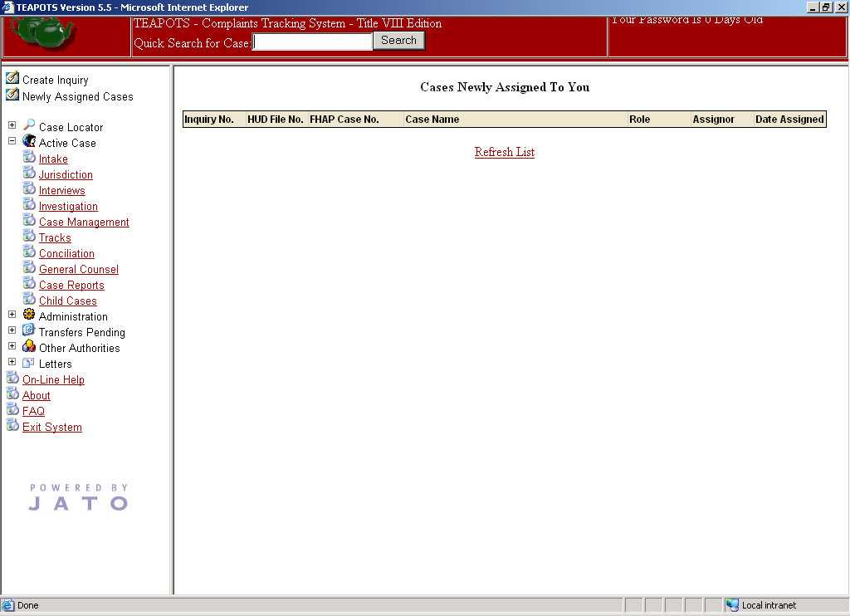
Click “+” to expand your options
NEVER USE the “X” TO EXIT TEAPOTS
All commands will be on the left hand side

Slide 6
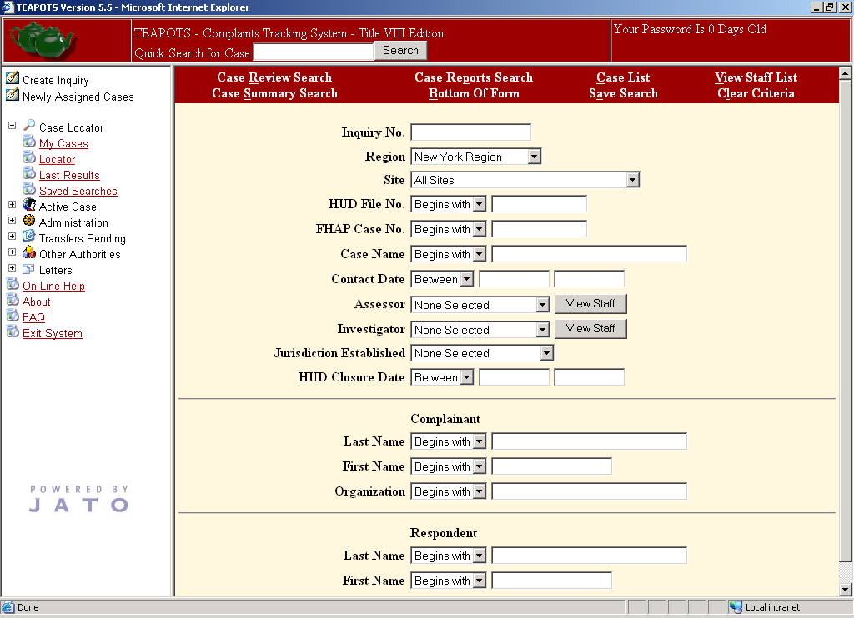
Click “Locator” to locate cases

Slide 7
Click “Case Review Search”
You can search by Inquiry Number
You can search by HUD Number
You can search by FHAP Number
You can search by Case Name
You can also search by Complainant or Respondent

Slide 8
Remember to change to the appropriate Region
Before you enter a case, check to see if it already exists in TEAPOTS using the “Case Review Search”
You can also specify which Site to search
If you are unsure of the spelling, use “contains”

Slide 9
Click “Case Review Search”
If you are unsure of the spelling, use “contains”

Slide 10
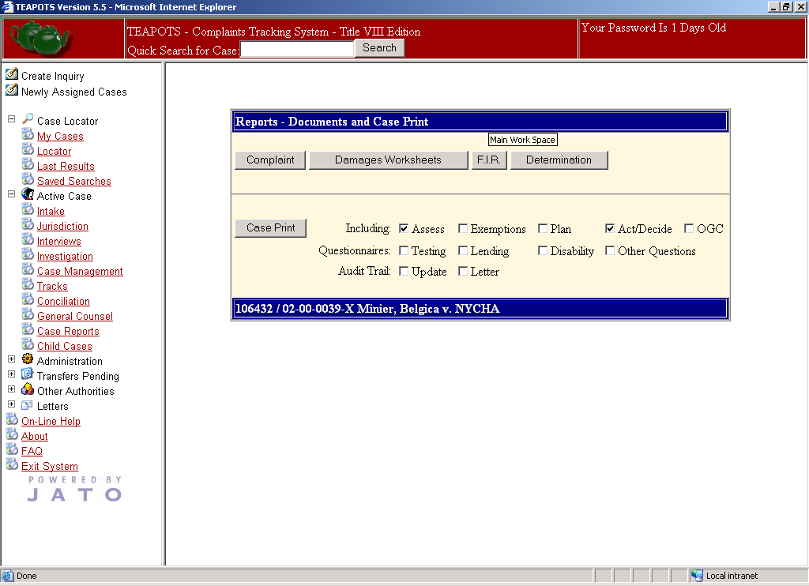
If you clicked on any case using the “Case Report Search”, you would be able to quickly print a copy of the Complaint, FIR, Determination, or Case Print.

Slide 11
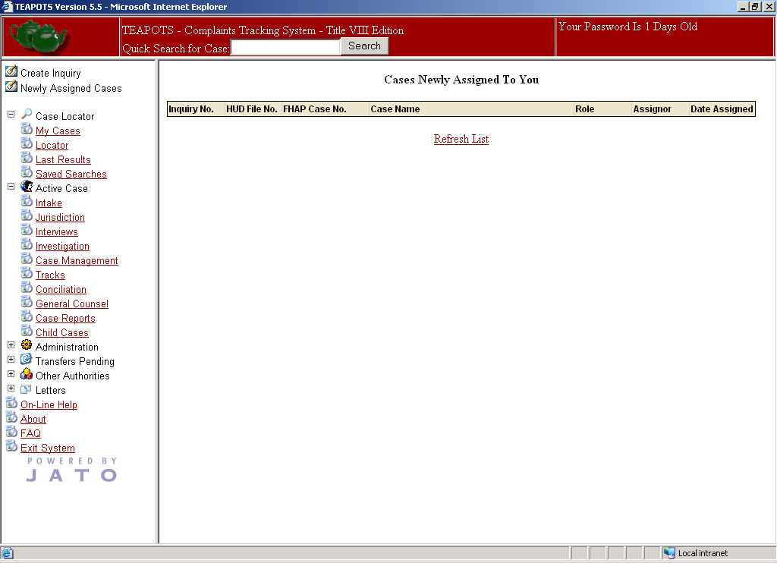
Click “Newly Assigned Cases” to view cases newly assigned to you

Slide 12
If you don’t find a complaint, you can then create an Inquiry
Click “Create Inquiry”
Inserting a Case is a two step process:
First, you need to add the information to create a new inquiry
Second, you need to fill in the necessary information for all fields on the Intake Screen

Slide 13
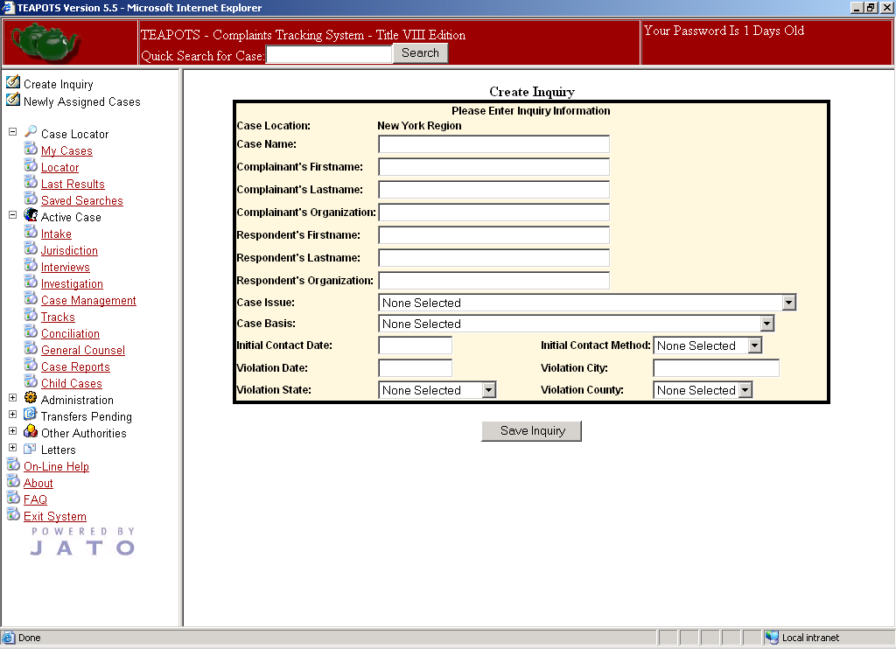
1
Complainant (Last Name, First Name) v. Respondent (Last Name, First Name)
Complainant’s Organization
Respondent’s Organization
In which State did the violation occur? (Select State using dropdown menu)
In which County did the violation occur? (Select County using dropdown)
Remember to Save Inquiry
When did the last discriminatory act occur?
In which City did the violation occur?
How did the Complainant contact you? (Select Contact Method using dropdown)
When did the Complainant first contact you?
What happened? (Select issue using dropdown)
Why did it happen? (Select Basis using dropdown)

Slide 14
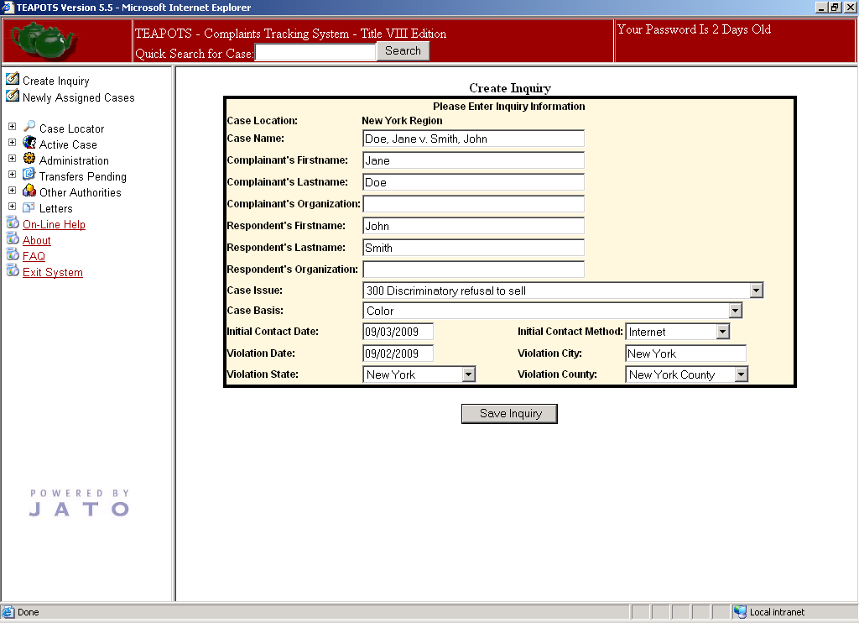
Remember to Save Inquiry

Slide 15
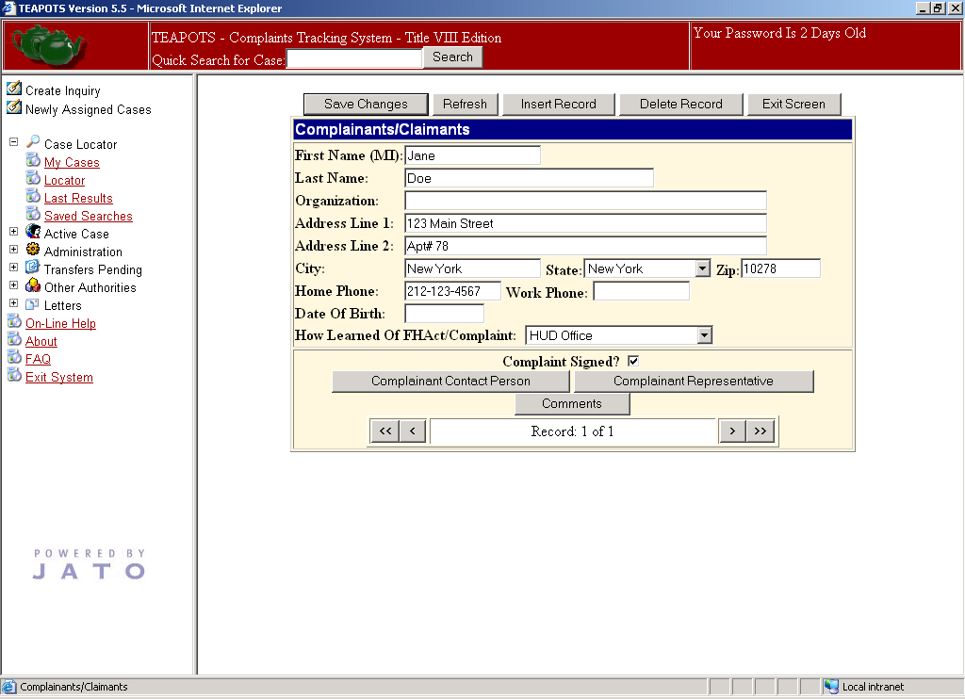
Remember to save the information
Exit Screen
Make sure you enter how the Complainant learned of the Fair Housing Act or Complaint
Make sure the Complainant has signed the Complaint form
Use this to scroll between records
Use this to scroll between records
The Complainant’s contact person’s information is entered here
The Complainant’s attorney’s information is entered here

Slide 16
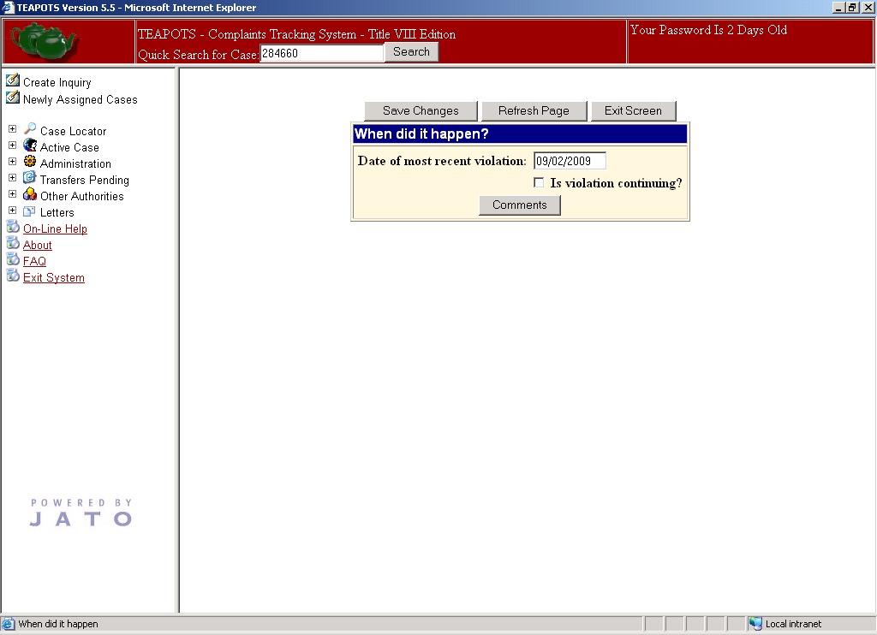
Remember to save the information
Exit Screen
The discriminatory act must have occurred within one year of the filing date
Click here if the violation is ongoing

Slide 17
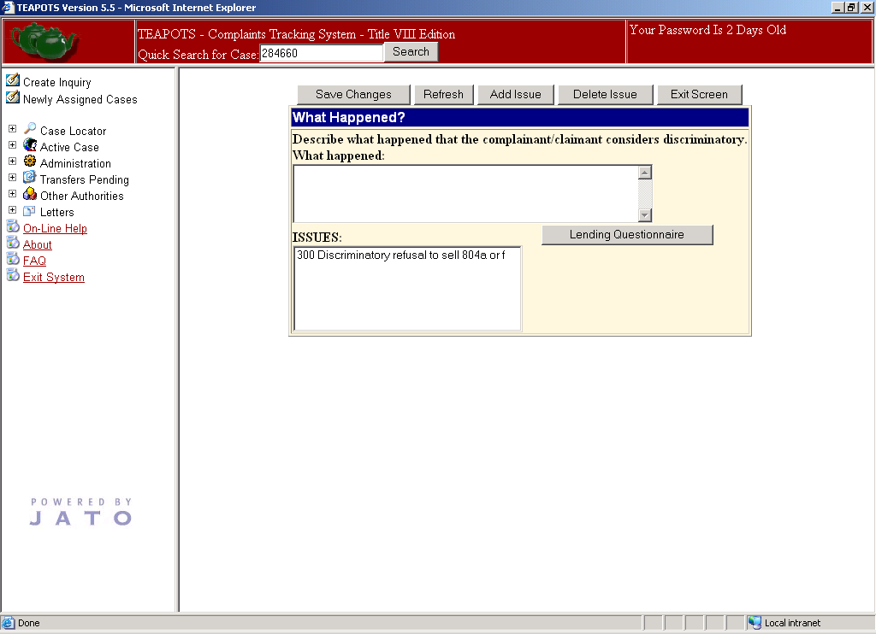
Click here to delete an issue
Click here to add more issues
Remember to save the information
Exit Screen
These are the issues that have been selected

Slide 18
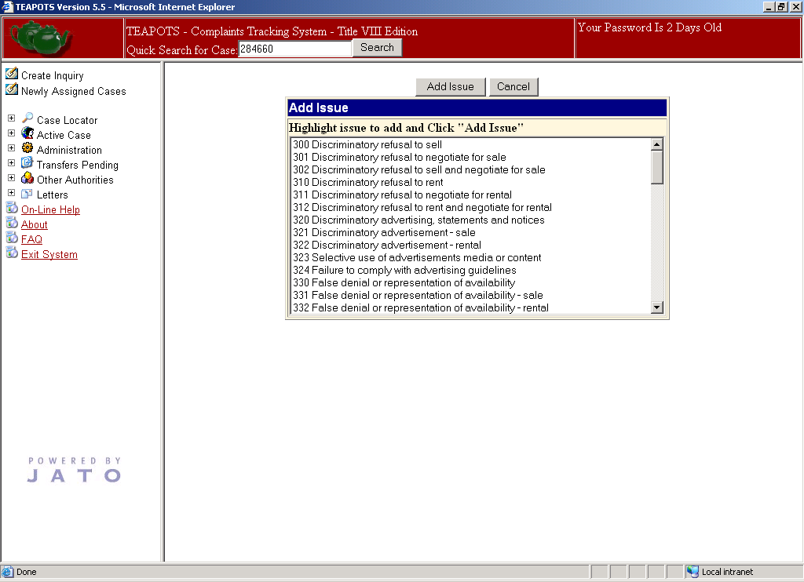
Click here to add the issue after selecting it
Select all applicable issues

Slide 19
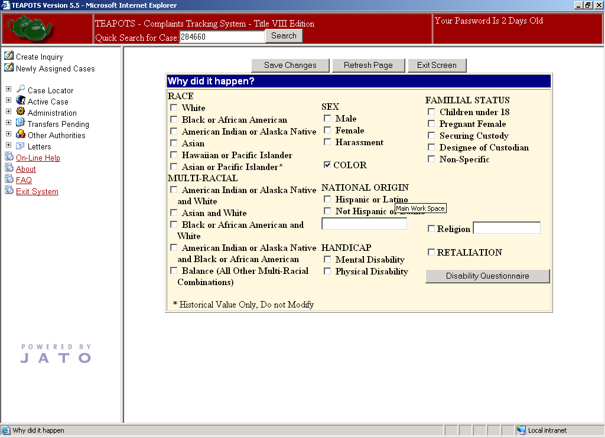
Remember to save the information
Exit Screen
Click all applicable bases
Please note that only HUD bases are available in this field

Slide 20
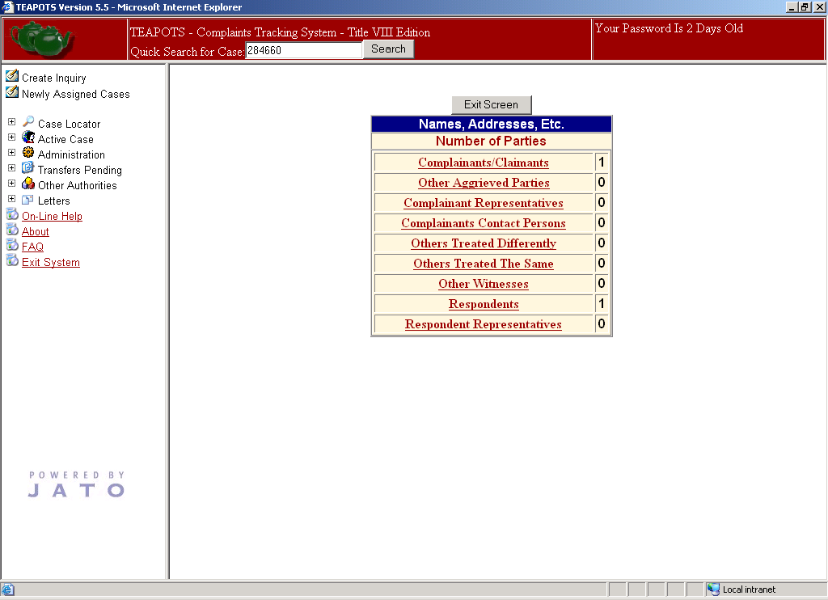
This will help you keep track of all of your records by showing you what you have entered. Click on a category to go to that record.

Slide 21
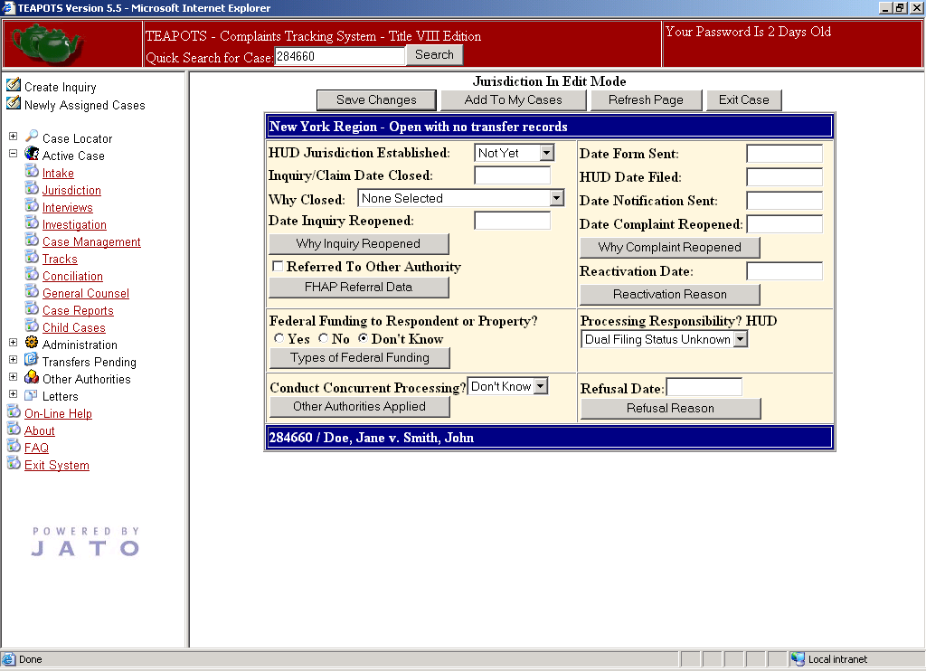
Click here to access FHAP Referral Data

Slide 22
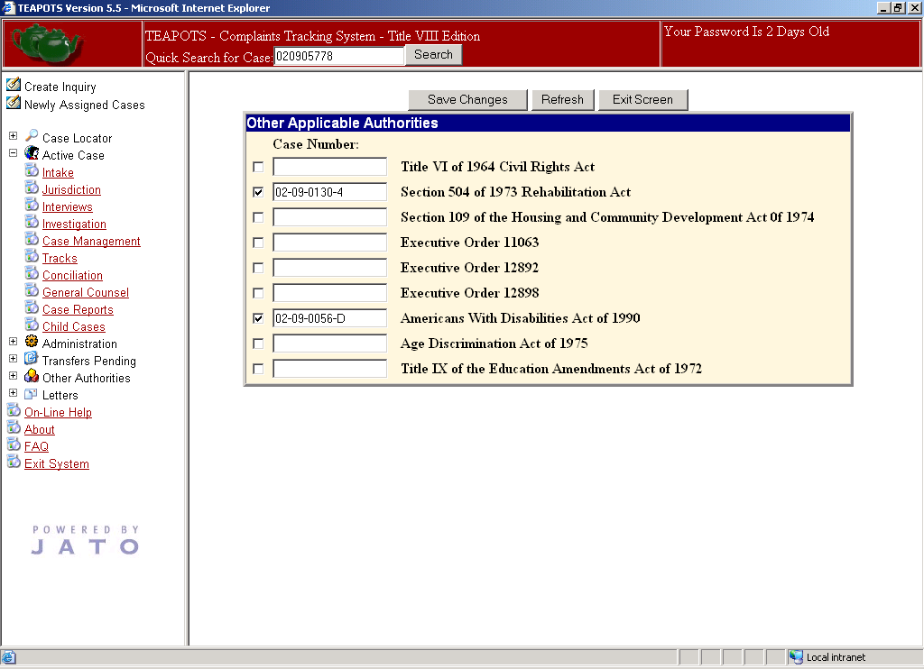
Remember to save the information
Exit Screen
If the Complaint is generated as a result of a natural disaster, please indicate it in the Title IX section using the name of the natural disaster. (I.e. Katrina, Rita)

Slide 23
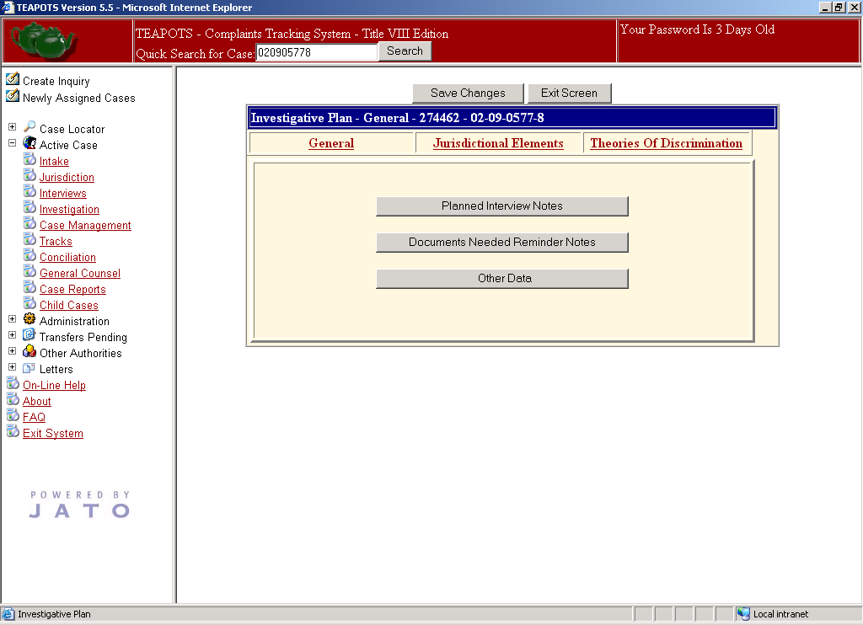
Click on Jurisdictional Elements

Slide 24
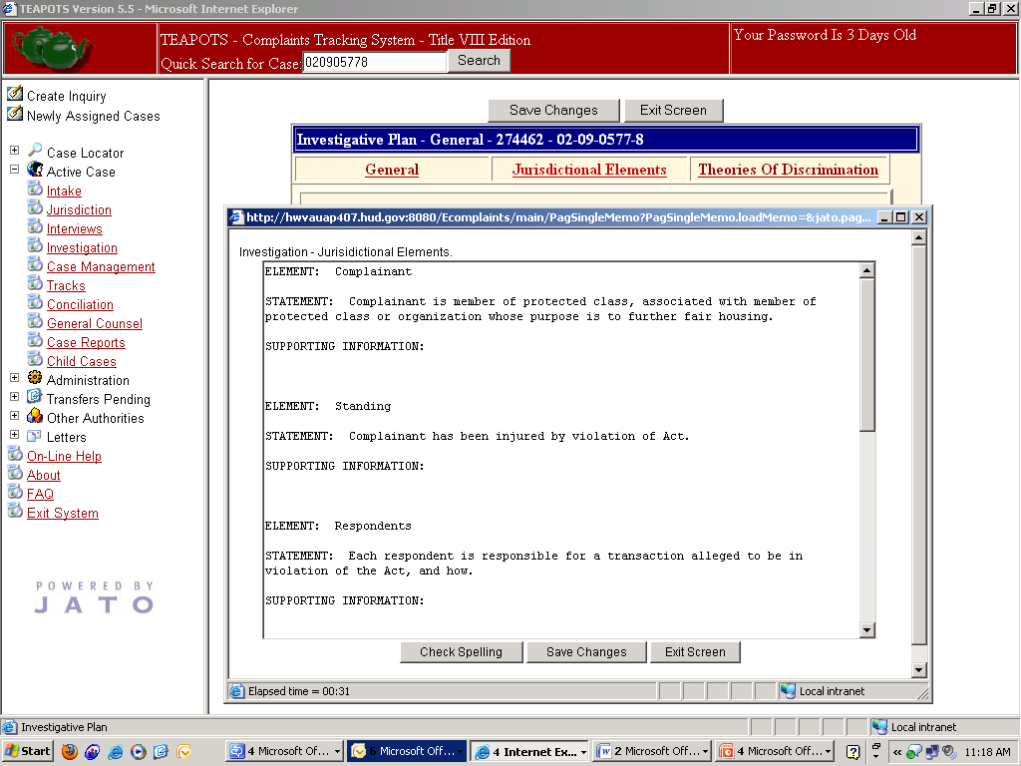
Type in the supporting information for each element
Remember to save the information
Exit Screen

Slide 25
Click on Theories of Discrimination

Slide 26
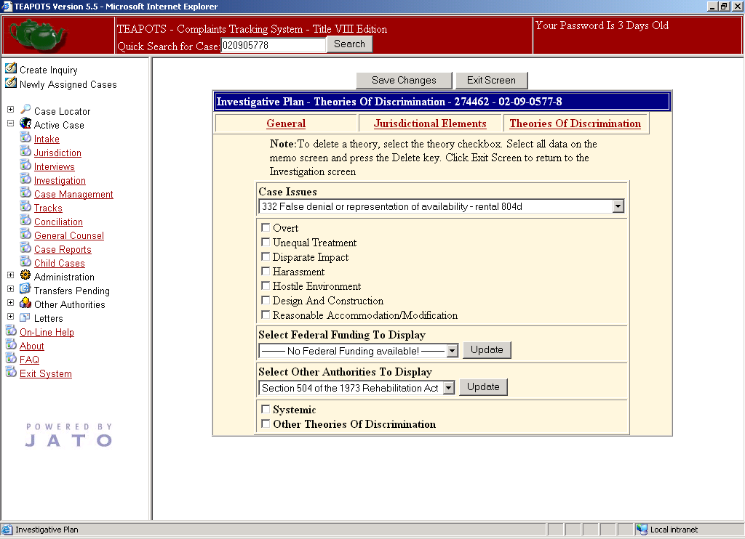
Select all applicable issues
Must complete for each Case Issues

Slide 27
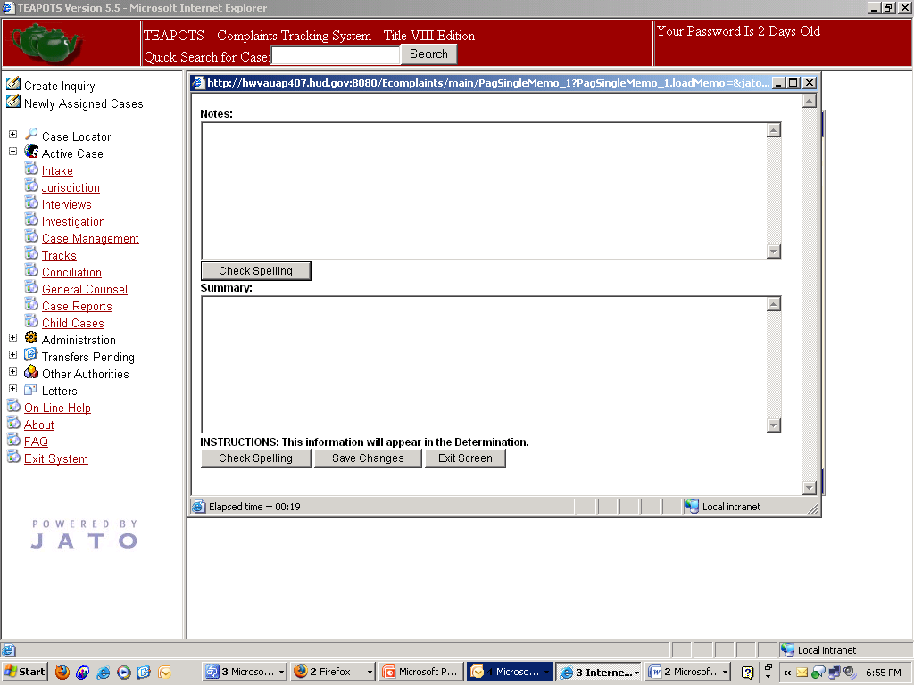
Do Not Use the “X”
Do Not Enter Notes
Remember to save the information
Exit Screen
Helpful Hint:
Type Summary of Respondent’s Defenses in MS Word, then cut and paste into this section because you may get logged out if too much time elapses.

Slide 28
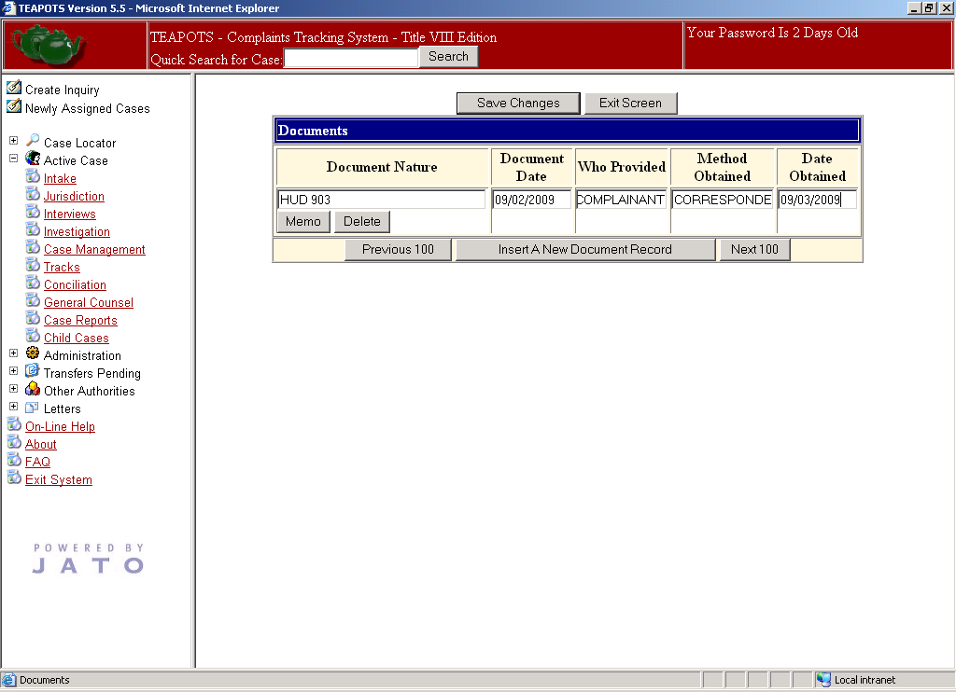
Remember to save the information
Who Provided the Document
Click here to add a New Document Record
Date on the Document
Method by which the Investigator received the document
Nature of the Document
Date the Document was received by the Investigator

Slide 29
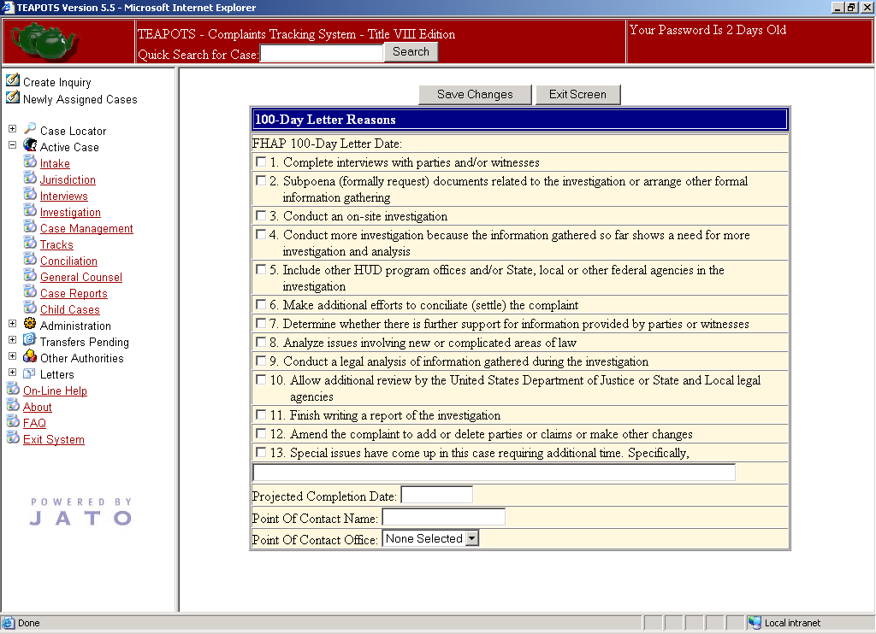
Remember to save the information
Choose applicable reason(s) for 100th Day letter
Please note that the reasons selected will appear on the 100th Day Letter that will be sent to all parties

Slide 30
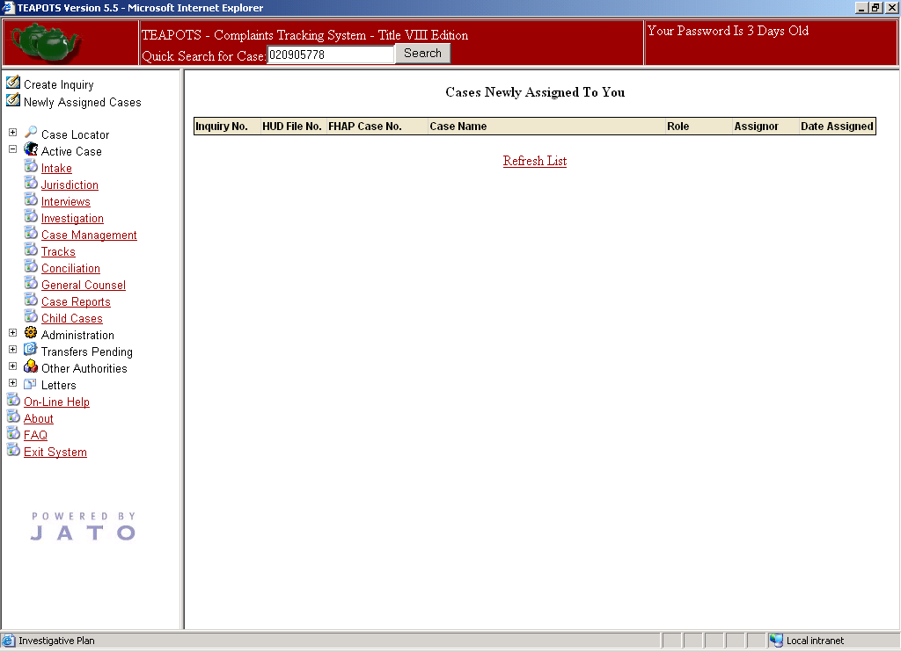
Always Exit TEAPOTS using this function

