Slide 1
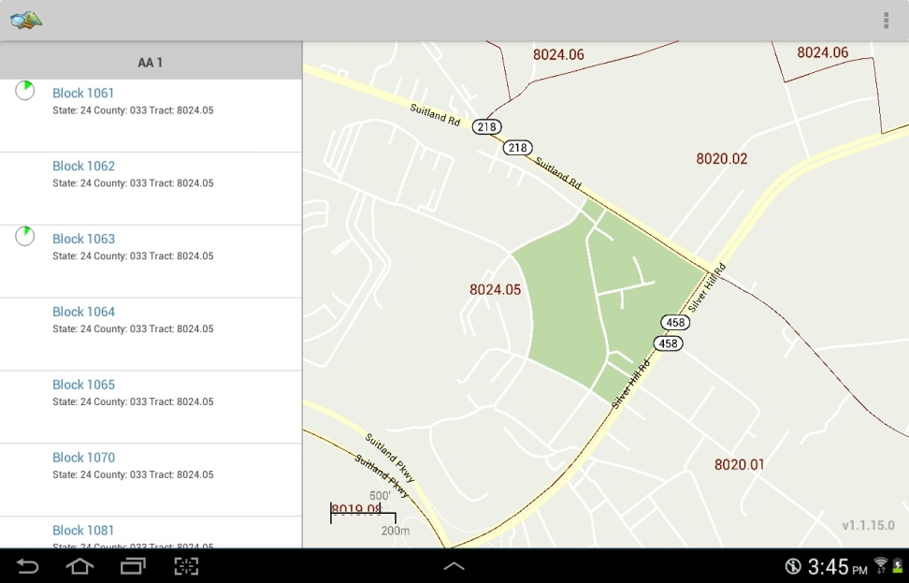
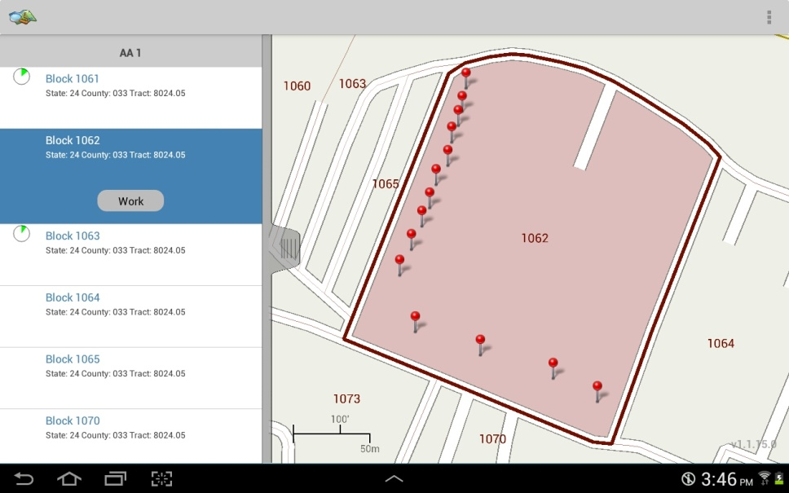
Block List/Map screen
Selecting a block
All blocks in the AA
Touch the block to be worked
Note how the block lights up on the map
Indicates work progress on all addresses in the block
Addresses and map spots in this guide are fictional and created for illustration and training purposes only
Touch ‘work’ to display the block address list
Location of each address in the block

Slide 2
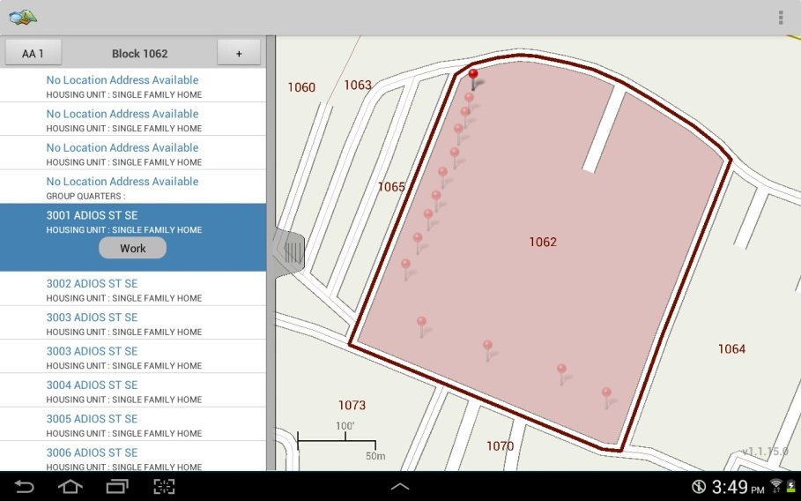
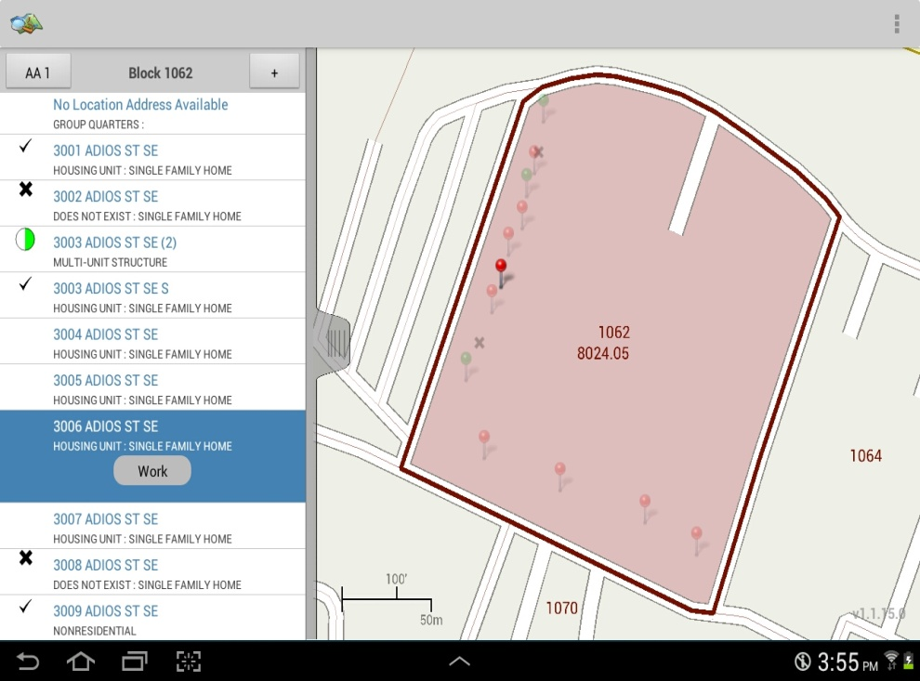
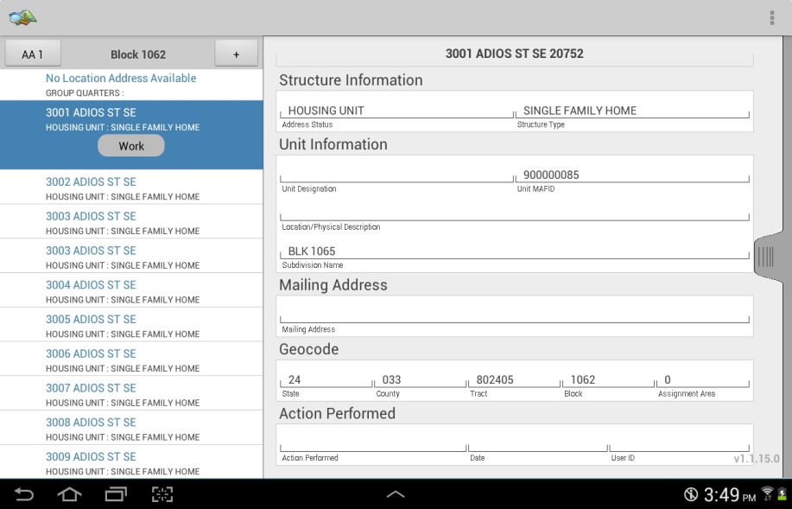
Address List/Map screen
Viewing an address
Indicates work progress on all units at the address
Number of units at the address
Block number
Touch to add a new address
Touching an address highlights it and causes it’s pin to jump out on the map.
Likewise, touching a pin causes it to jump out on the map and highlights the address on the list.
Slide tab to see details about the address
Indicates address has been worked
Indicates address has been deleted
Indicates address type
Pins indicate each address’s location and progress.
Red = worked
Green = not worked
Addresses and map spots in this guide are fictional and created for illustration and training purposes only

Slide 3
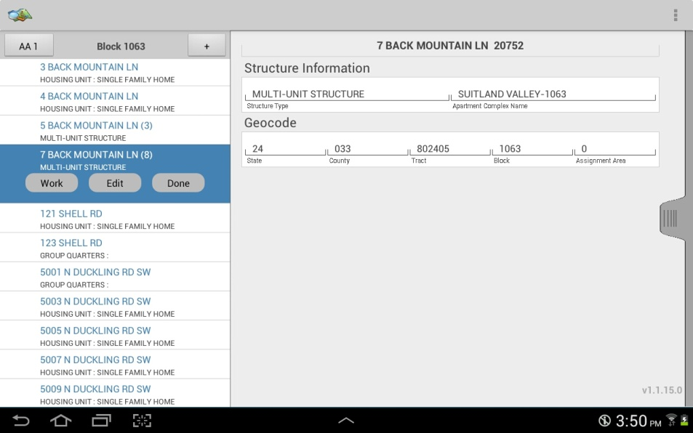

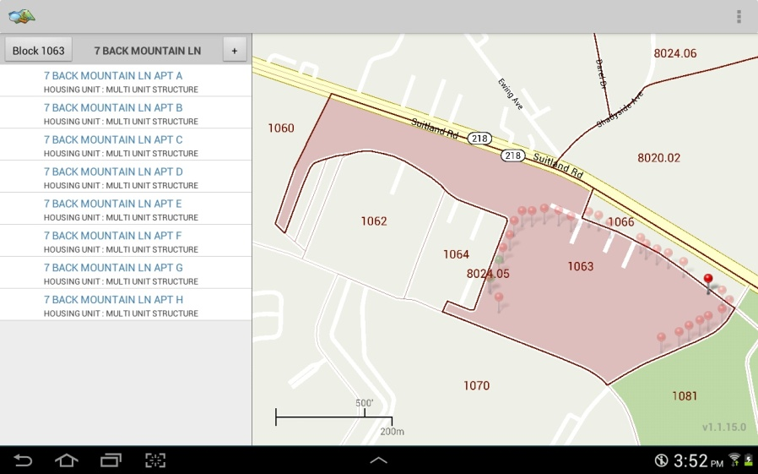
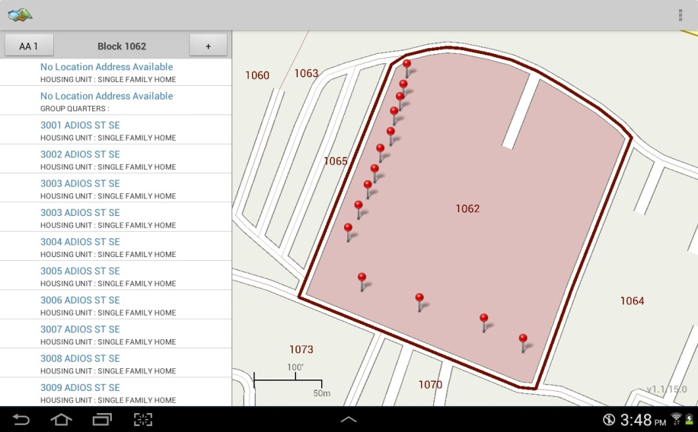
Viewing an address
(continued)
Working an address
To work a listed address touch the address then touch the ‘work’ button
For a multi-unit structure details about the structure will shown
Touch ‘work’ to display the list of units in the structure
To add a new address, touch the ‘+’ button
Touch a unit and slide the tab to see details about the unit

Slide 4
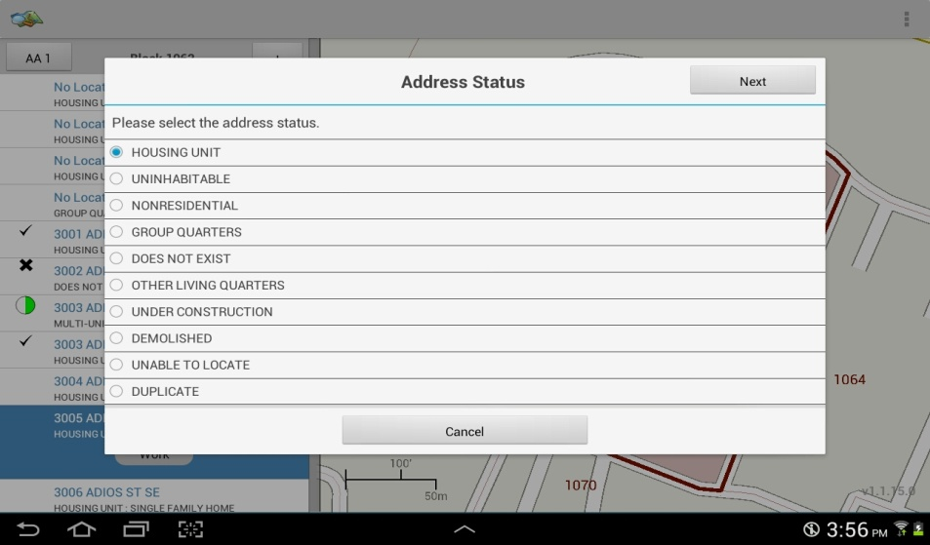
Working an address
(continued)
Indicates selection. May be pre-selected for addresses on the address list.
Touch to make or change a selection
Touch ‘next’ to proceed
Touch ‘cancel’ to return to address list
Addresses and map spots in this guide are fictional and created for illustration and training purposes only

