Slide 1
TSA Contact Center Survey 1652-0058
EMAIL

Slide 2
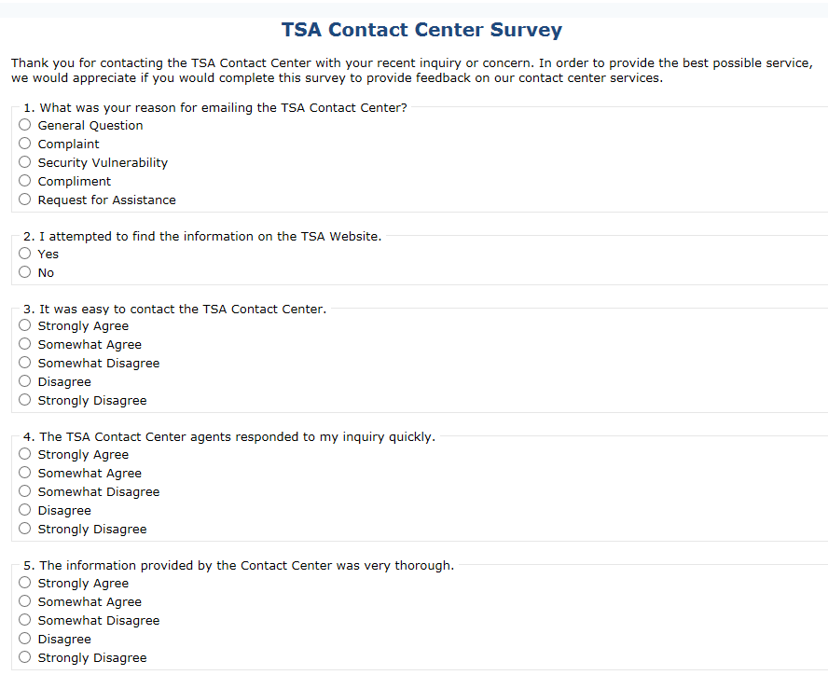

Slide 3
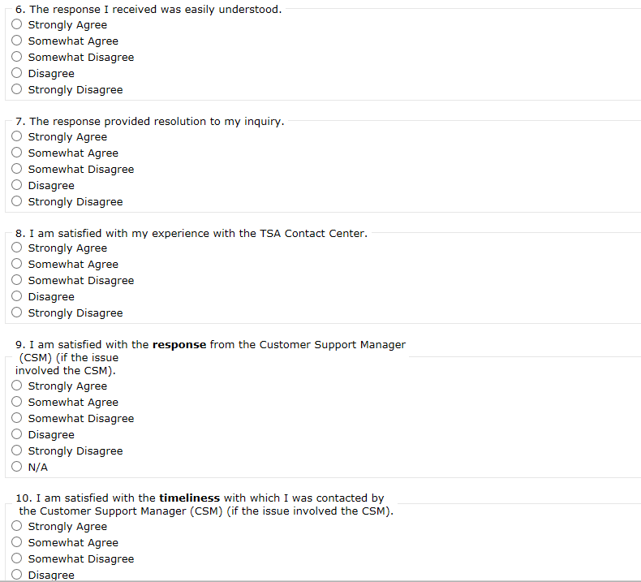

Slide 4
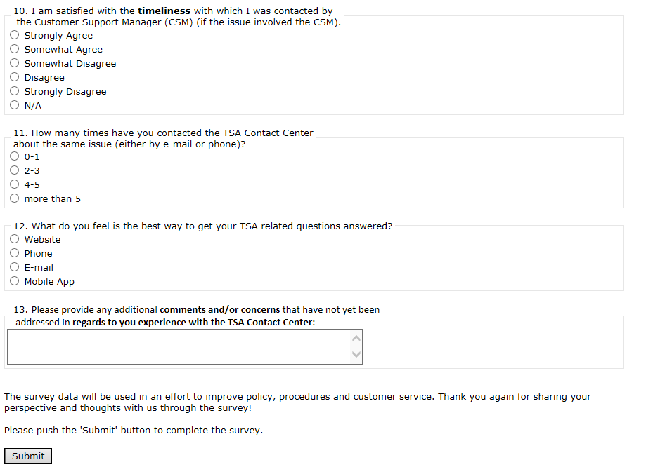

Slide 5


