Slide 1
Community TIGER Presentation
Draft Version 2.0 June 30, 2015

Slide 2
Initial Setup

Slide 3
Install Amazon WorkSpaces
Notes:
Navigate to https://clients.amazonworkspaces.com/
Download and install Amazon thin client software that corresponds to your device.

Slide 4
Register Amazon WorkSpaces
Notes:
Open Amazon WorkSpaces and, when prompted, enter registration code provided by the Census Bureau.

Slide 5
Access Amazon WorkSpaces
Notes:
Login with username and password provided by the Census Bureau.

Slide 6
Partner Toolbox

Slide 7
Getting Started
Notes:
Double-click the “Start Here.mxd.”

Slide 8
Getting Started
Notes:
Click the “Community TIGER Data Preparation Tool” located in the toolbar.

Slide 9
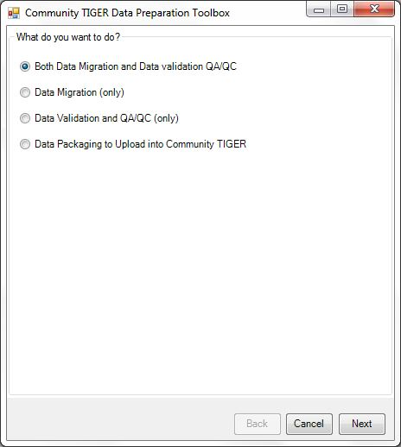
Getting Started
Notes:
Select the appropriate option. If you are just beginning, select “Both Data Migration and Data Validation QA/QC” and click “Next.” If you had previously migrated your data, you would select from the other choices.

Slide 10
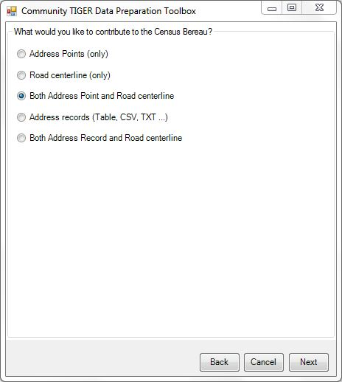
Getting Started
Notes:
Select the type of contribution from the available options and click “Next.”

Slide 11
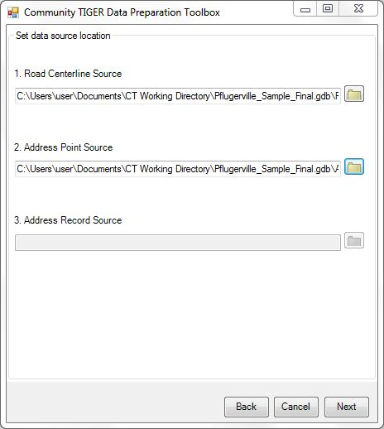
Getting Started
Notes:
Click the folder icon to set the data source location for each type of contribution selected previously and click “Next” when all data source locations are set.

Slide 12
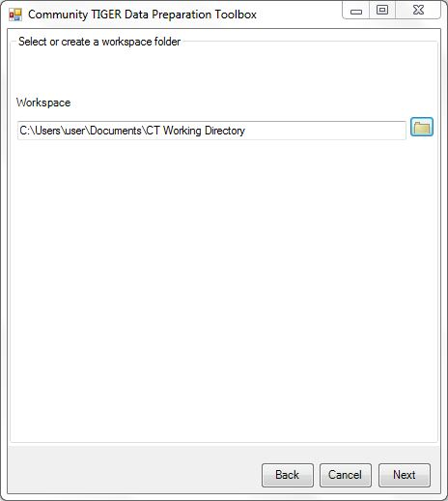
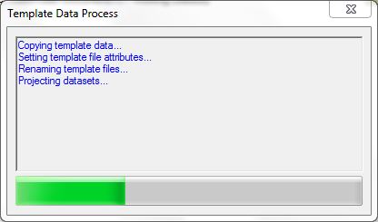
Getting Started
Notes:
Click the folder icon to select a workspace already created or to create a new workspace. Click “Next” when the workspace location is set. This will setup your workspace folder with the required template data with correct attributes as well as projecting datasets.

Slide 13
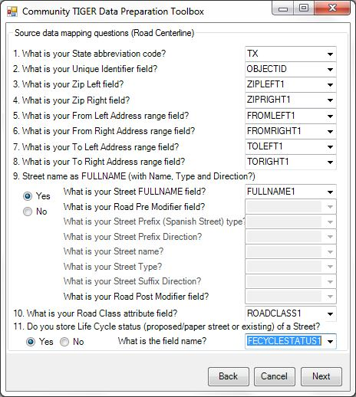
Data Migration – Road Centerline
Notes:
Select fields from data that correspond to fields in the local government data model from dropdown menus (field names that match local government data model field names are automatically mapped). Select “Next” when all mandatory data is mapped.

Slide 14
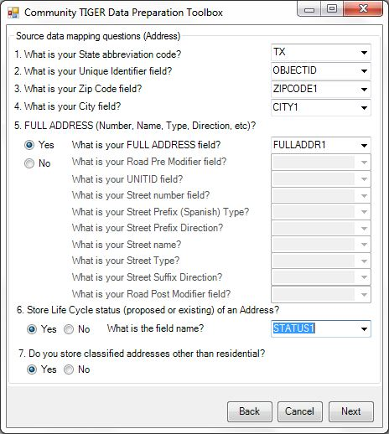
Data Migration – Address
Notes:
Select fields from data that correspond to fields in the local government data model from dropdown menus (field names that match local government data model field names are automatically mapped). Select “Next” when all mandatory data is mapped.

Slide 15
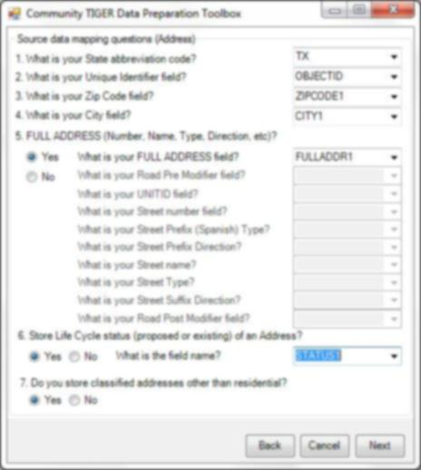
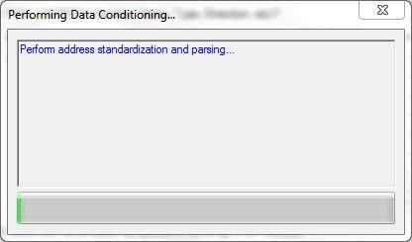
Data Migration
Notes:
Once all the mandatory data is mapped for your data sources, the tool runs data conditioning edits. These edits perform any standardization and parsing required as well as automated data clean-up.

Slide 16
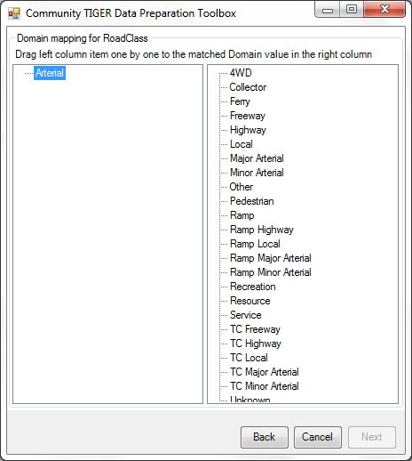
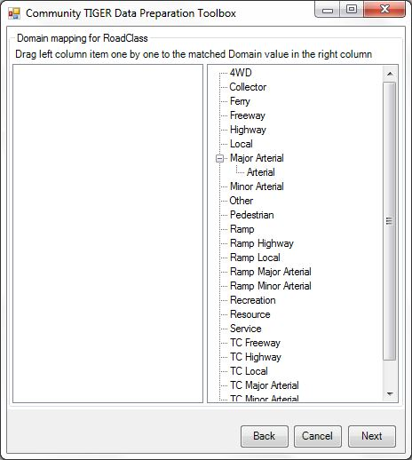
Data Migration – Road Centerline
Notes:
If prompted, map domain values by dragging value from the left column to the existing domain value it best relates to in the right column. Click “Next” when all domain values are mapped.

Slide 17
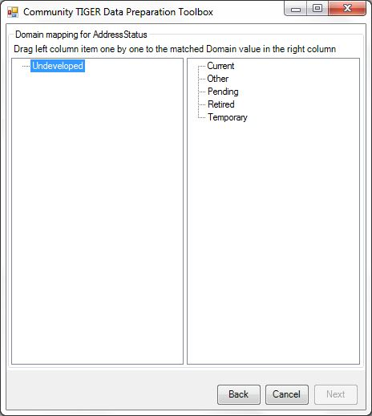
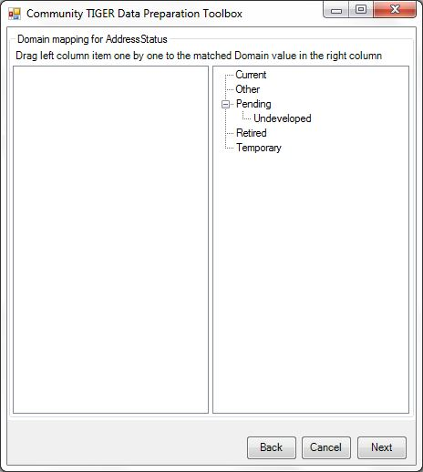
Data Migration – Address
Notes:
If prompted, map domain values by dragging value from the left column to the existing domain value it best relates to in the right column. Click “Next” when all domain values are mapped.

Slide 18
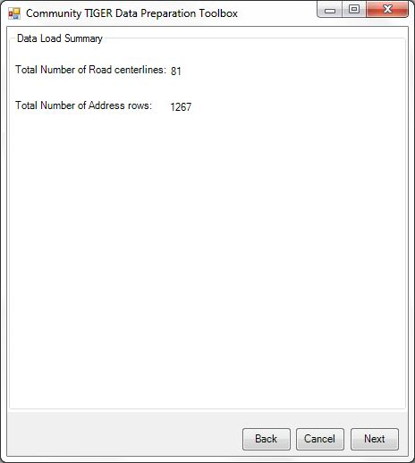
Data Migration
Notes:
Once data mapping is complete the “Data Load Summary” window displays the number of features migrated for each data source contribution, click “Next.”

Slide 19
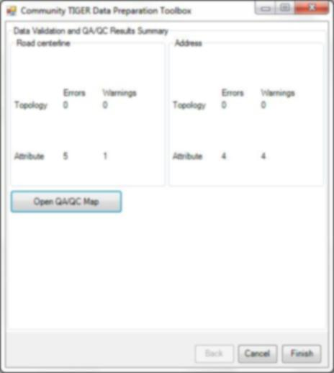
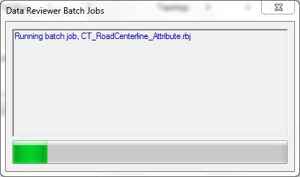
Data Validation
Notes:
At this point, the tool is running data validation edits on the migrated data. The data validation edits check your data, to ensure it meets Census Bureau standards and creates an error log for your review.

Slide 20
Data Validation
Notes:
The “Data Reviewer Batch Jobs” window displays the number of errors and warnings for both topology and attributes identified within each data source contribution. Click “Open the QA/QC Map” to view a map of the errors and warnings, or click “Finish” to move onto data packaging.

Slide 21
Data Validation
Notes:
The QA/QC map displays the results of data validation. Address points and road centerlines are classified by “Severity” either “No error/warning” (grey), “Error” (red), or “Warning” (yellow/orange depending on your display).

Slide 22
Data Clean-up
Notes:
Click the “Reviewer Session Manager” located in the toolbar and click “Browse” to select the Data Reviewer.gdb located within the workspace created earlier. Click “Add.” Select the latest session (highest number) from the “ID” dropdown menu within the “Session” box. Click “Start Session,” and then click “Close.”

Slide 23
Data Clean-up
Notes:
Click “Reviewer Table” located in the toolbar. Select column headers and drag to the grey area above the column headers to group the reviewer data (Suggested groupings are by “ORIGINTABLE,” then “SEVERITY,” then “CHECKTITLE”). Select “Start Editing” from the “Editor” dropdown menu on the toolbar.

Slide 24
Data Clean-up
Notes:
Select a record by double-clicking the record (this highlights the record on the map and displays the record’s attributes in the “Attributes” window) within the reviewer table and make any necessary edits within the “Attribute” window. When finished making edits, select “Save Edits” from the “Editor” dropdown menu on the toolbar, then “Stop Editing” from the “Editor” dropdown menu on the toolbar. Click the “Community TIGER Data Preparation Tool” located in the toolbar and select “Data Validation and QA/QC (only)” to repeat data clean-up as needed.

Slide 25
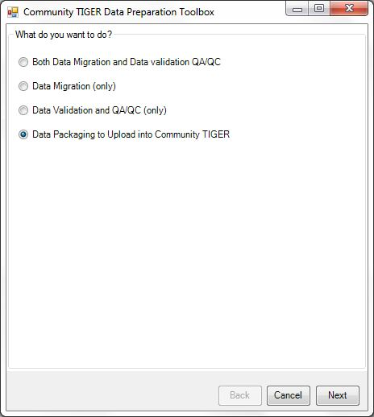
Data Packaging
Notes:
Click the “Community TIGER Data Preparation Tool” located in the toolbar. Select “Data Packaging to Upload into Community TIGER,”and click “Next” if you are satisfied with your submission. You also have the option to run “Data Validation and QA/QC” again to continue making corrections to your data.

Slide 26
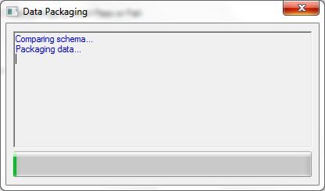
Data Packaging
Notes:
Click the folder icon to select the workspace created earlier and click “Next” when the workspace location is set.

Slide 27
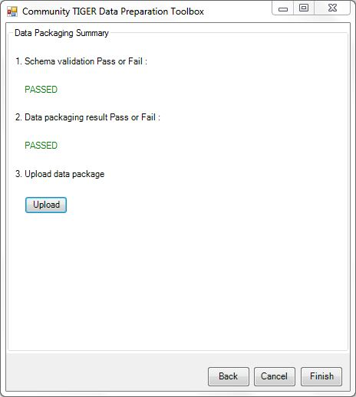
Data Packaging
Notes:
Once the schema validation and data packaging have both passed, click “Upload” to log into the Community TIGER Contribution Management System and upload the packaged data.

Slide 28
Contribution Management System (CMS)

Slide 29
Data Upload
Notes:
Navigate to http://communitytiger.census.gov and login with username and password provided by the Census Bureau.
Paperwork Reduction Act (PRA) Statement:
A federal agency may not conduct or sponsor, nor shall a person be subject to a penalty for failure to comply with a collection of information subject to the requirements of the Paperwork Reduction Act unless that collection of information displays a current valid OMB Control Number. This collection is voluntary. The authority for conducting this collection comes from Title 13 U.S.C, Sections 16, 141, and 193.
The OMB Control Number for this information collection is 0607-0795. Public reporting for this collection of information is estimated to be approximately 40 hours per response, including the time for reviewing instructions, completing and reviewing the collection of information.
Comments concerning the accuracy of this burden and suggestions for reducing the burden should be directed to: Paperwork Reduction 0607-0795, United States Census Bureau, 4600 Silver Hill Road, Room 3K138, Washington, DC 20233. You may email comments to paperwork@census.gov; use “Paperwork Project 0607-0795” as the subject.

Slide 30
Data Upload
Notes:
Click “Upload Data” to bring up the “Upload Data” window. Click “Browse...” to select your packaged data (a .zip file with the filename “CTPackage_<datetimestamp>” located within the workspace created earlier), then click “Open” once selected. Click “Upload Now” bringing up a status bar showing the progress of the file upload. When completed click “OK” to return to the Contribution Management System “Active Contribution” page. When the data processing is complete, an e-mail alerting that the data is ready for review is sent.

Slide 31
Data Analysis
Notes:
Click either “Review data analysis results” or “View details” to the right of “Data Analysis” in the middle column to bring up the “Data Analysis” map and table.

Slide 32
Data Analysis
Notes:
From here you can navigate the map, turn layers on/off using the “All layers” dropdown menu, and filter, sort, search and “Zoom To” records. Click “Download results” to bring up the “Download results” window. Click “Download Results” to save a .zip file of the data analysis records. This can also be accomplished from the Contribution Management “Active Contribution” page. Click “Back to contribution” to return to the Contribution Management System “Active Contribution” page.

Slide 33
Content Analysis
Notes:
Click either “Review your map” or “View details” to the right of “Content Analysis” in the third column to bring up the “Content Analysis” map and table.

Slide 34
Content Analysis
Notes:
From here you can navigate the map, turn layers on/off using the “All layers” dropdown menu, and filter, sort, search and “Zoom To” records. Click “Download results” to bring up the “Download results” window. Click “Download Results” to save a .zip file of the potential submission records. This can also be accomplished from the Contribution Management “Active Contribution” page. Click “Submit to Census” to bring up the “Metadata Form” window. Click “Back to contribution” to return to the Contribution Management System “Active Contribution” page.

Slide 35
Submit to Census Bureau
Notes:
From either the “Active Contribution” page or the “Content Analysis” page click “Submit to Census” to bring up the “Metadata Form” window. Enter the required information and click “Next” to complete each back. Click “Finish” after required information on the final page is entered.

Slide 36
Submit to Census Bureau
Notes:
Click “Finish” after required information on the final page is entered. When the submission to Census Bureau is complete, an e-mail notification of the status is sent.

Slide 37
Contact Information
If you have questions, please contact the U.S. Census Bureau Community TIGER Team:
E-mail - geo.community.tiger@census.gov
Phone - (888) 658-5580

