Slide 1
Attachment G: ODPHP Physical Activity Guidelines, 2nd Edition Quick Association Exercise OMB Control Number: 0990-0281 January 9, 2017 Submitted to: Sherrette Funn Office of the Chief Information Officer U.S. Department of Health and Human Services Submitted by: Frances Bevington Strategic Communication and Public Affairs Advisor Office of Disease Prevention and Health Promotion U.S. Department of Health and Human Services

Slide 6
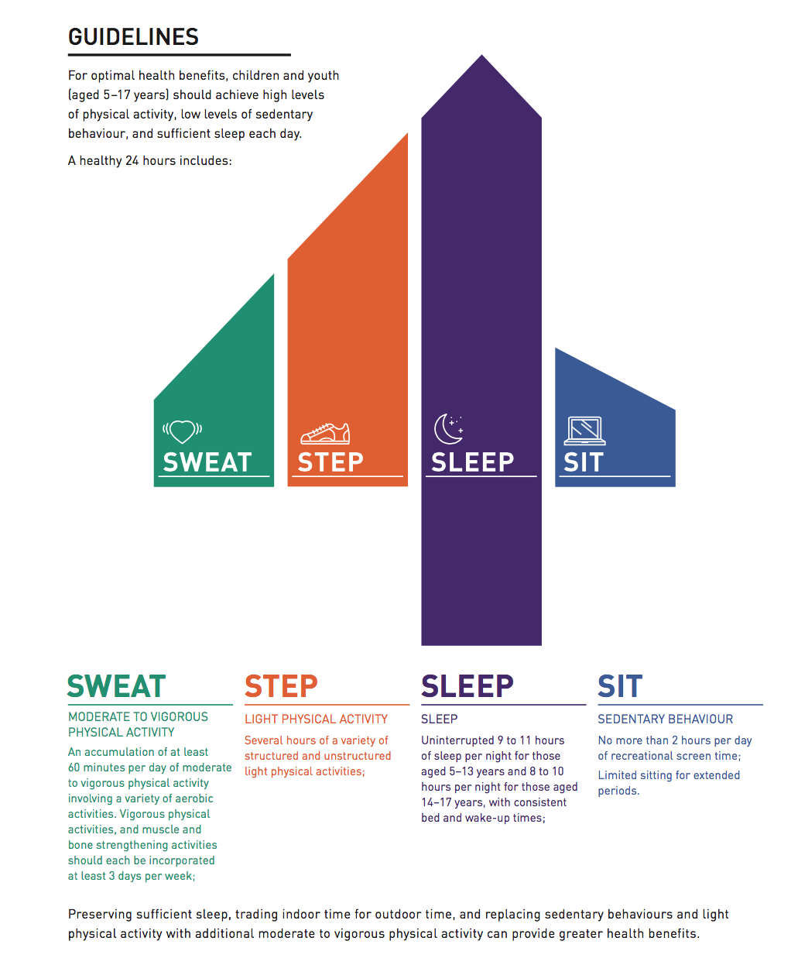

Slide 7
