Slide 1
ONLINE focus Group Ads
Developed in partnership with the Youth CAB

Slide 2
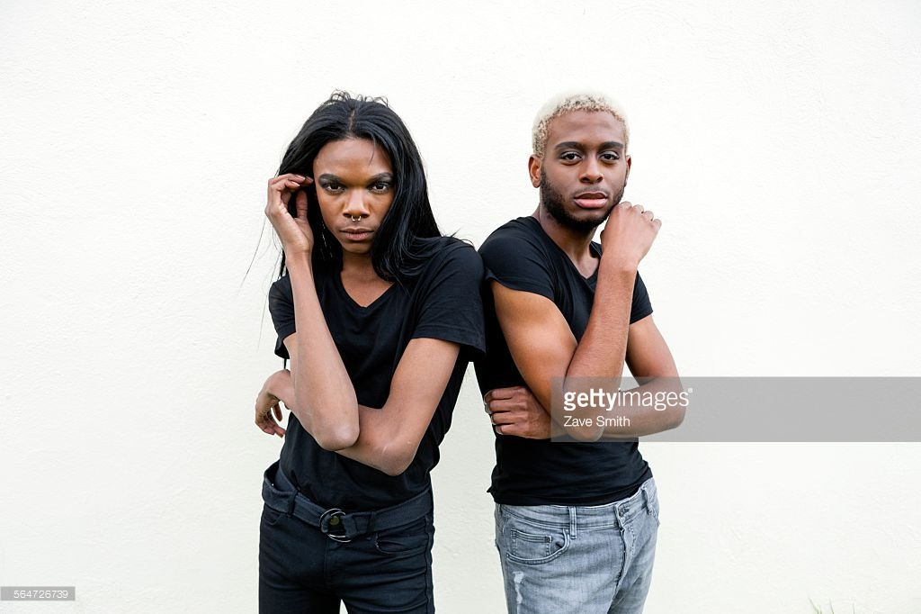
We are interested in your thoughts about sexual and gender identity, relationships, and HIV prevention.
Eligible participants will receive a $30 gift card.
Click to learn more about being in an online focus group!
Who is eligible to participate?
Transgender youth ages 13-24
&
Young men ages 13 to 18 who are attracted to guys

Slide 3
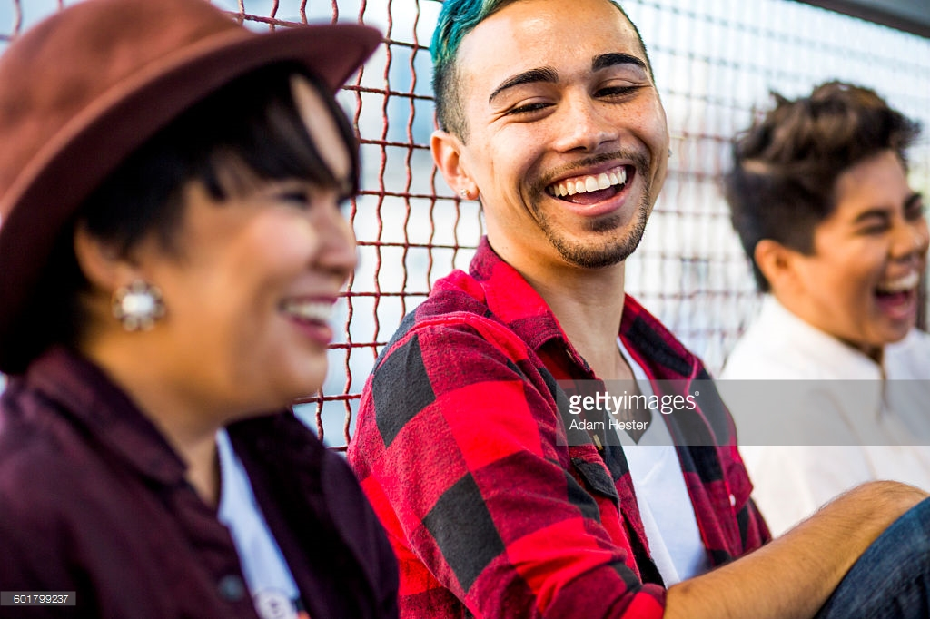
We are interested in your thoughts about sexual and gender identity, relationships, and HIV prevention.
Eligible participants will receive a $30 gift card.
Click to learn more about being in an online focus group!
Who is eligible to participate?
Transgender youth ages 13-24
&
Young men ages 13 to 18 who are attracted to guys

Slide 4

We need superheroes like you to help inform the fight for an HIV-free generation!
Eligible participants will receive a $30 gift card.
Click to learn more about being in an online focus group!
Who is eligible to participate?
Young men age 13-18 who are attracted to guys
&
transgender youth ages 13-24

Slide 5
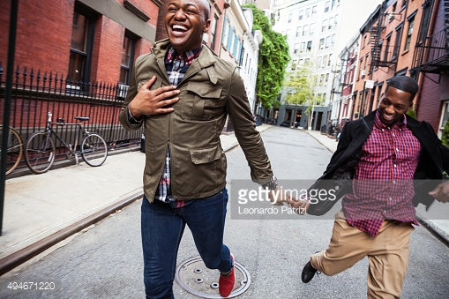
We are interested in your thoughts about sexual identity, relationships, and HIV prevention.
Eligible participants will receive a $30 gift card.
Click to learn more about being in an online focus group!
Who is eligible to participate?
Young men ages 13 to 18 who are attracted to guys

Slide 6

We are interested in your thoughts about sexual identity, relationships,
and HIV prevention.
Eligible participants will receive a $30 gift card.
Click to learn more about being in an online focus group!
Who is eligible to participate?
Young men ages 13 to 18 who are attracted to guys

Slide 7
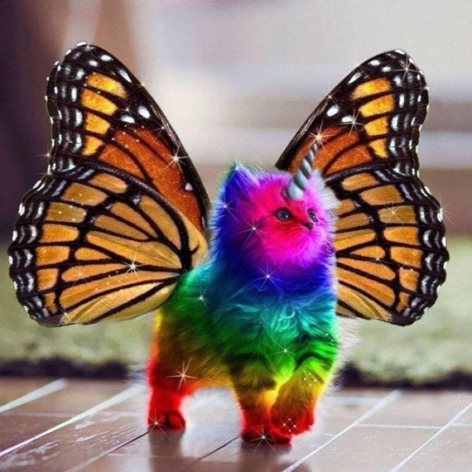
HIV PREVENTION NEEDS OUR GENERATION’S ATTENTION
We are interested in your thoughts about sexual identity, relationships,
and HIV prevention.
Eligible participants will receive a $30 gift card.
Click to learn more about being in an online focus group!
RIGHT MEOW

Slide 8
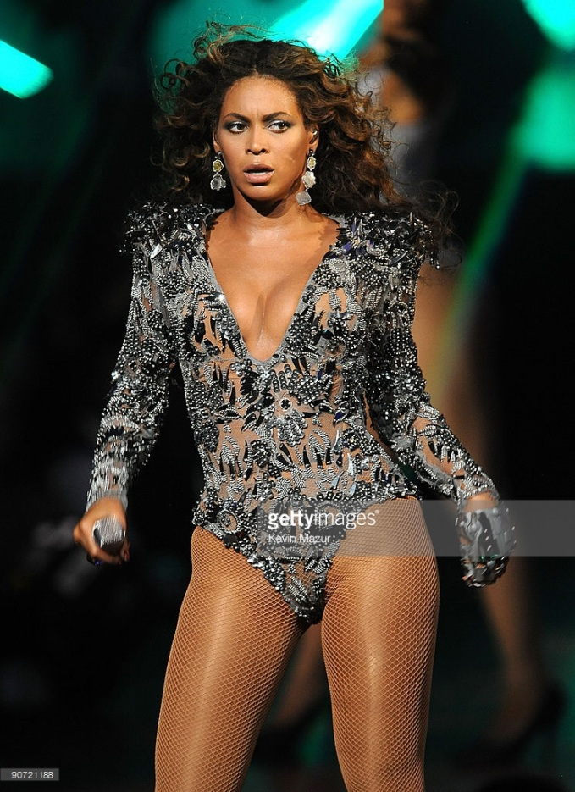
That look you give when…
We are interested in your thoughts about sexual identity, relationships,
and HIV prevention.
Eligible participants will receive a $30 gift card.
Click to learn more about being in an online focus group!
Bey doesn’t want to practice safe sex.

Slide 9
In-Person focus group ads
Developed in partnership with the Youth CAB

Slide 10
We are interested in your thoughts about sexual and gender identity, relationships, and HIV prevention.
Eligible participants will receive a $50 gift card.
Are you a young man who is 14-17 years old and attracted to guys?
Call (857) 313-6670 or
Email sgeffen@fenwayhealth.org to find out if you’re eligible!

Slide 11
We are interested in your thoughts about sexual and gender identity, relationships, and HIV prevention.
Eligible participants will receive a $50 gift card.
Are you a young man who is 14-17 years old and attracted to guys?
Call (857) 313-6670 or
Email sgeffen@fenwayhealth.org to find out if you’re eligible!

Slide 12
We need superheroes like you to help inform the fight for an HIV-free generation!
Eligible participants will receive a $50 gift card.
Are you a young man who is 14-17 years old and attracted to guys?
Call (857) 313-6670 or
Email sgeffen@fenwayhealth.org to find out if you’re eligible!

Slide 13
We are interested in your thoughts about sexual identity, relationships, and HIV prevention.
Eligible participants will receive a $50 gift card.
Are you a young man who is 14-17 years old and attracted to guys?
Call (857) 313-6670 or
Email sgeffen@fenwayhealth.org to find out if you’re eligible!

Slide 14
We are interested in your thoughts about sexual identity, relationships,
and HIV prevention.
Eligible participants will receive a $50 gift card.
Are you a young man who is 14-17 years old and attracted to guys?
Call (857) 313-6670 or
Email sgeffen@fenwayhealth.org to find out if you’re eligible!

Slide 15
HIV PREVENTION NEEDS OUR GENERATION’S ATTENTION
Are you a young man who is 14-17 years old and attracted to guys?
We are interested in your thoughts about sexual identity, relationships,
and HIV prevention.
Participants will be compensated $50 for their time.
Call (857) 313-6670 or
Email sgeffen@fenwayhealth.org to find out if you’re eligible!
RIGHT MEOW

Slide 16
That look you give when…
Are you a young man who is
14-17 years old and attracted to guys?
We are interested in your thoughts about sexual identity, relationships, and HIV prevention.
Participants will be compensated $50 for their time.
Call (857) 313-6670 or
Email sgeffen@fenwayhealth.org to find out if you’re eligible!
Bey doesn’t want to practice safe sex.

