Slide 1

Study Extension Webinar
OMB Approval No. 0584-0580
Approval Expires: XX/XX/20XX
APPENDIX V
Study extension webinar slides
[Date]
According to the Paperwork Reduction Act of 1995, an agency may not conduct or sponsor, and a person is not required to respond to, a collection of information unless it displays a valid OMB control number. The valid OMB control number for this information collection is 0584-0580. The time required to complete this information collection is estimated to average 1 hour per response, including the time for reviewing instructions, searching existing data sources, gathering and maintaining the data needed, and completing and reviewing the collection of information.

Slide 2
Greetings from the Feeding My Baby Study Team!
Westat
Altarum Institute
Public Health Foundation Enterprises WIC Program
Nutrition Policy Institute of the University of California
USDA Food and Nutrition Service
Notes:
Greetings from the Feeding My Baby Study team. Our team includes…..
We are pleased you are joining us today for updates on the study and we very much appreciate your continued cooperation and support for this important and unique study.

Slide 3
Webinar Agenda
Study objectives
Study timelines
Study activities
Highlights from study reports
Study activities during the extension
Role of State Agencies and sites during study extension period
Questions from State Agencies and sites
Notes:
Our agenda today is going to cover 7 topics starting with a brief review of the study objectives, timelines and activities. We’ll share highlights from study reports that have been produced to date. Then, we’ll talk about the future study activities to take place during the study extension period up to the time the children in the study turn age 5 and describe how we’ll be asking state agencies and WIC sites to assist.
We’ll end with time to answer your questions, and, over the next few weeks, we’ll also be having phone calls with each state agency and its sites in the study to talk about the assistance needed and address your questions.

Slide 4
Study Objectives
Update results of WIC infant feeding practices study conducted in 1994-95
Compare new findings with previous WIC study and other studies of infant and toddler feeding practices
Assess conditions of overfeeding and overconsumption
Identify nutrition education influences on infant and child feeding practices
Assess the impact of WIC on nutrition, health and developmental outcomes
Determine changes in feeding practices and behaviors as infants transition to toddlers and preschoolers
Identify factors that lead to continued, discontinued, or renewed participation in WIC through age 5 years
Notes:
The Feeding My Baby Study is designed to answer many questions regarding nutrition and feeding practices for infants and young children. Because it is a nationally representative, longitudinal study of children up to age 5, we have the opportunity to gain a tremendous amount of information about these topics. Major study objectives include…..

Slide 5
How will the findings be used?
Provide insight on the factors and influences that impact feeding practices—useful for planning nutrition education
Describe food and nutrient intake from infancy through age 5 years—useful for assessing WIC food packages
Identify factors associated with movement in and out of WIC—useful for addressing program retention and outreach
Inform the nation about the important role WIC plays in early childhood nutrition
Notes:
The findings from this study will be useful for WIC program policy and planning, and it will provide insights regarding infant and child feeding practices that will be valuable for health and nutrition practices outside of WIC. Examples of how the findings may be useful include…..

Slide 6
Study Timeline
2013: Study begins for prenatal through 24 months
2015: Study extended through 36 months
2106: Study extended through 60 months
2020: Study ends
Notes:
This snapshot of the timeline shows 4 points in time starting in 2013 when prenatal women and parents of young infants were recruited for the study through 2020 when the study will end with the publication of the final report.
Last year, we talked with you about a one year extension of the study through age 36 months; today we’re sharing information regarding a second extension to age 60 months.

Slide 7
Study States and Sites
Notes:
This map shows the states and sites that are participating in the study. The 27 states are shown in green and the red dots indicate where the 80 study sites are located. There have been changes in some of the site locations since 2013, however in most cases, replacement sites are in the same vicinity.
Webinar Poll: How many of webinar attendees have participated in the study activities since it began in 2013?

Slide 8
Study Activities
2013: Recruitment of prenatal women and infants into study; WIC staff interviews and survey
2013-2015: Interviews of prenatal women and infants from birth through 24 months; infant measurements at 6, 12 and 24 months
2015-2016: Interviews for children at 30 and 36 months; measurements at 36 months
2016-2019: Interviews for children at 42 through 60 months; measurements at 48 and 60 months
2020: Final report
Notes:
Study activities during each of the time periods include…..

Slide 9
Recruitment of Study Participants
Recruited 4,367 participants
  Prenatal women
  Mothers of infants up to 2.5 months old
Notes:
With help from all of you, we recruited 4,367 participants for the study. This met our recruitment goal.

Slide 10
Interviews with Parents/Caregivers
[add table of status of interviews at time of webinar]
Notes:
Since 2013, we have conducted a total of XXXXXXX interviews with the prenatal women and with the parents/caregivers of the infants and children. We have finished all of the interviews for children through age XX and we are currently conducting interviews for children age XX.

Slide 11
Measurements of Infants/Children
WIC data requests to State Agencies for measurements at 6, 12, and 24 months to date
Feeding My Baby measurement cards— beginning when children turn 36 months
Requests to healthcare providers
Home health agencies
[add bullet point on status of receiving measurement data]
Notes:
We are obtaining weight and height measurements through several sources. Most of the measurements to date have come via WIC administrative data requests to state agencies. The states have provided measurements from the WIC records for those in the study that continue to participate in WIC including measurements for ages 6, 12 and 24 months.
We are beginning to request measurements for children at age 36 months via a Feeding My Baby measurement card.
We also obtain measurements from children’s healthcare providers, and we offer parents the option of sending a home health care person to their home to conduct the measurements.
We’ve been successful in obtaining the measurements for …..

Slide 12
Study Highlights: Prenatal
2,649 women who enrolled in WIC prenatally (73%)
Topics
  Beliefs about breastfeeding
  Experience and advice about infant feeding
  WIC Program knowledge
  Intentions to breastfeed
Notes:
So, what have we learned from the study so far? The first report from the study—the Prenatal Report--was published in May, 2015 and is posted on the USDA FNS website. This report shares findings from interviews conducted with 2,649 of the prenatal mothers enrolled in the study who were interviewed on topics including…….

Slide 13
Participant Socio-demographics
Demographics of mothers | Percent
Race: White/Black | 59% and 25%
Ethnicity: Hispanic/Latino | 40%
Unmarried | 70%
≤ 75% poverty threshold | 63%
Food security: Low/Very low | 31% and 17%
History of breastfeeding | 54%
Weight: Overweight/Obese | 26% and 28%
Enroll: 1st-2nd trimester/1st child | 67% and 40%
Notes:
This is a brief look at the socio-demographics of the mothers.
Of interest:
1 – 17% of cohort of HHs have very low food security upon recruitment (which is when women enrolled in WIC)¹. This is quite a bit higher than the ERS 2013 report which found 11.9% of HHs that had been on WIC in past 30 days were food insecure
2 – 54% have history of breastfeeding
3 – 40% enrolled for 1st child
¹Six-item Short Form of the Food Security Module Survey. USDA Economic Research Service. http://www.ers.usda.gov/topics/food-nutrition-assistance/food-security-in-the-us/survey-tools.aspx#six
²Alisha Coleman-Jensen, Christian Gregory, and Anita Singh. Household Food Security in the United States in 2013
Economic Research Report No. (ERR-173) 41 pp, September 2014

Slide 14
Breastfeeding Beliefs--
More Positive
Notes:
WIC women’s acceptance of breastfeeding has greatly increased since the last study of WIC infant feeding practices.
Orange bars represent the responses of the mothers in our study and green represent the responses in the last study conducted in 1994-95.
As you can see with all items, the women in this study are more positive about breastfeeding than the past cohort.
We didn’t have enough data from the first study to determine whether the differences were statistically significant, but we can assume they represent real shifts in beliefs

Slide 15
Breastfeeding Beliefs--
Less Negative
Notes:
Same patterns are seen with barriers to breastfeeding. Fewer women in the current study believed these were barriers to breastfeeding.
Note the last item. A higher percentage of women said BF was painful compared to the past study.
As I mentioned, we could not determine whether it was statistically significant, but it does suggest there is a shift in thinking.
This may be an area of education that you can focus on.

Slide 16
Breastfeeding Beliefs by Socio-demographics
Race: African Americans least positive
Ethnicity: Hispanics most positive
Education: Less educated less positive
Notes:
We looked at beliefs by socio-demographics. Here are the results…..

Slide 17
Infant Feeding Advice
78%
Husband/boyfriend
WIC staff
68%
Mothers
62%
Doctor
51%
Friends
40%
Other relative
39%
Notes:
We asked the prenatal women who they talk to about infant feeding with the question:
Have you talked with any of the following people about whether you plan to breastfeed, formula feed, or both breastfeed and formula feed your baby?
Note that 68% of women said that they talk to WIC staff; second only to talking to their husband or boyfriend. WIC staff are an important source of information about infant feeding choice for WIC women.

Slide 18

Advice Important to Decision
>80%
Notes:
Irrespective of who they turned to for advice, over 80% said the advice was important to making a decision. The discussions you have about breastfeeding with WIC mothers are influential.

Slide 19
Infant Feeding Intention(IFI) Scale*
I am planning to only formula feed my baby and do not plan to breastfeed at all.
I am planning to breastfeed my baby or at least try.
When my baby is 1 month old, I will be breastfeeding without using any formula or other milk.
When my baby is 3 months old, I will be breastfeeding my baby without using any formula or other milk.
When my baby is 6 months old, I will be breastfeeding my baby without using any formula or other milk.
*developed by Nommsen-Rivers (2010)
Notes:
We measured infant feeding intentions of prenatal women in the study using the IFI scale which is…..
Women answered 5 questions indicating their level of agreement from --
Strongly agree, agree, neither agree or disagree, disagree, strongly disagree.
The total score can be between 0 and 16. The higher the score, the higher the intention.

Slide 20
Mean IFI Score
All prenatal women in study = 9.8
Prenatal women in study pregnant with 1st child = 10.2
Notes:
The score for all prenatal women in the study was 9.8.
The score for prenatal women pregnant with their 1st child was 10.2.
As a comparison, the researcher who developed the score calculated 11.8 in sample of low-income women having 1st child.

Slide 21
Higher Intention to Breastfeed
Hispanic
Married
>75% of poverty guidelines
Breastfed previously for >3 months
More education
Notes:
Then we looked at intention to breastfeed by socio-demographics.
Participants with these characteristics had a higher intention to breastfeed.

Slide 22
Lower Intention to Breastfeed
African American
Pregnant with a third or subsequent child
Having been on WIC previously
Not living with the baby’s father
Engaging in discussions about infant feeding plans with no more than one person
Notes:
And participants with these characteristics had a lower intention to breastfeed.

Slide 23
No Impact on Intention to Breastfeed
Food security
Pregnancy trimester joined WIC
Weight before pregnancy
Born in the US
Notes:
Interestingly, these characteristics had no effect on intention to breastfeed.

Slide 24
Intention to Breastfeed:
Regression Model
  Socio-demographics + Beliefs + Advice/experiences → Intentions to Breastfeed
  Regression model explains nearly 34% of the variability in IFI scores.
Notes:
Then we hypothesized that socio-demographic characteristics + beliefs + advice may influence BF intentions.
But some of the demographics and beliefs may be correlated with each other.
So we used regression analysis to estimate the independent effect of these variables on intention.
We found the regression model explains nearly 34% of the variability in IFI scores.

Slide 25
Socio-demographics (SD)+ Beliefs + Advice = Intention
Explanatory variable | Coefficient sign | Significance
SD: Some BF history | Positive | Significant
SD: >High School education | Positive | Significant
SD: Mother living with father of baby | Positive | Significant
SD: Second/subsequent born | Negative | Significant
Belief: Benefits Index | Positive | Significant
Belief: Barriers Index | Negative | Significant
Advice: Spoke with >1 person about feeding plans | Positive | Significant
Notes:
Here are the highly significant variables.
Sociodemographics: Having some history of BF, >HS education, and mother living with father of baby all have positive effect on intention to BF.
Having a 2nd or subsequent born has a negative effect on intention to BF.
Benefit index is positively correlated with intention to BF
Barrier index is negatively correlated with the intention to BF
Lastly: speaking with >1 person about feeding plans has a positive effect on intention to BF

Slide 26
Summary
Breastfeeding is viewed much more favorably than 20 years ago
Views on Benefits drive intention to breastfeed; vary by race, ethnicity and education level
Advice from more than one person impacts intention
Study reports available at http://www.fns.usda.gov/wic/wic-studies
Notes:
Summary of findings in Prenatal Report……
You can find the reports from the study on the FNS website at the address shown.

Slide 27
Study Highlights: Infant
[include 5-6 slides of findings for infants if approved by FNS]

Slide 28
Study Activities during Extension
Obtain State/local IRB approvals
Notify parents/caregivers and ask them to continue with study
Stay in contact with parents/caregivers
Conduct four additional interviews—42, 48, 54, 60 months
Obtain weight and height measurements at 48 and 60 months
Notes:
Now we want to turn our attention to the future….the study activities during the extension to age 5. The key activities include…..

Slide 29
Study Participation during Extension
Estimates: number of children who will continue in study and percent of completed interviews*
 | Number in Study | Percent Interviews Completed
42 Months | 2,319 | 57%
48 Months | 2,200 | 54%
54 Months | 2,087 | 52%
60 Months | 1,980 | 49%
* Children remain in study regardless of WIC enrollment status
Notes:
Here are our estimates of the number of children who will continue in the study and the percent of their parents who will participate in the 4 interviews during the study extension.
We started with a little over 4,000 infants and expect to have about half of them in the study at the end of 5 years, with about half of their parents completing the last interview at 60 months. Note that children remain in the study even if they are no longer participating in WIC.

Slide 30
Keeping Parents/Caregivers Engaged
Extension flyer, birthday cards, thank you notes, phone calls, text messages
Incentives
  $45 - $60 (plus $10 for use of cell phone) for interviews 42, 58, 54 and 60 months
  $50 (plus $10 for transportation) for obtaining measurements at 48 months
  $60 (plus $10 for transportation) for obtaining measurements at 60 months
Notes:
One of our biggest challenges is to keep parents/caregivers engaged in the study—participating in the interviews and providing the measurements. We use several methods to keep in touch with them including….
During the study extension to age 5, we are increasing the amount the parent/caregiver will receive for participating in interviews and providing measurements. The amounts for interviews range from $45 at 42 months to $60 at 60 months and we provide an additional $10 if the parent uses their own cell phone.
For parents who obtain the measurements and send them in to us, they will receive $50 for the measurements at 48 months and $60 at 60 months, plus $10 to cover transportation costs.
The parents/caregivers will also be provided with small incentives for returning HIPPA consent forms and updating their contact information with us.

Slide 31
Assistance from States and Sites
Obtaining measurements at 48 and 60 months (age 4 and 5 years)
All parents/caregivers will be asked to take child to WIC site or healthcare provider for measurements
Measurement cards will be provided to all parents/caregivers to obtain measurements and return to Westat
Notes:
During the study extension, we’ll need help from you to obtain the weight and height measurements for the children at 48 and 60 months. The amount of assistance we’ll need is fairly small but it will have a large impact on the study results. We believe measurements taken at WIC sites are one of the most accurate sources available.
We will ask all parents/caregivers of the children in the study at those times to…..

Slide 32
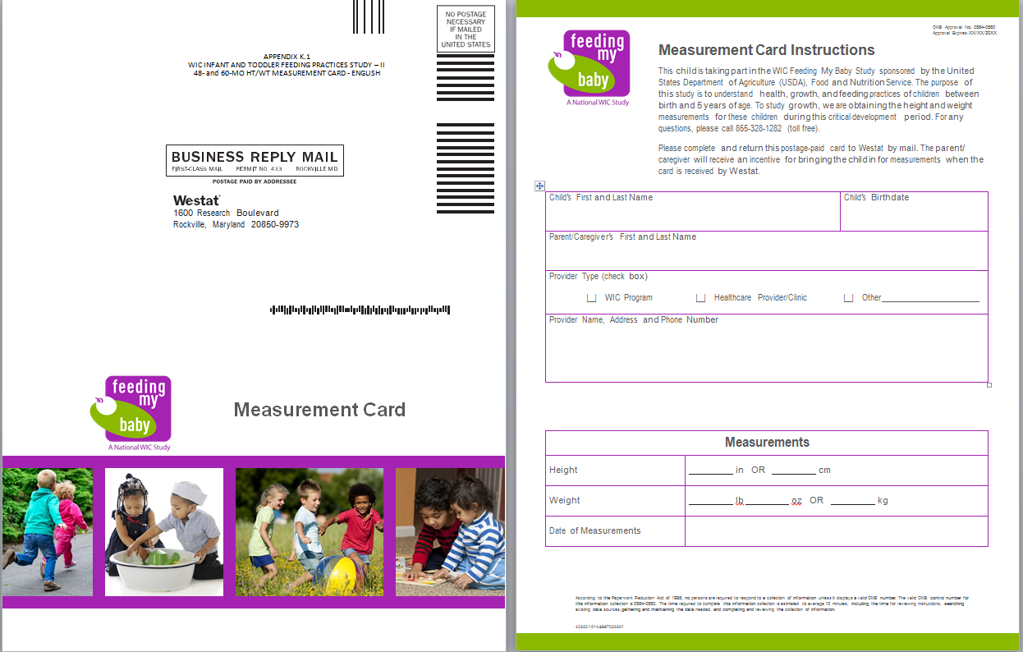
Measurement Card
Notes:
This is what the measurement card looks like. Some of you have probably seen this because we are currently sending it to parents of the children in the study who are reaching their third birthday if they are no longer participating in WIC. We are asking them to take the child to a WIC site or healthcare provider for the measurements and to return the card to us. We will be using this same card for the 4 and 5 year old children.
Our experience to date with the 3 year old children is limited but most parents are choosing to take their child to [WIC sites? Healthcare providers?]

Slide 33
Measurements at WIC Sites
All children in the study—some on WIC and some not on WIC
All parents/caregivers will be offered incentive to have measurement card completed and returned
  On WIC at 48 months: recertification
  Not on WIC at 48 and 60 months: identify convenient WIC site for parent/caregiver
Notes:
All parents/caregivers of children in the study will receive the measurement card near the time of the child’s fourth and fifth birthdays. Some of these children will still be on WIC when they turn 4 but most are likely to be no longer receiving WIC.
All parents will be offered the incentives to return the completed measurement cards.
For children on WIC at age 4, they will be advised to take the card to their next WIC appointment which may be around the time of their recertification appointment. We would like WIC sites to complete it with the measurements taken around age 4.
For children not on WIC at age 4, and for all children at age 5, the parents will be asked to take the child to a WIC site or their healthcare provider for the measurements and to return the completed measurement card. For the parents who choose to go to WIC for the measurements, we will suggest the WIC site where they were enrolled in the study if they still live in the area where it is located. If the family or the site has relocated, we will assist them with identifying a site that is convenient for them.
We’ll discuss the best approach for identifying sites with the state agencies in our upcoming calls.

Slide 34
Measurement Data Alternatives
WIC data request for 48 month measurements
  only if child is on WIC and measurement card not returned
Request for measurements from healthcare provider
Parent/caregiver sends in copy of record from healthcare provider
Home health agency
Notes:
If the measurement card is not returned…..

Slide 35
Other Assistance from WIC
Help with locating parents/caregivers of children in the study if….
  They can’t be located through other means
  They are believed to be participating in WIC
Notes:
If we cannot get in touch with parents/guardians using the contact information we will contact the site or, if preferred, the state agency where they were enrolled in the study but only if…..
We will ask for updated contact information if you have information that is more current that what we have. We have been making these requests of WIC sites or state agencies since the study began and appreciate the cooperation we’ve received.

Slide 36

What are your questions?
Notes:
Now we’d like to hear your questions about the study or the activities during the extension to age 5.
As mentioned earlier, we’ll be setting up calls with each state and the sites in their state to have a chance to talk about the specifics and logistics for the assistance we’ll need through the end of the study.

Slide 37

Thank you for your support!
Notes:
Opportunity for all on team to make comments of thanks.

