Slide 1
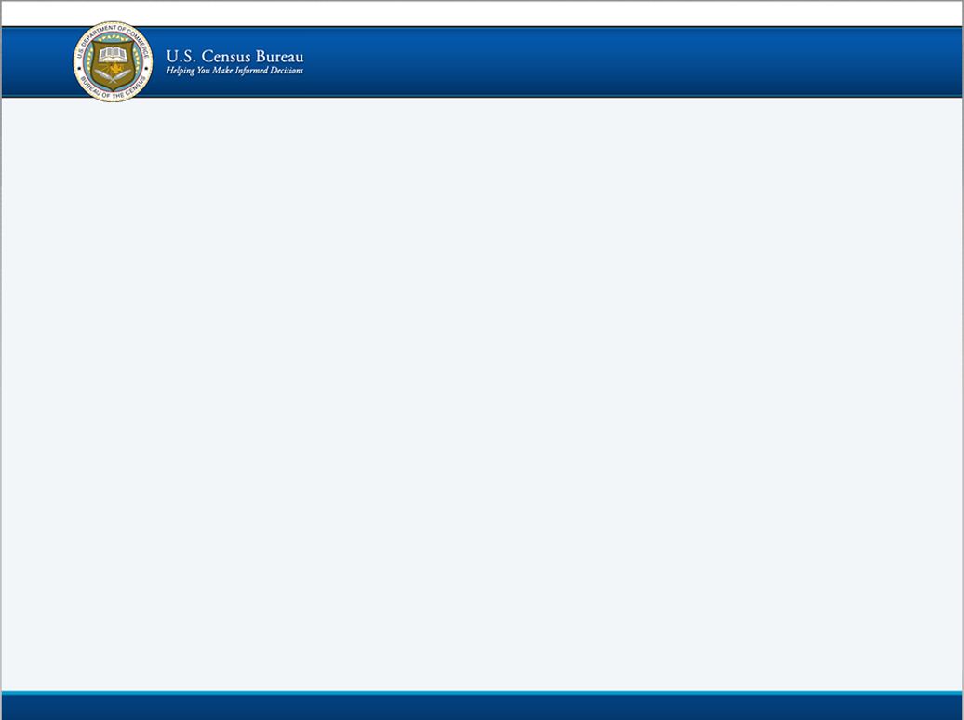
DRAFT Welcome Screen (Available on test day), page 1
PROPOSED
WELCOME
The U.S. Census Bureau welcomes you to the Group Quarters Electronic Response (eResponse) Data Test website.
Your responses to the eResponse Test will assist us in our planning efforts to enumerate Group Quarter (GQ) facilities for the 2020 Census.
If you have questions regarding this test, please email DCMD.Special.Enumeration.Branch.List@census.gov or call 301-763-9333.
Thank you for your participation.
Login
Login by entering the appropriate information and press the ‘Login’ button
User ID and Password are case sensitive
User ID:
Password:
Note: You session will expire if you remain on one screen for 45 minutes .
** WARNING **
You have accessed a UNITED STATES GOVERNMENT computer. User of this computer without authorization or for purposes for which authorization has been extended is a violation of Federal law and can be punishable with fines or imprisonment (PUBLIC LAW 99-474). System usage may be monitored, recorded, and subject to audit. Any information that you enter into this system may be used by Census Bureau for statistical purposes, including but not limited to improving the efficiency of our data collection programs. For information regarding the use of this system and how your privacy is protected, visit our online privacy webpage at https://census.gov/privacy. Use of this system indicates consent to the collection, monitoring, recording and use of information provided in this system.
Burden Statement | About | Accessibility | Privacy | Security

Slide 2
DRAFT Profile Validation, page 2
PROPOSED
Display the GQ administrator’s profile
Prompt GQ administrator to confirm the displayed profile
Allow GQ administrator to update address data
GQ Facility Primary Contact Person Name
GQ Facility Primary Contact Title
GQ Facility Primary Contact Phone
GQ Facility Primary Contact Business E-mail Address
Against the user’s own profile

Slide 3
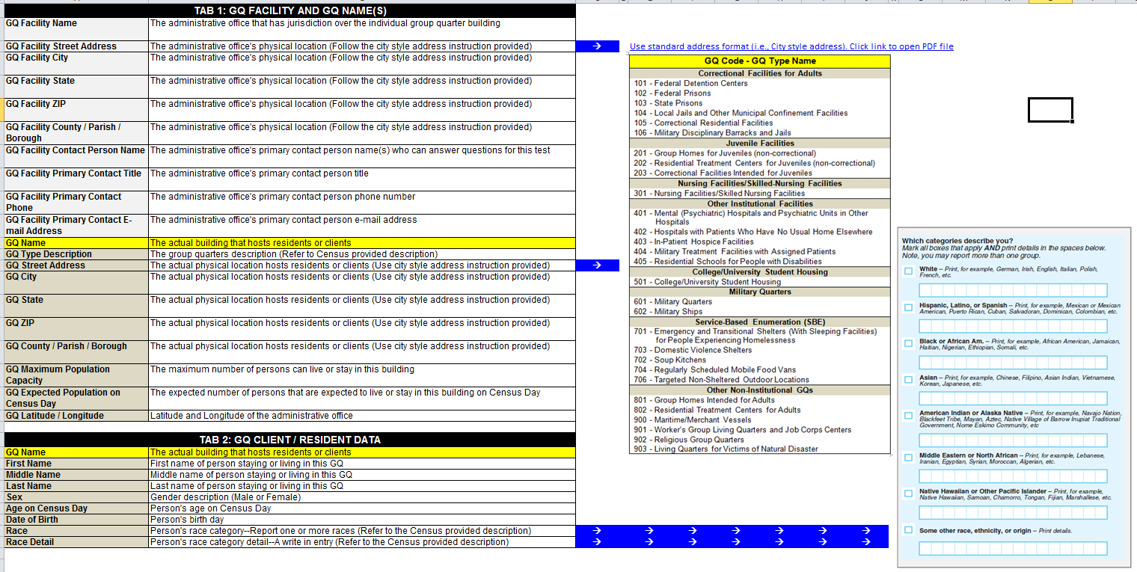
Requested Data, page 3A
PROPOSED
DO NOT SUBMIT THE FOLLOWING INFORMATION:
Personal Social Security Number or Federal Tax ID
Domestic violence shelter data
Information that the Census Bureau did not ask for

Slide 4
Instructions, page 3B
PROPOSED
There are two ways to provide your e eResponse data:
(PREFERED METHOD) Use the Excel Template. Download it and copy and paste the requested data directly to the spreadsheet
Provide the requested data in the original or as-is format (e.g., Excel, text, Access, SPSS, SAS, or Oracle)
Downloadable Standard Record Excel Template
Sample data in Standard Record Excel Template
Example standard address format guidelines
DO NOT SUBMIT THE FOLLOWING INFORMATION:
Personal Social Security Number or Federal Tax ID
Domestic violence shelter data
Information that the Census Bureau did not request

Slide 5
DRAFT Upload wizard, page 4
PROPOSED
Upload Wizard
Upload wizard
“Please select your eResponse data file…”
Upload
Maybe display the file name here ?
Submit

Slide 6
DRAFT Thank you page, page 5
PROPOSED
Thank you for participating in the Group Quarters Electronic Response Data Test.
Previous
Log Out

