Slide 1
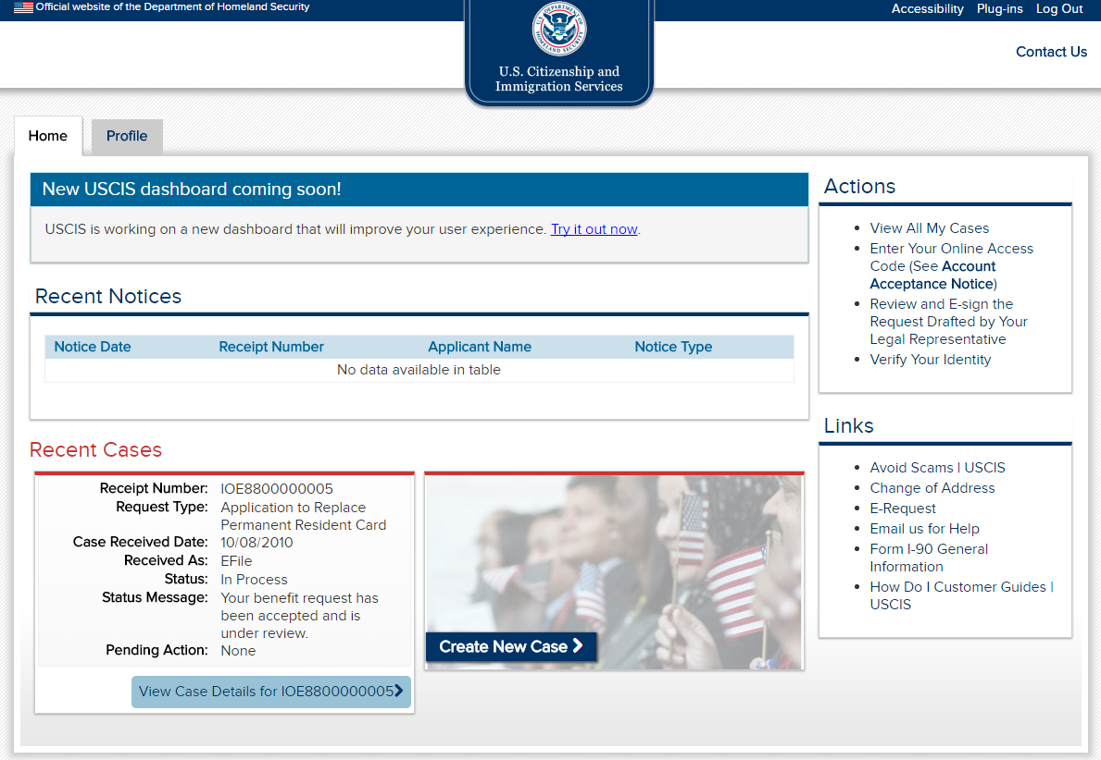

Slide 2
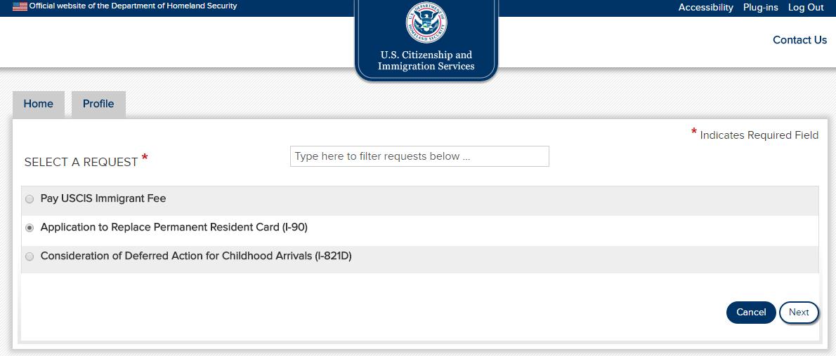

Slide 3
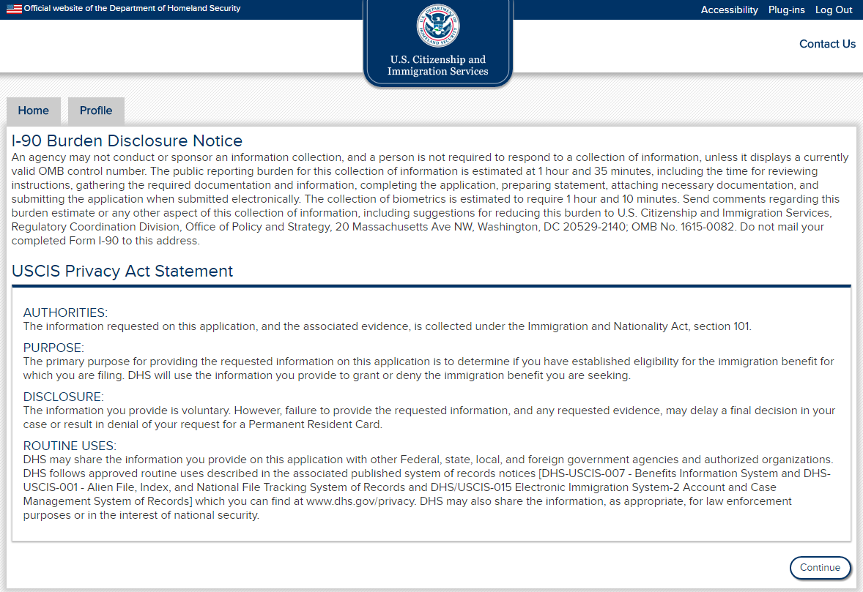

Slide 4
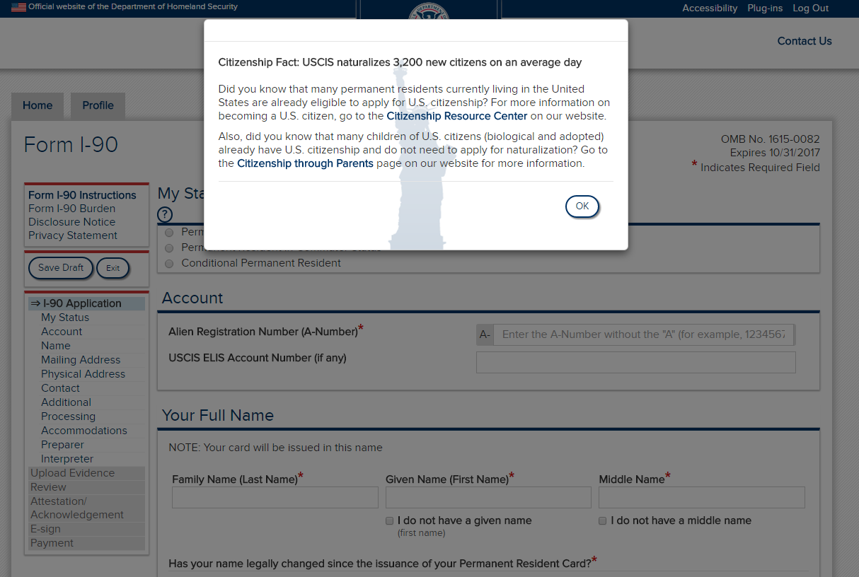

Slide 5
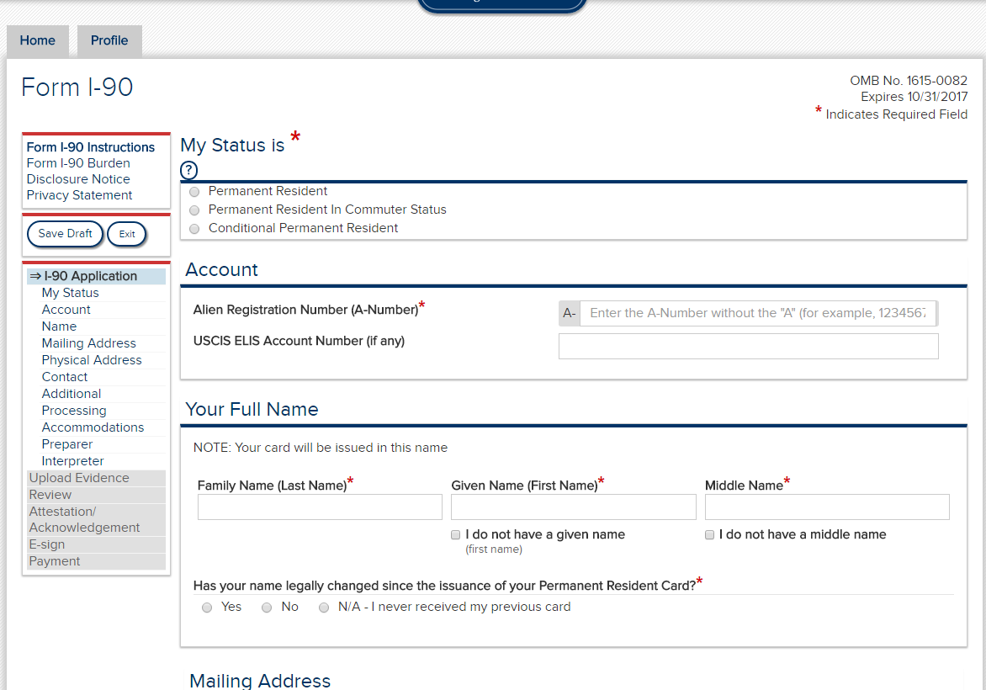
View on entry; no option selected under “My Status is”

Slide 6
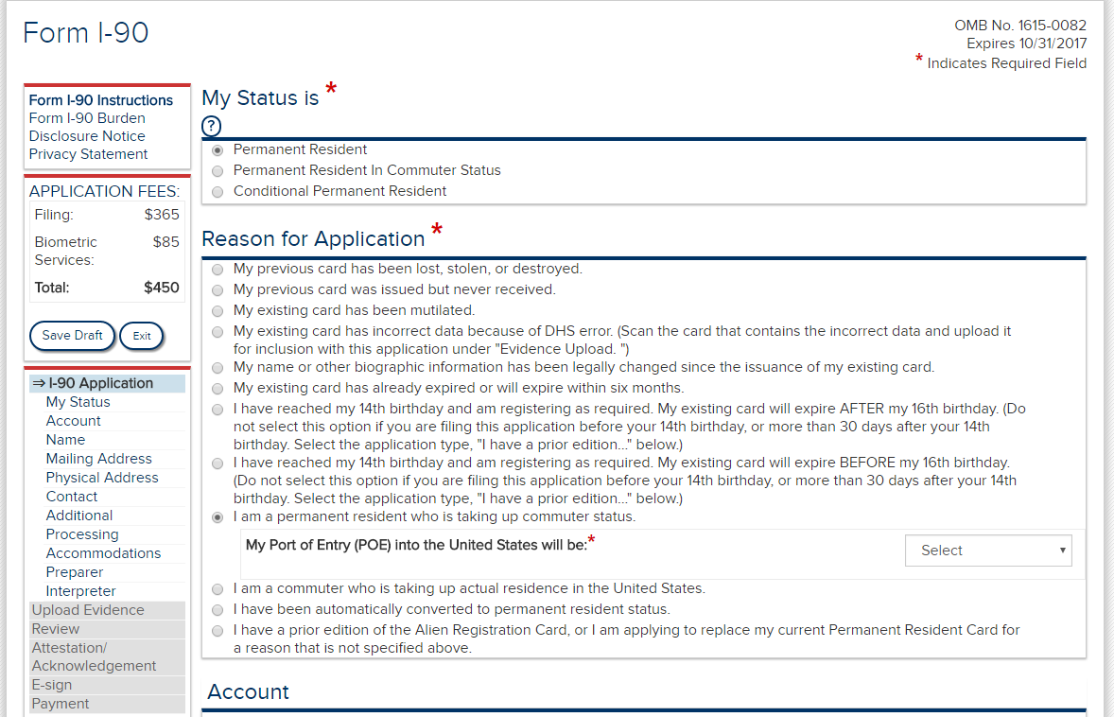
When “Permanent Resident” is selected, the corresponding “Reason for Application” options are displayed. If “taking up commuter status” is selected, the drop down for POE is displayed.

Slide 7
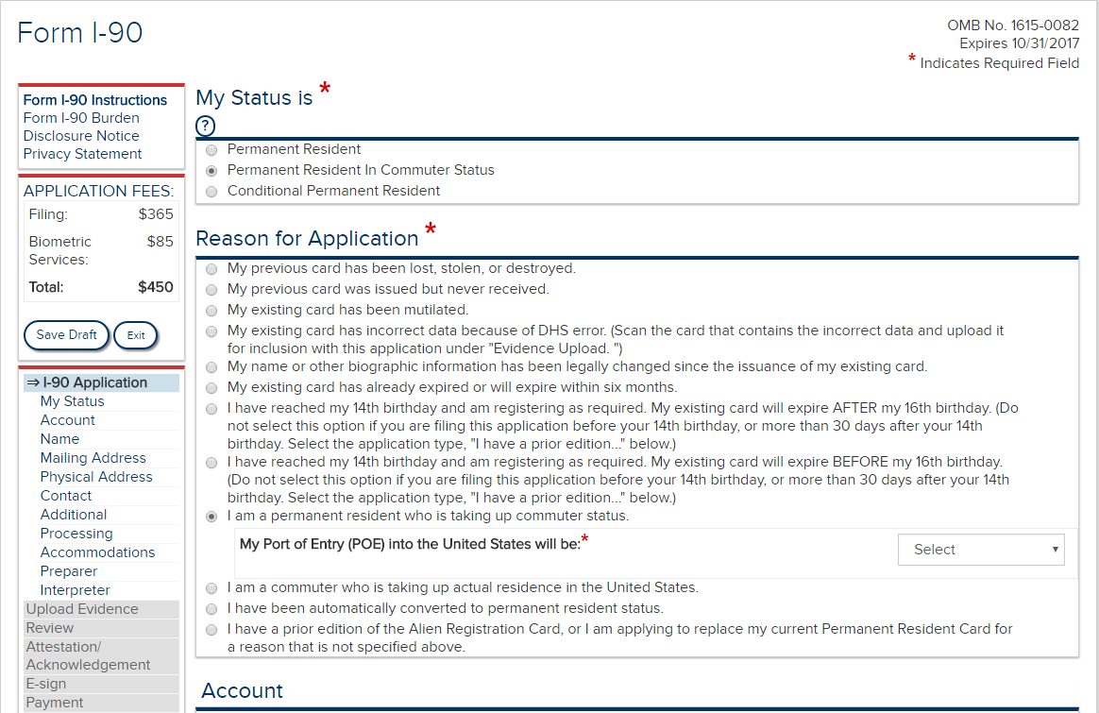
When “Permanent Resident in Commuter Status” is selected, the corresponding “Reason for Application” options are displayed. If “taking up commuter status” is selected, the drop down for POE is displayed.

Slide 8
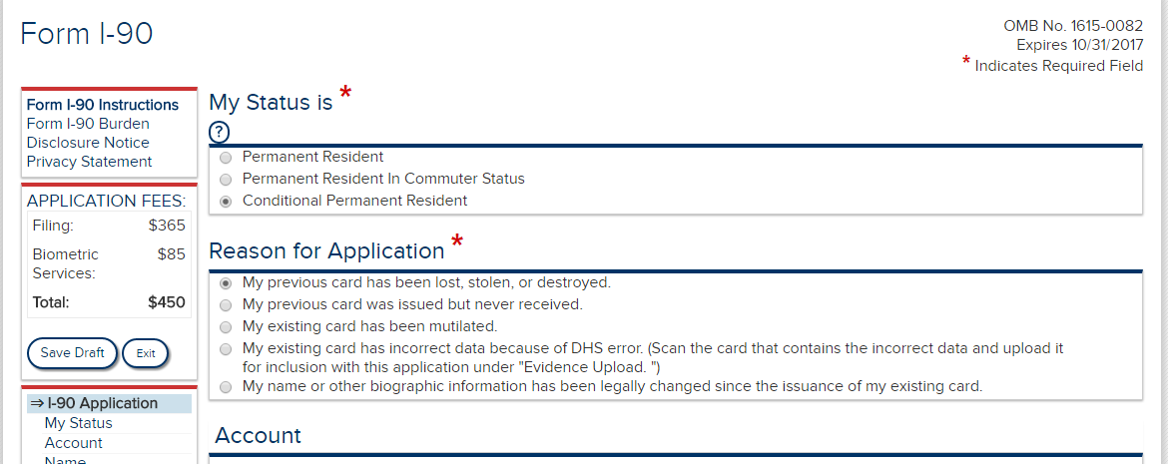
When “Conditional Permanent Resident” is selected, the corresponding “Reason for Application” options are displayed.

Slide 9
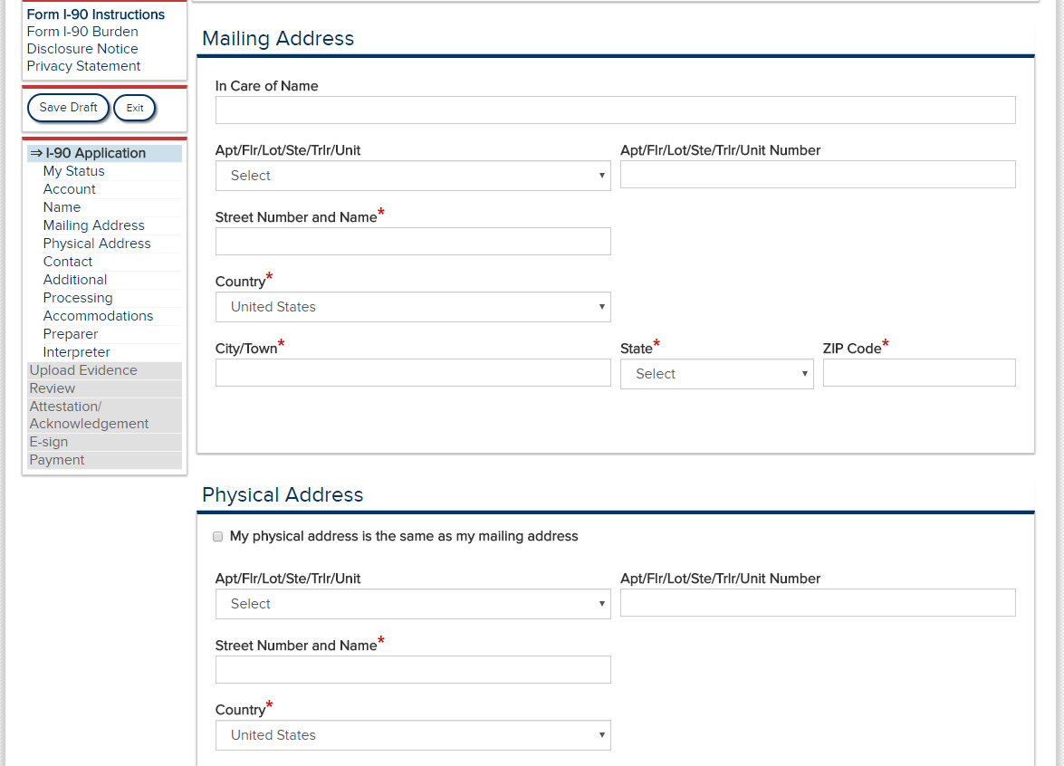

Slide 10
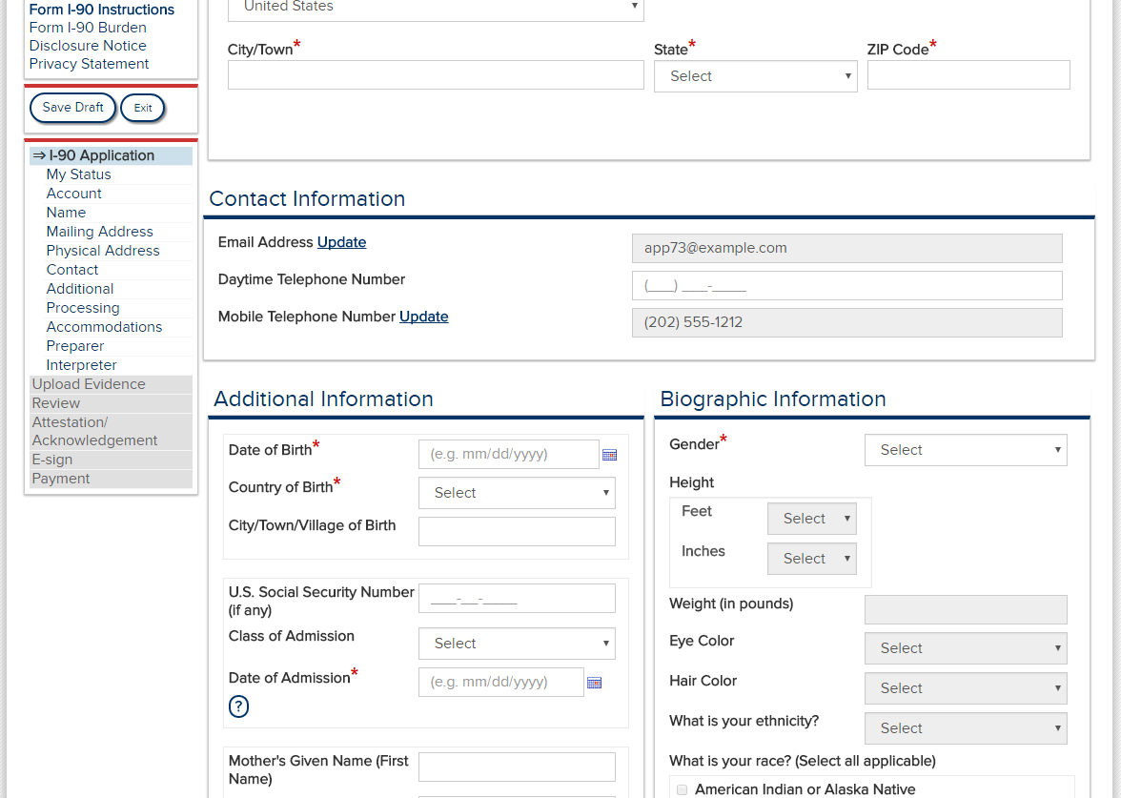

Slide 11
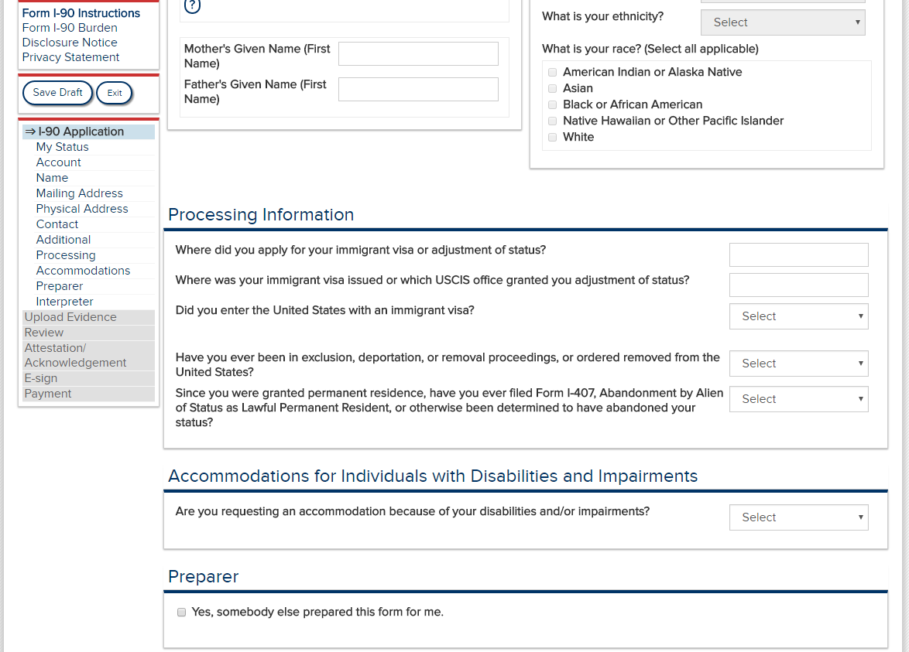

Slide 12
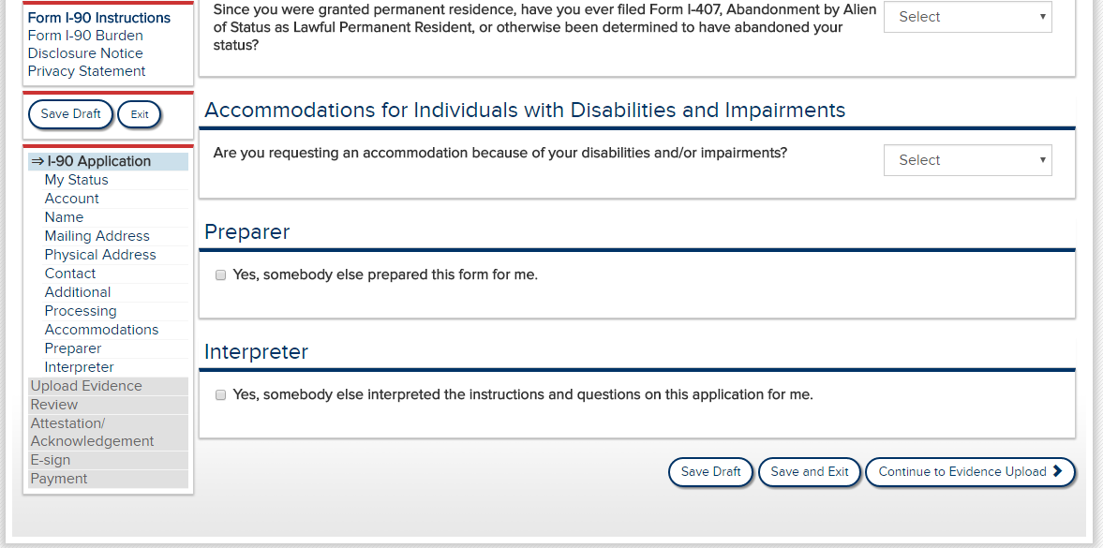

Slide 13
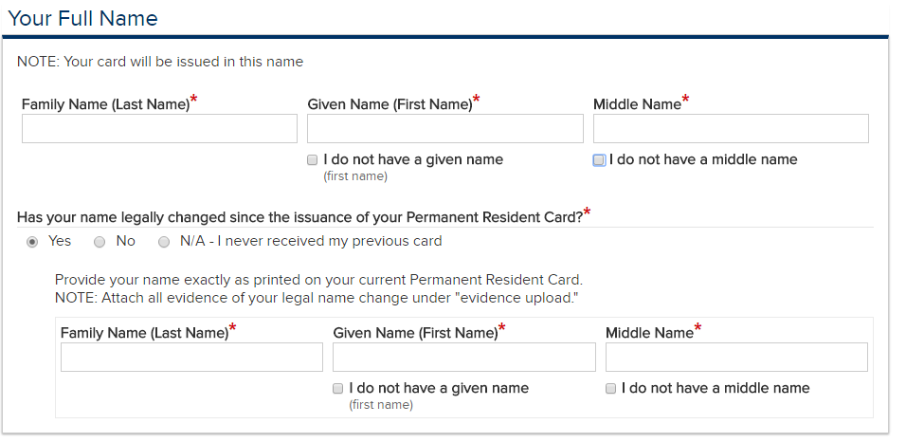
If the applicant selects Yes in response to “Has your name legally changed…,” the instructions to “Provide your name…” and the corresponding data entry fields are displayed. These remain hidden if either No or N/A are selected.

Slide 14
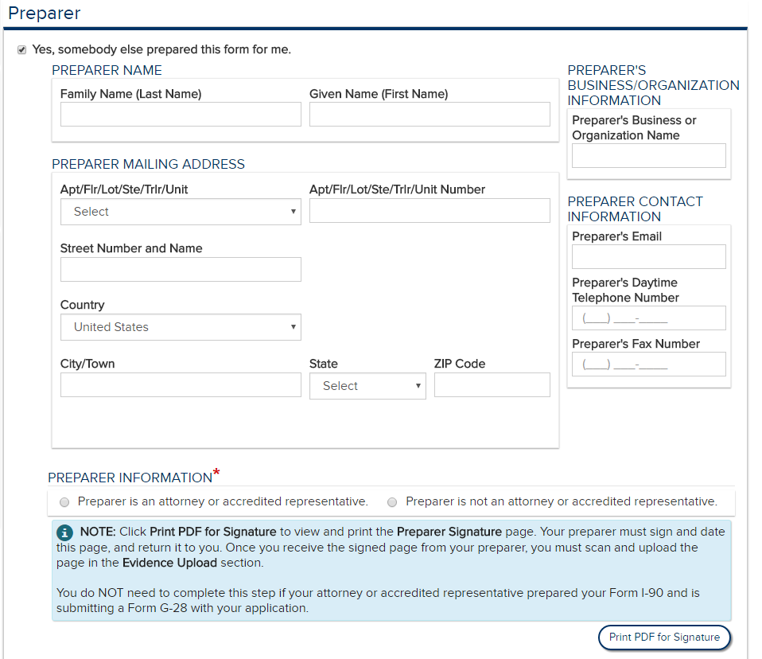
If the checkbox for “Yes, somebody else prepared this form for me.” is selected, the Preparer data entry fields are displayed. These remain hidden if the checkbox is not selected.

Slide 15
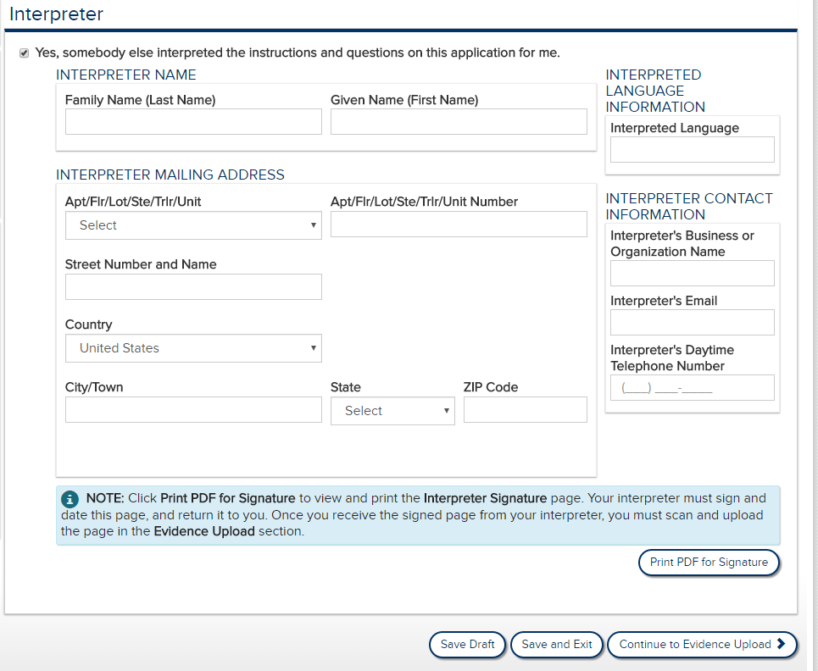
If the checkbox for “Yes, somebody else interpreted…for me.” is selected, the Interpreter data entry fields are displayed. These remain hidden if the checkbox is not selected.

Slide 16
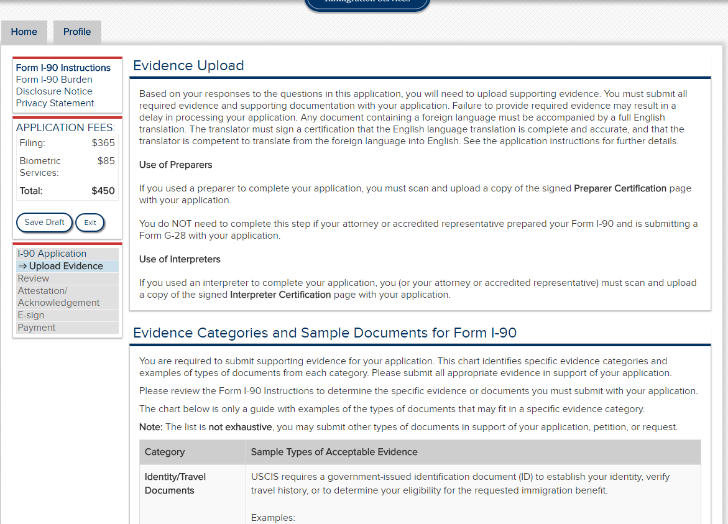

Slide 17
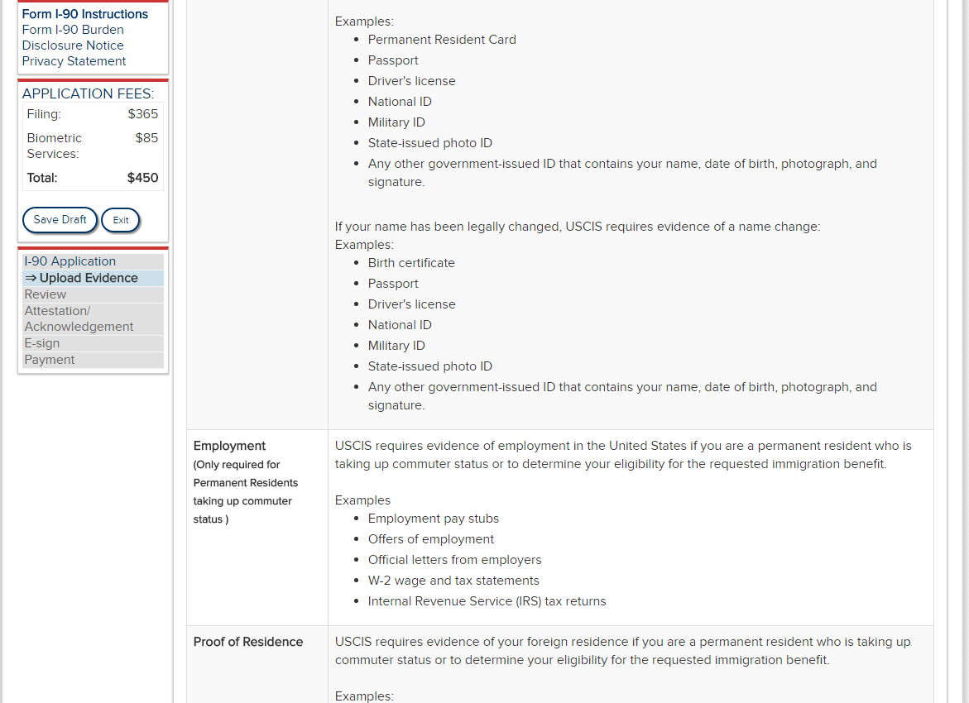

Slide 18
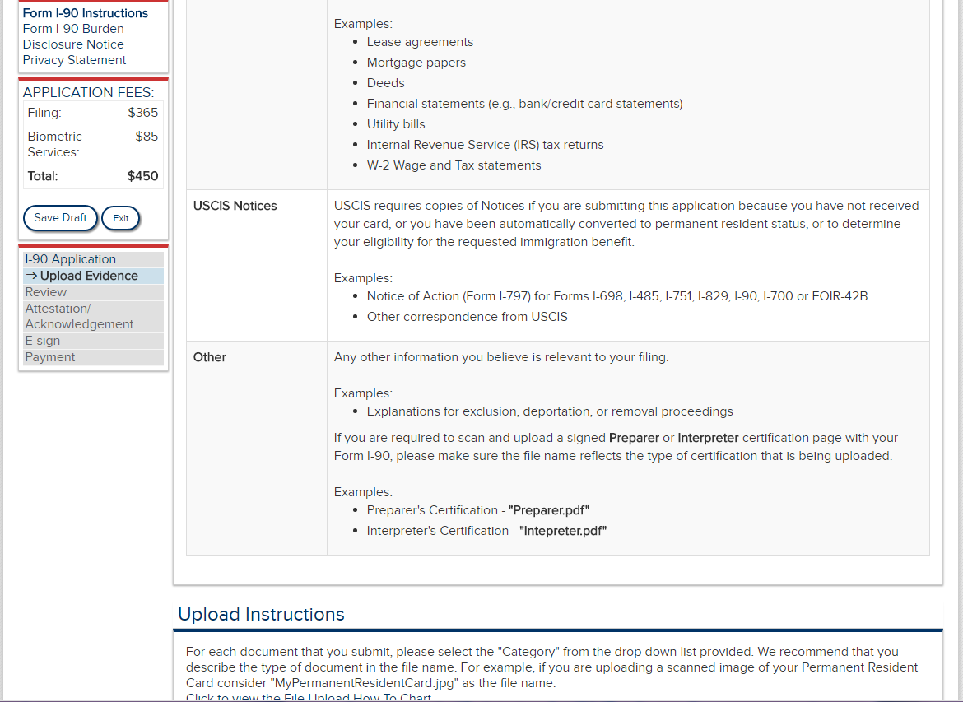

Slide 19
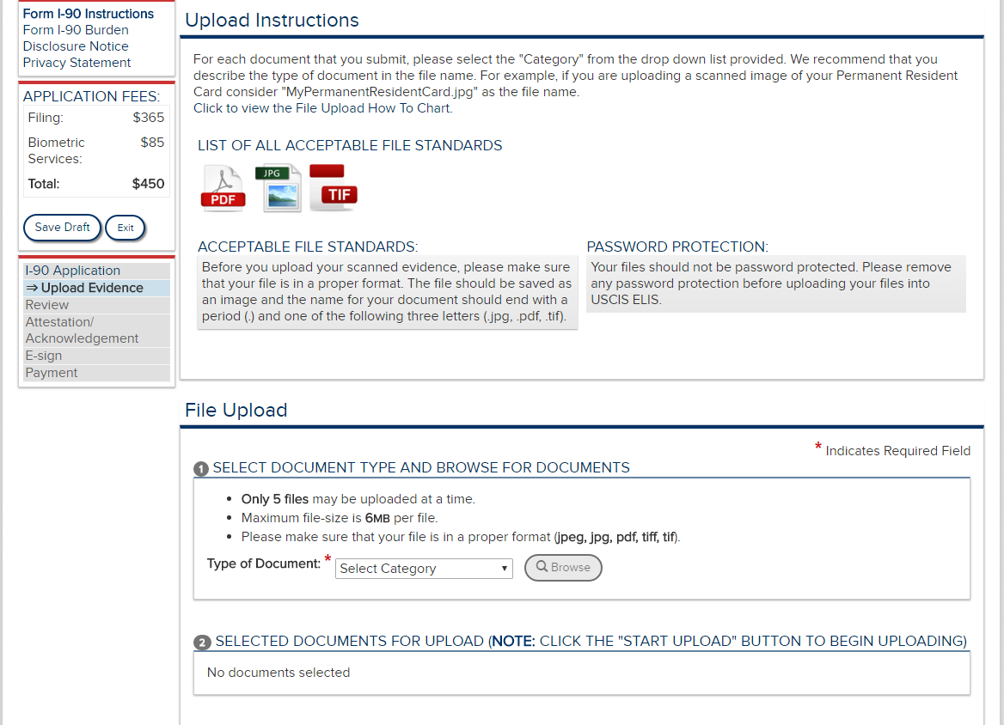

Slide 21
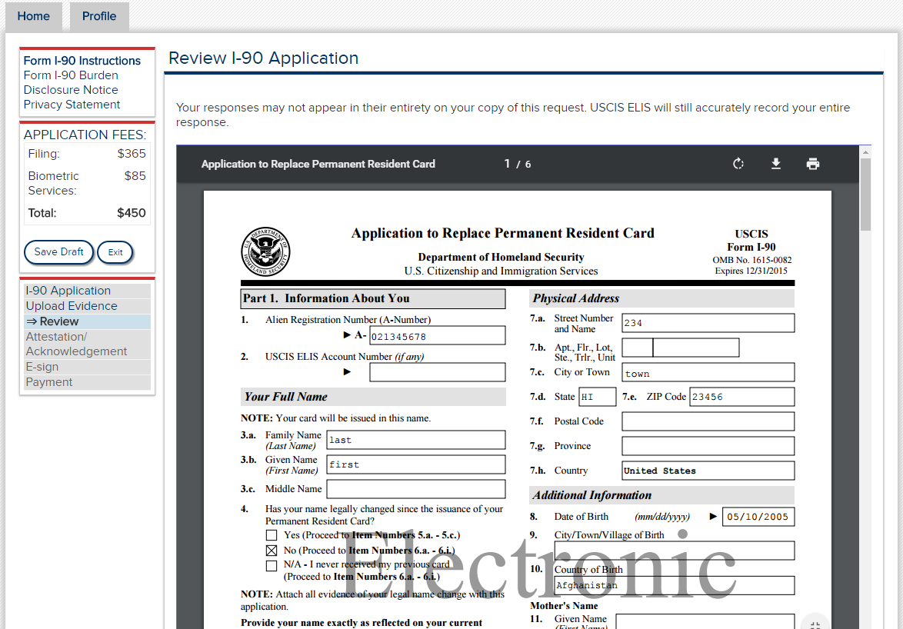

Slide 22
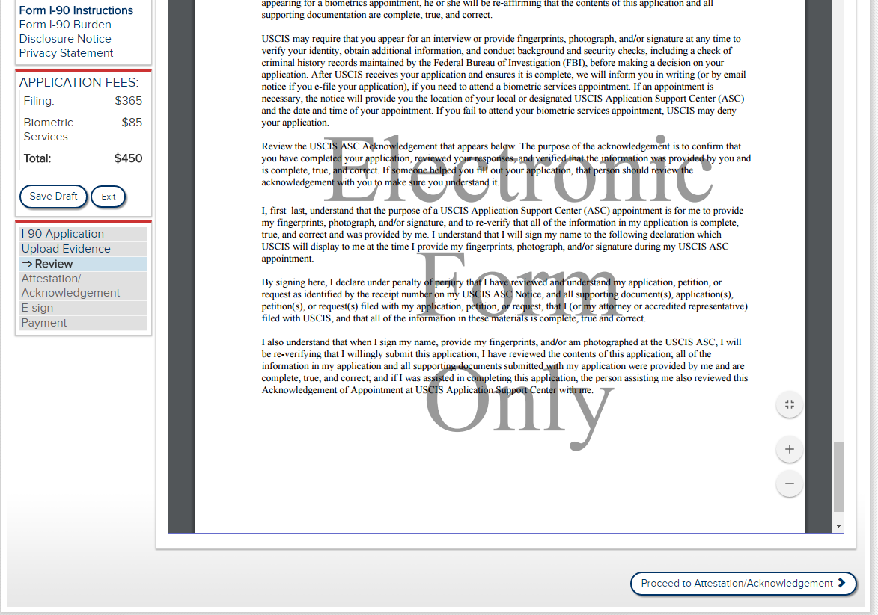

Slide 23
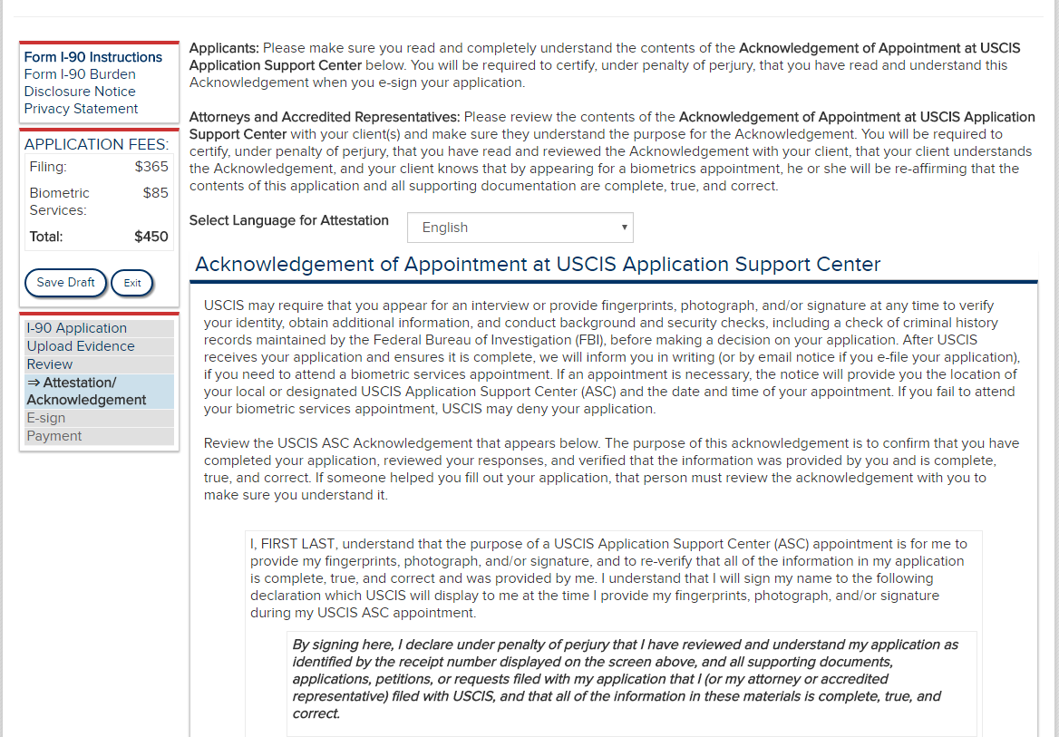

Slide 25
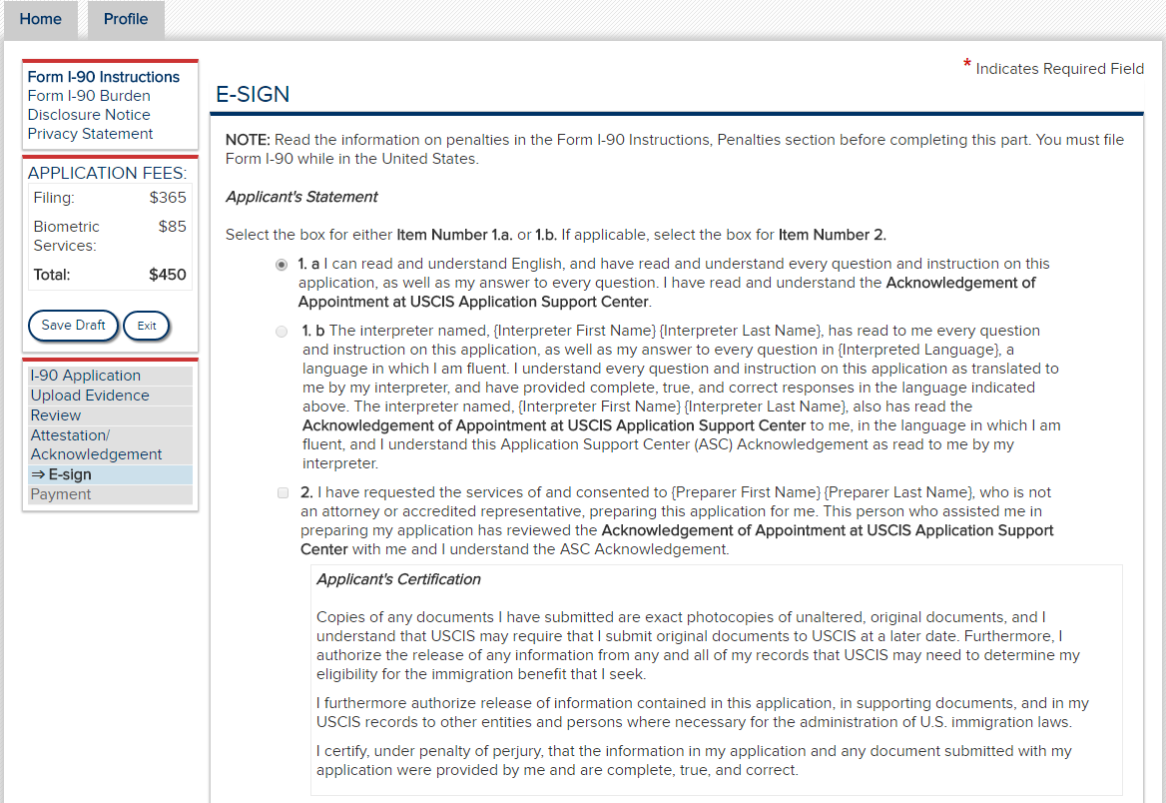

Slide 26
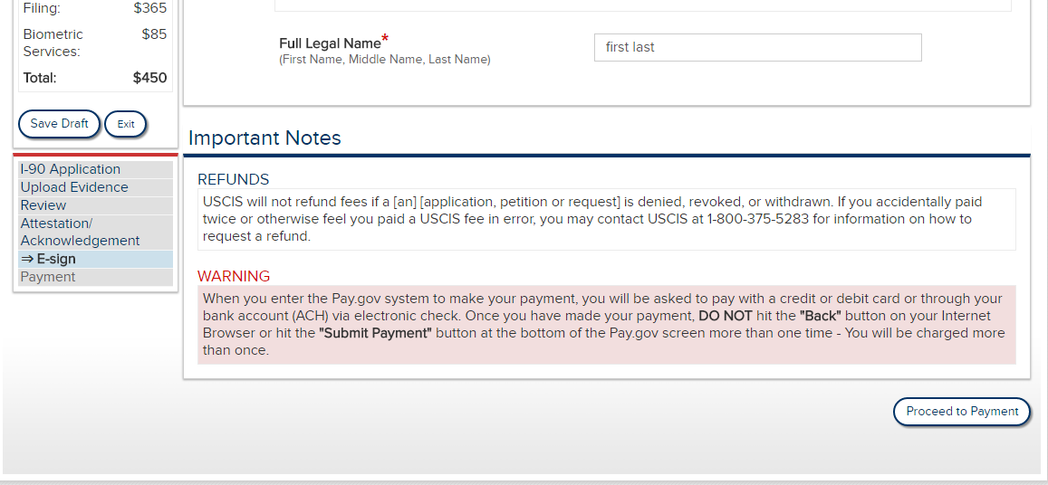

Slide 27
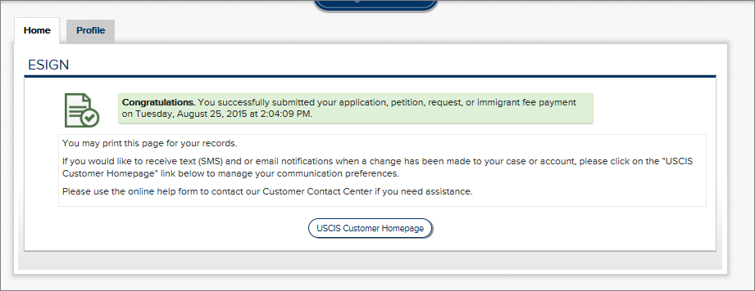
Payment transactions are processed via the Pay.gov website. This process is not represented in these screen shots. Please see the USCIS Electronic Fee Payment IC for the Pay.gov screens.
Once the transaction is complete, the applicant receives a confirmation screen, and can return to the homepage.

