Slide 1
Screen Shots of Online Forms for
Data Access Request, Renewal, and Close-out

Slide 2
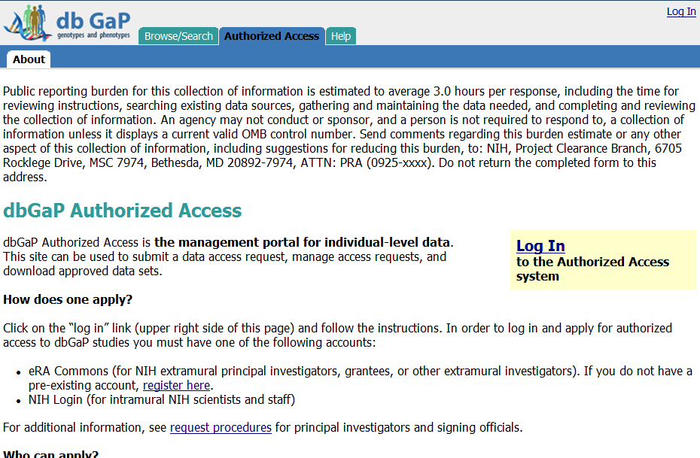
Public reporting burden for this collection of information is estimated to vary from 15 to 45 minutes per response, including the time for reviewing instructions, searching existing data sources, gathering and maintaining the data needed, and completing and reviewing the collection of information. An agency may not conduct or sponsor, and a person is not required to respond to, a collection of information unless it displays a currently valid OMB control number. Send comments regarding this burden estimate or any other aspect of this collection of information, including suggestions for reducing this burden, to: NIH, Project Clearance Branch, 6705 Rockledge Drive, MSC 7974, Bethesda, MD 20892-7974, ATTN: PRA (0925-xxxx). Do not return the completed form to this address.

Slide 3
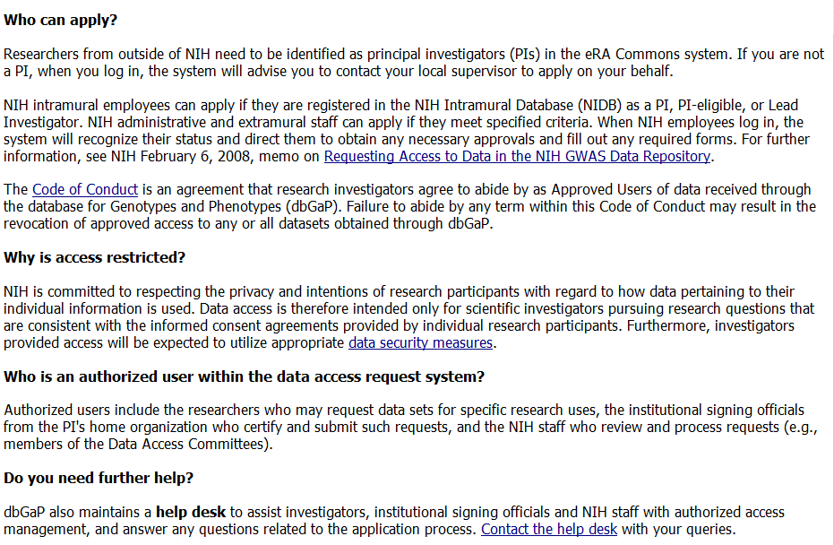

Slide 5
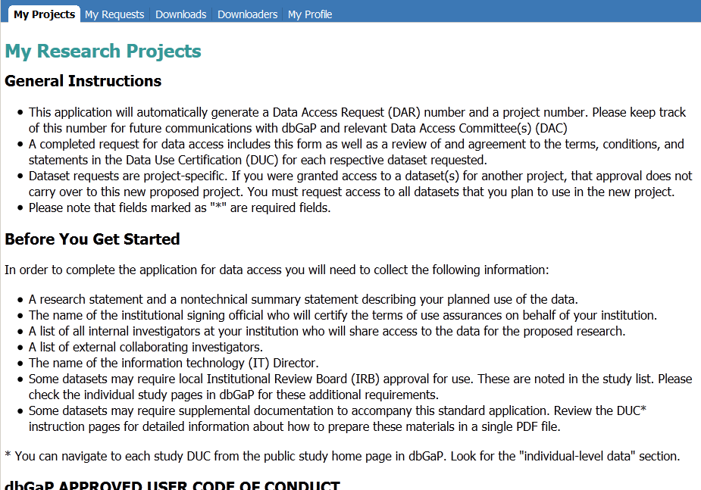

Slide 7
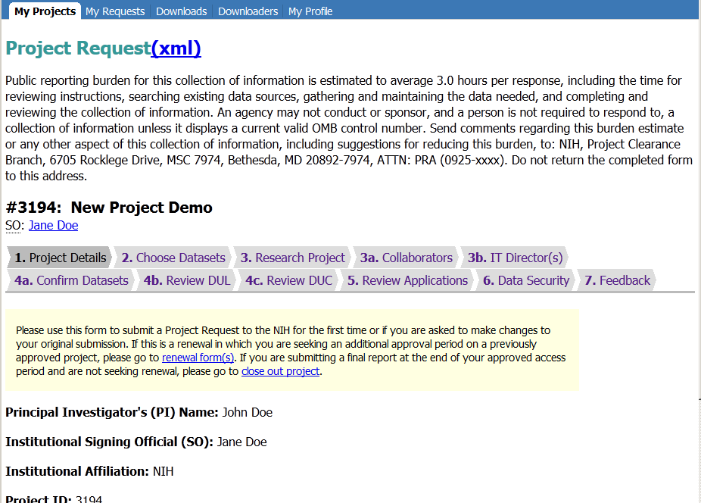
Public reporting burden for this collection of information is estimated to vary from 15 to 45 minutes per response, including the time for reviewing instructions, searching existing data sources, gathering and maintaining the data needed, and completing and reviewing the collection of information. An agency may not conduct or sponsor, and a person is not required to respond to, a collection of information unless it displays a currently valid OMB control number. Send comments regarding this burden estimate or any other aspect of this collection of information, including suggestions for reducing this burden, to: NIH, Project Clearance Branch, 6705 Rockledge Drive, MSC 7974, Bethesda, MD 20892-7974, ATTN: PRA (0925-xxxx). Do not return the completed form to this address.

Slide 9
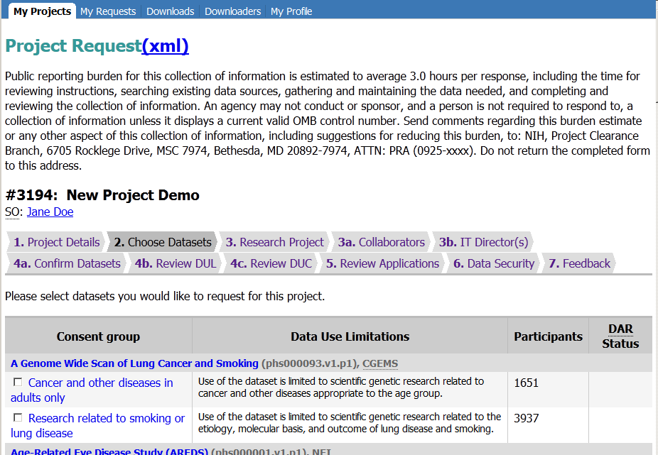
Public reporting burden for this collection of information is estimated to vary from 15 to 45 minutes per response, including the time for reviewing instructions, searching existing data sources, gathering and maintaining the data needed, and completing and reviewing the collection of information. An agency may not conduct or sponsor, and a person is not required to respond to, a collection of information unless it displays a currently valid OMB control number. Send comments regarding this burden estimate or any other aspect of this collection of information, including suggestions for reducing this burden, to: NIH, Project Clearance Branch, 6705 Rockledge Drive, MSC 7974, Bethesda, MD 20892-7974, ATTN: PRA (0925-xxxx). Do not return the completed form to this address.

Slide 11
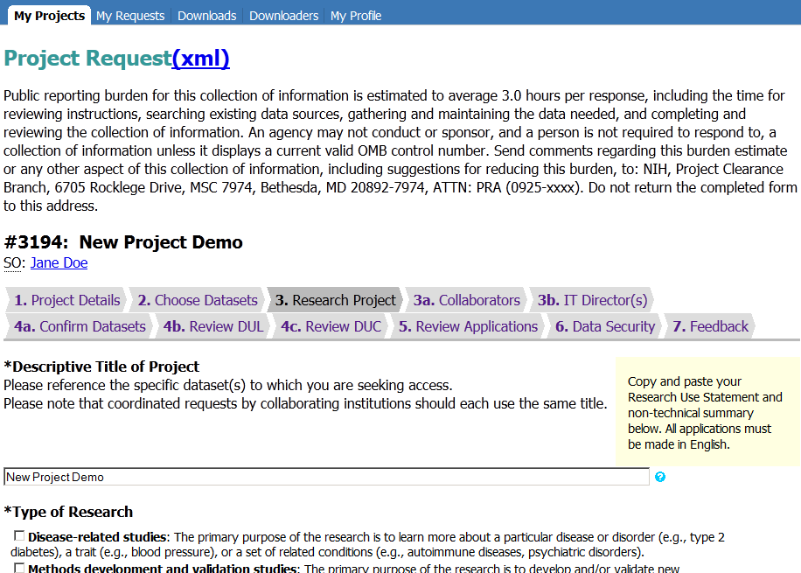
Public reporting burden for this collection of information is estimated to vary from 15 to 45 minutes per response, including the time for reviewing instructions, searching existing data sources, gathering and maintaining the data needed, and completing and reviewing the collection of information. An agency may not conduct or sponsor, and a person is not required to respond to, a collection of information unless it displays a currently valid OMB control number. Send comments regarding this burden estimate or any other aspect of this collection of information, including suggestions for reducing this burden, to: NIH, Project Clearance Branch, 6705 Rockledge Drive, MSC 7974, Bethesda, MD 20892-7974, ATTN: PRA (0925-xxxx). Do not return the completed form to this address.

Slide 12
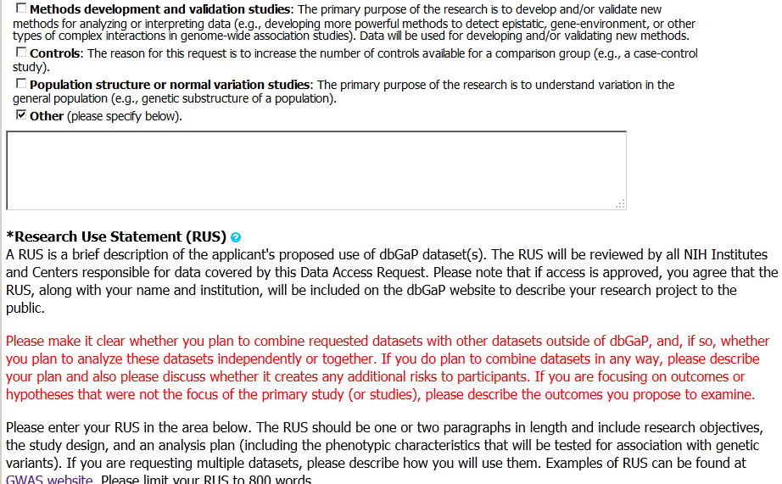

Slide 13
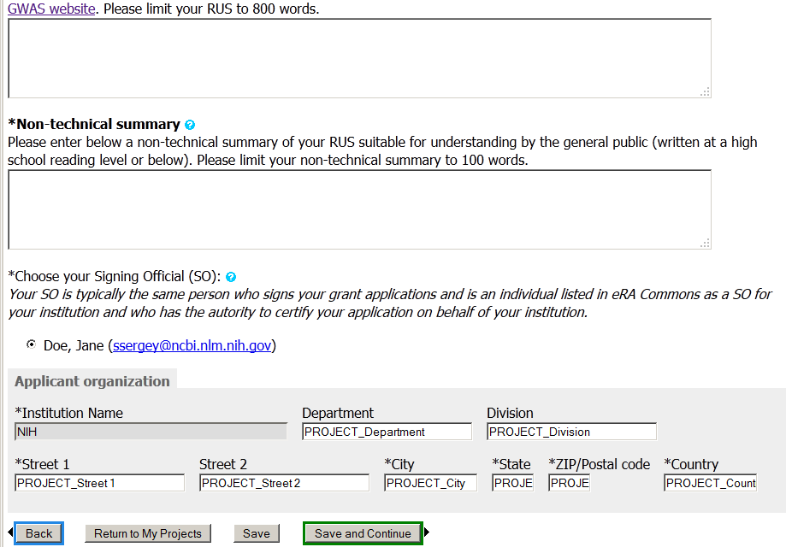

Slide 14
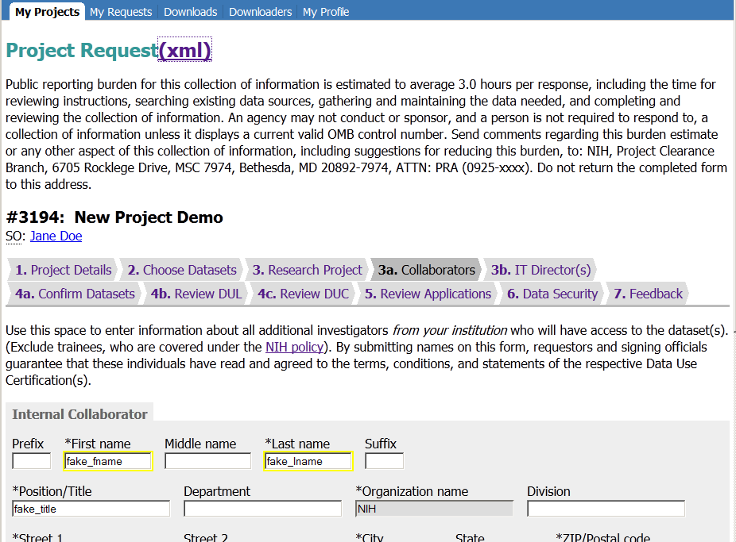
Public reporting burden for this collection of information is estimated to vary from 15 to 45 minutes per response, including the time for reviewing instructions, searching existing data sources, gathering and maintaining the data needed, and completing and reviewing the collection of information. An agency may not conduct or sponsor, and a person is not required to respond to, a collection of information unless it displays a currently valid OMB control number. Send comments regarding this burden estimate or any other aspect of this collection of information, including suggestions for reducing this burden, to: NIH, Project Clearance Branch, 6705 Rockledge Drive, MSC 7974, Bethesda, MD 20892-7974, ATTN: PRA (0925-xxxx). Do not return the completed form to this address.

Slide 15
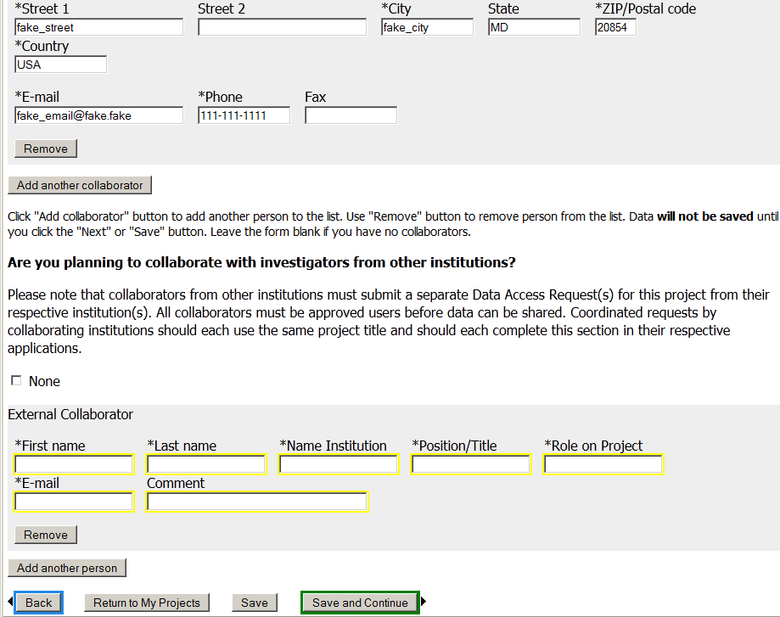

Slide 16
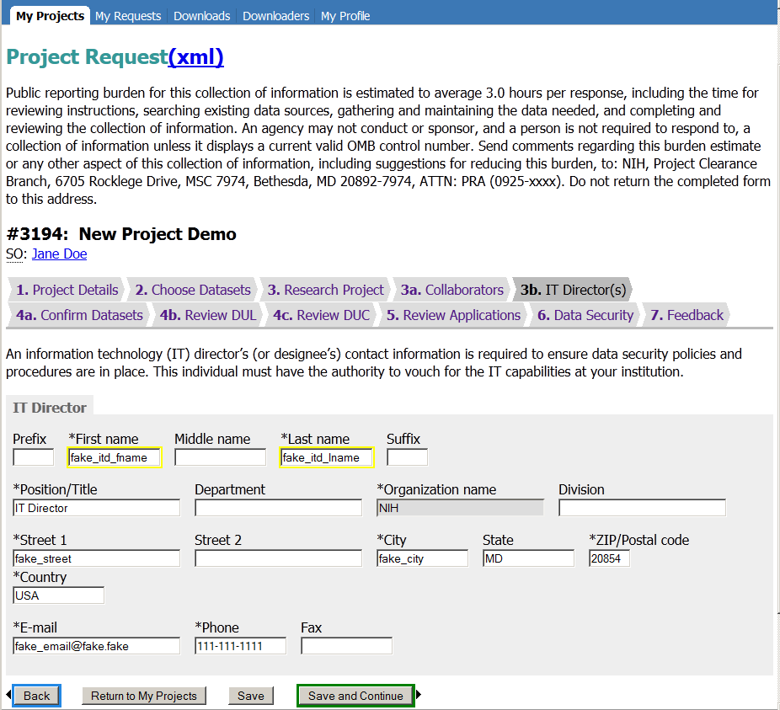
Public reporting burden for this collection of information is estimated to vary from 15 to 45 minutes per response, including the time for reviewing instructions, searching existing data sources, gathering and maintaining the data needed, and completing and reviewing the collection of information. An agency may not conduct or sponsor, and a person is not required to respond to, a collection of information unless it displays a currently valid OMB control number. Send comments regarding this burden estimate or any other aspect of this collection of information, including suggestions for reducing this burden, to: NIH, Project Clearance Branch, 6705 Rockledge Drive, MSC 7974, Bethesda, MD 20892-7974, ATTN: PRA (0925-xxxx). Do not return the completed form to this address.

Slide 17
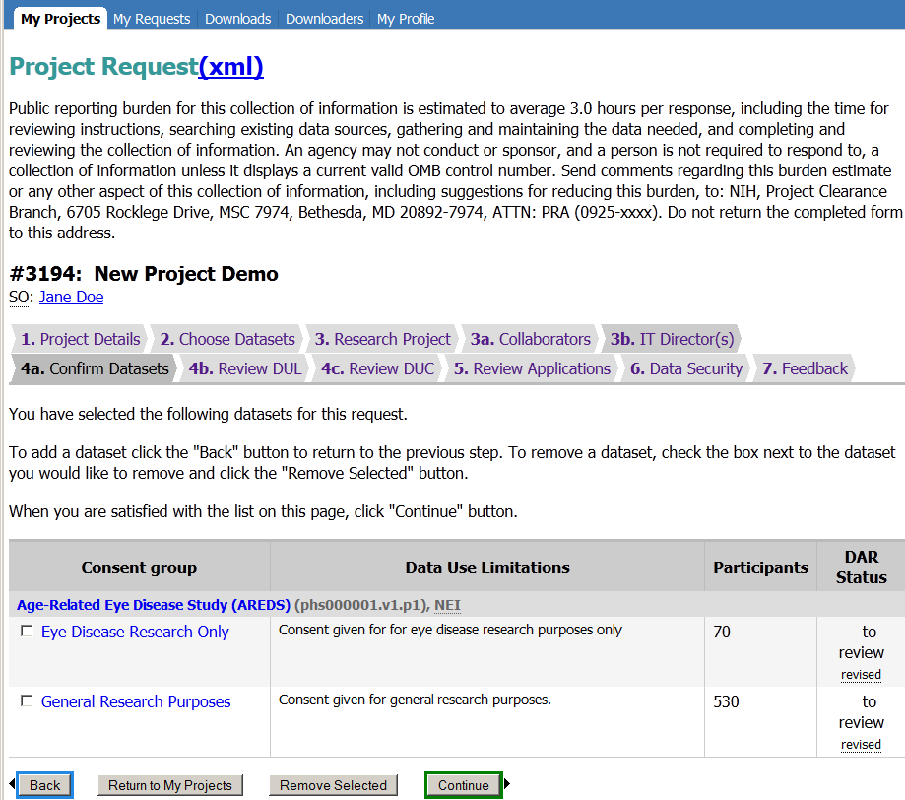
Public reporting burden for this collection of information is estimated to vary from 15 to 45 minutes per response, including the time for reviewing instructions, searching existing data sources, gathering and maintaining the data needed, and completing and reviewing the collection of information. An agency may not conduct or sponsor, and a person is not required to respond to, a collection of information unless it displays a currently valid OMB control number. Send comments regarding this burden estimate or any other aspect of this collection of information, including suggestions for reducing this burden, to: NIH, Project Clearance Branch, 6705 Rockledge Drive, MSC 7974, Bethesda, MD 20892-7974, ATTN: PRA (0925-xxxx). Do not return the completed form to this address.

Slide 18
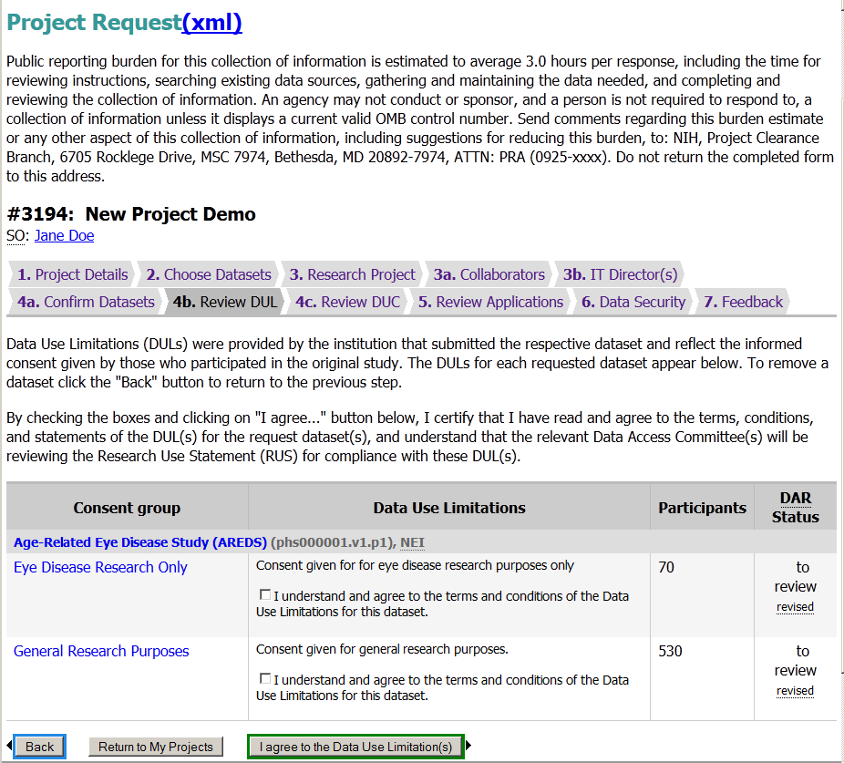
Public reporting burden for this collection of information is estimated to vary from 15 to 45 minutes per response, including the time for reviewing instructions, searching existing data sources, gathering and maintaining the data needed, and completing and reviewing the collection of information. An agency may not conduct or sponsor, and a person is not required to respond to, a collection of information unless it displays a currently valid OMB control number. Send comments regarding this burden estimate or any other aspect of this collection of information, including suggestions for reducing this burden, to: NIH, Project Clearance Branch, 6705 Rockledge Drive, MSC 7974, Bethesda, MD 20892-7974, ATTN: PRA (0925-xxxx). Do not return the completed form to this address.

Slide 19
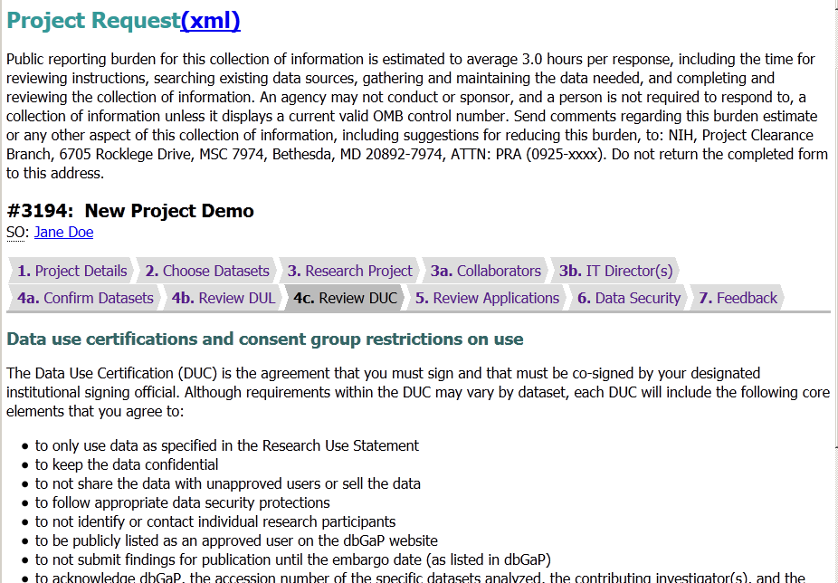
Public reporting burden for this collection of information is estimated to vary from 15 to 45 minutes per response, including the time for reviewing instructions, searching existing data sources, gathering and maintaining the data needed, and completing and reviewing the collection of information. An agency may not conduct or sponsor, and a person is not required to respond to, a collection of information unless it displays a currently valid OMB control number. Send comments regarding this burden estimate or any other aspect of this collection of information, including suggestions for reducing this burden, to: NIH, Project Clearance Branch, 6705 Rockledge Drive, MSC 7974, Bethesda, MD 20892-7974, ATTN: PRA (0925-xxxx). Do not return the completed form to this address.

Slide 21
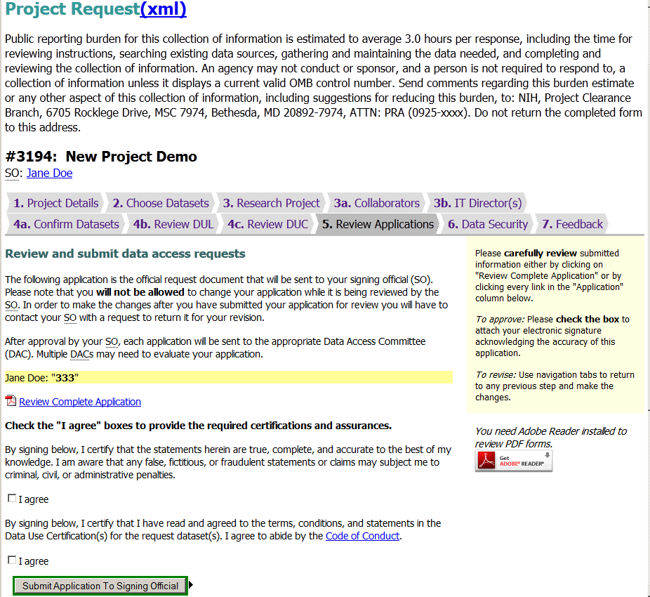
Public reporting burden for this collection of information is estimated to vary from 15 to 45 minutes per response, including the time for reviewing instructions, searching existing data sources, gathering and maintaining the data needed, and completing and reviewing the collection of information. An agency may not conduct or sponsor, and a person is not required to respond to, a collection of information unless it displays a currently valid OMB control number. Send comments regarding this burden estimate or any other aspect of this collection of information, including suggestions for reducing this burden, to: NIH, Project Clearance Branch, 6705 Rockledge Drive, MSC 7974, Bethesda, MD 20892-7974, ATTN: PRA (0925-xxxx). Do not return the completed form to this address.

Slide 22
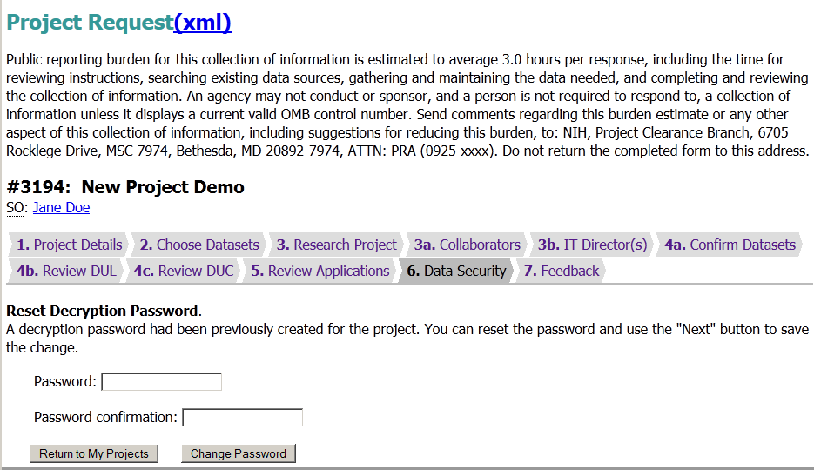
Public reporting burden for this collection of information is estimated to vary from 15 to 45 minutes per response, including the time for reviewing instructions, searching existing data sources, gathering and maintaining the data needed, and completing and reviewing the collection of information. An agency may not conduct or sponsor, and a person is not required to respond to, a collection of information unless it displays a currently valid OMB control number. Send comments regarding this burden estimate or any other aspect of this collection of information, including suggestions for reducing this burden, to: NIH, Project Clearance Branch, 6705 Rockledge Drive, MSC 7974, Bethesda, MD 20892-7974, ATTN: PRA (0925-xxxx). Do not return the completed form to this address.

Slide 23
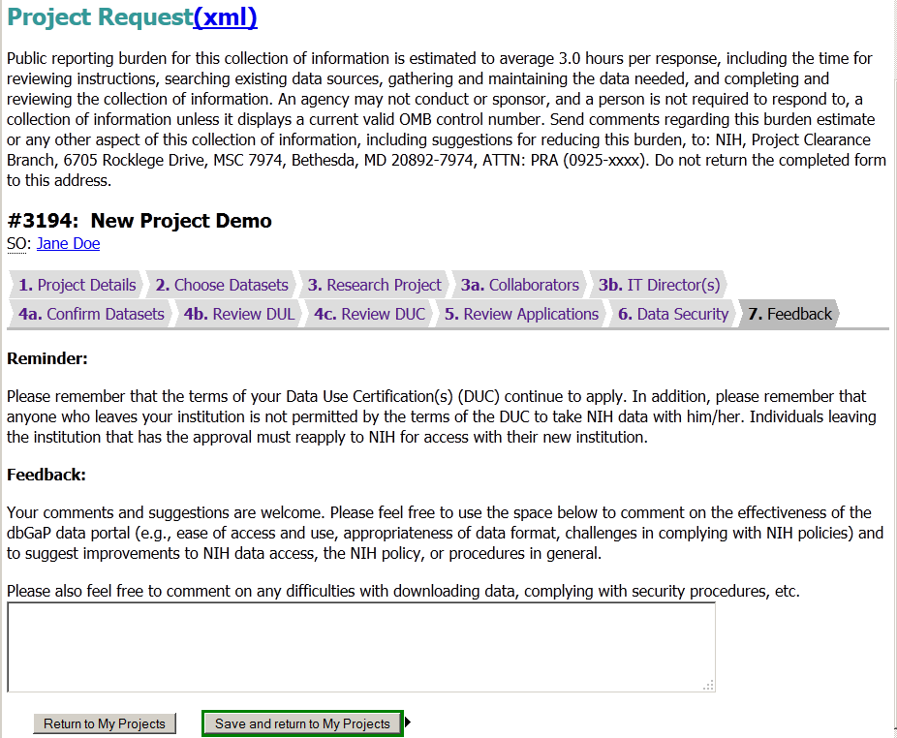
Public reporting burden for this collection of information is estimated to vary from 15 to 45 minutes per response, including the time for reviewing instructions, searching existing data sources, gathering and maintaining the data needed, and completing and reviewing the collection of information. An agency may not conduct or sponsor, and a person is not required to respond to, a collection of information unless it displays a currently valid OMB control number. Send comments regarding this burden estimate or any other aspect of this collection of information, including suggestions for reducing this burden, to: NIH, Project Clearance Branch, 6705 Rockledge Drive, MSC 7974, Bethesda, MD 20892-7974, ATTN: PRA (0925-xxxx). Do not return the completed form to this address.

Slide 24
dbGaP Authorized Access
Project Renewal Web Forms

Slide 25
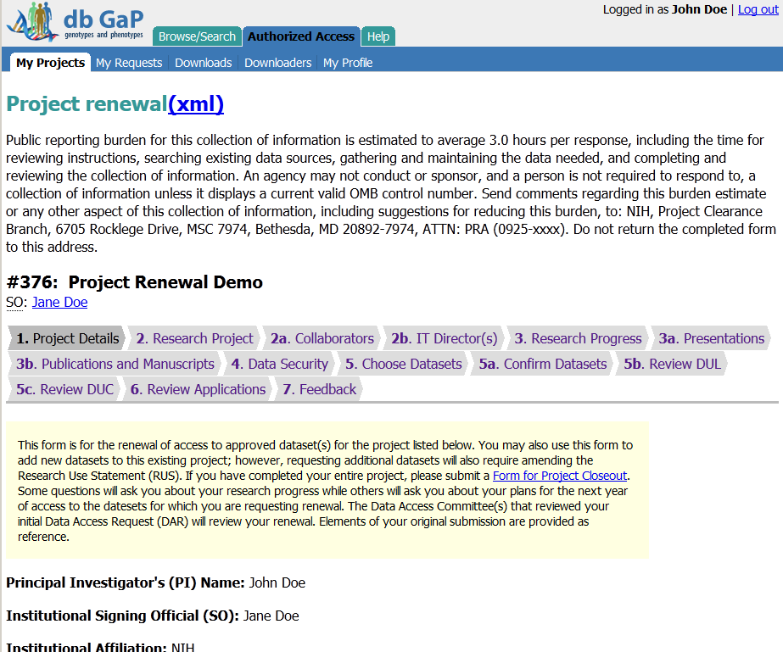
Public reporting burden for this collection of information is estimated to vary from 15 to 45 minutes per response, including the time for reviewing instructions, searching existing data sources, gathering and maintaining the data needed, and completing and reviewing the collection of information. An agency may not conduct or sponsor, and a person is not required to respond to, a collection of information unless it displays a currently valid OMB control number. Send comments regarding this burden estimate or any other aspect of this collection of information, including suggestions for reducing this burden, to: NIH, Project Clearance Branch, 6705 Rockledge Drive, MSC 7974, Bethesda, MD 20892-7974, ATTN: PRA (0925-xxxx). Do not return the completed form to this address.

Slide 26
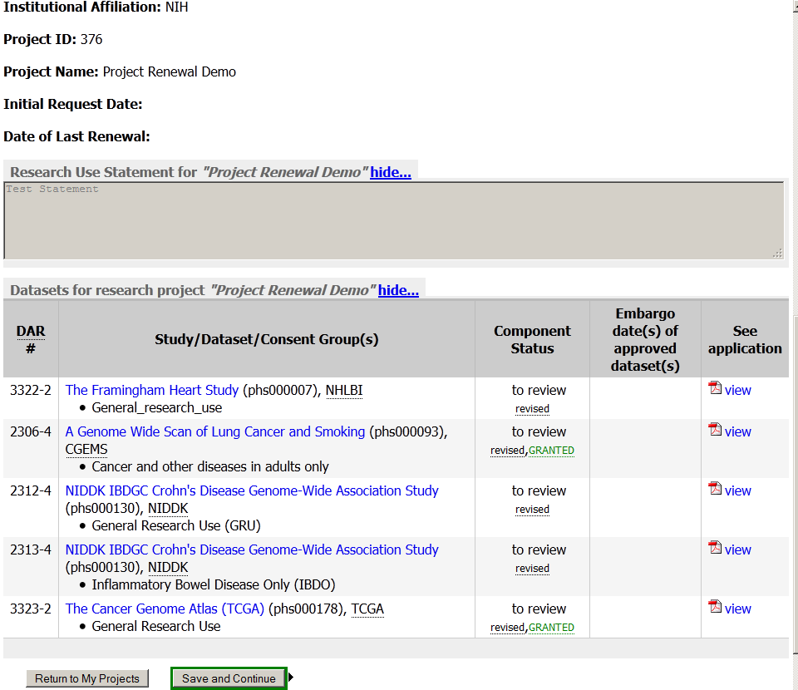

Slide 27
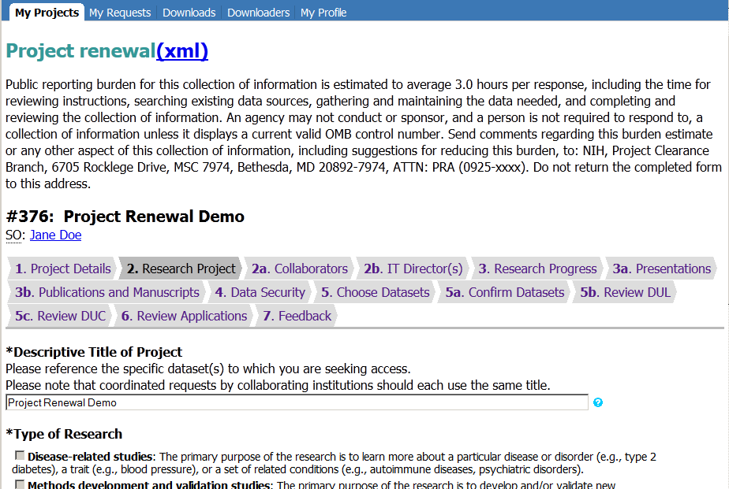
Public reporting burden for this collection of information is estimated to vary from 15 to 45 minutes per response, including the time for reviewing instructions, searching existing data sources, gathering and maintaining the data needed, and completing and reviewing the collection of information. An agency may not conduct or sponsor, and a person is not required to respond to, a collection of information unless it displays a currently valid OMB control number. Send comments regarding this burden estimate or any other aspect of this collection of information, including suggestions for reducing this burden, to: NIH, Project Clearance Branch, 6705 Rockledge Drive, MSC 7974, Bethesda, MD 20892-7974, ATTN: PRA (0925-xxxx). Do not return the completed form to this address.

Slide 28
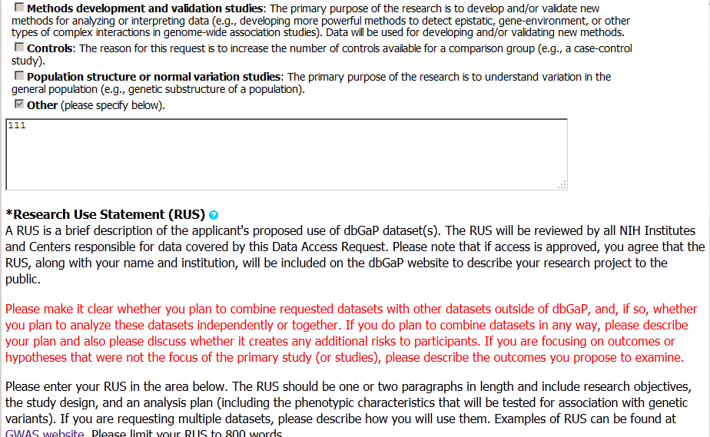

Slide 29
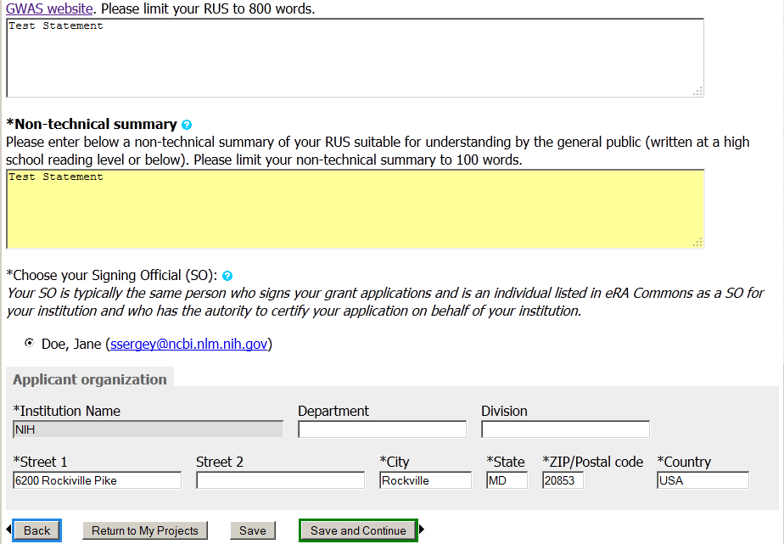

Slide 30
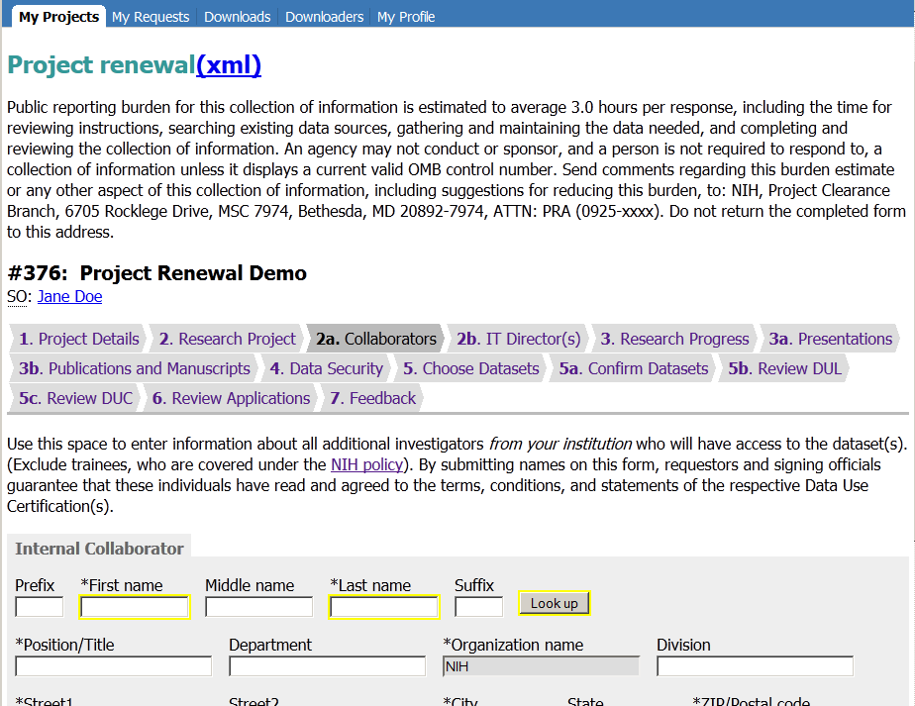
Public reporting burden for this collection of information is estimated to vary from 15 to 45 minutes per response, including the time for reviewing instructions, searching existing data sources, gathering and maintaining the data needed, and completing and reviewing the collection of information. An agency may not conduct or sponsor, and a person is not required to respond to, a collection of information unless it displays a currently valid OMB control number. Send comments regarding this burden estimate or any other aspect of this collection of information, including suggestions for reducing this burden, to: NIH, Project Clearance Branch, 6705 Rockledge Drive, MSC 7974, Bethesda, MD 20892-7974, ATTN: PRA (0925-xxxx). Do not return the completed form to this address.

Slide 31
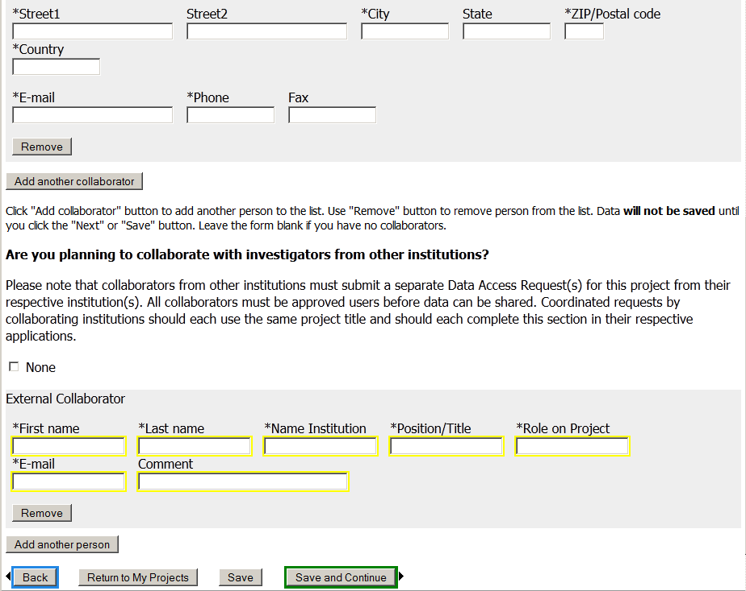

Slide 32
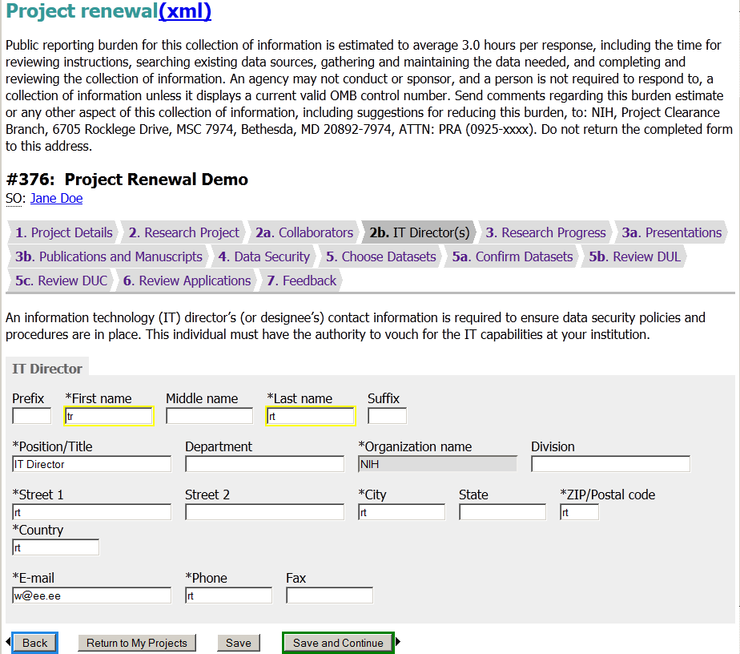
Public reporting burden for this collection of information is estimated to vary from 15 to 45 minutes per response, including the time for reviewing instructions, searching existing data sources, gathering and maintaining the data needed, and completing and reviewing the collection of information. An agency may not conduct or sponsor, and a person is not required to respond to, a collection of information unless it displays a currently valid OMB control number. Send comments regarding this burden estimate or any other aspect of this collection of information, including suggestions for reducing this burden, to: NIH, Project Clearance Branch, 6705 Rockledge Drive, MSC 7974, Bethesda, MD 20892-7974, ATTN: PRA (0925-xxxx). Do not return the completed form to this address.

Slide 33
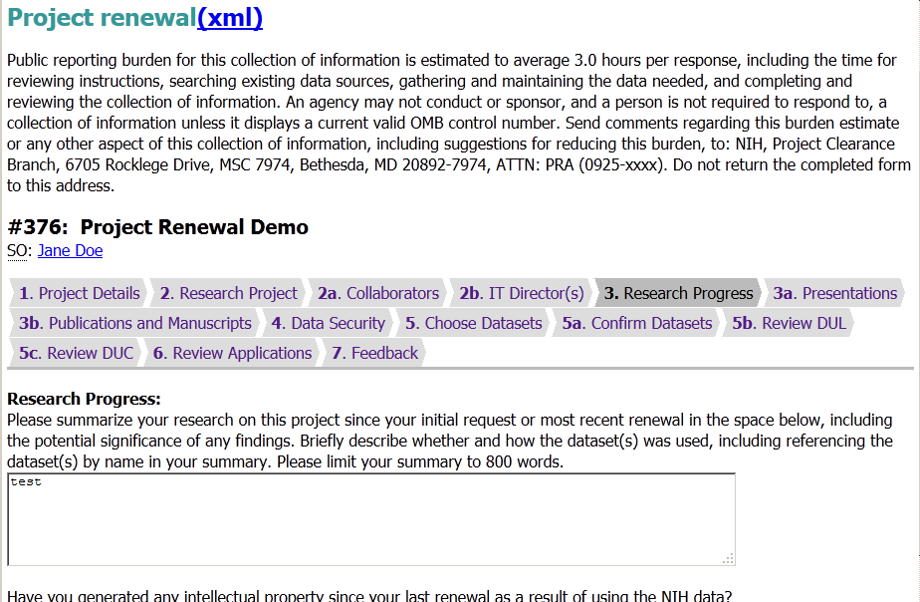
Public reporting burden for this collection of information is estimated to vary from 15 to 45 minutes per response, including the time for reviewing instructions, searching existing data sources, gathering and maintaining the data needed, and completing and reviewing the collection of information. An agency may not conduct or sponsor, and a person is not required to respond to, a collection of information unless it displays a currently valid OMB control number. Send comments regarding this burden estimate or any other aspect of this collection of information, including suggestions for reducing this burden, to: NIH, Project Clearance Branch, 6705 Rockledge Drive, MSC 7974, Bethesda, MD 20892-7974, ATTN: PRA (0925-xxxx). Do not return the completed form to this address.

Slide 34
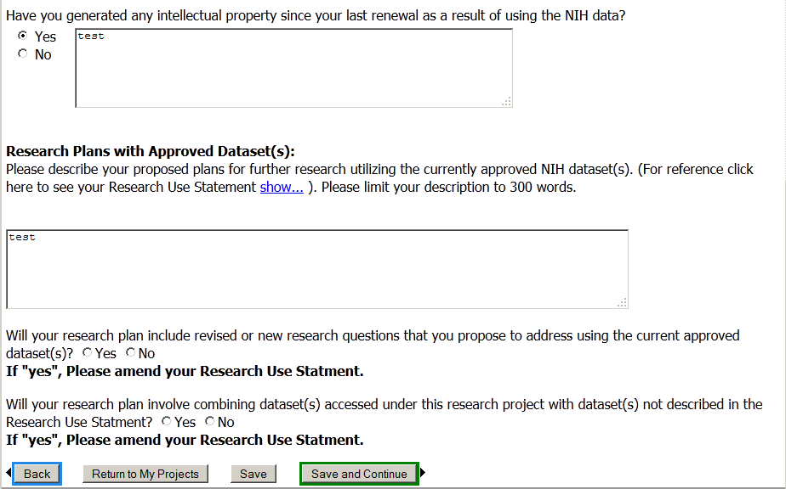

Slide 35
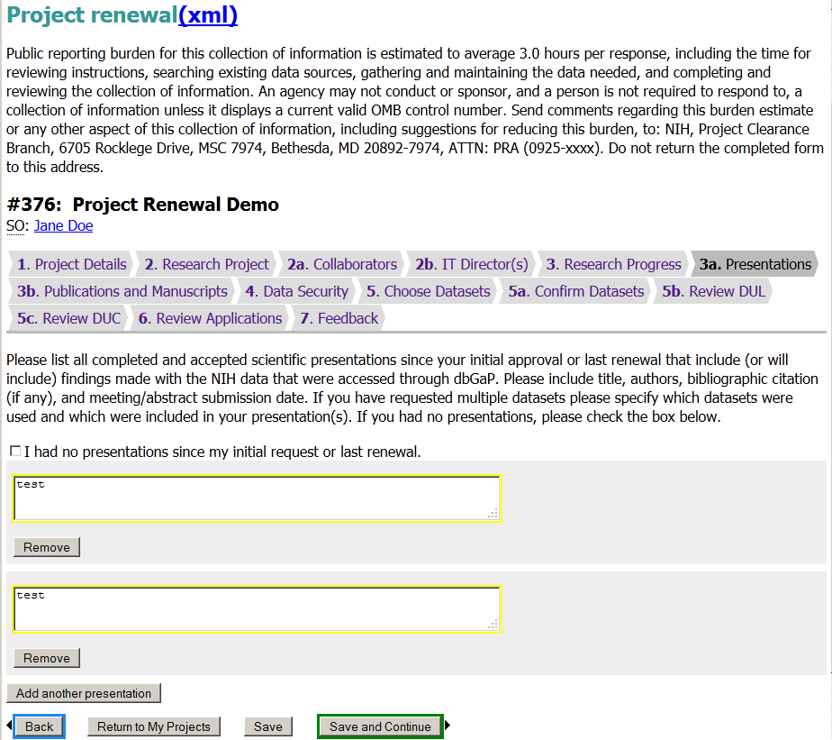
Public reporting burden for this collection of information is estimated to vary from 15 to 45 minutes per response, including the time for reviewing instructions, searching existing data sources, gathering and maintaining the data needed, and completing and reviewing the collection of information. An agency may not conduct or sponsor, and a person is not required to respond to, a collection of information unless it displays a currently valid OMB control number. Send comments regarding this burden estimate or any other aspect of this collection of information, including suggestions for reducing this burden, to: NIH, Project Clearance Branch, 6705 Rockledge Drive, MSC 7974, Bethesda, MD 20892-7974, ATTN: PRA (0925-xxxx). Do not return the completed form to this address.

Slide 36
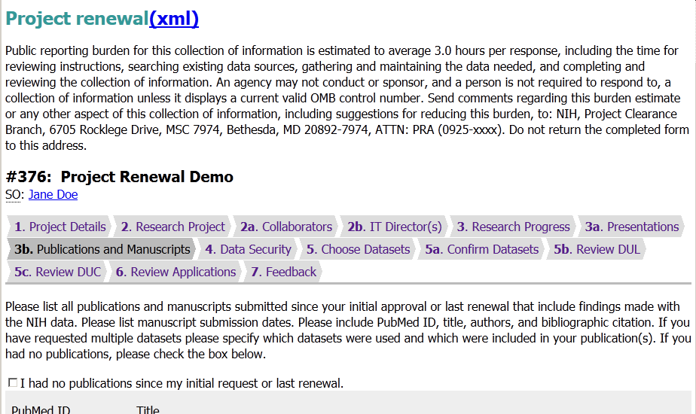
Public reporting burden for this collection of information is estimated to vary from 15 to 45 minutes per response, including the time for reviewing instructions, searching existing data sources, gathering and maintaining the data needed, and completing and reviewing the collection of information. An agency may not conduct or sponsor, and a person is not required to respond to, a collection of information unless it displays a currently valid OMB control number. Send comments regarding this burden estimate or any other aspect of this collection of information, including suggestions for reducing this burden, to: NIH, Project Clearance Branch, 6705 Rockledge Drive, MSC 7974, Bethesda, MD 20892-7974, ATTN: PRA (0925-xxxx). Do not return the completed form to this address.

Slide 38
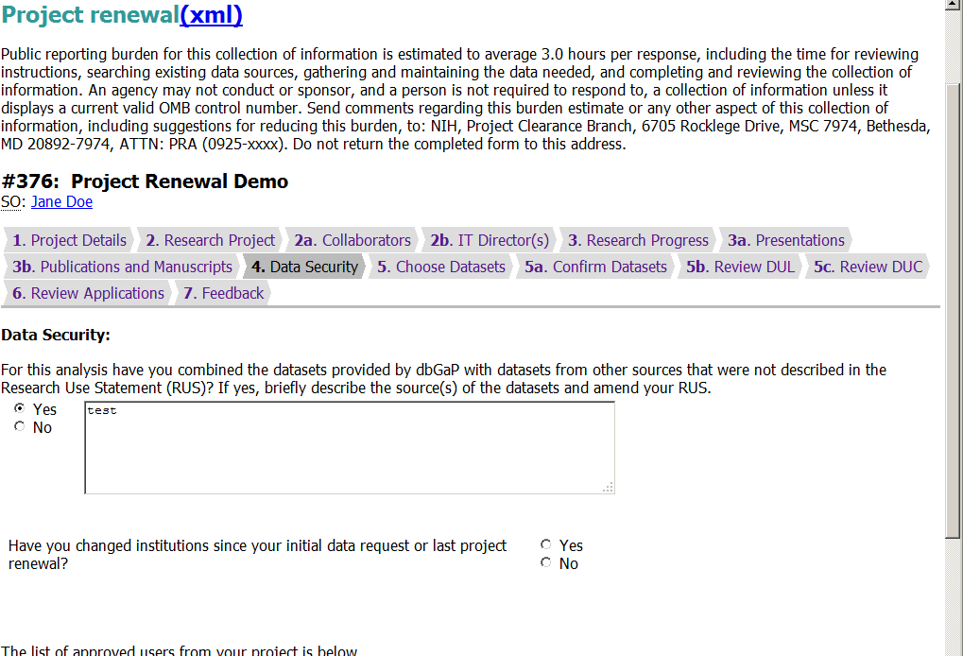
Public reporting burden for this collection of information is estimated to vary from 15 to 45 minutes per response, including the time for reviewing instructions, searching existing data sources, gathering and maintaining the data needed, and completing and reviewing the collection of information. An agency may not conduct or sponsor, and a person is not required to respond to, a collection of information unless it displays a currently valid OMB control number. Send comments regarding this burden estimate or any other aspect of this collection of information, including suggestions for reducing this burden, to: NIH, Project Clearance Branch, 6705 Rockledge Drive, MSC 7974, Bethesda, MD 20892-7974, ATTN: PRA (0925-xxxx). Do not return the completed form to this address.

Slide 39
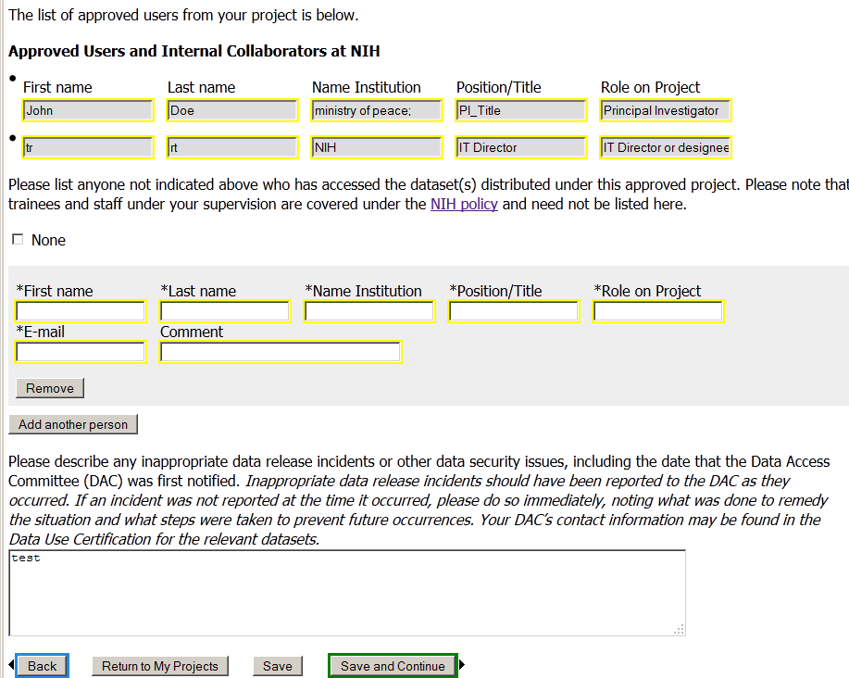

Slide 40
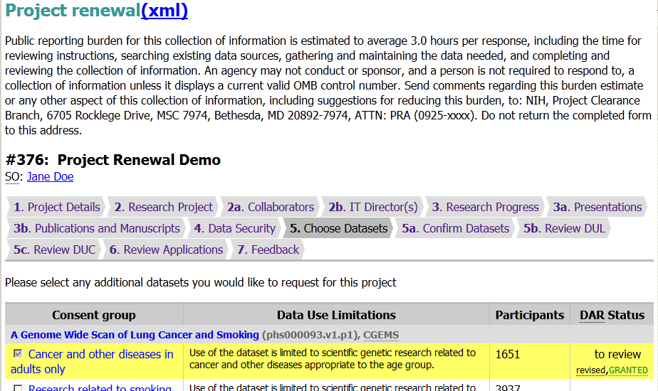
Public reporting burden for this collection of information is estimated to vary from 15 to 45 minutes per response, including the time for reviewing instructions, searching existing data sources, gathering and maintaining the data needed, and completing and reviewing the collection of information. An agency may not conduct or sponsor, and a person is not required to respond to, a collection of information unless it displays a currently valid OMB control number. Send comments regarding this burden estimate or any other aspect of this collection of information, including suggestions for reducing this burden, to: NIH, Project Clearance Branch, 6705 Rockledge Drive, MSC 7974, Bethesda, MD 20892-7974, ATTN: PRA (0925-xxxx). Do not return the completed form to this address.

Slide 42
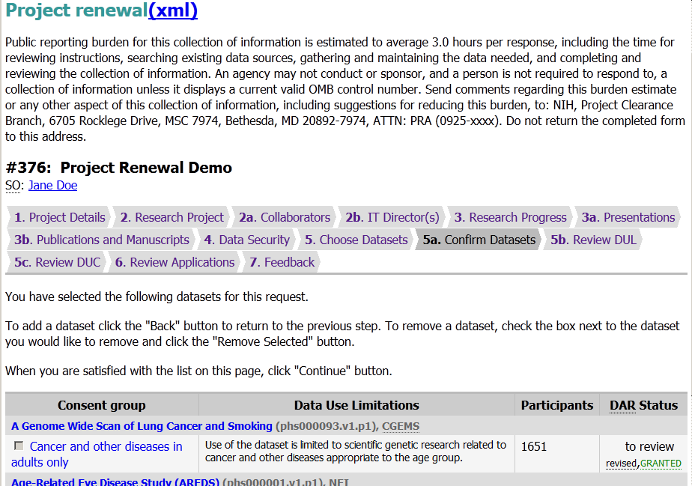
Public reporting burden for this collection of information is estimated to vary from 15 to 45 minutes per response, including the time for reviewing instructions, searching existing data sources, gathering and maintaining the data needed, and completing and reviewing the collection of information. An agency may not conduct or sponsor, and a person is not required to respond to, a collection of information unless it displays a currently valid OMB control number. Send comments regarding this burden estimate or any other aspect of this collection of information, including suggestions for reducing this burden, to: NIH, Project Clearance Branch, 6705 Rockledge Drive, MSC 7974, Bethesda, MD 20892-7974, ATTN: PRA (0925-xxxx). Do not return the completed form to this address.

Slide 44
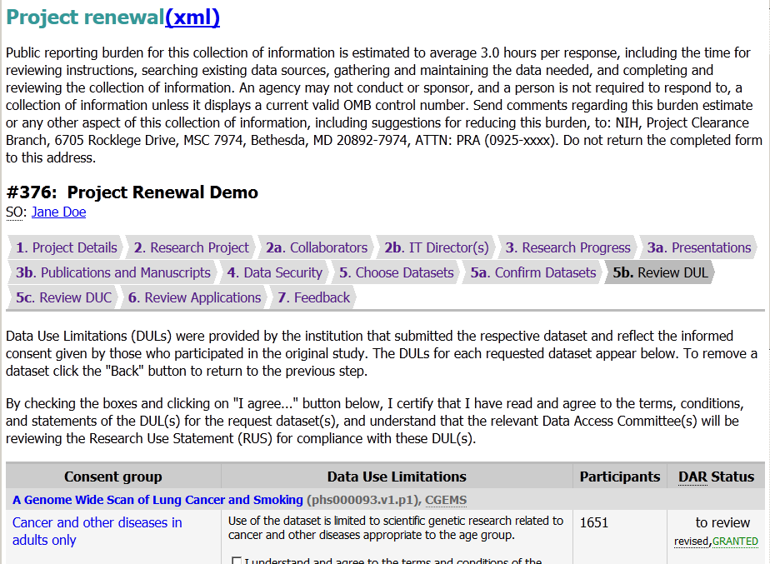
Public reporting burden for this collection of information is estimated to vary from 15 to 45 minutes per response, including the time for reviewing instructions, searching existing data sources, gathering and maintaining the data needed, and completing and reviewing the collection of information. An agency may not conduct or sponsor, and a person is not required to respond to, a collection of information unless it displays a currently valid OMB control number. Send comments regarding this burden estimate or any other aspect of this collection of information, including suggestions for reducing this burden, to: NIH, Project Clearance Branch, 6705 Rockledge Drive, MSC 7974, Bethesda, MD 20892-7974, ATTN: PRA (0925-xxxx). Do not return the completed form to this address.

Slide 46
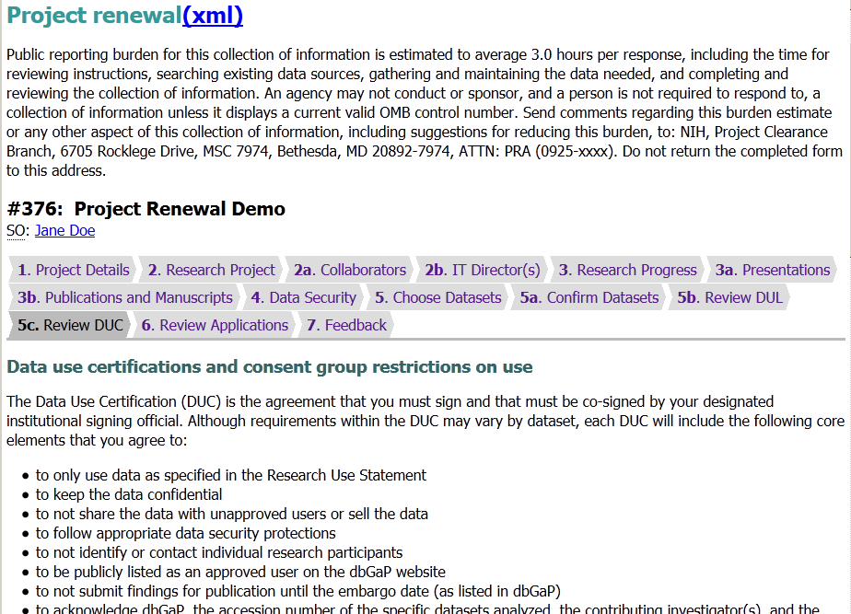
Public reporting burden for this collection of information is estimated to vary from 15 to 45 minutes per response, including the time for reviewing instructions, searching existing data sources, gathering and maintaining the data needed, and completing and reviewing the collection of information. An agency may not conduct or sponsor, and a person is not required to respond to, a collection of information unless it displays a currently valid OMB control number. Send comments regarding this burden estimate or any other aspect of this collection of information, including suggestions for reducing this burden, to: NIH, Project Clearance Branch, 6705 Rockledge Drive, MSC 7974, Bethesda, MD 20892-7974, ATTN: PRA (0925-xxxx). Do not return the completed form to this address.

Slide 47
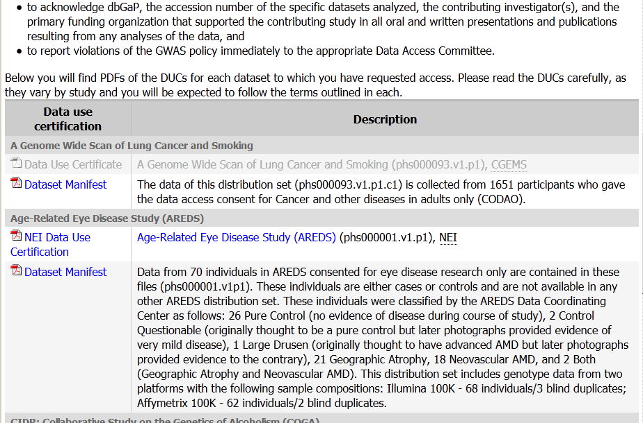

Slide 48
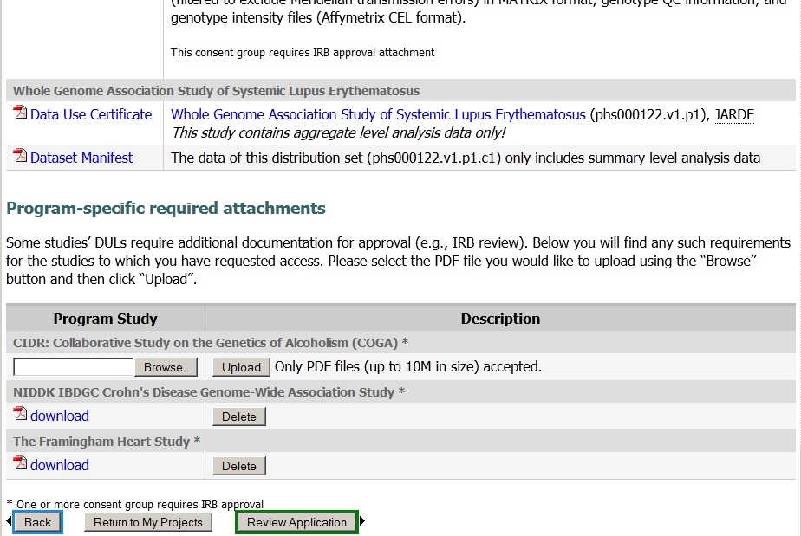

Slide 49
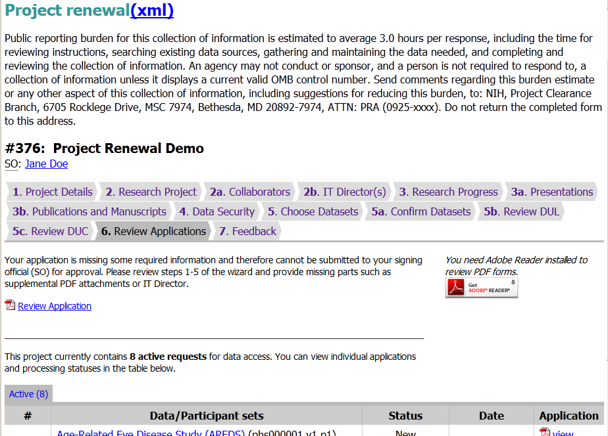
Public reporting burden for this collection of information is estimated to vary from 15 to 45 minutes per response, including the time for reviewing instructions, searching existing data sources, gathering and maintaining the data needed, and completing and reviewing the collection of information. An agency may not conduct or sponsor, and a person is not required to respond to, a collection of information unless it displays a currently valid OMB control number. Send comments regarding this burden estimate or any other aspect of this collection of information, including suggestions for reducing this burden, to: NIH, Project Clearance Branch, 6705 Rockledge Drive, MSC 7974, Bethesda, MD 20892-7974, ATTN: PRA (0925-xxxx). Do not return the completed form to this address.

Slide 50
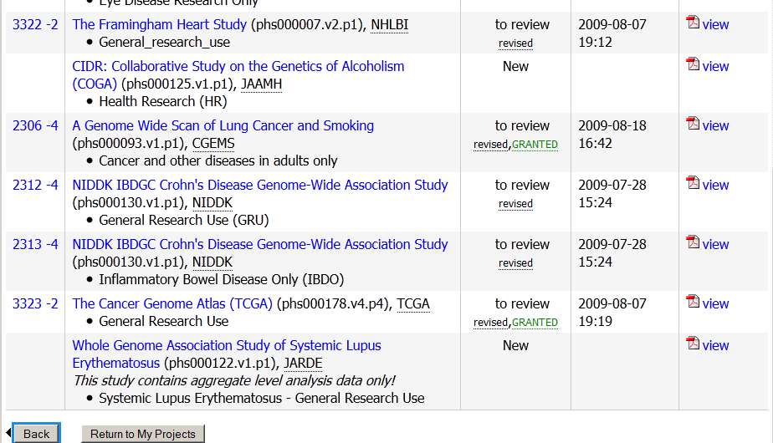

Slide 51
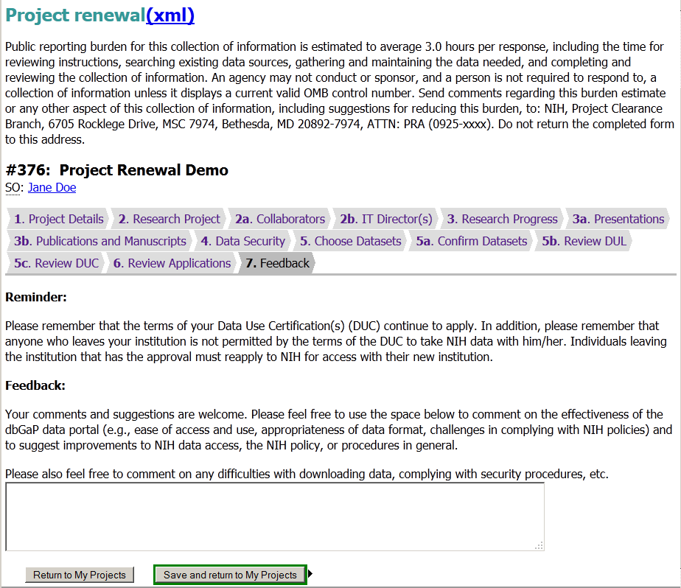
Public reporting burden for this collection of information is estimated to vary from 15 to 45 minutes per response, including the time for reviewing instructions, searching existing data sources, gathering and maintaining the data needed, and completing and reviewing the collection of information. An agency may not conduct or sponsor, and a person is not required to respond to, a collection of information unless it displays a currently valid OMB control number. Send comments regarding this burden estimate or any other aspect of this collection of information, including suggestions for reducing this burden, to: NIH, Project Clearance Branch, 6705 Rockledge Drive, MSC 7974, Bethesda, MD 20892-7974, ATTN: PRA (0925-xxxx). Do not return the completed form to this address.

Slide 52
dbGaP Authorized Access
Project Closeout Web Forms

Slide 53
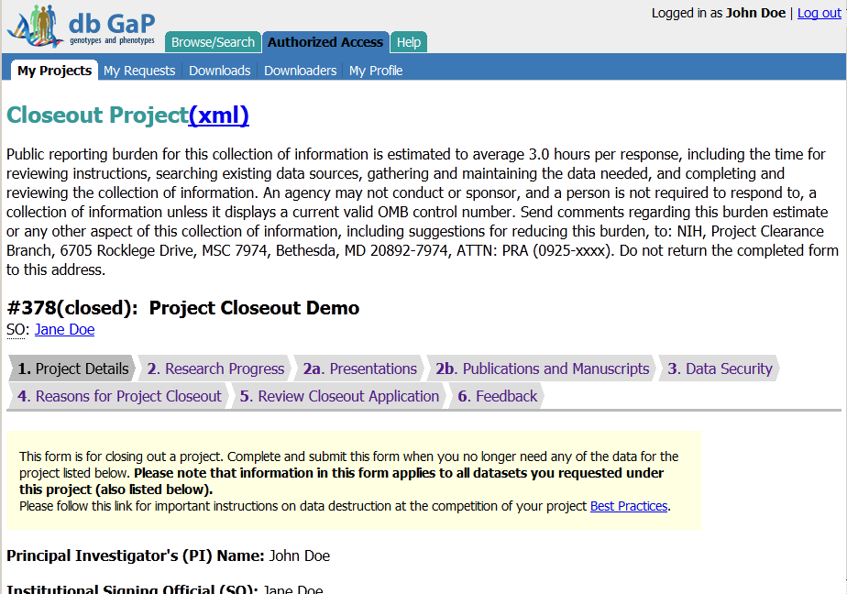
Public reporting burden for this collection of information is estimated to vary from 15 to 45 minutes per response, including the time for reviewing instructions, searching existing data sources, gathering and maintaining the data needed, and completing and reviewing the collection of information. An agency may not conduct or sponsor, and a person is not required to respond to, a collection of information unless it displays a currently valid OMB control number. Send comments regarding this burden estimate or any other aspect of this collection of information, including suggestions for reducing this burden, to: NIH, Project Clearance Branch, 6705 Rockledge Drive, MSC 7974, Bethesda, MD 20892-7974, ATTN: PRA (0925-xxxx). Do not return the completed form to this address.

Slide 54
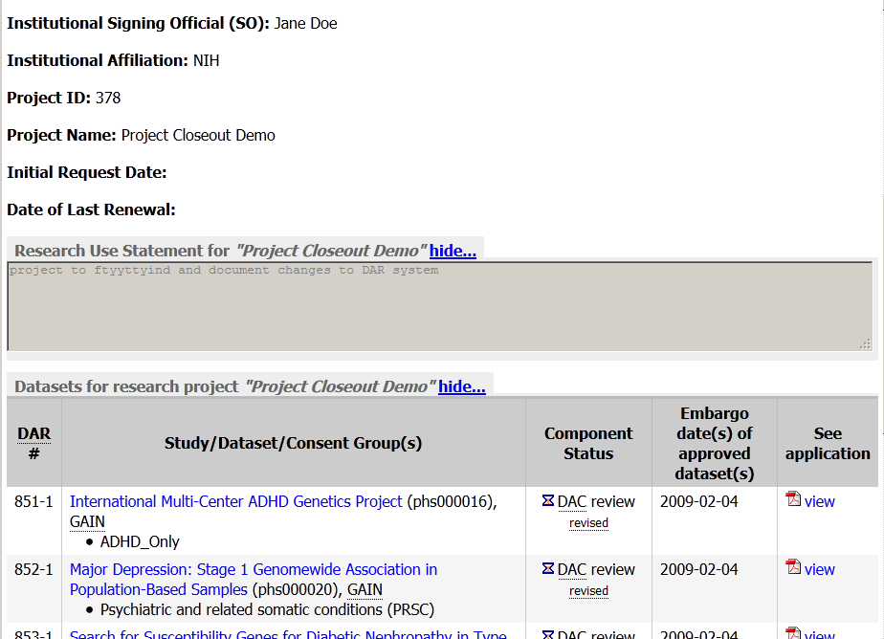

Slide 56
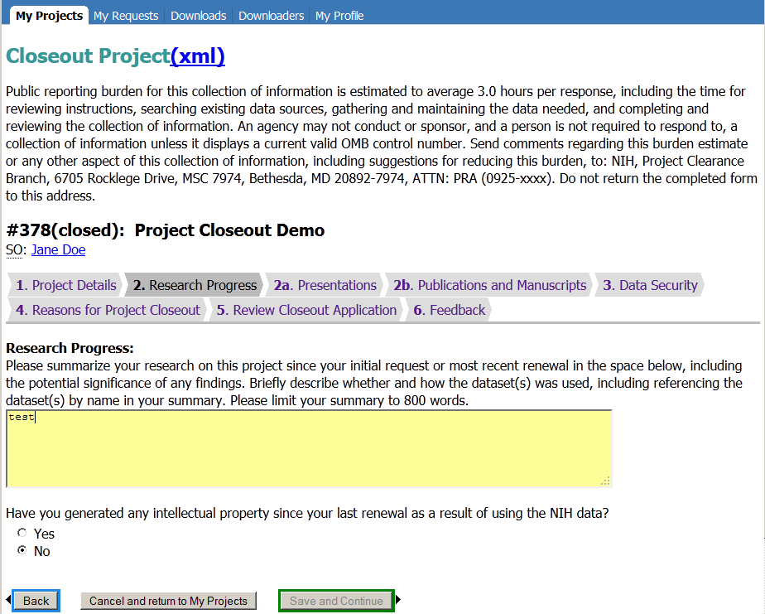
Public reporting burden for this collection of information is estimated to vary from 15 to 45 minutes per response, including the time for reviewing instructions, searching existing data sources, gathering and maintaining the data needed, and completing and reviewing the collection of information. An agency may not conduct or sponsor, and a person is not required to respond to, a collection of information unless it displays a currently valid OMB control number. Send comments regarding this burden estimate or any other aspect of this collection of information, including suggestions for reducing this burden, to: NIH, Project Clearance Branch, 6705 Rockledge Drive, MSC 7974, Bethesda, MD 20892-7974, ATTN: PRA (0925-xxxx). Do not return the completed form to this address.

Slide 57
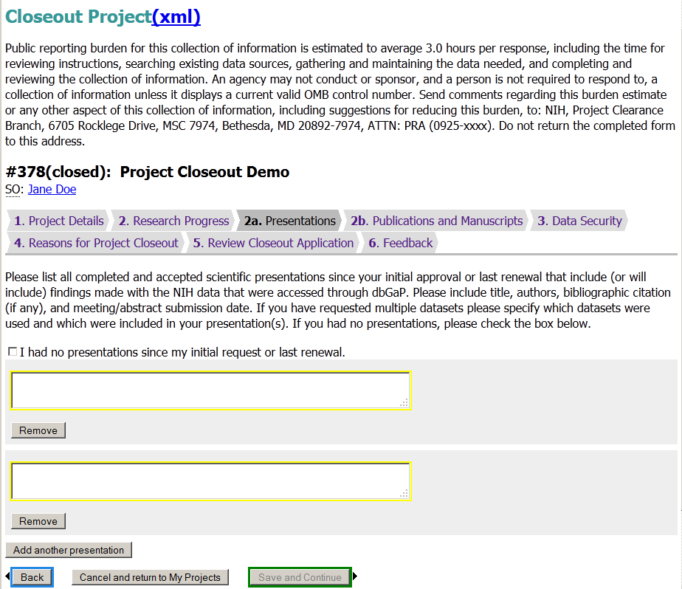
Public reporting burden for this collection of information is estimated to vary from 15 to 45 minutes per response, including the time for reviewing instructions, searching existing data sources, gathering and maintaining the data needed, and completing and reviewing the collection of information. An agency may not conduct or sponsor, and a person is not required to respond to, a collection of information unless it displays a currently valid OMB control number. Send comments regarding this burden estimate or any other aspect of this collection of information, including suggestions for reducing this burden, to: NIH, Project Clearance Branch, 6705 Rockledge Drive, MSC 7974, Bethesda, MD 20892-7974, ATTN: PRA (0925-xxxx). Do not return the completed form to this address.

Slide 58
Public reporting burden for this collection of information is estimated to vary from 15 to 45 minutes per response, including the time for reviewing instructions, searching existing data sources, gathering and maintaining the data needed, and completing and reviewing the collection of information. An agency may not conduct or sponsor, and a person is not required to respond to, a collection of information unless it displays a currently valid OMB control number. Send comments regarding this burden estimate or any other aspect of this collection of information, including suggestions for reducing this burden, to: NIH, Project Clearance Branch, 6705 Rockledge Drive, MSC 7974, Bethesda, MD 20892-7974, ATTN: PRA (0925-xxxx). Do not return the completed form to this address.

Slide 60
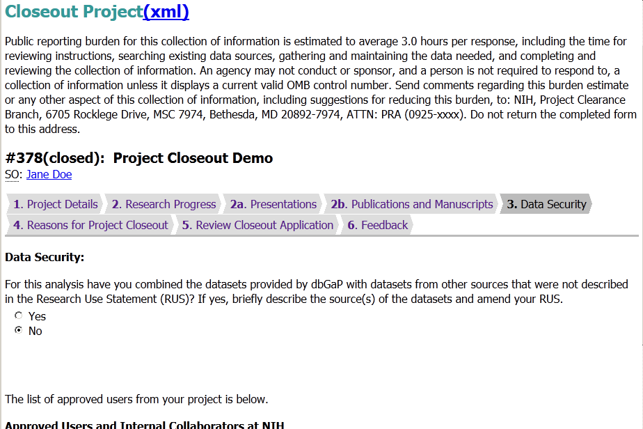
Public reporting burden for this collection of information is estimated to vary from 15 to 45 minutes per response, including the time for reviewing instructions, searching existing data sources, gathering and maintaining the data needed, and completing and reviewing the collection of information. An agency may not conduct or sponsor, and a person is not required to respond to, a collection of information unless it displays a currently valid OMB control number. Send comments regarding this burden estimate or any other aspect of this collection of information, including suggestions for reducing this burden, to: NIH, Project Clearance Branch, 6705 Rockledge Drive, MSC 7974, Bethesda, MD 20892-7974, ATTN: PRA (0925-xxxx). Do not return the completed form to this address.

Slide 61
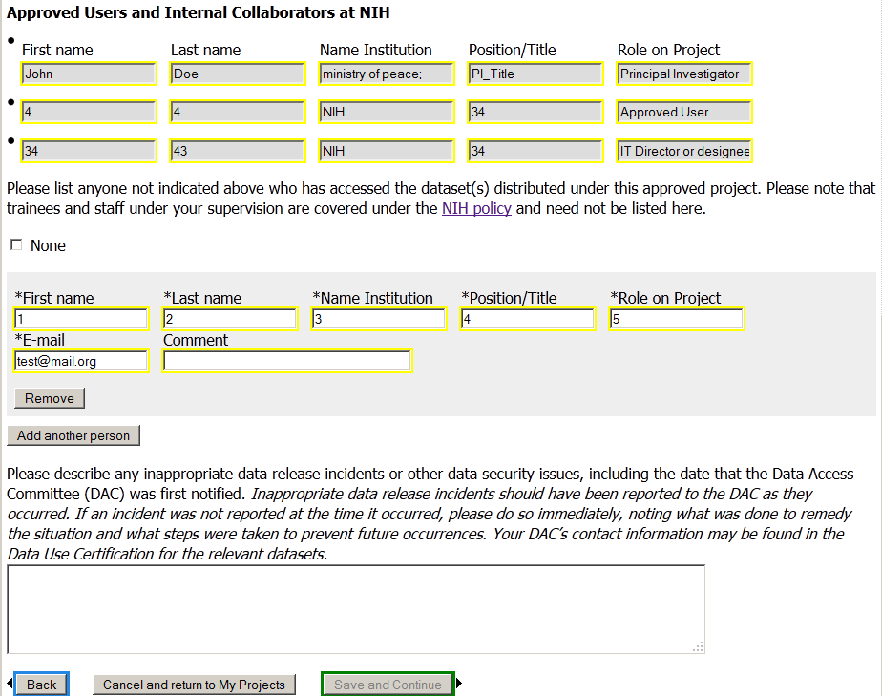

Slide 62
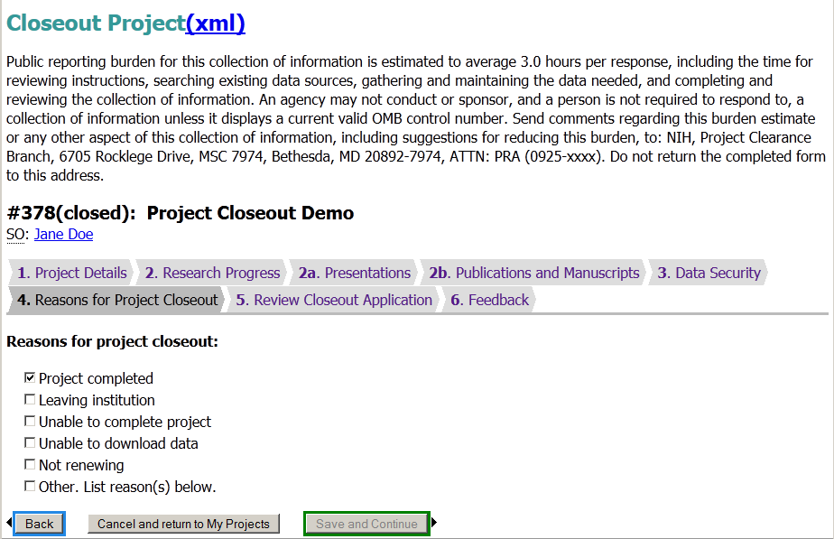

Slide 63
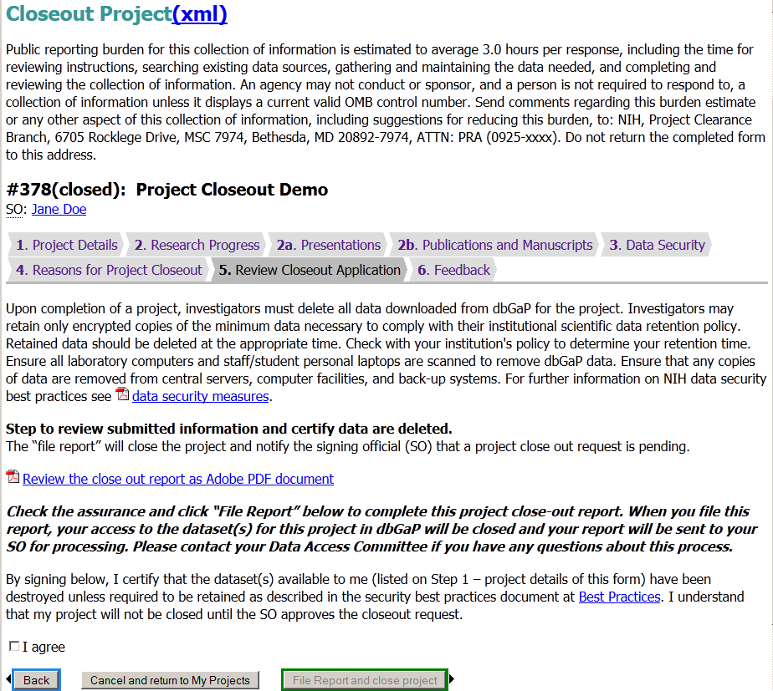

Slide 64
