Slide 1
Electronic System for Travel Authorization (ESTA) New questions (9800-086)
U.S. Customs and Border Protection
February 2016

Slide 2
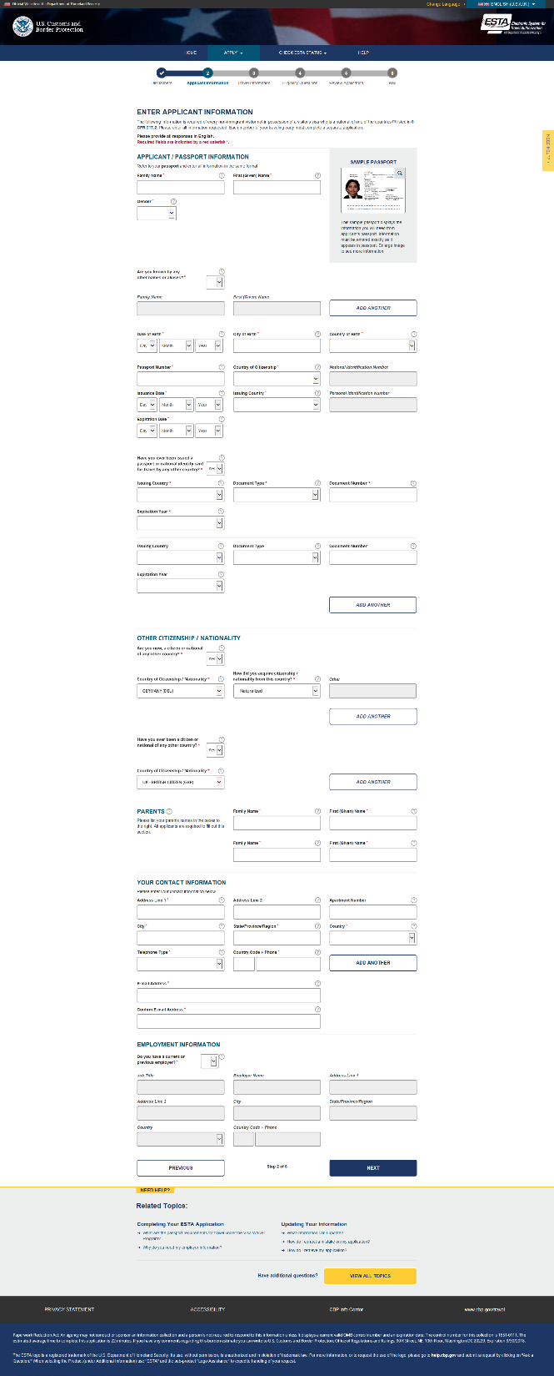

Slide 3
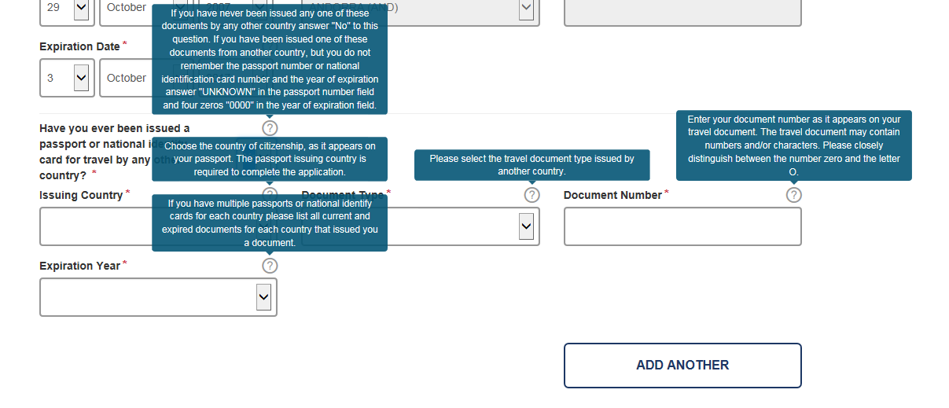
Application Information Page – with additional Passport Question and fields

Slide 4
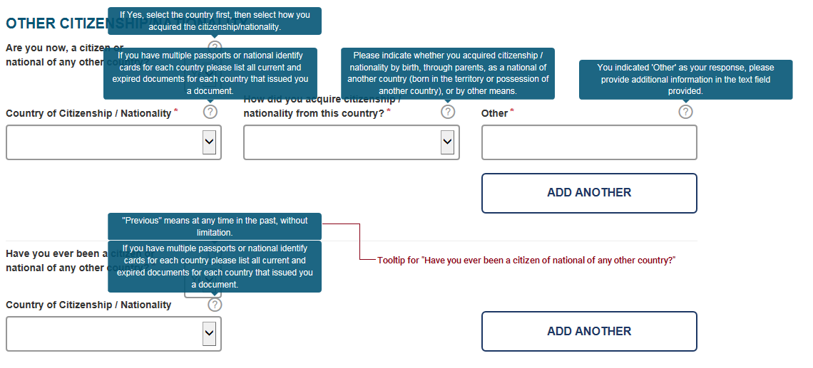
Application Information Page – with new Citizenship questions

Slide 5
Eligibility Questions Page for Iran travel
Select the country you traveled to on or after March 1, 2011.
Please enter the date (MONTH, YEAR) you arrived in Iran, Iraq, Syria, or Sudan.
Please enter the date (MONTH, YEAR) you departed from Iran, Iraq, Syria, or Sudan.
Please enter the primary purpose of your travel to Iran, Iraq, Syria, or Sudan.
Business entity means work you performed on behalf of any employer, with or without payment.
What specific type of work does your employer use in your job description. For example, Office Manager, Administrative Assistant , or Cashier.
Primary address should allow us to contact your previous employer by mail, if necessary.
If you do not know this information, please enter UNKNOWN
If you do not know this information, please enter UNKNOWN

Slide 6
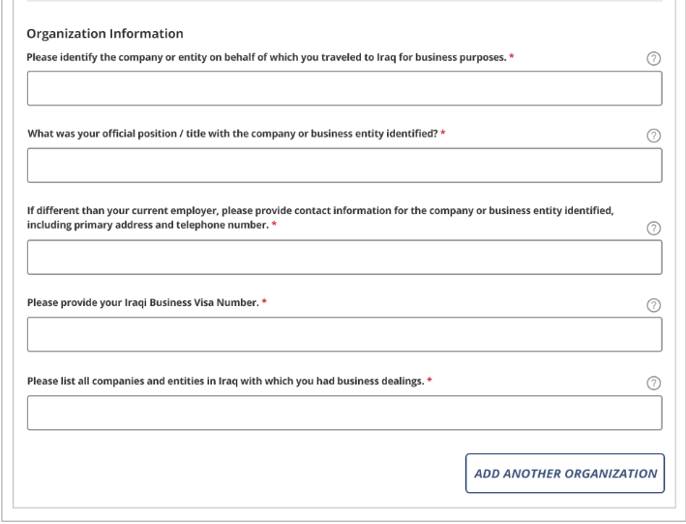
Eligibility Questions Page for Iraq travel
Select the country you traveled to on or after March 1, 2011.
Please enter the date (MONTH, YEAR) you arrived in Iran, Iraq, Syria, or Sudan.
Please enter the date (MONTH, YEAR) you departed from Iran, Iraq, Syria, or Sudan.
Please enter the primary purpose of your travel to Iran, Iraq, Syria, or Sudan.
Business entity means work you performed on behalf of any employer, with or without payment.
What specific type of work does your employer use in your job description. For example, Office Manager, Administrative Assistant , or Cashier.
Primary address should be sufficient allow us to contact your previous employer by mail, if necessary.
If you do not know this information, please enter UNKNOWN
If you do not know this information, please enter UNKNOWN

Slide 7
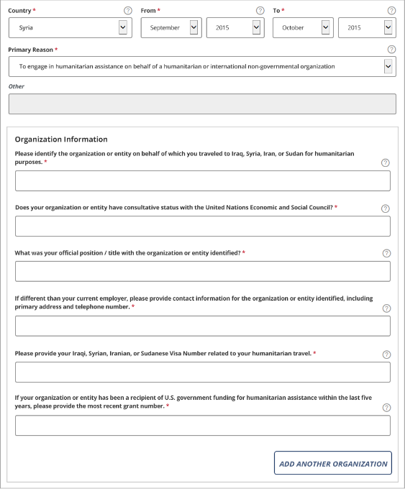
Eligibility Questions Page for Humanitarian/NGO travel (1)
Select the country you traveled to on or after March 1, 2011.
Please enter the date (MONTH, YEAR) you arrived in Iran, Iraq, Syria, or Sudan.
Please enter the date (MONTH, YEAR) you departed from Iran, Iraq, Syria, or Sudan.
Please enter the primary purpose of your travel to Iran, Iraq, Syria, or Sudan.
For example, international governmental organizations (IGOs) include the United Nations, NATO, the IMF, And the World Bank. International non-governmental organizations (NGOs) include Amnesty International and the International Red Cross
If you do not know this information, please enter UNKNOWN
What specific type of work does your employer use in your job description. For example, Office Manager, Administrative Assistant , or Cashier.

Slide 8
Eligibility Questions Page for Humanitarian/NGO travel (2)
Primary address should be sufficient allow us to contact your previous employer by mail, if necessary.
If you do not know this information, please enter UNKNOWN
If you do not know this information, please enter UNKNOWN
Please provide us information about the type of work you’re doing in country during this time.
Please provide details about the scope of your assigned duties within the country in question.
Please include any information you are willing to share about other NGOs or international, national, or state agencies with which you worked
Please provide any details about the organization that you believe will be helpful.
Any additional comments.
Please provide any other details that you believe will be helpful.

Slide 9
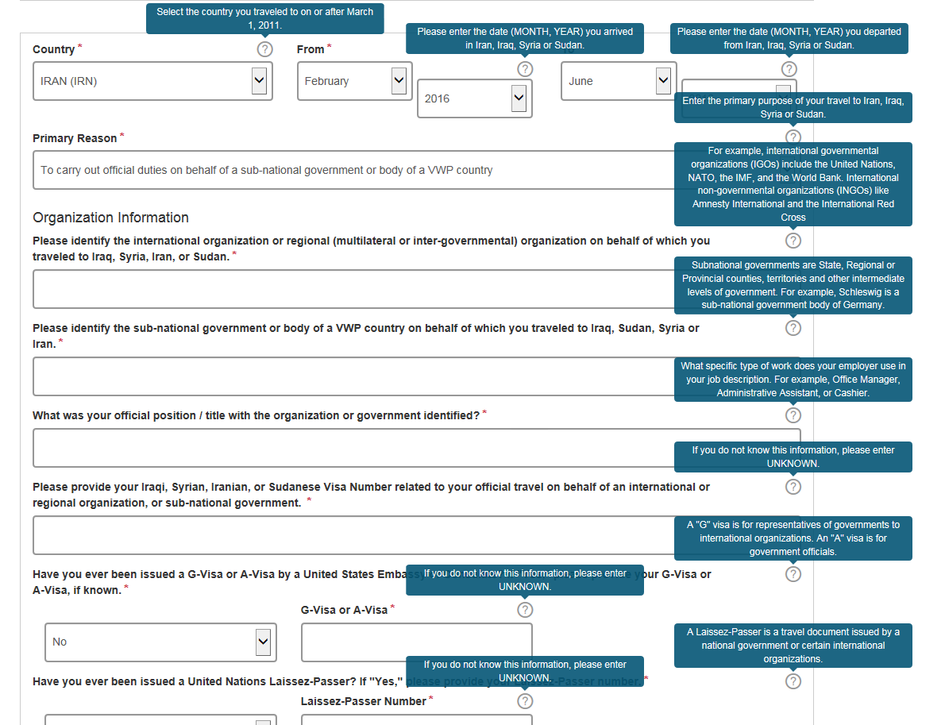
Eligibility Questions Page for International Organization OR Sub-national government travel

Slide 10
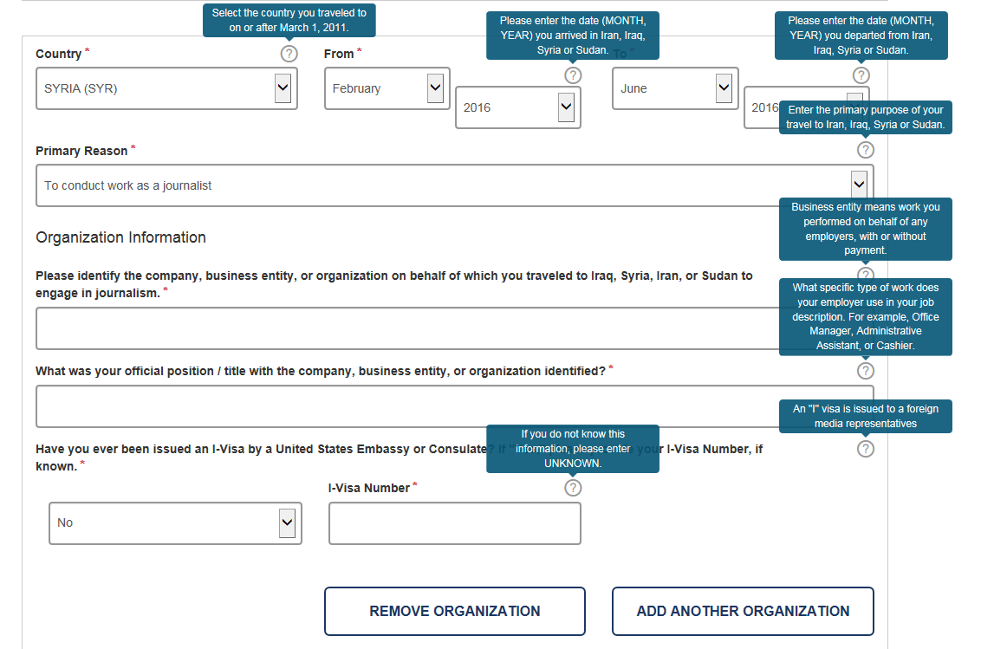
Eligibility Questions Page for Journalism

