Slide 1


Electronic System for Travel Authorization (ESTA)
U.S. Customs and Border Protection
August 2015

Slide 2
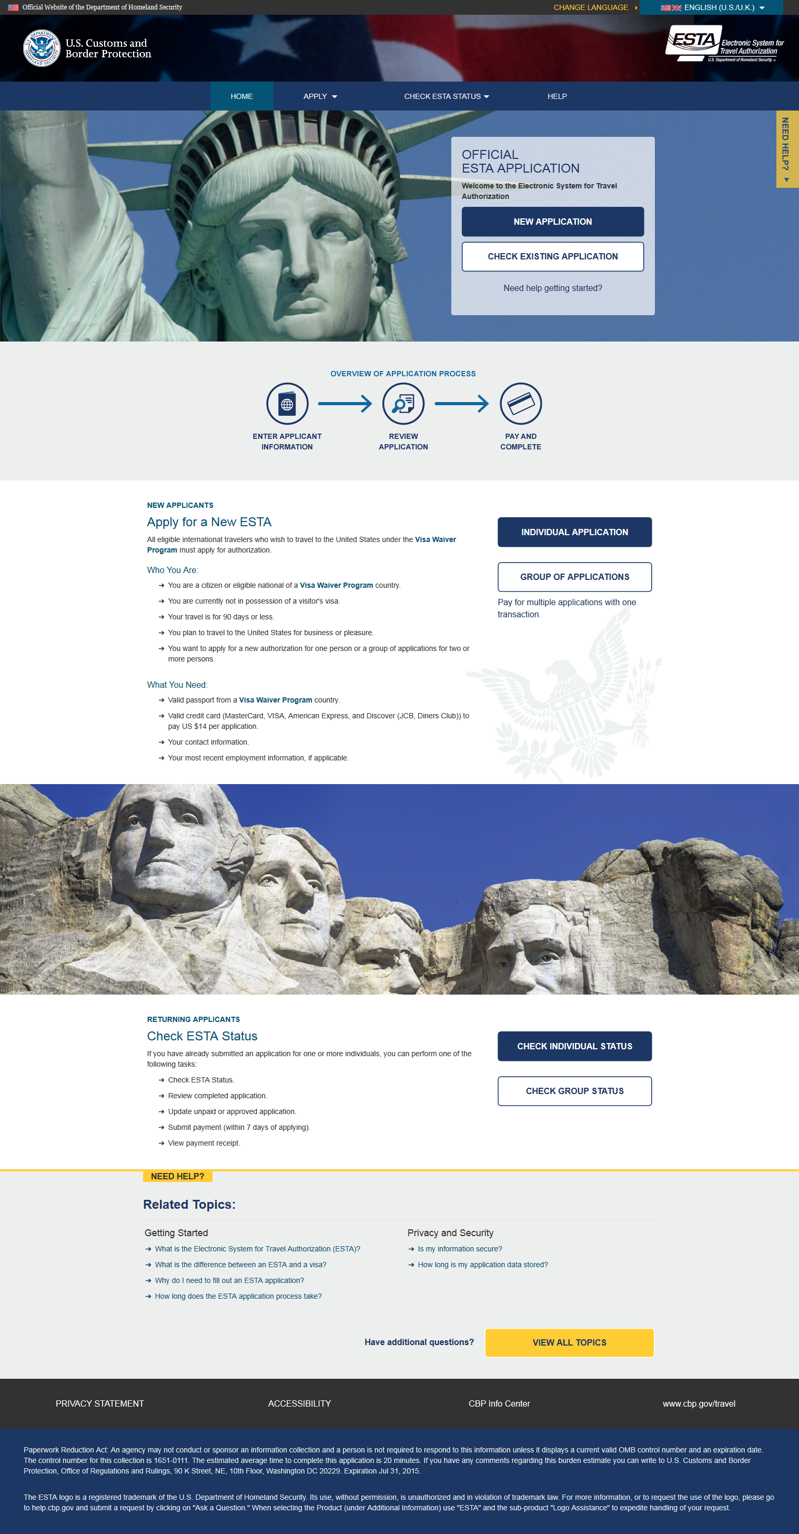
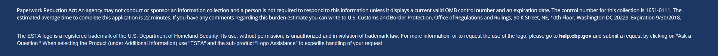
Entire Welcome Page

Slide 3
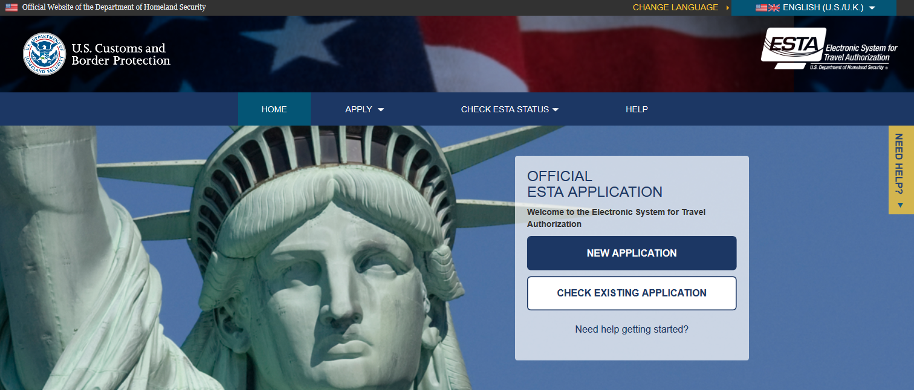
Welcome Page Heading

Slide 4
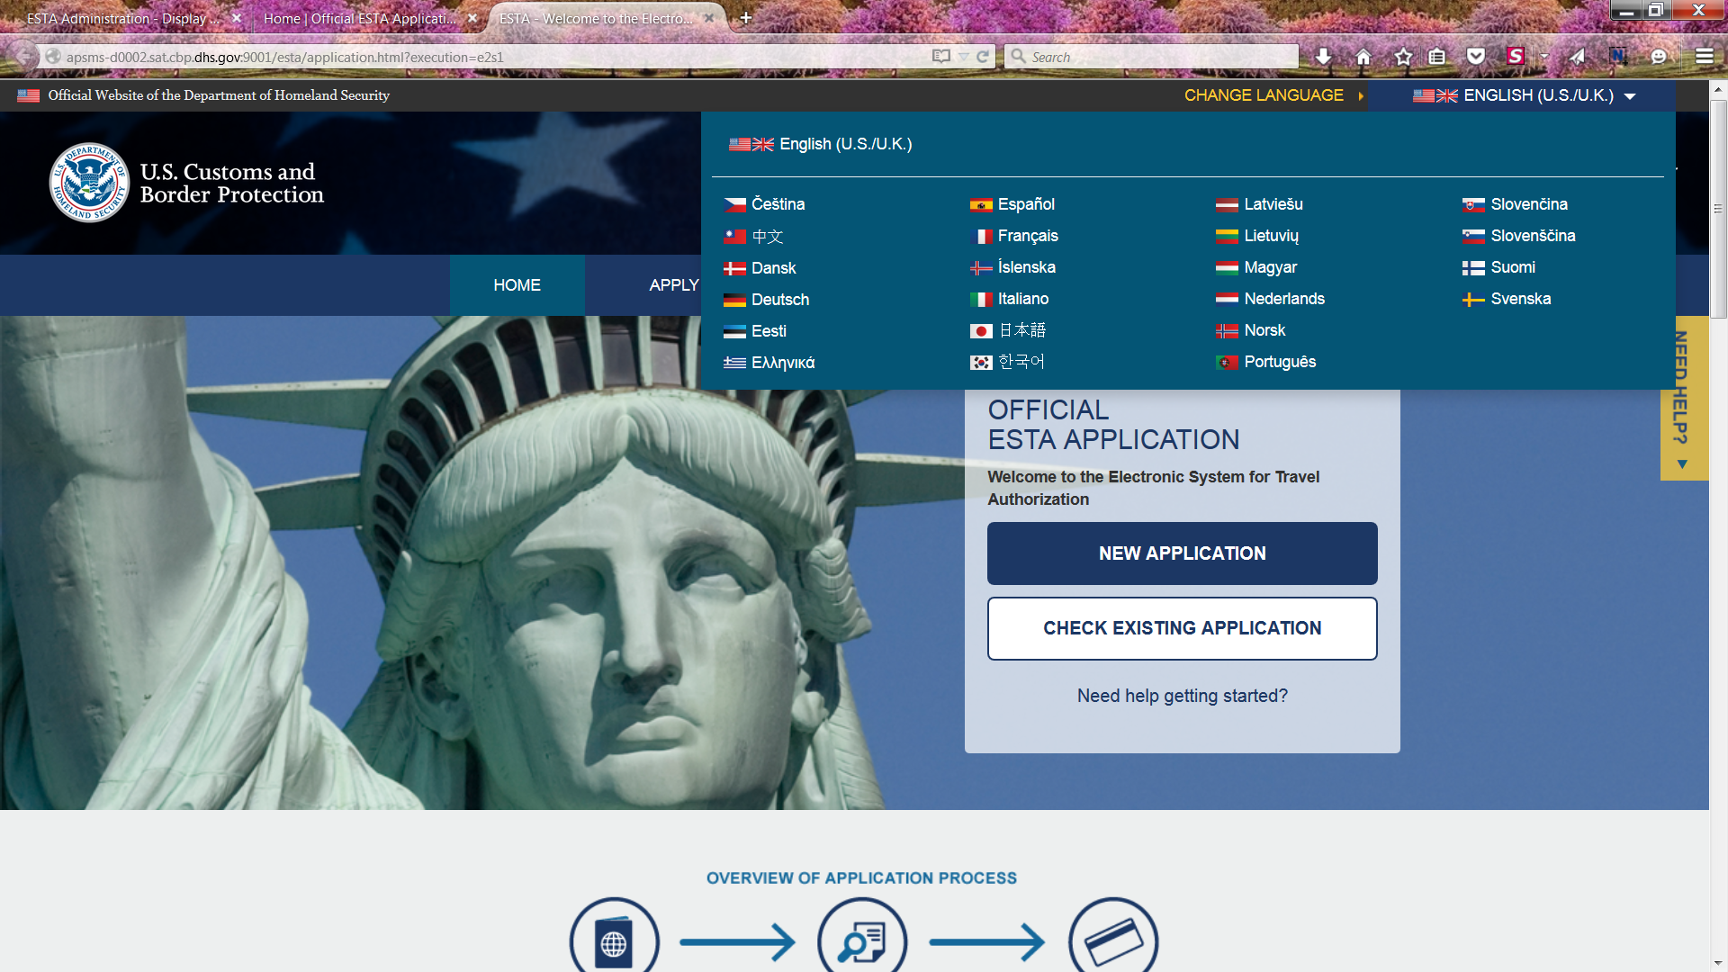
Language Menu
Applicants can choose to view the ESTA site in a different language by clicking the down arrow on the upper right corner. This option is available on every page.

Slide 5
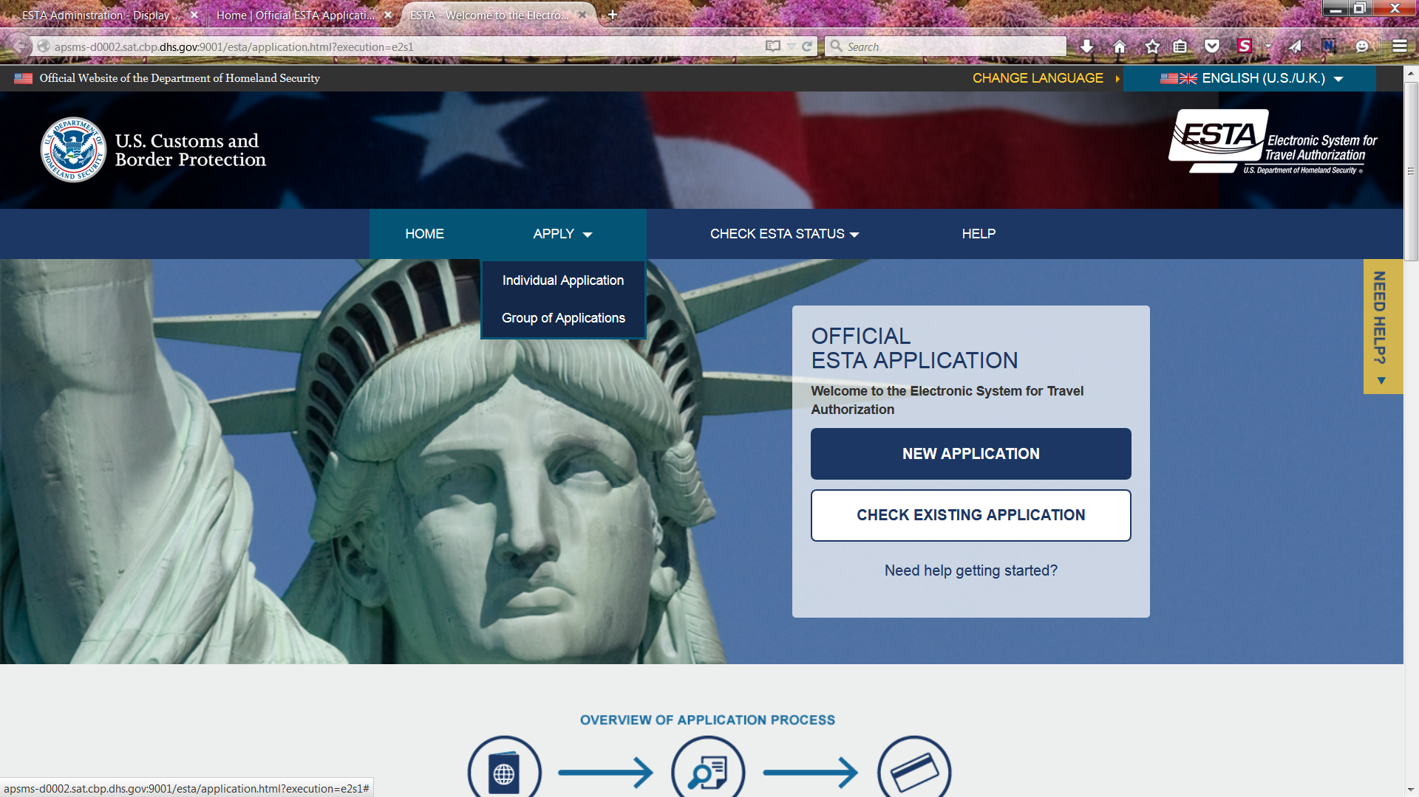
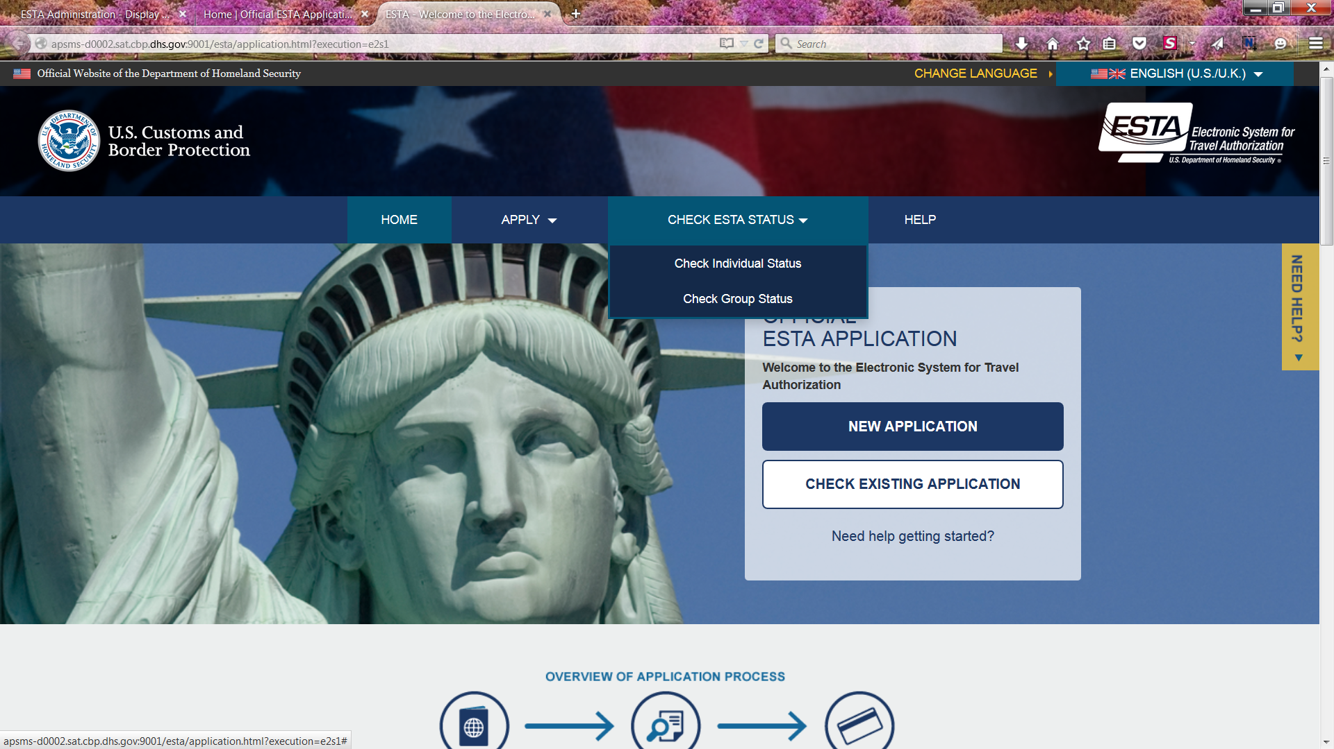
Navigation Menu
For visitors updating or checking the status of an existing travel authorization.
For visitors applying for a new travel authorization.

Slide 6
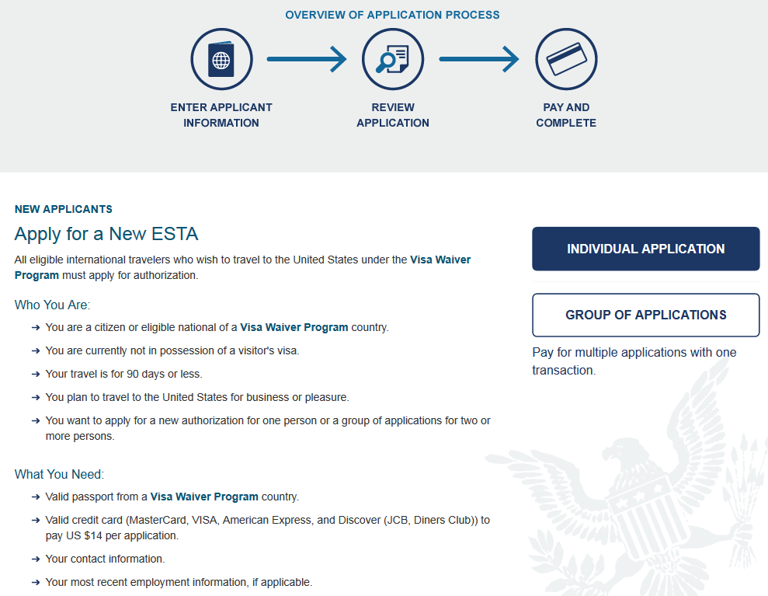
Instructions and Links for Applying
The main page of the ESTA site contains instructions on how to apply for an ESTA.

Slide 7
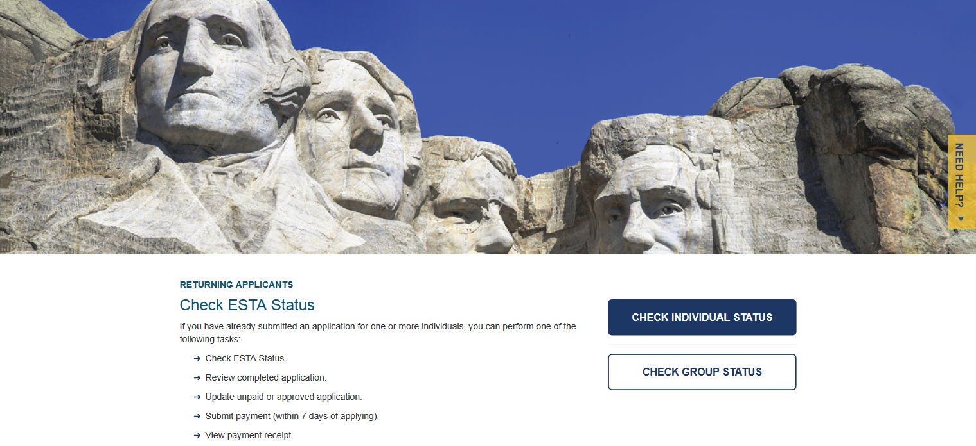
Instructions and Links checking Application Status
The main page of the ESTA site also contains instructions on how to check the status of existing applications.

Slide 8
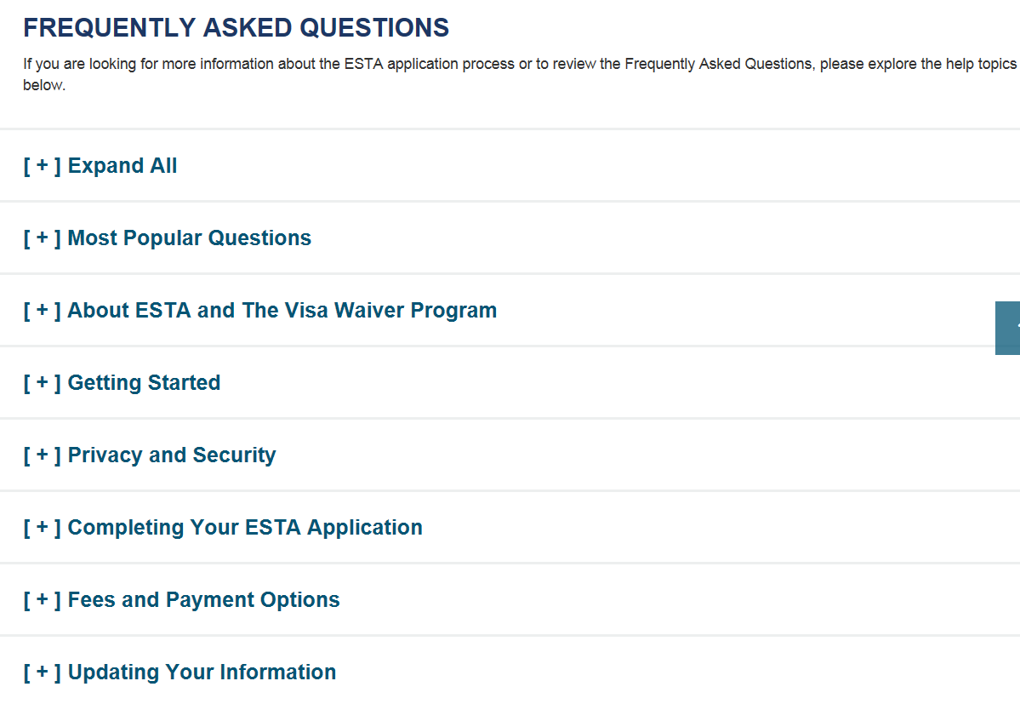
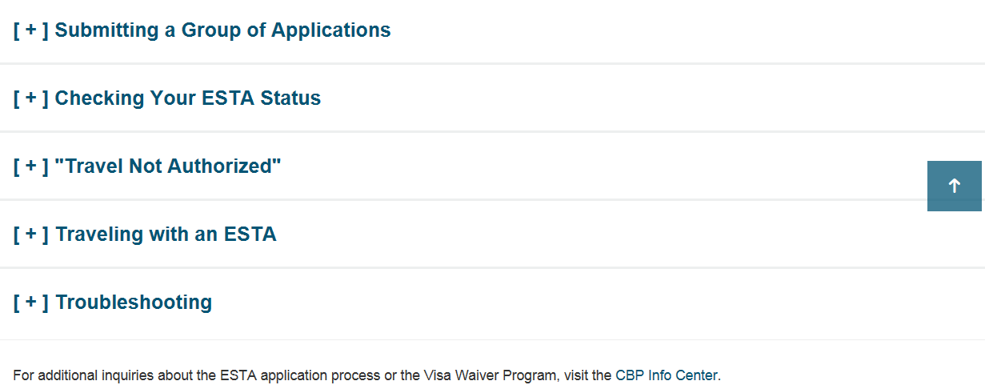
FAQ Page
The FAQ page can be accessed by clicking the “Help” icon on the main menu. FAQs are categorized by topics, each FAQ section can be collapsed or expanded to display questions.

Slide 9
Help Topics
Applicants can also access ESTA instructional resources by clicking on the yellow “Need Help” icon on the right side of the screen or by scrolling to the bottom of the page. Help Topics can be accessed from every page.
The bottom of each page includes links to ESTA’s Privacy and Accessibility statements, the CBP Info Center and the CBP Travel website.

Slide 10

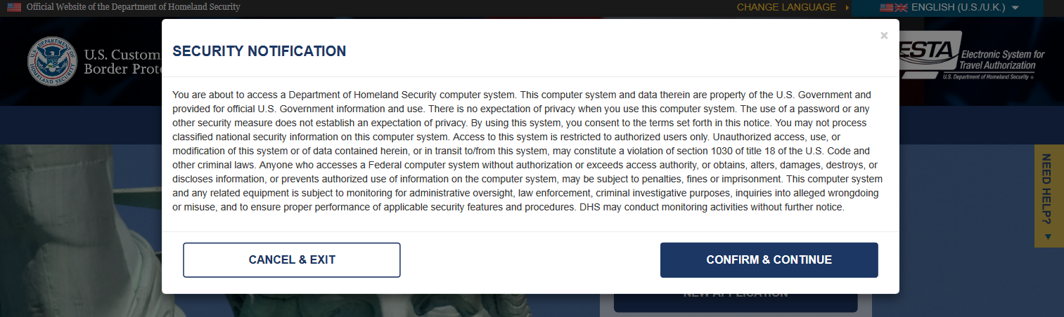
Applying for an ESTA
To apply for a group or individual application click one of the two options provided under the “Apply” icon. After the applicant makes a selection a Security Notification will pop up. In order to continue with the application process they must select “Confirm and Continue”. On the following screens the applicant will be asked to acknowledge a Disclaimer and the Travel Promotion Act.

Slide 11
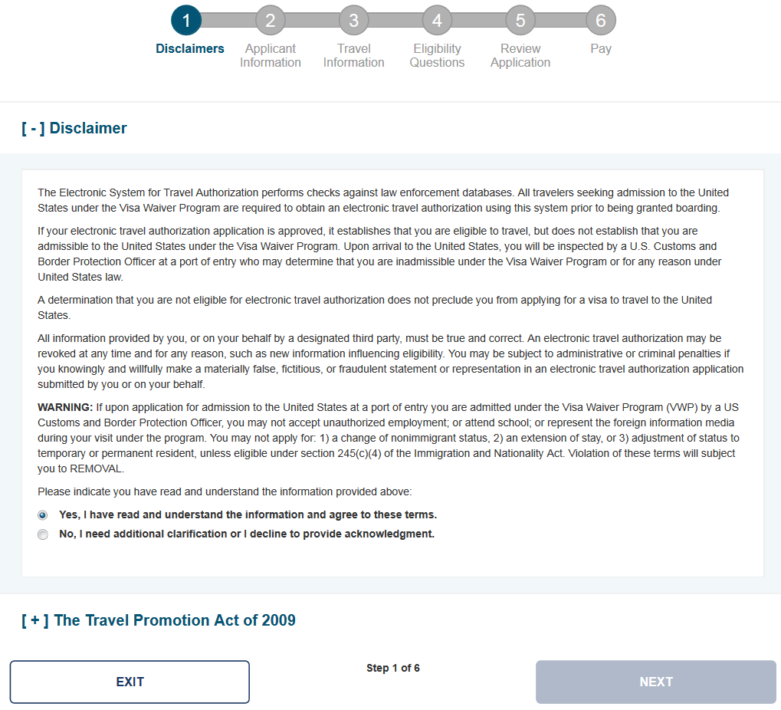
Disclaimer Page
Progress indicator at the top of the page illustrates each step of the ESTA application throughout the entire process.

Slide 12
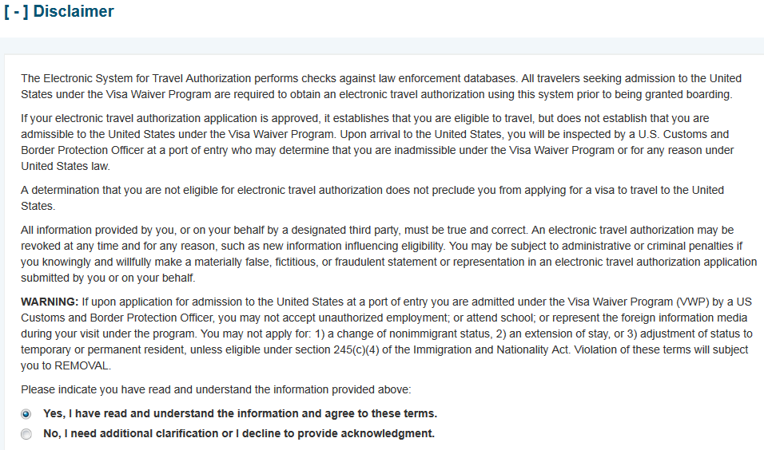
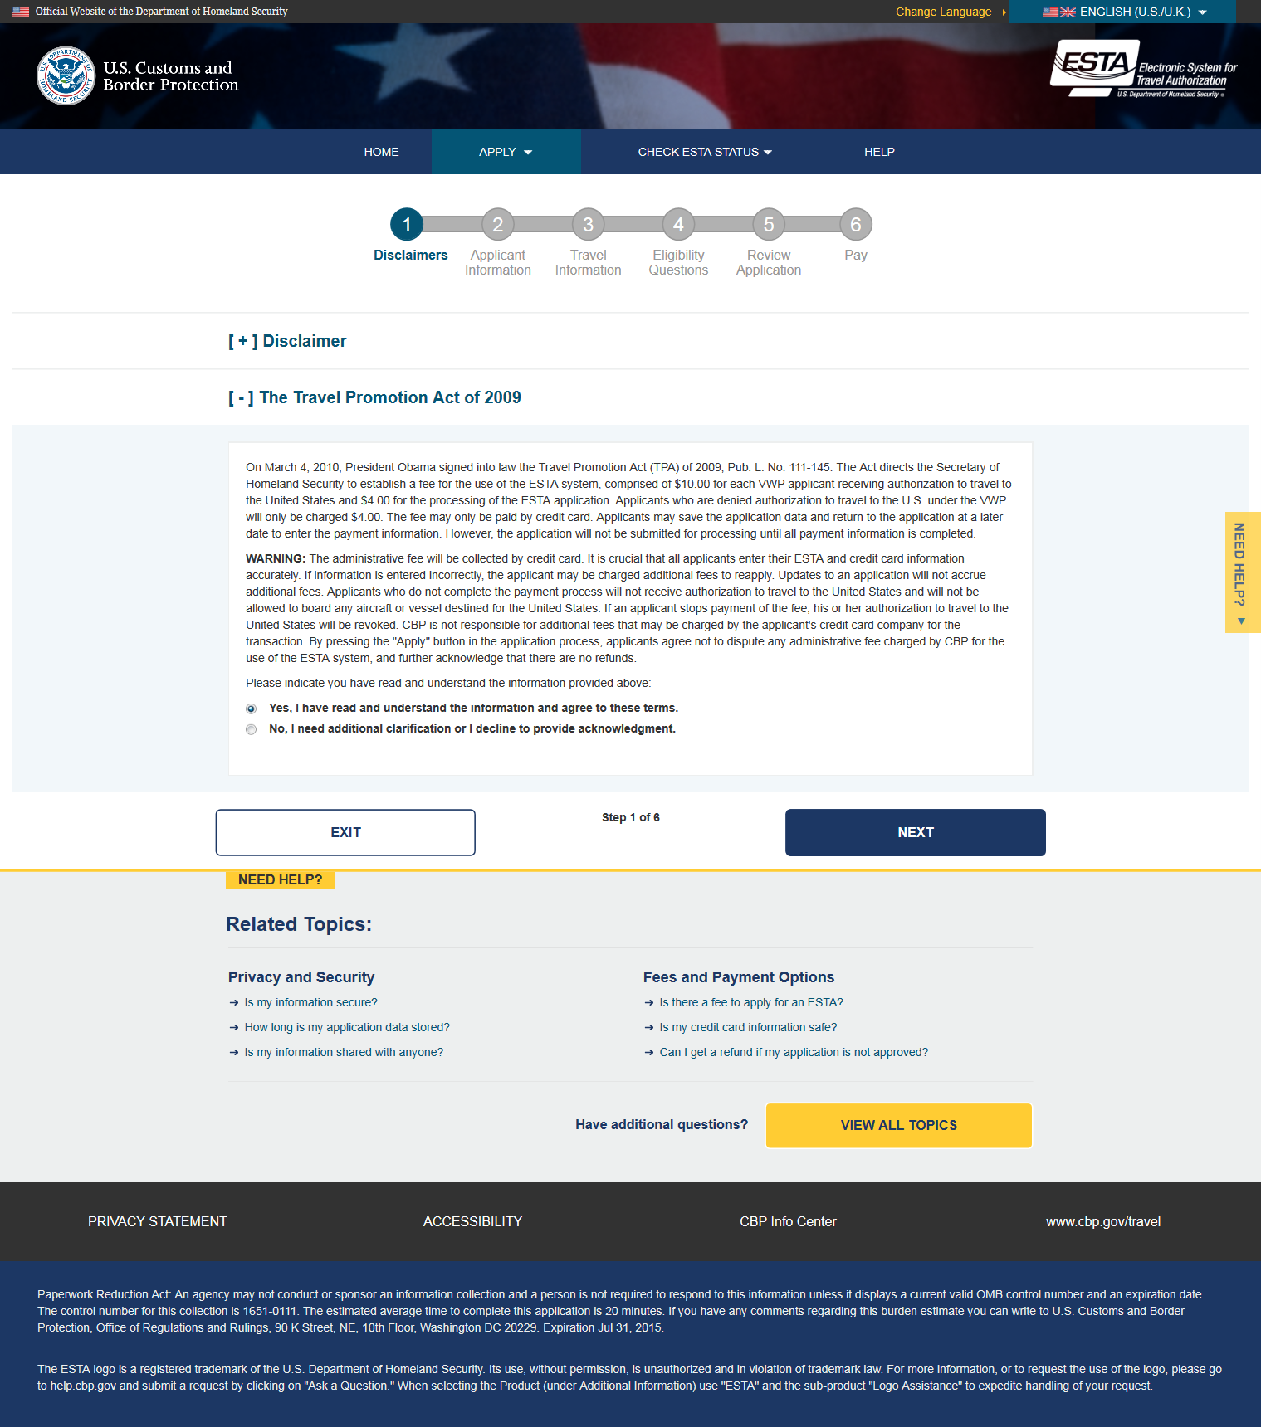
Travel Promotion Act Page
Once “Yes” is selected the Disclaimer section will be collapsed and the TPA section will expanded.

Slide 13
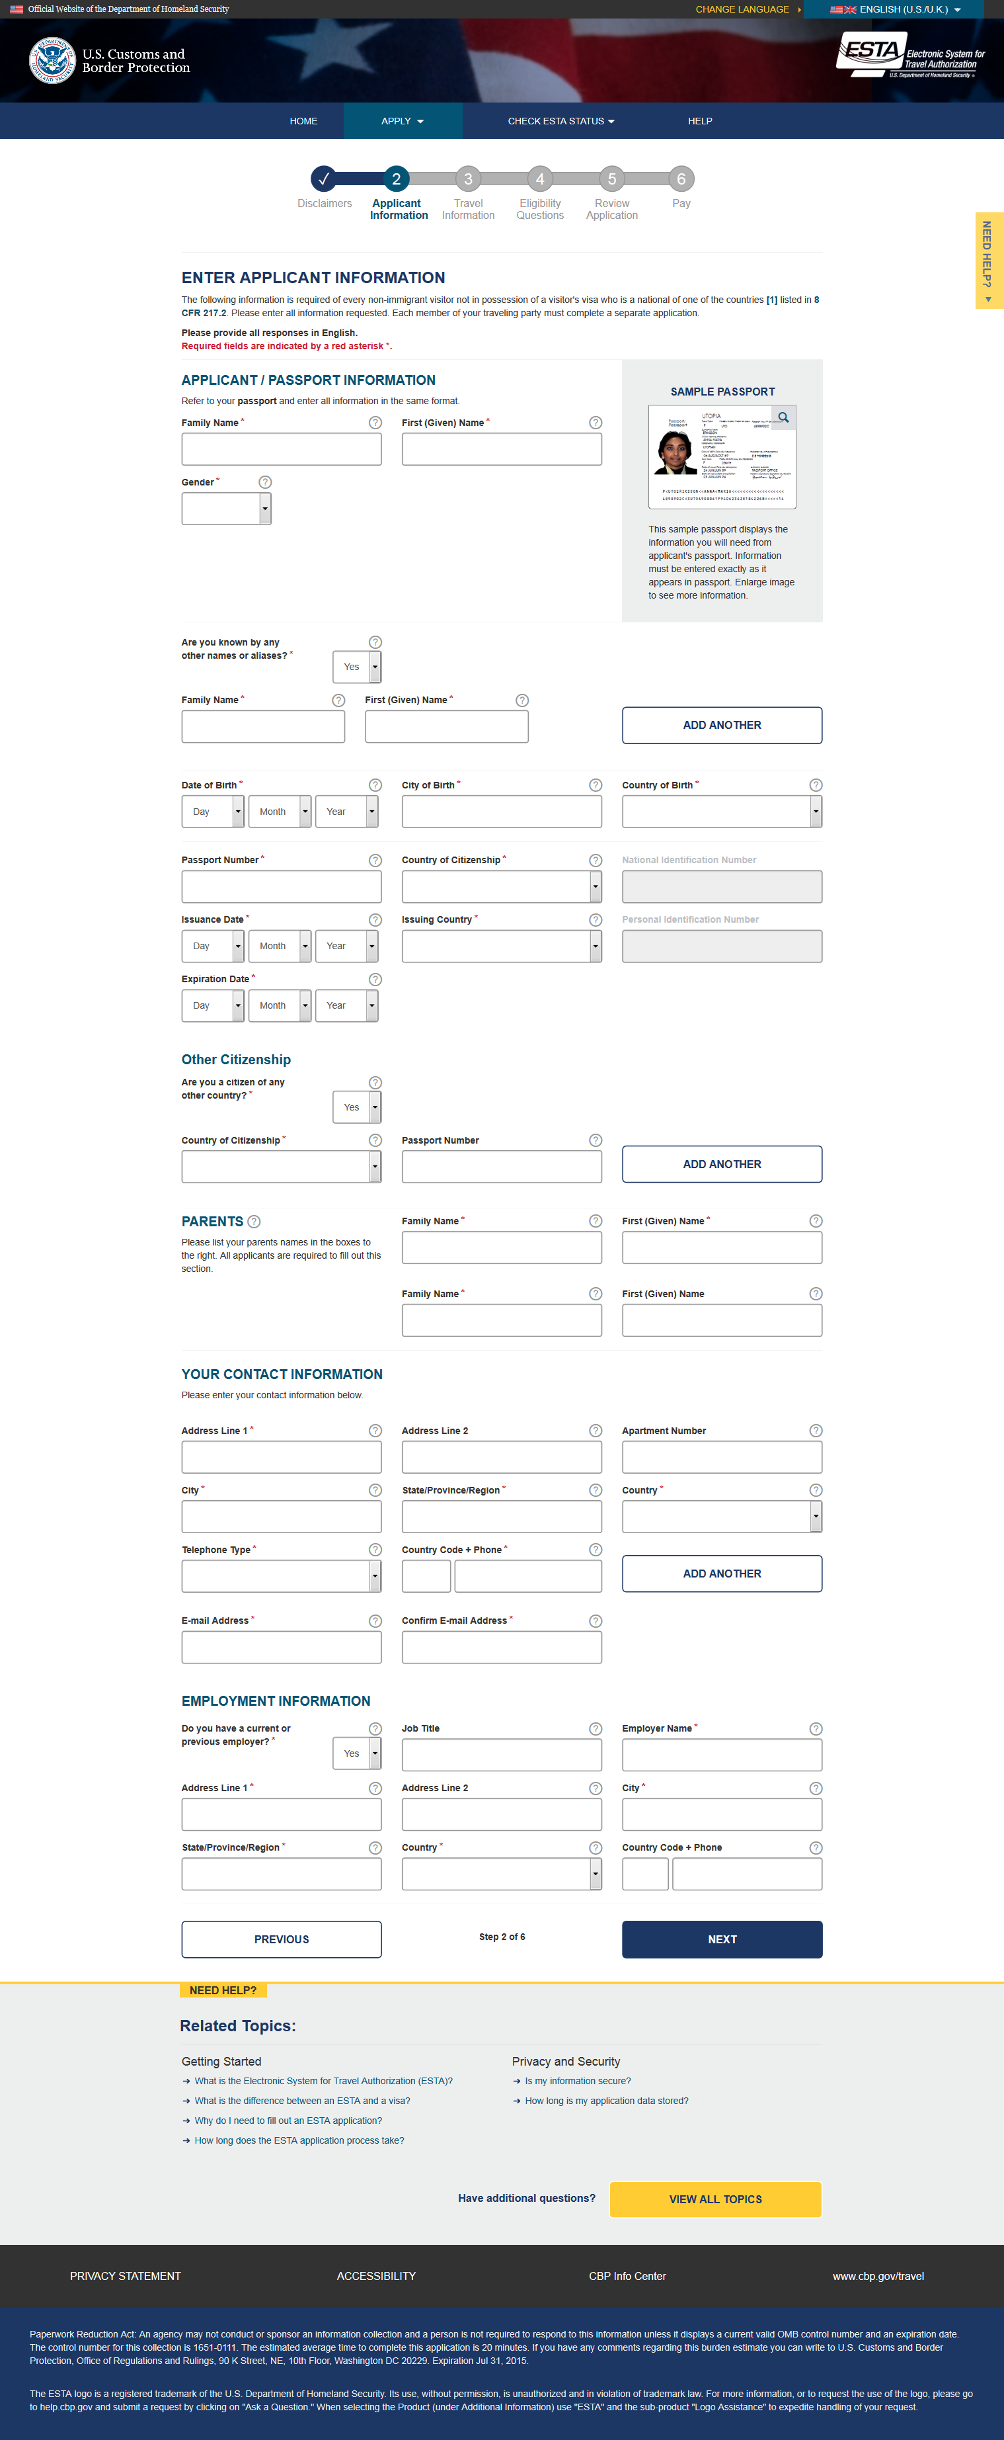
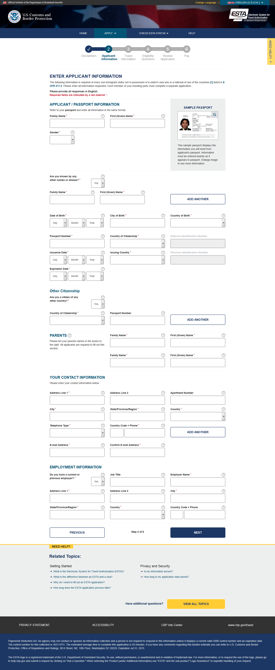

Applicant and Passport Information
Please see new passport / citizenship questions on Slides 14 through 16
After acknowledging the disclaimers the applicant will be asked to enter in their personal information (or the information of whoever they are applying for).

Slide 14
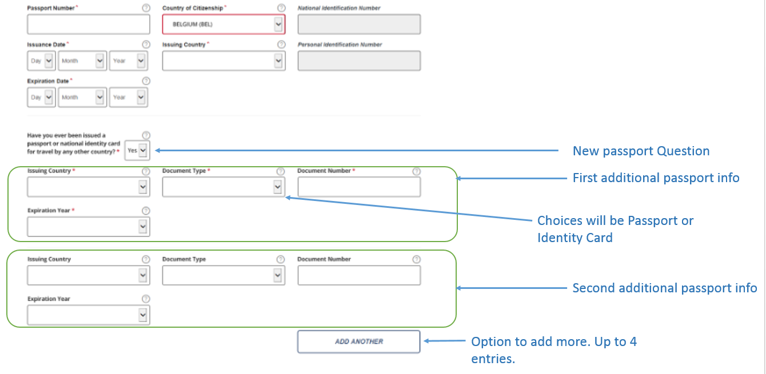
Application Information – Additional Passport Question and Fields

Slide 15
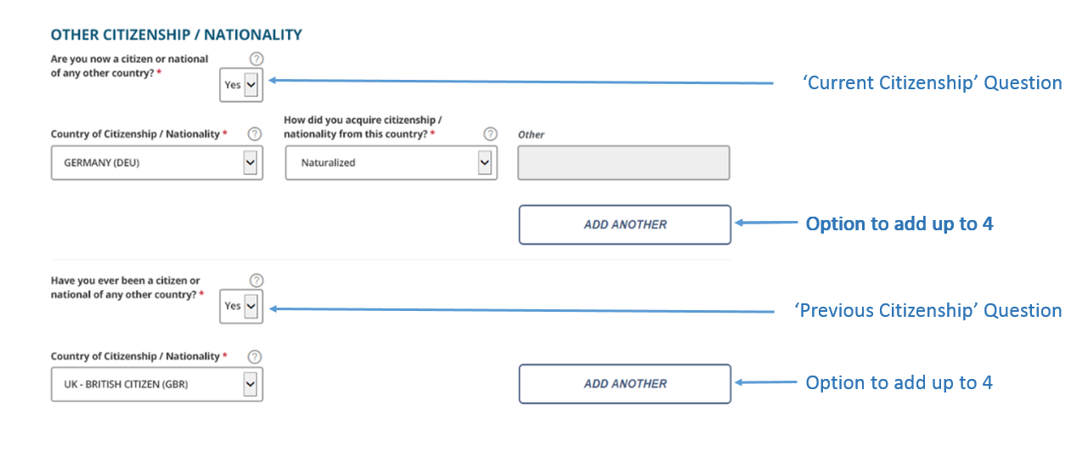
Application Information – New Citizenship Questions

Slide 16
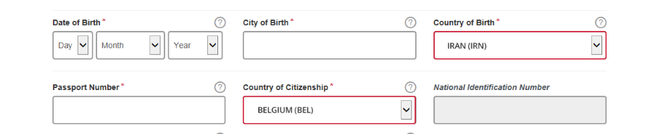
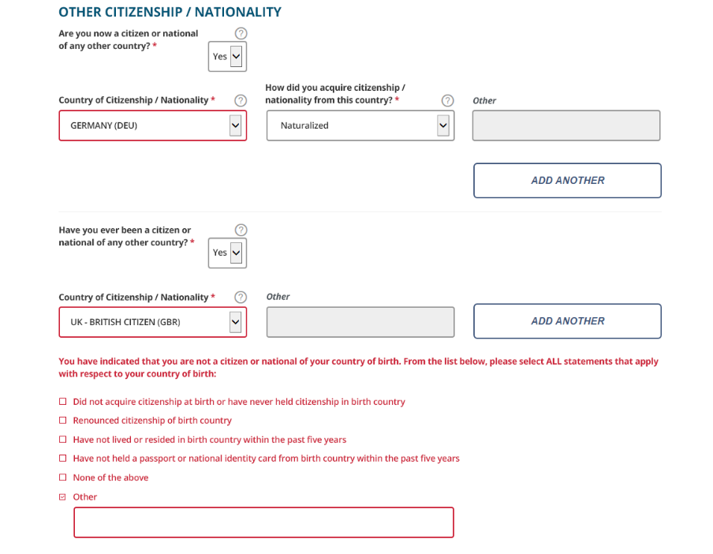
Application Information – Birth Country, Citizenship Mismatch
BIRTH COUNTRY MISMATCH Upon clicking ‘Next’ from this page, the system will validate the Country of Birth, the Country of Citizenship, the Current Other Country of Citizenship / Nationality, and the Previous Other Country of Citizenship/Nationality fields. If none of the country of citizenship fields match the Country of Birth, the system will ask the applicant to select the reason for it.

Slide 17
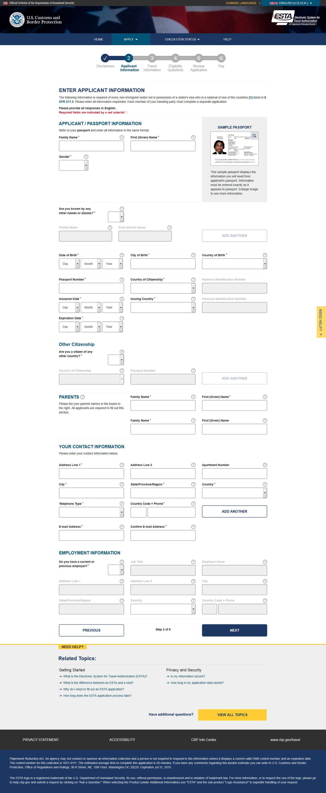
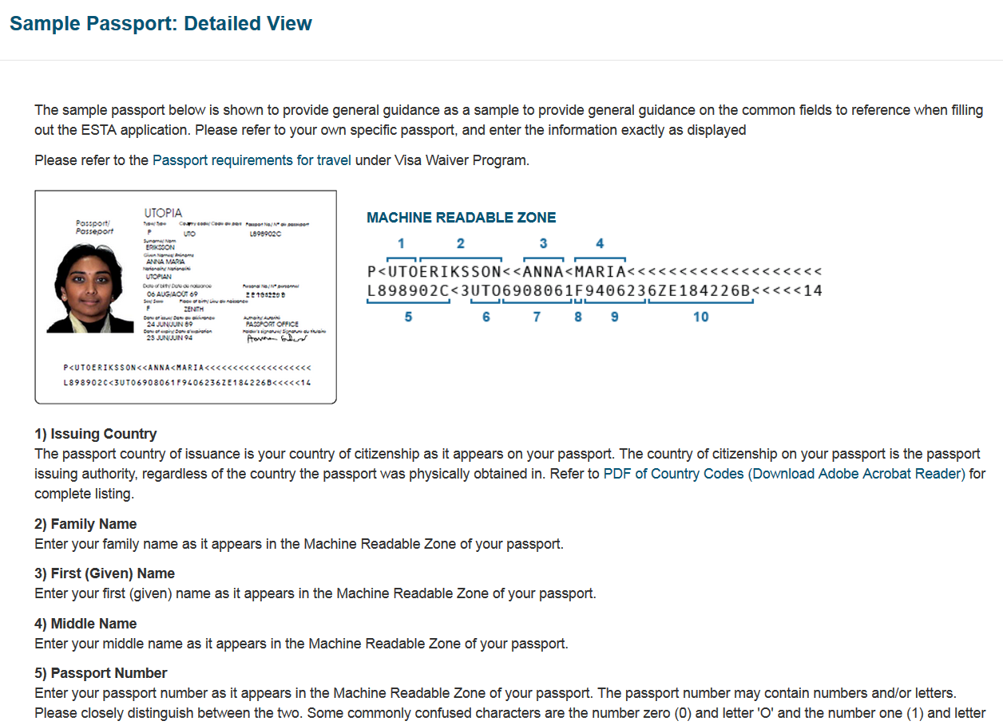
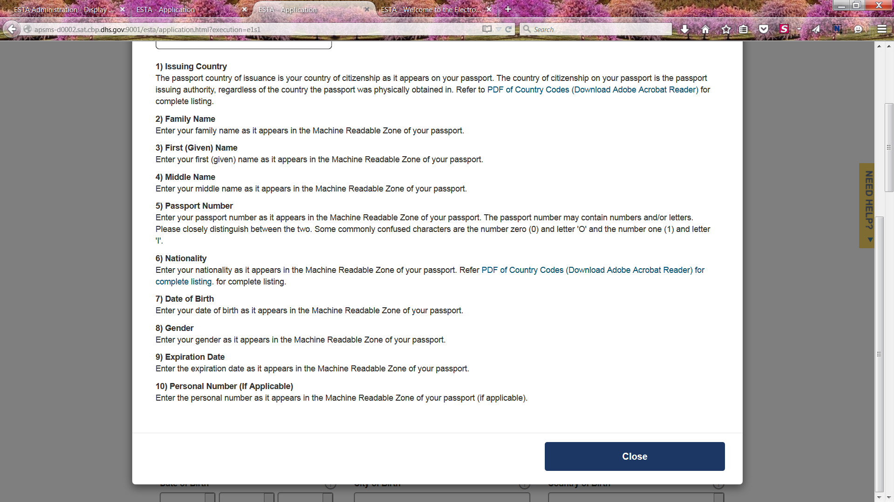
Sample Passport
On the right side of the Applicant Information page there is a help screen that shows the applicant where to find the requested information on their passport. This help screen can be accessed by clicking the magnifying glass on the upper right hand side of the passport image.

Slide 18
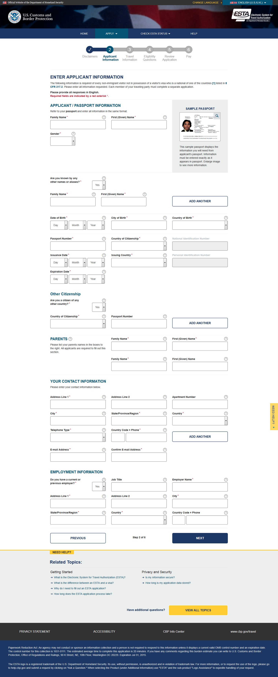
Contact and Employment Information
On the next screen the applicant will be asked to enter their contact and employment information.

Slide 19
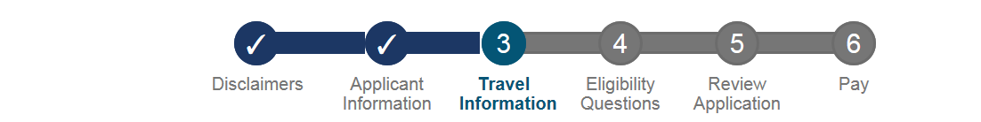
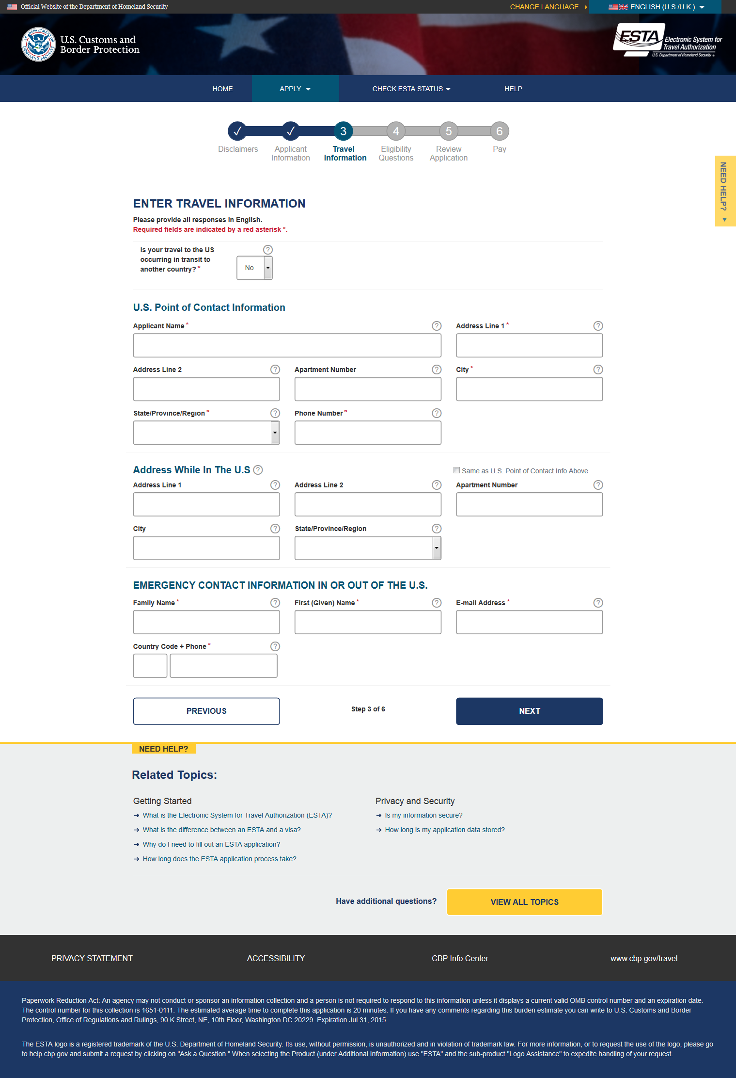
Travel Information
On the third screen the applicant will be asked to enter their travel information.

Slide 20
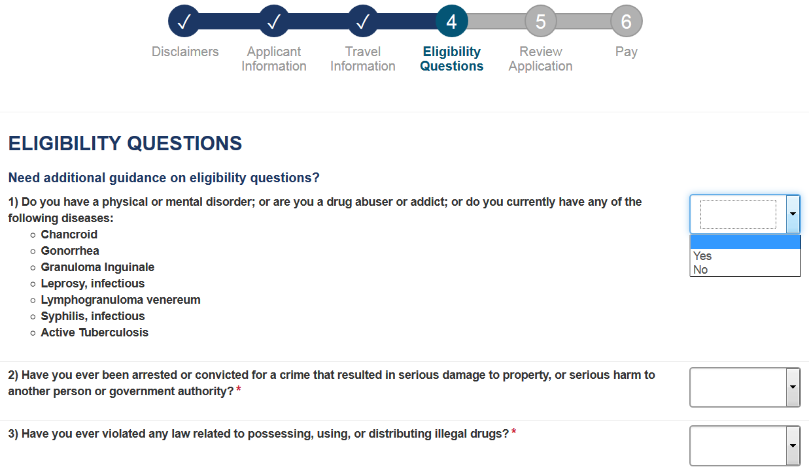
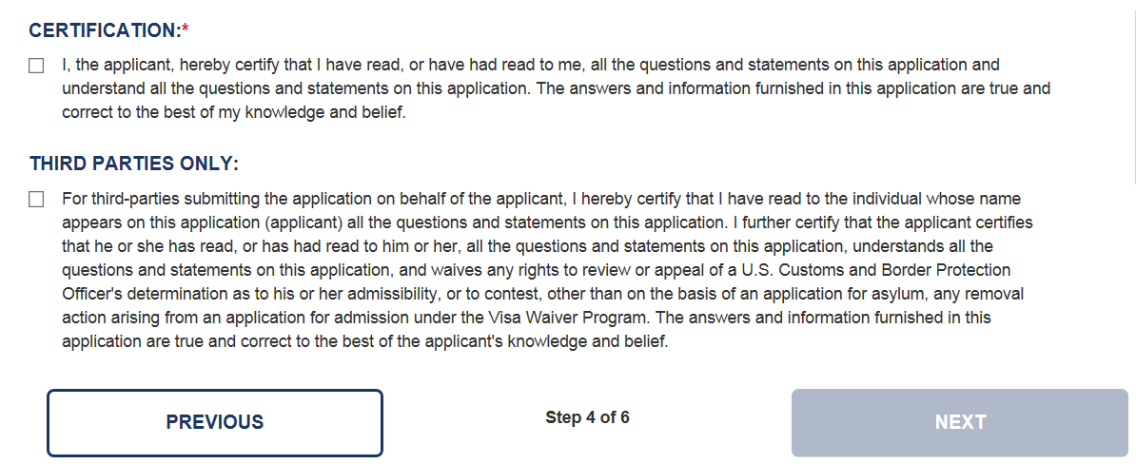
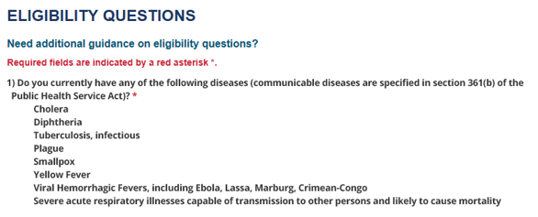
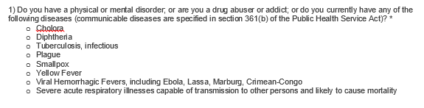
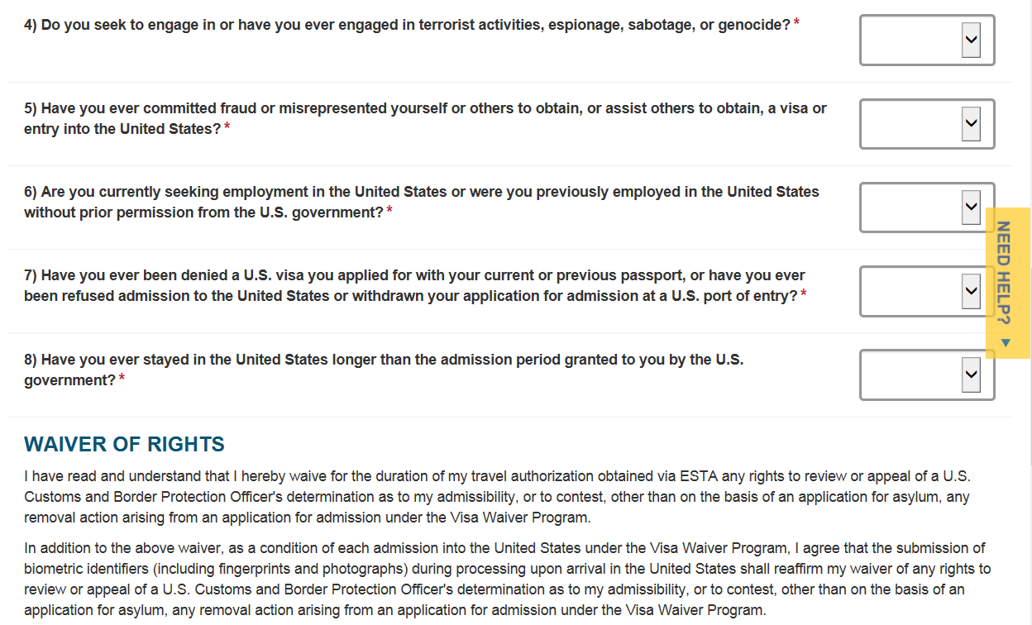
Eligibility Questions and Waiver of Rights
On the fourth screen the applicant will be asked a series of eligibility questions. This page includes a drop down menu where the applicant can selection Yes or No to each question.
Please see new eligibility questions on Slides 21 through 26

Slide 21
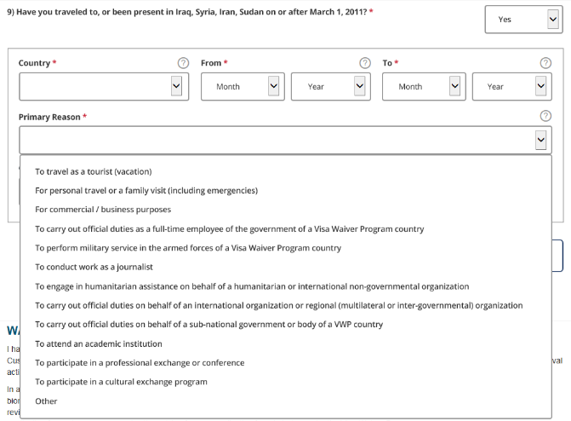
Eligibility Questions – Question 9 Primary Reason
When answer to Question 9 is ‘Yes’, the section below with Country, From, To, and Primary Reason fields open up with the option to add more travels.
Option to add additional travel. Up to 10 can be added.

Slide 22
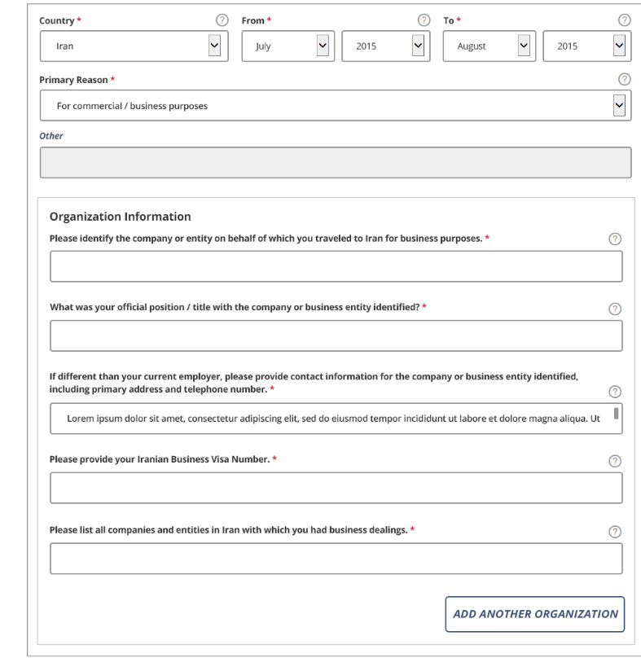
Eligibility Questions - Iran Travel
If travel is to Iran and the primary reason is commercial/business purposes, the Iran specific organization questions are shown below
On clicking this button, the Organization information section will repeat for additional entry. Up to 4 entries

Slide 23
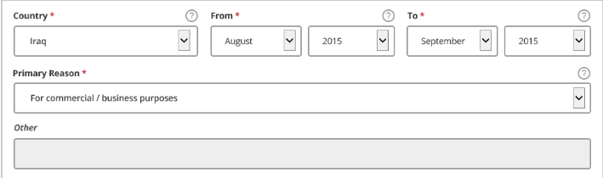
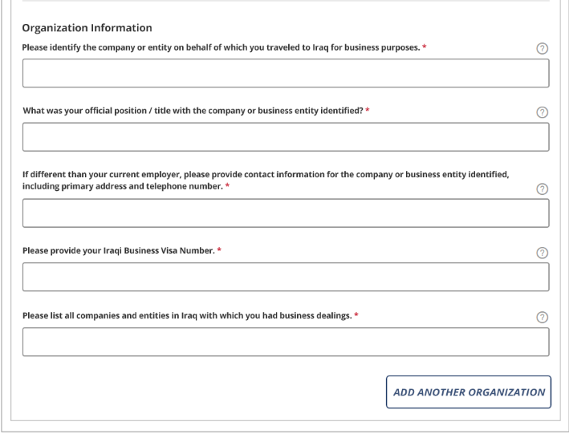
Eligibility Questions - Iraq Travel
If travel is to Iraq and the primary reason is commercial/business purposes, the Iraq specific organization questions are shown below
On clicking this button, the Organization information section will repeat for additional entry. Up to 4 entries

Slide 24
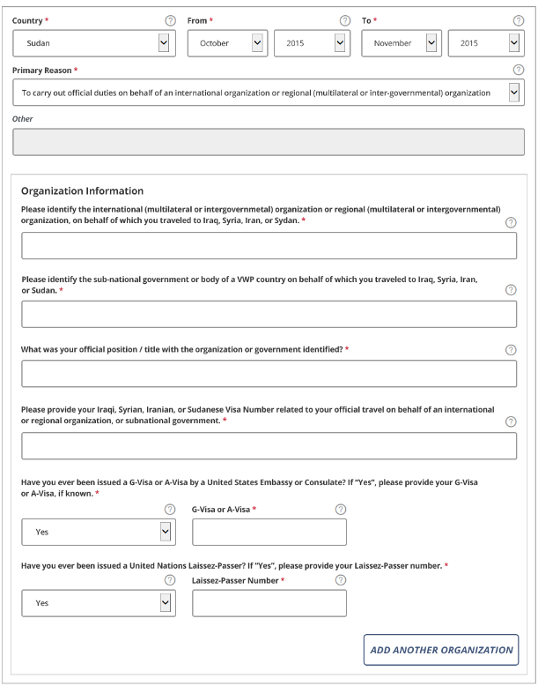
Eligibility Questions - International Organization / Sub-National Government
If Primary purpose of travel is: “To carry out official duties on behalf of an international organization…” OR “To carry out official duties on behalf of a sub-national government…”, the specific organization questions are shown below
On clicking this button, the Organization information section will repeat for additional entry. Up to 4 entries.

Slide 25
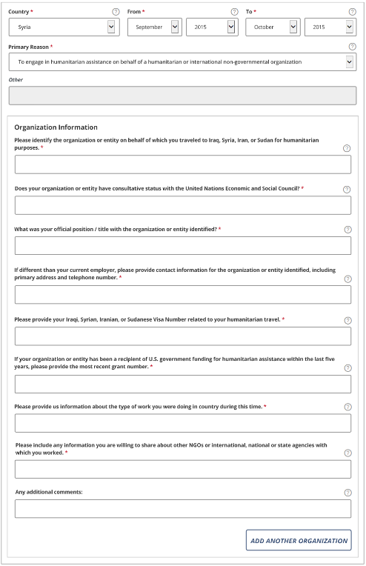
Humanitarian/NGO travel
If travel is to engage in humanitarian assistance, the Humanitarian/NGO specific organization questions are shown below
On clicking this button, the Organization information section will repeat for additional entry. Up to 4 entries.

Slide 26
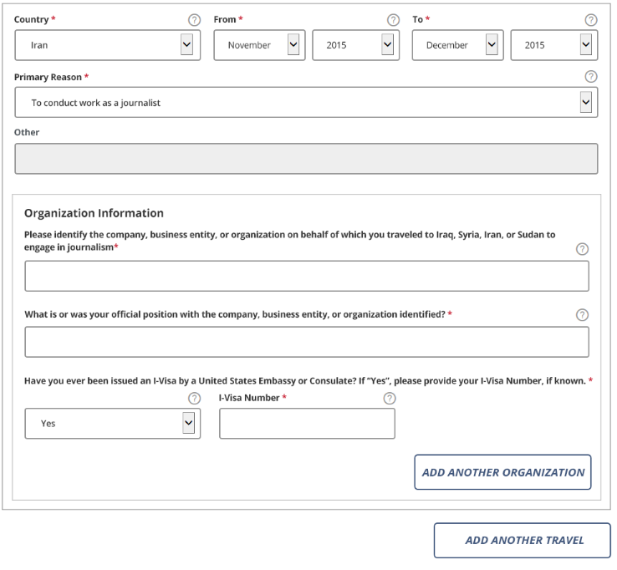
Eligibility Questions - Journalism
If travel’s primary reason is to work as a journalist, the Journalism specific organization questions are shown below
On clicking this button the Organization information section will repeat for additional entry (up to 4).
On clicking this button the travel information including Country, From, To, and Primary Reason will repeat for additional entry

Slide 27
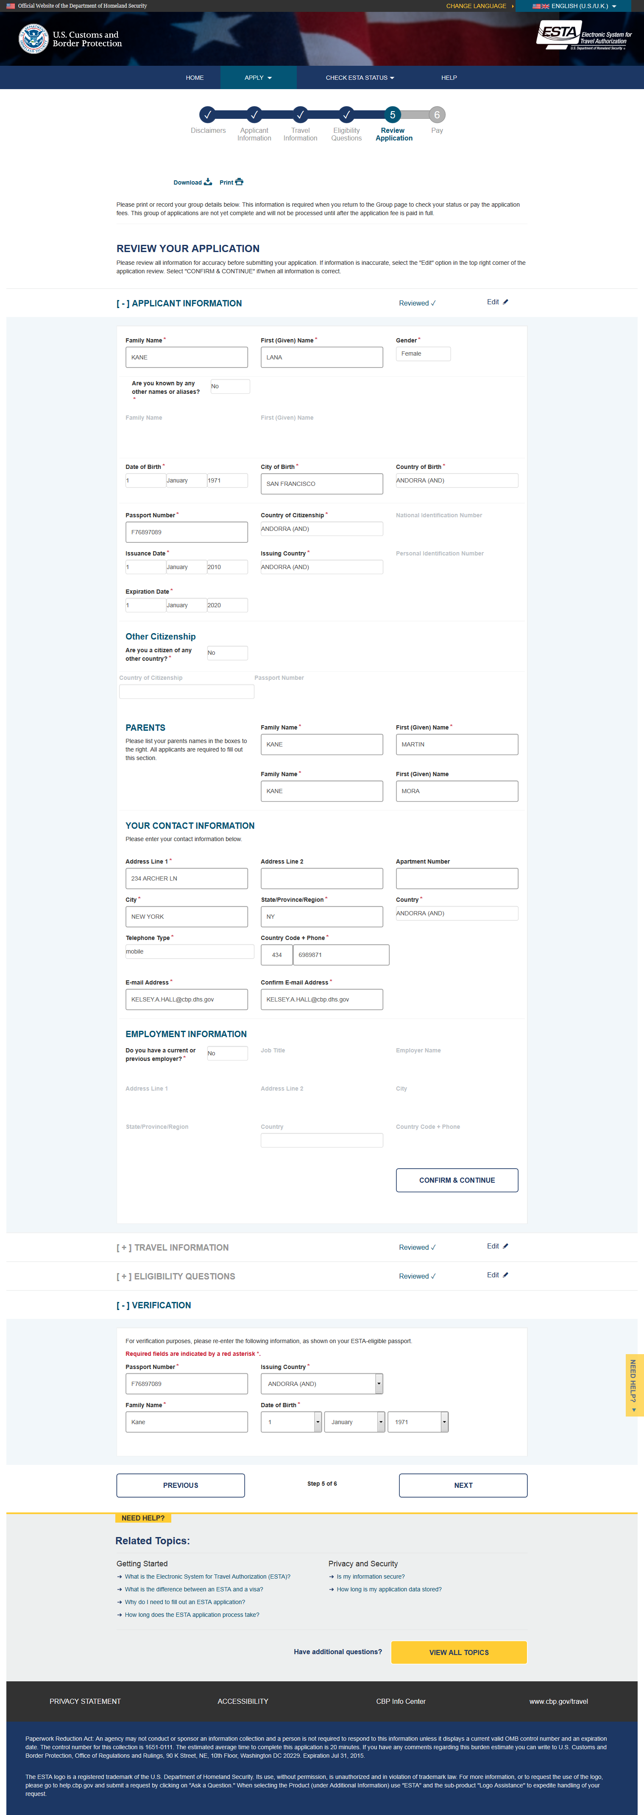
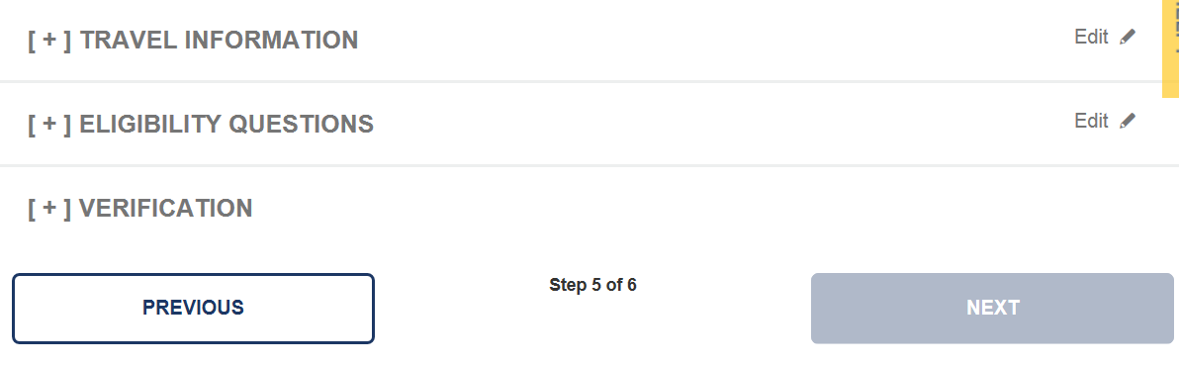
Review- Applicant Information
On the final page the applicant will be given the option to review and edit their application before they submit it. To complete this part of the application the applicant must select “Confirm & Continue” icon on each section.

Slide 28
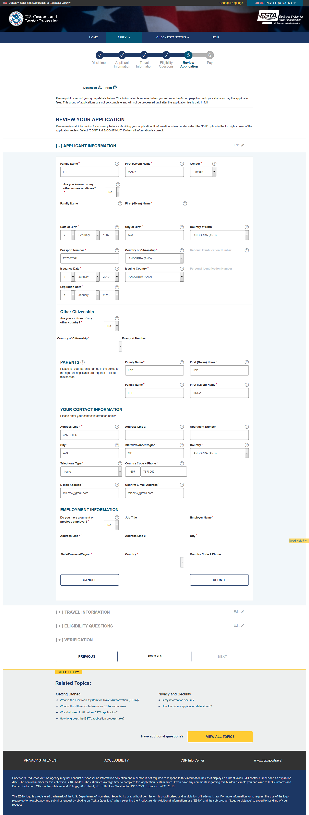
Edit Applicant Information
On the review page the applicant can also make updates to their application before submitting it. This can be done by clicking the “Edit” icon, making the changes then clicking “Update”.

Slide 29
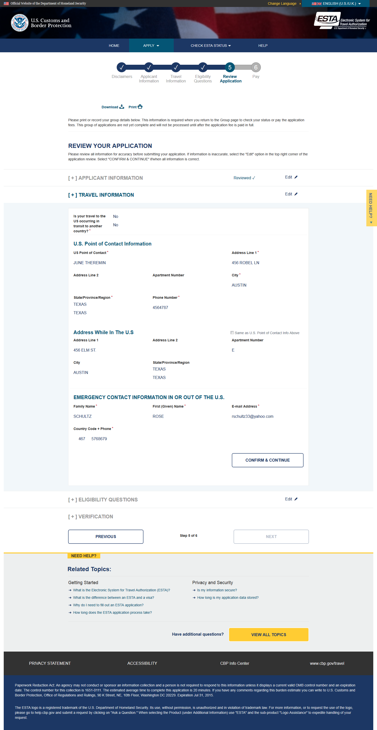
Review- Travel Information

Slide 30
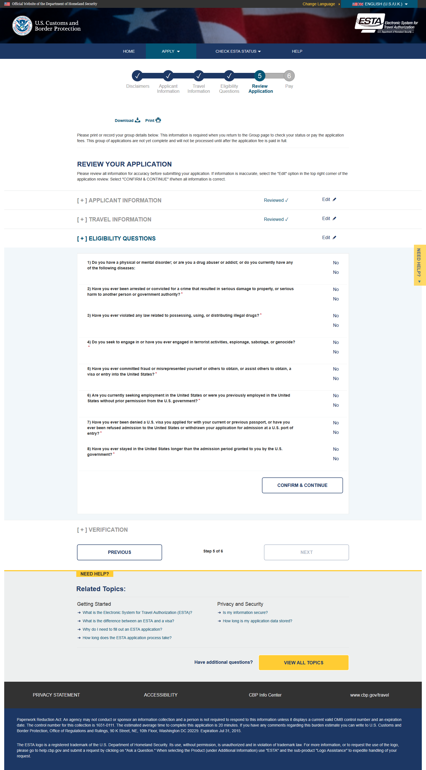
Review- Eligibility Questions

Slide 31
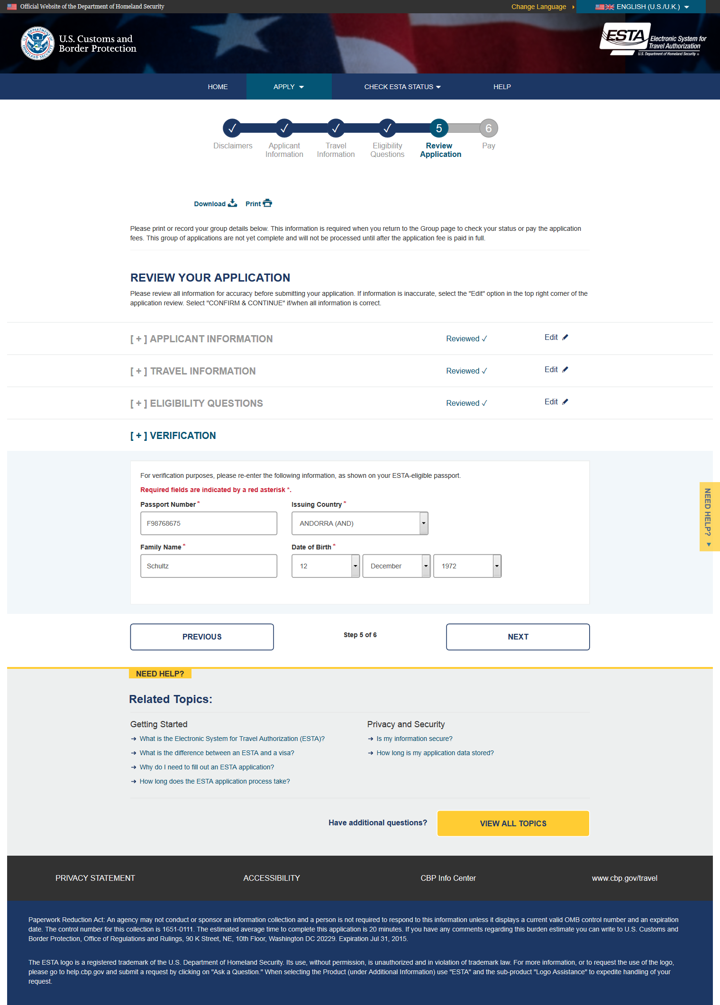
Review- Verification

Slide 32
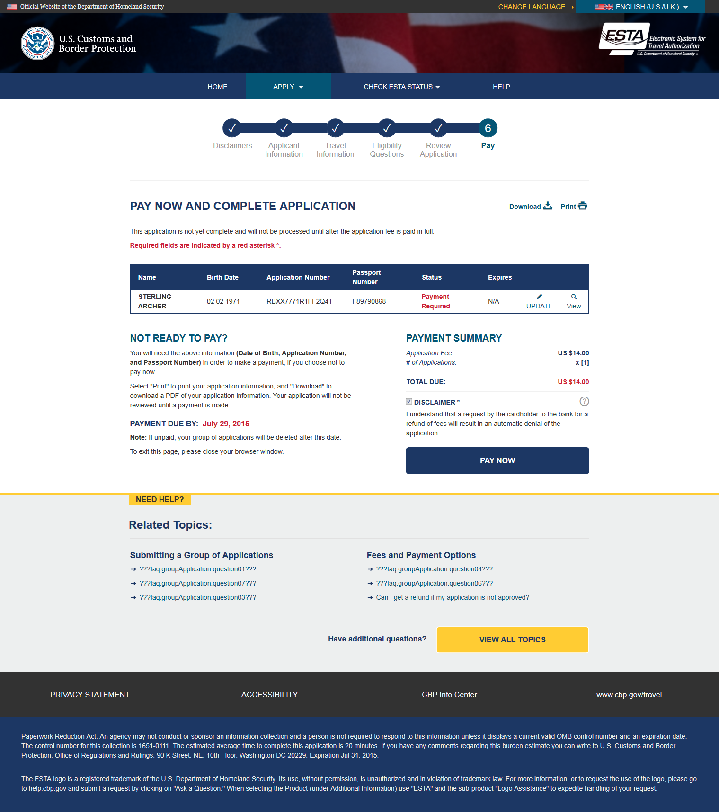
Application Status Page (Single)
After selecting “Confirm and Continue”, then “Next” on each section of the Application Review page the applicant will be taken to the Application Status page. From this page the applicant can pay, print, view, or update their application.

Slide 33
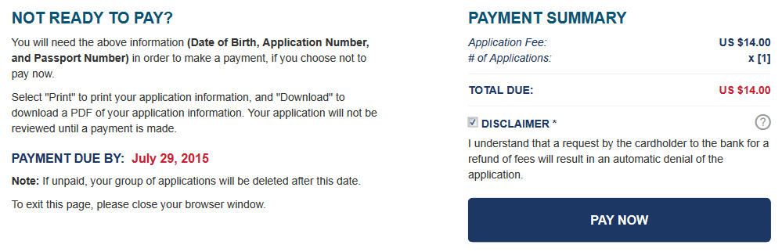
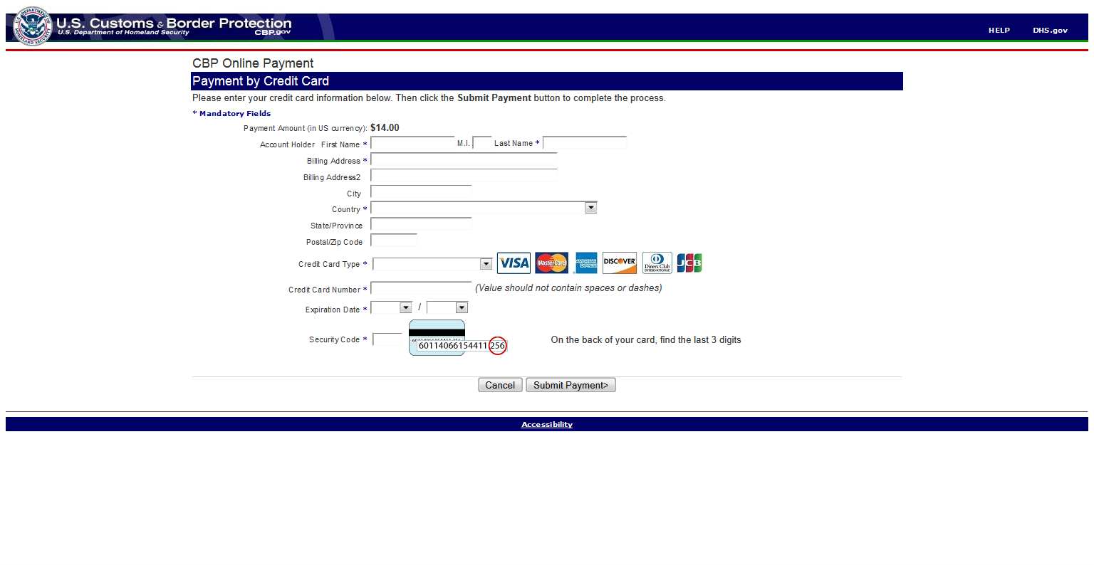
Submit Payment
From the Application Status page (group or individual), applicants can submit payment by checking the Disclaimer and clicking the “Pay Now” button.

Slide 34
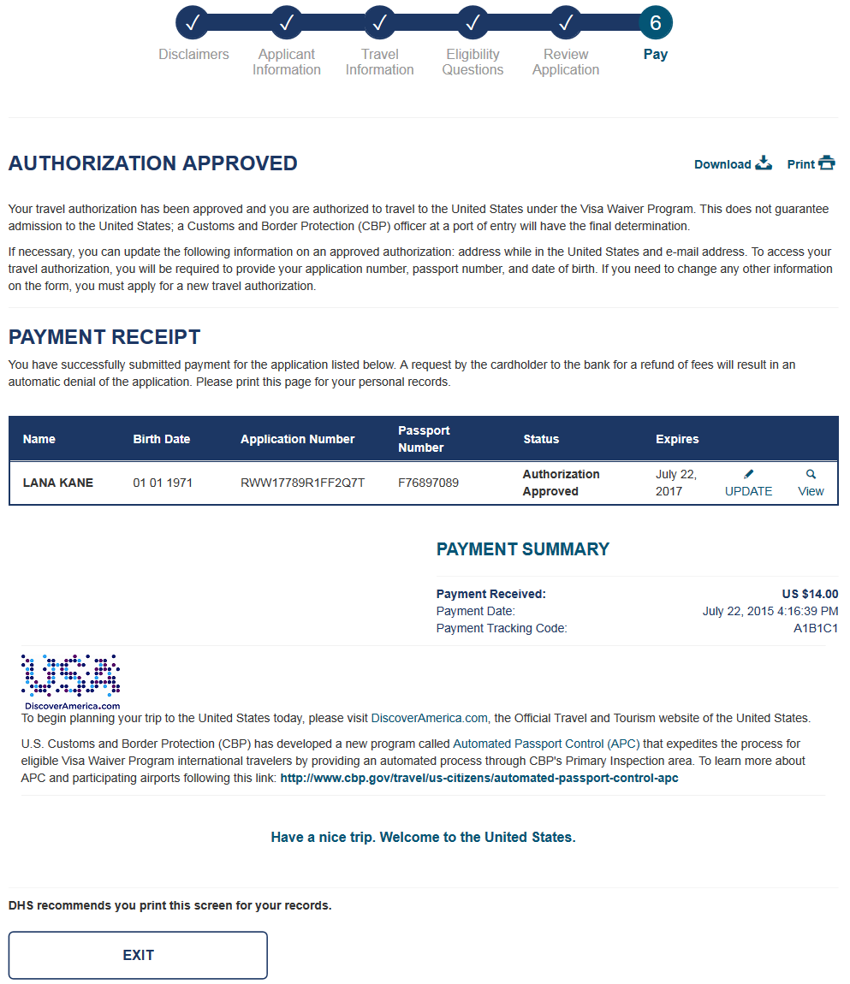
Status- Authorization Approved
When a travel authorization is approved they will see this image when they check their application status.

Slide 35
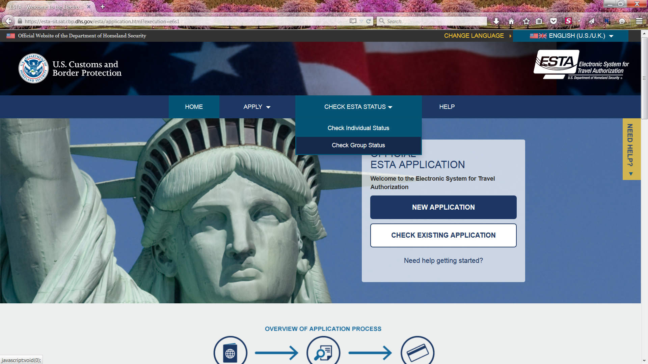
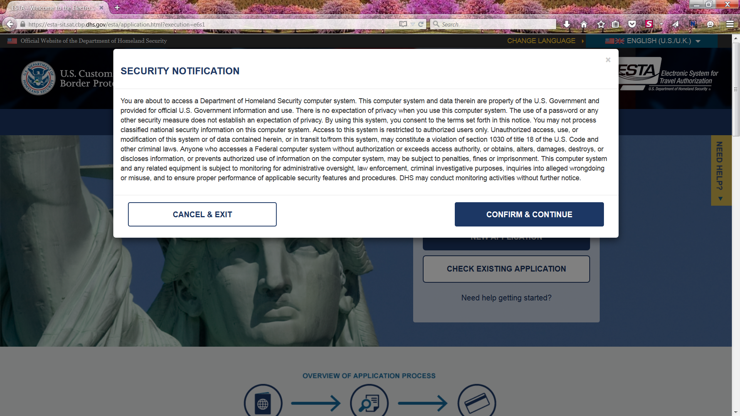


Retrieve one Application
An applicant can check the status of an existing individual application by selecting “Check Individual Status” under the “Check ESTA Status” menu button on the main page. The applicant will then be asked to enter in data related to the desired application. After the requested data is entered they will select “Retrieve Application”.

Slide 36

Questions?
Call the ESTA PMO:
202-344-3710

Slide 37

Updating Application
From the Application Status page for an individual or group of ESTAs, the applicant has the option to update each approved application. This can be done by selecting the “Update” icon located next to each approved travel authorization.

Slide 38

Viewing Application
From the Application Status page for an individual or group of ESTAs, the applicant has the option to view each application. This can be done by selecting the “View” icons located next to each application.

Slide 39

Printing Application
From the Application Status page for an individual or group of ESTAs the applicant has the option to print the summary of each application and the payment summary. This can be done by selecting the “Print” icon on the upper right corner of the page.

Slide 40

Status-Authorization Pending
When a travel authorization is pending review they will see the above image when they check their application status.

Slide 41

Status-Travel Not Authorized
When a travel authorization is denied they will see this image when they check their application status.

Slide 42

Status-Authorization Approved/ Denied
Each application in a group will be adjudicated individually so each application could have a different status, as shown here.

Slide 43


