Slide 1
USCIS Appointment Scheduler
Making an Appointment inside the U.S.

Slide 2
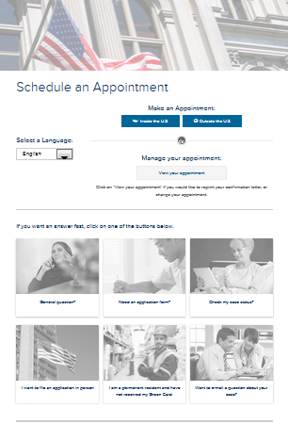
Landing page – 3 parts
Notes:
DHS Warning will have a header

Slide 3
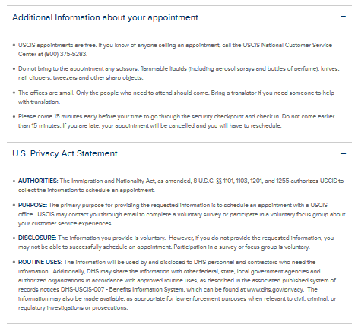
USCIS Accessibility Statement -
The United States Citizenship and Immigration Service (USCIS), a component of the Department of Homeland Security (DHS), is committed to making its electronic and information technologies accessible to individuals with disabilities by meeting or exceeding the requirements of Section 508 of the Rehabilitation Act (29 U.S.C. 794d), as amended in 1998. Section 508 is a federal law that requires agencies to provide individuals with disabilities equal access to electronic information and data comparable to those who do not have disabilities, unless an undue burden would be imposed on the agency. The Section 508 standards are the technical requirements and criteria that are used to measure conformance within this law. More information on Section 508 and the technical standards can be found at www.section508.gov.
Paperwork Reduction Act -
Burden Disclosure Notice
An agency may not conduct or sponsor an information collection, and a person is not required to respond to a collection of information unless it displays a currently valid OMB control number. The public reporting burden for this collection of information is estimated at 6 minutes per response, including the time for reviewing instructions and completing and submitting the information. Send comments regarding this burden estimate or any other aspect of this collection of information, including suggestions for reducing this burden, to: U.S. Citizenship and Immigration Services, Office of Policy and Strategy, Regulatory Coordination Division, 20 Massachusetts Avenue, N.W., Washington, DC 20529. OMB No. 1615-0113. Do not mail your application to this address.
OMB Control Number: 1615-0113
Expiration Date: 03-31-2016

Slide 4
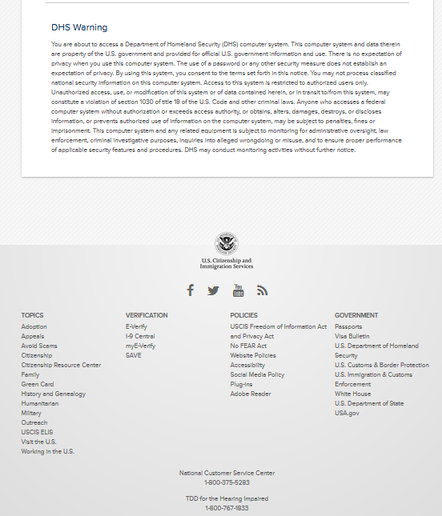

Slide 5
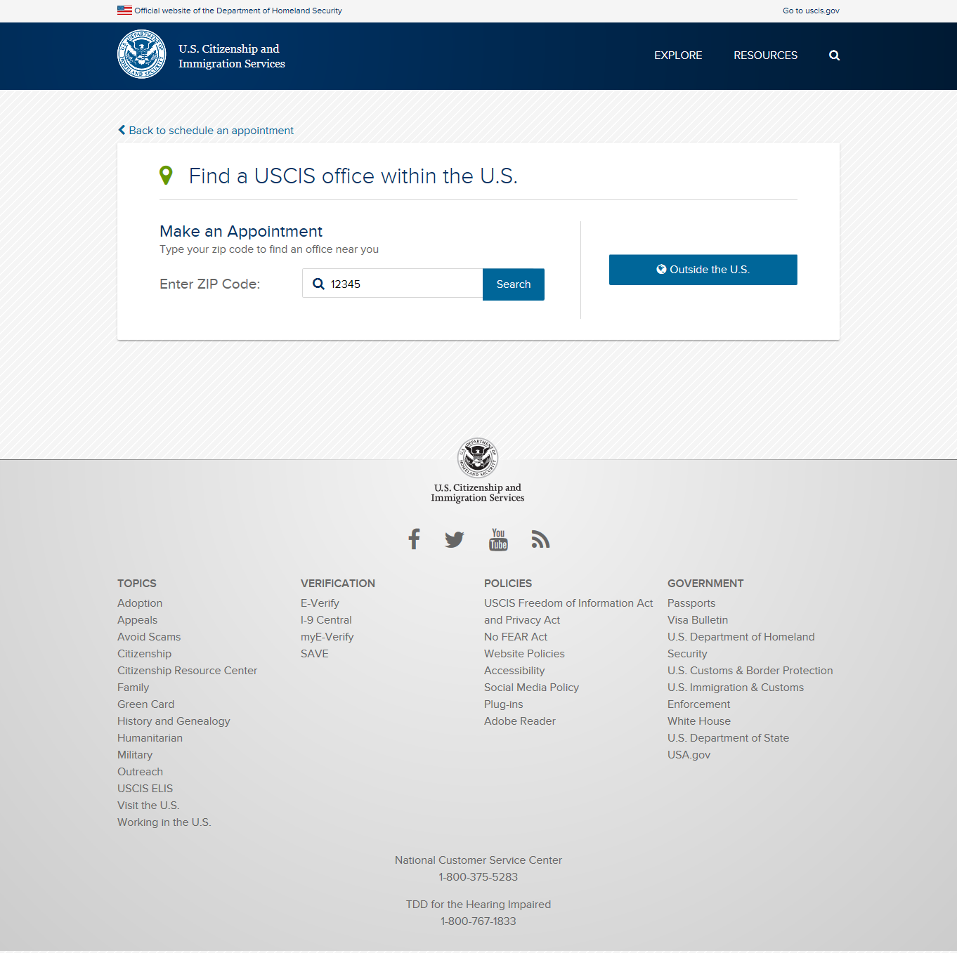
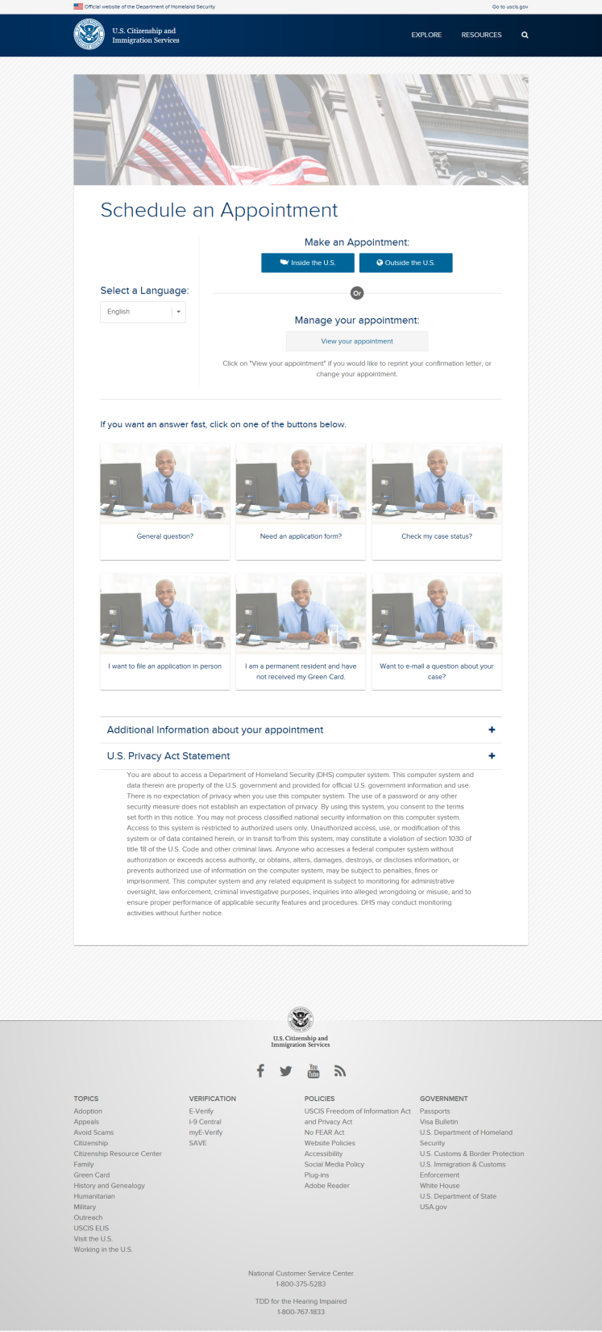

Slide 6
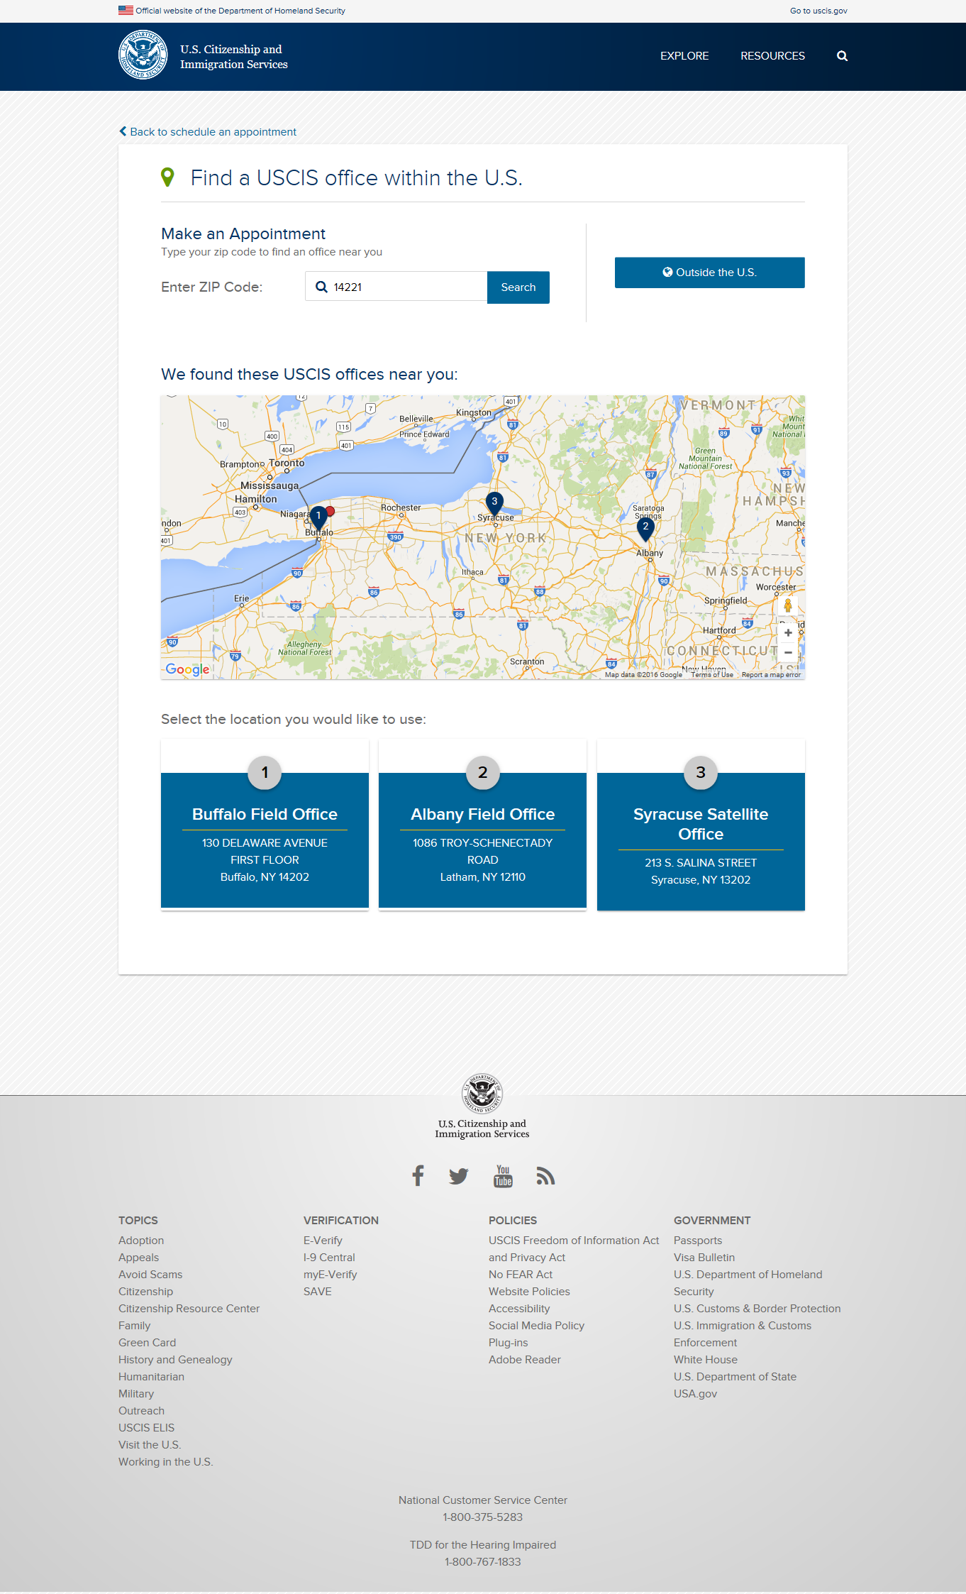

Slide 7
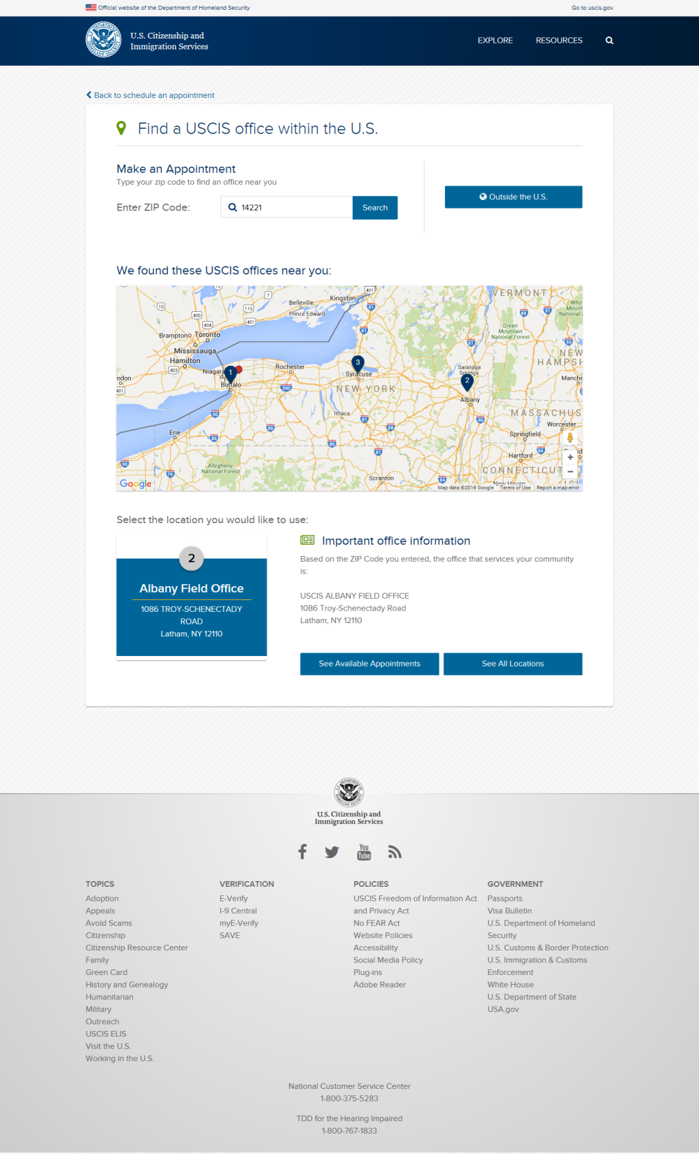

Slide 8
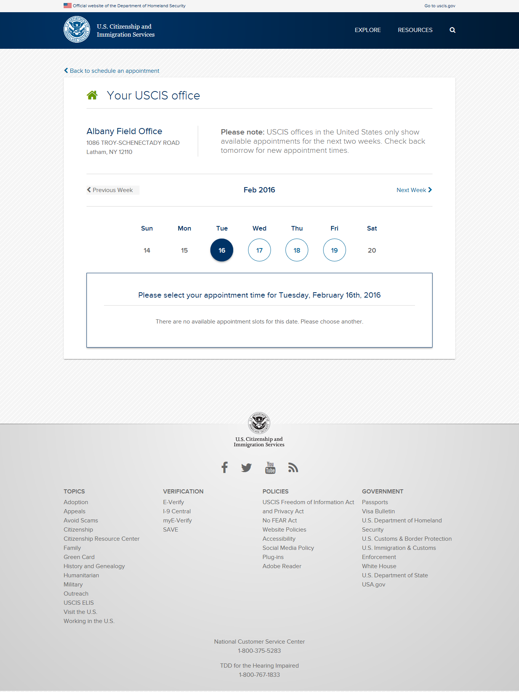

Slide 9
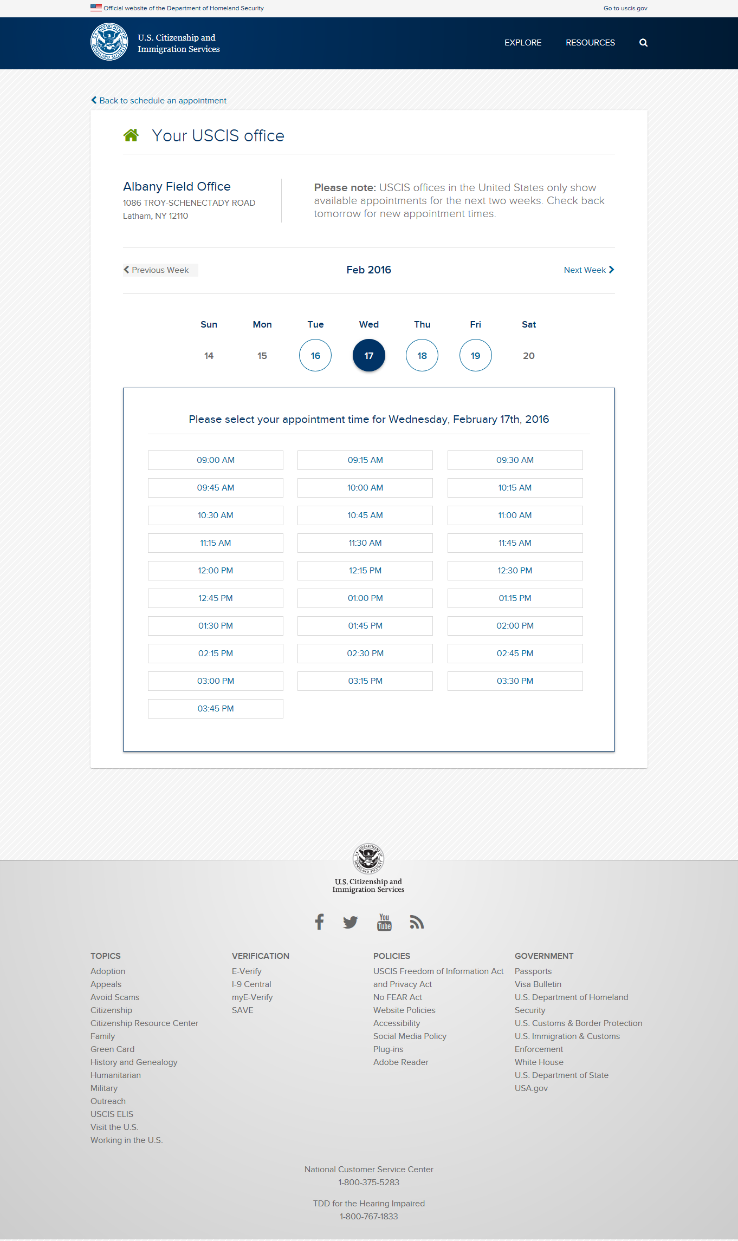

Slide 10
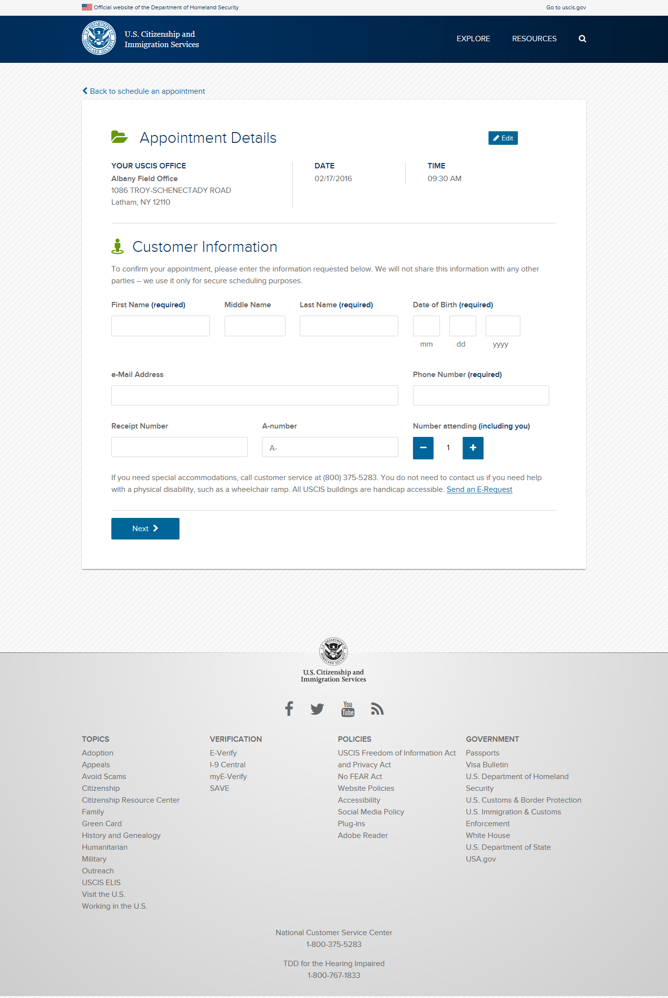

Slide 11
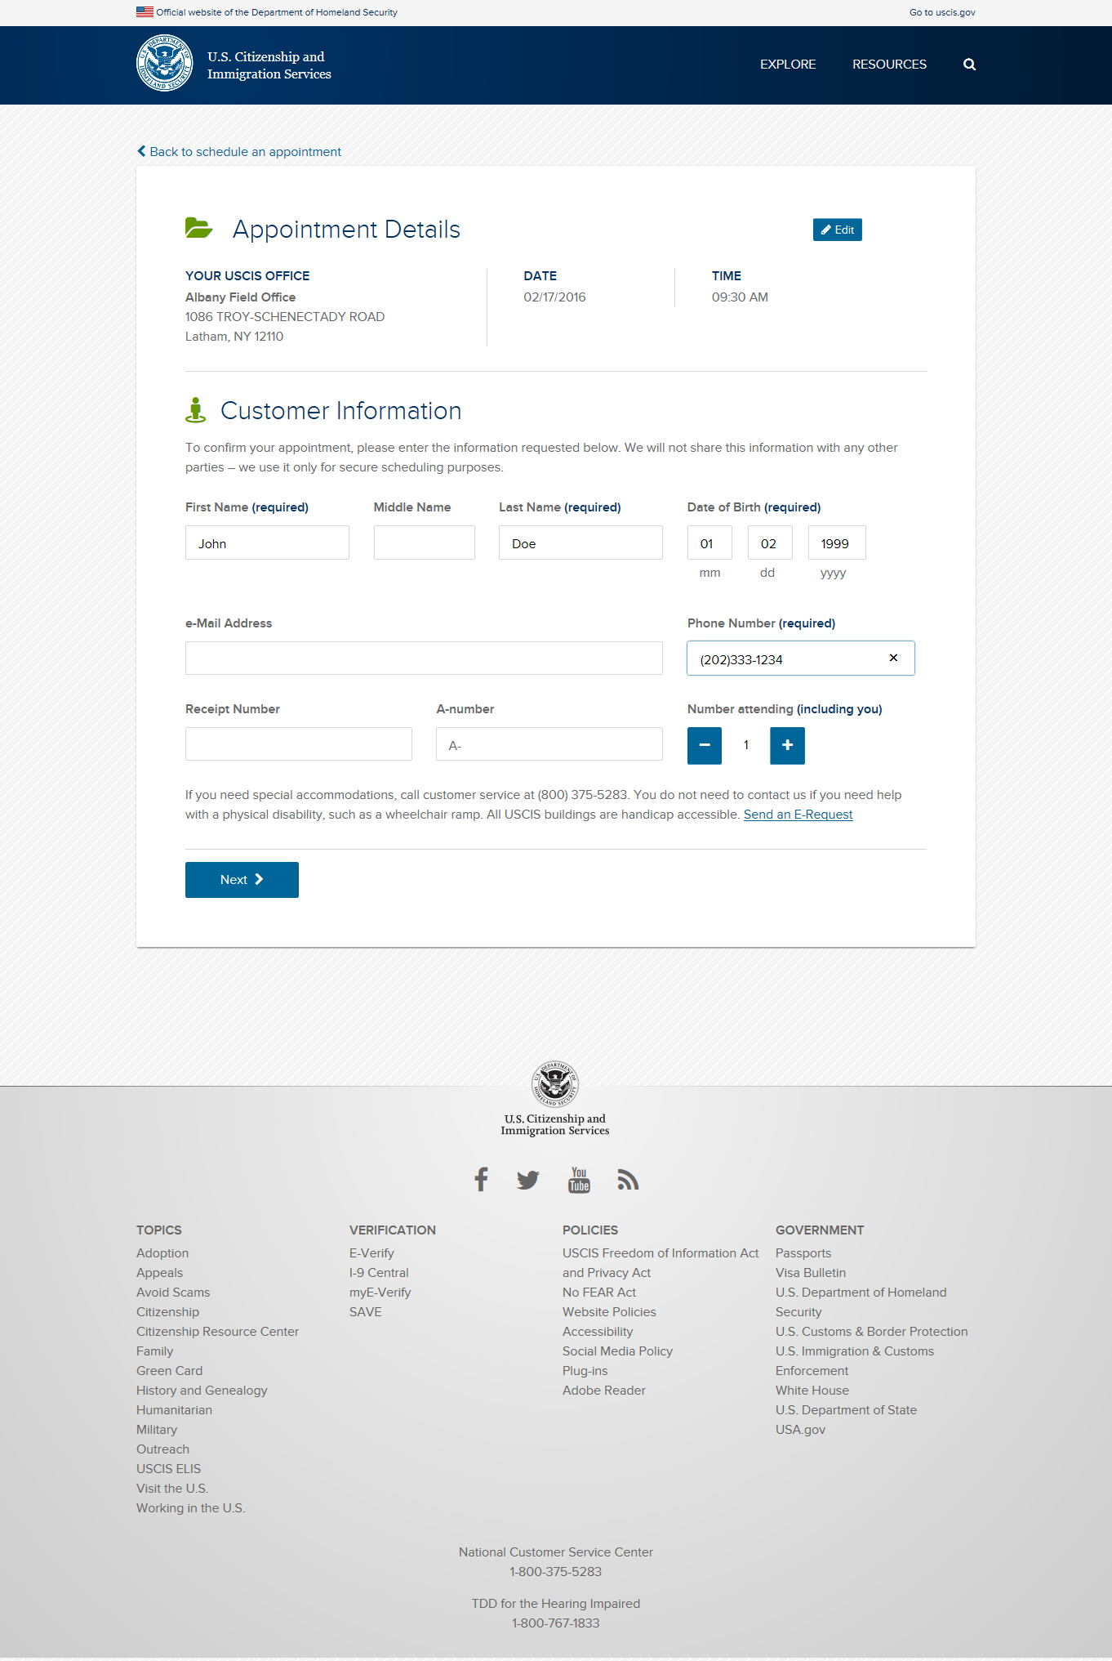

Slide 12
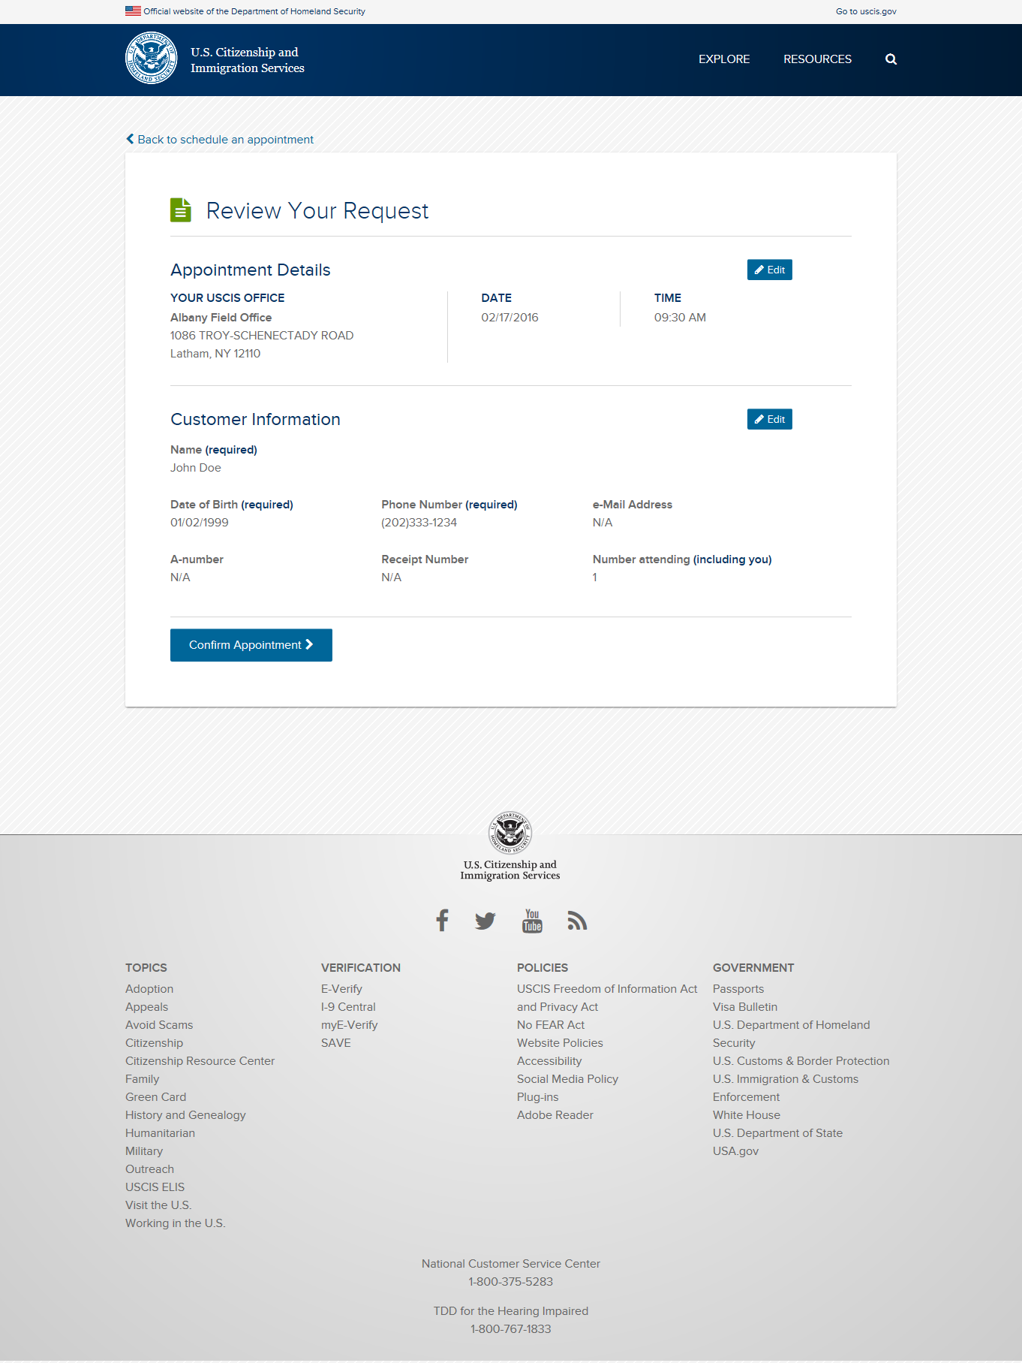

Slide 13
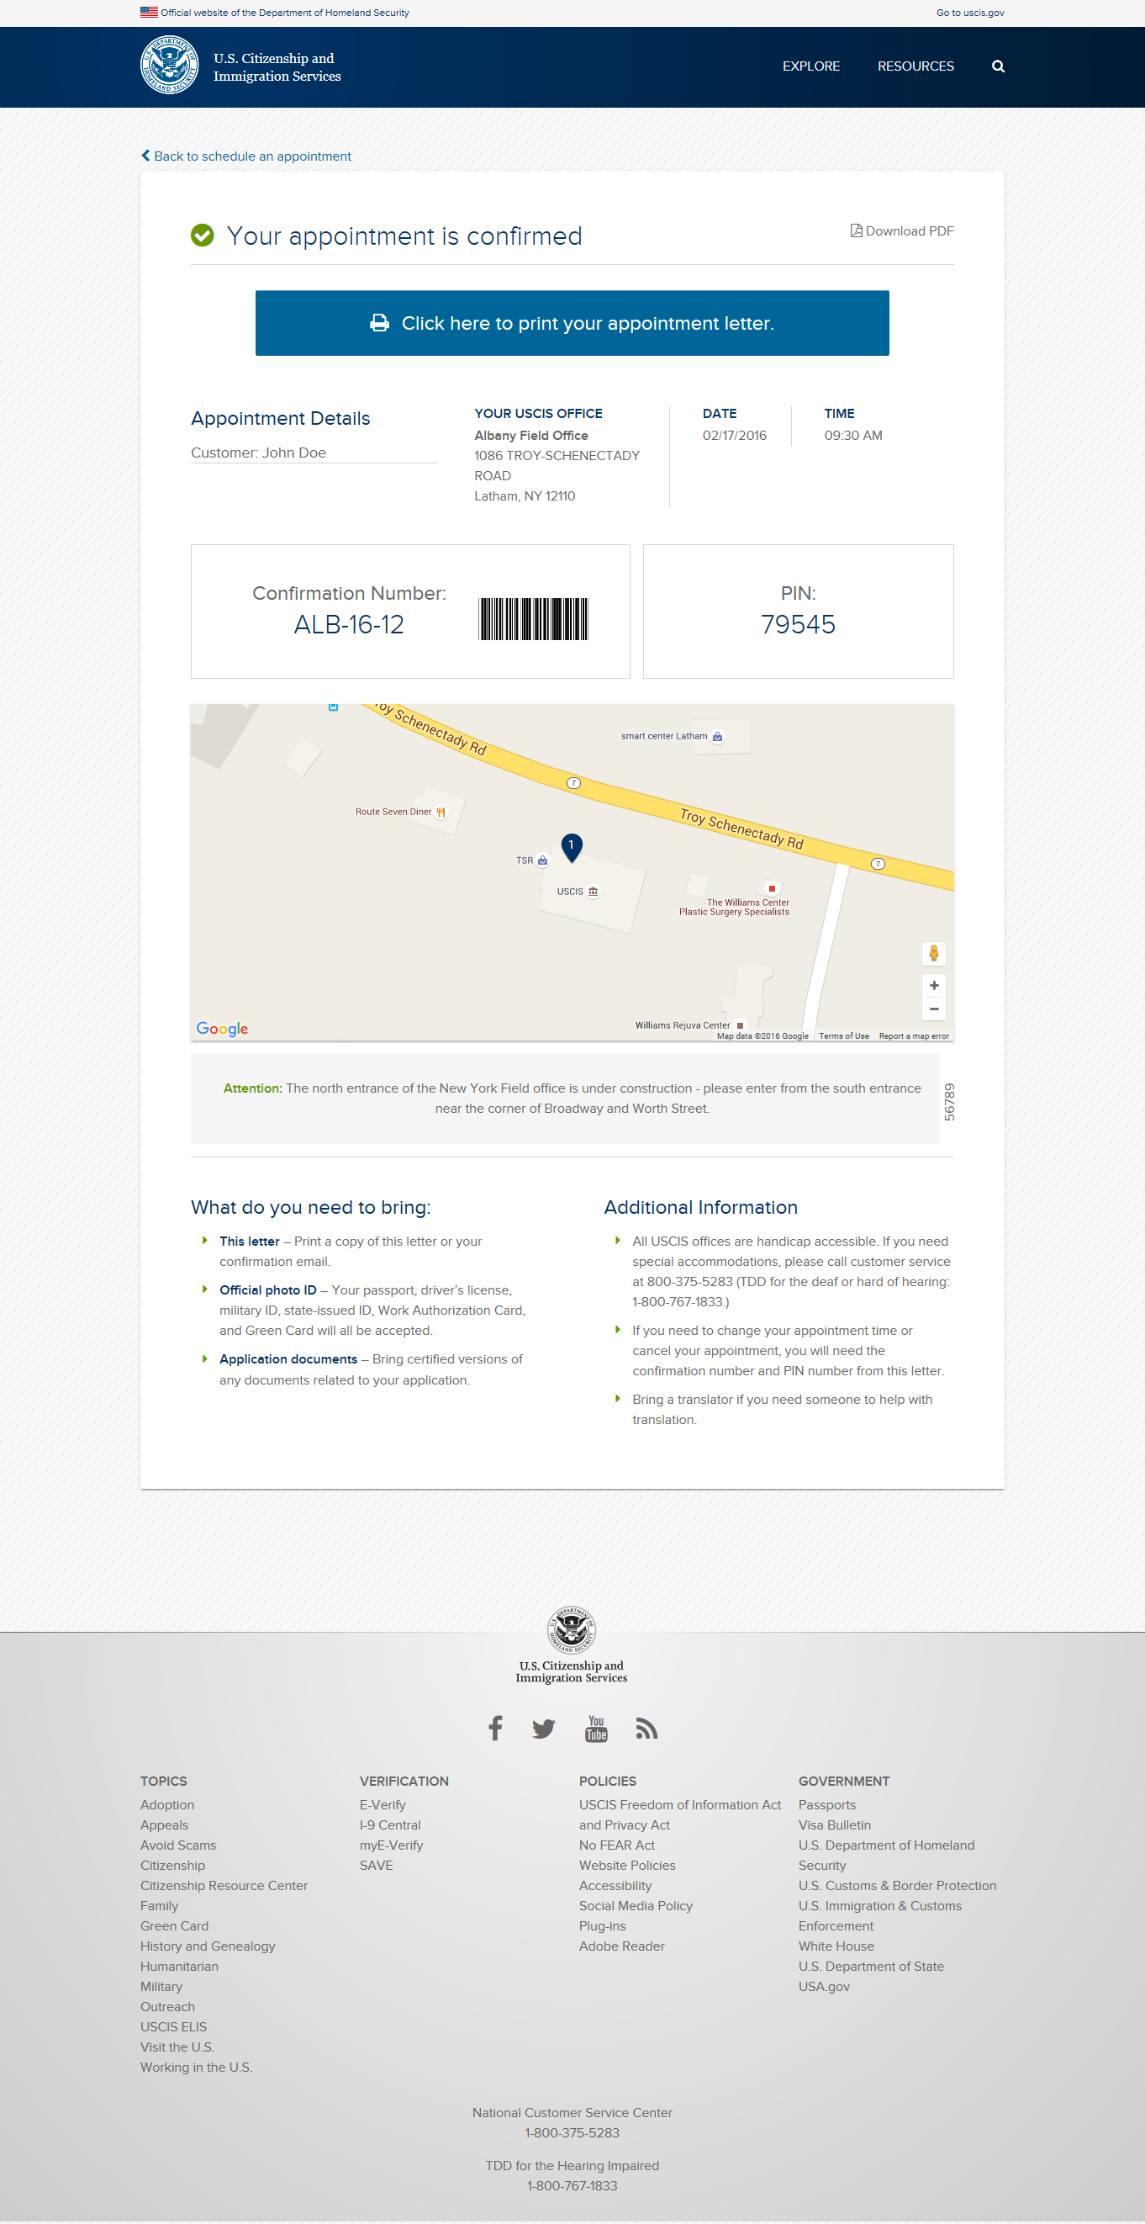

Slide 14
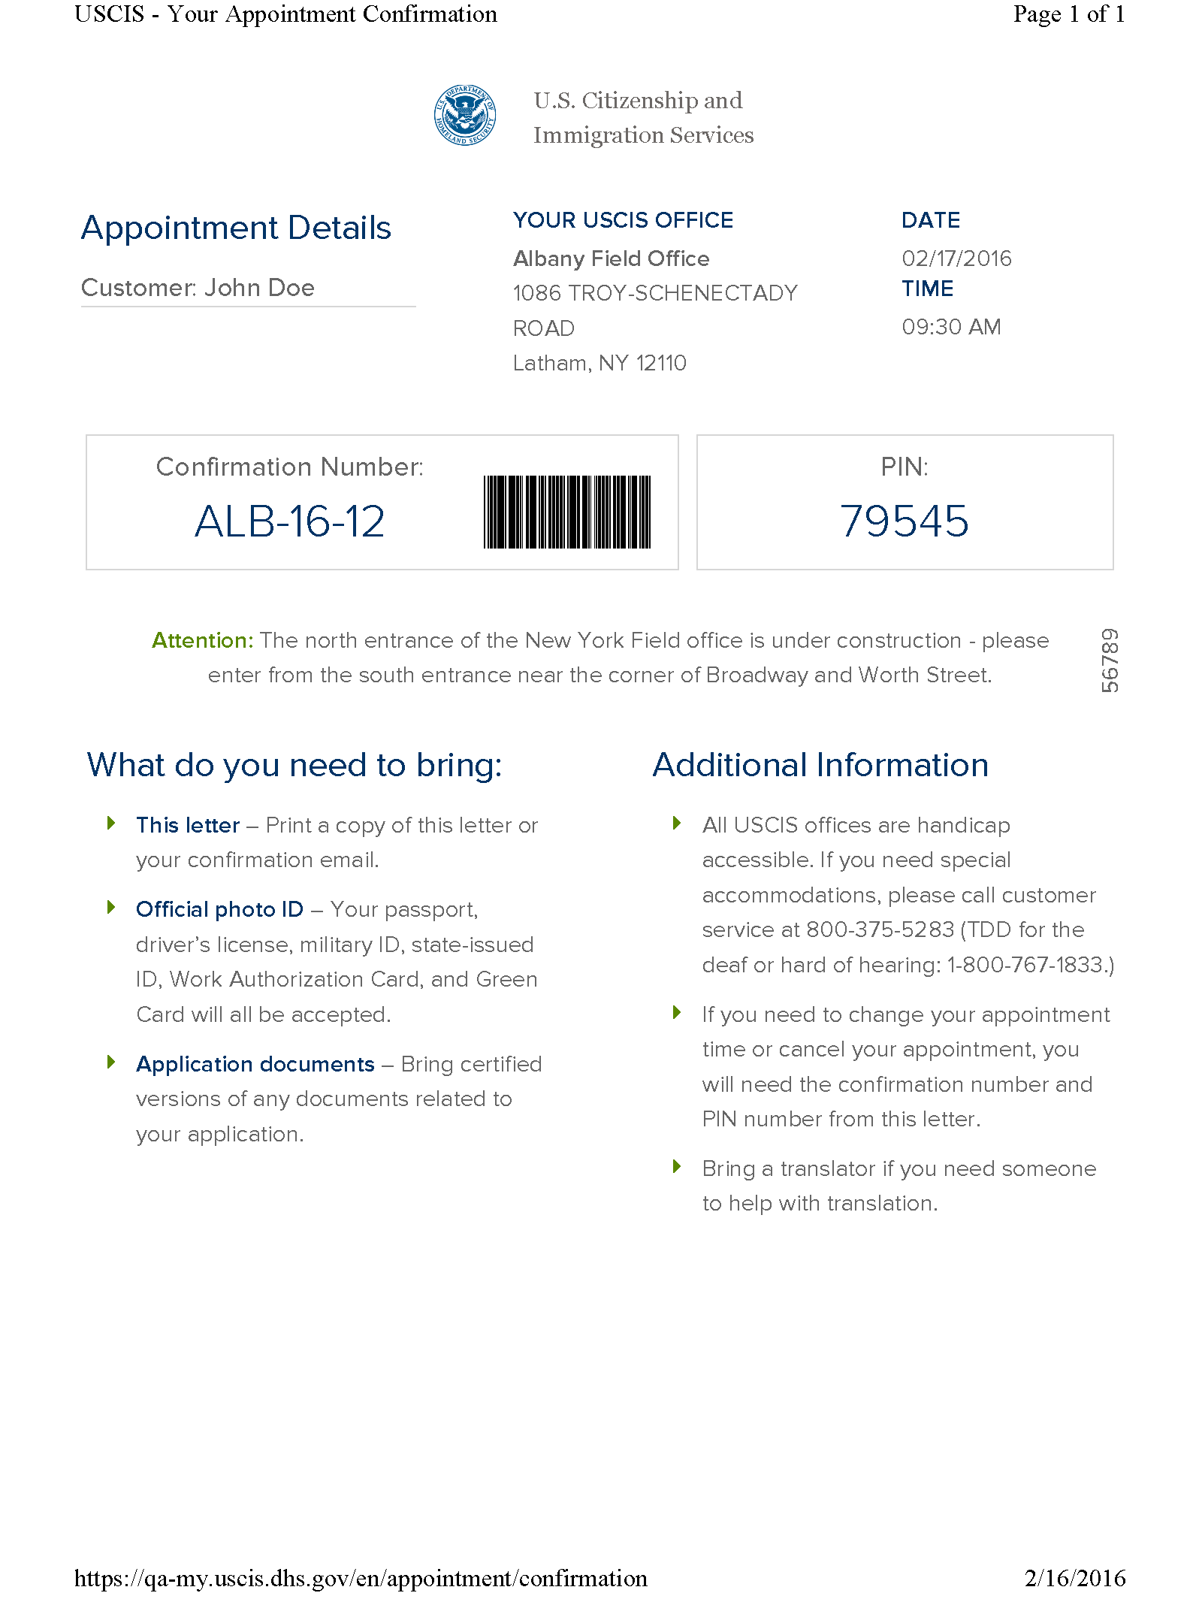

Slide 15
USCIS Appointment Scheduler
Making an Appointment outside the U.S.

Slide 16
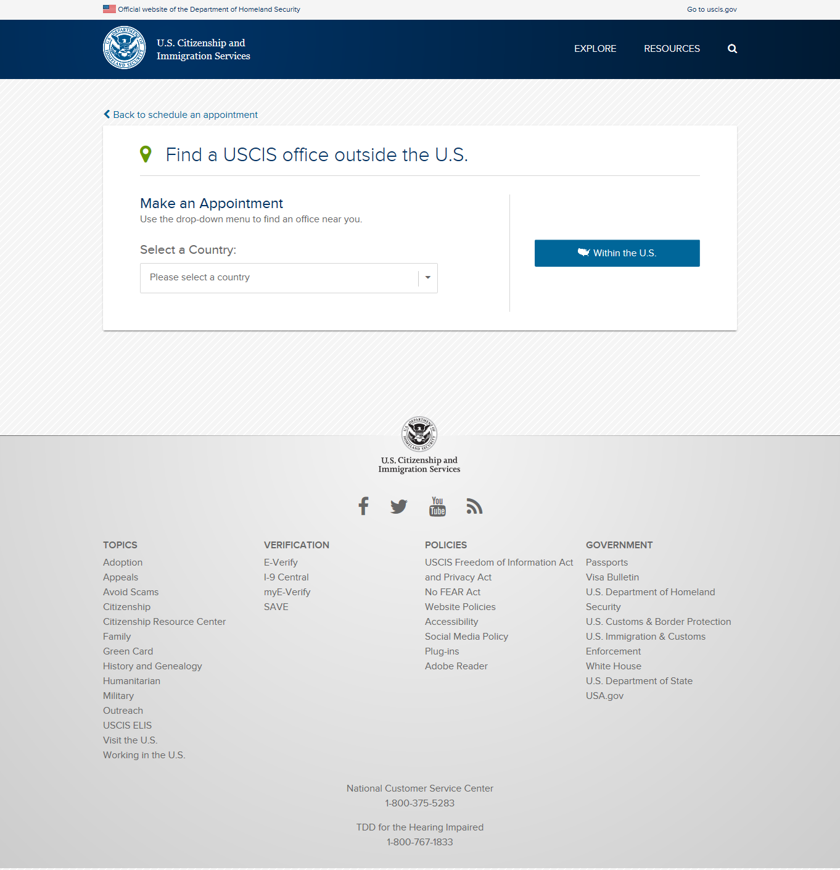

Slide 17
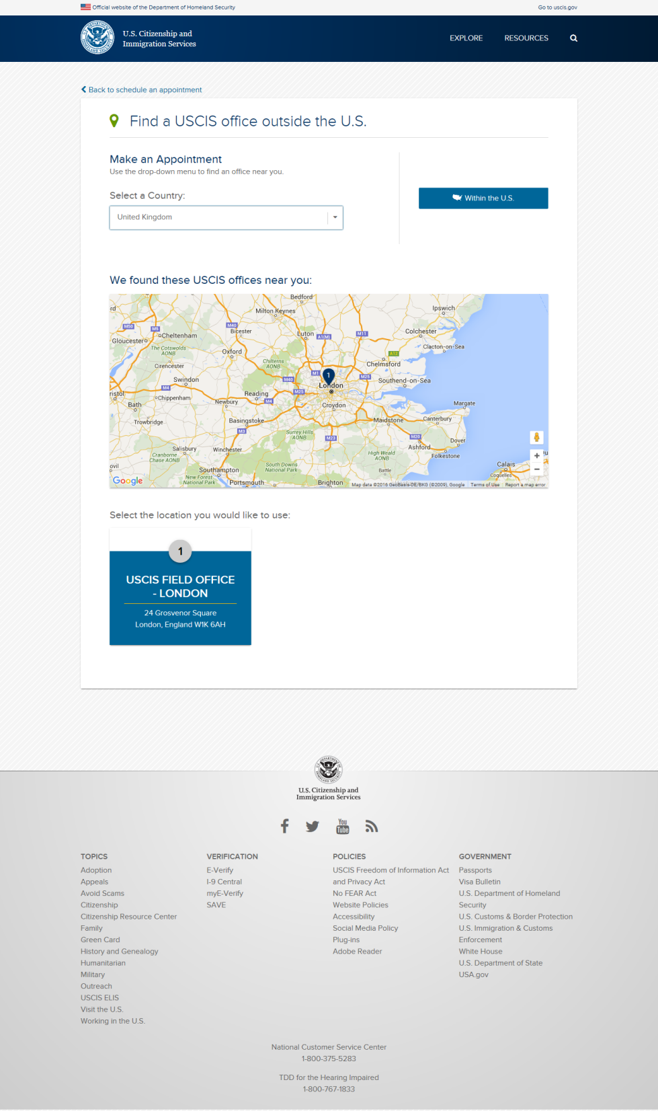

Slide 18
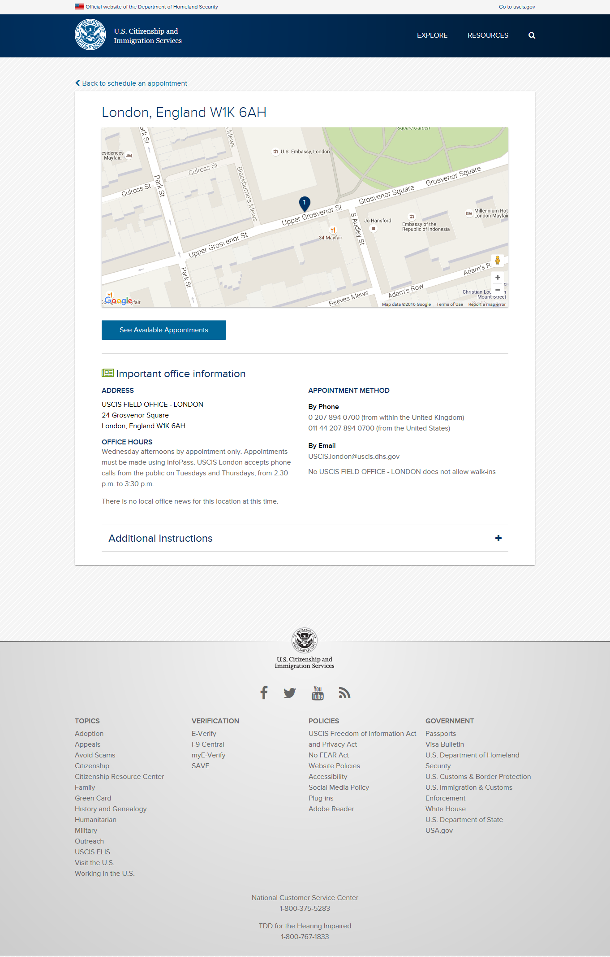

Slide 19
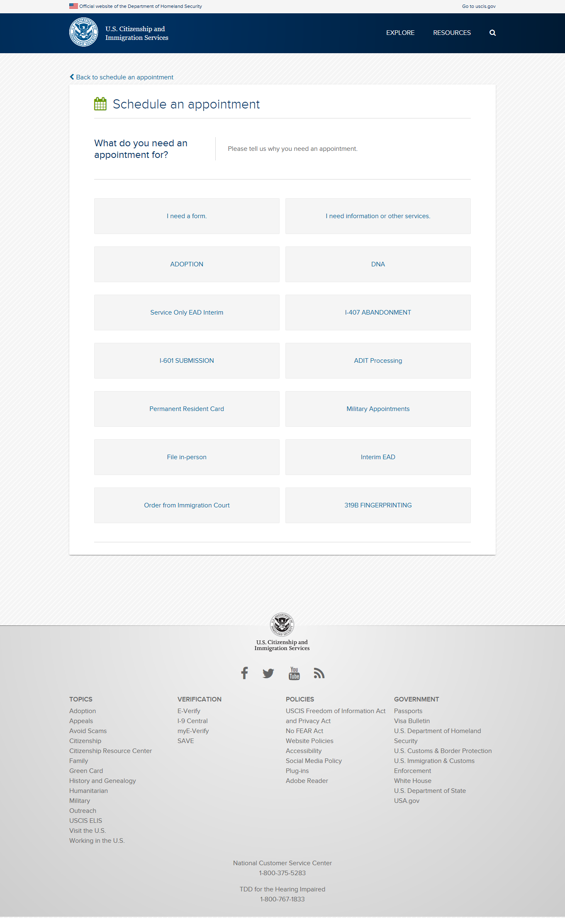

Slide 20
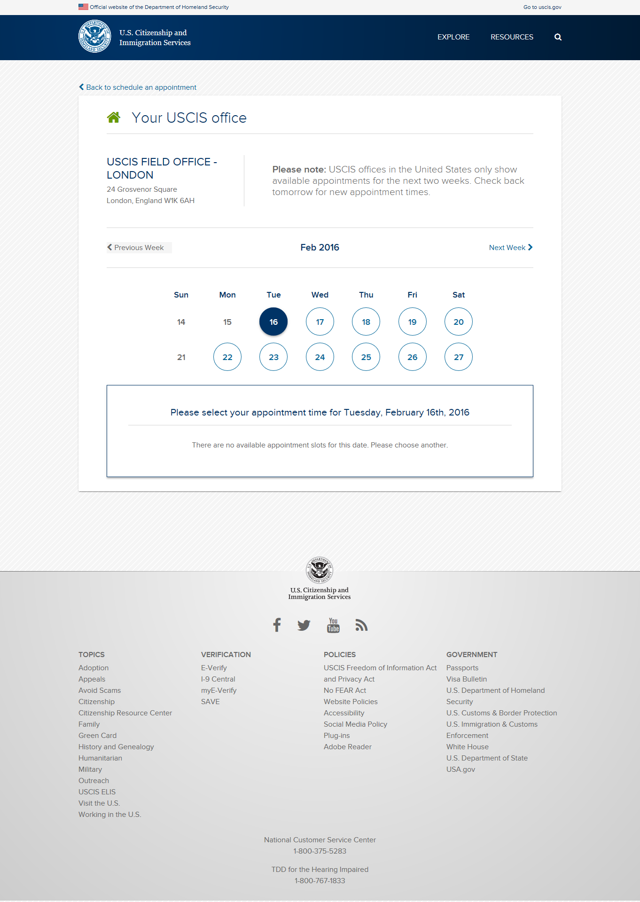

Slide 21
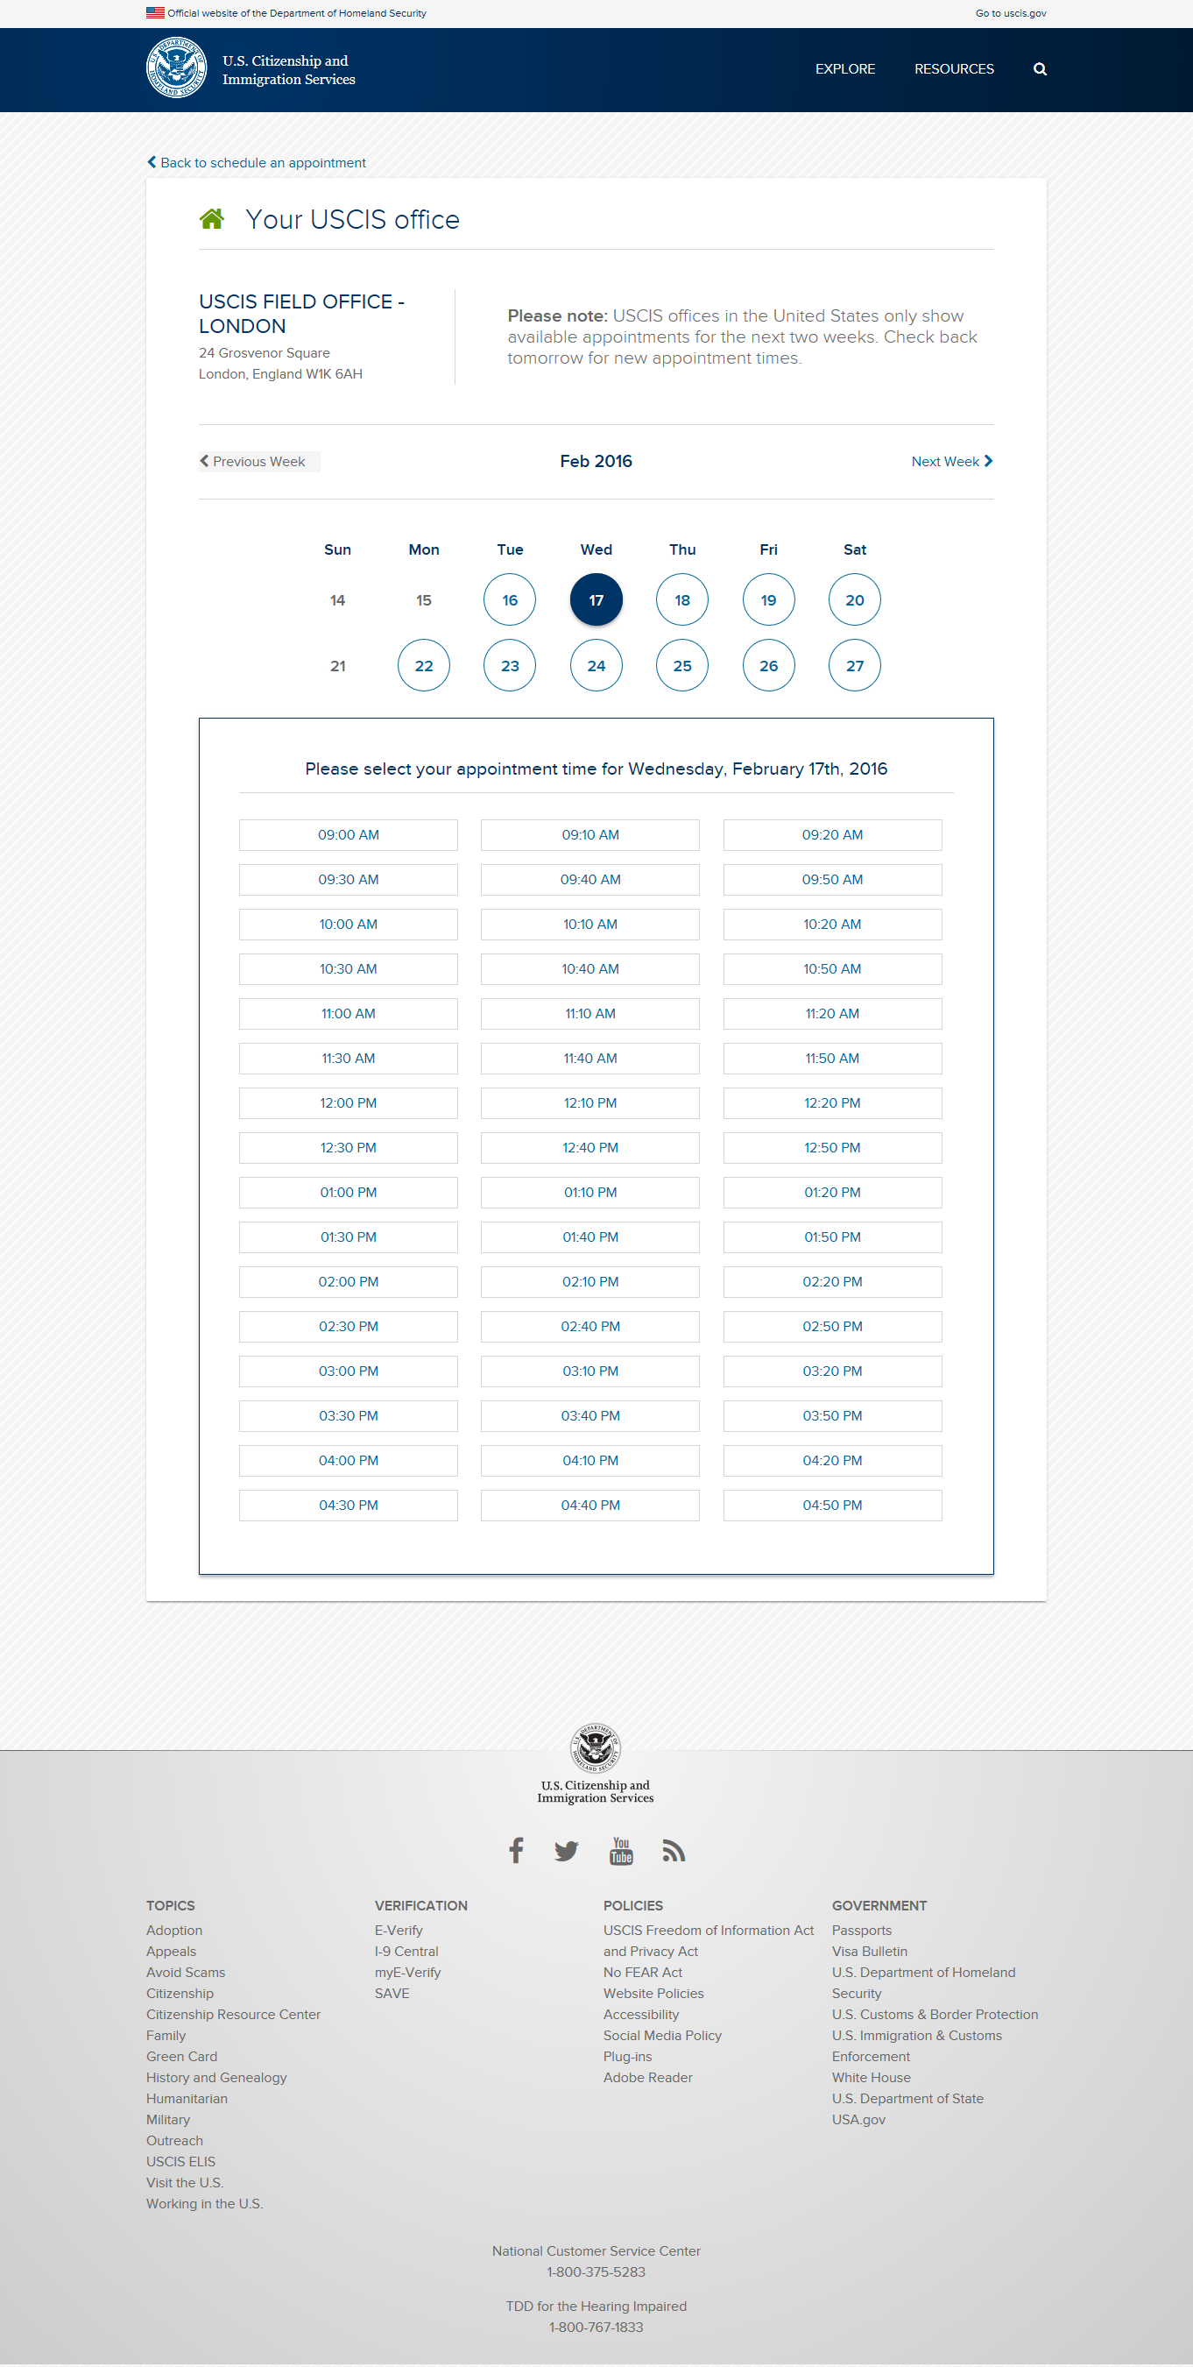

Slide 22
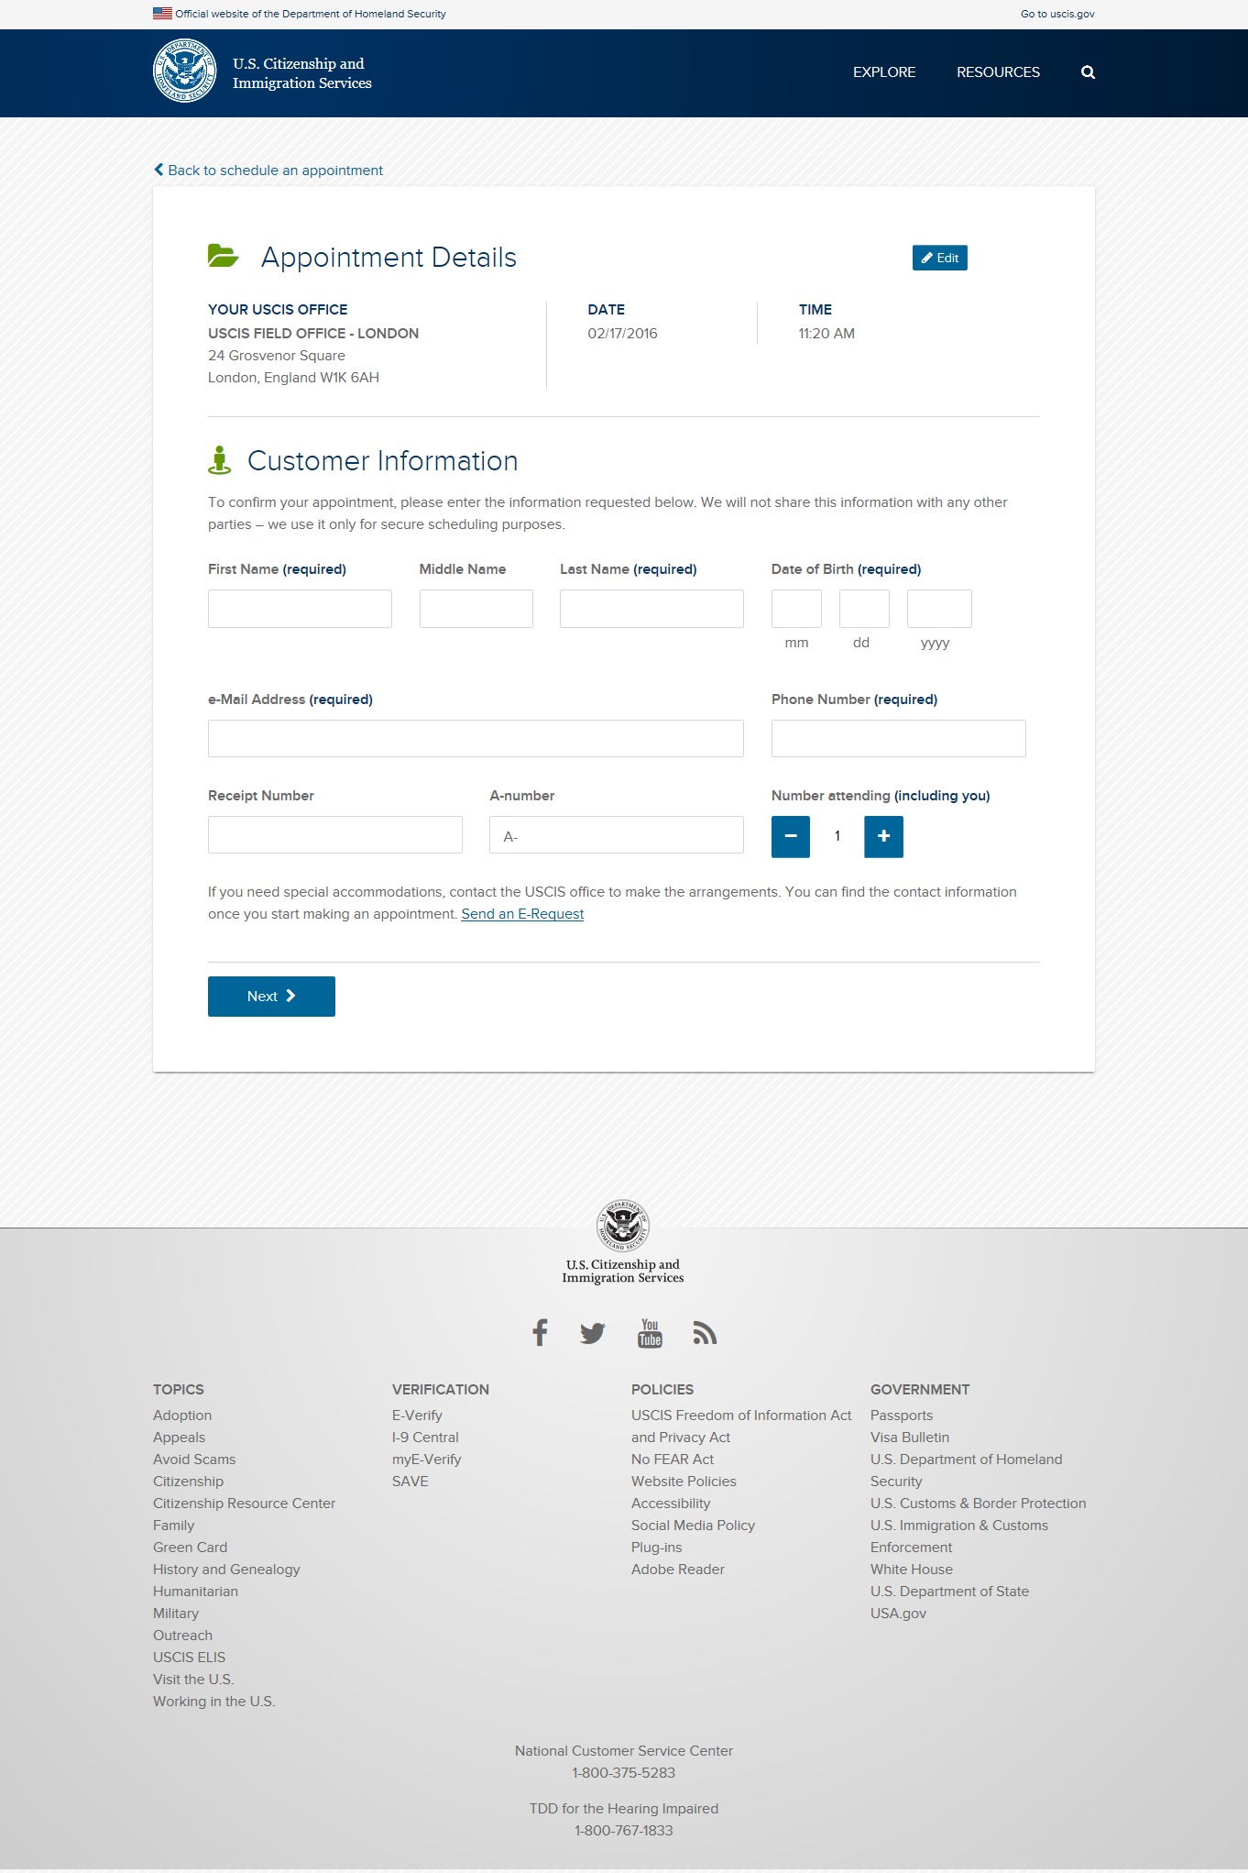

Slide 23
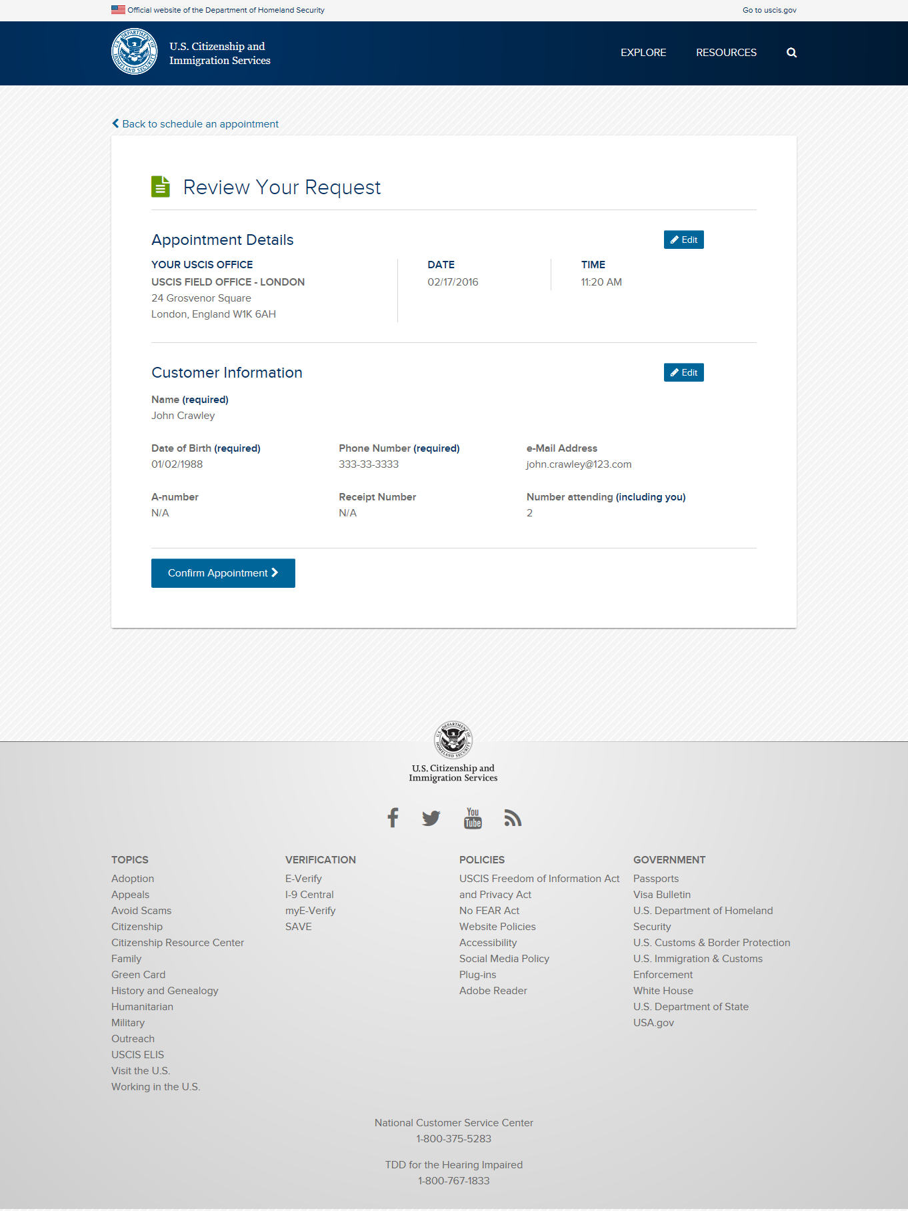

Slide 24
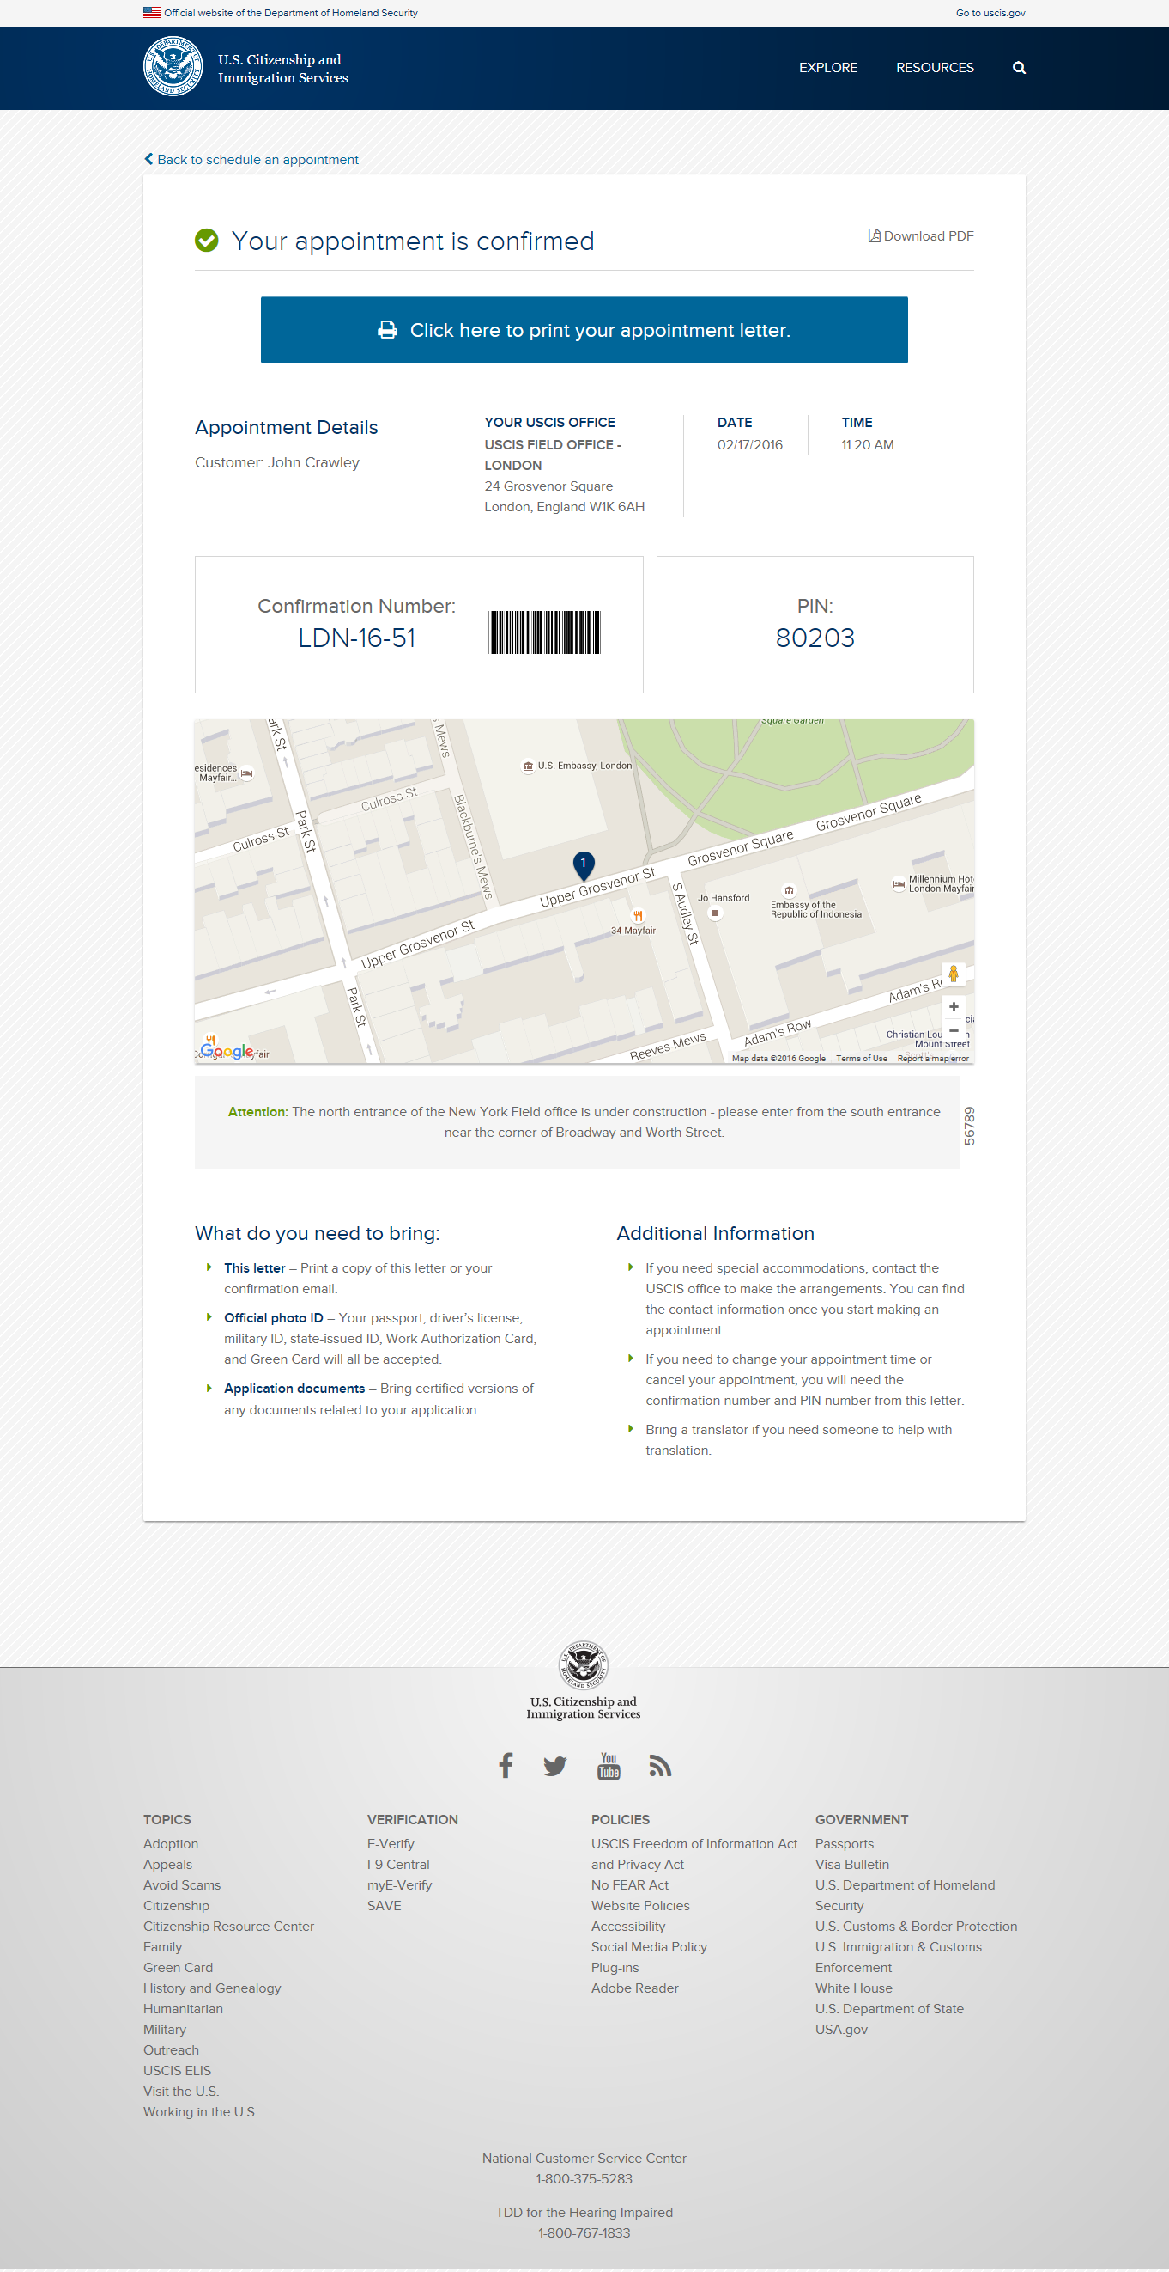

Slide 26
USCIS Appointment Scheduler
Manage an Appointment inside the U.S.

Slide 27
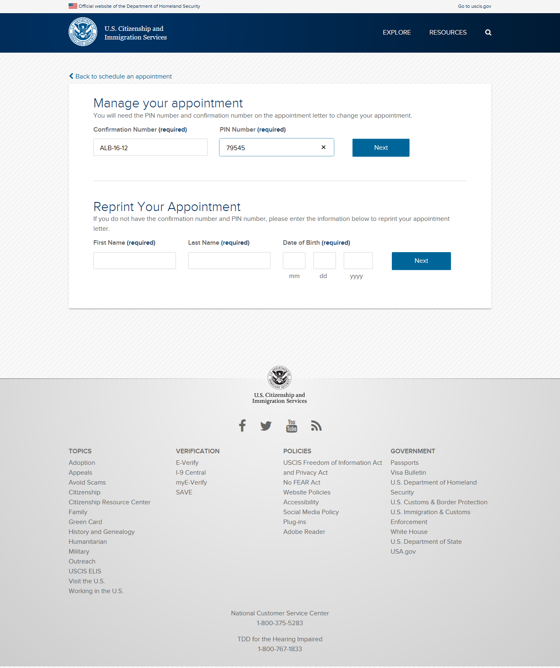

Slide 28
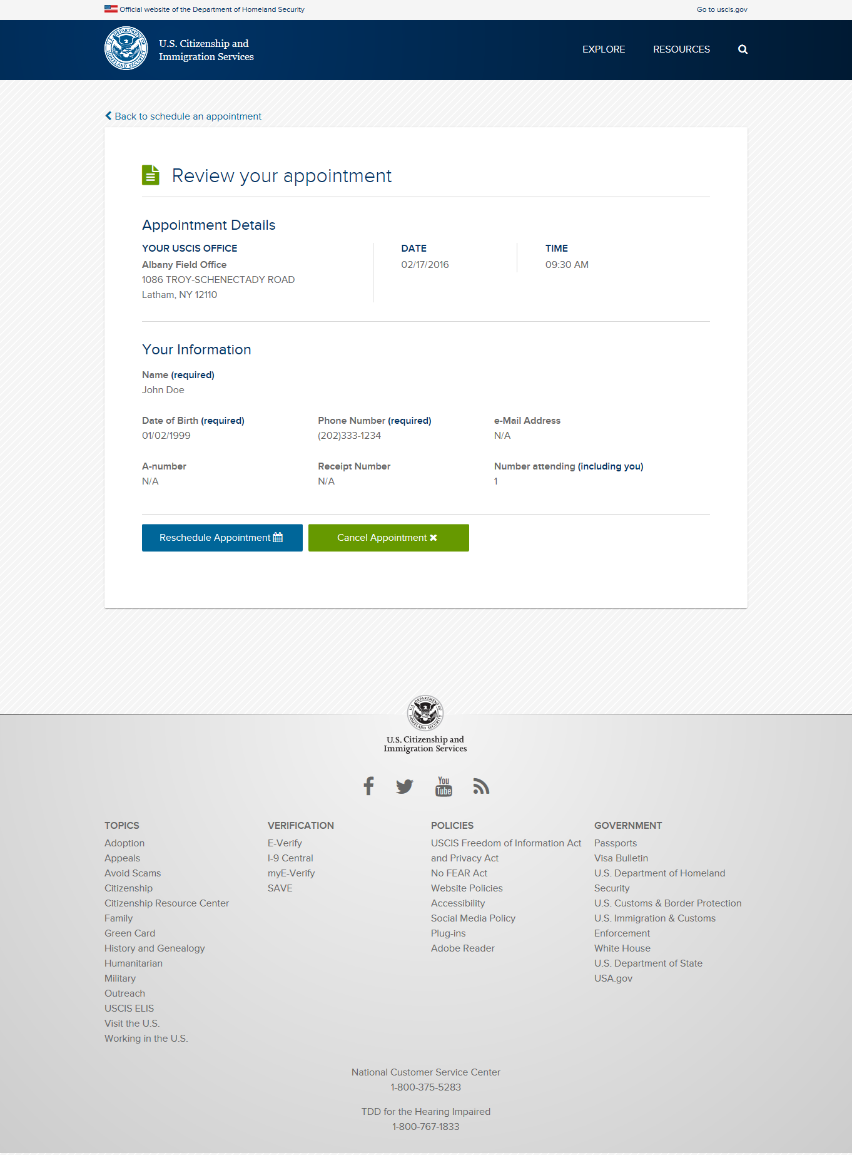

Slide 29
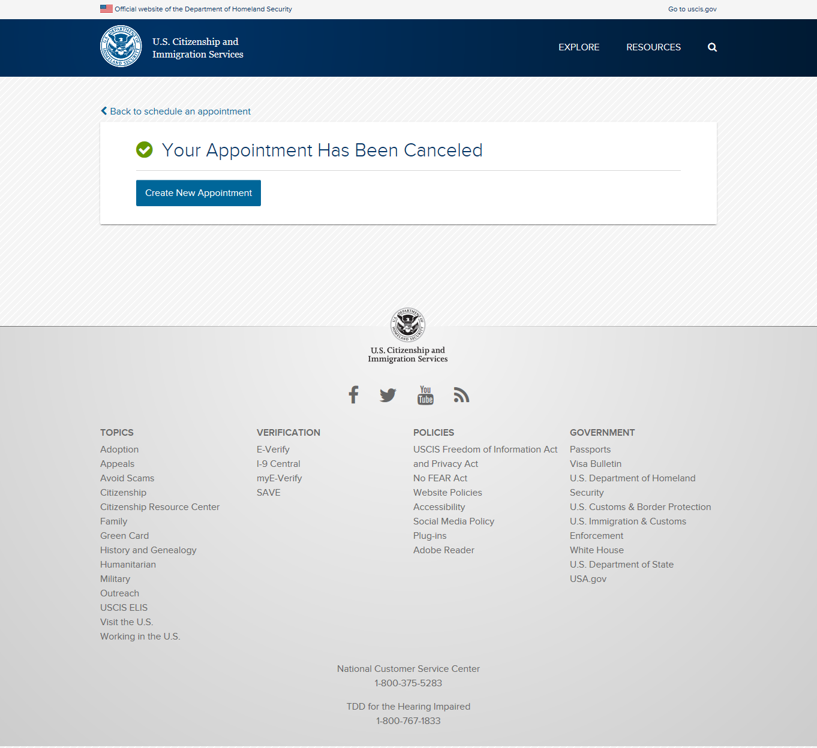

Slide 30
USCIS Appointment Scheduler
Rescheduling an Appointment inside the U.S.

Slide 35
USCIS Appointment Scheduler
Reprint your confirmation letter

Slide 37
