Slide 1
Section 5 Grants Pilot:
Learn Grants Test Model
Webinar

Slide 2
Purpose & Discussion Topics
Purpose
To provide an summary of the DATA Act and the Section 5 Grants Pilot and execute the Learn Grants Test Model.
Discussion Topics
DATA Act Overview
Grants.gov Background
Section 5 Grants Pilot Requirements
Learn Grants Background
First Knowledge Quiz
Learn Grants Content Overview
Second Knowledge Quiz
Conclusion
Section 5 Grants Pilot – Approach & Framework

Slide 3
DATA Act Overview
Establish Government-Wide Data Standards
Simplify Reporting
Improve Quality of Data
In May 2014, Public Law 113-101 Digital Accountability and Transparency Act of 2014 (DATA Act) was signed into law with the purpose to establish government-wide financial data standards and increase the availability, accuracy, and usefulness of federal spending information.

Slide 4
Section 5 Grants Pilot Requirements
The goal of the Pilot is to implement Section 5 of DATA Act, which requires the Federal Government to, “establish a pilot program with the participation of appropriate Federal agencies to facilitate the development of recommendations for –
(A) standardized reporting elements across the Federal government (§5(b)(1)(A));
(B) the elimination of unnecessary duplication in financial reporting (§5(b)(1)(B));
(C) the reduction of compliance costs for recipients of Federal awards (§5(b)(1)(C)).”
The Office of Management and Budget (OMB) has engaged HHS to serve as the executing agent for the Section 5 Grants Pilot.

Slide 5
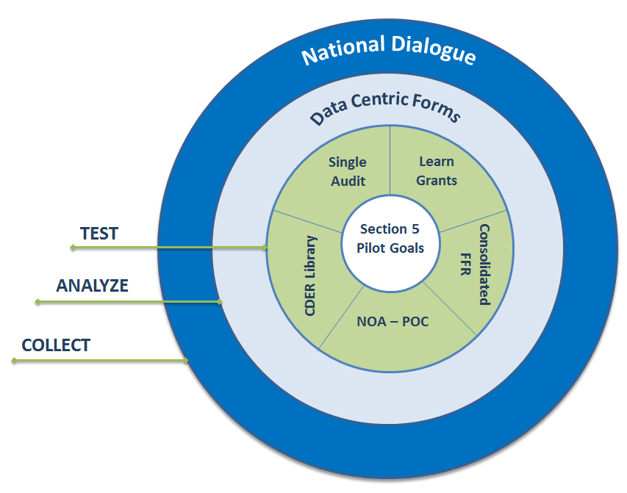
Section 5 Grants Pilot – Approach & Framework
HHS DAP created the Section 5 Grants Pilot Framework, which takes a holistic approach to meeting the Section 5 Pilot Goals by:
Collecting feedback through the National Dialogue (https://cxo.dialogue2.cao.gov/).
Analyzing data centric forms.
Testing models like the CDER Library, Consolidated FFR, Single Audit, NOA – POC, Learn Grants, and other models as appropriate.
Each component of the Framework interacts with and informs the others.
Section 5 Grants Pilot Framework
Section 5 Pilot Goals
Standardize reporting elements.
Eliminate unnecessary duplication.
Reduce compliance costs for Federal award recipients.

Slide 6
Grants.gov Background
The Grants.gov Program Management Office was established in 2002 and is managed by the Department of Health and Human Services as an E-Government initiative operating under the governance of the Office of Management and Budget.
The site is an online portal serving as a single access point for the 26 Federal grant-making agencies and houses information on over 1,000 grant programs (including international programs funded by Federal agencies).
The portal allows individuals and organizations to:
Register with Grants.gov;
Find funding opportunities by searching for specific opportunities or filtering based on search criteria;
Complete, sign, and submit application packages.
Grants.gov also allows individuals and organizations to track their applications throughout the Federal review process.
In 2015 Grants.gov:
Averaged nearly 20,000 daily users;
Posted over 4,700 total discretionary opportunities; and
Processed over 250,000 total submissions!

Slide 7
Learn Grants Background
In May 2015 Grants.gov launched the Learn Grants tab within Grants.gov.
Learn Grants was developed by feedback from the grant recipient community and provides a single source of information regarding the Federal grants lifecycle.
Test: As a Section 5 Grants Pilot Test Model participant, we would like to test your level of understanding of the Federal grants lifecycle before and after using the Learn Grants tab.
Next Steps
In order to test the effect of using the Learn Grants tab on your understanding of the grants lifecycle we will conduct two knowledge quizzes. The first knowledge quiz will be taken without using Learn Grants, while the second will be taken after access to the tab.
Knowledge quiz without Learn Grants (15 minutes)
Learn Grants content overview
Knowledge quiz with use of Learn Grants (15 minutes)
Learn Grants survey

Slide 8
First Knowledge Quiz Instructions
Please complete the first knowledge quiz on the grants lifecycle using the link below.
You will have 15 minutes to complete this exercise.
Please do not consult Learn Grants or Grants.gov.
Please let us know if you have any questions or experience any technical difficulties.
Do not worry if you do not know the answers, just try your best.
First Knowledge Quiz Link: <<SURVEYMONKEY>>

Slide 9
First Knowledge Quiz – 10 Minutes Remaining
10 Minutes Remaining!

Slide 10
First Knowledge Quiz – 5 Minutes Remaining
5 Minutes Remaining!

Slide 11
First Knowledge Quiz – Complete
Thank you for your participation, if you have not done so please submit your quiz now.

Slide 12
Learn Grants Content Overview – Grants Learning Center
Learn Grants homepage containing links to all information housed in the Learn Grants tab.

Slide 13
Learn Grants Content Overview – Grants 101
Introduction to the phases of the grants lifecycle.
Includes detailed information on the Pre-Award, Award, and Post Award phases.

Slide 14
Learn Grants Content Overview – Rules & Legislation
Contains a history of Federal grant policies, an overview of rules & regulations, and links to relevant legislation.

Slide 15
Learn Grants Content Overview – Grant Eligibility
Helps applicants determine if they are eligible for funding opportunities on Grants.gov.

Slide 16
Learn Grants Content Overview – Grant Terminology
Provides a glossary of grant terminology.

Slide 17
Learn Grants Content Overview – Grant-Making Agencies
Contains information on the 26 Federal grant-making agencies.

Slide 18
Learn Grants Content Overview – Grant Community
A source of grant community information including upcoming events and updates on the Section 5 Grants Pilot!

Slide 19
Learn Grants Content Overview – Grant Systems
Contains links to the various systems and tools involved in the registration, application, and reporting process associated with Federal awards. Includes links to tools such as the Common Data Repository (CDER) Library and USASpending.gov.

Slide 20
Learn Grants Content Overview – Grant Programs
Helps users identify funding opportunities and leverage resources for all kinds of potential grant applicants.

Slide 21
Learn Grants Content Overview – Grant Reporting
The Reporting & Oversight page includes an overview of the Federal Funding Accountability and Transparency Act (FFATA) as well as information on the oversight and reporting processes.

Slide 22
Learn Grants Content Overview – Grant Fraud
Provides an overview of grant fraud and scams as well as resources for identifying and reporting fraudulent behavior.

Slide 23
Second Knowledge Quiz Instructions
Please complete the second knowledge quiz on the grants lifecycle using the link below.
You will have 15 minutes to complete this exercise.
Please feel free to navigate the Learn Grants tab, http://www.grants.gov/web/grants/learn-grants.html, to assist you in answering the questions.
Please let us know if you have any questions or experience any technical difficulties.
Do not worry if you do not know the answers, just try your best.
Second Knowledge Quiz Link: <<SURVEYMONKEY>>

Slide 24
Second Knowledge Quiz – 10 Minutes Remaining
10 Minutes Remaining!

Slide 25
Second Knowledge Quiz – 5 Minutes Remaining
5 Minutes Remaining!

Slide 26
Learn Grants Survey
Please complete the Learn Grants survey below.
This brief survey asks you to provide your opinion about your Learn Grants experience and will be used by HHS DAP to obtain input regarding the Learn Grants tab.
Survey Link: <<SURVEYMONKEY>>

Slide 27
Contact Information
For more information or questions, please contact the DAP Mailbox:
DATAActPMO@hhs.gov

Slide 28
Section 5 Grants Pilot FAQs
Q: Even though no funds are available for the Pilot, might you be able to make experts available to the participants in implementing the Pilot. Will any type of technical assistance be available?
A: DAP will be available to assist Pilot participants through out the test process.
Q: What is the intent of the Section 5 Grants Pilot?
A: The intent of the Section 5 Grants Pilot is to test tools/methods/forms/models to meet DATA Act’s Section Pilot 5 Pilot requirements.
Q: What will be expected of Section 5 Grants Pilot participants?
A: Depending on the Test Model, Pilot participants will be expected to complete surveys, forms, and/or participate in tests and/or focus groups. Participants will be expected to share data on burden hours and any other data that may assist DAP in making recommendations to Congress.
Q: What is the timeframe for the Section 5 Grants Pilot?
A: Overall, DAP began Section 5 Pilot testing in March 2016 and will continue until May 2017

