Slide 1
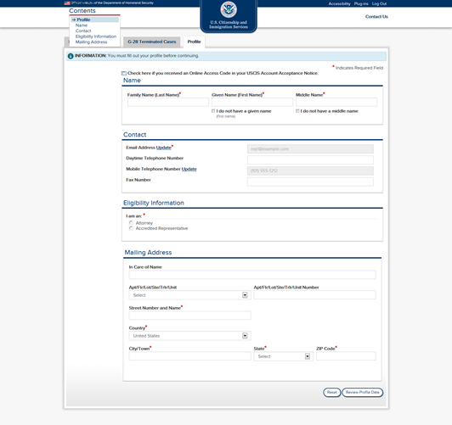
Representative profile creation process.

Slide 2
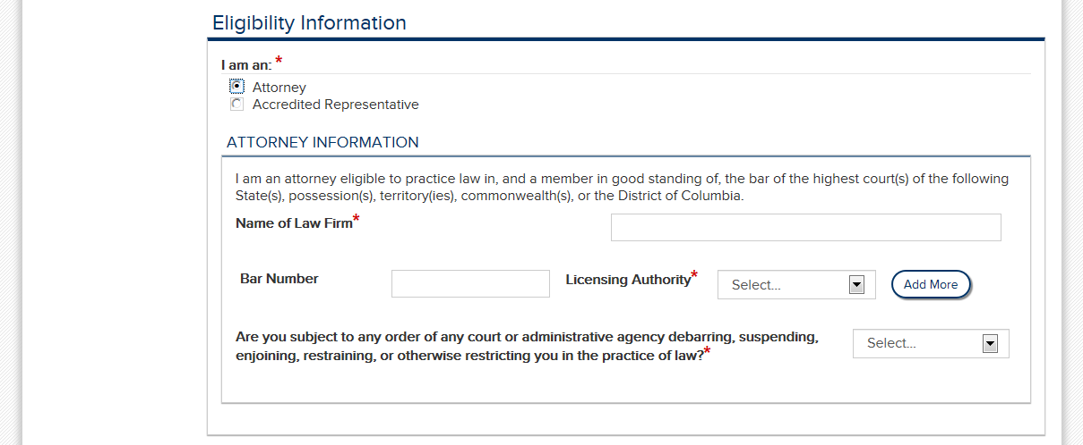
Detail view – “Attorney” selected.
Are you subject to any order of any court or administrative agency disbarring, suspending, enjoining, restraining, or otherwise restricting you in the practice of law?*

Slide 3
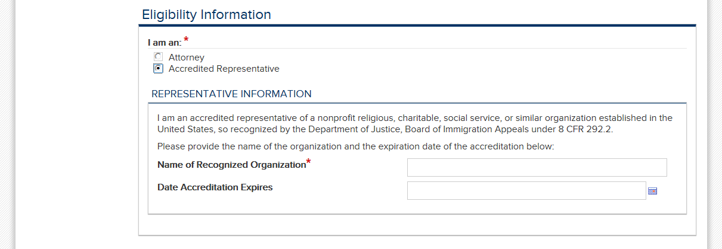
Detail view – “Accredited Representative” selected.

Slide 4
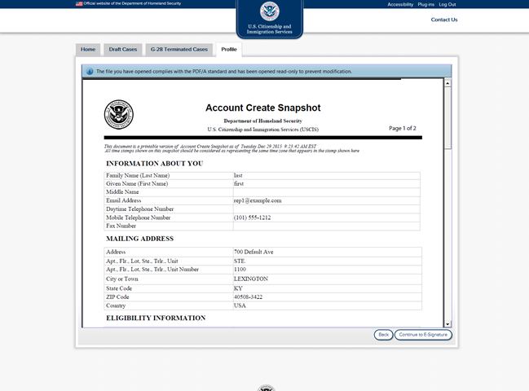
Representative reviews Account Create Snapshot PDF

Slide 5
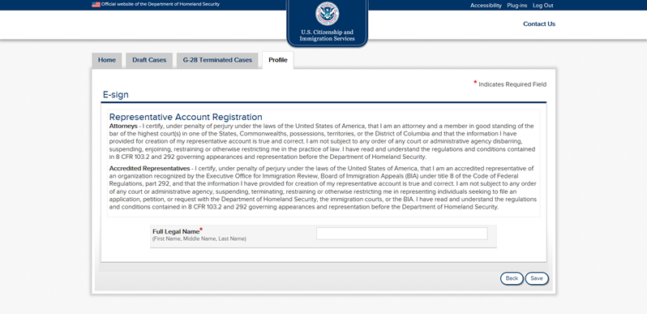
Representative e-signs to finalize account creation.

Slide 6
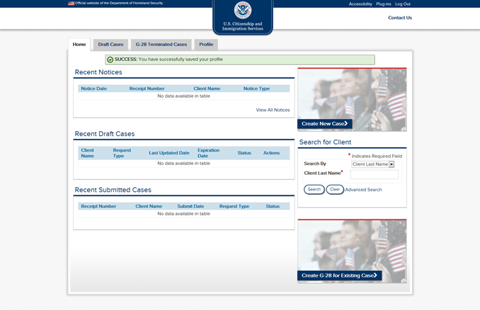
Profile created successfully. Representative can Create New Case.

Slide 7
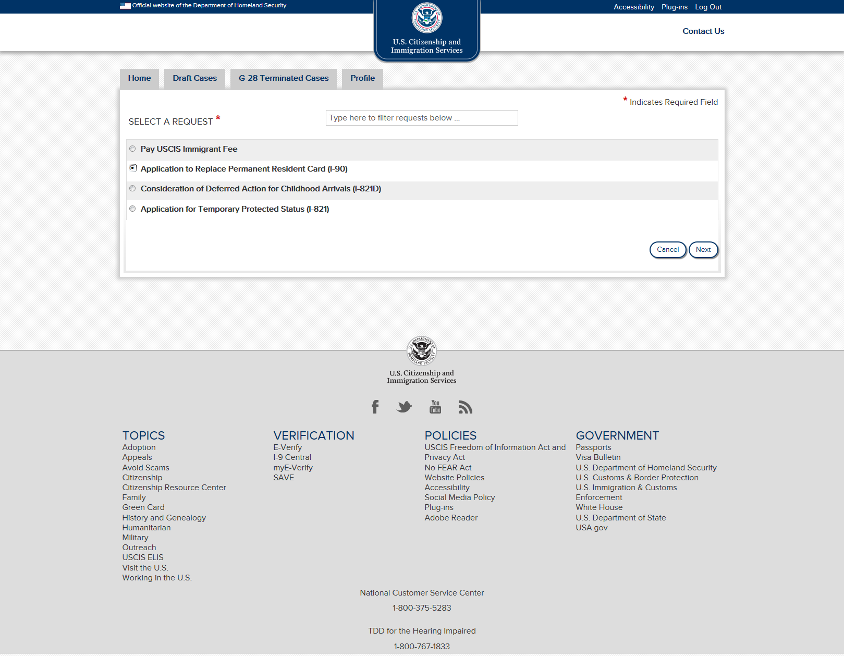

Slide 8
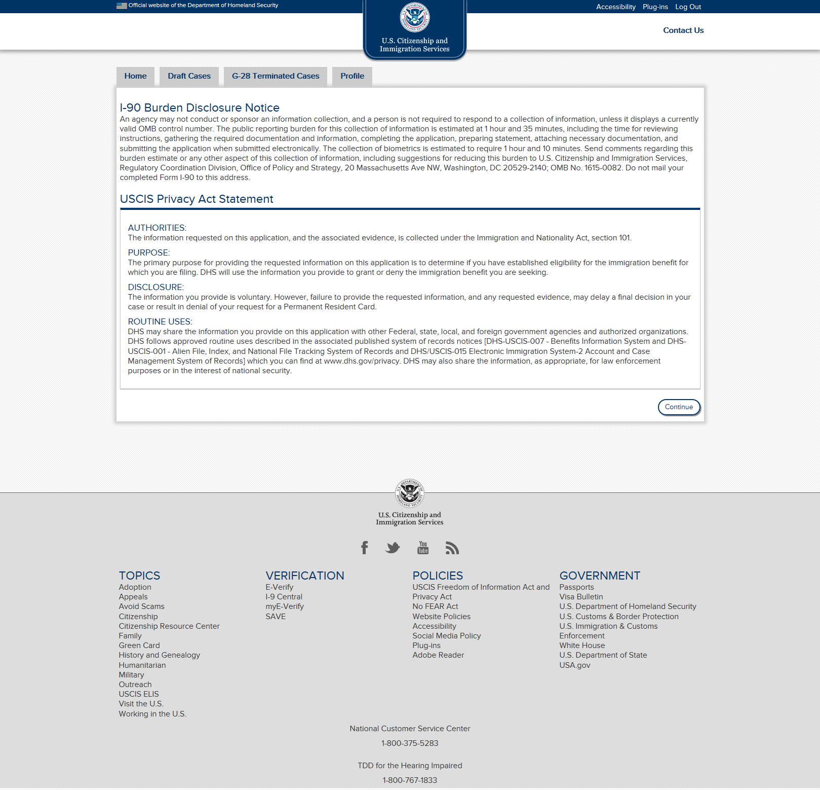
Burden Disclosure Notice and USCIS Privacy Act Statement for the selected case type are displayed.

Slide 9
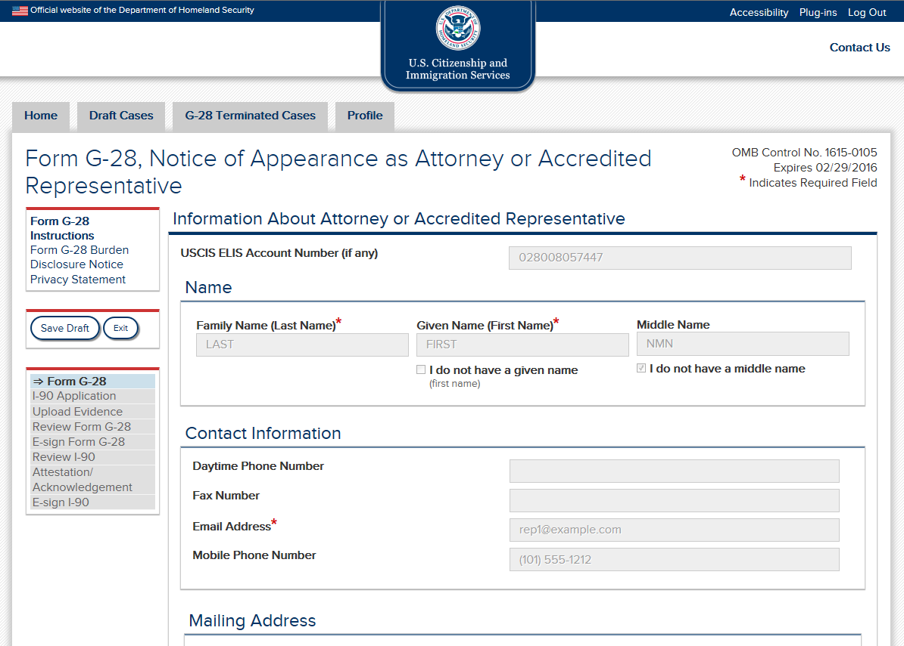
Information already provided in the representative’s profile will be prepopulated.

Slide 10
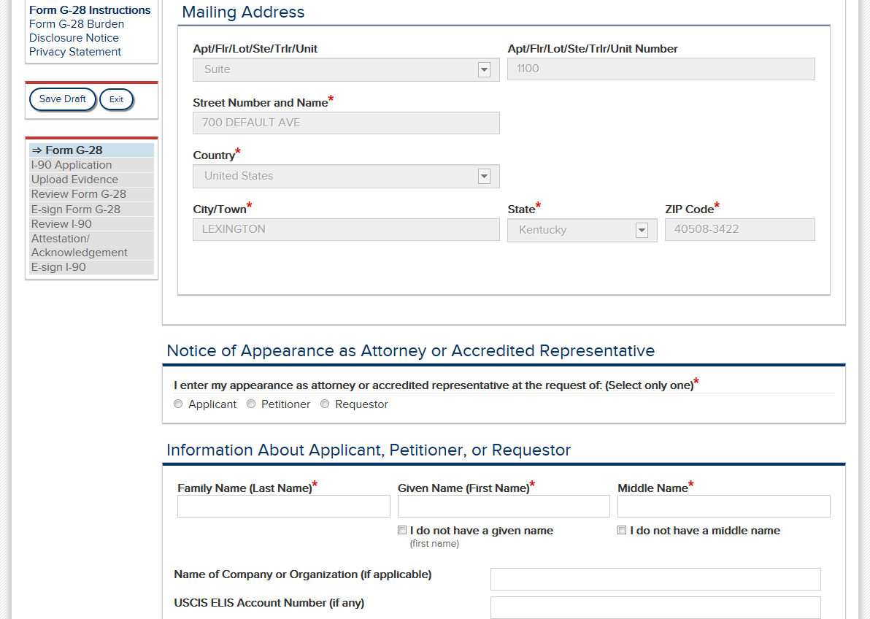

Slide 11
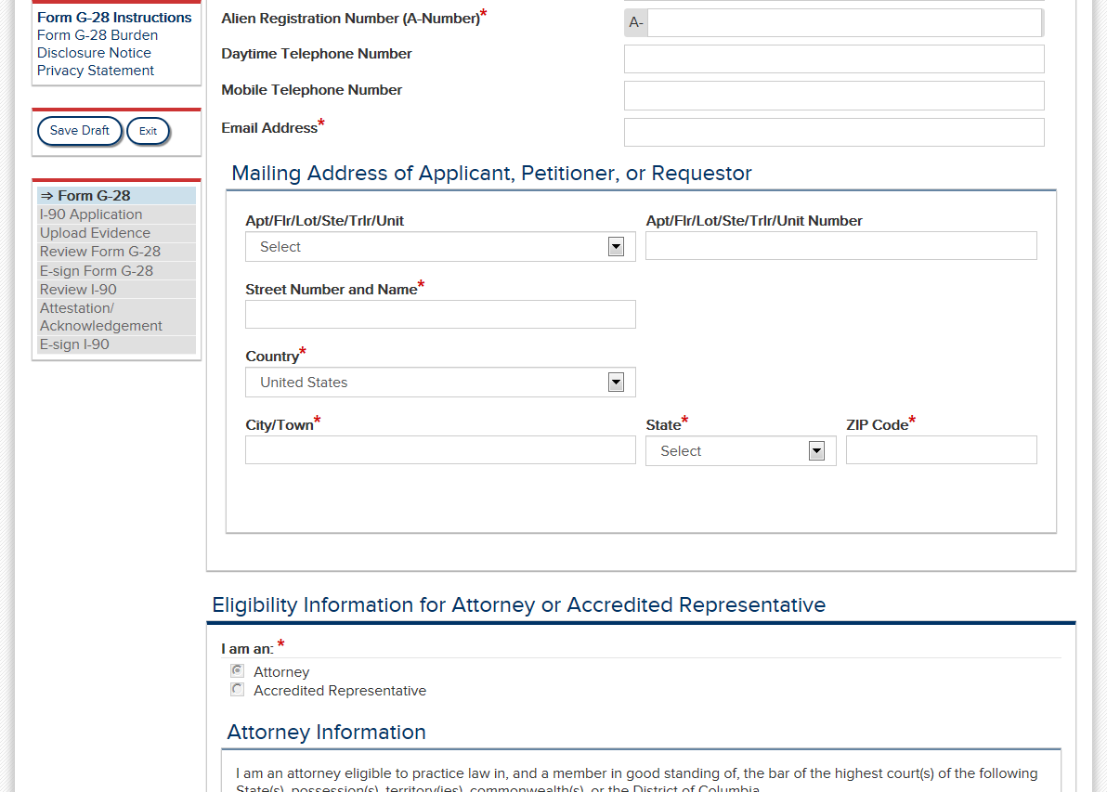
[Addition to screens: the following instruction language will be added above the mailing address fields.]
NOTE: Provide the mailing address of the applicant, petitioner, or requestor. Do not provide the business mailing address of the attorney or accredited representative unless it serves as the safe mailing address on the application, petition, or request being filed with this Form G-28.

Slide 12
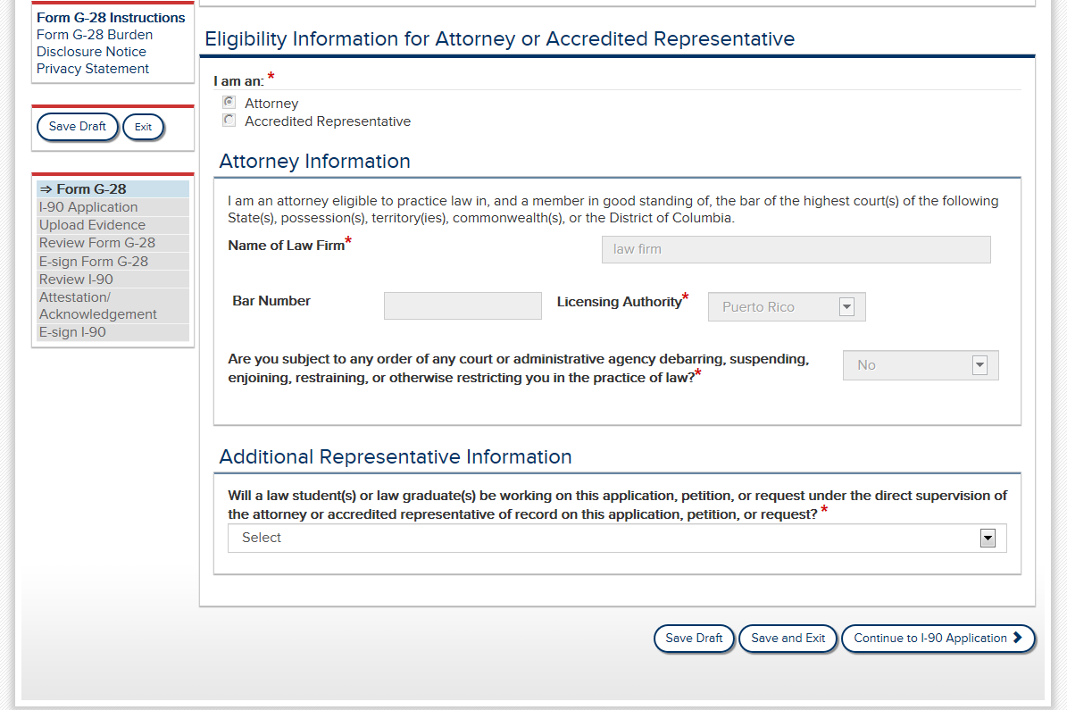
If the case were being filed in an Accredited Representative account, the accredited rep language would be displayed here instead of the Attorney language (see slide 3).
Are you subject to any order of any court or administrative agency disbarring, suspending, enjoining, restraining, or otherwise restricting you in the practice of law?*

Slide 13
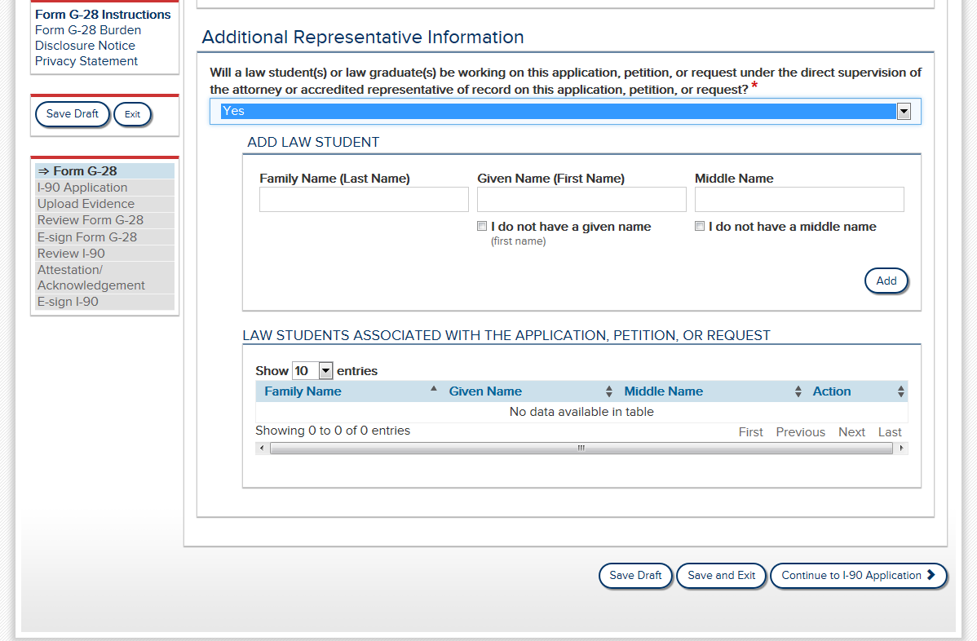

Slide 14
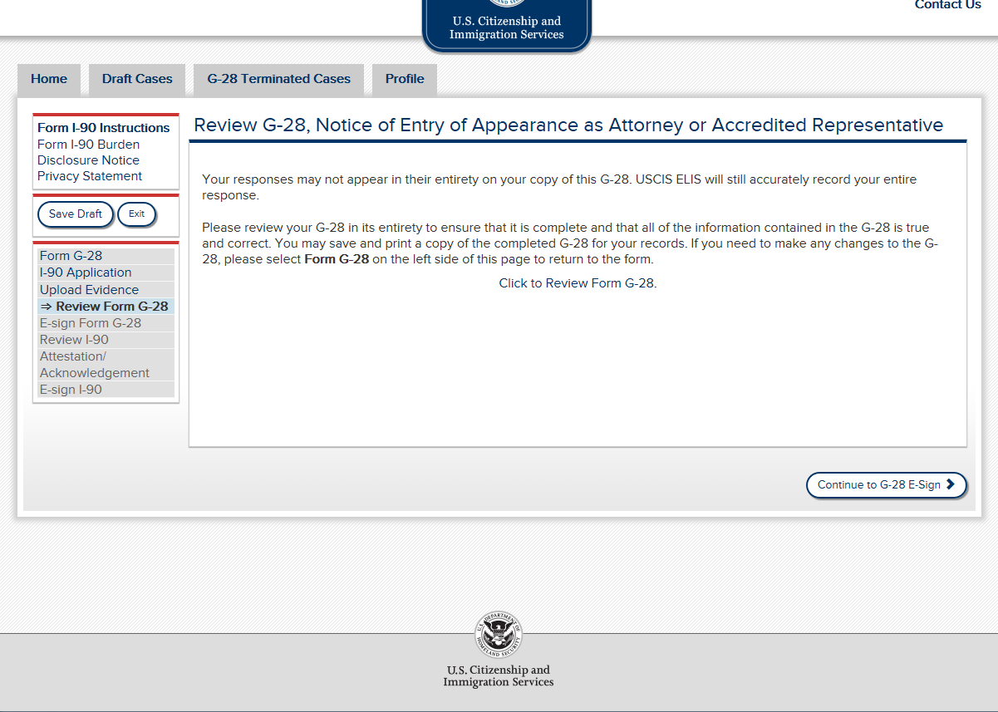
Once the case information has been filled out, the attorney or accredited representative will have an opportunity to review the Form G-28 before proceeding to e-signature.

Slide 15
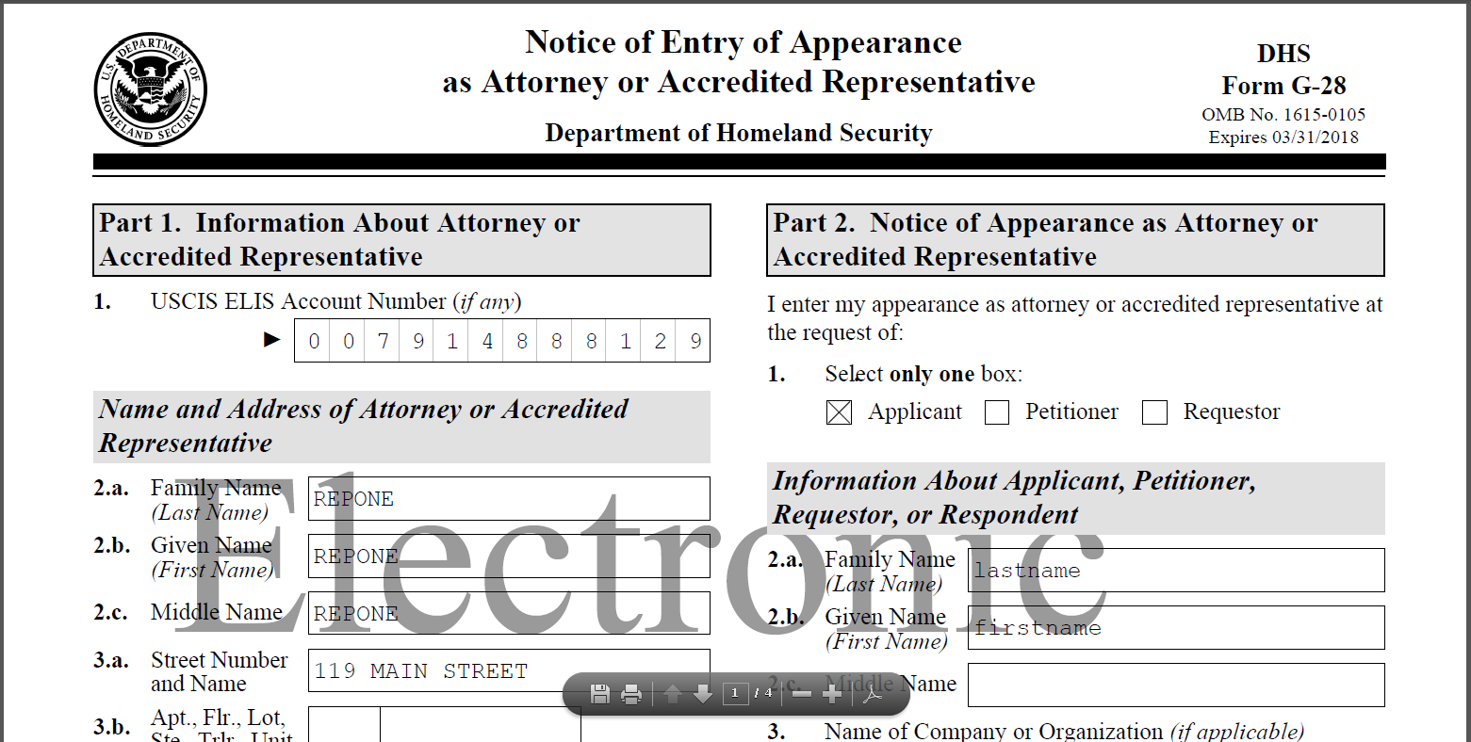
Representative can review PDF version of all information entered.

Slide 16
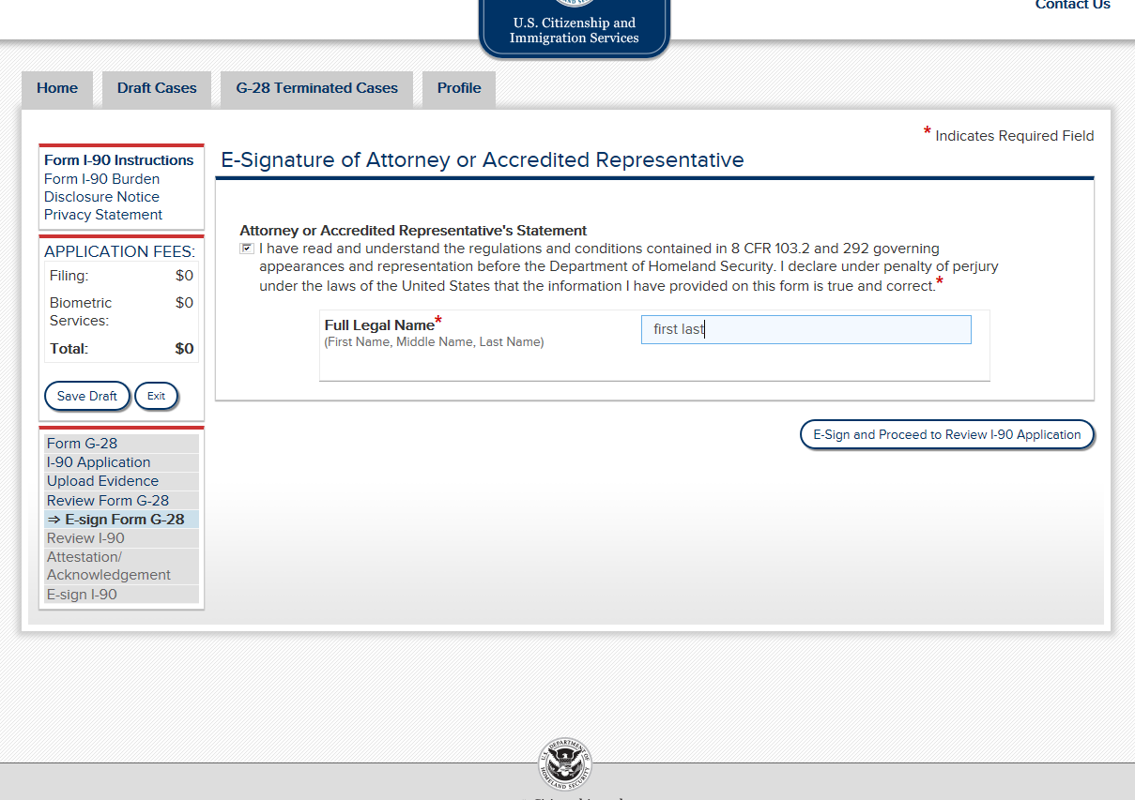
After e-signing the G-28, the representative would also review the application they filled out, and e-sign for the application (process not depicted here).

Slide 17
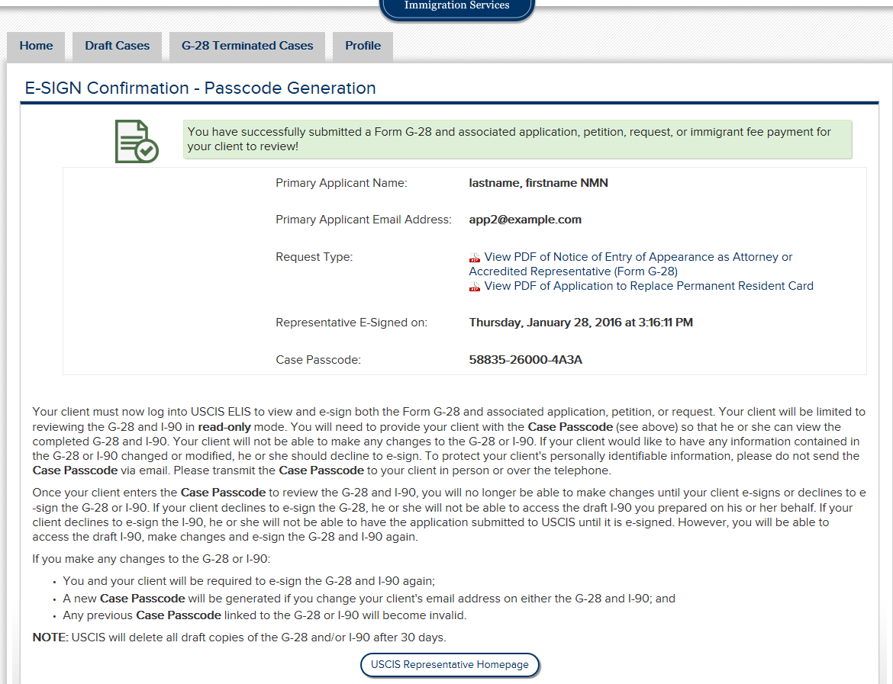
After e-signing, representative receives confirmation and case passcode to provide to client.
You have successfully submitted a Form G-28 and associated application, petition, or request for your client to review!

Slide 18
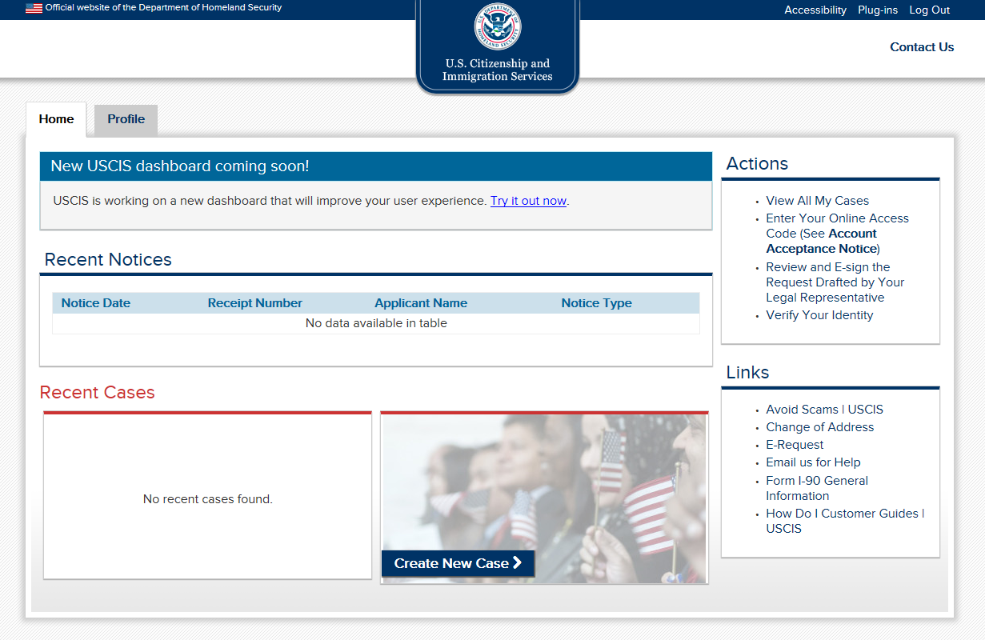
Client signs in to his/her account to review the G-28 and case-related information entered by the representative.

Slide 19
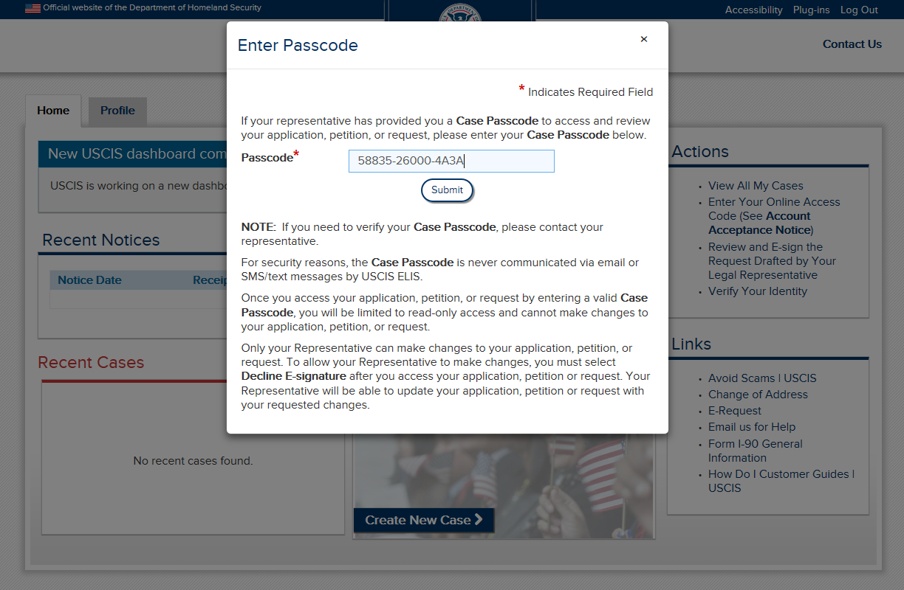
Client enters case passcode provided by attorney or accredited representative.

Slide 20
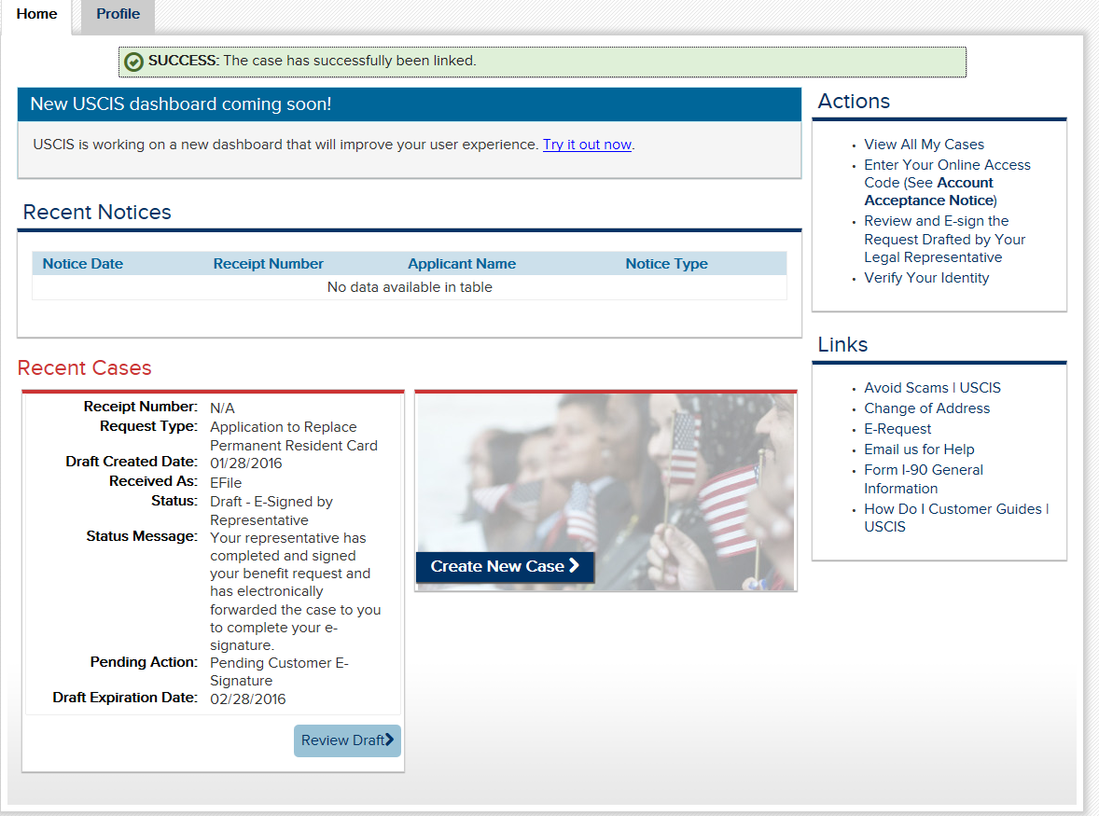
Client selects “Review Draft” to see the information entered on the G-28 by the attorney or accredited representative.

Slide 21
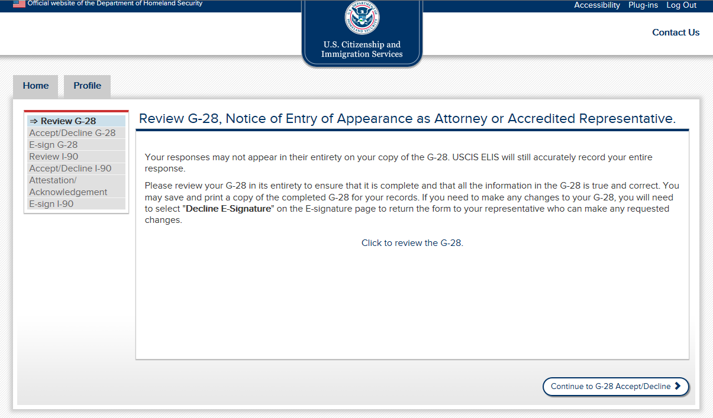

Slide 22
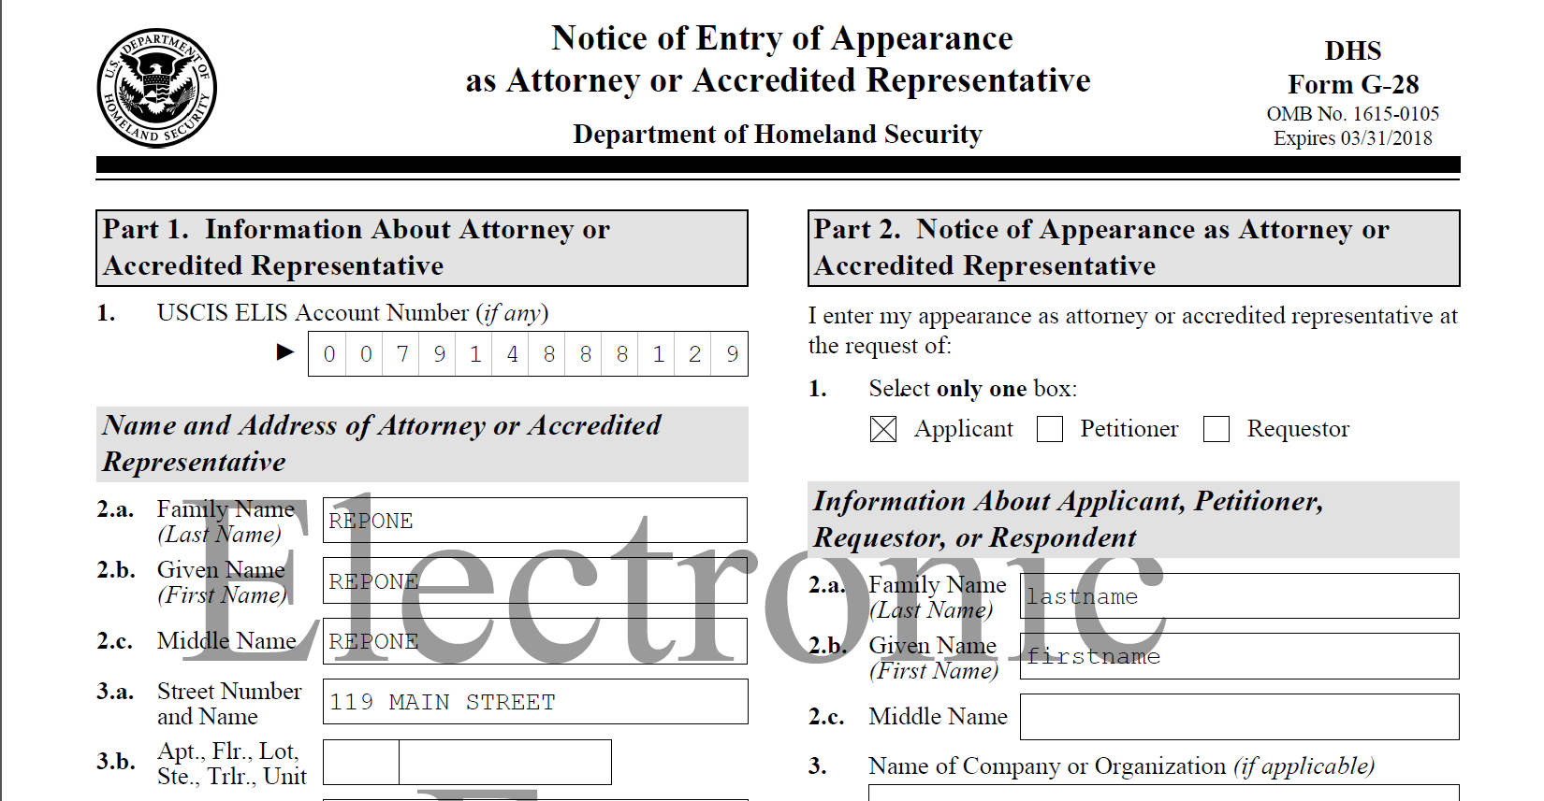
Client can review PDF of all information entered by the representative before e-signing.

Slide 23
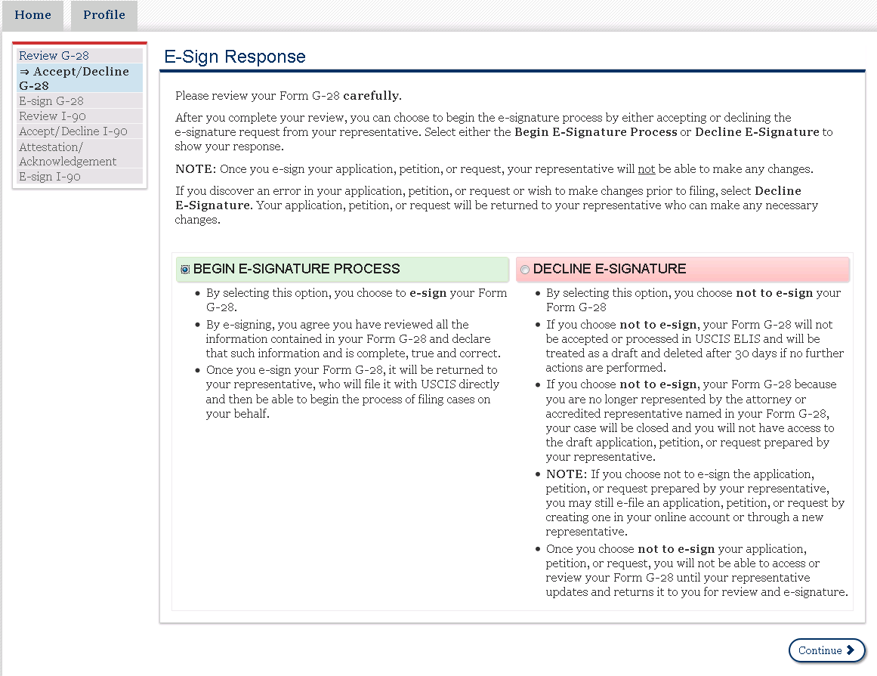
Client selects “Begin E-Signature Process” to e-sign the G-28.

Slide 24
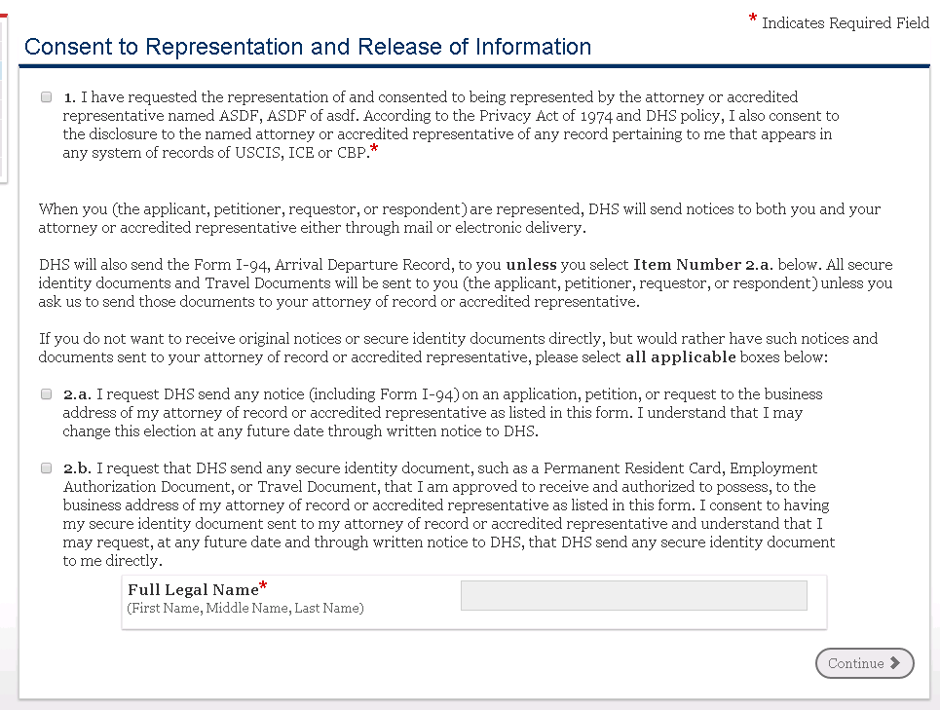
Client reviews Consent language, selects where documents should be mailed, and e-signs. Changes are in red font.
1. I have requested the representation of and consented to being represented by the attorney or accredited representative named LAST NAME, FIRST NAME of ORGANIZATION NAME. According to the Privacy Act of 1974 and DHS policy, I also consent to the disclosure to the named attorney or accredited representative of any record pertaining to me that appears in any system of records of USCIS, ICE, or CBP.*
DHS will also send the Form I-94, Arrival Departure Record, to you unless you select Item Number 2.a. in Part 4. All secure identity documents and Travel Documents will be sent to you (the applicant petitioner, or requestor) at your U.S. mailing address unless you ask us to send your secure identity documents to your attorney or accredited representative.
2.a. I request DHS to send any notice (including Form I-94) on an application, petition, or request to the U.S. business address of my attorney of record or accredited representative as listed in this form. I understand that I may change this election at any future date through written notice to DHS.
2.b. I request that DHS send any secure identity document, such as a Permanent Resident Card, Employment Authorization Document, or Travel Document, that I am approved to receive and authorized to possess, to the U.S. business address of my attorney of record or accredited representative as listed in this form or to a designated military or diplomatic address for pickup in a foreign country (if permitted). I consent to having any secure identity document sent to my attorney of record or accredited representative’s U.S. business address and understand that I may request, at any future date and through written notice to DHS, that DHS send any secure identity document to me directly.

Slide 25
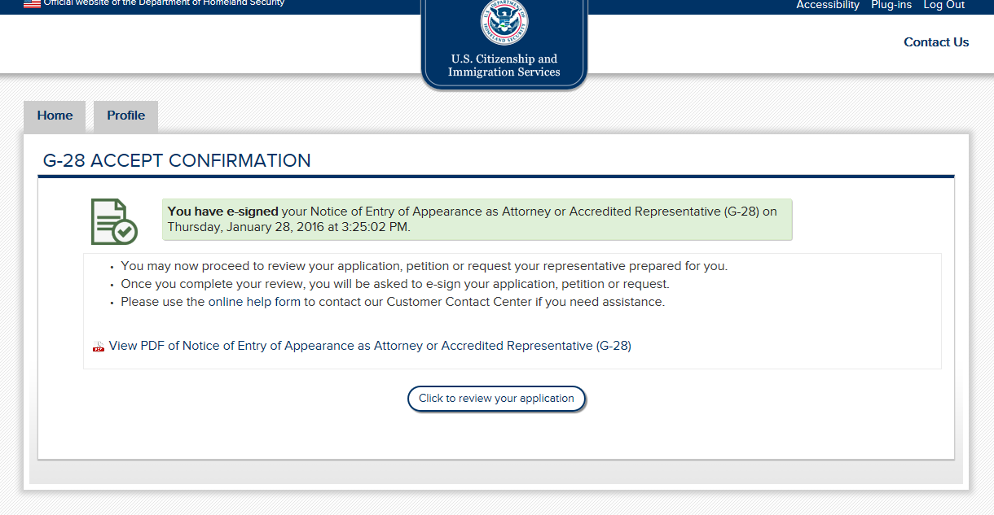
Client receives notification that the G-28 was e-signed.

Slide 26
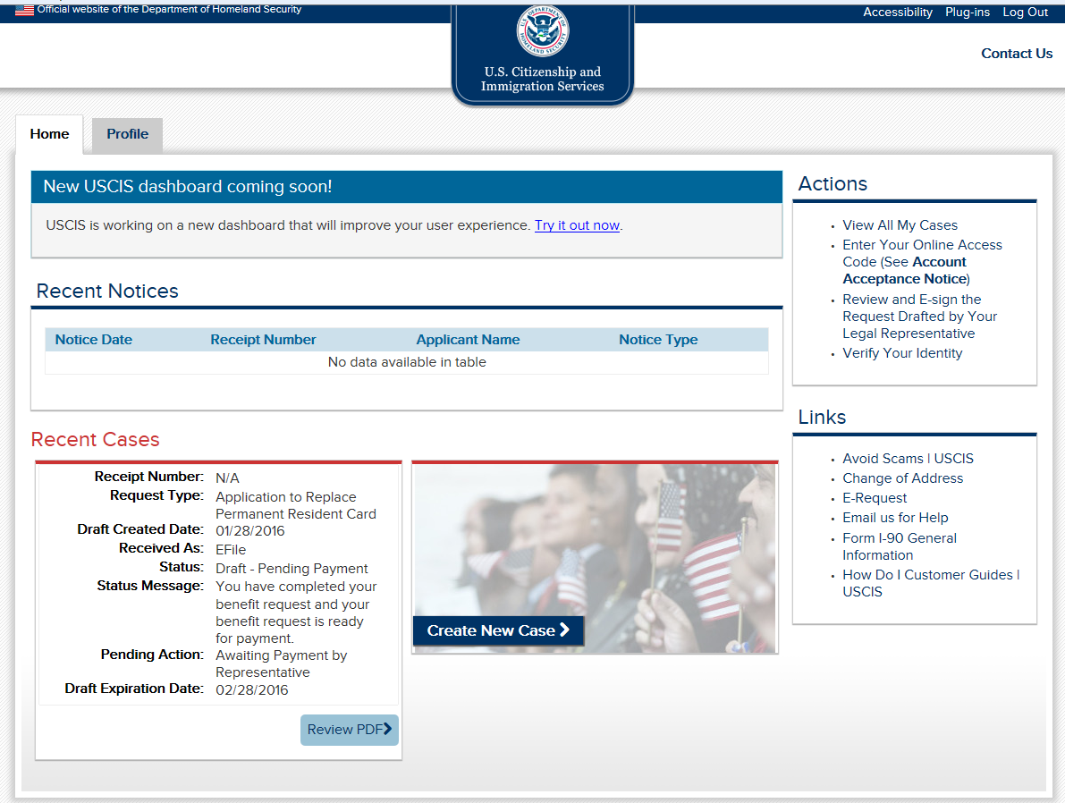
After e-signing, client receives notification that case is pending payment by representative.

Slide 27
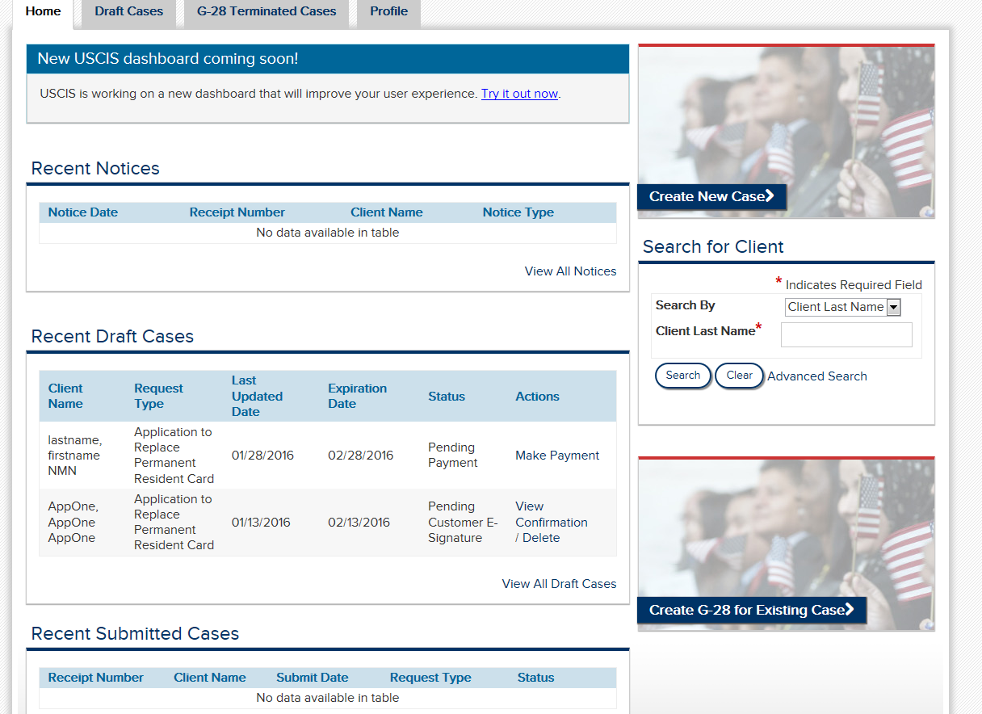
Representative receives notice that case is pending payment.

Slide 28
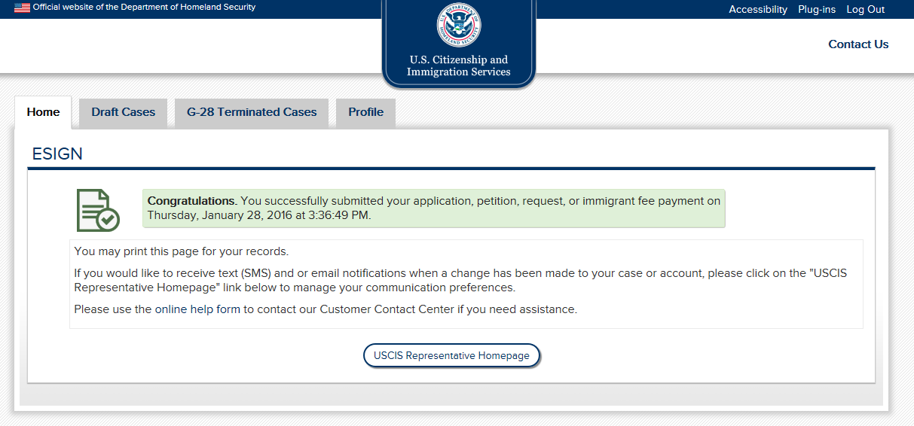
Congratulations. You successfully submitted your application, petition, or request on Thursday, January 28, 2016 at 3:36:49 PM.

