Slide 1
Passenger Perception Survey for TSA Synect Digital Signage Demonstration
Postcard

Slide 2
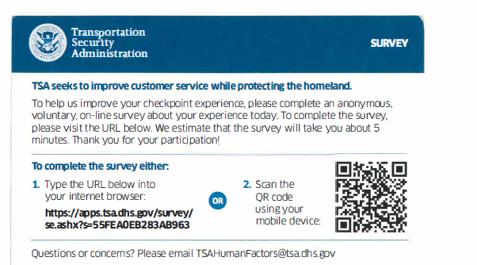

Slide 3
Paperwork Reduction Act Statement: TSA is collecting this information to assess passenger experience with digital signage. The public burden for this voluntary collection of information is estimated to be approximately 1.5 minutes. An agency may not conduct or sponsor, and persons are not required to respond to a collection of information, unless it displays a valid OMB control number. The OMB control number assigned to this collection is 1652-0058, which expires 07/31/2019. Send comments regarding this burden estimate or collection to: TSA-11, Attention: PRA 1652-0058, Passenger Perception Survey for TSA Synect Digital Signage Demonstration, 601 South 12th Street, Arlington, VA 20598-6011.

