Slide 1
FY19 Creative Concepts/Approaches

Slide 2
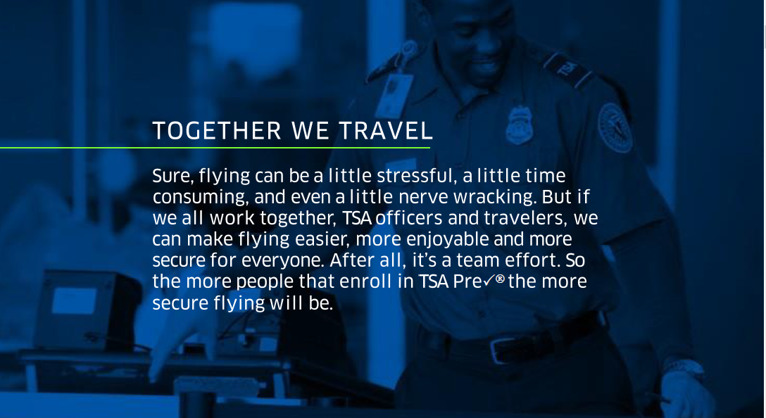

Slide 3


Slide 4
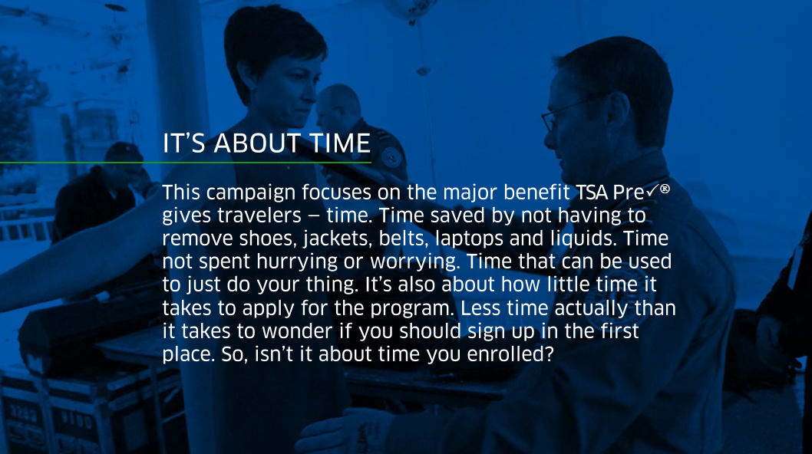
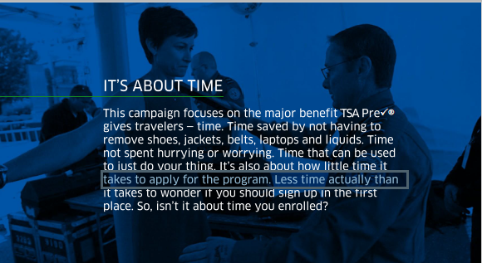

Slide 5
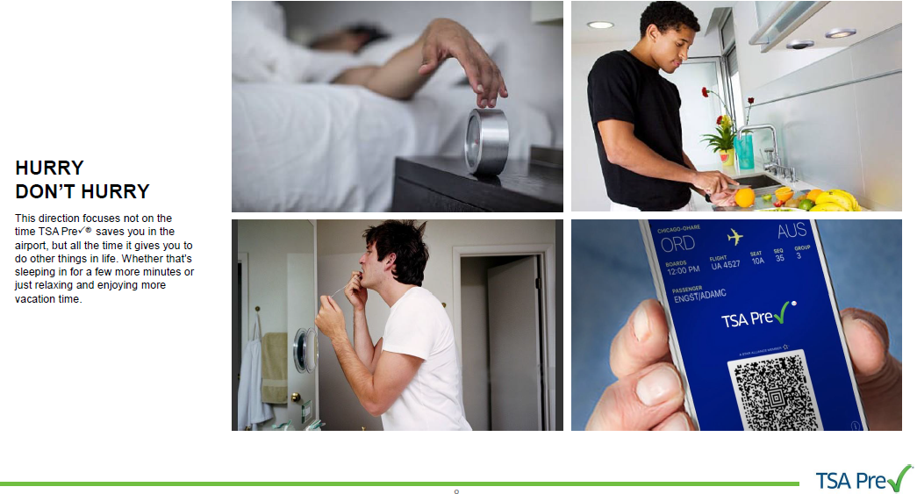

Slide 6



Slide 7
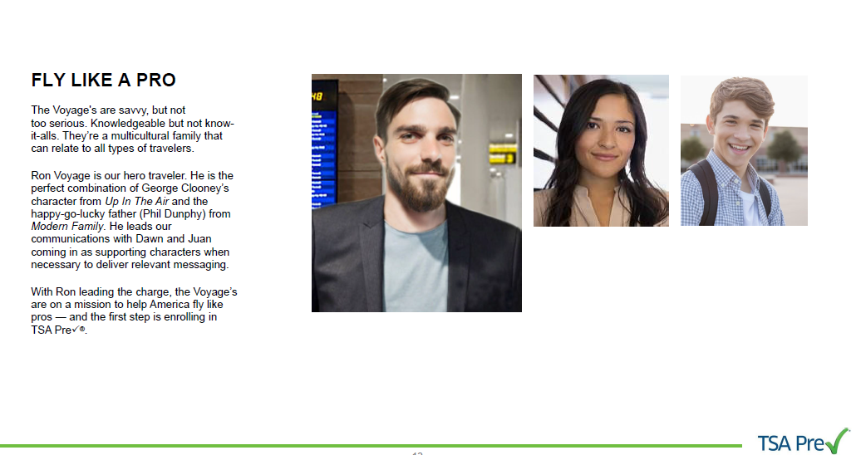
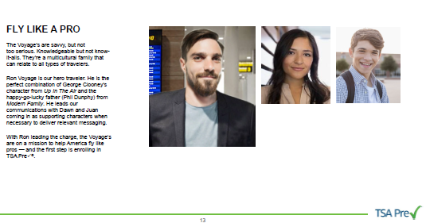

Slide 8
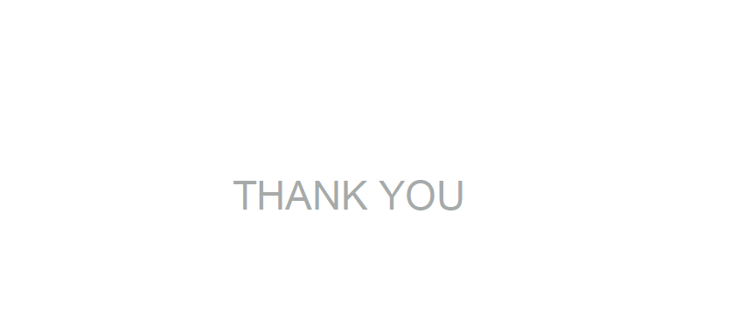
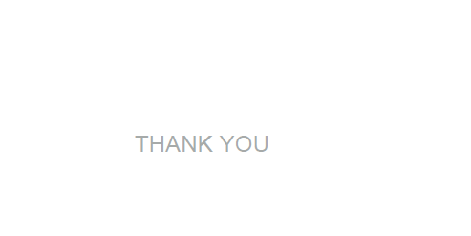

Slide 9
PAPERWORK REDUCTION ACT BURDEN STATEMENT: TSA is collecting this information to identify ongoing improvement opportunities for TSA Precheck advertisements. The public burden for collecting this information is estimated to be approximately 10 minutes. This is a voluntary collection of information. Send comments regarding this burden estimate or collection to: TSA-11, Attention: PRA 1652-0058, 601 South 12th Street, Arlington, VA 20598. An agency may not conduct or sponsor, and persons are not required to respond to a collection of information, unless it displays a valid OMB control number. The OMB control number assigned to this collection is 1652-0058, TSA Precheck FY19 Creative Concept Survey, which expires 07/31/2019.

