Slide 1


Enterprise Services Directorate | Verification Division
E-Verify PRA Submission
September 2016 | Version 5

Slide 2
E-Verify High Level Process Flow
Enroll Company
Complete Tutorial
Create Case
Receive Initial Case Results
Employment Authorized
(In most cases)
Verification in Process
Tentative Nonconfirmation (TNC)
Related Slides:
42-50
Final Nonconfirmation (FNC)
Related Slides:
51-55
(In certain cases)
Employment Authorized
Reverification
Related Slides: 65-89
(In certain cases)

Slide 3
Enroll Company
Steps:
Access E-Verify Enrollment Website
Read and Agree to Terms to Access the E-Verify Website
Review Enrollment Checklist and Collect Needed Information (offline)
Determine Access Method (choose company type)
Select Organization Designation and Applicable Federal Contractor Category
Select Option for reverification
Sign MOU
Enter Company Information
Register Users
Review and Certify Information
Print MOU

Slide 4
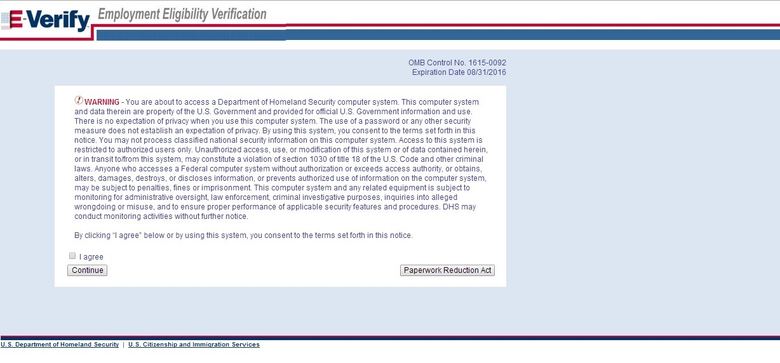
Privacy Statement

Slide 5
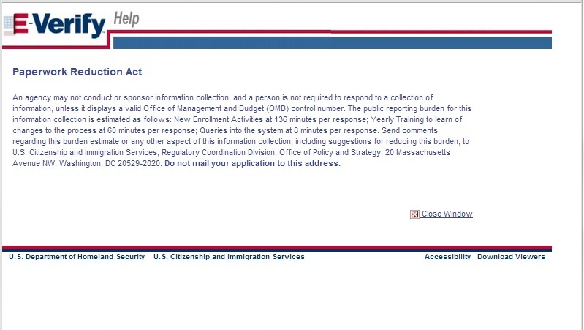
Paperwork Reduction Act Help

Slide 6
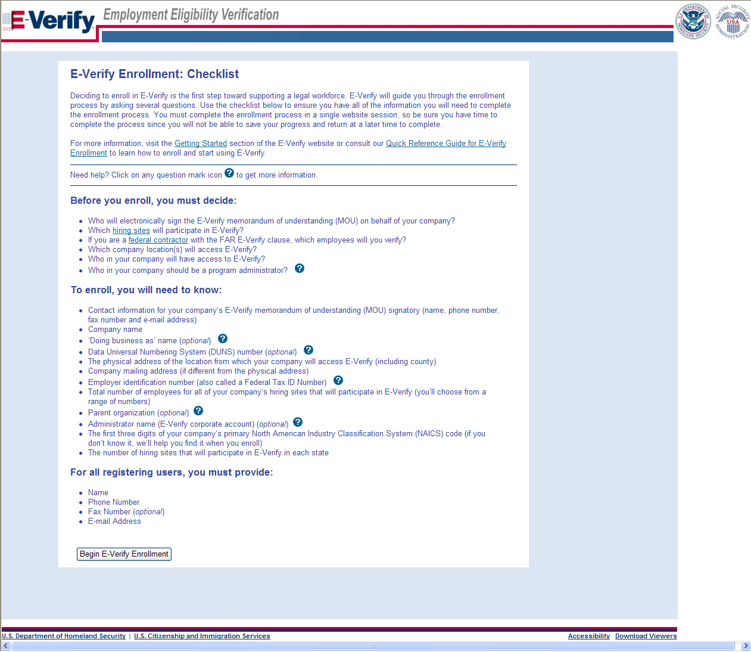
Review Enrollment Checklist
∙If you will create reverification cases for employees without existing cases in E-Verify

Slide 7
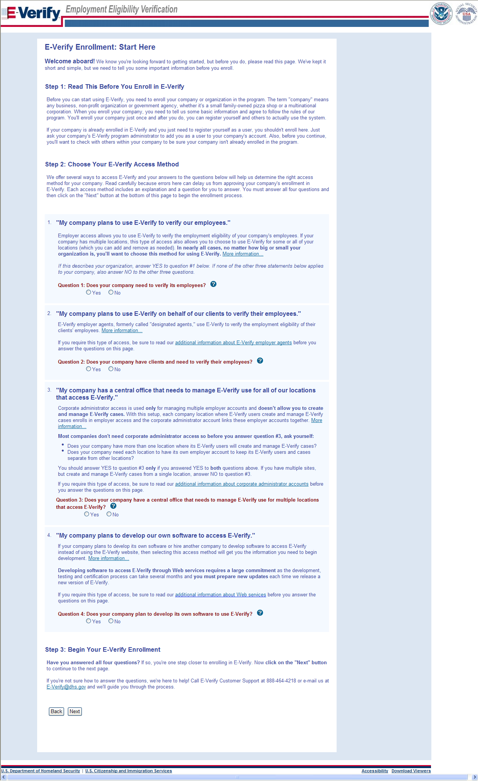
Determine Access Method

Slide 8
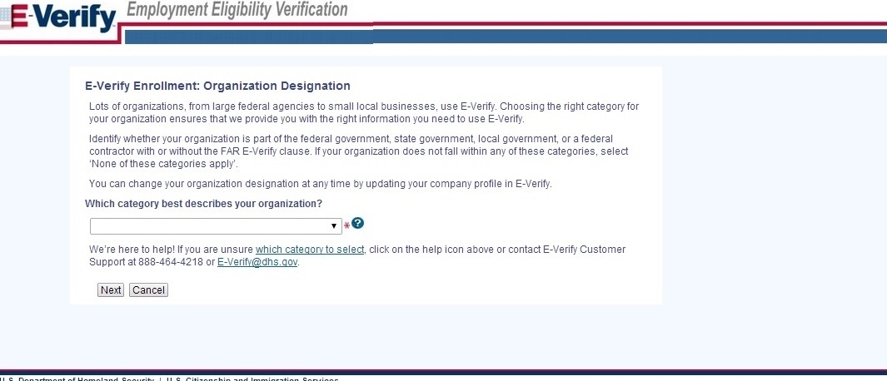
Select Organization Designation

Slide 9
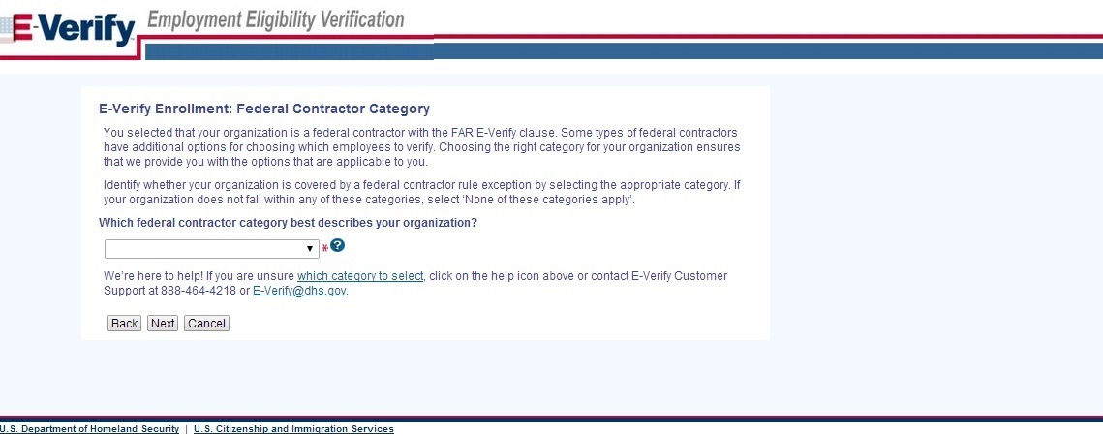
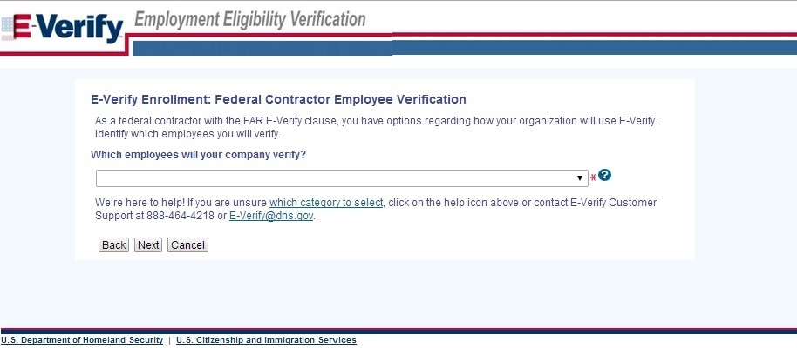
Select Federal Contractor Category

Slide 10
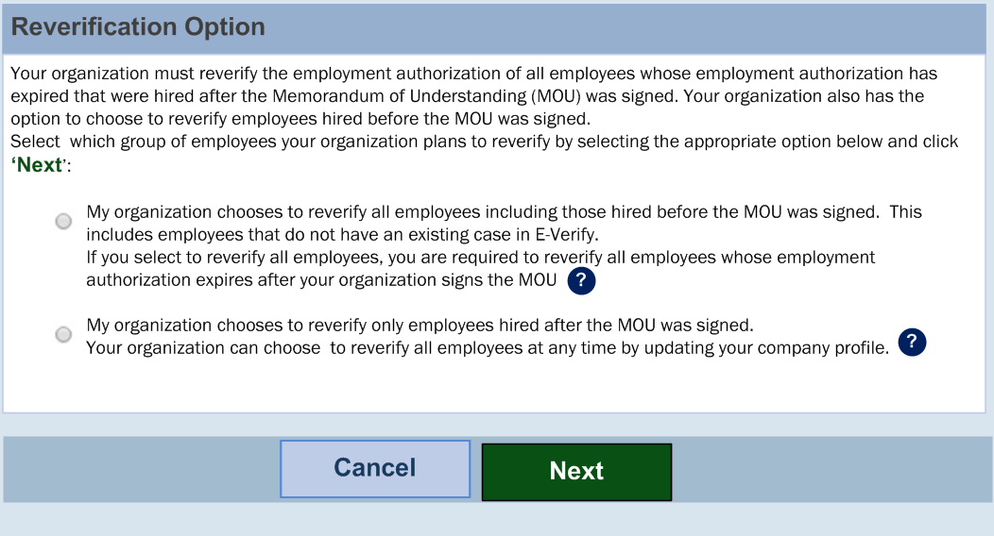
Select Reverification Opt-in
Option to reverify all employees.

Slide 11
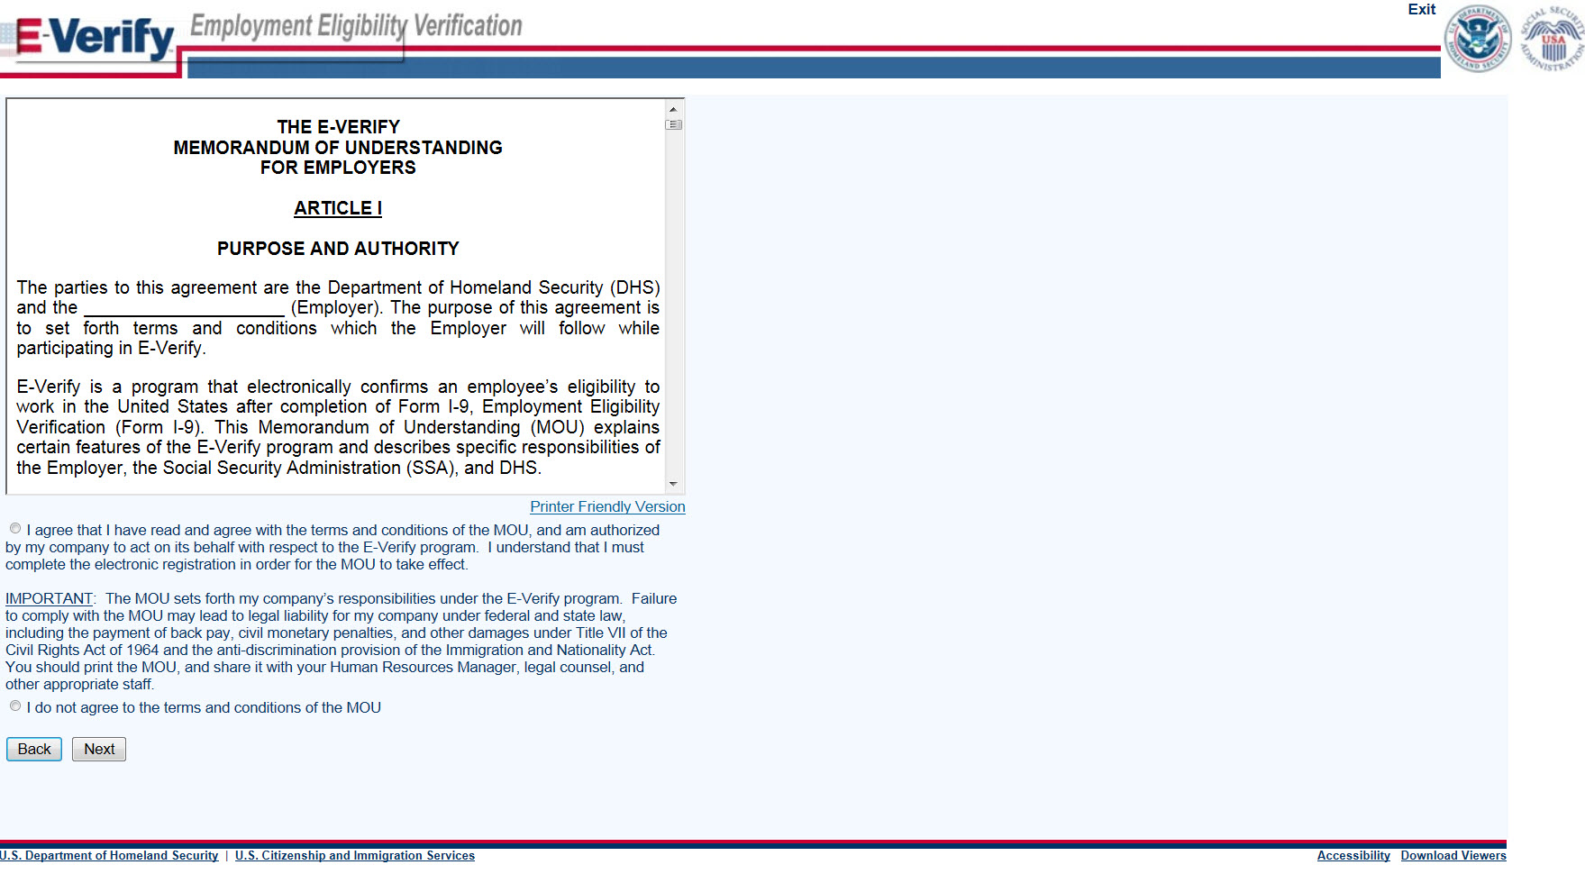
Sign MOU

Slide 12
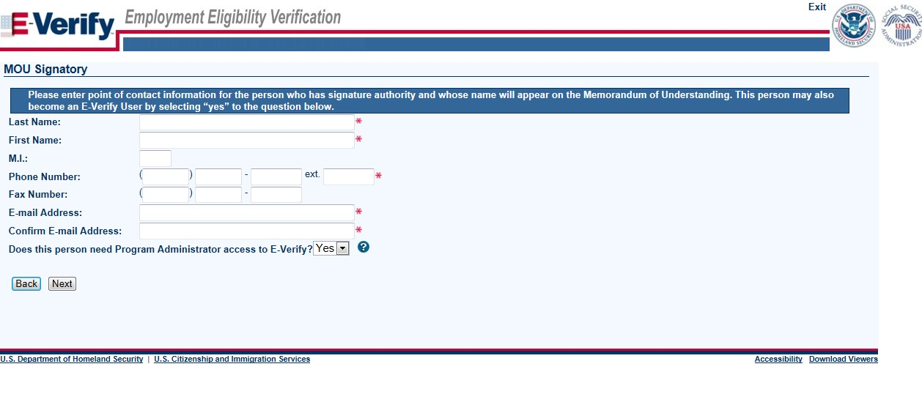
Enter Company Information – MOU Signatory

Slide 13
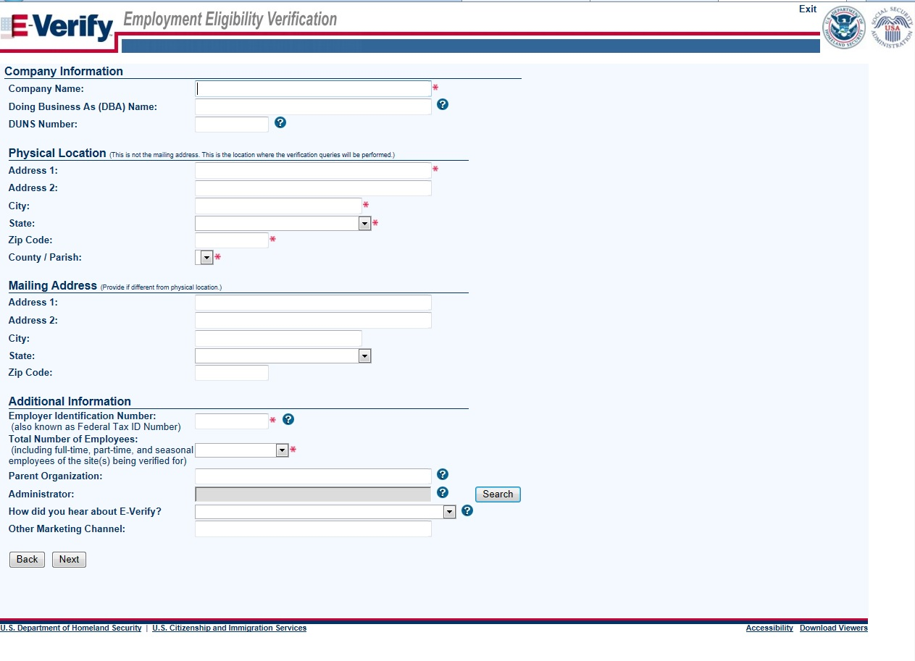
Enter Company Information

Slide 14
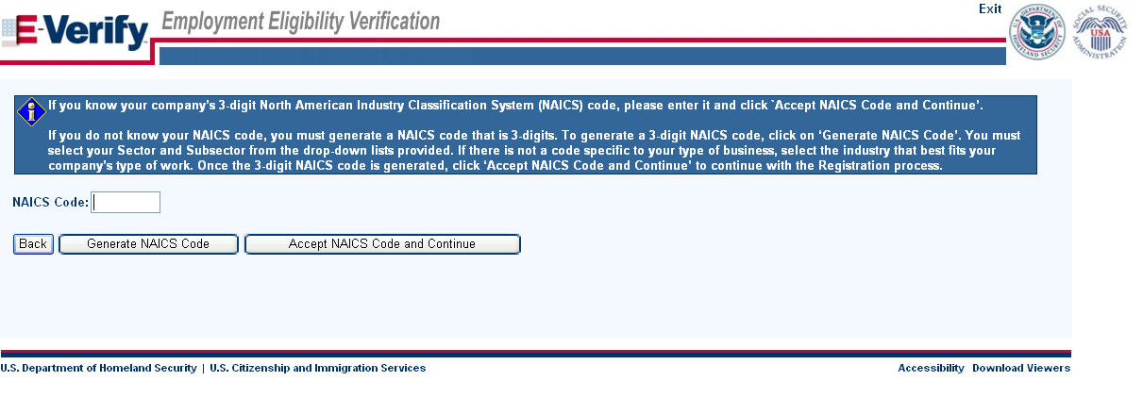
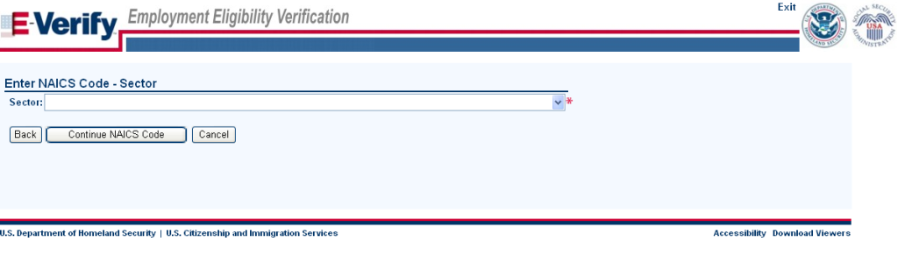
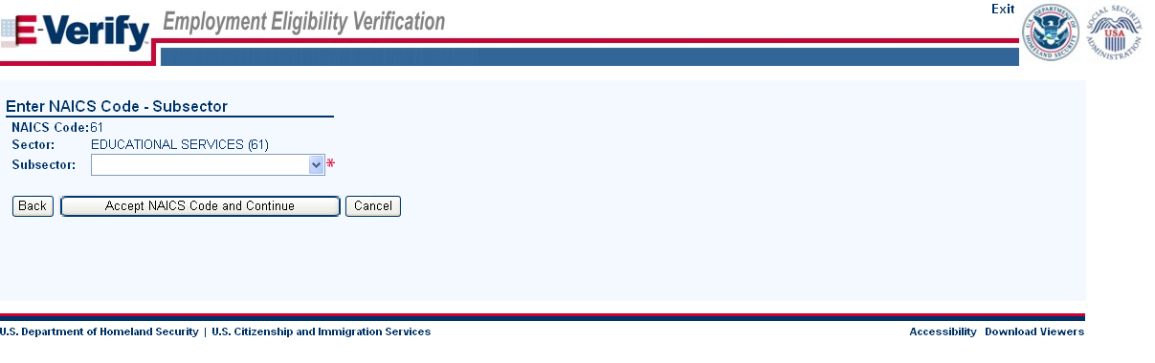
Enter NAICS Code

Slide 15
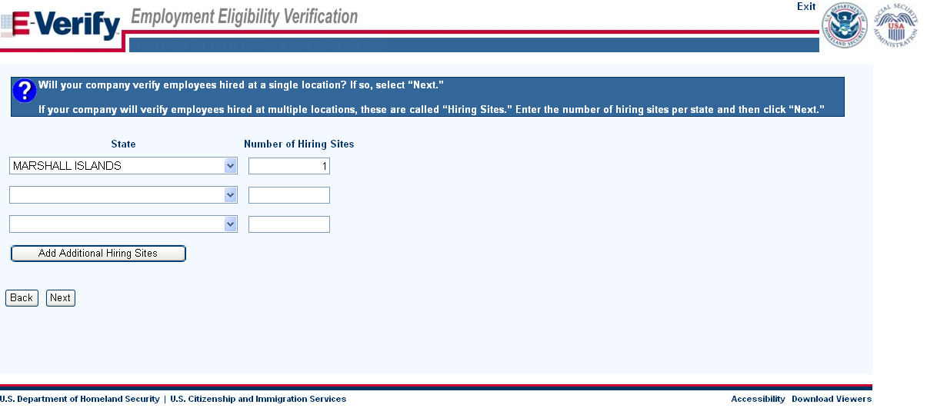
Enter Hiring Site Information
VIRGINIA

Slide 16
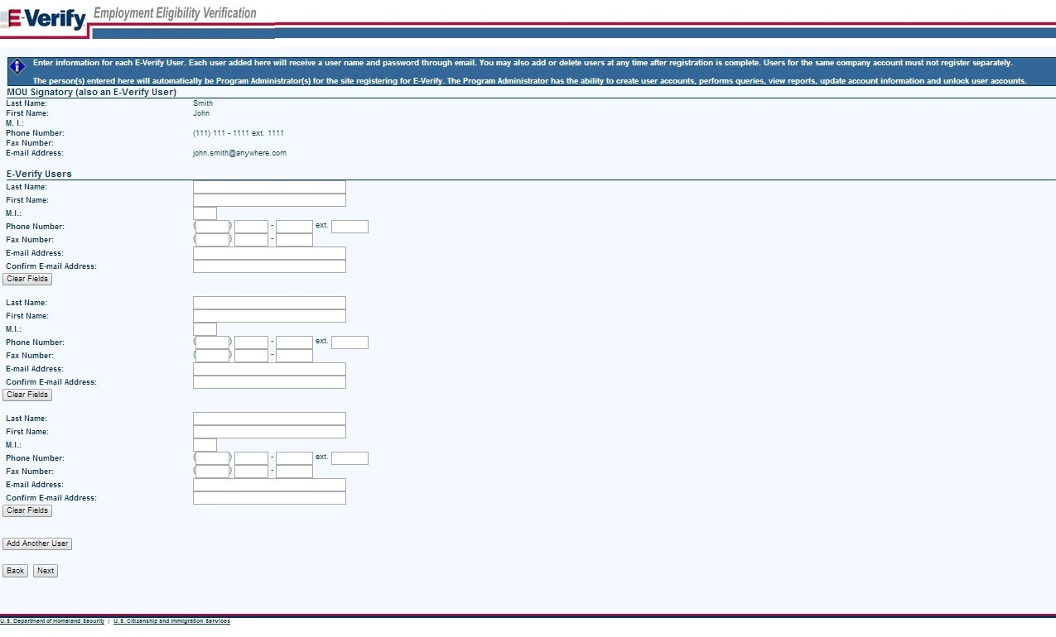
Register E-Verify Users

Slide 17
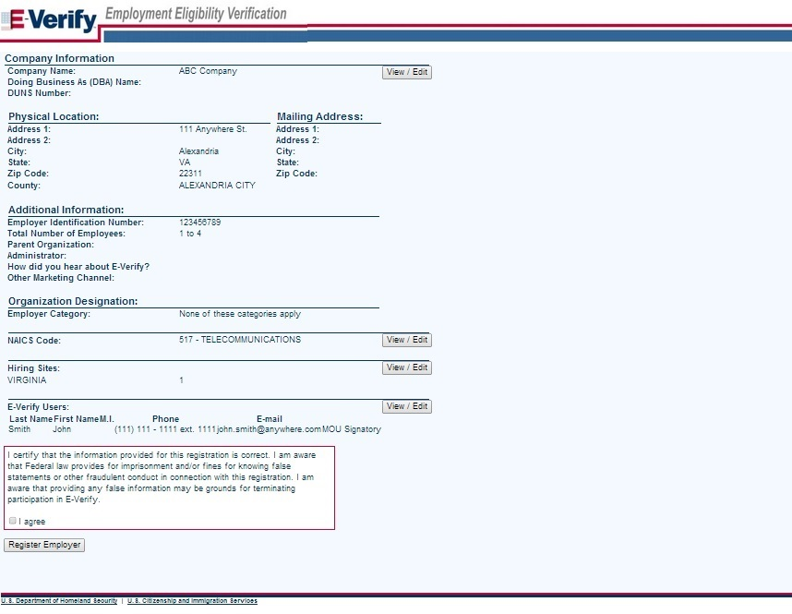
Review and Certify Information

Slide 18
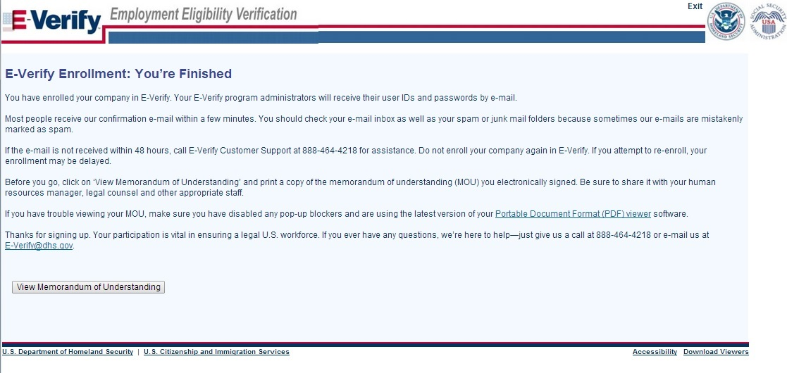
Print MOU

Slide 19
Complete Tutorial
Steps:
Log into E-Verify
Receive Required Tutorial Notification
Complete Tutorial
Pass Knowledge Test

Slide 20
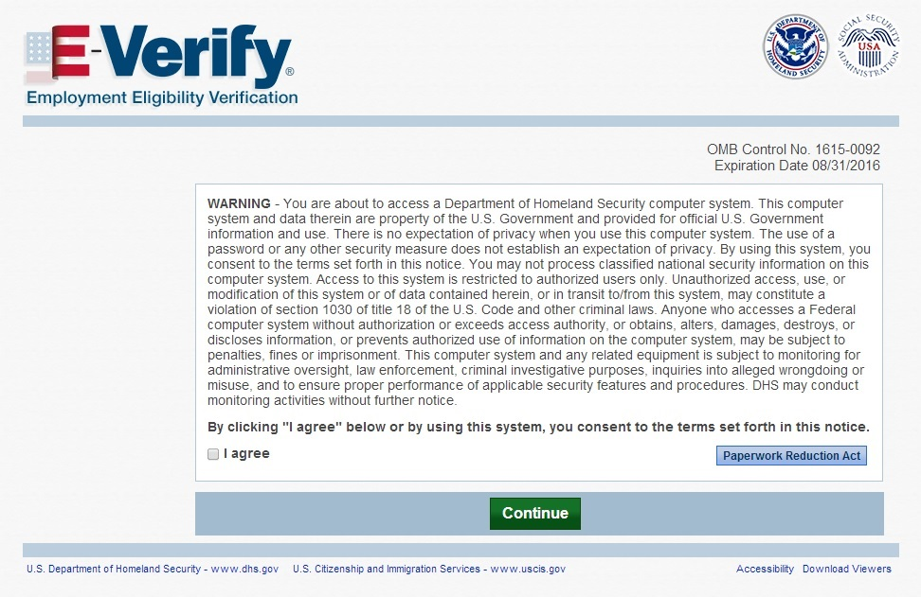
Access E-Verify Website

Slide 21
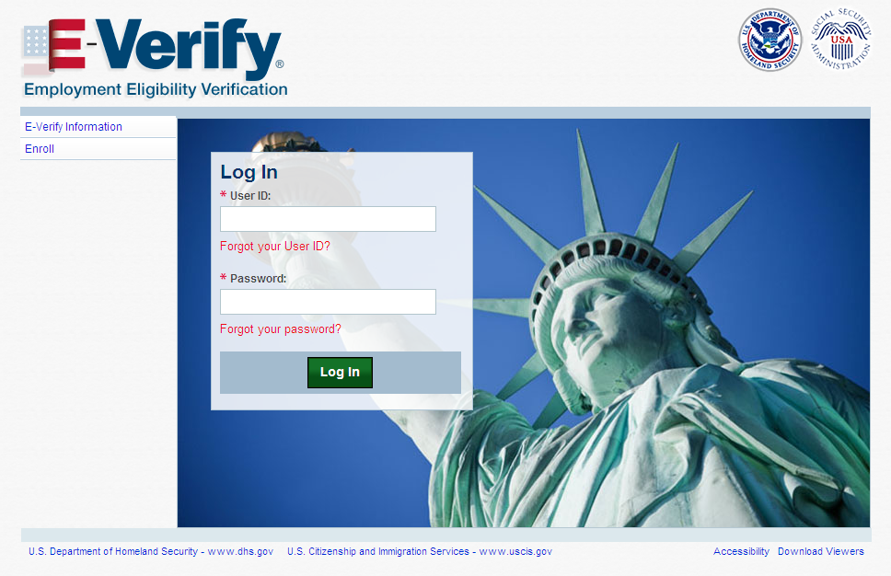
E-Verify Log-in Screen

Slide 22
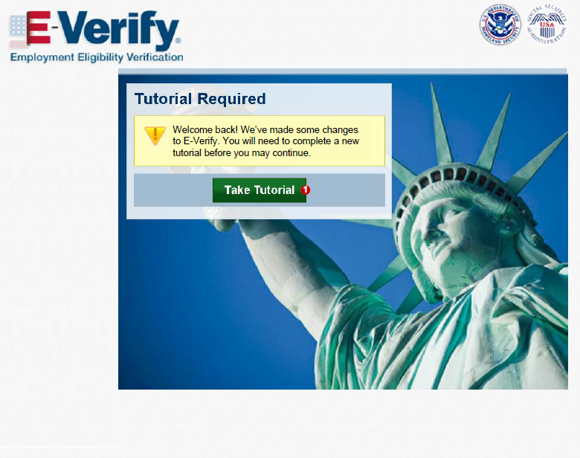
Tutorial Required

Slide 23
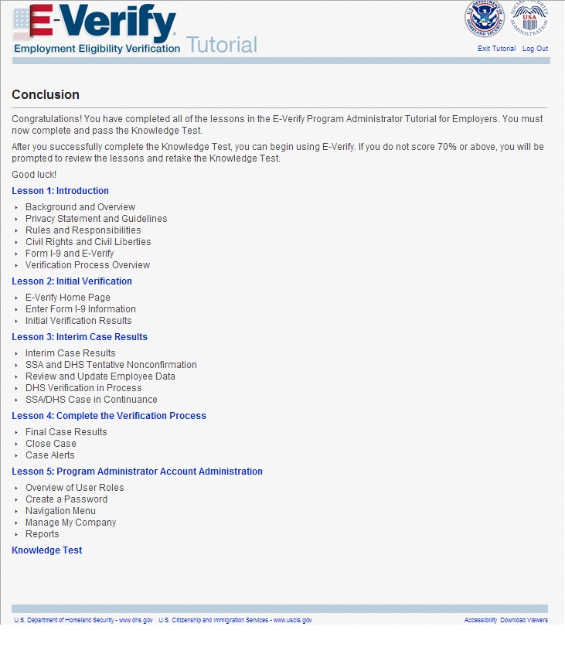
Tutorial Completion Screen

Slide 24
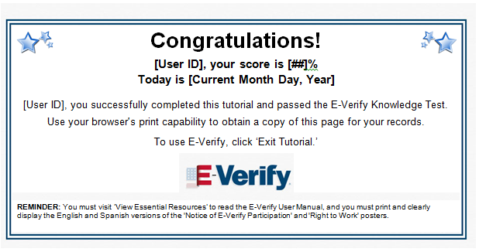
Knowledge Test Completed

Slide 25
Create Case
Steps:
Log into E-Verify
Select Create New Case
Select and Enter Form I-9 Information
Submit Case to E-Verify
Check Case Information (Pre-TNC Check)

Slide 26
Access E-Verify Website

Slide 27
E-Verify Log-in Screen

Slide 28
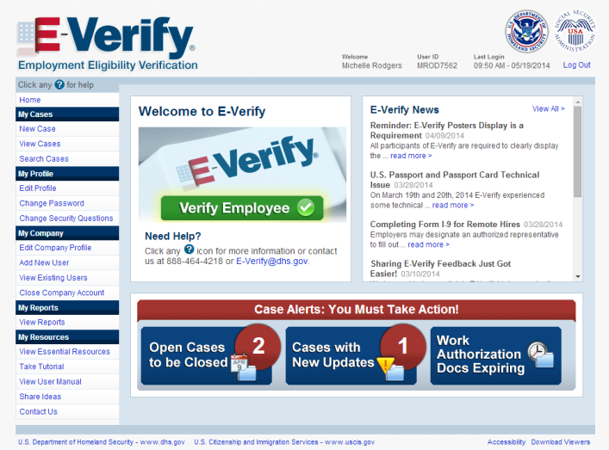

E-Verify Home Screen
John Smith
USER1234
Create Case

Slide 29
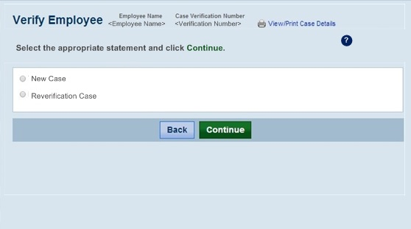


Case Selection

Slide 30
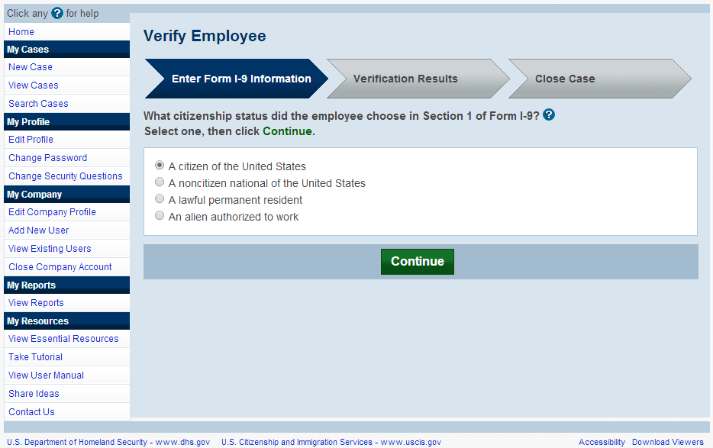
Select Citizenship Status
Create Case

Slide 31
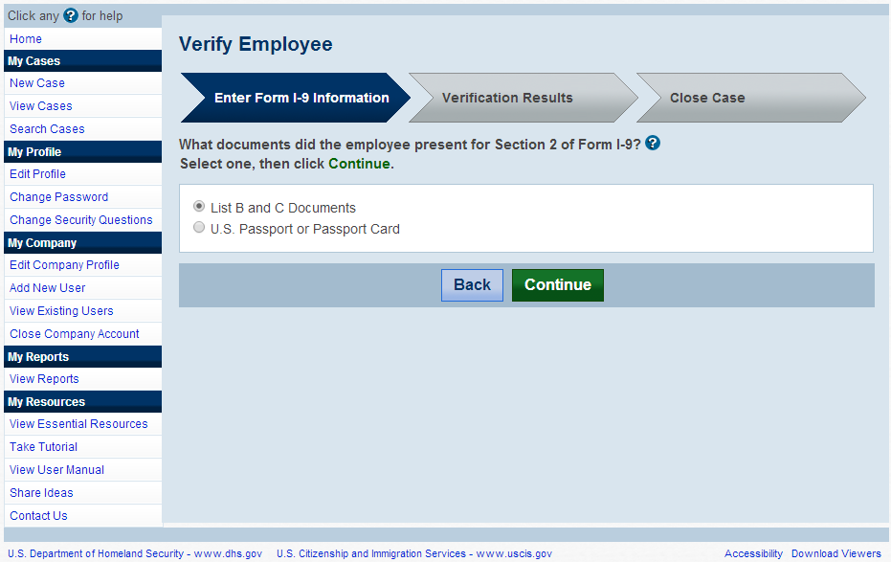
Select Document Type
Create Case

Slide 32
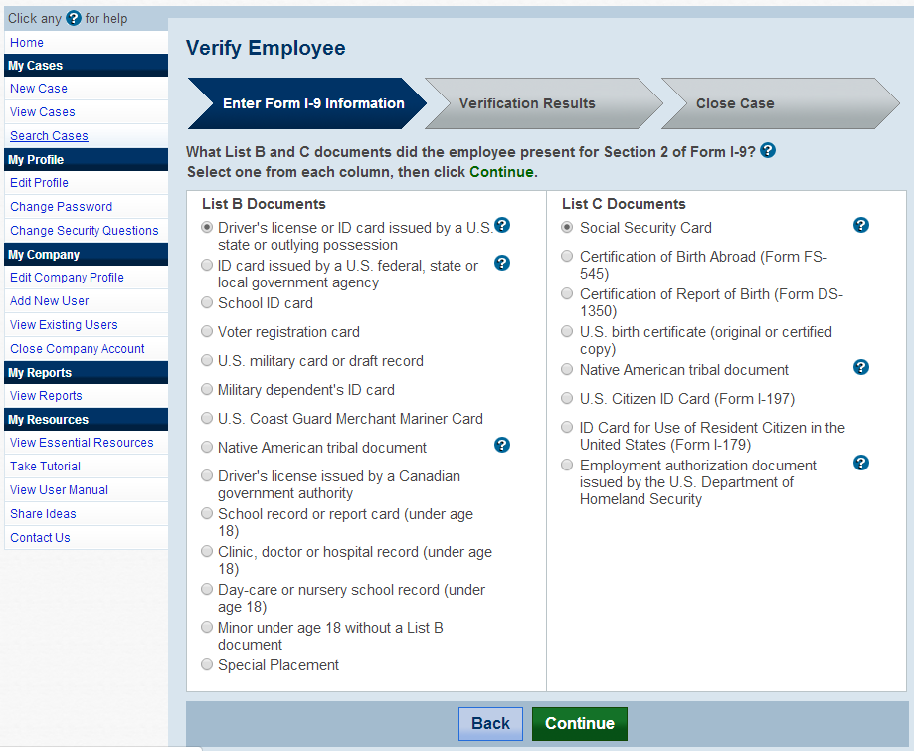
Select List B and List C Documents
(if “List B and C documents” selection is made)
Create Case

Slide 33
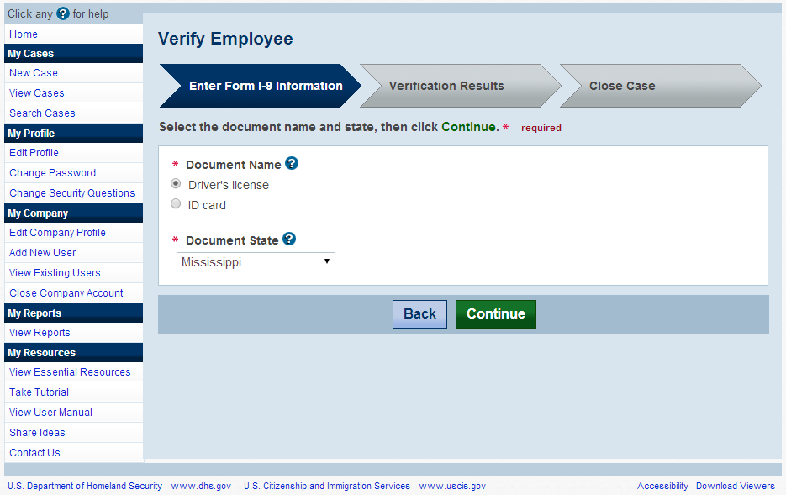
Select List B Document
(if Driver’s License is selected from List B)
Create Case

Slide 34
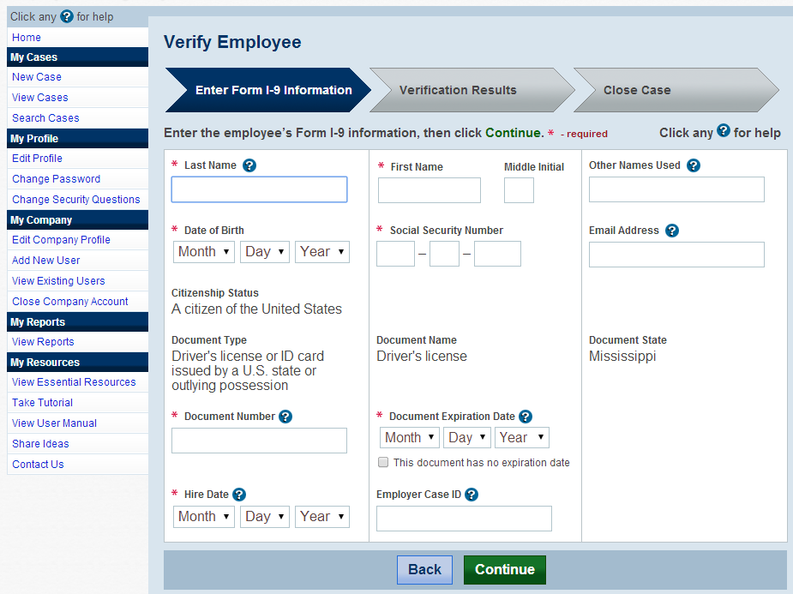
Enter Form I-9 Information
(if Driver’s License is selected)
Create Case

Slide 35
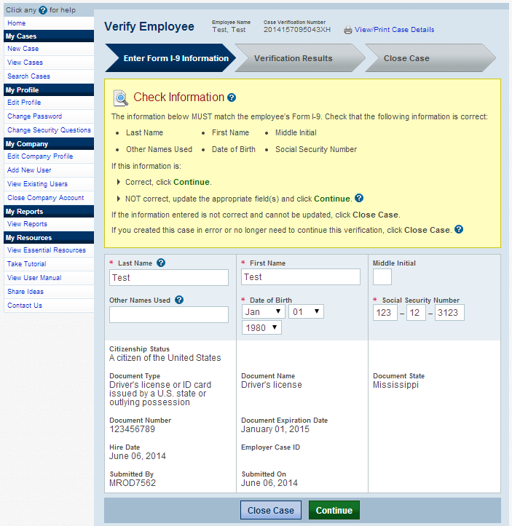
Check Case Information (Pre-TNC Check)
Create Case

Slide 36
Receive Results –
Verification in Process
Steps:
Receive Verification in Process Response (if applicable)

Slide 37
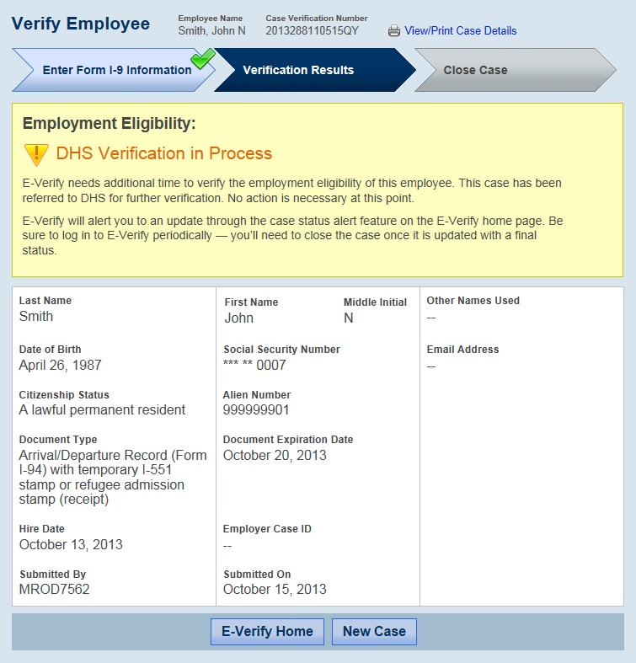
DHS Verification in Process

Slide 38
Photo Matching
Steps:
Compare Employee Photo on Screen to Document Photo
Indicate if the Photos Match
Receive Results – Employment Authorized (if matched) (see slides 39-40)
Receive Results – DHS Tentative Nonconfirmation (if not matched) (see slides 45-49)

Slide 39
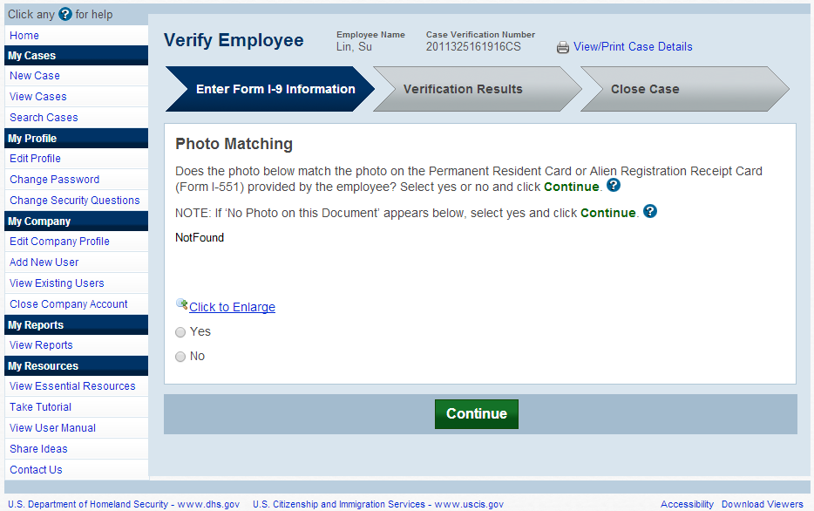

Photo Matching
May occur if any of the following documents are presented:
Create Case
U.S. Passport
Form I-551
Form I-766

Slide 40
Receive Results – EA
Steps:
Receive Employment Authorized (EA) Response
Close Case (see slides 57-61)

Slide 41
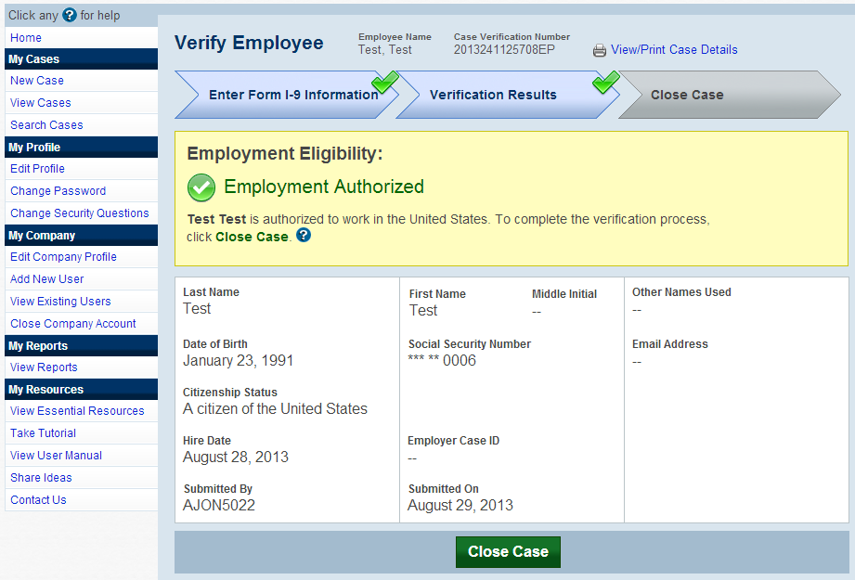
Employment Authorized- Initial Case Result
Create Case

Slide 42
Receive Results –
SSA Tentative Nonconfirmation
Steps:
Receive SSA Tentative Nonconfirmation (TNC) Response
Review, Print, and Sign Further Action Notice
Indicate if Employee Chooses to Contest SSA TNC
Employee Contacts SSA and Resolves TNC (offline)
Receive Results – Employment Authorized (if resolved) (see slides 39-40)
Receive Results – SSA Final Nonconfirmation (if unresolved) (see slides 50-52)

Slide 43
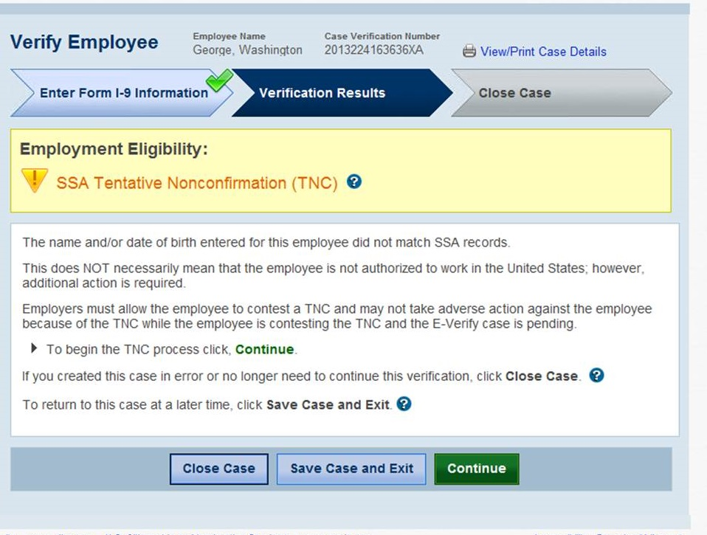
SSA Tentative Nonconfirmation

Slide 44
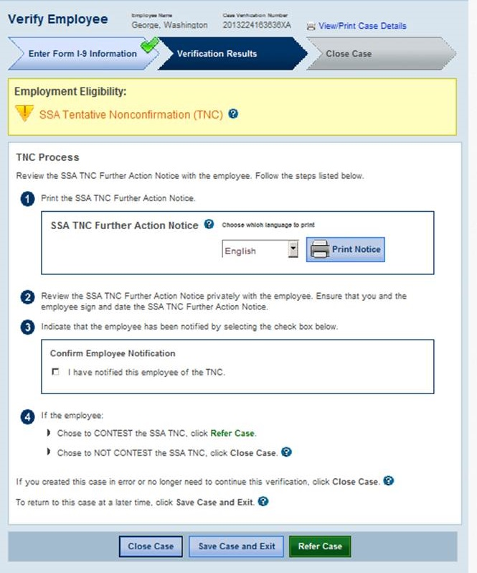
SSA Tentative Nonconfirmation –
Case Referral Process

Slide 45
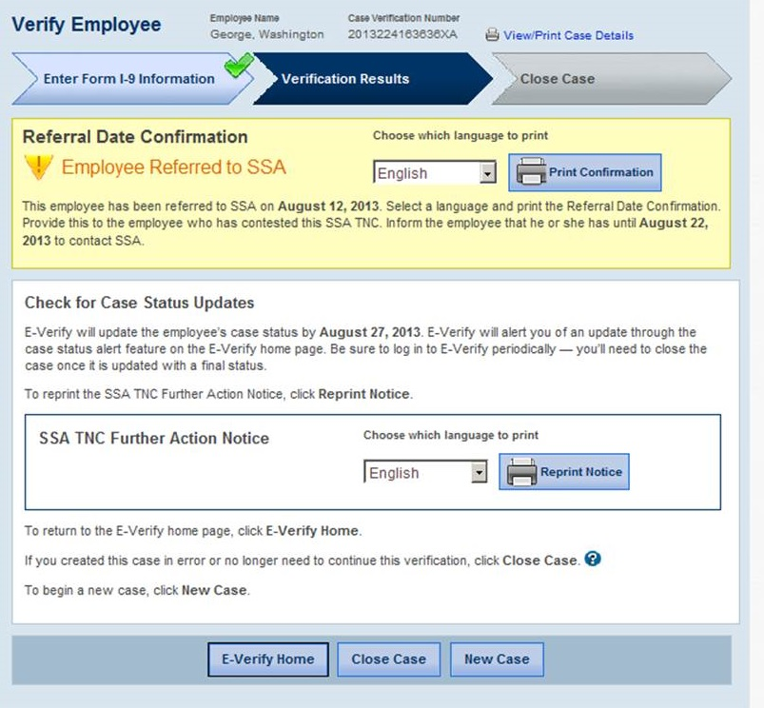
SSA Tentative Nonconfirmation Referred to SSA

Slide 46
Receive Results –
DHS Tentative Nonconfirmation
Steps:
Receive DHS Tentative Nonconfirmation (TNC) Response
Review, Print, and Sign Further Action Notice
Indicate if Employee Chooses to Contest DHS TNC
Attach and Submit Copy of Employee’s Photo Document (if photo TNC)
Employee Contacts DHS and Resolves TNC (offline)
Receive Results – Employment Authorized (if resolved) (see slides 39-40)
Receive Results – DHS Final Nonconfirmation (if unresolved) (see slide 53-56)

Slide 47
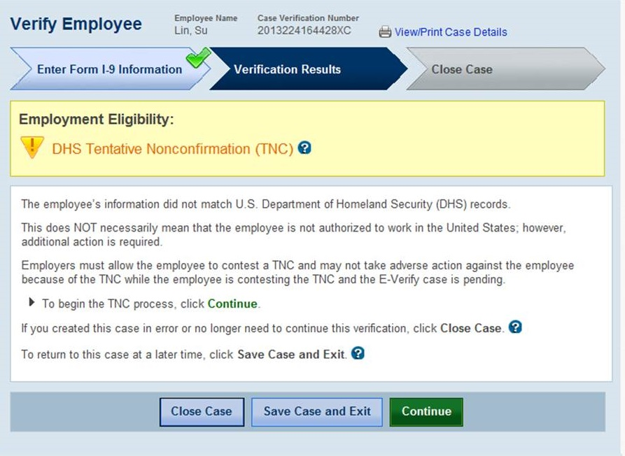
DHS Tentative Nonconfirmation

Slide 48
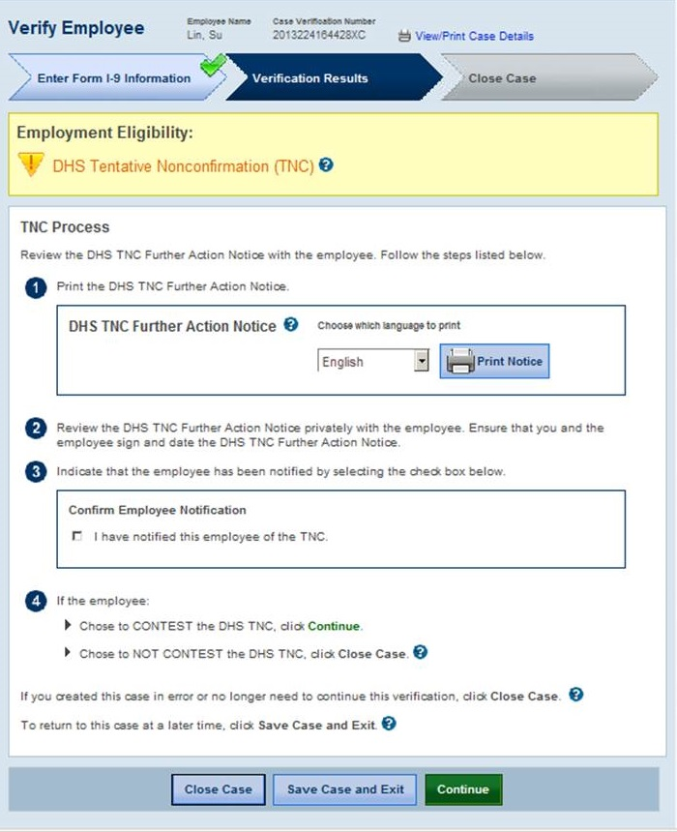
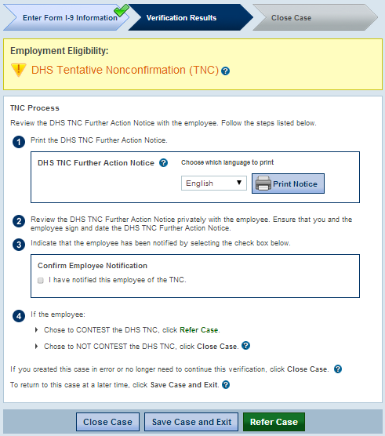
DHS Tentative Nonconfirmation –
Case Referral Process

Slide 49
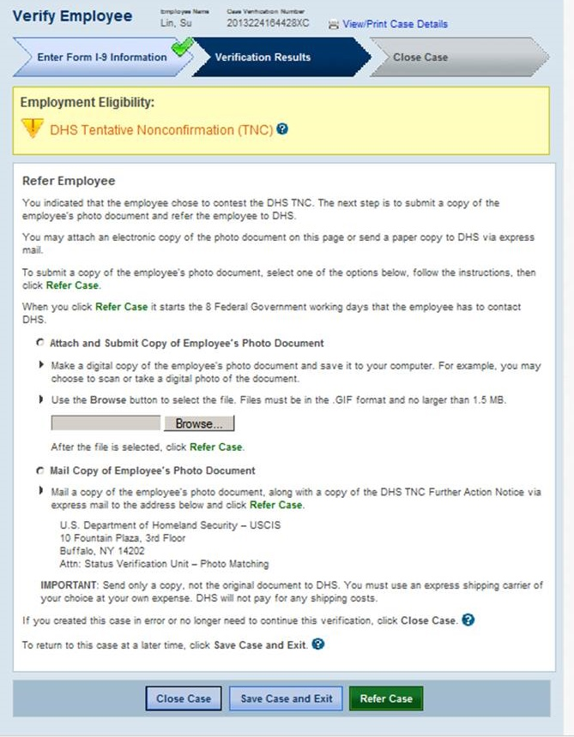
DHS Tentative Nonconfirmation –
Photo Document Submission Process
(if Photo TNC)

Slide 50
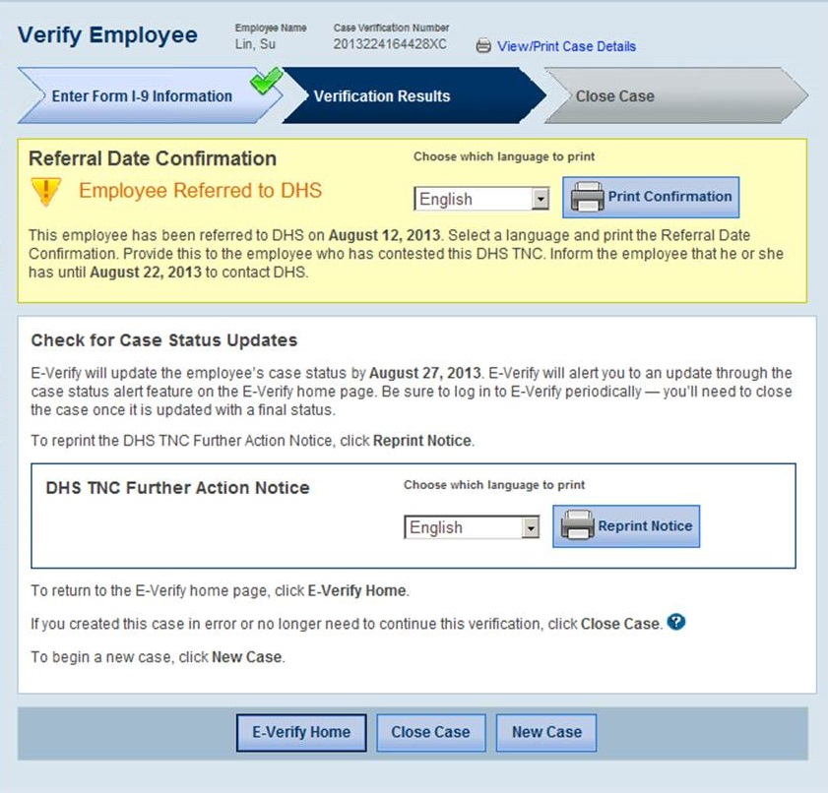
DHS Tentative Nonconfirmation Referred to DHS

Slide 51
Receive Results – SSA Final Nonconfirmation
Steps:
Receive SSA Final Nonconfirmation Response
Close Case (see slides 57, 62-64)

Slide 52
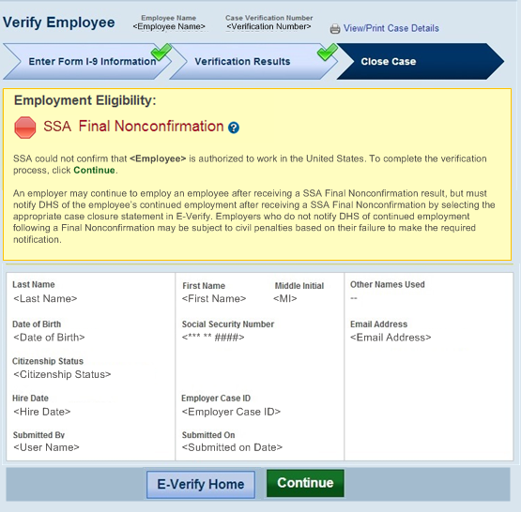
SSA Final Nonconfirmation

Slide 53
Receive Results – DHS Final Nonconfirmation
Steps:
Receive DHS Final Nonconfirmation or DHS No Show Response
Close Case (see slides 57, 62-63, 65)

Slide 54
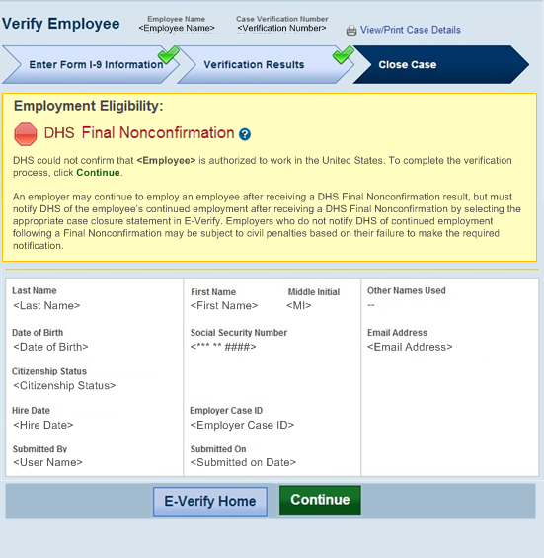
DHS Final Nonconfirmation

Slide 55
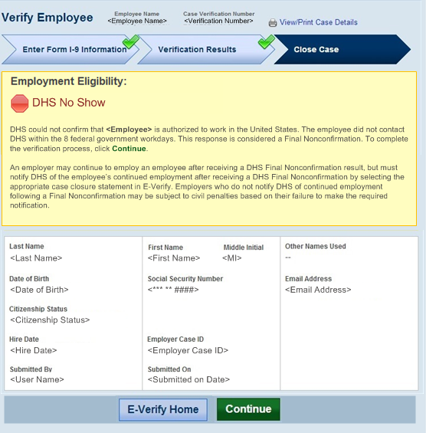
DHS No Show

Slide 56
Case Closure
Case Closure for Employment Authorized and Final Nonconfirmation Cases Steps:
Select Employment Status
Select Case Closure Reason
Receive Case Closed Screen

Slide 57
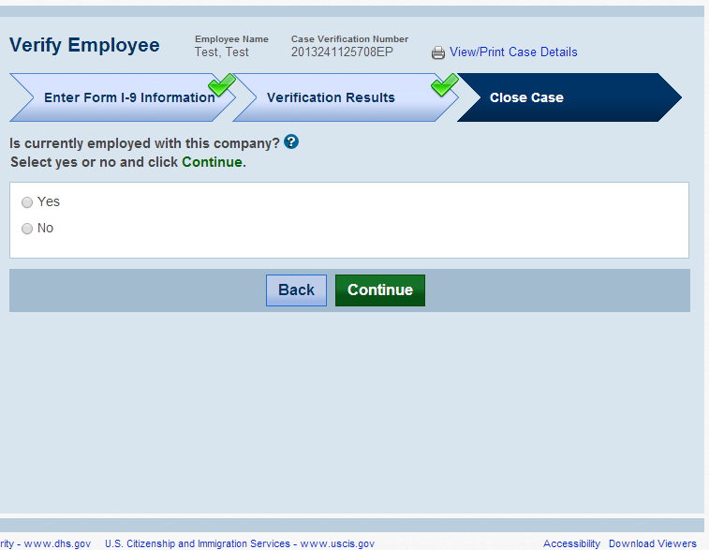
Employment Authorized – Select Employment Status

Slide 58
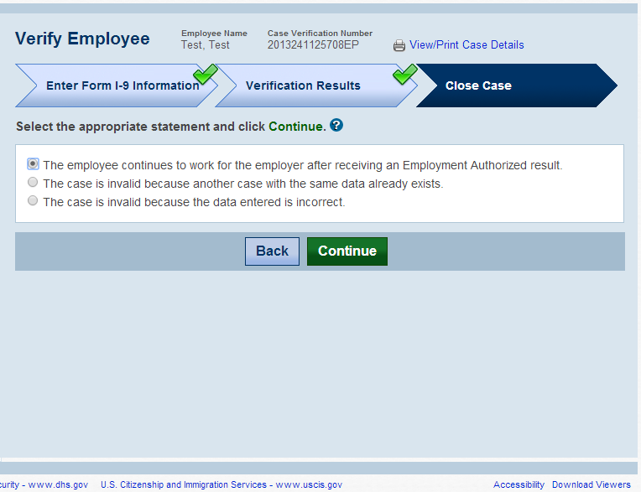
Employment Authorized Case Closure – Still Employed

Slide 59
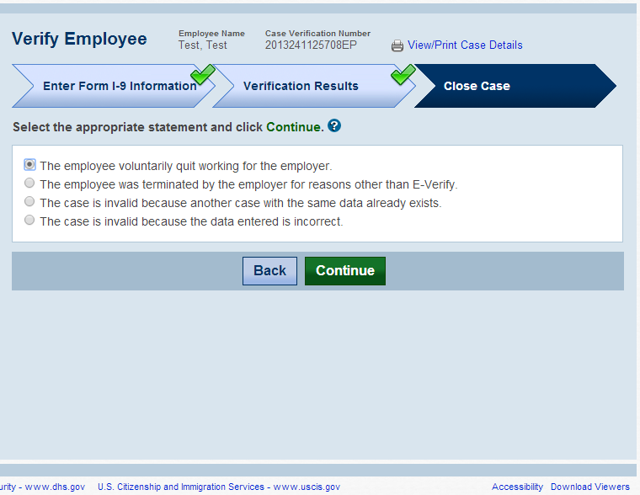
Employment Authorized Case Closure – No Longer Employed

Slide 60
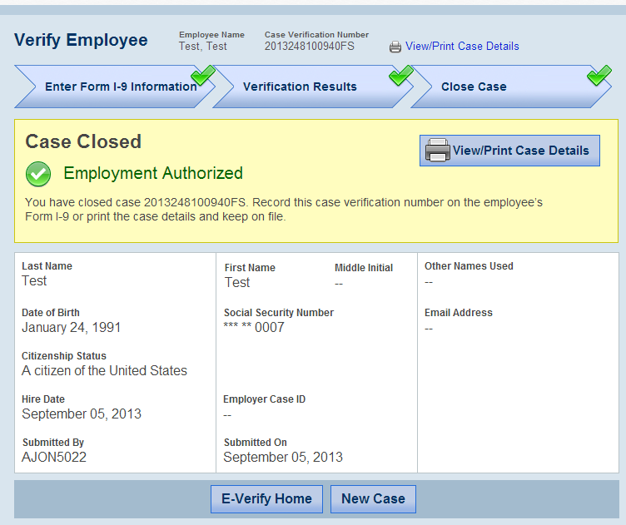
Employment Authorized Case Closed

Slide 61
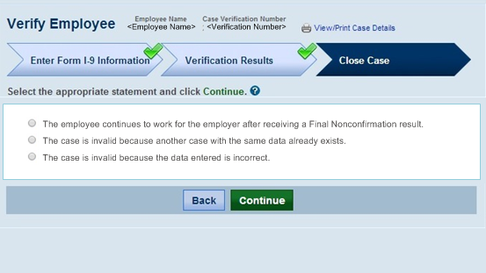
Final Nonconfirmation Case Closure – Still Employed

Slide 62

Final Nonconfirmation Case Closure – No Longer Employed

Slide 63

SSA Final Nonconfirmation Case Closed

Slide 64

DHS Final Nonconfirmation Case Closed

Slide 65
Reverification
Reverification of Existing Case Steps:
Select Reverification Required Case Alert
Enter Case Information for Reverification
Submit Case for Reverification (see Case Result Options below)
  Additional Screens:
    Employment Authorized future validity date (see slide 76)
    Reverification not required (see slides 77-78)
    Enter late case reason (if the Reverification Case was created more than three days after the previous Work Authorization document expired) (see slide 79)
    Search Cases (to use the new “Reverification Required” search feature) (see slide 80)
    Reverification of existing case from case status at any time after initial case result (see slide 81)
New Reverification Case Steps:
Option to reverifiy all employees, including those hired prior to signed MOU (slides 83-85)
Begin New Reverification Case
Select Previous Citizenship Status
Enter Case Information for Reverification
Submit Case for Reverification (see Case Result Options below)
Case Result Options (based on existing processes):
    Receive Results – Employment Authorized (if case passes verification) (see slides 40-41)
Receive Results – Verification in Process (see slides 36-37)
Receive Results – Pre-TNC Check (see slide 35)
Receive Results – DHS Tentative Nonconfirmation (if case does not pass verification) (see slides 46-48, 50)

Slide 66

Reverification of Existing Case
Continuing our Goal of Effective Communication

Slide 67

Reverification of Existing Case– Select Reverification Required Case Alert

Slide 68

Reverification of Existing Case –
View Cases: Reverification Required
.
Employer clicks case number to start the Reverification process or indicate it is not required .

Slide 69

Reverification of Existing Case - After Case Closed
This screen will be displayed for existing cases that require reverification and have work authorization documents that have expired.

Slide 70

Reverification of Existing Case – Document Type Selection

Slide 71

Reverification of Existing Case – Document Type Selection – List A

Slide 72

Reverification of Existing Case – Enter Section 3 Form I-9 Information
Employers review and update existing case information.

Slide 73
Additional Screens
(Existing Cases only)
Continuing our Goal of Effective Communication

Slide 74

Additional Screens: Employment Authorized future validity date
as of XX/XX/XXXX. To complete the verification process

Slide 75

Additional Screens: Reverification not Required
.

Slide 76

Additional Screens: Reverification not Required
.

Slide 77

Additional Screens: Enter Late Case Reason
(if the Reverification Case was created more than three days after the previous Work Authorization document expired)

Slide 78

Additional Screens: Search Cases
(to use the new “Reverification Required” search function)
Cases that meet the criteria for reverification can be located and a case started through the Search Case function.

Slide 79

Reverification of Existing Case –
From Case Status at any time
.
Employer clicks continue to start the Reverification process. Before 90 day case alert and after initial case result. Giving employer an opportunity to reverify at any time.

Slide 80
New Reverification Case
Continuing our Goal of Effective Communication

Slide 81

Opt-in Reverify cases for existing employees prior to signed MOU
Reverification Option: Test Company will Reverify All Employees

Slide 82

Opt-in Reverify cases for existing employees prior to signed MOU
Reverification Option: Test Company will Reverify All Employees

Slide 83

Opt-in Reverify cases for existing employees prior to signed MOU

Slide 84
New Reverification Case – Select Create Case

Slide 85

New Reverification Case – Select Case Type

Slide 86

New Reverification Case – Select Citizenship Status

Slide 87
New Reverification Case – Document Type Selection

Slide 88

New Reverification Case – Document Type Selection – List C

Slide 89

New Reverification Case – Enter Section 3 Form I-9 Information

Slide 90
Continuing our Goal of Effective Communication

