Slide 1
Privacy Act Statement: Authority: 44 U.S.C. § 3101 and 44 U.S.C. § 3534 authorize the collection of this information. Purpose: DHS will use this information to create and manage your user account and grant access to the Infrastructure Protection (IP) Gateway. Routine Use: This information may be disclosed as generally permitted under 5 U.S.C. § 552a(b) of the Privacy Act of 1974. This includes using the information, as necessary and authorized by the routine uses published in DHS/ALL-004 - General Information Technology Access Account Records System (GITAARS) November 27, 2012, 77 Fed. Reg. 70,792. Disclosure: Furnishing this information is voluntary; however failure to provide the information requested may delay or prevent DHS from processing your access request.
IP Gateway User Registration
Registration, feedback, and logon screen to updated to include the following:
OMB Control Number: 1670-0009
Expiration Date: XX/XX/XXXX
Paperwork Reduction Act: The public reporting burden to complete this information collection is estimated at 30 minutes per response, including the time for reviewing instructions, searching existing data sources, gathering and maintaining the data needed, and the completing and reviewing the collected information. An agency may not conduct or sponsor, and a person is not required to respond to a collection of information unless it displays a currently valid OMB control number and expiration date. Send comments regarding this burden estimate or any other aspect of this collection of information, including suggestions for reducing this burden to DHS/NPPD/IICD, Kimberly Sass, Kimberly.sass@hq.dhs.gov ATTN: PRA [OMB Control Number 1670-0009.

Slide 2
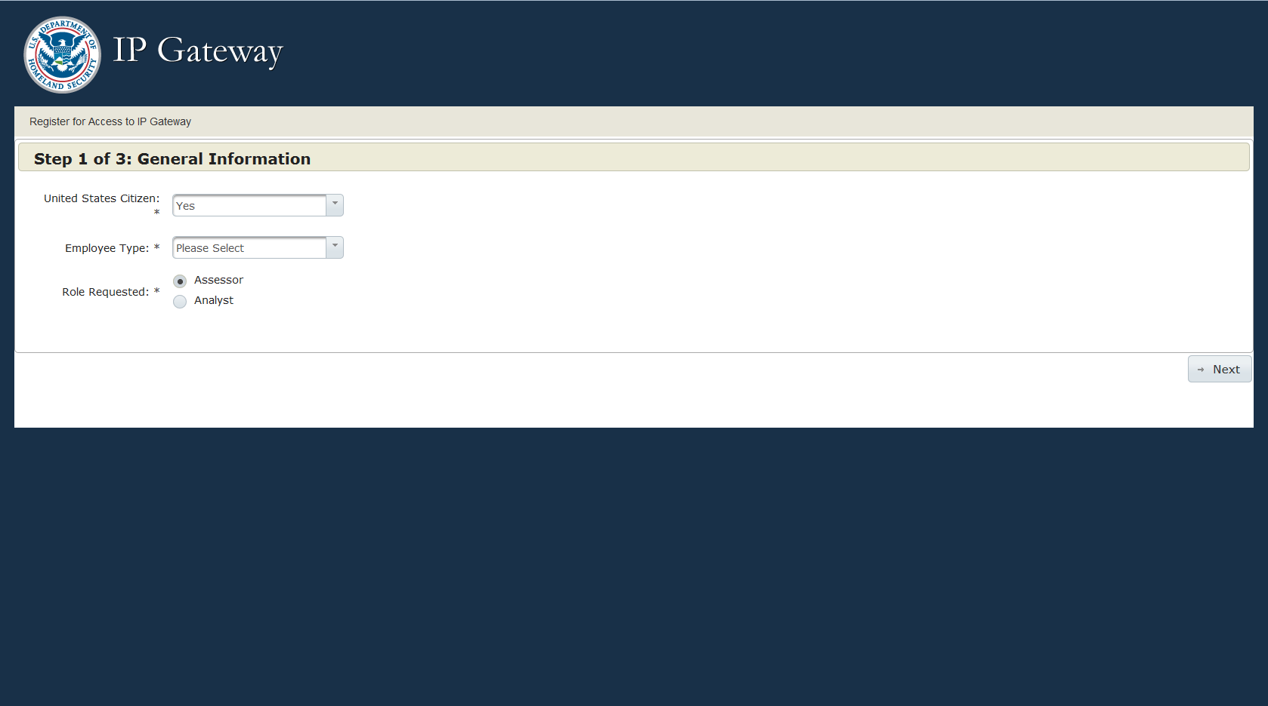
IP Gateway User Registration Step 1

Slide 3
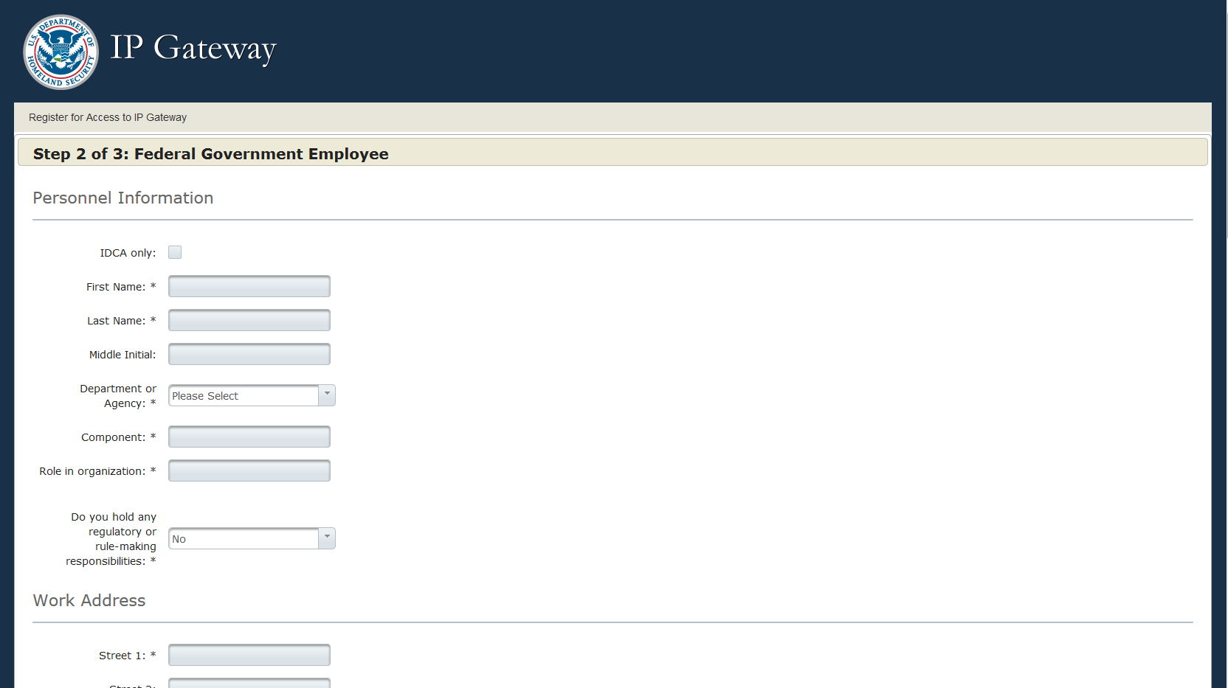
IP Gateway User Registration Step 2 Federal Employee

Slide 4
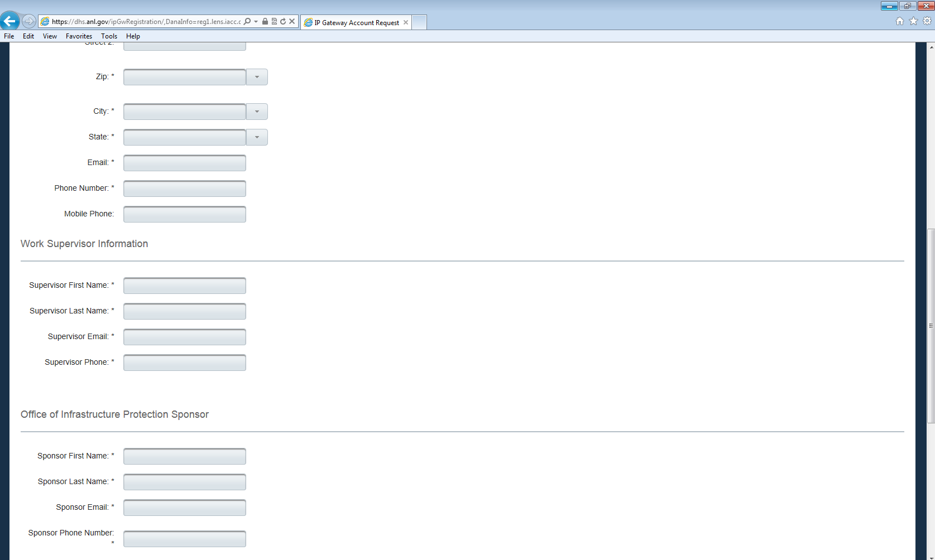
IP Gateway User Registration Step 2 Federal Employee Continued

Slide 5
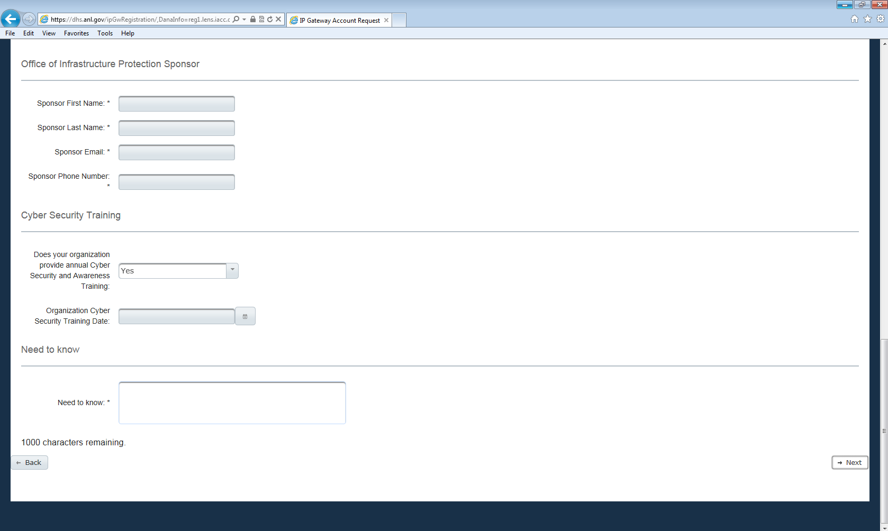
IP Gateway User Registration Step 2 Federal Employee Continued

Slide 6
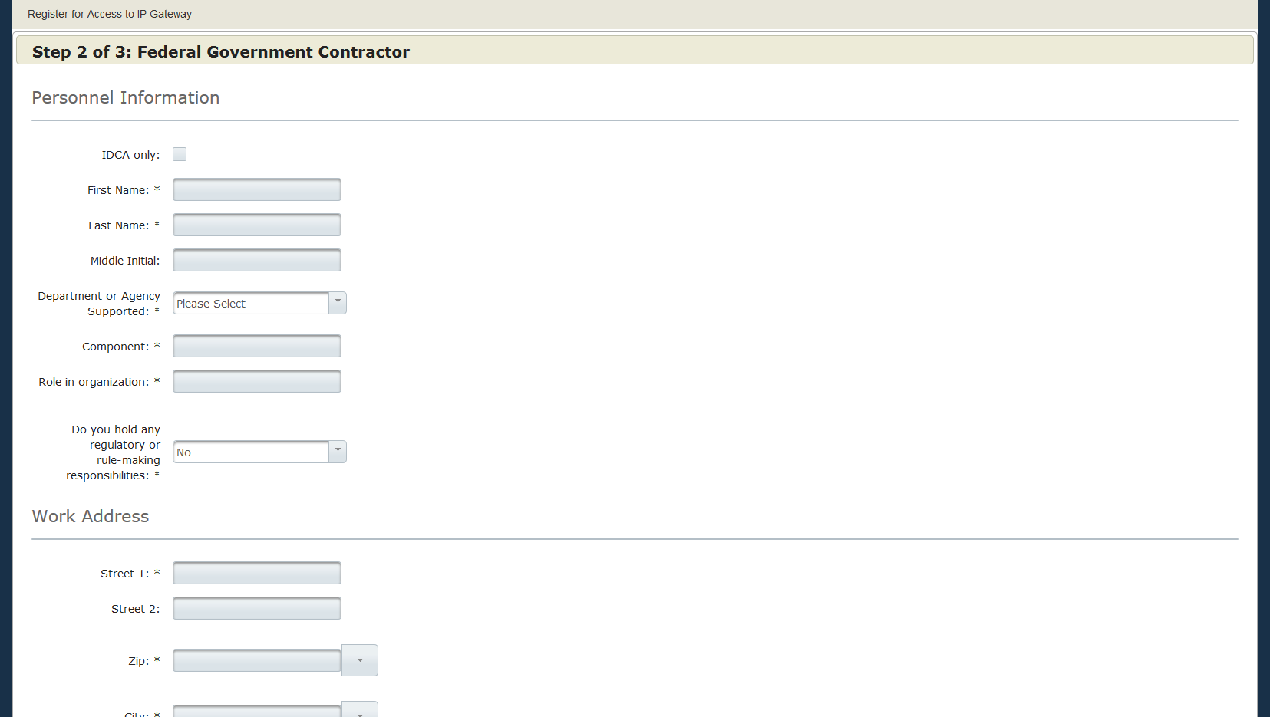
IP Gateway User Registration Step 2 Federal Government Contractor

Slide 7
IP Gateway User Registration Step 2 Federal Government Contractor Continued

Slide 8
IP Gateway User Registration Step 2 Federal Government Contractor Continued

Slide 9
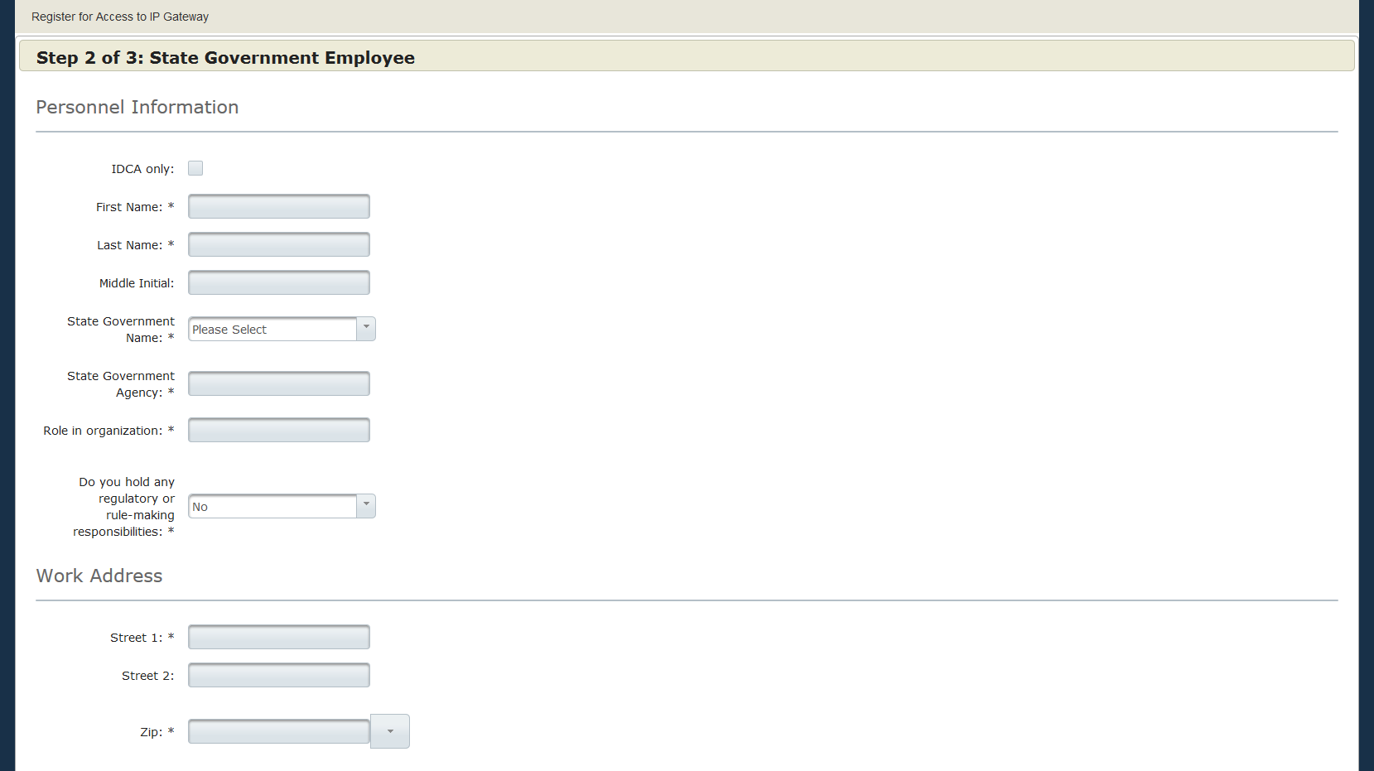
IP Gateway User Registration Step 2 State Government Employee

Slide 10
IP Gateway User Registration Step 2 State Government Employee Continued

Slide 11
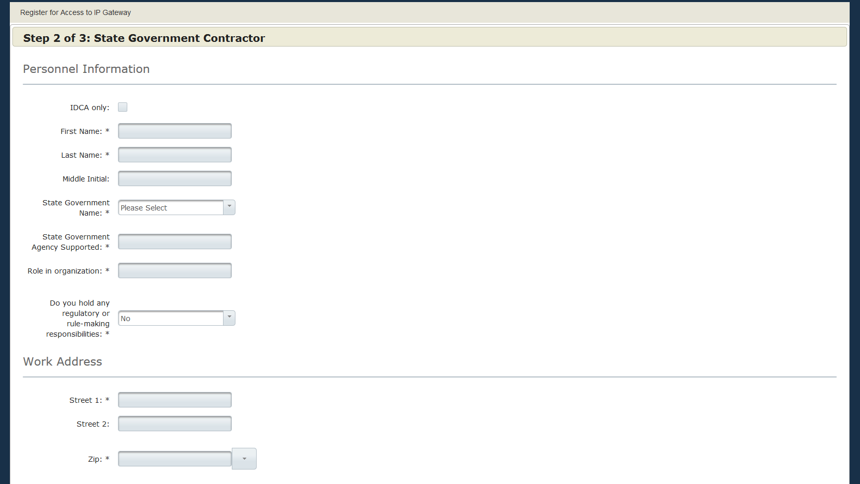
IP Gateway User Registration Step 2 State Contractor

Slide 12
IP Gateway User Registration Step 2 State Contractor Continued

Slide 13
IP Gateway User Registration Step 2 State Contractor Continued

Slide 14
IP Gateway User Registration Step 2 Local Government Employee

Slide 15
IP Gateway User Registration Step 2 Local Government Employee

Slide 16
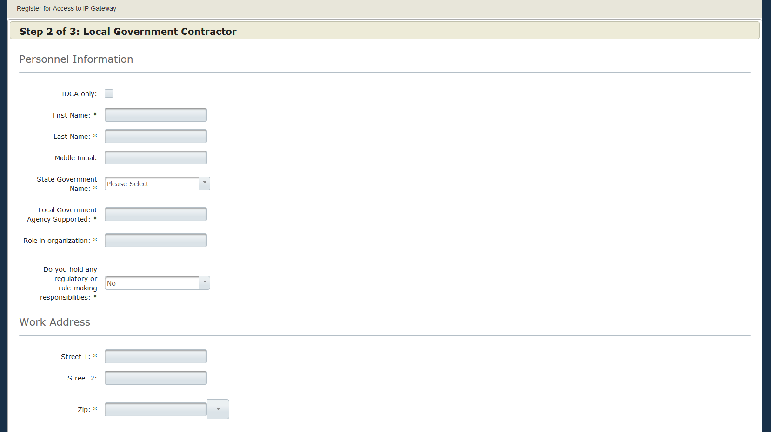
IP Gateway User Registration Step 2 Local Government Contractor

Slide 17
IP Gateway User Registration Step 2 Local Government Contractor Continued

Slide 18
IP Gateway User Registration Step 2 Local Government Contractor Continued

Slide 19
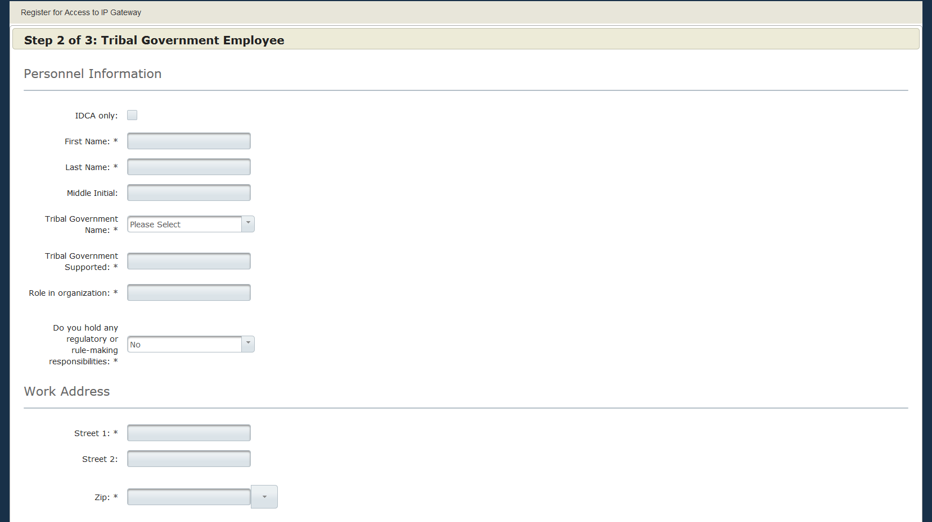
IP Gateway User Registration Step 2 Tribal Government Employee

Slide 20
IP Gateway User Registration Step 2 Tribal Government Employee Continued

Slide 21
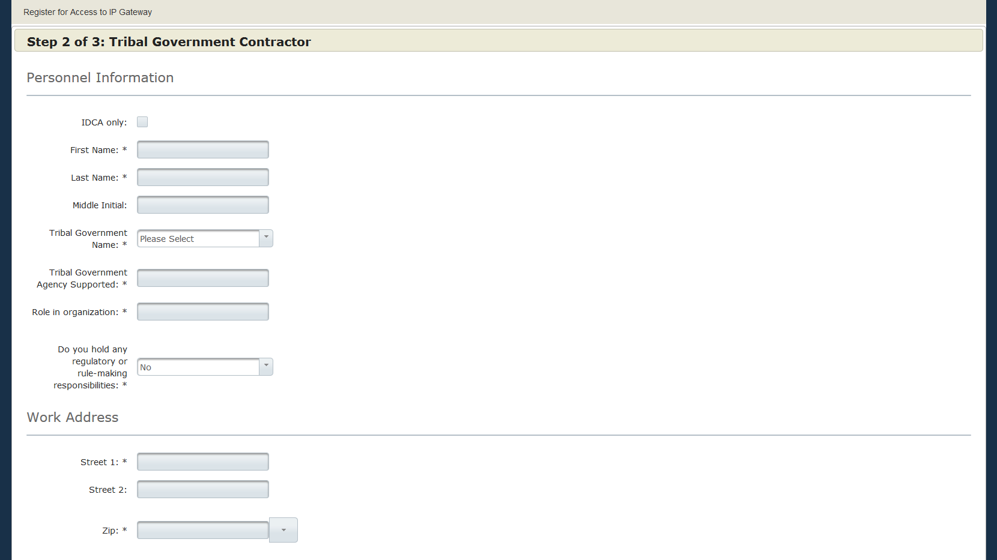
IP Gateway User Registration Step 2 Tribal Government Contractor

Slide 22
IP Gateway User Registration Step 2 Tribal Government Contractor Continued

Slide 23
IP Gateway User Registration Step 2 Tribal Government Contractor Continued

Slide 24
IP Gateway User Registration Step 3

