Slide 1
Gainful Employment Focus Group Sample Templates

Slide 2
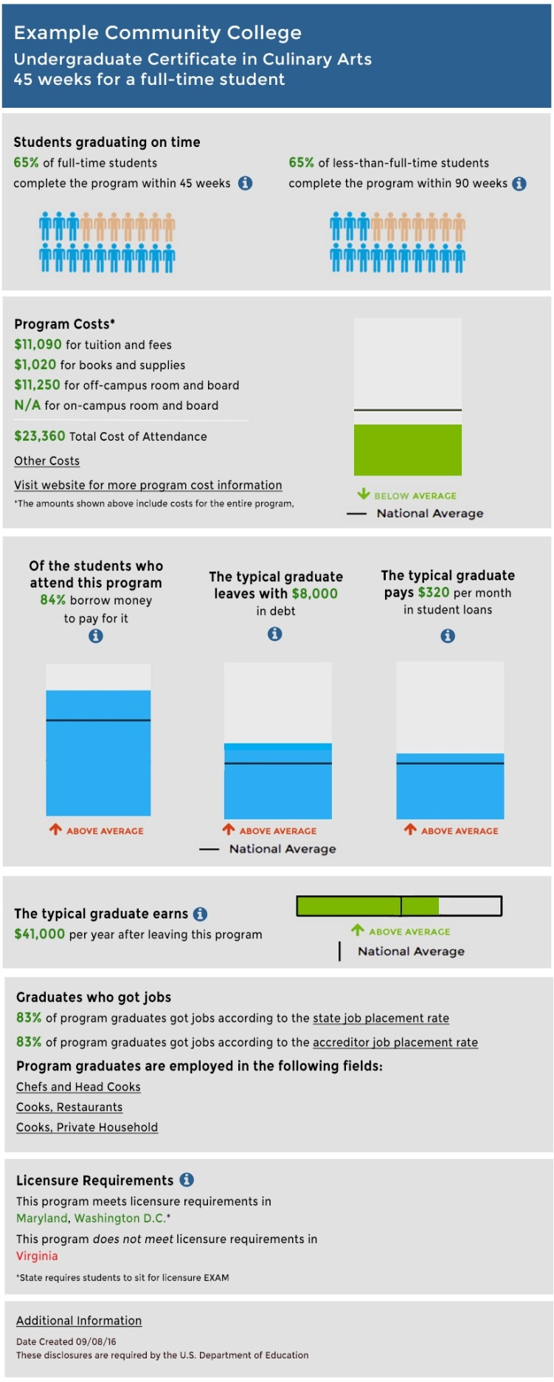
Example Template

Slide 3
Students Graduating on Time

Slide 4
Students Graduating on Time

Slide 5
Students Graduating on Time

Slide 6
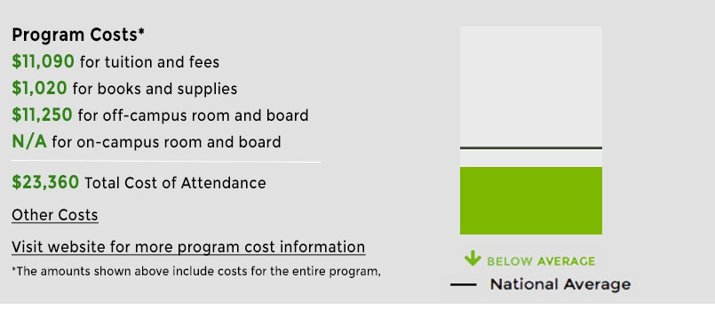
Program Costs

Slide 7
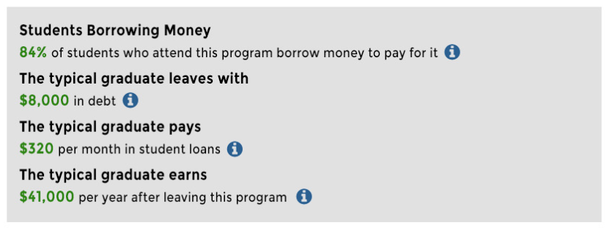
Debt and Borrowing

Slide 8
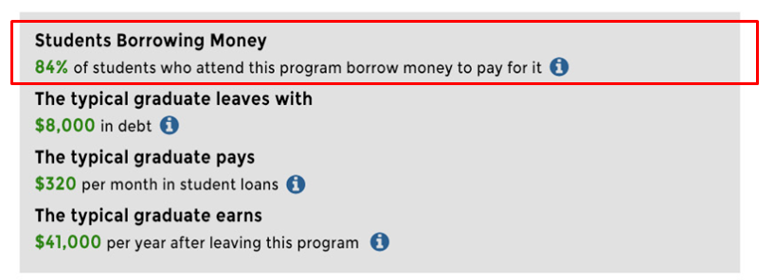
Debt and Borrowing

Slide 9
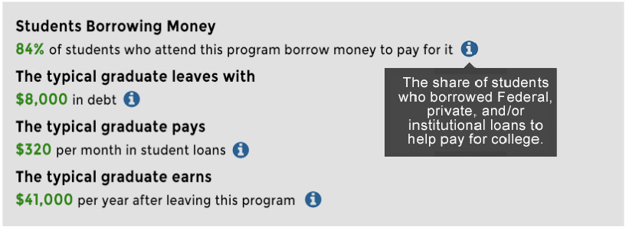
Debt and Borrowing

Slide 10
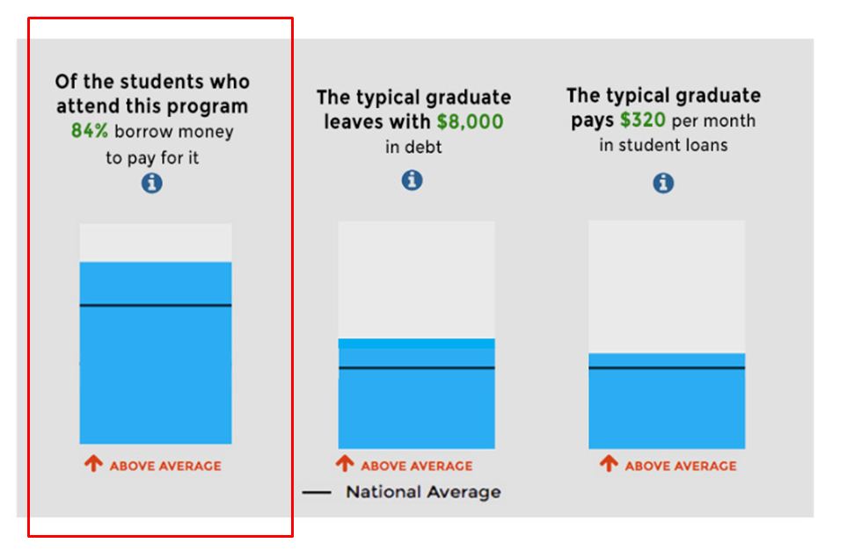
Debt and Borrowing

Slide 11
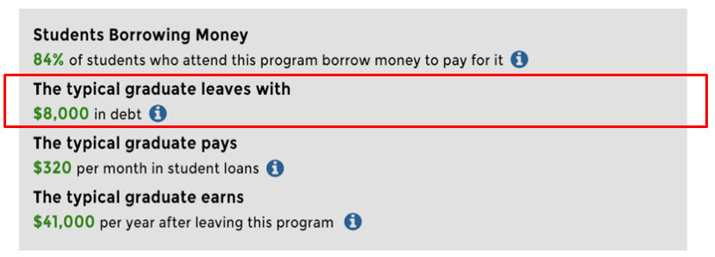
Debt and Borrowing

Slide 12
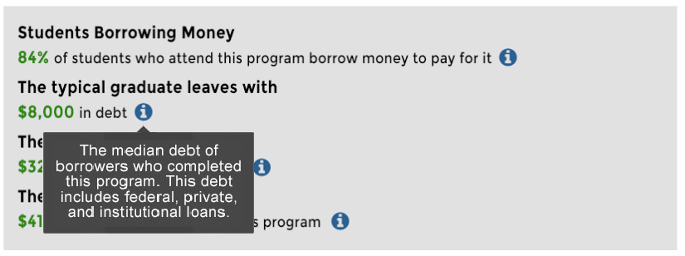
Debt and Borrowing

Slide 13
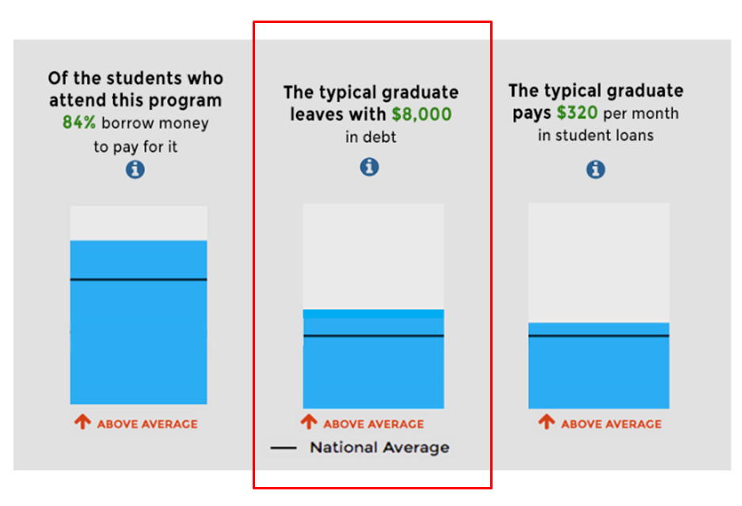
Debt and Borrowing

Slide 14
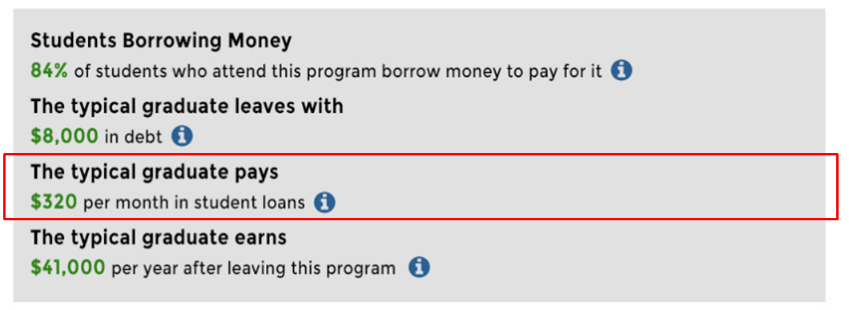
Debt and Borrowing

Slide 15
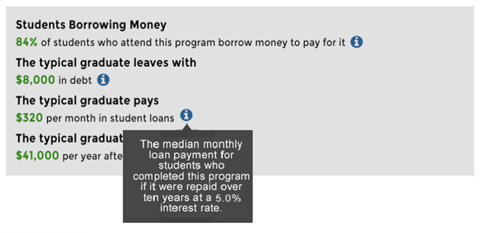
Debt and Borrowing

Slide 16
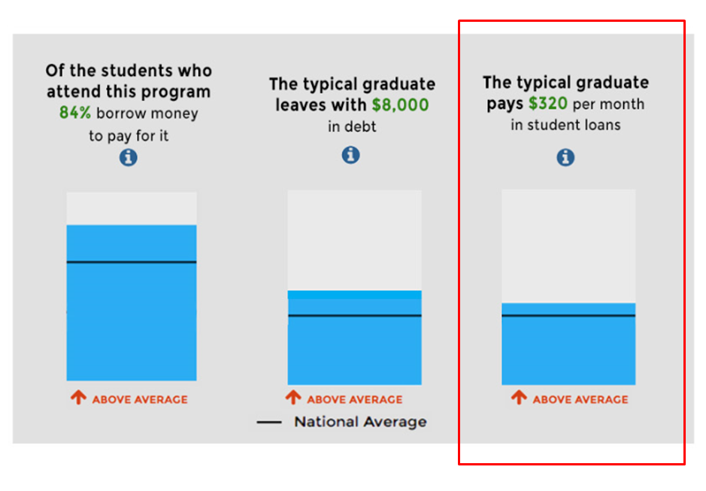
Debt and Borrowing

Slide 17
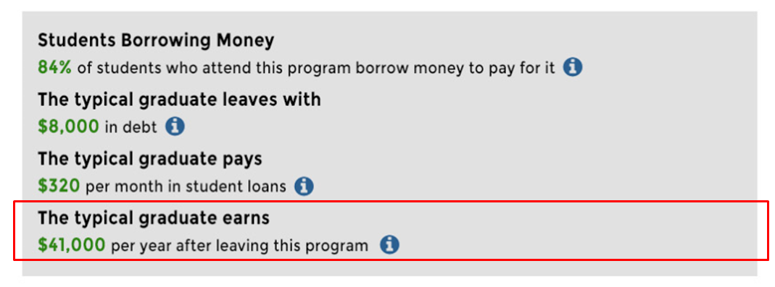
Debt and Borrowing

Slide 18
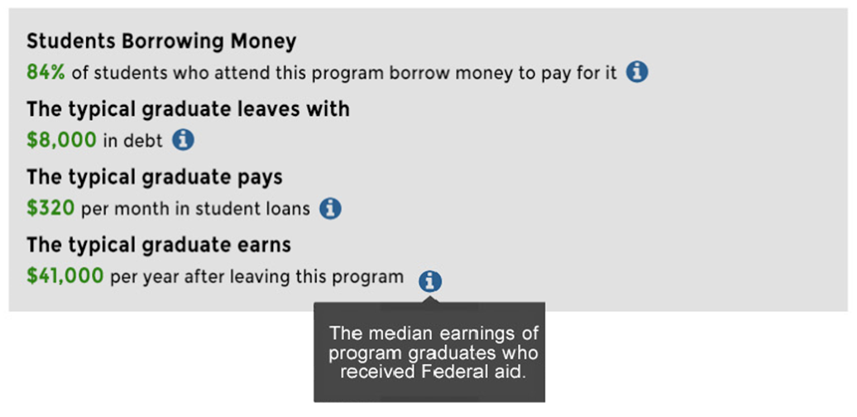
Debt and Borrowing

Slide 19
Debt and Borrowing

Slide 20
Licensure Requirements

Slide 21
Licensure Requirements

Slide 22
Loan Repayment Rate
1

Slide 23
Loan Repayment Rate
2

Slide 24
Loan Repayment Rate
3

Slide 25
Loan Repayment Rate
4

Slide 26
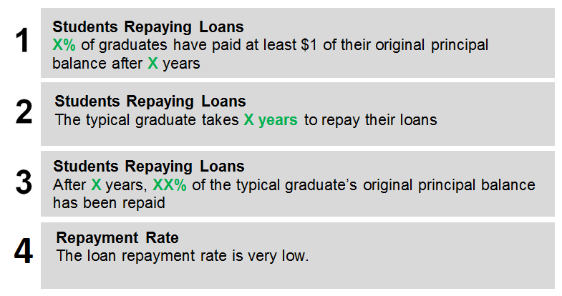
Loan Repayment Rate

Slide 27
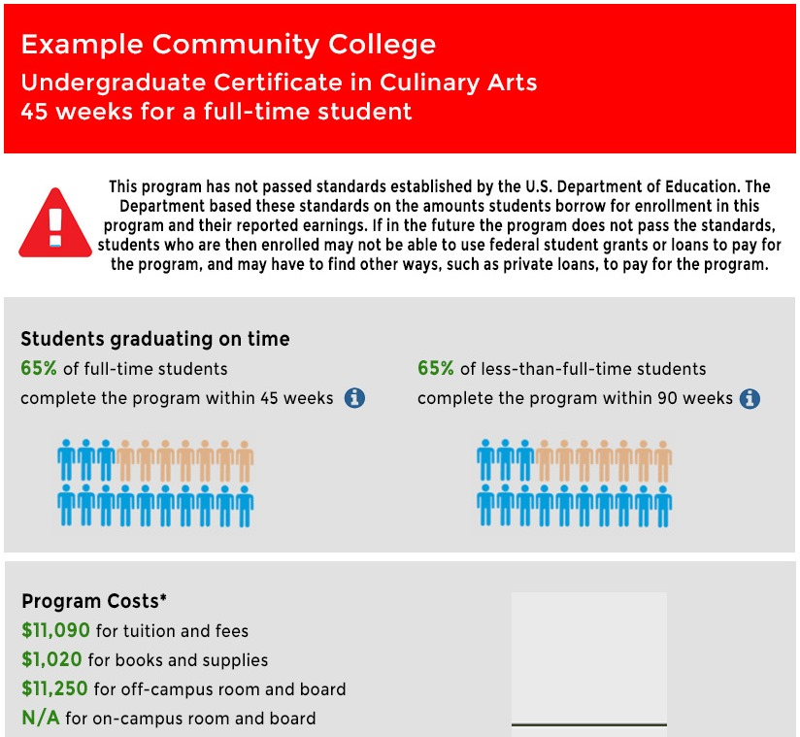
Additional Header Language

Slide 28
Additional Header Language

Slide 29
Additional Header Language

Slide 30
Additional Header Language
Version #2
Version #3

Slide 31
Additional Header Language
Version #1
Version #2
Version #3

Slide 32
Example Template

