Slide 1
Notes:
What does this question mean in your own words.
How did you come up with your answer?
Y: Describe the orientation program.

Slide 2
Notes:
What does this question mean in your own words.
(If needed) what is a preceptor.

Slide 3
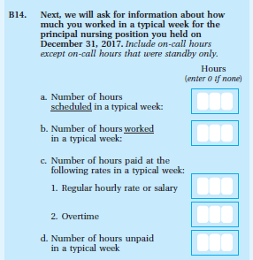
Notes:
Tell me how you answered this question. Review their answers for each question.
(If needed), did you work any on-call hours?
Y: Did you include those in your answer; were any of those standby only? Why did you include/exclude those hours?
N: Go to next screen

Slide 4
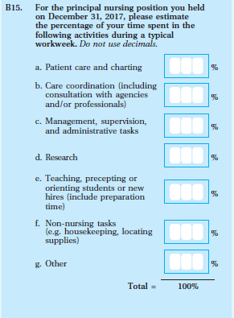
Notes:
Do you have any comments on this screen?
Tell me more about how you came up with your answer.
If they entered something for c: Tell me more about what types of tasks you were thinking about when you answered x for number c.

Slide 5
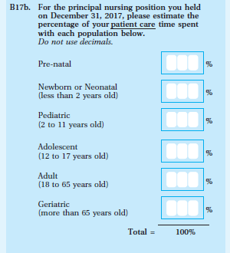
Notes:
Do you have any comments on this question or on the response choices?
Do the ages match your understanding of the definition for these groups?

Slide 6
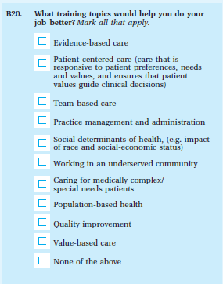
Notes:
Please read through the training topics.
You selected x, y, z (if applicable)
Do you have any comments on the training topics listed?
Are any training topics missing?

Slide 7
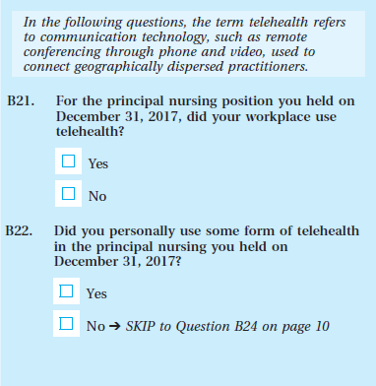
Notes:
Please reread the instruction text in italics print. Have you ever heard of the term telehealth before today? Do you have any comments about the instruction?
What were you thinking about as you answered the two questions about telehealth?

Slide 8
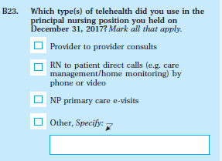
Notes:
What does this question mean in your own words.
(If needed) what is telehealth.

Slide 9
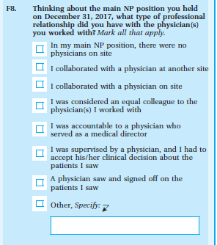
Notes:
Tell us more about what you were thinking as you answered this question.
Was any part of the question or any of the response categories confusing?
(If so) what was confusing?

Slide 10
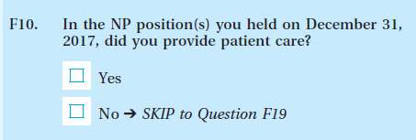
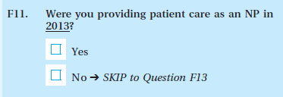
Notes:
There were two questions about patient care.
Tell us more about what you were thinking as you answered these questions. We will start with F10.

Slide 11
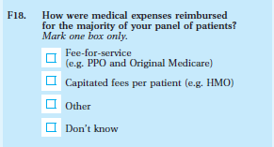
Notes:
Tell us more about what you were thinking as you answered this question.
(if necessary) What type of reimbursement types were you thinking about as you answered this question.
For the first response option, what type of fee for service were you thinking about.
(If they only mention PPO and Original Medicare): do you think we are only interested in those 2 types of fee for service or are we interested in others as well.
How about for capitated fees. What were you thinking about.
(If they only mentioned HMO). do you think we are only interested in that type of reimbursement or are we interested in others as well

