Slide 1
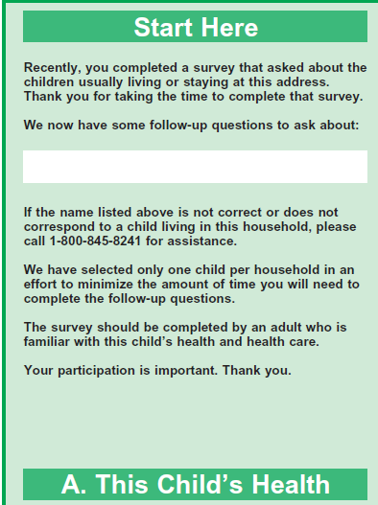
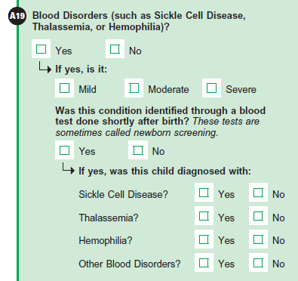
Notes:
T1, T2, T3: Tell me more about how you answered these questions.

Slide 2
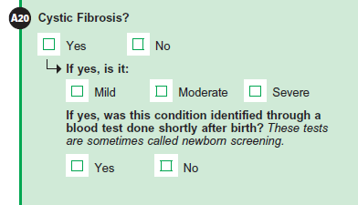
Notes:
T1, T2, T3: Tell me more about how you answered these questions.

Slide 3
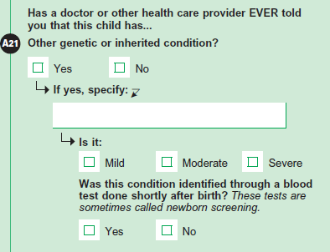
Notes:
T1, T2, T3: Tell me more about how you answered these questions.

Slide 4
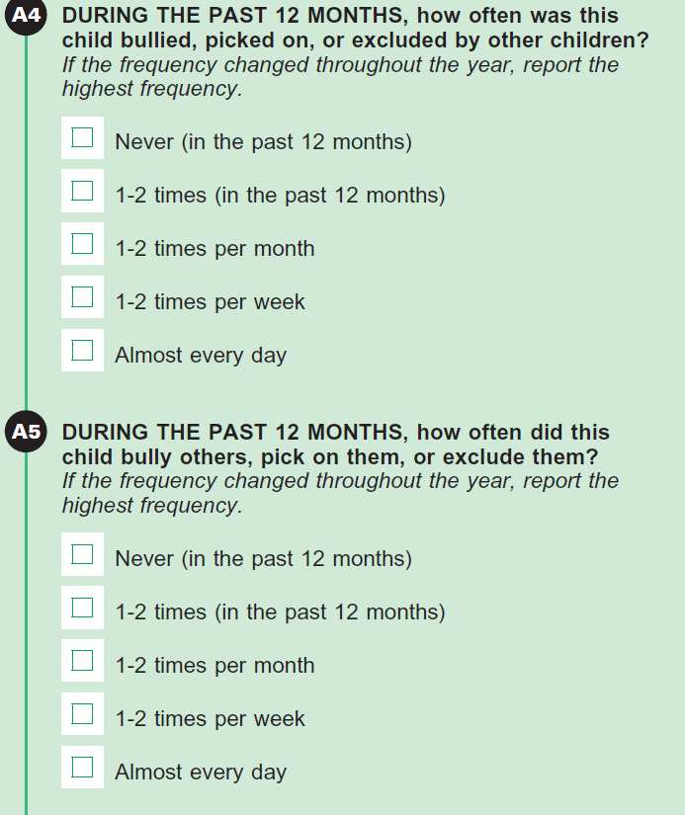
Notes:
T2 and T3 only: Tell me more about how you answered these questions.

Slide 5
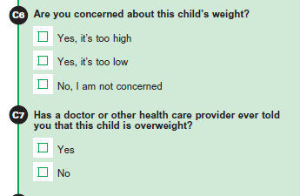
Notes:
Tell me more about how you answered these questions.
T1-T3
C6 is not a new question, but C7 is. We will show both screens and note what they say in relation to both these questions.
(one option for C7 would have been to ask only of C6 = Yes, it's too high, the decision was to ask of everyone to cover instances where maybe a doctor said the child is overweight but the respondent is not concerned - would want to measure how often this occurs... Will be interesting to hear any feedback participants may offer on this item.)

Slide 6
Notes:
Tell me more about how you answered this question.
T1 (C30)
T3 (C29)
T2 (C28)

Slide 7
Notes:
This was on #3 only.
Tell me more about how you answered this question.

Slide 8
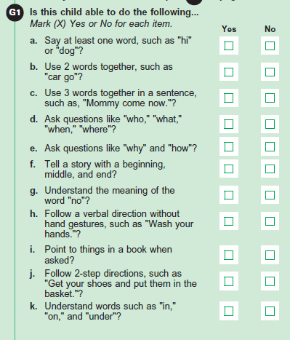
Notes:
T1 only: Tell me more about how you answered this question.

Slide 9
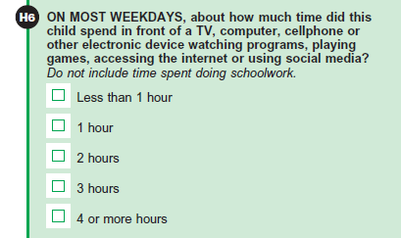
Notes:
T2 and T3 only: Tell me more about how you answered this question.
What types of activities did you include and how much time does your child spend on each of those activities?
Did you include time doing schoolwork in your estimate?
About how much time is spent doing schoolwork electronically during a weekday?
Was it easy or difficult to separate out doing schoolwork from other electronic activities? Why? Tell me more (if needed)

Slide 10
Notes:
T3: Tell me more about how you answered this question.

Slide 11
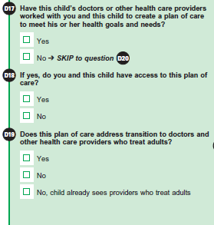
Notes:
T3: Tell me more about how you answered these questions.
If necessary,
On the first question, what does creating a plan of care mean to you?
What does the middle question mean to you?
What does the last question mean to you?

