Slide 1
WELCOME
Why should I respond?
The information you provide will help determine the content and design of the 2020 Census
It’s safe, secure and confidential. Your information and privacy are protected.
It’s quick and easy. This survey will take about 10 minutes to complete.
What to expect?
The U.S. Census Bureau asks general questions about the household, including how many people live in the house and if the home is owned or rented.
For each person living in the household, we also ask for the name, relationship to the householder, sex, age/date of birth, race and ethnicity and whether or not the person sometimes lives or stays somewhere else.
The U.S. Census Bureau is researching modern and cost-efficient methods for the population to exercise its civic obligation to be counted in the 2020 Census.
Whether through the internet, telephone, traditional paper questionnaires, or in-person visits, the Census Bureau is committed to making the mandatory once-a-decade headcount quick, easy, and safe for all to participate.
[Start Questionnaire]
Notes:
Do you have any comments on this screen?
(POINT TO THE MIDDLE SECTION: Why should I respond?/What to expect?) Did you read these paragraphs on this screen? Y/N
If Y: What did you think this message is about?
If N: Please take a moment and read it now. What do you think this message is about?

Slide 2
CAPTCHA
Check the box below to enter the survey.
<reCAPTCHA>
[Submit] [Cancel]
Notes:
If there were issues with CAPTCHA button: Tell me about your experience with this screen.

Slide 3
LOGIN
You will need the materials we mailed to you in order to start. All the information that you provide will remain confidential.
Please Log In Please enter the 12-digit USER ID found in the materials we mailed to you. User ID: _____ - _____ - ____ [Login button] If you do not have a USER ID, click here.
<Image of User IDlocation>
Where can I find my 12-digit USER ID?
In the enclosed LETTER, click here
On the front of the QUESTIONNAIRE, click here
Below the barcode on the POSTCARD, click here
Notes:
Do you have any comments on this screen?
(ID) If there were issues with entering User ID:
Tell me about your experience with this screen.
(NON-ID) Please tell me about your experience with this screen.

Slide 4
LOGIN
You will need the materials we mailed to you in order to start. All the information that you provide will remain confidential.
Please Log In Please enter the 12-digit USER ID found in the materials we mailed to you. User ID: _____ - _____ - ____ [Login button] If you do not have a USER ID, click here.
<Image of User IDlocation>
Where can I find my 12-digit USER ID?
In the enclosed LETTER, click here
On the front of the QUESTIONNAIRE, click here
Below the barcode on the POSTCARD, click here
Notes:
Did you see the English button at the top?
Do you have any comments on this?
Was it easy to find [TARGET] language? Why or why not?

Slide 5
LOGIN
You will need the materials we mailed to you in order to start. All the information that you provide will remain confidential.
Please Log In Please enter the 12-digit USER ID found in the materials we mailed to you. User ID: _____ - _____ - ____ [Login button] If you do not have a USER ID, click here.
<Image of User IDlocation>
Where can I find my 12-digit USER ID?
In the enclosed LETTER, click here
On the front of the QUESTIONNAIRE, click here
Below the barcode on the POSTCARD, click here
Login failed. Please try again.
Your account has been temporarily locked. You will be able to access the survey in 30 minutes.
Notes:
[OPTIONAL: POINT TO THE EDIT TEXT BOXES] What would you do if you encountered this screen?
(ID) CONTINUE TO #6, <CONFIRM>
(NON-ID) SKIP TO #8 , <RESIDENCE>

Slide 6
CONFIRM
Are you completing the 2018 Census Test for the address below? (Help)
<FULL ADDRESS>
• Yes • No
Notes:
[ID ONLY] Do you have any comments on this screen?

Slide 7
VERIFY_ADDRESS
On <REFDATE>, will you be living or staying at <ADDRESS>? (Help)
● Yes
● No
Notes:
[ID ONLY] Do you have any comments on this screen?
SKIP TO #10 , <RR_ROUTE> & <RR_ADDRESS>

Slide 8
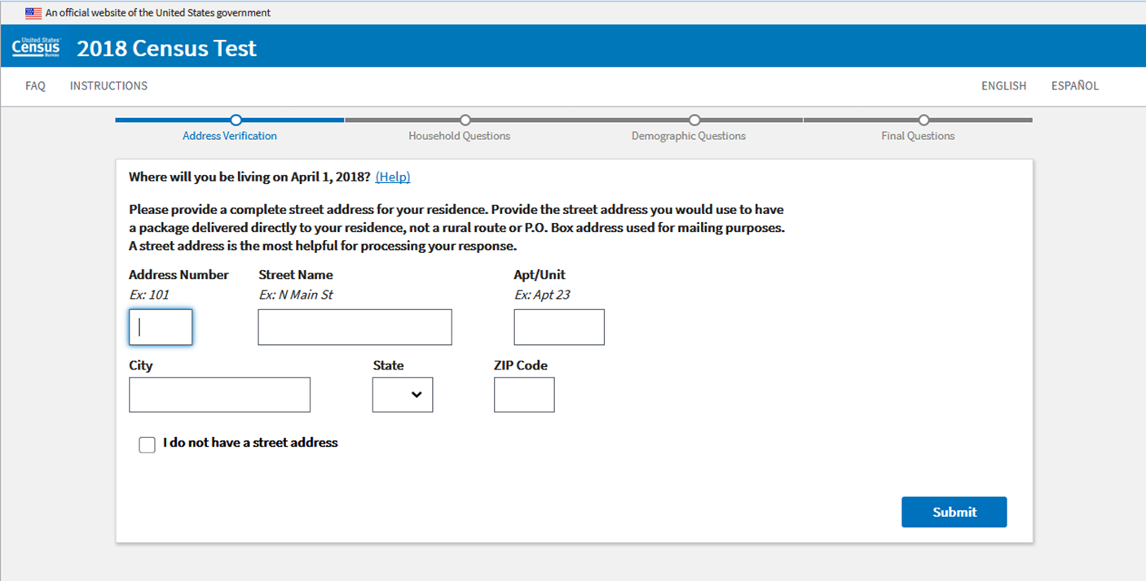
RESIDENCE
Notes:
[NON-ID ONLY]
Do you have any comments on this screen?
If you were write your own address, not the address on the Login Card, would you write your address in English or in <TARGET LANGUAGE>? Why or why not?
If R had any issues with filling out the address: Please tell me about your experience with this screen.

Slide 9
STAN_RESIDENCE
Please review your address
Here is the address you submitted using standard abbreviations and formatting. (help)
If the address is correct, select “Submit”. If you would like to make changes, select “Edit”.
<Full standardized address>
Please make the necessary changes in the fields below.
Notes:
[NON-ID ONLY]
Do you have any comments on this screen?
If R had any issues with filling out the address: Please tell me about your experience with this screen.

Slide 10
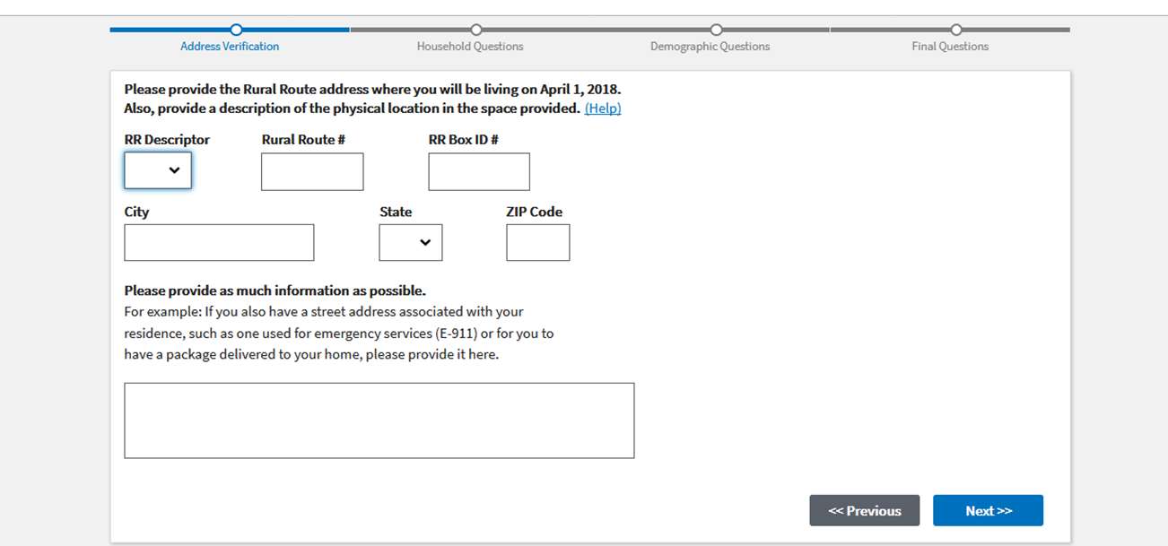
RURAL_ROUTE & RR_ADDRESS
Notes:
(ALL CASES)
You did not see these screens before but please take a look.
What do you think they mean by 'Rural Route‘ here?

Slide 11
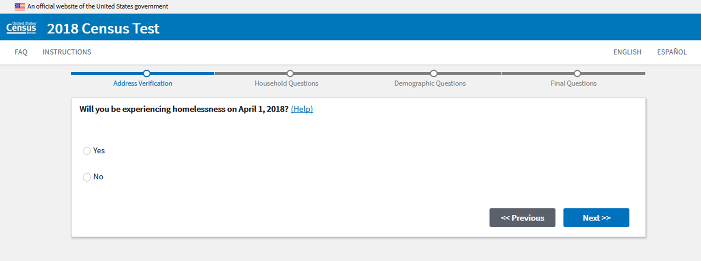
HOMELESS
Notes:
You did not see this screen before but please take a look. What are they asking here?
IF NEEDED: Can you give me an example?

Slide 12
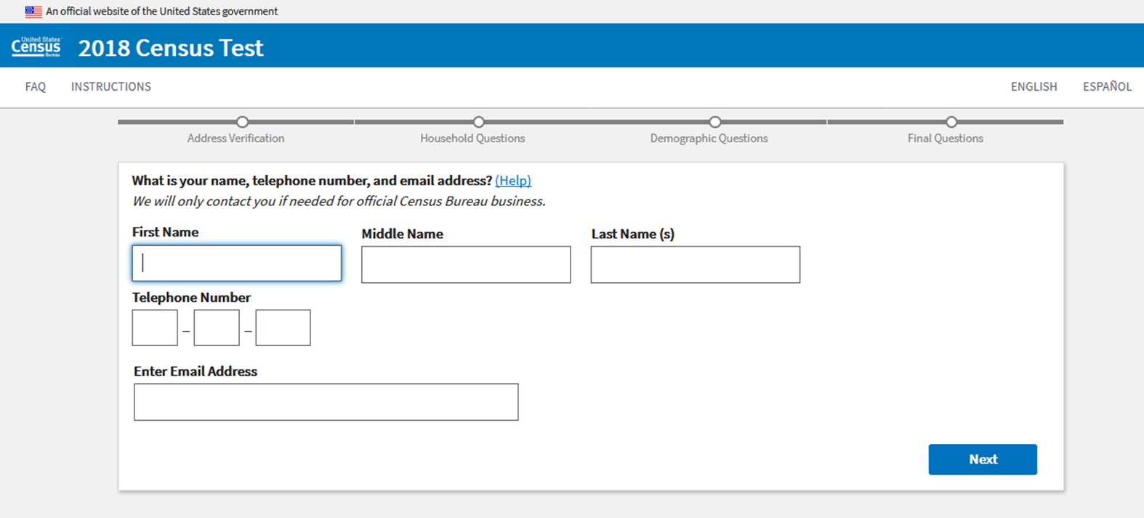
RESPONDENT
What is your name, phone number, and email address? We will only contact you if needed for official Census Bureau business. (Help)
Notes:
Do you have any comments on this screen?
If R provided the name in TARGET LANGUAGE (or using diacritics), instead of English:
Can you tell me how you decided to write your name in TARGET LANGUAGE?
(POINT TO INSTRUCTION, “We will only contact you…”)Did you read this instruction?
What does the instruction mean in your own words?
Is that the phone number most likely to reach you? (If no, probe more about why R didn’t give a phone # (s)he answers.)
Is that the email address you are most likely to check? (If no, probe more about why R didn’t give an email (s)he checks often.)

Slide 13
HOUSEHOLD DASHBOARD
Notes:
Do you have any comments on this screen?

Slide 14
POPCOUNT
Notes:
Do you have any comments on this screen?
If they added people later in the interview ask:
I believe you entered x people at this question, can you tell me a little more about why you did not include y or z at this question but you added them later?

Slide 15
POPCOUNT
Notes:
If R did not see this screen, say:
This is the screen that you would receive, if you click the “For more information…” link in the previous question.
To all Rs:
Do you have any comments on this screen?
Based on these instructions, where should college students be included?
(POINT TO <Why We Ask> paragraph) Did you read this paragraph at the bottom? Y/N
If yes: Tell me what you thought about this paragraph. Do you have any comments?
If no: Please take a moment to read this part now. Tell me what you thought about this. Do you have any comments?

Slide 16
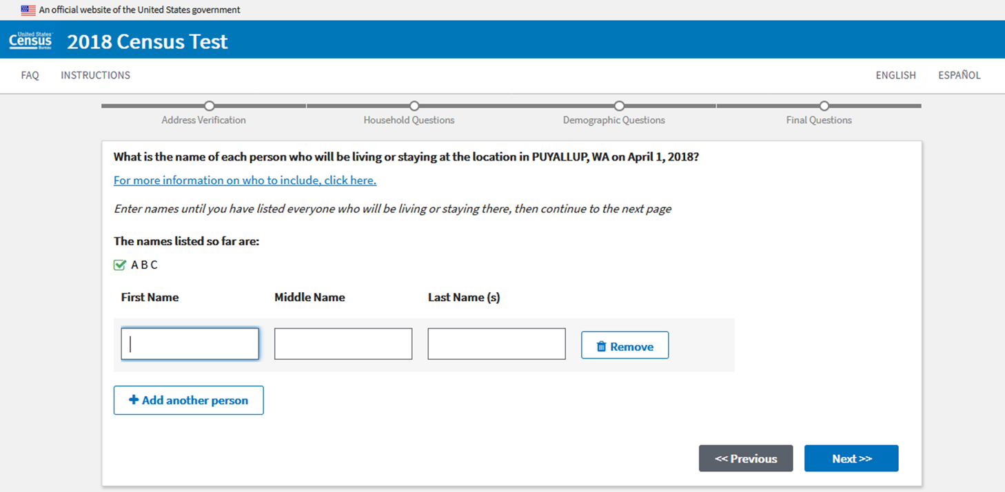
PEOPLE
Notes:
Do you have any comments on this screen?
(If R provided names in TARGET LANGUAGE)
Can you tell me how you decided to enter the names in [TARGET LANGAUGE]?
(Point to the instruction about providing names) Did you noticed this instruction when you were completing the survey?
If R had any issues with providing names: Please tell me about your experience with this screen.

Slide 17
UC (1)
Notes:
Do you have any comments on this screen?
If R had any issues: Please tell me about your experience with this screen.
[NEW LANGUAGES ONLY: TG, PL, FR, HC, PT, JP]
-What do you think they mean by 'foster children'?
-Can you give me an example of 'people without a permanent place to live'?
[IF NO SELECTED, SKIP TO #19; IF YES SELECTED, CONTINUE TO #18]

Slide 18
UC (2)
Notes:
(IF R SEE THIS SCREEN)
Do you have any comments on this screen?
If R had issues: Please tell me more about your experience with this screen.

Slide 19
HOME
Notes:
Tell me more about why you chose [their answer].
IF R=RENTER, CONTINUE TO #20
IF R=OWNER, SKIP TO #21

Slide 20
OWNER (rented)
Notes:
(RENTER ONLY) Probe only if there were issues. Such as “Do you have any comments on this screen?”
SKIP TO #22

Slide 21
OWNER (owned)
Notes:
(OWNER ONLY) Probe only if there were issues. Such as “Do you have any comments on this screen?”
CONTINUE TO #22

Slide 22
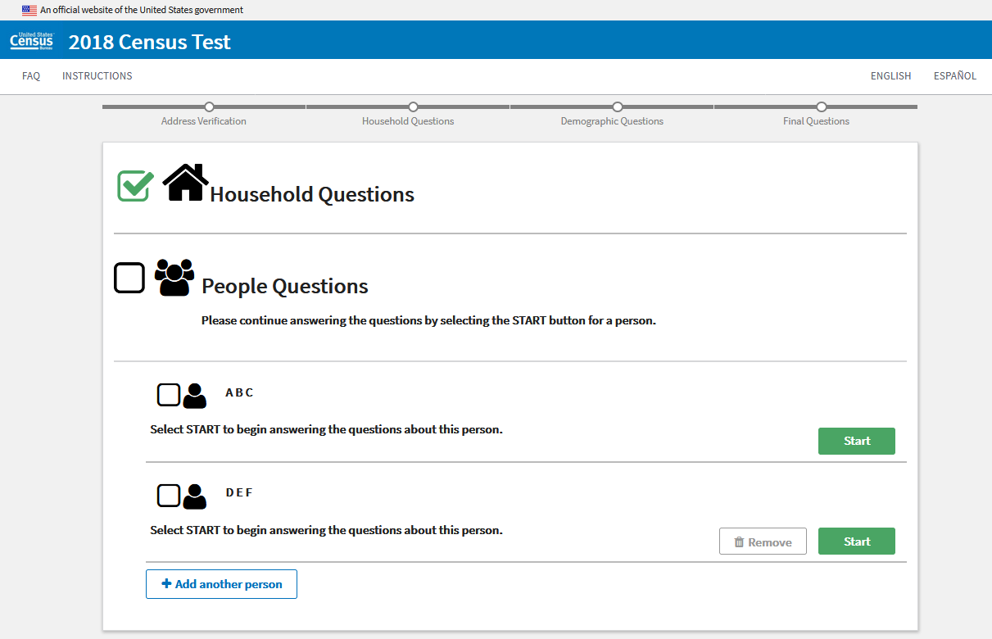
DEMOGRAPHIC DASHBOARD
Notes:
Do you have any comments on this screen?

Slide 23
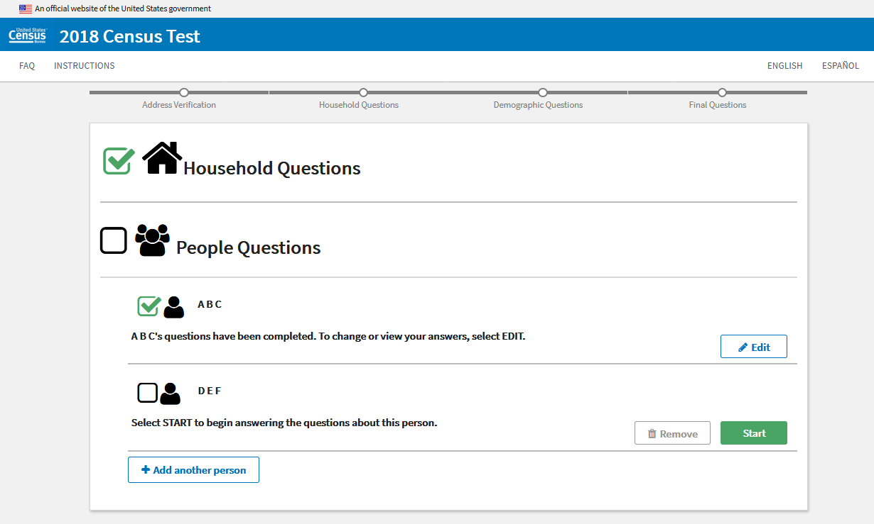
DEMOGRAPHIC DASHBOARD (Edit)
Notes:
Probe ONLY IF there were issues. Such as “Do you have any comments on this screen?”

Slide 24
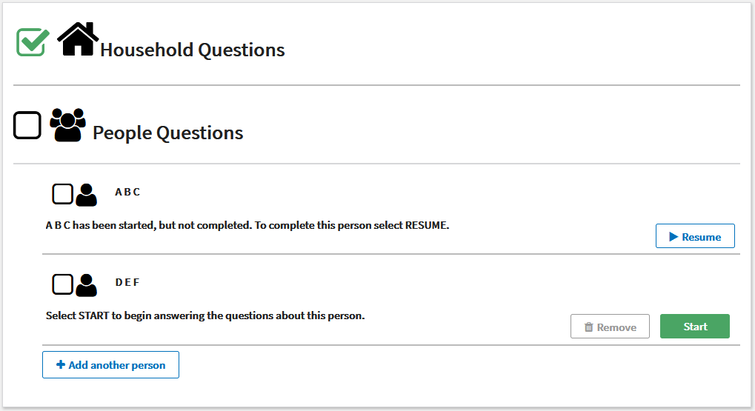
DEMOGRAPHIC DASHBOARD (Resume)
Notes:
Probe ONLY IF there were issues. Such as “Do you have any comments on this screen?”

Slide 25
ADD_PERSON
Notes:
Probe ONLY IF there were issues. Such as “Do you have any comments on this screen?”

Slide 26
REALATIONSHIP
Notes:
Do you have any comments on this screen?
Did you have any difficulty finding the correct relationship?
[NEW LANGUAGES ONLY: TG, PL, FR, HC, PT, JP]
-Please read through these response options.
Is there anything that is unclear to you? What is it? What do you think it means?
-(If not mentioned by R) What do you think they mean by ‘unmarried partner’? Does the translation sound natural in [TARGET LANGUAGE]?
What about “roommate or housemate”?

Slide 27
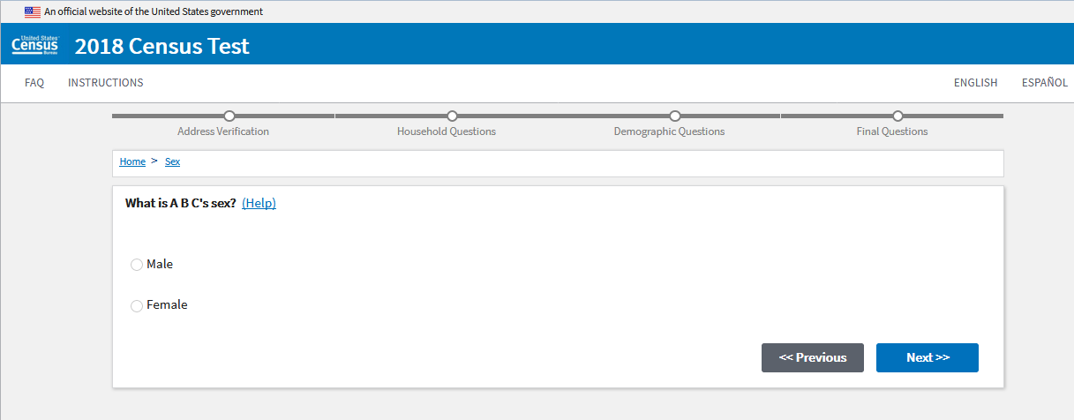
SEX
Notes:
Probe if there were any issues

Slide 28
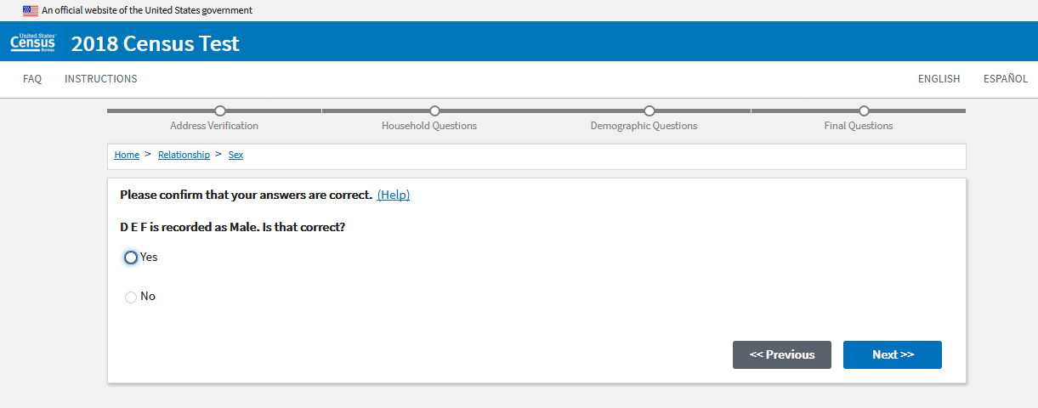
SEXRELEDIT (PTRSEXCONFIRM)
Notes:
[ONLY IF R SAW THIS SCREEN]
Do you have any comments on this screen?
If there were issues: Please tell me about your experience with this screen.

Slide 29
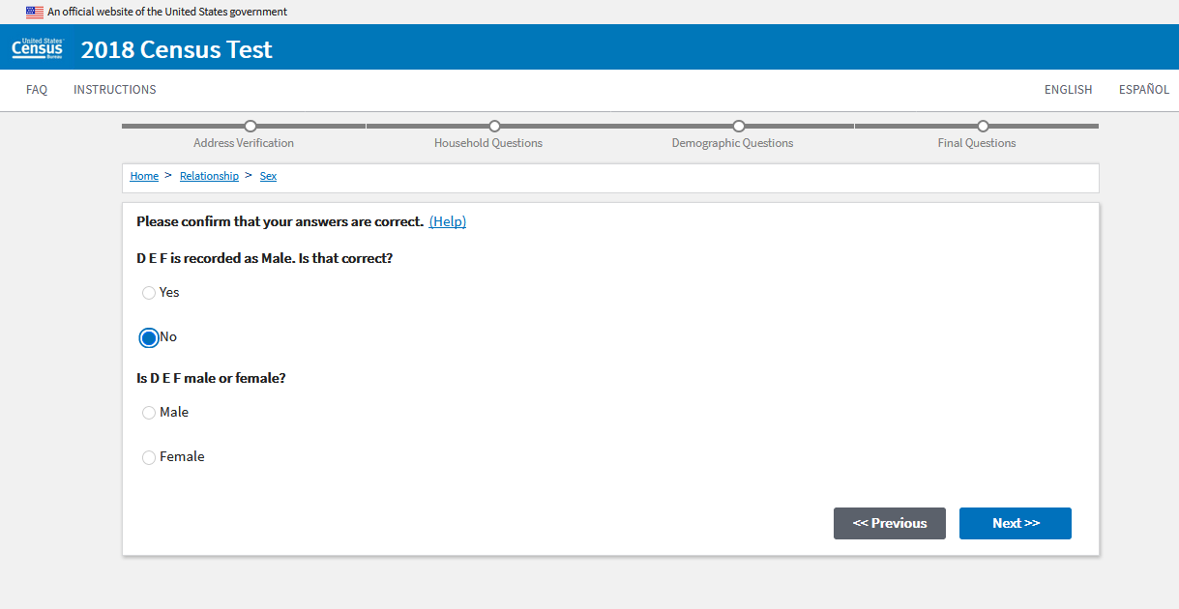
SEXRELEDIT (PTRSEX2)
Notes:
[ONLY IF R SAW THIS SCREEN]
Do you have any comments on this screen?
If there were issues: Please tell me about your experience with this screen.

Slide 30
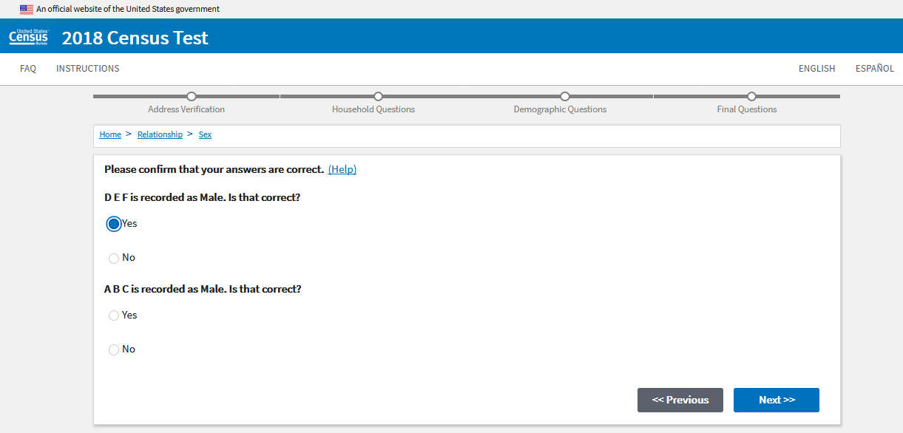
SEXRELEDIT (REFSEXCONFIRM)
Notes:
[ONLY IF R SAW THIS SCREEN]
Do you have any comments on this screen?
If there were issues: Please tell me about your experience with this screen.

Slide 31
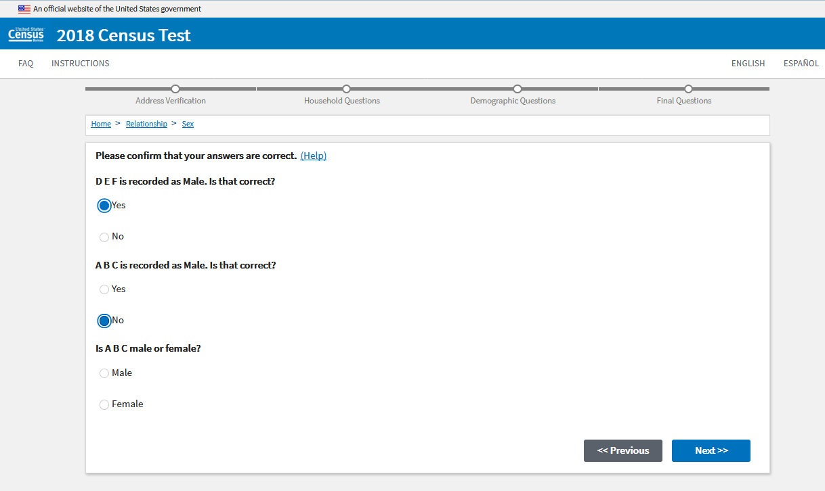
SEXRELEDIT (REFSEX2)
Notes:
[ONLY IF R SAW THIS SCREEN]
Do you have any comments on this screen?
If there were issues: Please tell me about your experience with this screen.

Slide 32
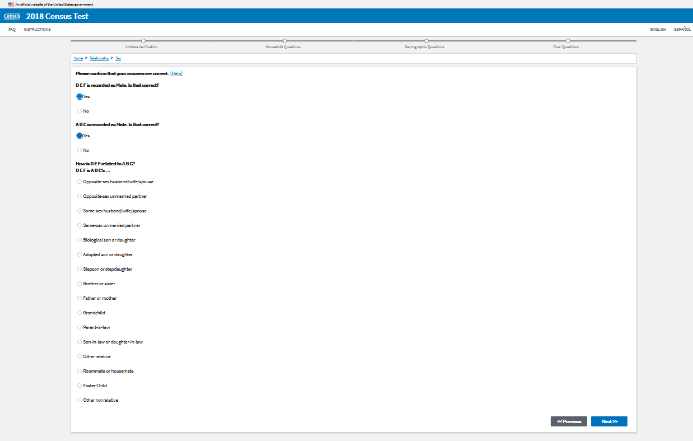
SEXRELEDIT (RELATION2)
Notes:
[ONLY IF R SAW THIS SCREEN]
Do you have any comments on this screen?
If there were issues: Please tell me about your experience with this screen.

Slide 33
DOB
Notes:
Were there any household members whose age you didn’t know?
If so, what did you do? (Fill in what you knew? Leave the question blank? Making something up?)
Probe only if there were issues. Such as “Do you have any comments on this screen?”

Slide 34
HISP
Notes:
Please take a look at this screen.
Do you have any comments on the instructions, the question or answer options?
What word would you use to describe these choices?

Slide 35
RACE
Notes:
Please take a look at this screen.
Do you have any comments on the instructions, the question or answer options?
What word would you use to describe these choices?
If someone identifies with more than one of these options, could they choose as many as apply to them one or could they just choose one?

Slide 36
Placeholder for New Citizenship Screen
Is this person a citizen of the United States?
Yes, born in the United States
Yes, born in Puerto Rico, Guam, the U.S. Virgin Islands, or Northern Marianas
Yes, born abroad of U.S. citizen parent or parents
Yes, U.S. citizen by naturalization
Year of naturalization ____
No, not a U.S. citizen

Slide 37
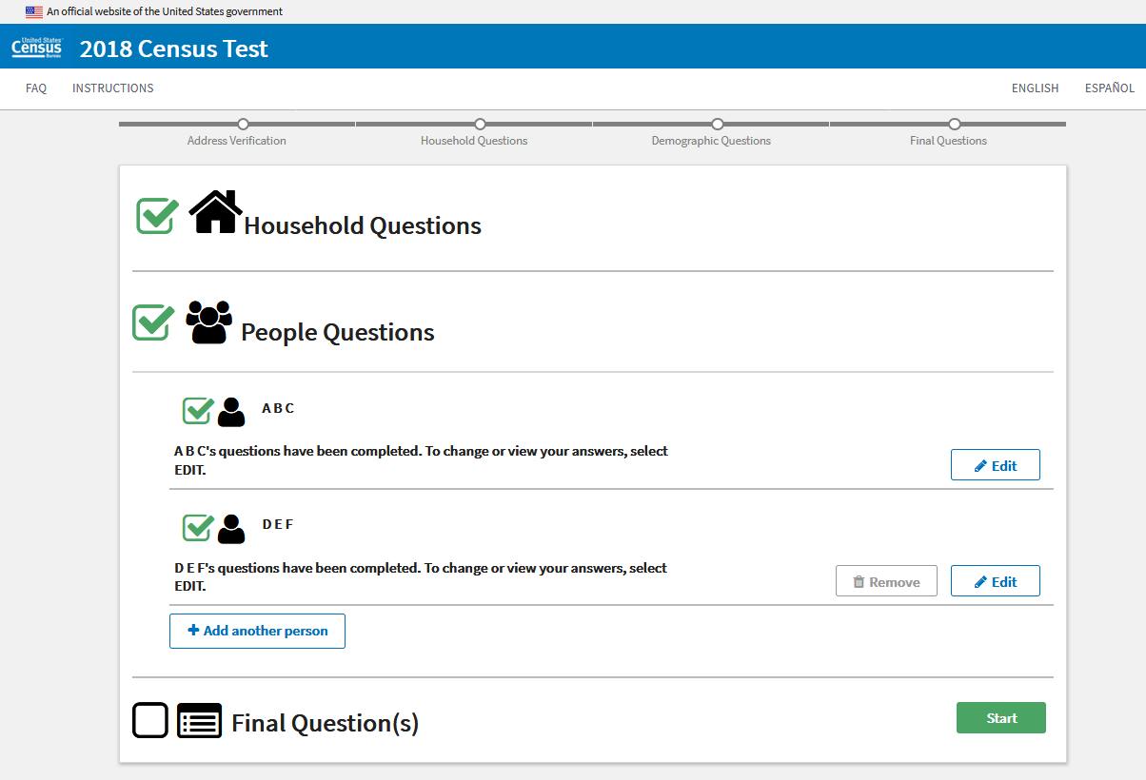
DASHBOARD Final Questions
Notes:
Do you have any comments about this screen?
If there were any issues: Please tell me your experience with this screen.

Slide 38
OC
Notes:
Probe only if there were issues. Such as “Do you have any comments on this screen?”
What time period were you thinking of when you answered this question.
Verify or probe that they do not have any other address where they could be counted.
[NEW LANGUAGES ONLY: TG, PL, FR, HC, PT, JP]
-What does “nursing home” mean to you in this question?
-What do you think they mean here by 'at a seasonal or second residence'? Can you give me an example?

Slide 39
OC_HH
Notes:
If R received this screen, “Do you have any comments on this screen?”

Slide 40
OC_P
Notes:
If R received this screen, “Do you have any comments on this screen?”

Slide 41
SUBMIT
Notes:
Probe only if there was an issue:
Do you have any comments on this screen?

Slide 42
DASHBOARD (SUBMIT)
Notes:
“Do you have any comments on this screen?”

Slide 43
CONFIRMATION
Notes:
“Do you have any comments on this screen?”

Slide 44
INITIAL LETTER
Show the lead letter
Notes:
[For ID path] This is the letter that you used to log in to this survey at the beginning.
[For Non ID path] The Census Bureau usually sends out a letter like this to each household to ask for participation.
Please take a moment to look over this letter. What was your first impression of this letter? If you received a letter like this at home by mail, do you think you would type the internet address and the User ID to access the survey? Why or why not?
What about other [TARGET LANGUAGE] speakers? Would they try to log in the survey to participate in the 2020 Census by reading this letter? Why or why not?
The initial letter from the Census Bureau will be only in English as you see. Is there any way to make this easier for [TARGET LANGUAGE] speakers to participate in the Census using this letter? How can we improve this letter?

