Slide 1
Electronic System for Travel Authorization (ESTA)
U.S. Customs and Border Protection
February 2016

Slide 2
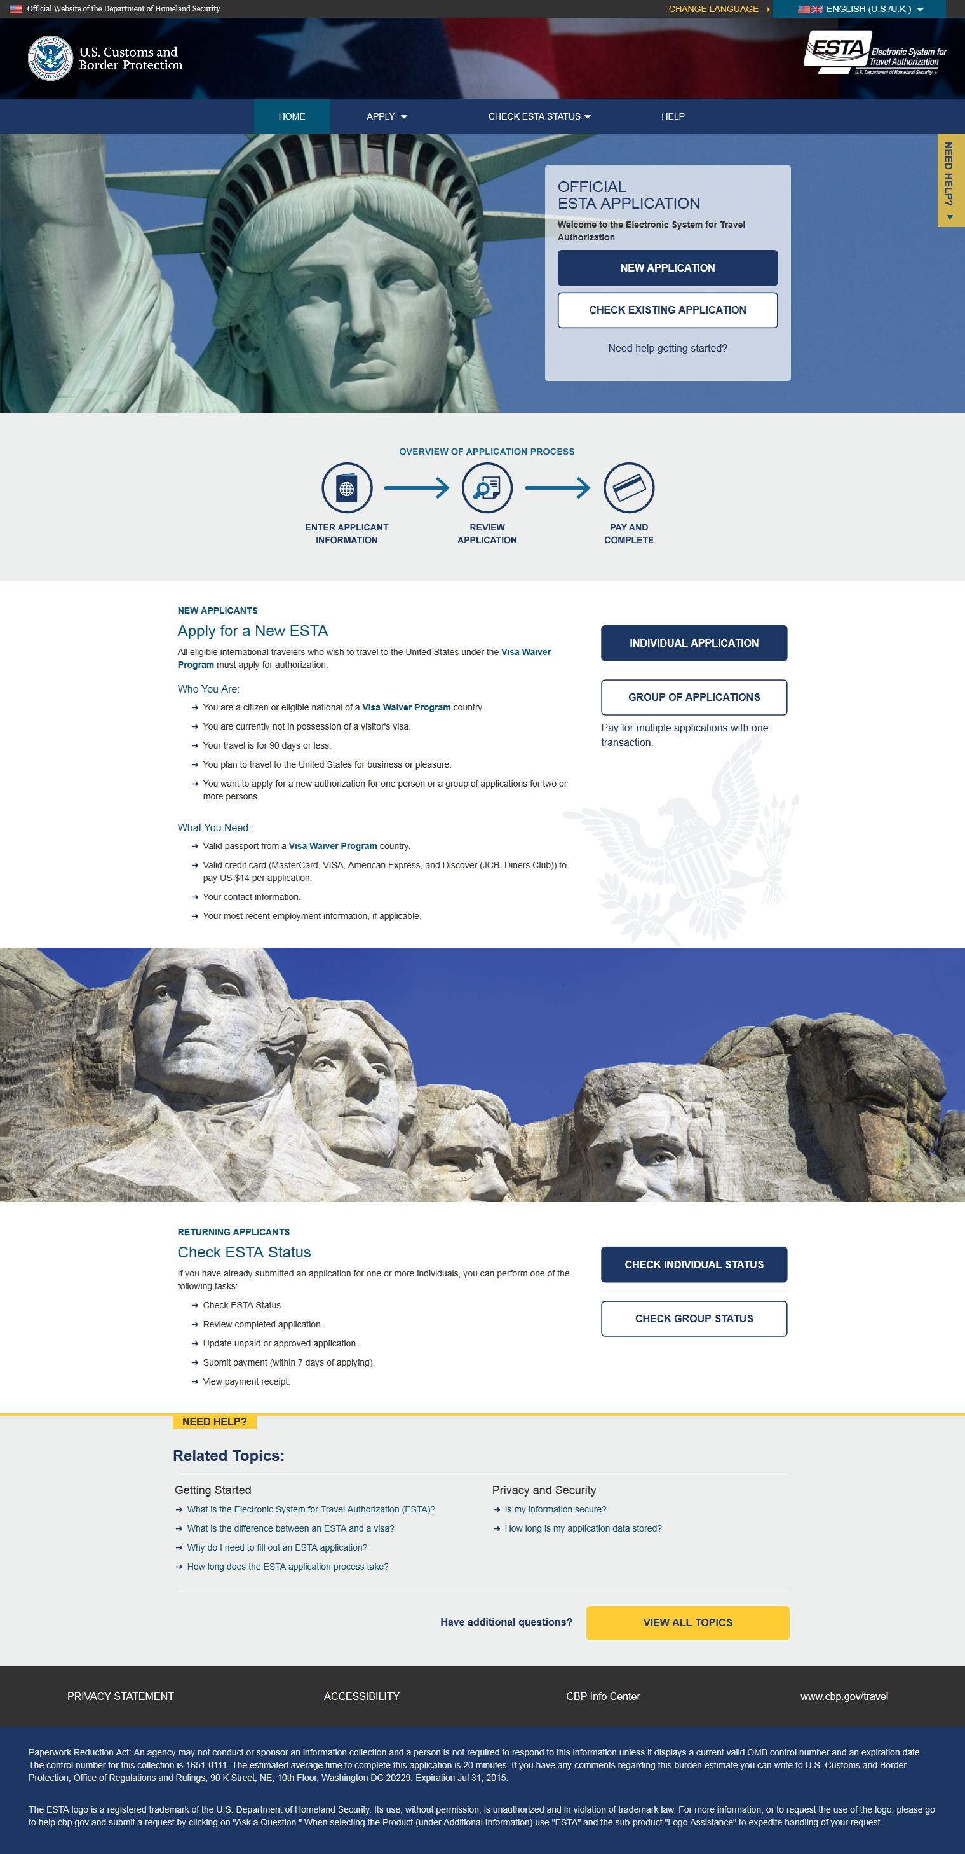
Entire Welcome Page

Slide 3
Navigation Menu
For visitors updating or checking the status of an existing travel authorization.
For visitors applying for a new travel authorization.

Slide 4
Language Menu
Applicants can choose to view the ESTA site in a different language by clicking the down arrow on the upper right corner. This option is available on every page.

Slide 5
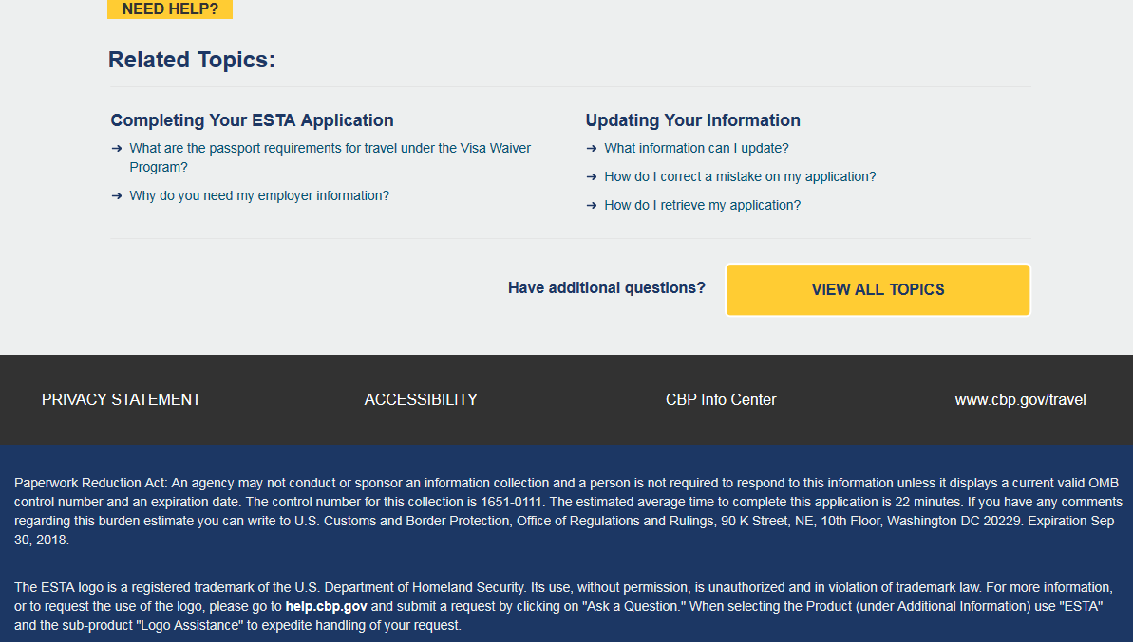
Paperwork Reduction Act
For this release the Paperwork Reduction Act expiration date was updated to September 30, 2018

Slide 6
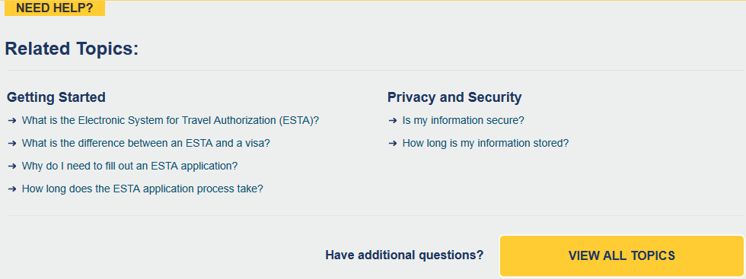
Help Topics
Applicants can also access ESTA instructional resources by clicking on the yellow “Need Help” icon on the right side of the screen or by scrolling to the bottom of the page. Help Topics can be accessed from every page.

Slide 7
Applying for an ESTA
To apply for a group or individual application click one of the two options provided under the “Apply” icon. After the applicant makes a selection a Security Notification will pop up. In order to continue with the application process they must select “Confirm and Continue”. On the following screens the applicant will be asked to acknowledge a Disclaimer and the Travel Promotion Act.

Slide 8
Disclaimer and Travel Act Promotion Page

Slide 9
Applicant and Passport Information
After acknowledging the disclaimers the applicant will be asked to enter in their personal information (or the information of whoever they are applying for).

Slide 10
Conditional Question Country of Birth Question
If the applicant’s is not a current or former citizen of their birth country they will be prompted to answer an additional questionnaire about their country of birth. The option “None of the above” has been removed with this release.

Slide 11
Additional Passport and ID Information
Additional fields where the applicant can enter their Global Entry Program membership data has been added to the ESTA application.

Slide 12
Contact and Employment Information
On the next screen the applicant will be asked to enter their contact and employment information.

Slide 13
Application Information Page – with new Social Media question

Slide 14
Travel Information
On the third screen the applicant will be asked to enter their travel information.

Slide 15
Eligibility Questions and Waiver of Rights
On the fourth screen the applicant will be asked a series of eligibility questions. This page includes a drop down menu where the applicant can selection Yes or No to each question.

Slide 16
New Eligibility Question
A new eligibility question that asks if the applicant has traveled to Syria, Iran, Sudan, Libya, Somalia, and Yemen has been added. If they answer “Yes” to this question they will be asked to select from the above options the primary reason for their trip. If they select certain options they will be asked to fill out an additional questionnaire. These additional fields can be seen on the next few slides. Per this release if an applicant selects Libya, Somalia, and Yemen as well they will also be asked to fill out the questionnaire.

Slide 17
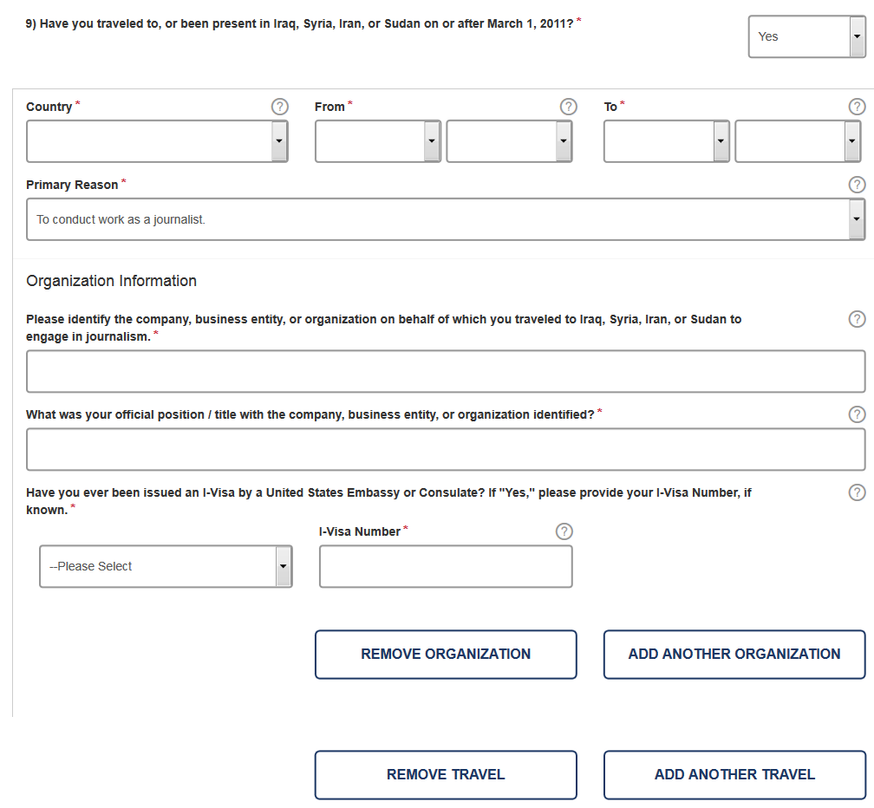
Additional Eligibility Questions: Journalist
If an applicant selects “To conduct work as a journalist” as their primary reason for travelling to Iraq, Syria, Iran, or Sudan they will be asked to identify the company they worked for; the position they held; and their I-Visa Number. The applicant can click question mark bubbles next to each question if they are unsure of how they should respond to each question. If needed, additional entries can be added by clicking “Add Another Organization” or “Add Another Travel”, this option is available under each drop down menu.

Slide 18
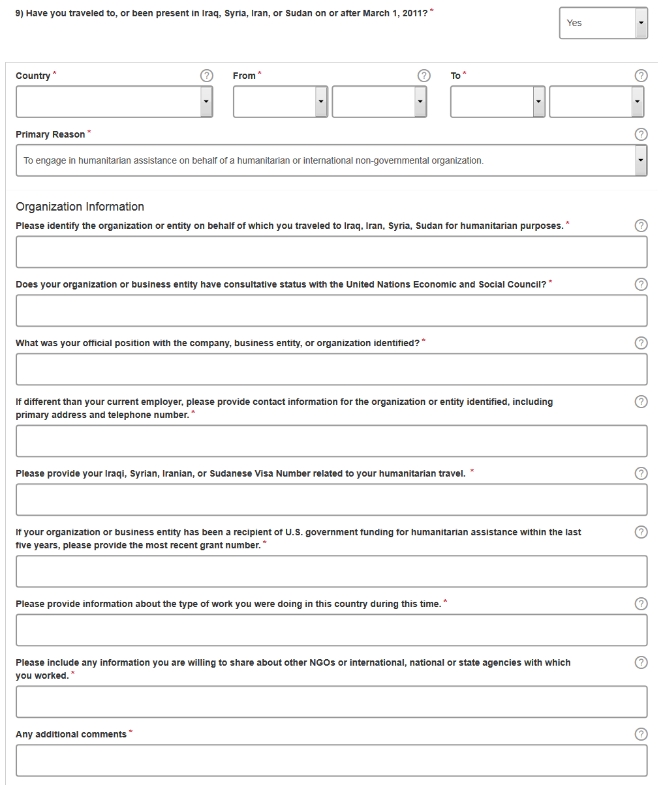
Additional Eligibility Questions: Humanitarian
If an applicant selects “To engage in humanitarian or international non-governmental organization” as their primary reason for travelling to Iraq, Syria, Iran, or Sudan they will be asked to identify the company they worked for; the position they held; they type of work they performed; the sources of funding for this organization; and their Visa Number. The applicant can click the question mark bubbles next to each question if they are unsure of how they should respond to the questions.

Slide 19
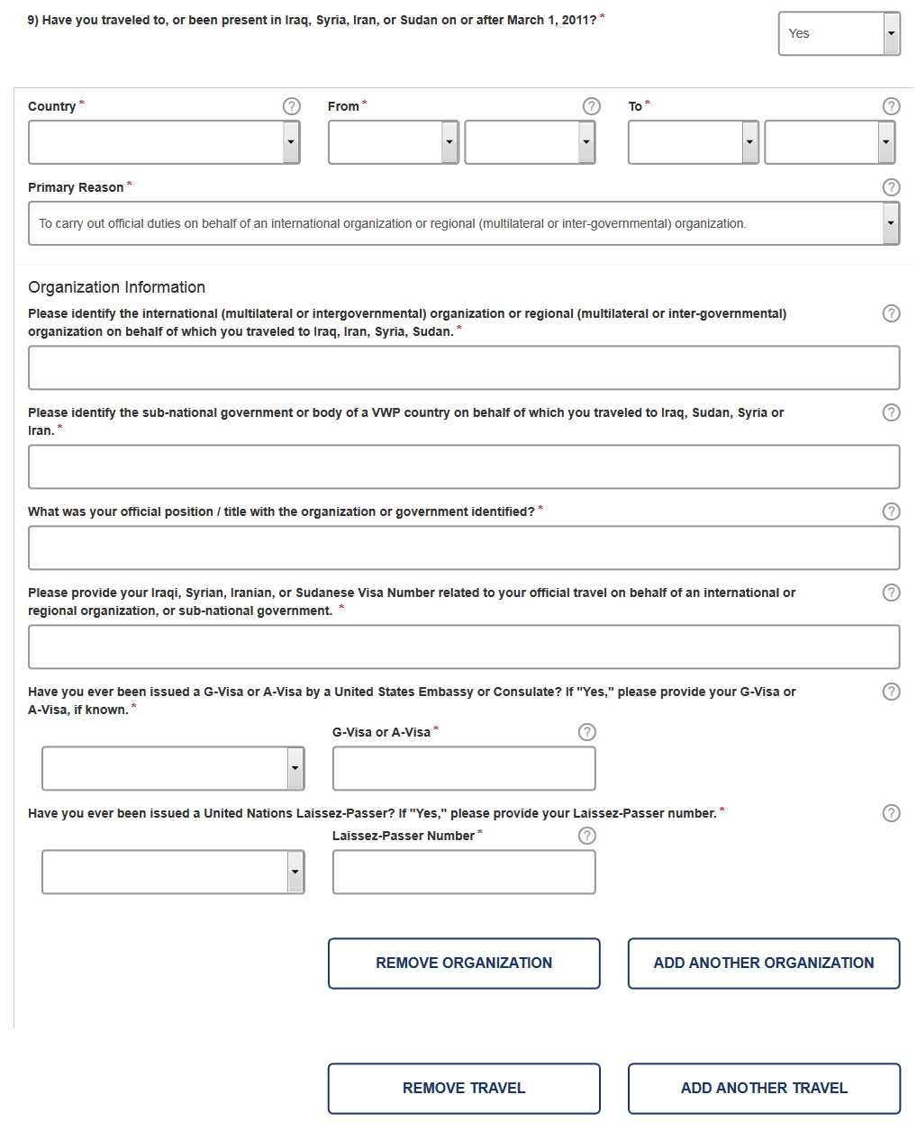
Additional Eligibility Questions: Government or International
If an applicant selects “To carry out official duties on behalf of an international organization or regional organization” as their primary reason for travelling to Iraq, Syria, Iran, or Sudan they will be asked to identify the company they worked for; the position they held; they type of work they performed; if they have ever been issued a Laissez-Passer from the United Nations; and their Visa Number. The applicant can click question mark bubbles next to each question if they are unsure of how they should respond to each question.

Slide 20
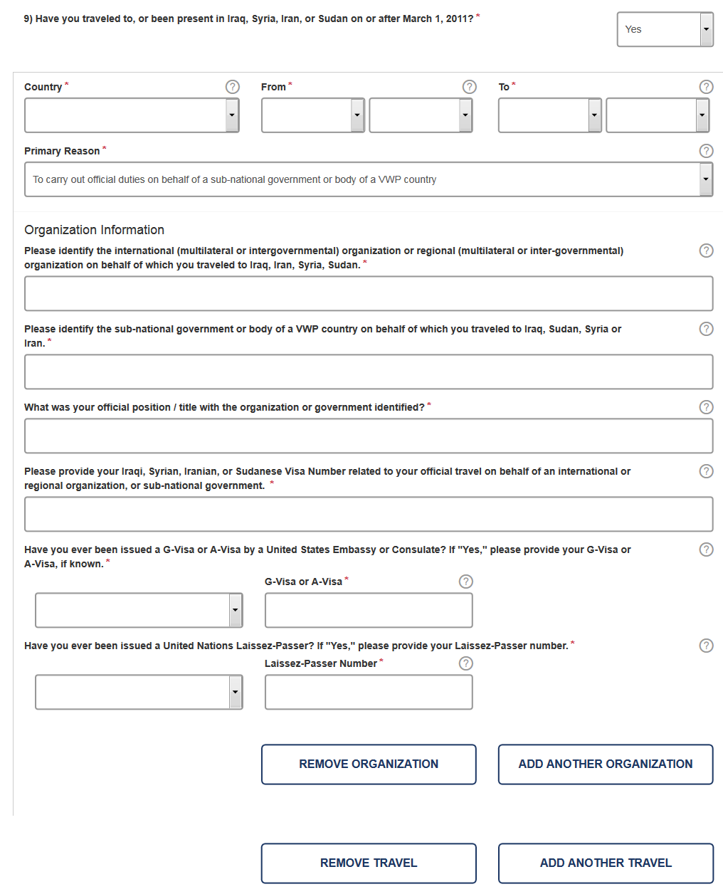
Additional Eligibility Questions- Sub-National or VWP
If an applicant selects “To carry out official duties on behalf of sub-national government body of a VWP country” as their primary reason for travelling to Iraq, Syria, Iran, or Sudan they will be asked to identify the company they worked for; the position they held; they type of work they performed; if they have ever been issued a Laissez-Passer from the United Nations; and their Visa Number. The applicant can click question mark bubbles next to each question if they are unsure of how they should respond to each question.

Slide 21
Application Review Page
On the final page the applicant will be given the option to review and edit their application before they submit it. To complete this part of the application the applicant must select the “Confirm & Continue” icon on each section.

Slide 22
Application Status Page (Single)
After selecting “Confirm and Continue” on each drop down menu on the Application Review page the applicant will be taken to the Application Status page. From this page the applicant can pay, print, view, or update their application.

Slide 23
Creating a Group (Step 1)
Applying for travel authorization for multiple passports and paying for them as a group is similar to applying for an individual application except that the applicant would select “Group of Applications” instead of “Individual Applications” on the main menu. When the group option is chosen the applicant will be asked to enter information for the group point of contact.

Slide 24
Application Status Page (Group)
After adding an application to a group, the applicant will be able to add additional applications to the group before making payment.

Slide 25
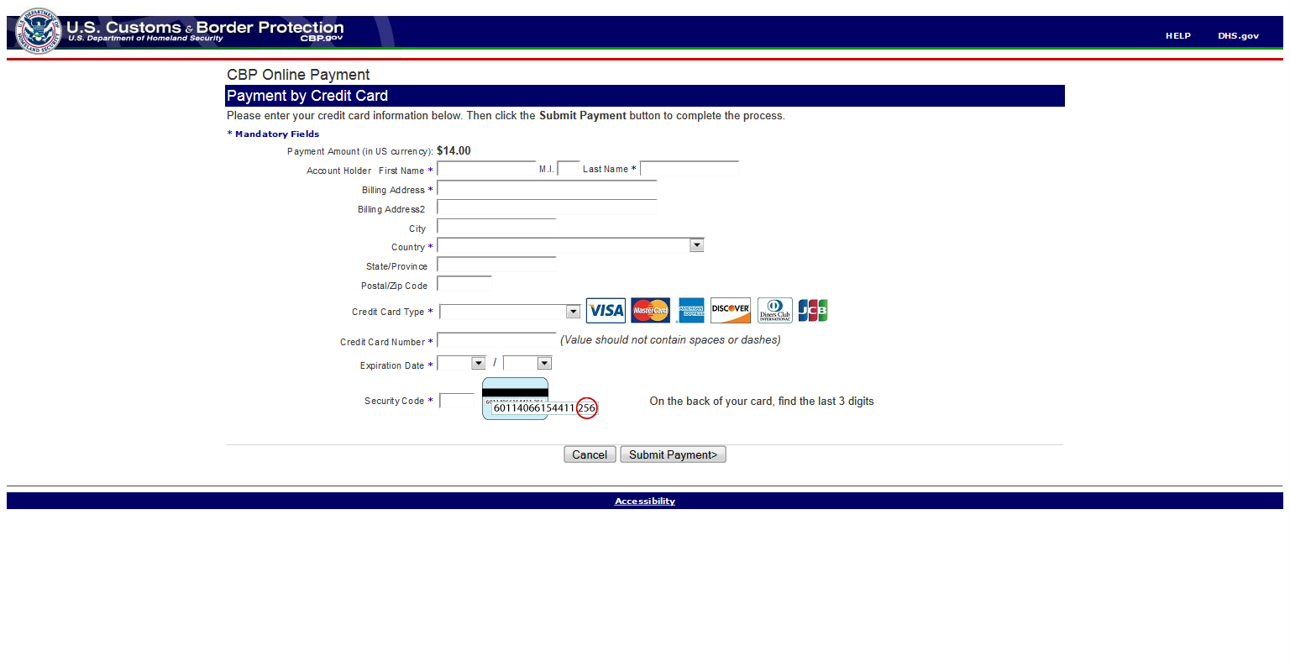
Submit Payment
From the Application Status page (group or individual), applicants can submit payment by checking the Disclaimer and clicking the “Pay Now” button.

Slide 26
Retrieve one Application
An applicant can check the status of an existing individual application by selecting “Check Individual Status” under the “Check ESTA Status” menu button on the main page. The applicant will then be asked to enter in data related to the desired application. After the requested data is entered they will select “Retrieve Application”.

Slide 27
Retrieve a Group of Applications
An applicant can check the status of a group application by selecting “Check Group Status” under the “Check ESTA Status” menu button on the main page. The applicant will then be asked to enter the group POC information. After the requested data is entered they will select “Retrieve Application”.

Slide 28
Retrieving Group ID
If a group point of contact forgets their group ID they can retrieve it by selecting “I do not know my Group ID”. Upon selecting this option they will be asked to enter in the group point of contact’s information. After the requested data is entered they will click “Email Group ID”, which will prompt the system to send the group owner their group ID.

Slide 29
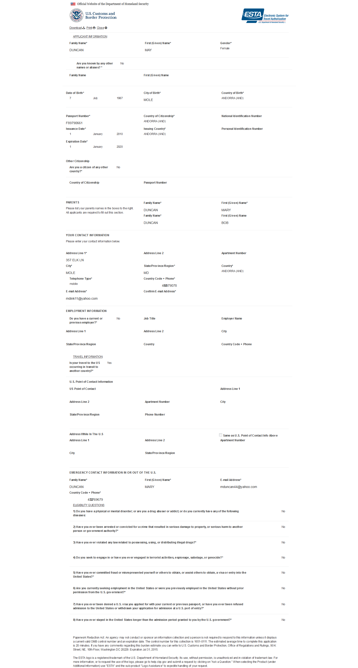
Updating or Viewing Application
From the Application Status page for an individual or group of ESTAs, the applicant has the option to update or view each application. This can be done by selecting either the “Update” or “View” icon located next to each application.

Slide 30
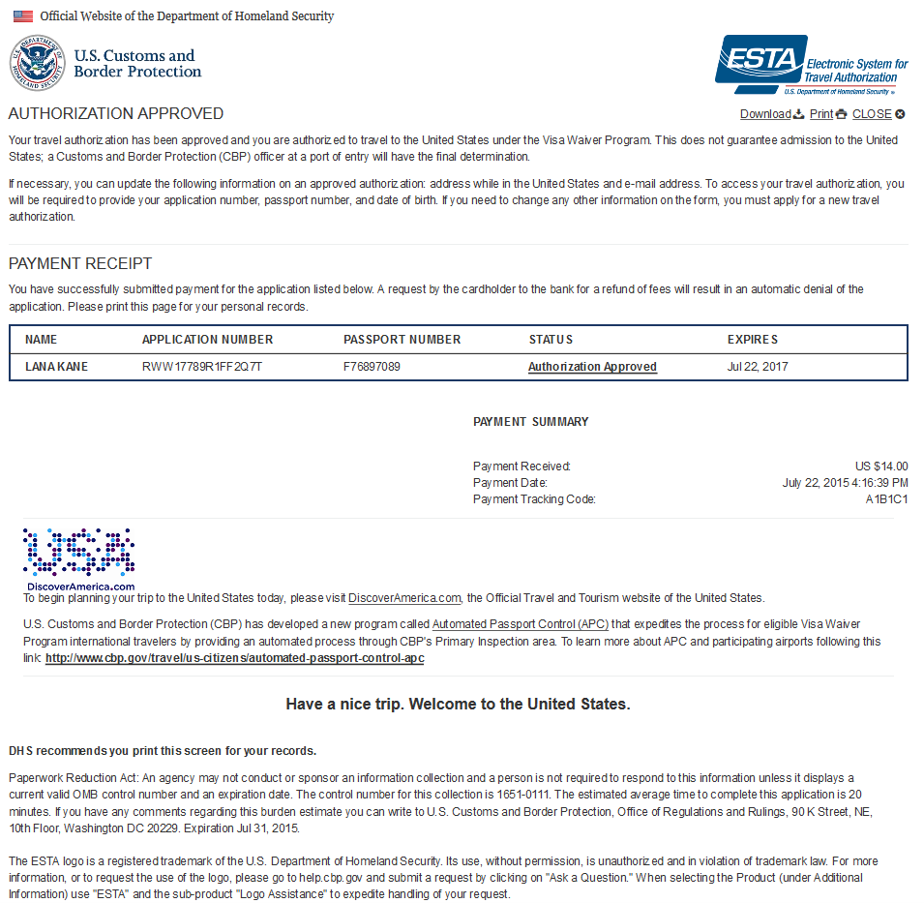
Printing Application
From the Application Status page for an individual or group of ESTAs the applicant has the option to print each application. This can be done by selecting either the “Print” icon on the upper right corner of the page.

Slide 31
Status-Travel Not Authorized
When a travel authorization is denied they will see this image when they check their application status.

Slide 32
Status- Authorization Approved
When a travel authorization is approved they will see this image when they check their application status.

Slide 33
Status-Authorization Approved/ Denied
Each application in a group will be adjudicated individually so each application could have a different status, as shown here.

