Slide 1
OMB: 0703-0036 EXP: XX XXXX
Screen Shots with Intended Changes

Slide 2
Privacy Act Statement
FOR OFFICIAL USE ONLY – PRIVACY ACT SENSITIVE: Any misuse or unauthorized disclosure of this information may result in both criminal and civil penalties.
PRIVACY ACT STATEMENT:
Authority: 10 U.S.C. 5013, Secretary of the Navy; 10 U.S.C. 6954, Midshipmen: number; 10 U.S.C. 6956, Midshipmen: Nominations and Selection to fill Vacancies; 10 U.S.C. 6957, Selection of Persons form Foreign Countries; 10 U.S.C. 6958, Midshipmen: Qualifications for Admissions; 10 U.S.C. 6962, Midshipmen: Discharge for Unsatisfactory Conduct or Inaptitude; 10 U.S.C. 6958, Midshipmen: Discharge for Deficiency; E.O. 9397 (SSN), as amended; DoDI 1322.22, Service Academies; and N01531-1.
Purpose: Applicant files contain information used for personal information verification and to evaluate/determine competitive standing and eligibility for appointment to the Naval Academy. Midshipmen records consist of academic, military, and physical records used to track each students progress in the Naval Academy program.
Routine Use: Information will only be collected and accessed by the United States Naval Academy for the purpose of admissions and enrollment. Additionally, records may specifically be disclosed outside the DoD as a routine use pursuant to 5 U.S.C. 522a(b)(3) as follows: 1.) to Congressional staffers for the purpose of reviewing applicants for status, nomination, and admission to the Naval Academy; 2.) to parents and legal guardians of midshipmen for academic, performance, disciplinary, health, and/or welfare issues; 3.) to the United States Naval Academy Sponsor Program for the purpose of assigning Midshipmen with a sponsor; 4.) to the United States Naval Institute for the purpose of relaying information about benefits; 5.) to the Naval Academy Athletic Association for the purpose of promoting and funding the Naval Academy Intercollegiate Athletic Program; 6.) to the United States Naval Academy Foundation for the purpose of sponsoring midshipmen candidates; and 7.) to the United States Naval Academy Alumni Association for the purpose of supporting the Naval Academy mission.
Disclosure: Voluntary; however, failure to provide the required information may result in a delay or inability to process the applicant’s application or allow for the continued enrollment of a Midshipman at the Naval Academy.
Privacy Act Statement

Slide 3
OMB Symbol
OMB Symbol

Slide 4
Agency Disclosure Notice
AGENCY DISCLOSURE NOTICE: The public reporting burden for this collection of information is estimated to average 1.35 hours, including the time for reviewing instructions, searching existing data sources, gathering and maintaining the data needed, and completing and reviewing the collection of information. Send comments regarding this burden estimate or any other aspect of this collection of information, including suggestions for reducing the burden, to the Department of Defense, Washington Headquarters Services, Executive Services Directorate, Directives Division, 4800 Mark Center Drive, East Tower, Suite 02G09, Alexandria, VA 22350-3100 (OMB (0703-0036).
Respondents should be aware that notwithstanding any other provision of law, no person shall be subject to any penalty for failing to comply with a collection of information if it does not display a current valid OMB control number.
PLEASE DO NOT RETURN YOUR RESPONSE TO THE ABOVE ADDRESS.
Responses should be sent to: United States Naval Academy, Office of Admissions, 52 King George St., Annapolis, MD. 21402
Agency Disclosure Notice

Slide 5
1531/34 USNA Preliminary Application
OMB Symbol
Privacy Act Statement

Slide 6
1531/34 USNA Preliminary Application

Slide 7
1531/34 USNA Preliminary Application

Slide 8
1531/34 USNA Preliminary Application
Agency Disclosure Notice

Slide 9
Candidate Log In Page
OMB Symbol
Privacy Act Statement
Agency Disclosure Notice

Slide 10
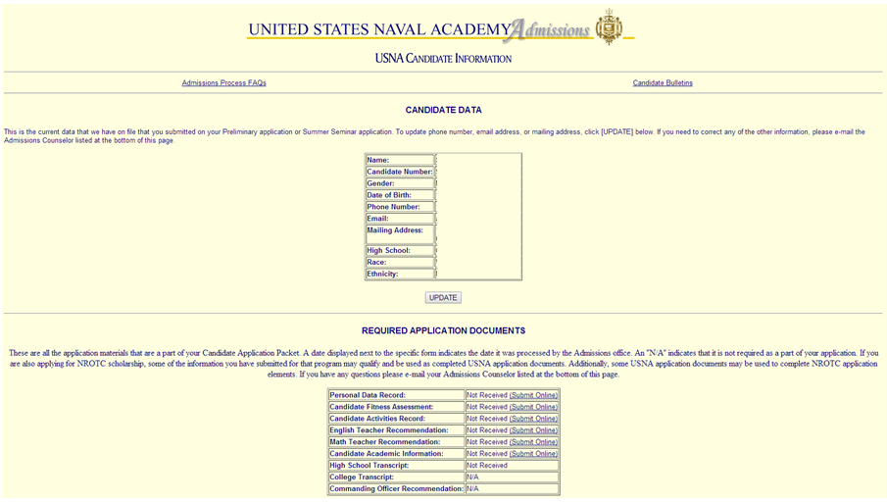
Candidate Information System Page
OMB Symbol
Privacy Act Statement

Slide 11
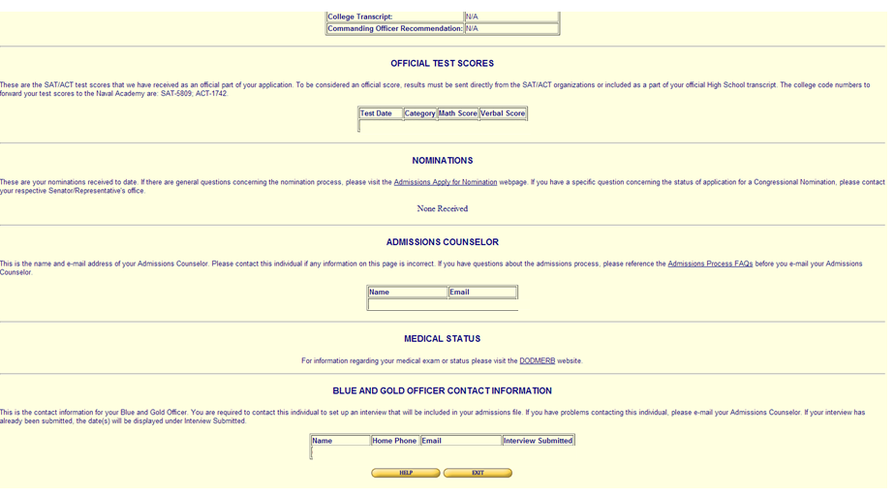
Candidate Information System Page
Agency Disclosure Notice

Slide 12
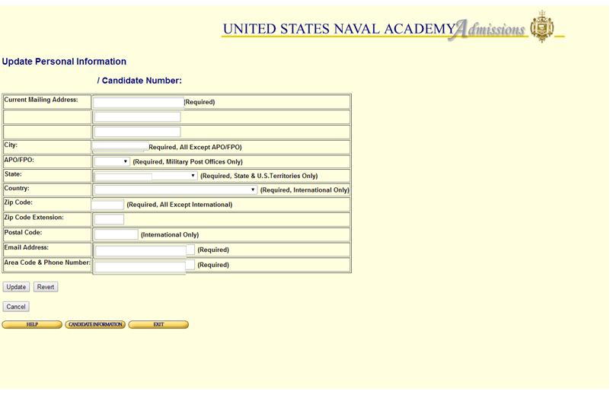
Candidate Information System Candidate Update Module
OMB Symbol
Privacy Act Statement
Agency Disclosure Notice

Slide 13
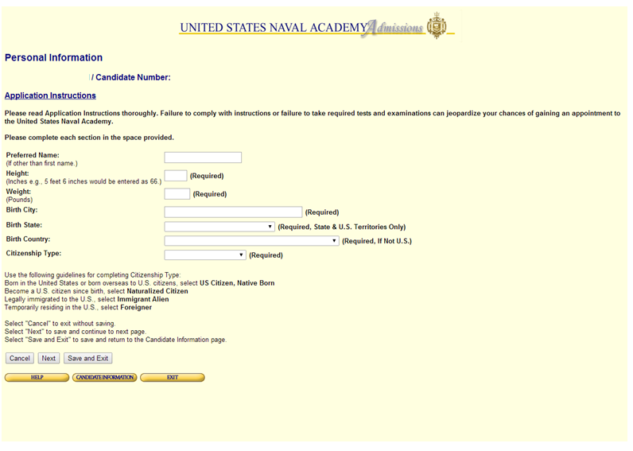
Personal Data Record Personal Information

Slide 14
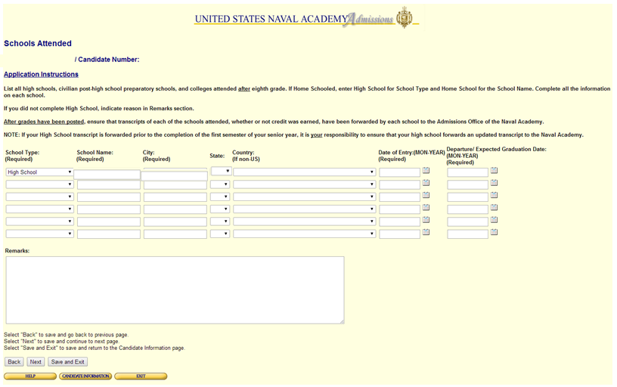
Personal Data Record Schools Attended

Slide 15
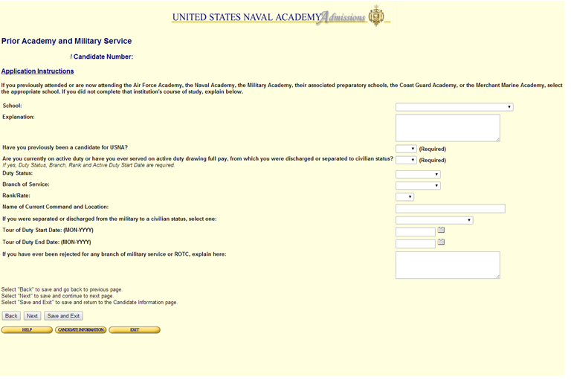
Personal Data Record Prior Service

Slide 16
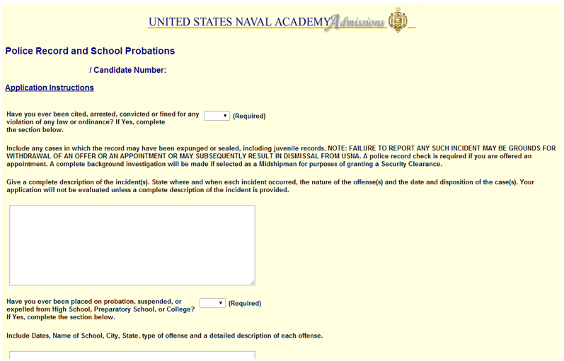
1110/12 Personal Data Record Police Record/School Probations

Slide 17
1110/12 Personal Data Record Police Record/School Probations

Slide 18
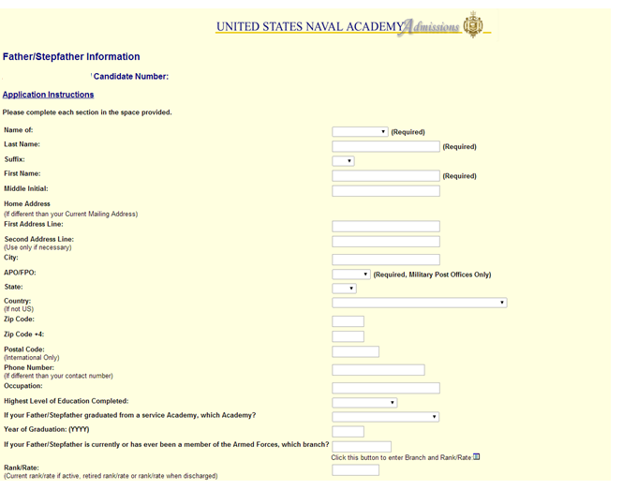
1110/12 Personal Data Record Father/Stepfather Information

Slide 19
1110/12 Personal Data Record Father/Stepfather Information

Slide 20
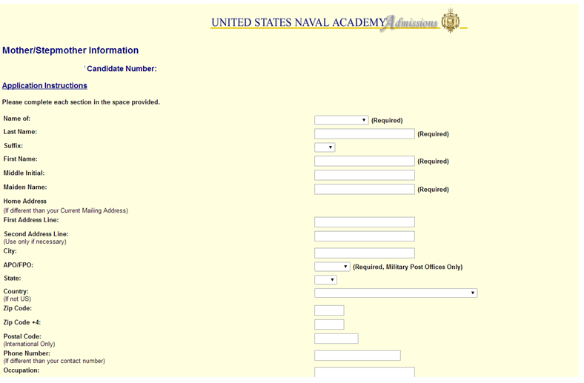
1110/12 Personal Data Record Mother/Stepmother Information

Slide 21
1110/12 Personal Data Record Mother/Stepmother Information

Slide 22
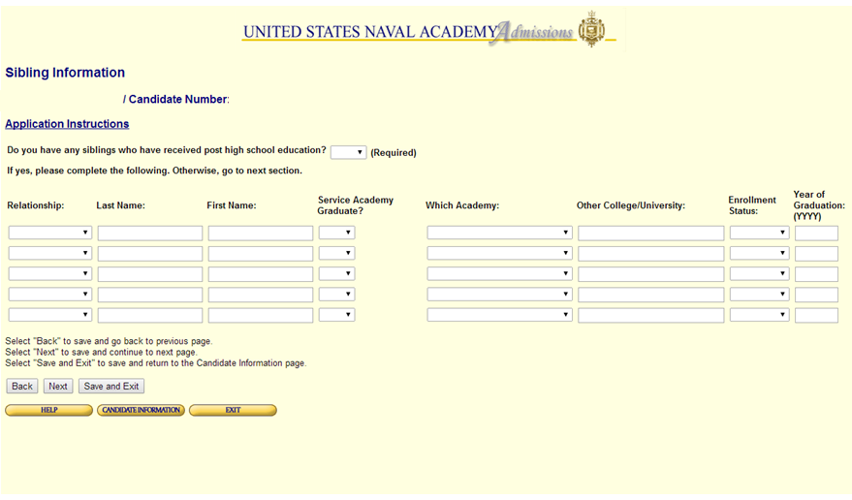
1110/12 Personal Data Record Sibling Information

Slide 23
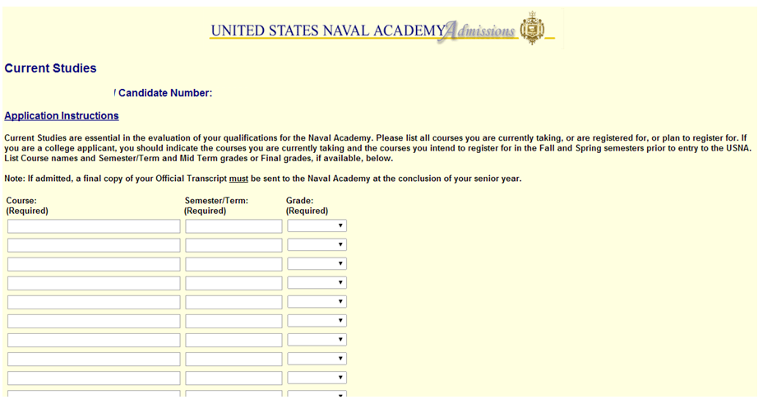
1110/12 Personal Data Record Current Studies

Slide 24
1110/12 Personal Data Record Current Studies

Slide 25
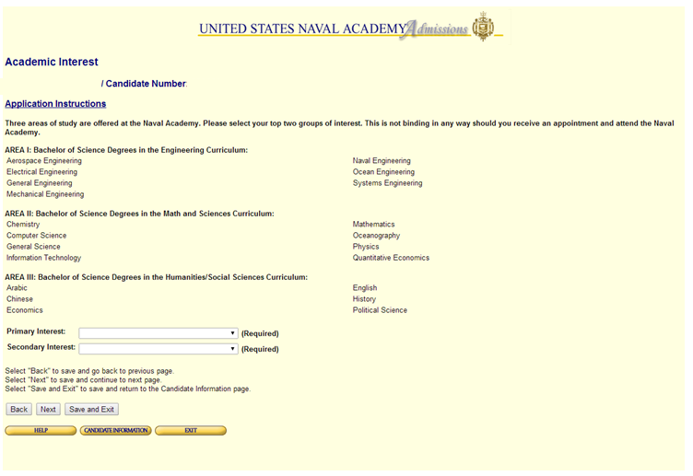
1110/12 Personal Data Record Academic Interest

Slide 26
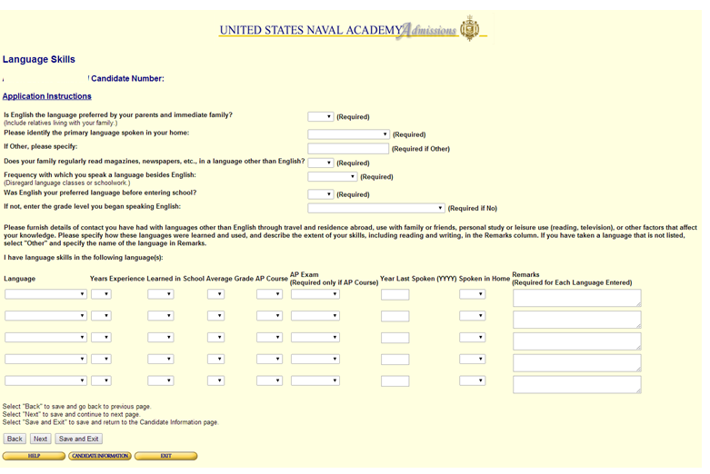
1110/12 Personal Data Record Language Skills

Slide 27
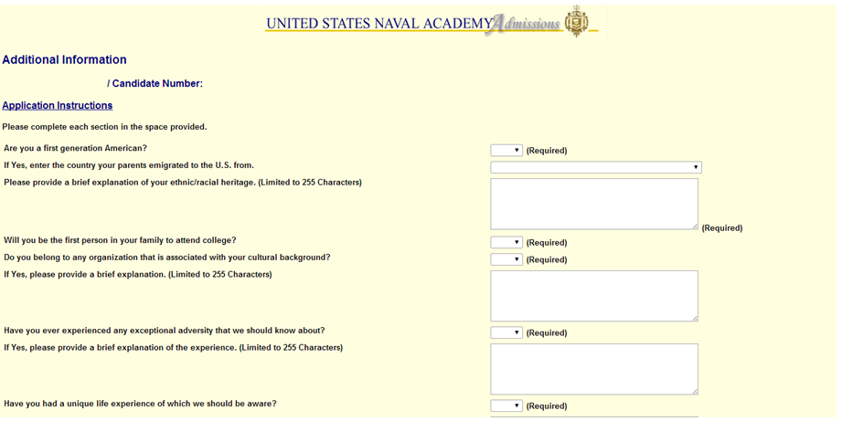
1110/12 Personal Data Record Additional Information

Slide 28
1110/12 Personal Data Record Additional Information

Slide 29
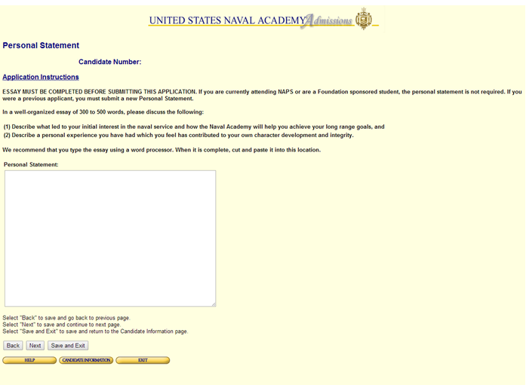
1110/12 Personal Data Record Personal Statement

Slide 30
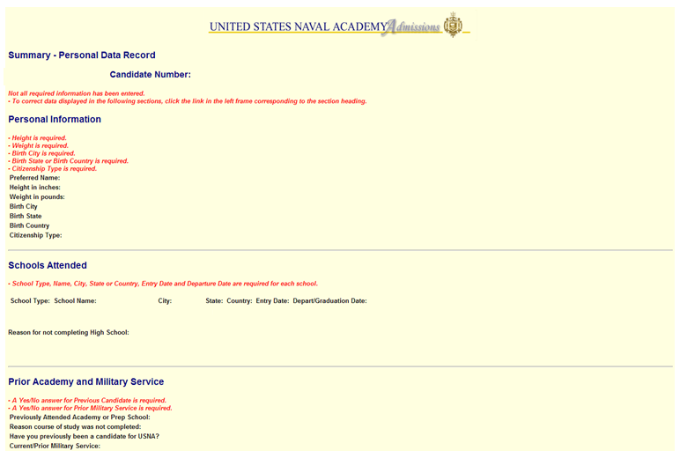
1110/12 Personal Data Record Summary/Submission

Slide 31
1110/12 Personal Data Record Summary/Submission

Slide 32
1110/12 Personal Data Record Summary/Submission

Slide 33
1110/12 Personal Data Record Summary/Submission

Slide 34
1110/12 Personal Data Record Summary/Submission

Slide 35
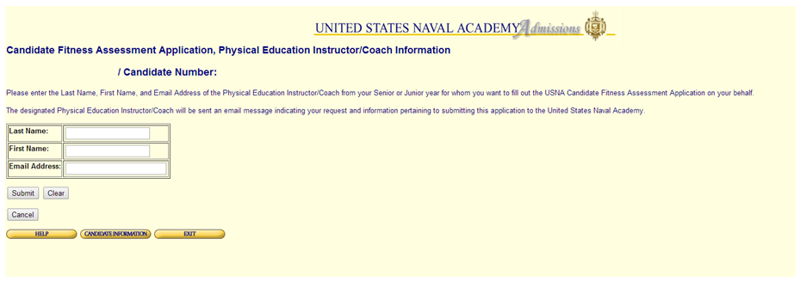
1110/91 Candidate Fitness Assessment

Slide 36
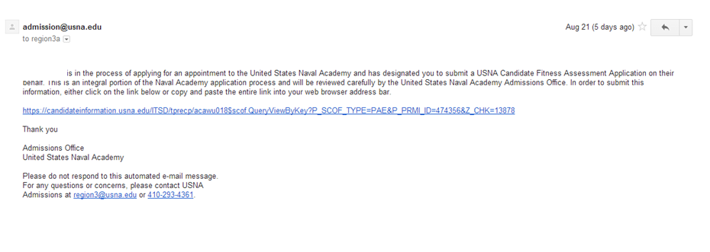
1110/91 Candidate Fitness Assessment

Slide 37
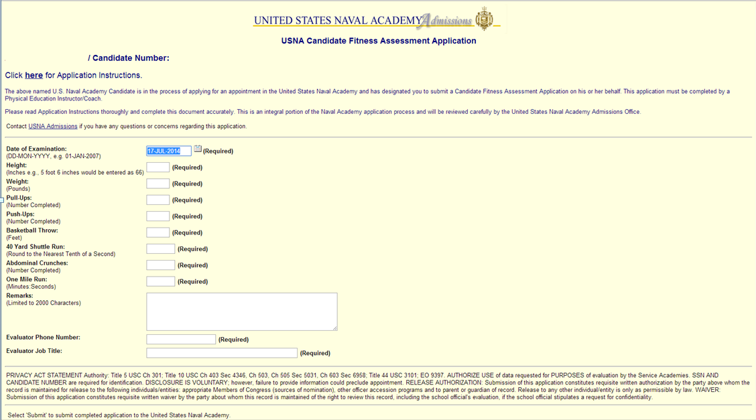
1110/91 Candidate Fitness Assessment
Privacy Act Statement
OMB Symbol
Agency Disclosure Notice

Slide 38
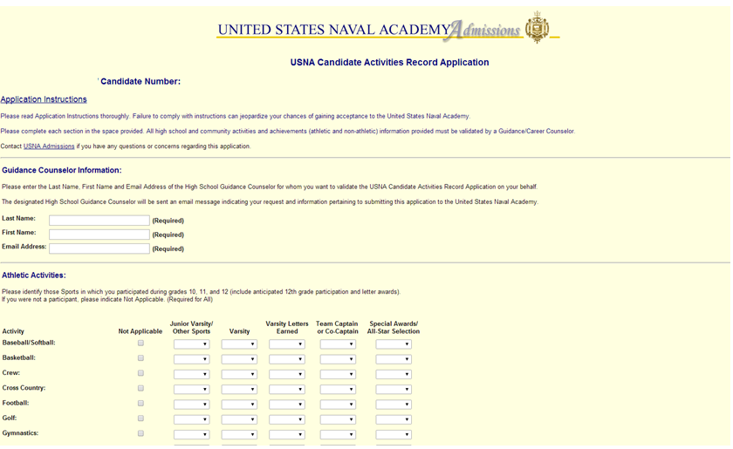
1110/11 Candidate Activities Record

Slide 39
1110/11 Candidate Activities Record

Slide 40
1110/11 Candidate Activities Record

Slide 41
1110/11 Candidate Activities Record

Slide 42
1110/11 Candidate Activities Record

Slide 43
1110/11 Candidate Activities Record

Slide 44
1110/11 Candidate Activities Record Verification Email

Slide 45
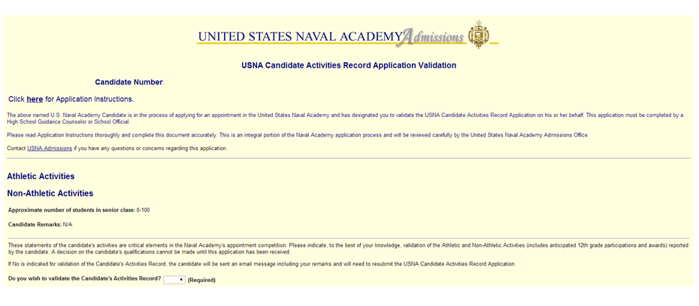
1110/11 Candidate Activities Record Verification
OMB Symbol
Privacy Act Statement

Slide 46
1110/11 Candidate Activities Record Verification
Agency Disclosure Notice

Slide 47
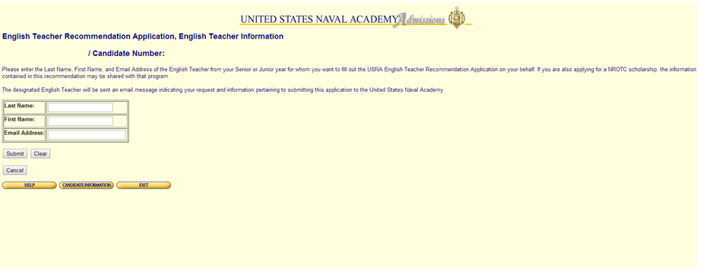
English Recommendation

Slide 48
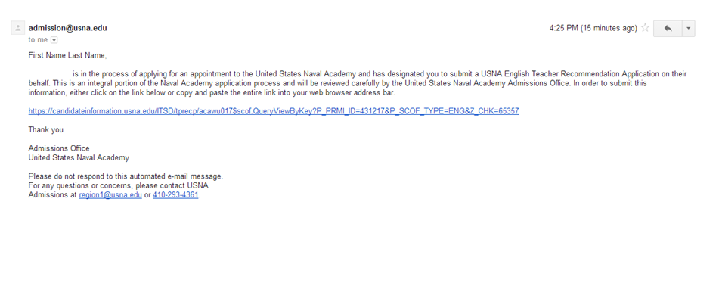
English Recommendation

Slide 49
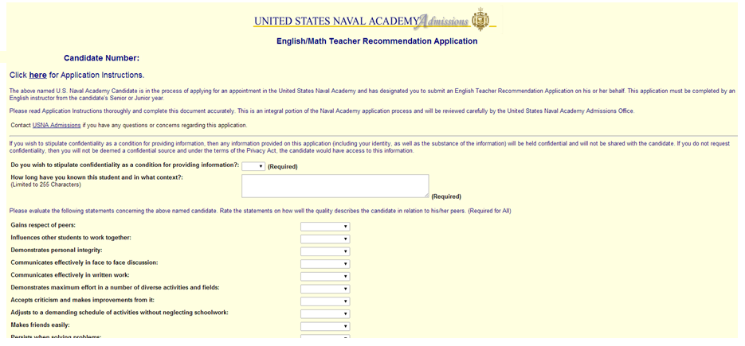
English Recommendation
OMB Symbol
Privacy Act Statement

Slide 50
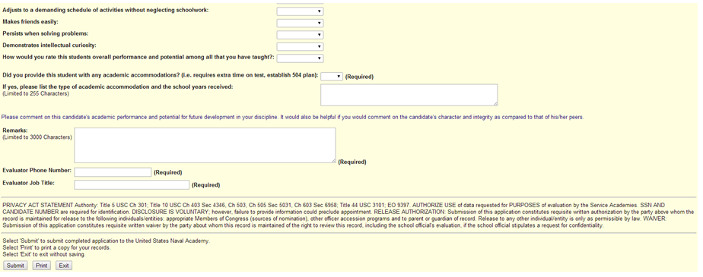
English Recommendation
Agency Disclosure Notice

Slide 51
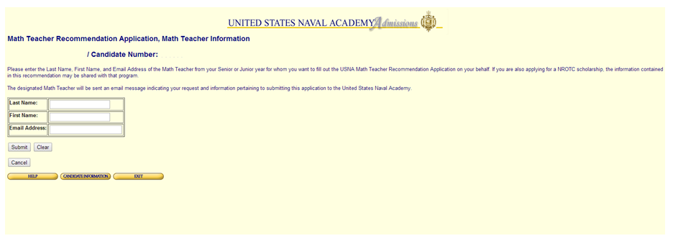
Math Recommendation

Slide 52
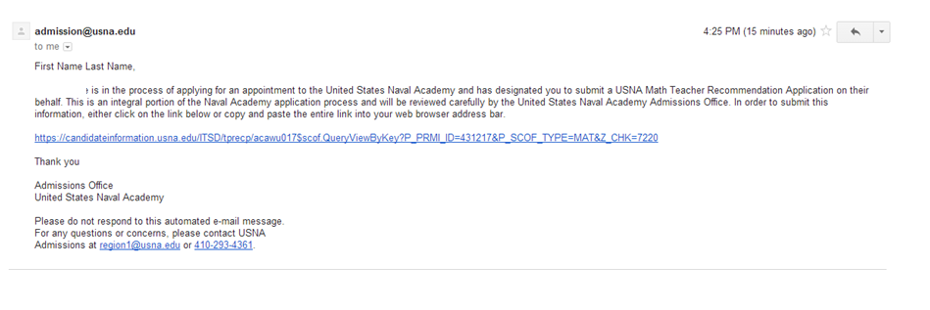
Math Recommendation

Slide 53
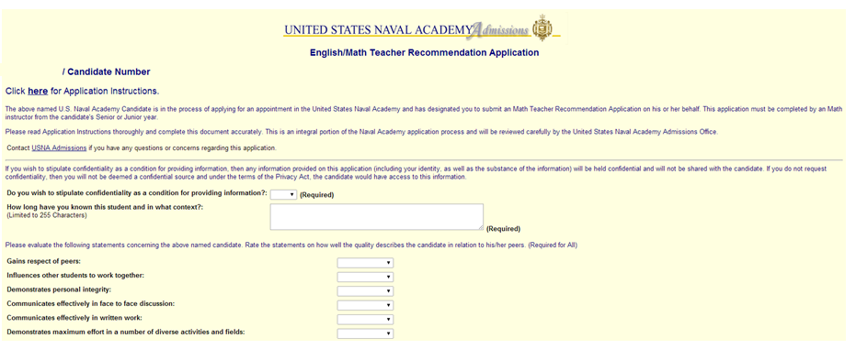
Math Recommendation
OMB Symbol
Privacy Act Statement

Slide 54
Math Recommendation
Agency Disclosure Notice

Slide 55
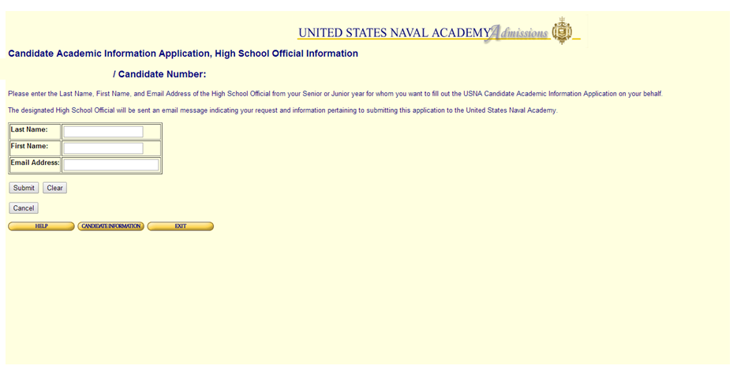
1110/15 Candidate Academic Information/Request for Transcript

Slide 56
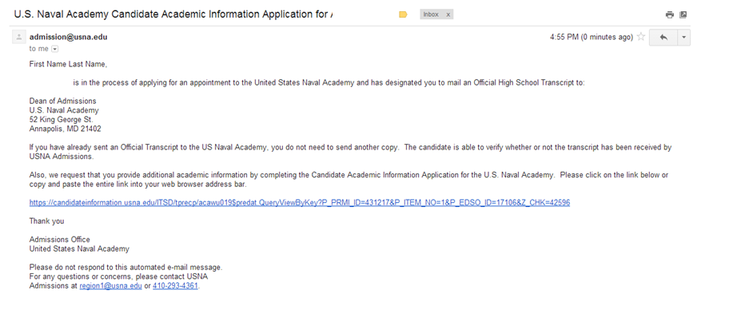
1110/15 Candidate Academic Information/Request for Transcript

Slide 57
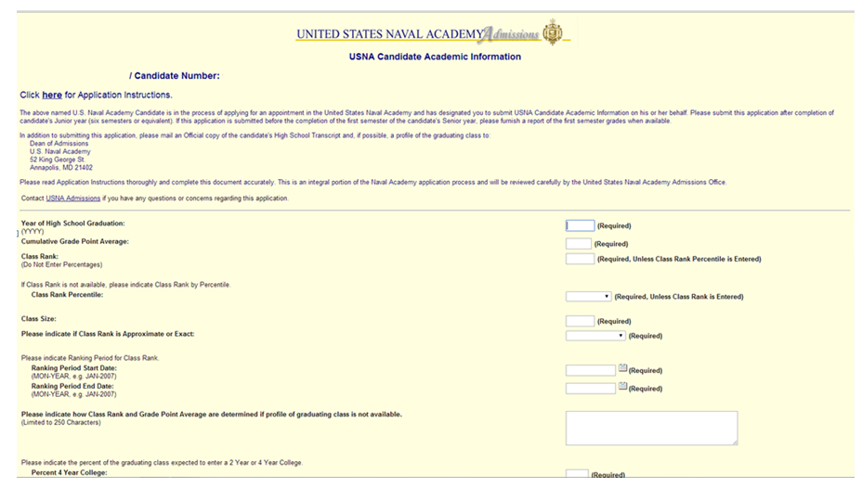
1110/15 Candidate Academic Information/Request for Transcript
OMB Symbol
Privacy Act Statement

Slide 58
1110/15 Candidate Academic Information/Request for Transcript
Agency Disclosure Notice

Slide 59
1110/92 Request for Information Application
OMB Symbol
Privacy Act Statement

Slide 60
1110/92 Request for Information Application
Agency Disclosure Notice

Slide 61
Summer Seminar
OMB Symbol
Privacy Act Statement

Slide 62
Summer Seminar

Slide 63
Summer Seminar

Slide 64
Summer Seminar

Slide 65
Summer Seminar

Slide 66
Summer Seminar

Slide 67
Summer Seminar
Agency Disclosure Notice

