Slide 1


Benchmarking outpatient antibiotic prescribing

Slide 2
IMS Health Xponent database
262.5 million antibiotic prescriptions dispensed in 2011
842 prescriptions per 1000 persons
Clinical Infectious Diseases 2015;60(9):1308–16

Slide 3
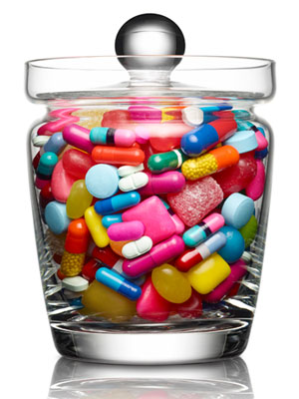
Clinical Infectious Diseases 2015;60(9):1308–16

Slide 4
Clinical Infectious Diseases 2015;60(9):1308–16

Slide 5
Clinical Infectious Diseases 2015;60(9):1308–16

Slide 6
Clinical Infectious Diseases 2015;60(9):1308–16

Slide 7
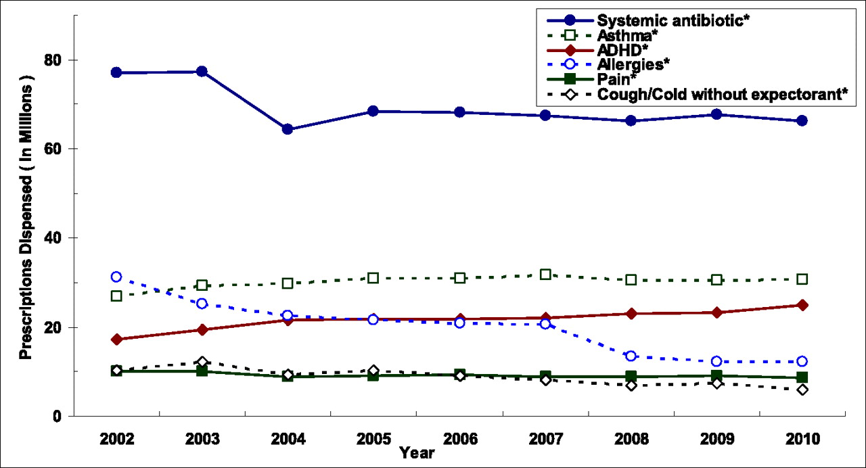
Antibiotic use: outpatient children
Chai G et al. Pediatrics 2012;130:23-31

Slide 8
Ternhag A. NEJM 2013;369:1175-1176. Hicks LA et al. NEJM 2010;368:1461-2
Outpatient antibiotic prescribing (Rx/1000)
 | US | Sweden
All | 833 | 388
quinolones | 105 | 25
macrolides | 185 | 12
cephalosporins | 117 | 12
Notes:
Swedish Institute for Communicable Disease Control

Slide 9
Ternhag A. NEJM 2013;369:1175-1176. Hicks LA et al. NEJM 2010;368:1461-2
Outpatient antibiotic prescribing (Rx/1000)
 | US | Sweden
All | 833 | 388
quinolones | 105 | 25
macrolides | 185 | 12
cephalosporins | 117 | 12
Notes:
Swedish Institute for Communicable Disease Control

Slide 10
Adverse effects of antibiotic use
use drives resistance
bacteria have shown the ability to become resistant to every antibiotic that has been developed
Notes:
Antibiotics are wonderful drugs that can be extremely useful; however, like all medications, they have a downside …
Adverse effects of antibiotics bring children to the ED commonly – rates comparable to warfarin, digoxin, and insulin
Use – and overuse – drives resistance, and antibiotic-resistant infections cause harm (both morbidity and mortality)
And they cost money – CDC estimates $20 billion in excess healthcare costs; 8 million extra days (US)
All of this emphasized the need to use antibiotics judiciously, and, ultimately, the call for ASPs

Slide 11
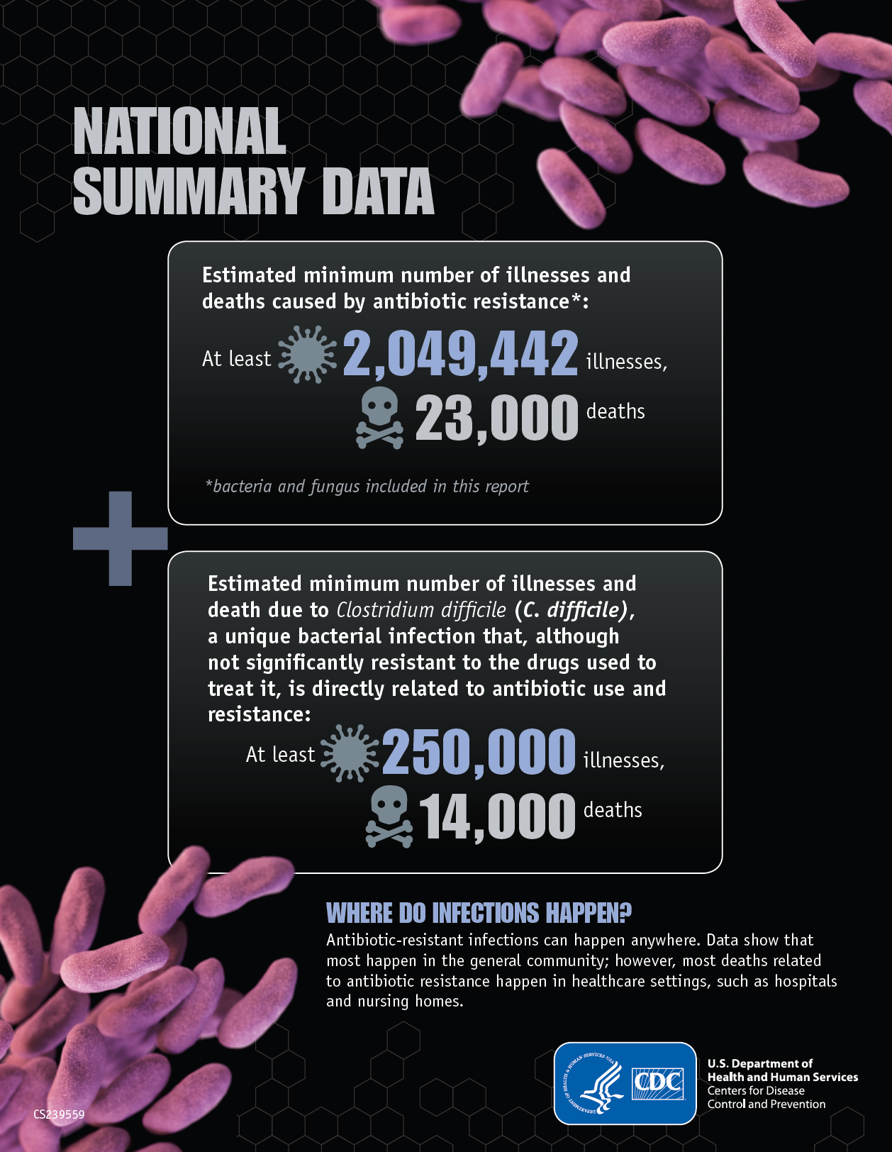

Slide 12
Resistance aside…
5%–25% diarrhea
1 in 1000 visit emergency department for adverse effect of antibiotic
comparable to insulin, warfarin, and digoxin
1 in 4000 chance that an antibiotic will prevent serious complication from ARTI
Shehab N. CID 2008:47; Linder JA. CID 2008:47

Slide 13
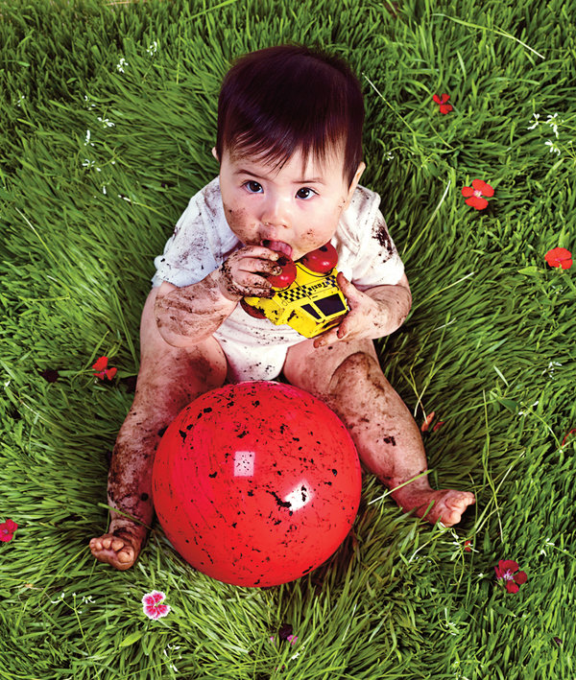

Slide 14
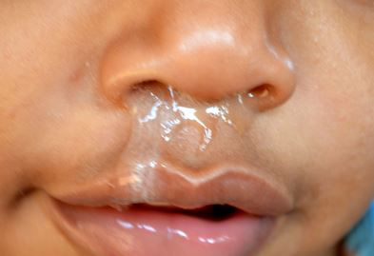
Antibiotic use for artis
21% of all ambulatory visits for children receive an antibiotic RX
72% for ARTI
Hersh Pediatrics 2011;128;1053

Slide 15
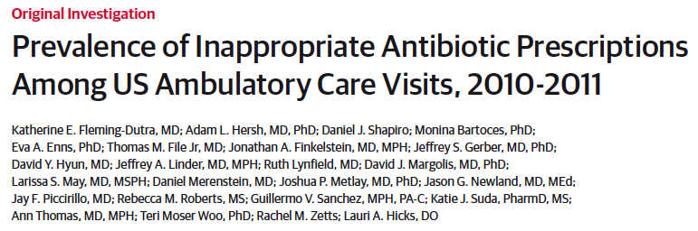
diagnosis-specific rates of total and appropriate antibiotic prescribing determined based on national guidelines and regional variation
30% overall reduction suggested
50% for ARTIs

Slide 16
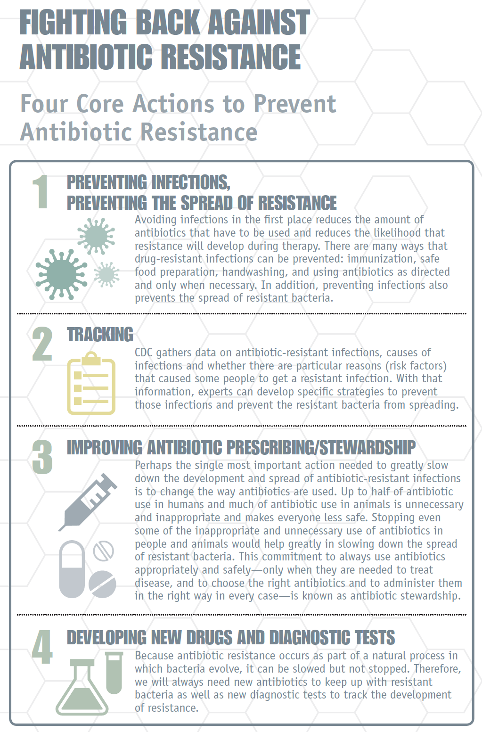
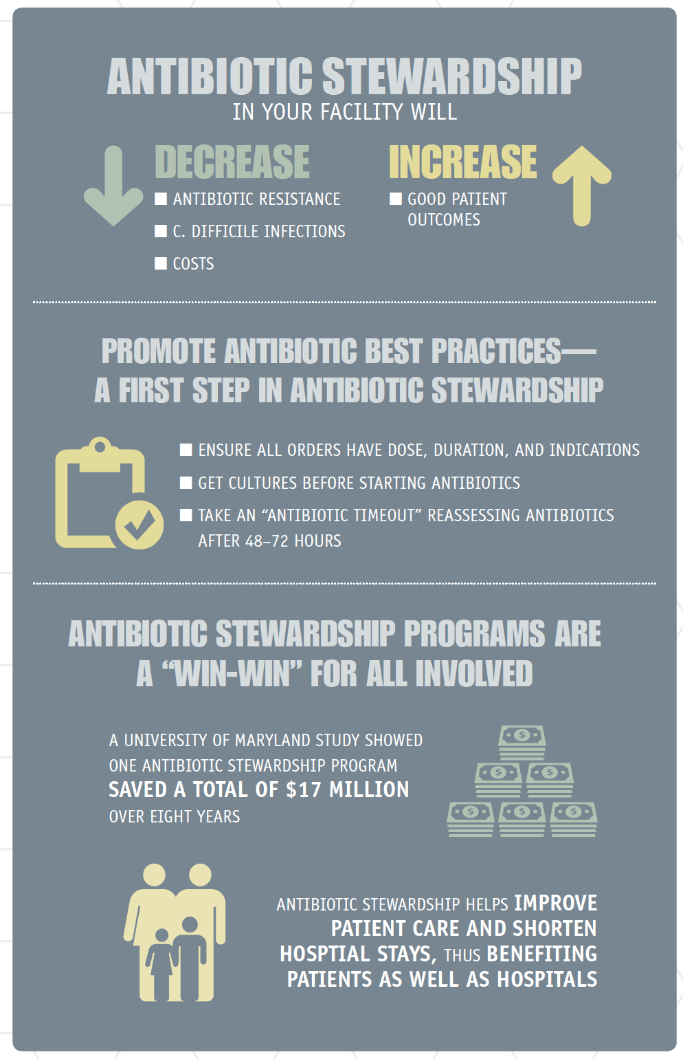

Slide 17
What we would like to do:
Show antibiotic prescribing rates across CHOP practices
Get YOUR FEEBACK on how best to display these data
Use these data to establish an achievable benchmark for antibiotic prescribing for ARTIs
Notes:
To summarize ...

Slide 20
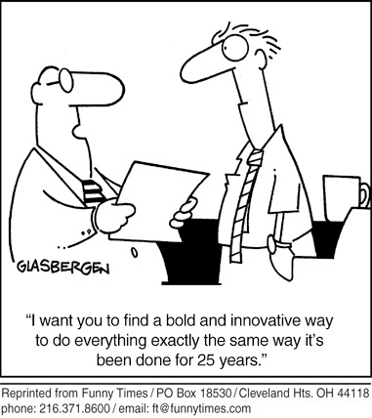
Thank you
gerberj@chop.edu

